Slide 1



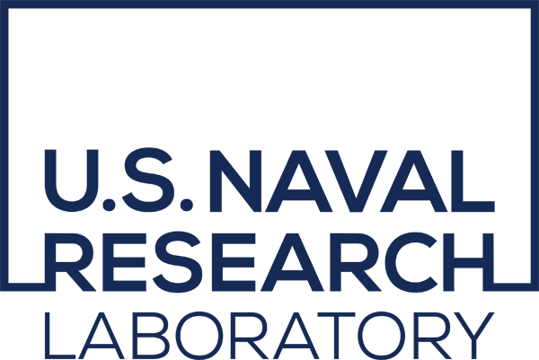

The role of global internal wave modeling in the SWOT mission
Brian K. Arbic, University of Michigan
FilaChange SWOT AdAC meeting
30 August 2022
Thanks to a very long list of collaborators, and to NOAA and DOE for additional funding.

Slide 2
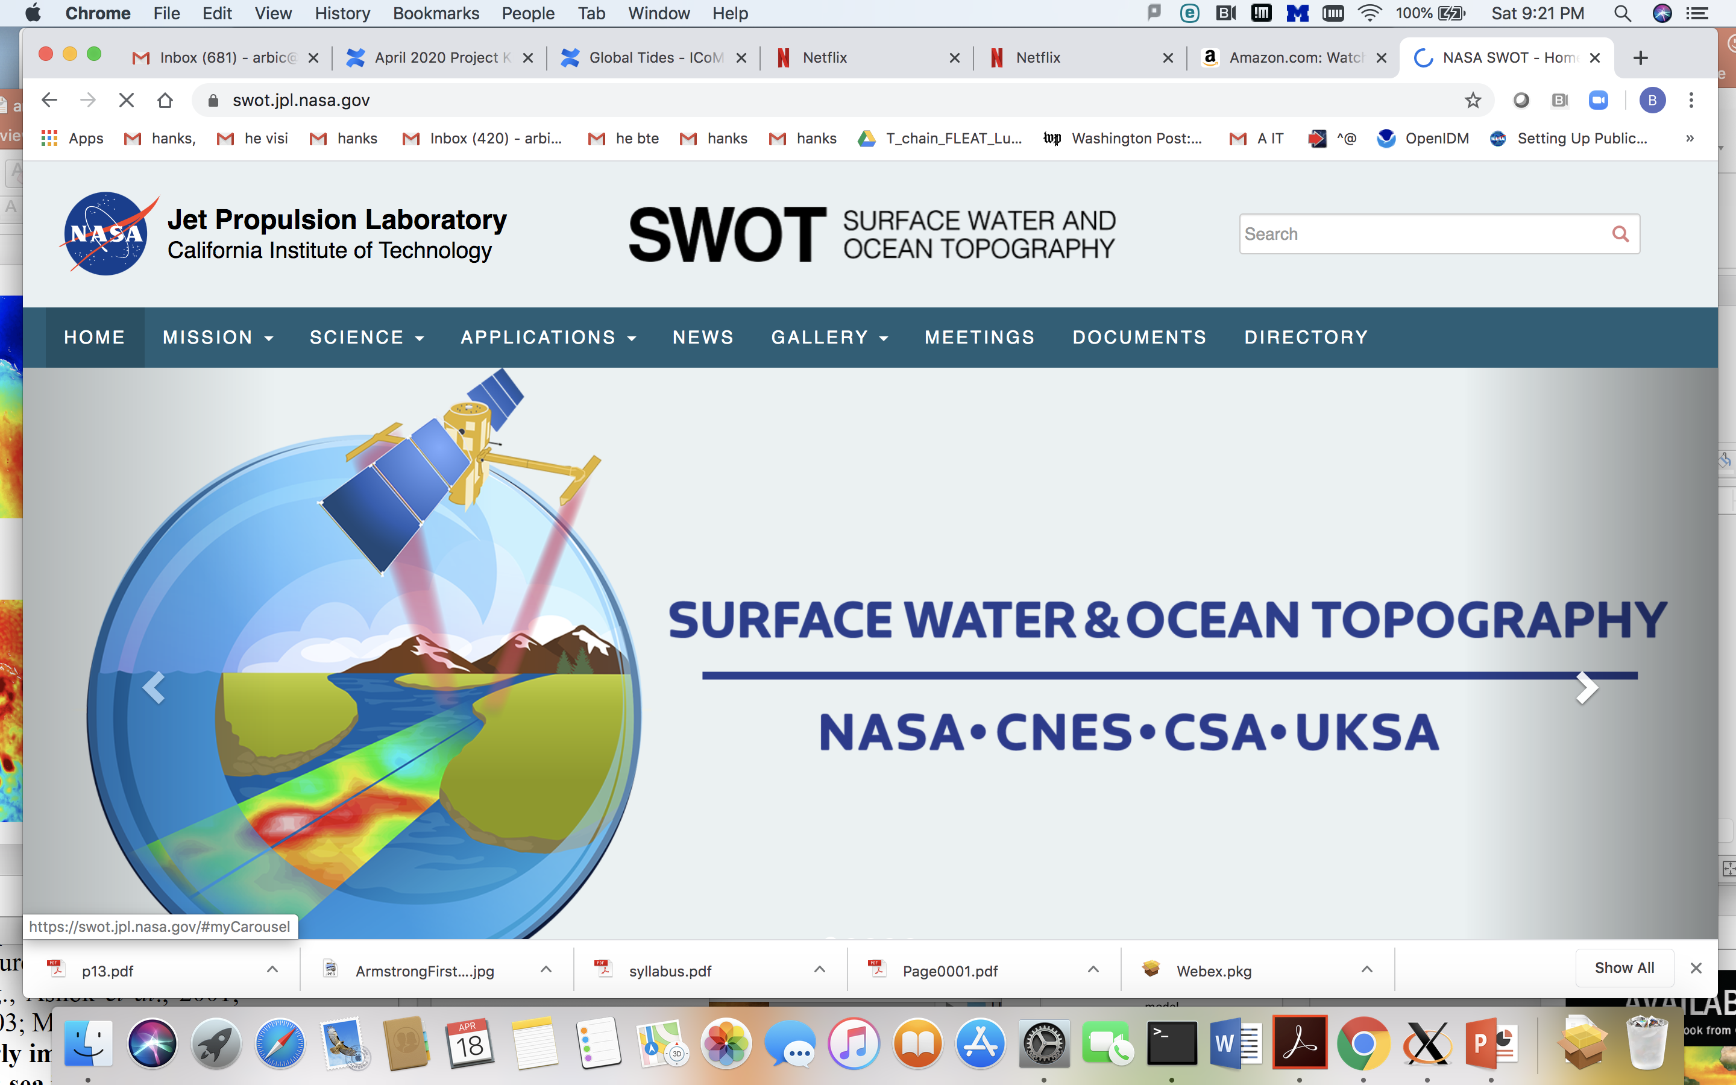
SWOT will measure
surface water heights
over oceans, lakes,
and rivers→
Joint oceanography +
hydrology mission
In contrast to current
nadir altimeters, SWOT
measurements will be
in two-dimensional
swaths rather than
one-dimensional tracks
Feature resolution will be
much higher
Planned launch in
December 2022

Slide 3
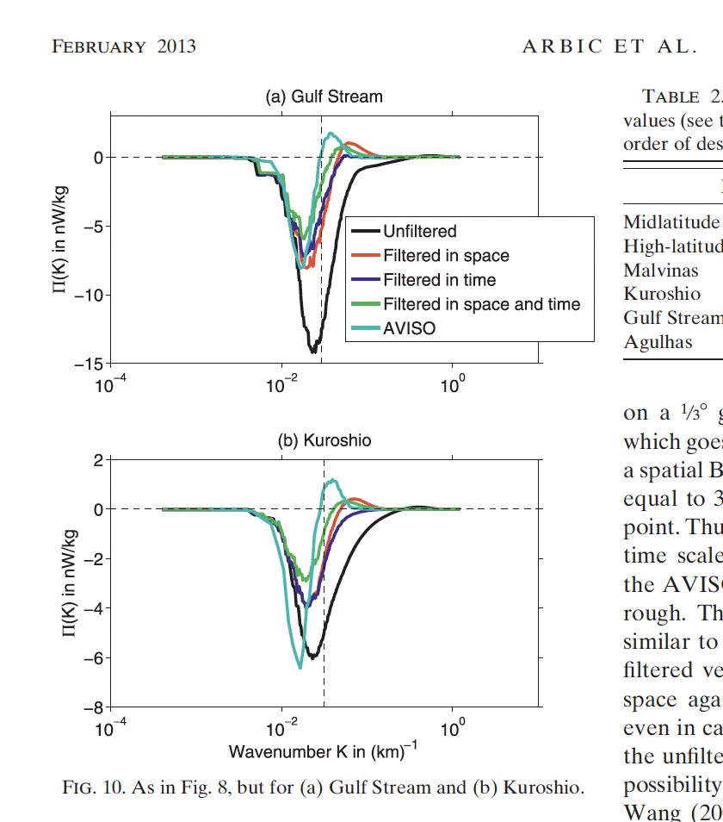
Resolution and energy cascade computation

Slide 4
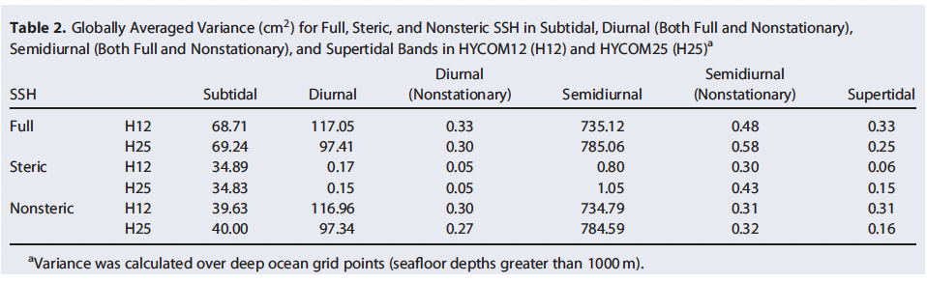
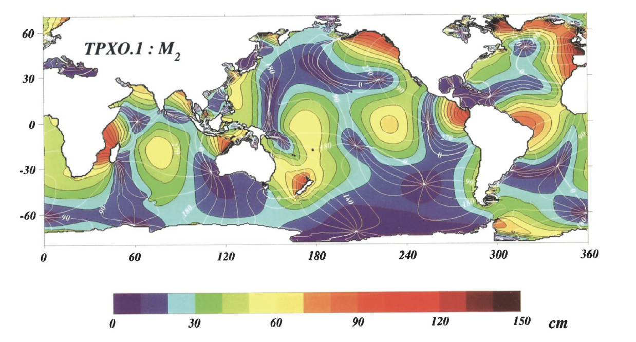
Need to remove large-scale tides from nadir altimeter data
Barotropic tides dominate sea surface
height (SSH) variance.
Known for a long time.
c.f., Table at right from Savage et al. (2017a). →
Barotropic tides have large horizontal scales, at least in the open ocean.
Figure of M₂ amplitudes and phases from Egbert et al. (1994). →

Slide 5
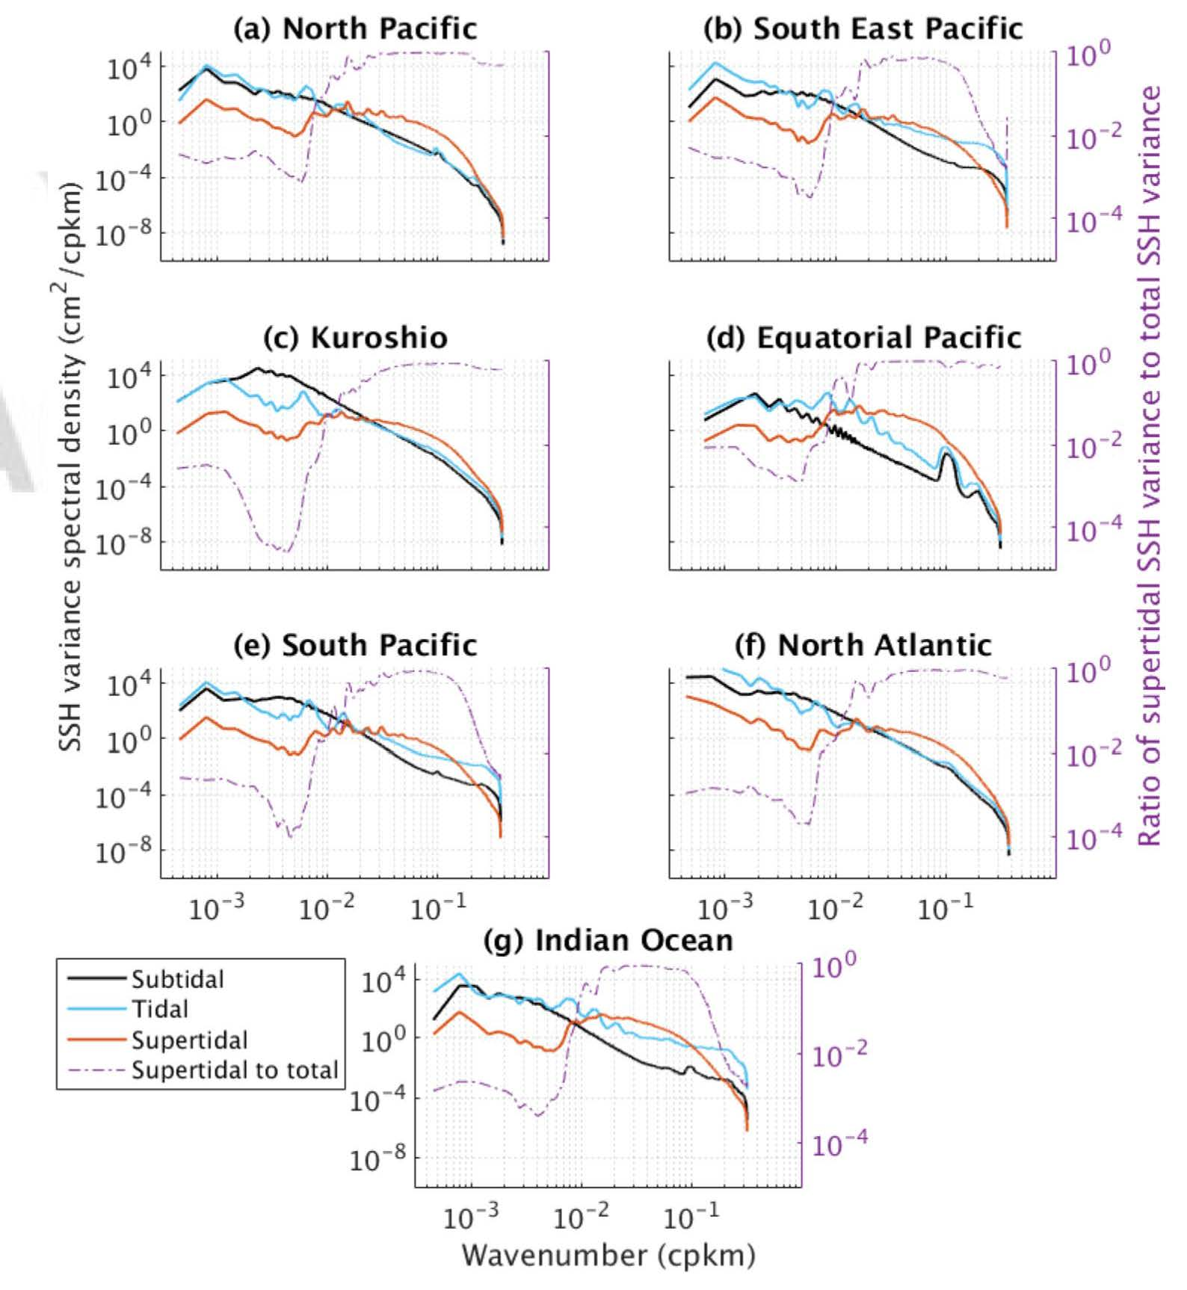
Band-integrated SSH wavenumber spectra over different regions in 1/48° MITgcm LLC4320 (Savage et al. 2017b)
At the high wavenumbers of interest for SWOT, the tidal and supertidal frequencies can dominate in some regions.
See also Richman et al. (2012) and many others, including:
Callies and Ferrari (2013),Bühler et al. (2014), Rocha et al. (2016a,b), Qiu et al. (2018, 2020), Torres et al. (2018, 2019), Wang et al. (2019), Klein et al. (2019), Cao et al. (2020), others

Slide 6
Global internal tide and gravity wave models
Global hydrodynamical models of internal tides and internal gravity waves (IGWs) can be used to examine the relative contributions of internal waves and balanced motions to SSH.
They are a new frontier in global ocean modeling.

Slide 7
Slide from Richard Ray’s "100 years of tides” talk at Fall 2019 AGU meeting

Slide 8
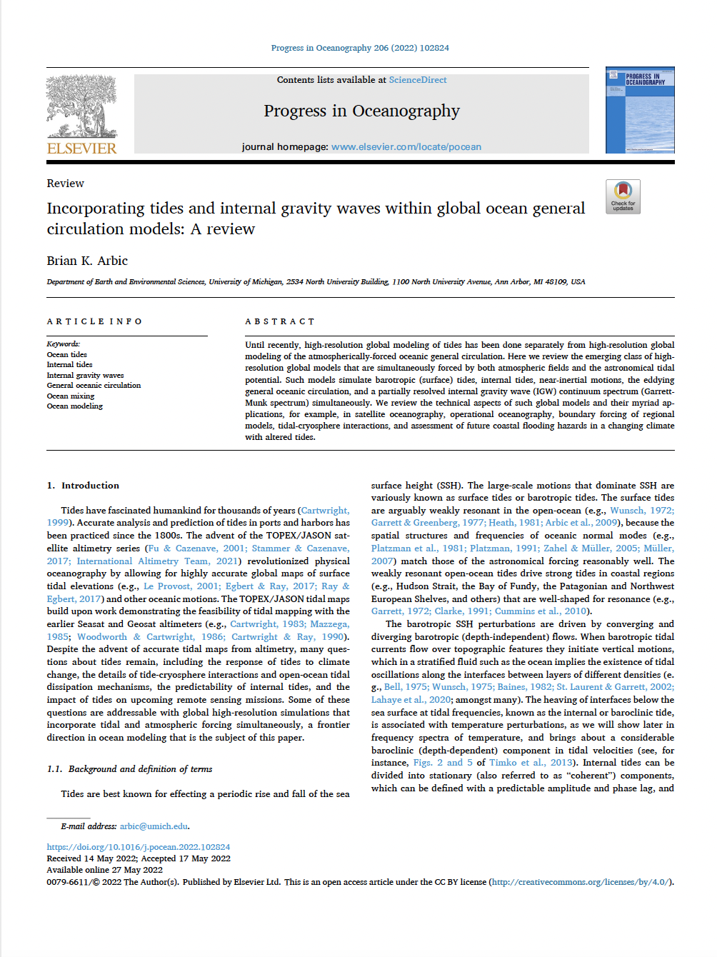
Arbic 2022 Progress in Oceanography
review article
Arbic et al. (2018) review chapter

Slide 9
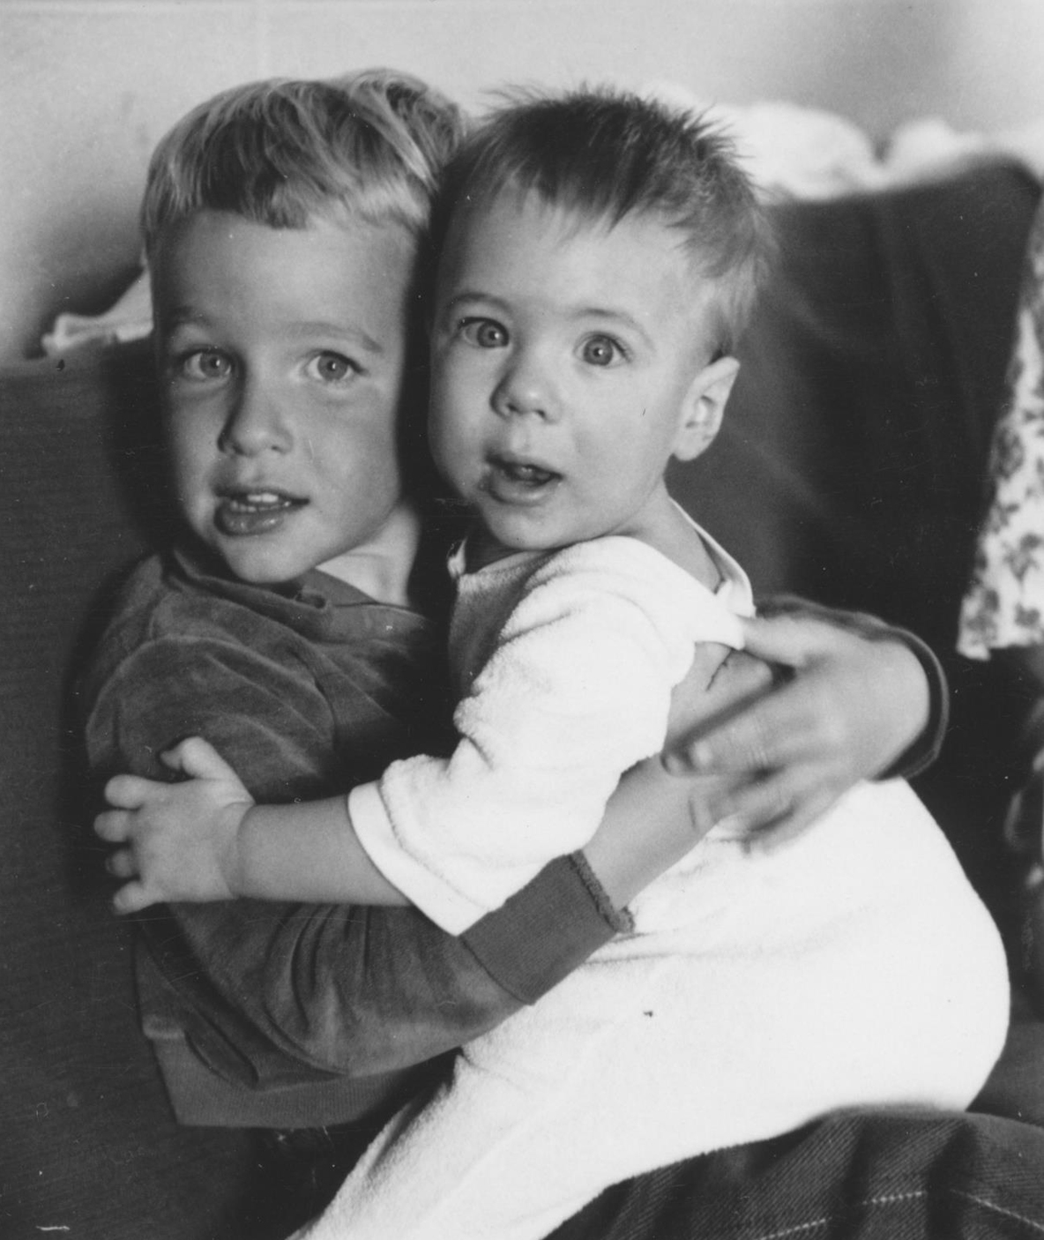
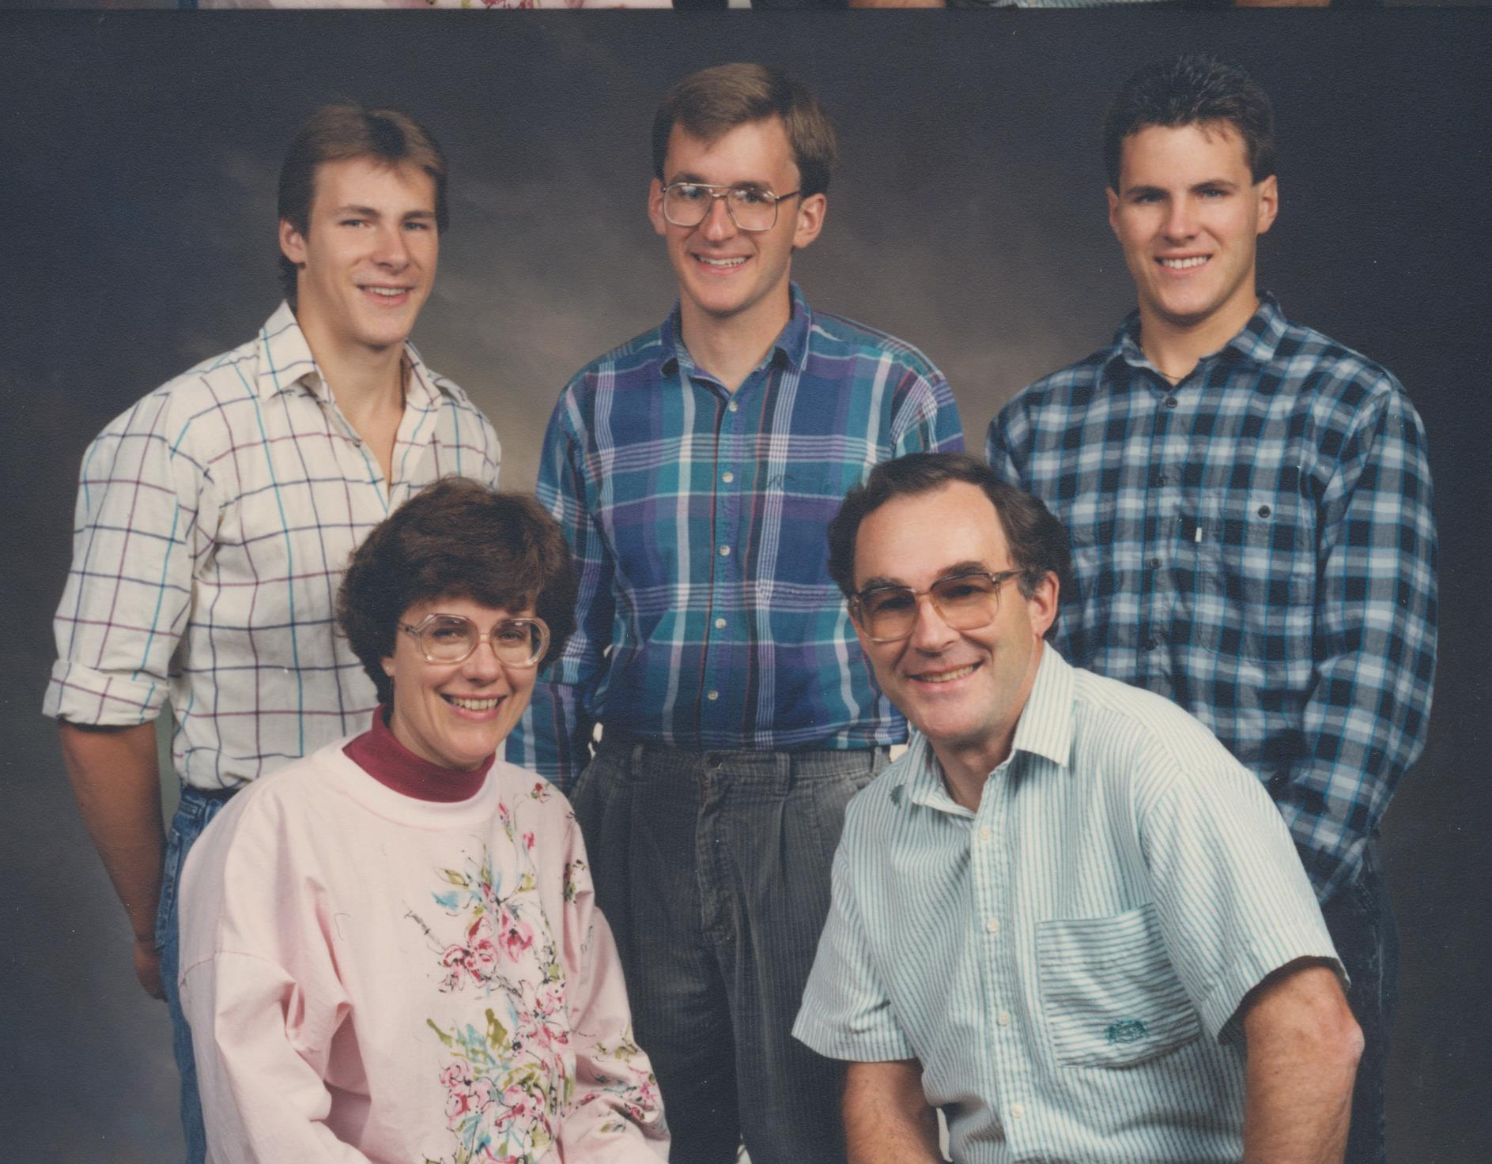
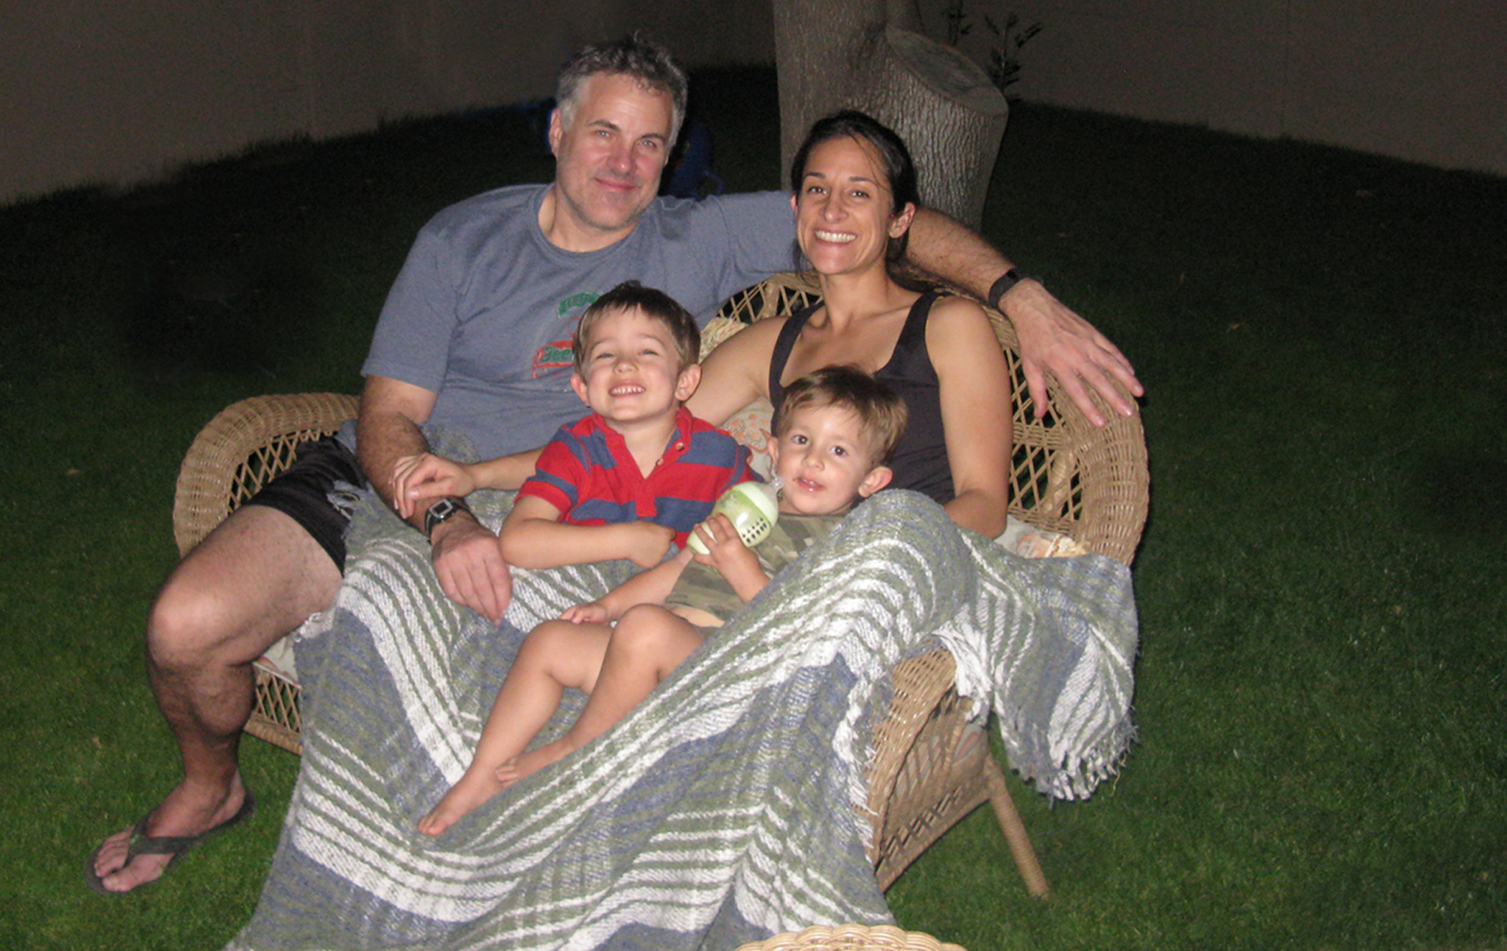
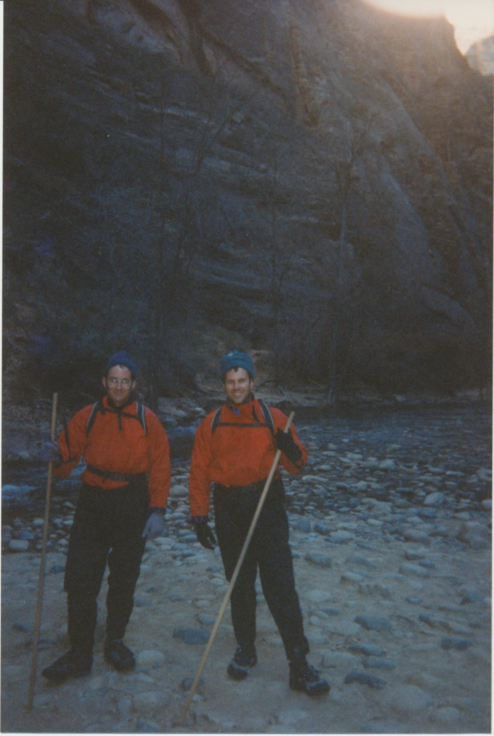
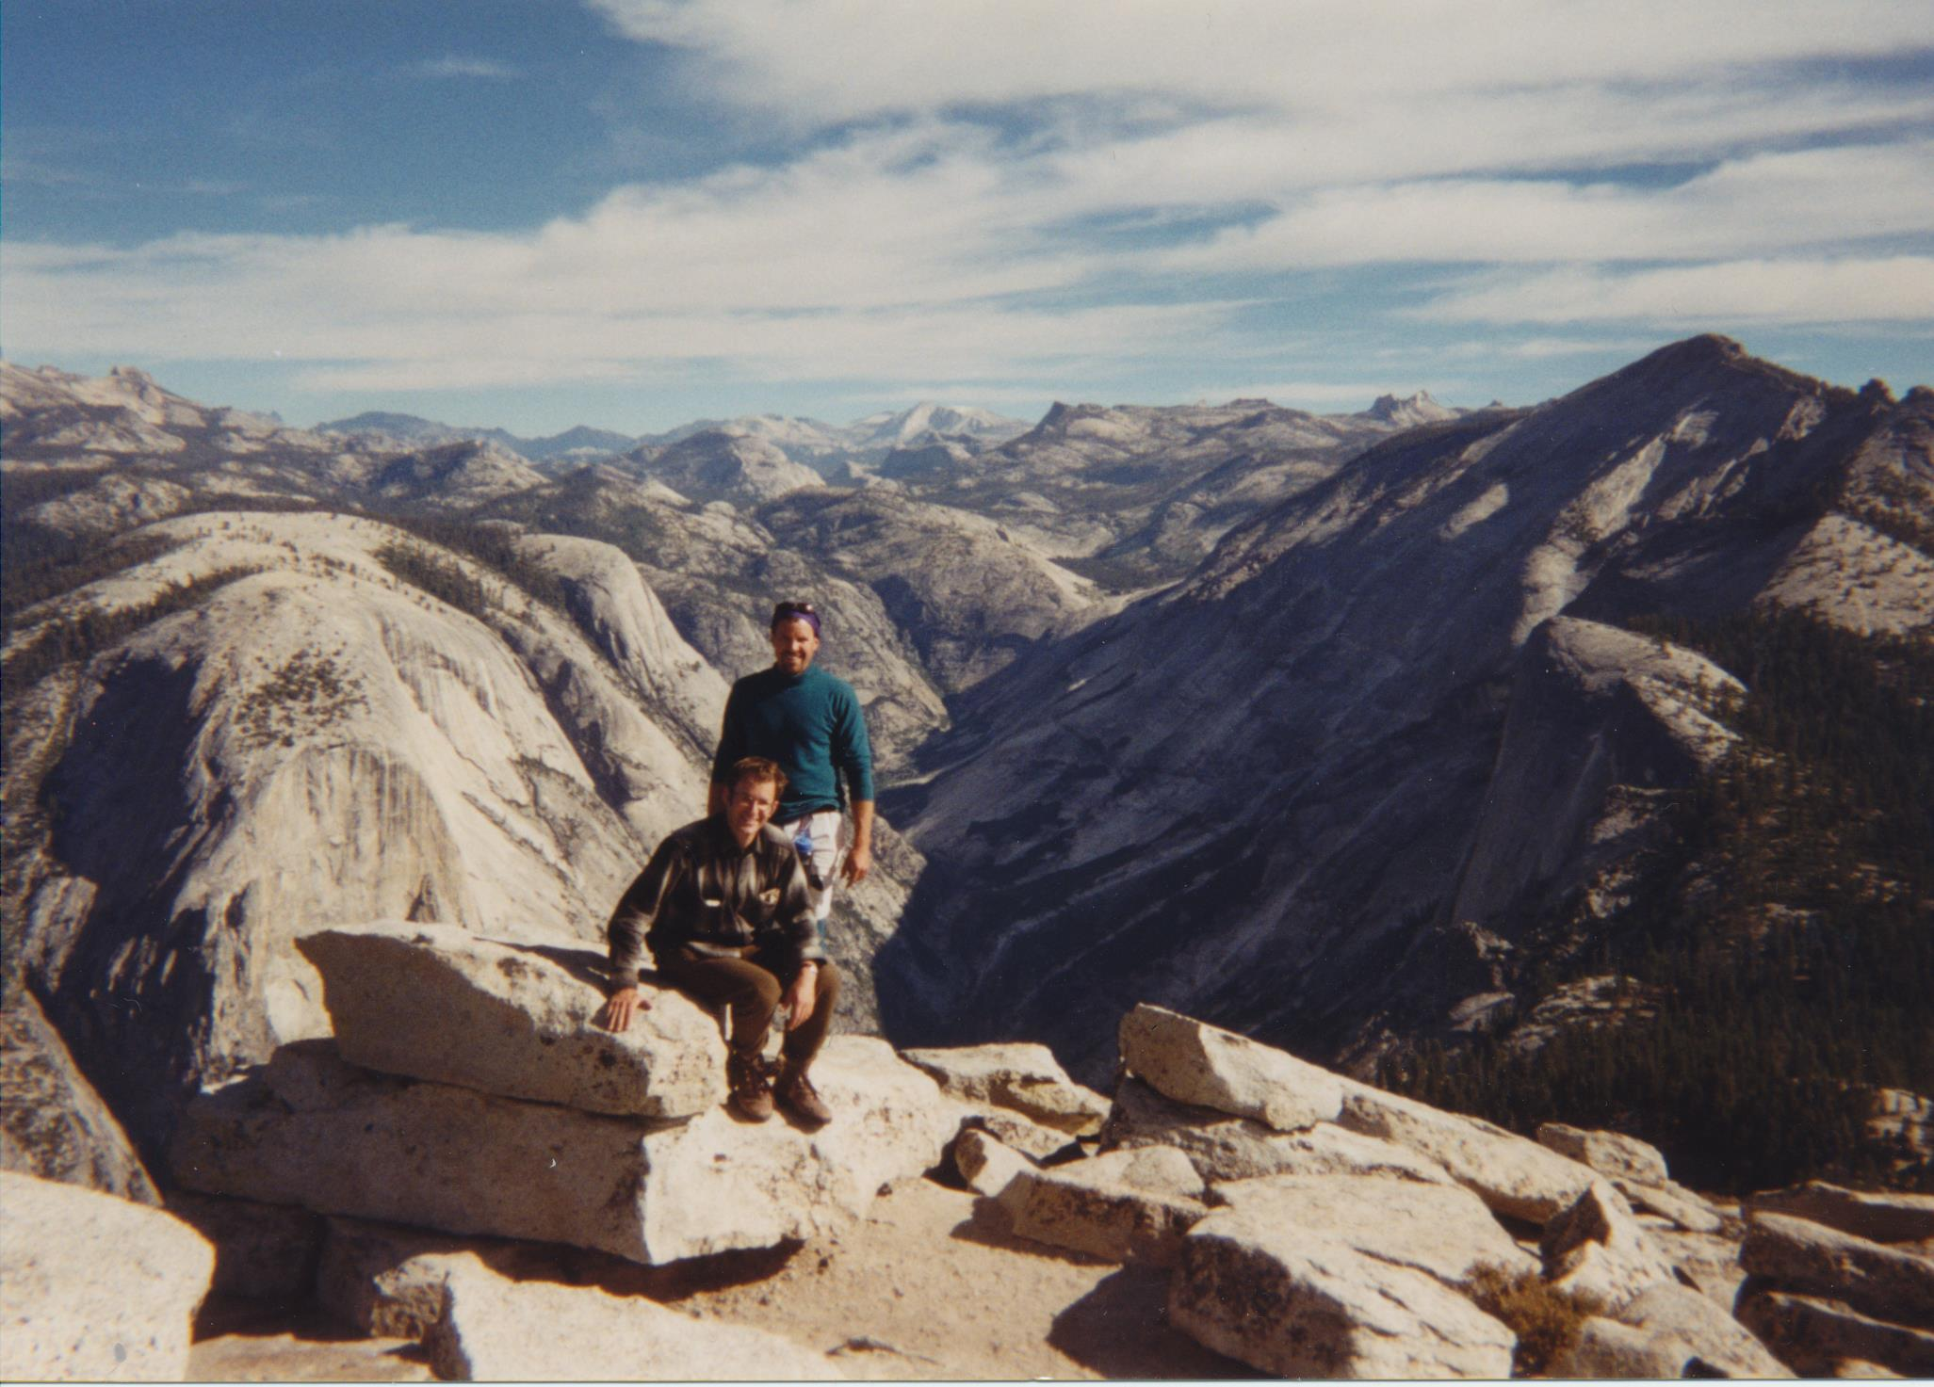
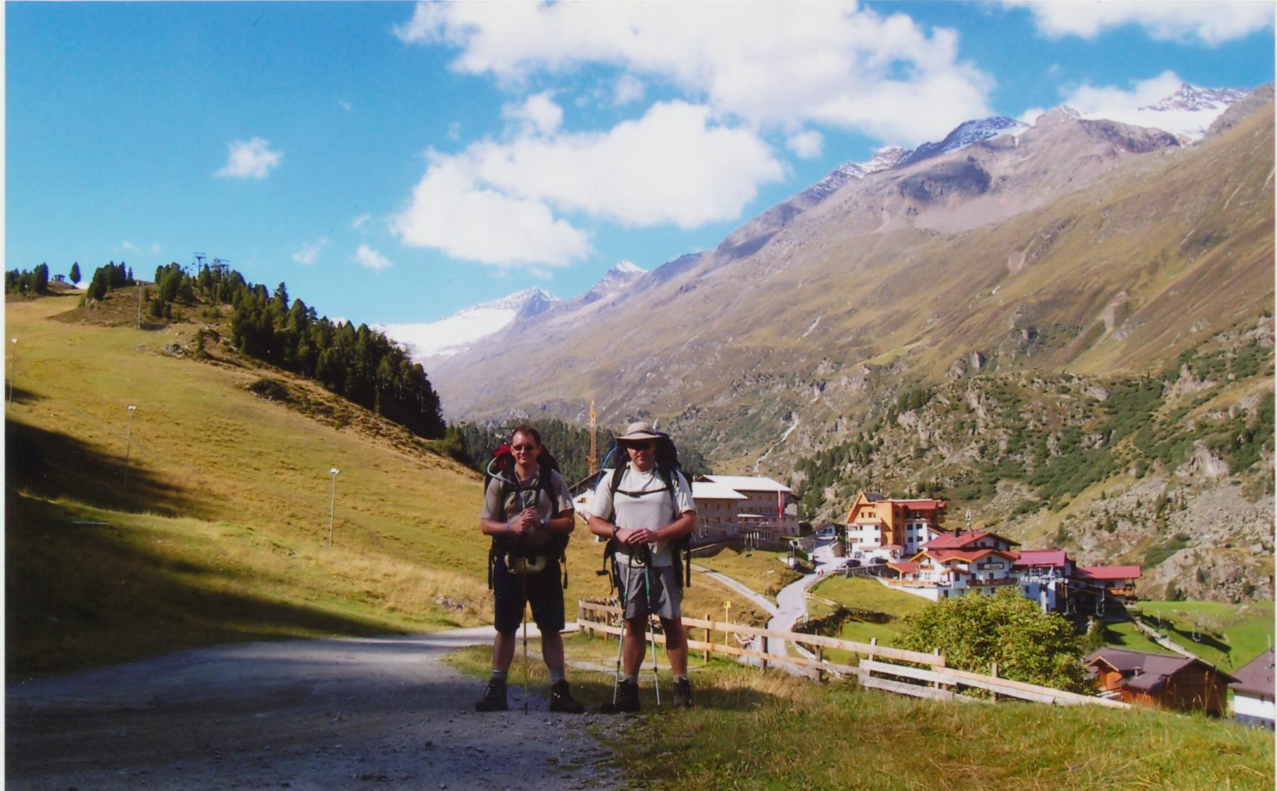
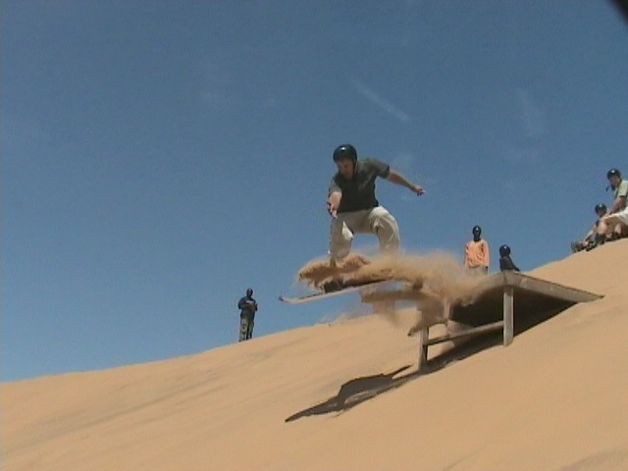

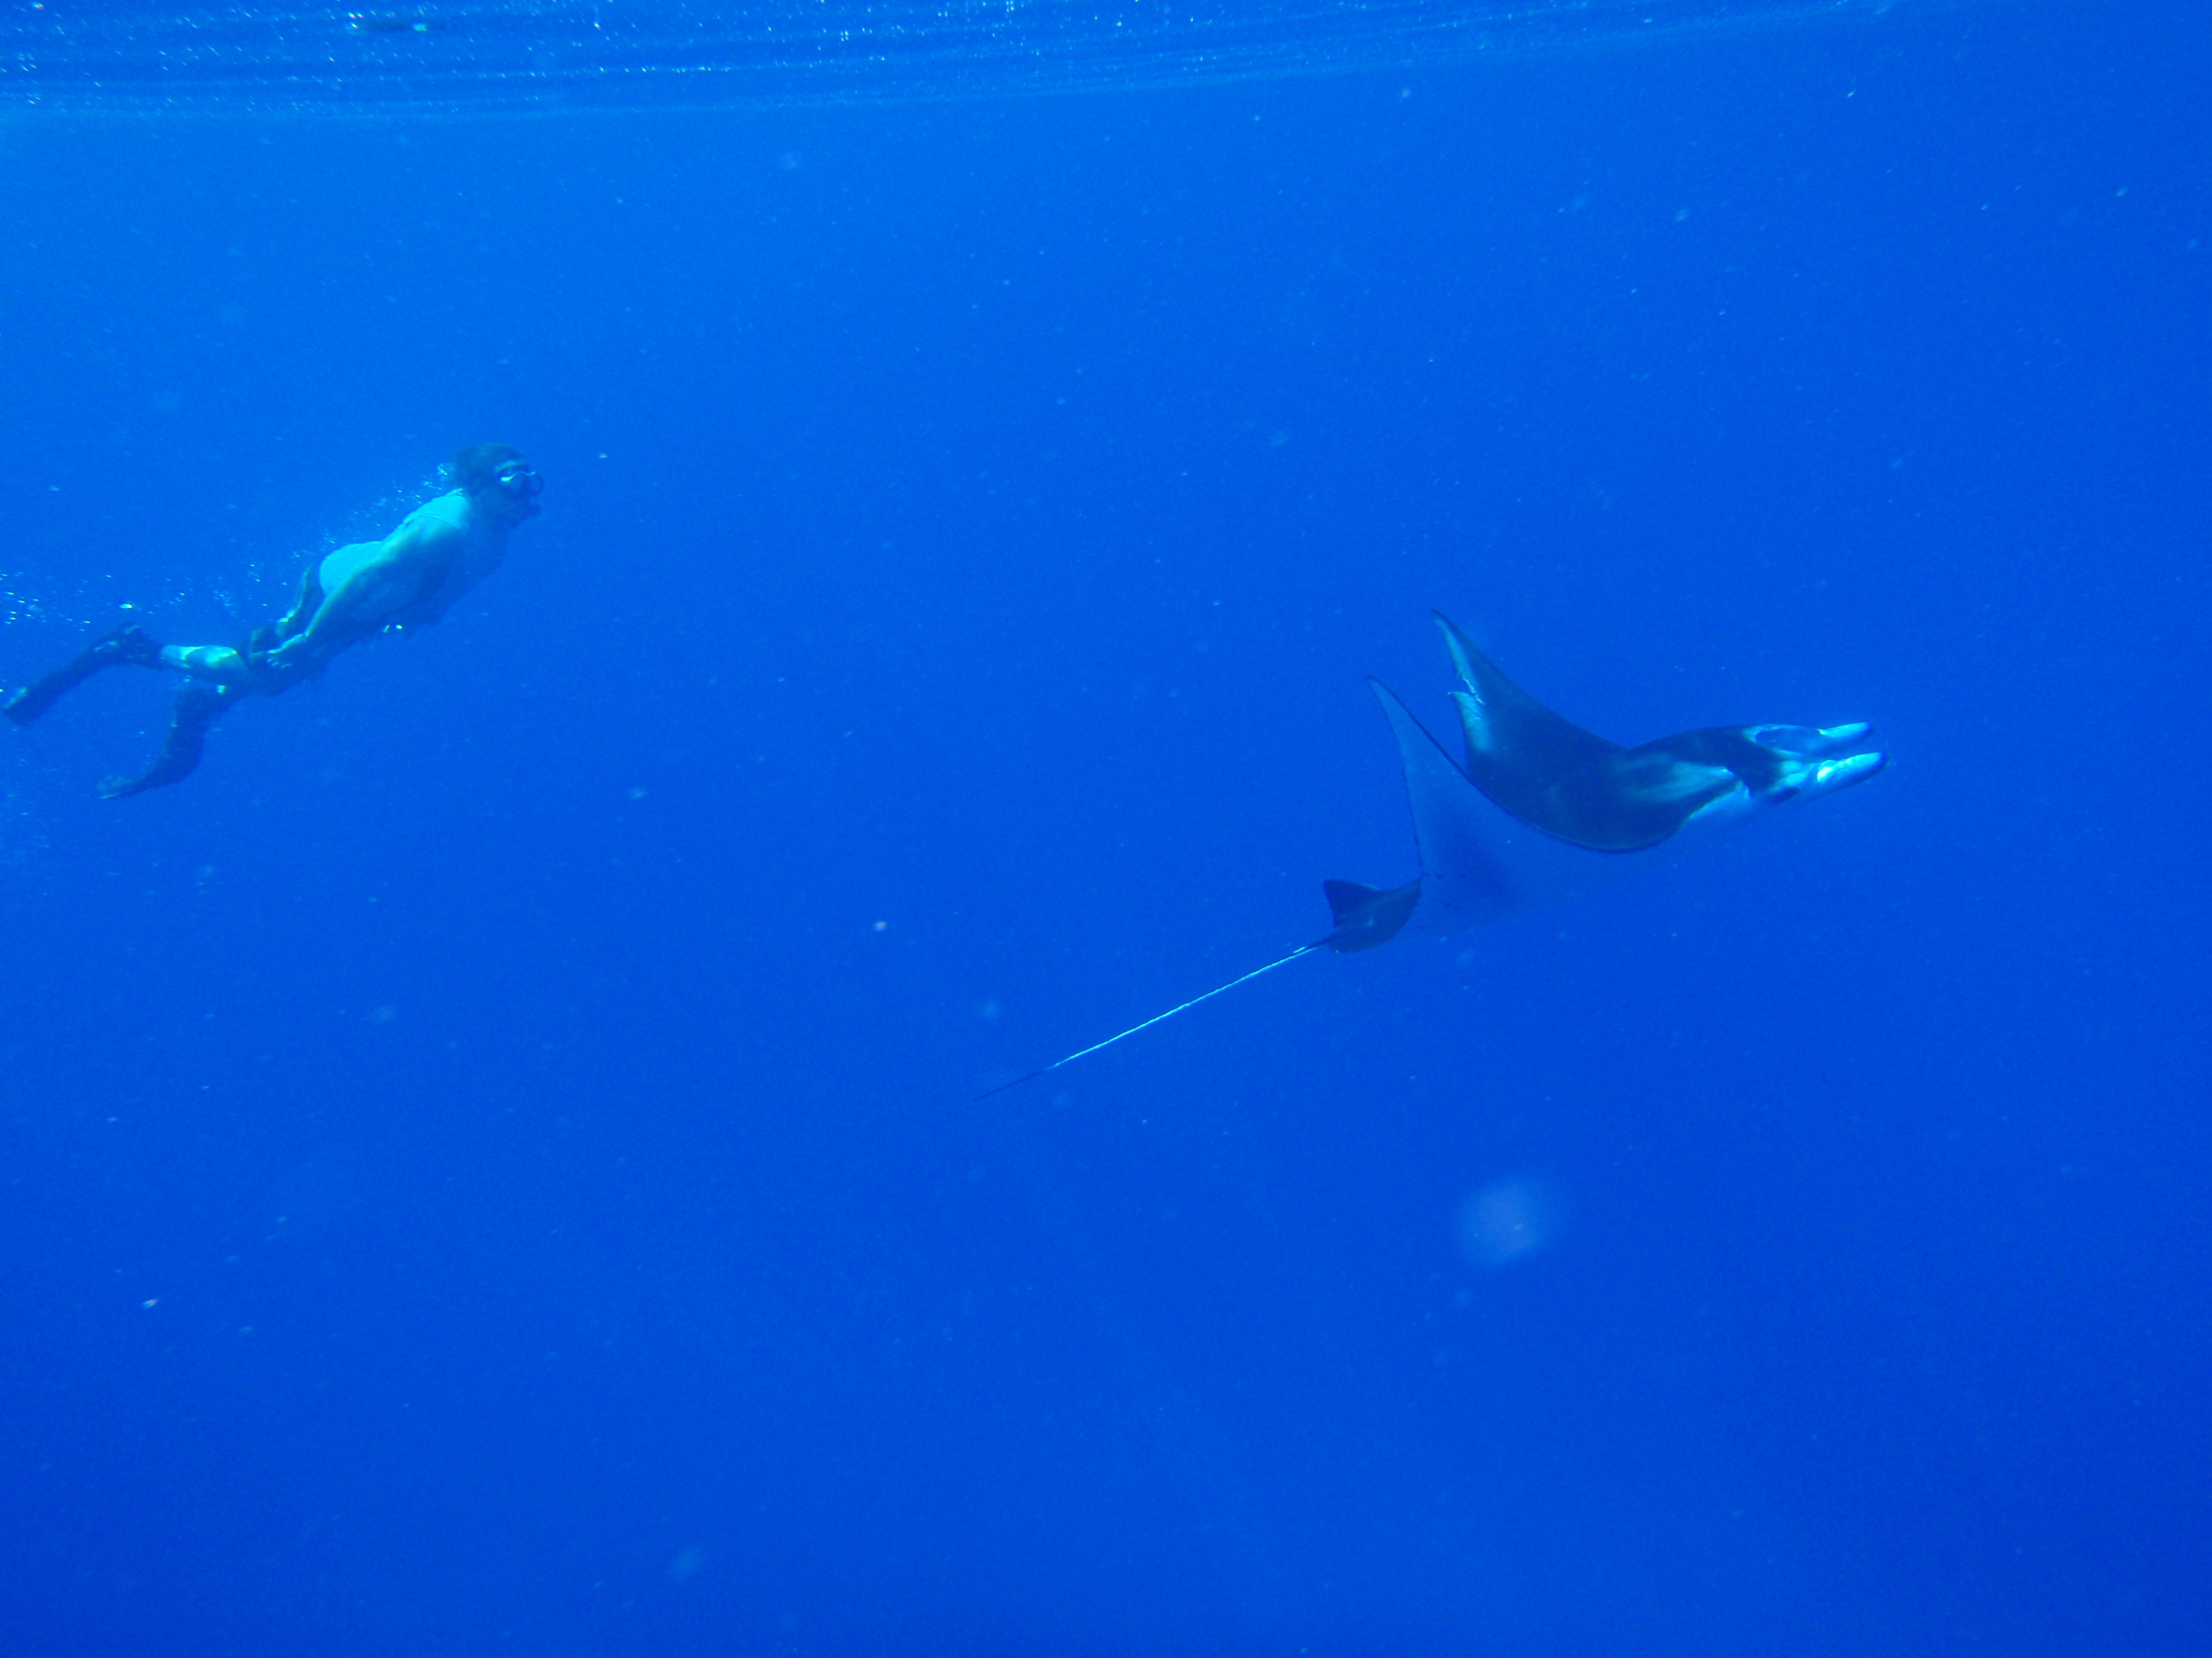
Dedication
Joel Bernard Arbic
April 11, 1969-December 2, 2017
FAMILY
Brian and Joel, Dec 1969
Dan, Brian, Joel, Mom, Dad, late 1980s
Joel, Shantala, Rowan, Remy, 2017
OUR
OUTDOOR
TRIPS
Virgin River Narrows, Zion, 1997
Top of Half Dome, Yosemite, 1998
Austrian Alps, 2005
18 MONTH
AROUND-THE-WORLD
TRIP WITH SHANTALA
Namibia, 2007
Machapuchare Base Camp, Himalayas, 2008
Borneo, 2008

Slide 10
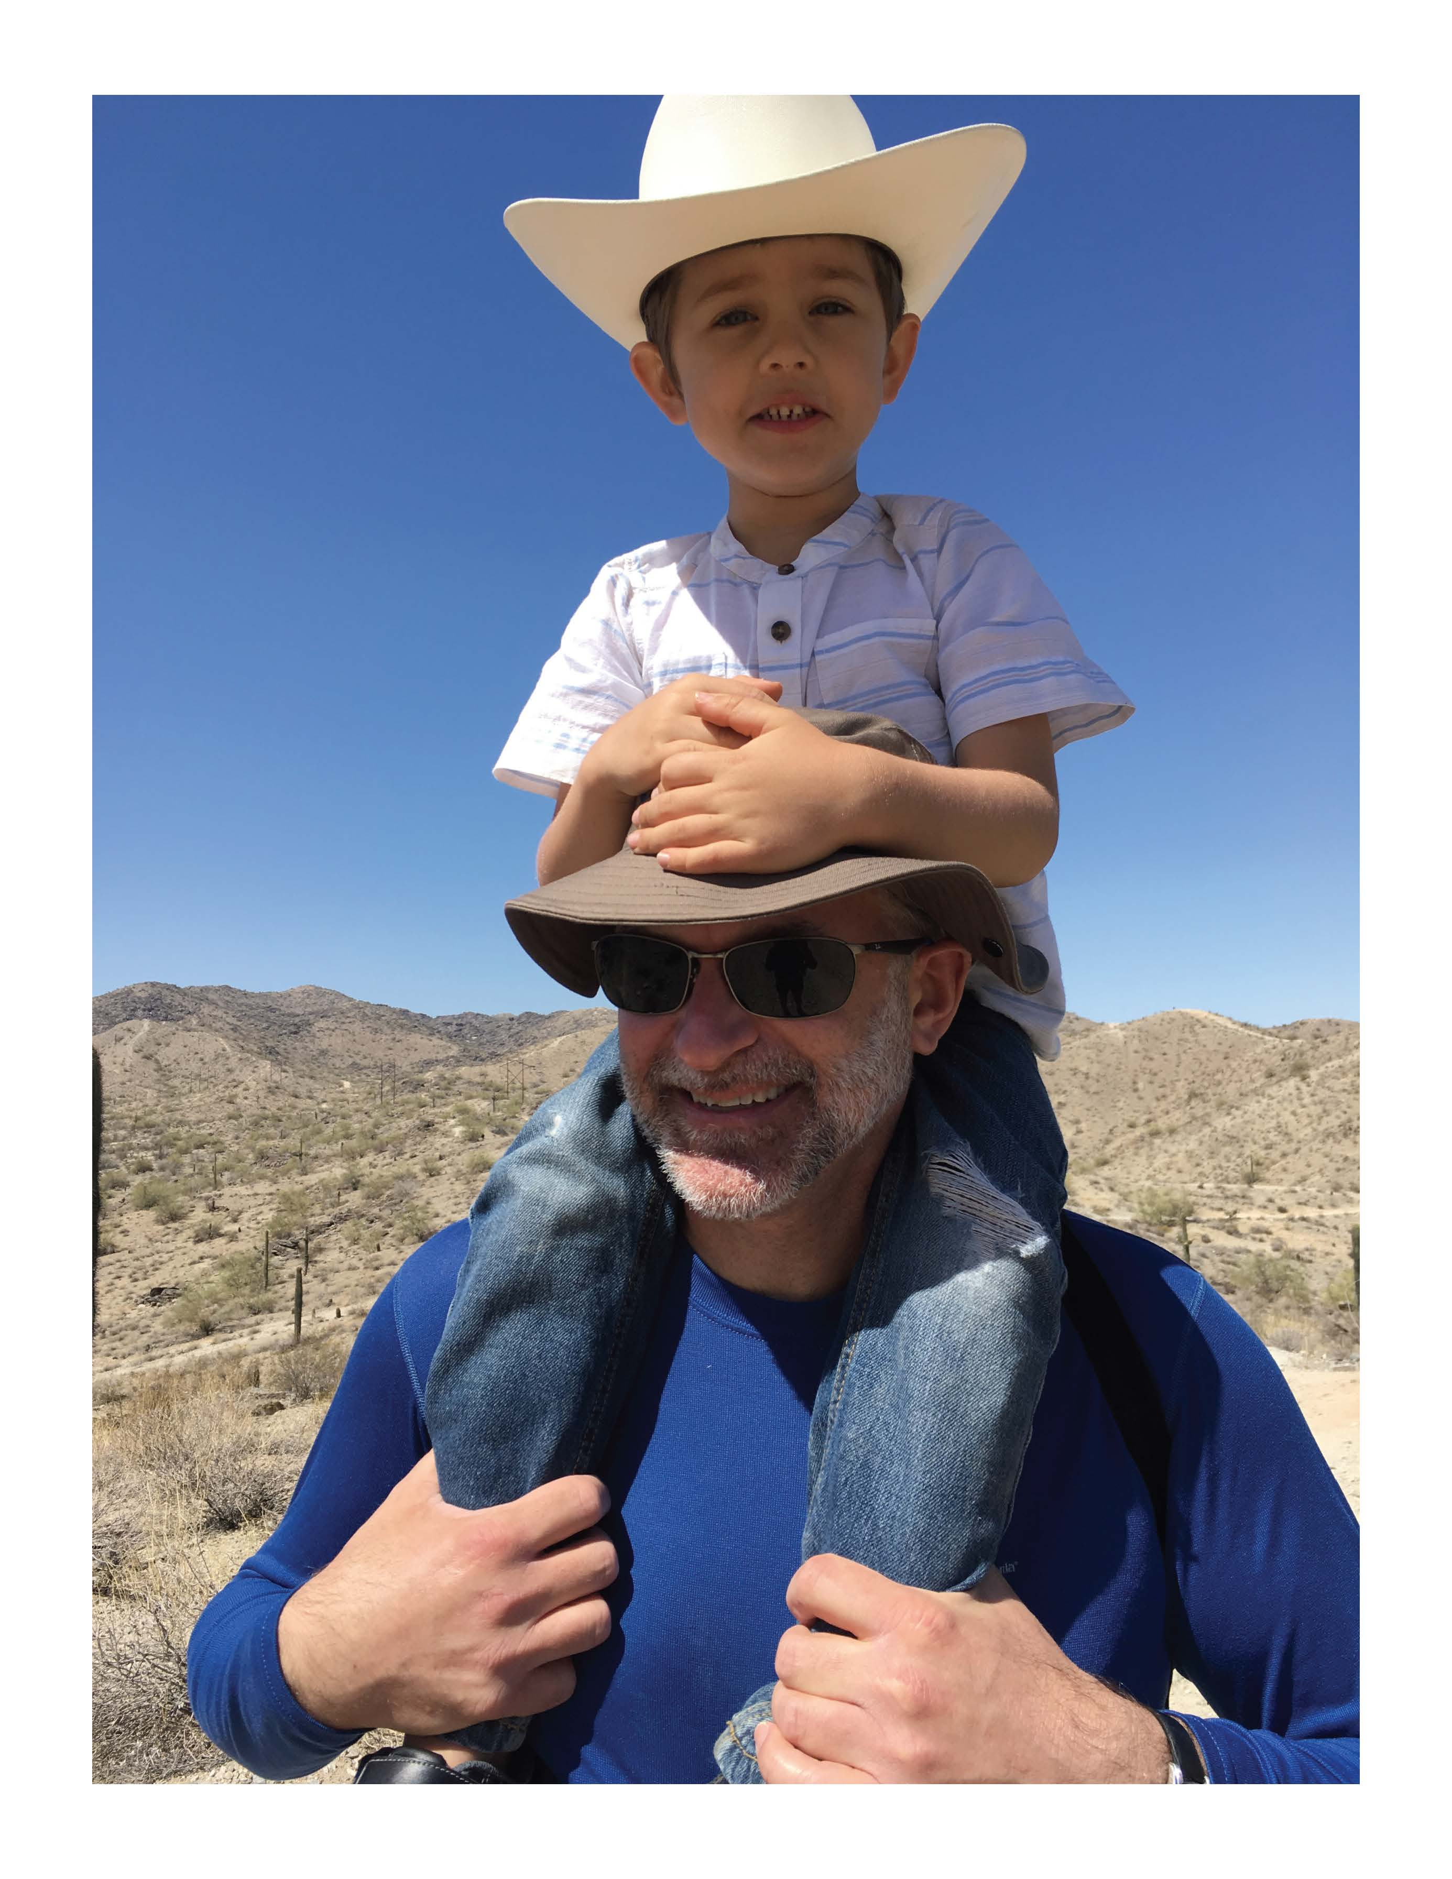
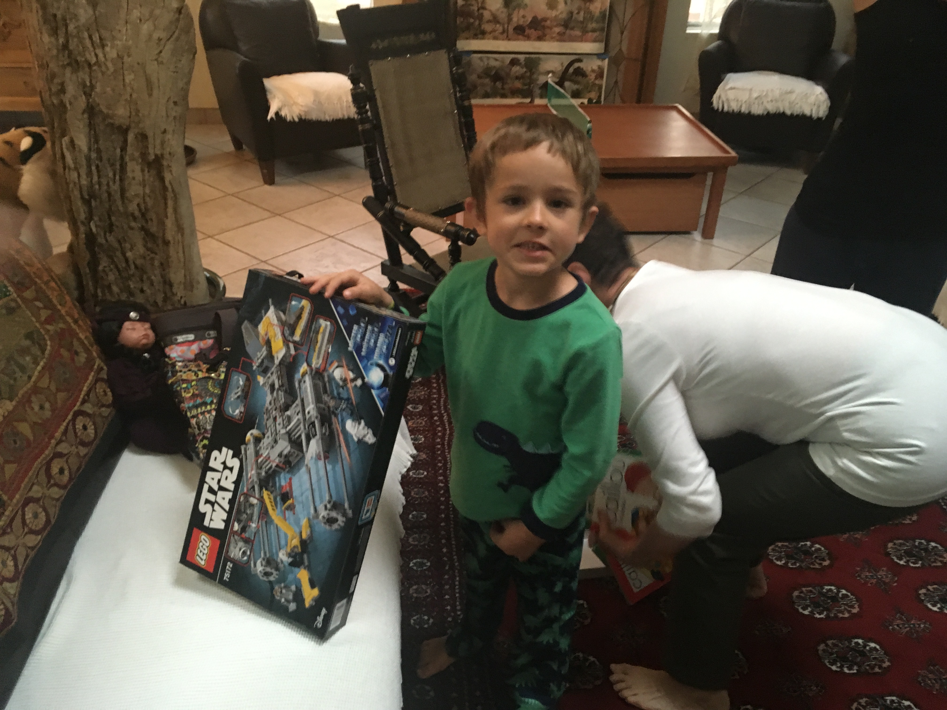
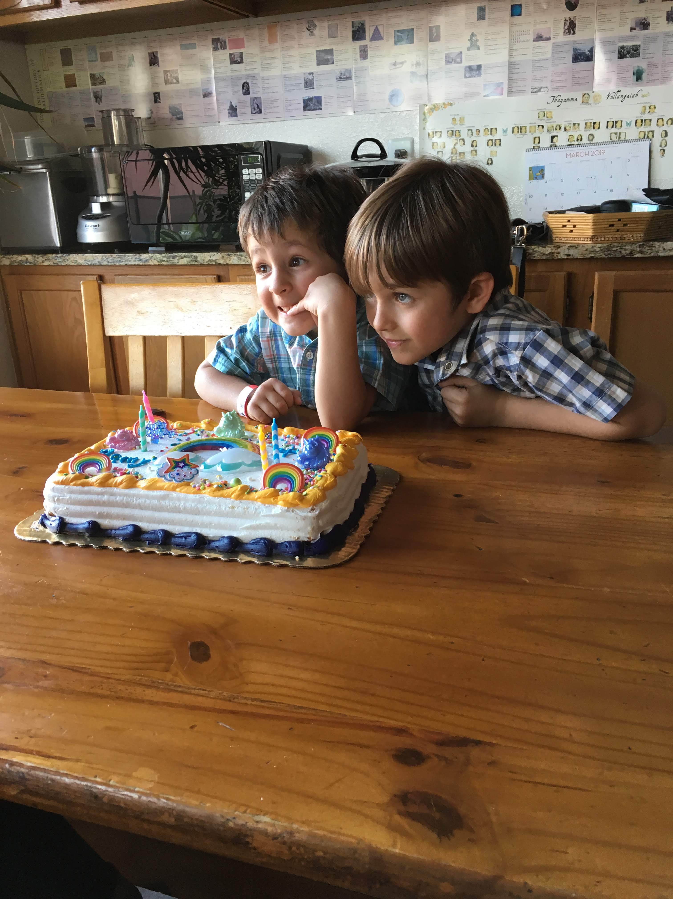
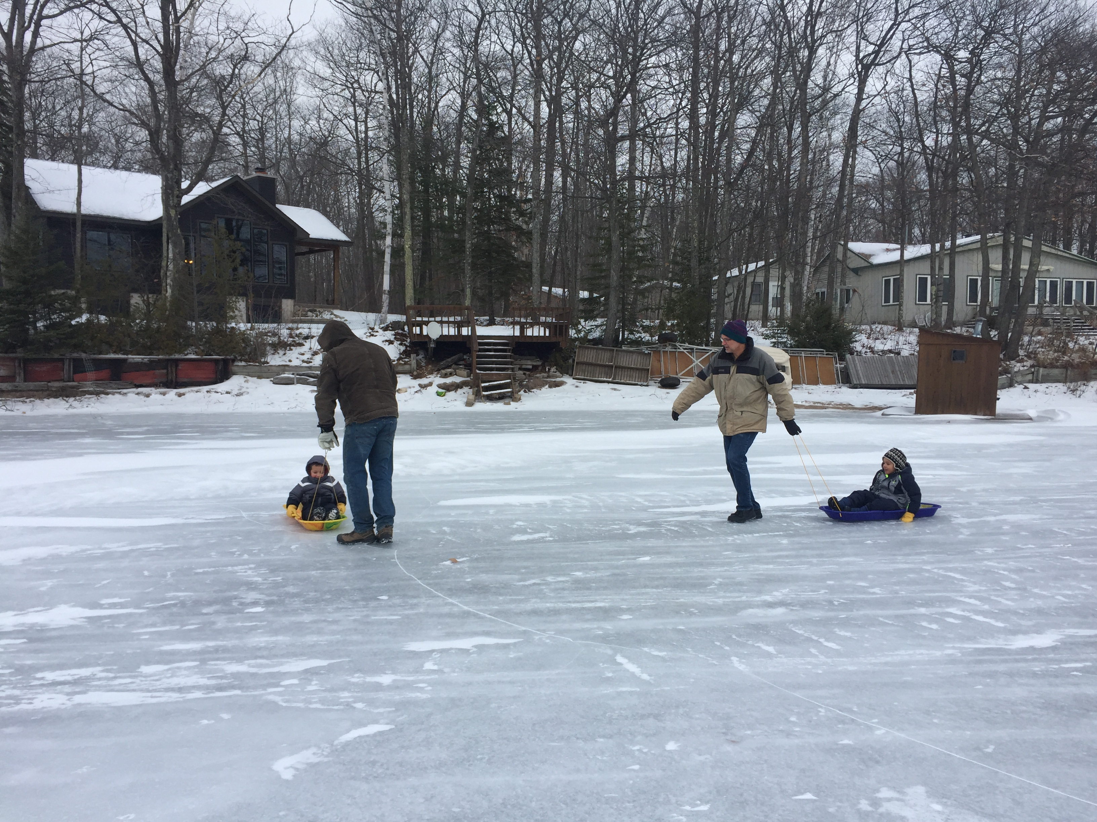
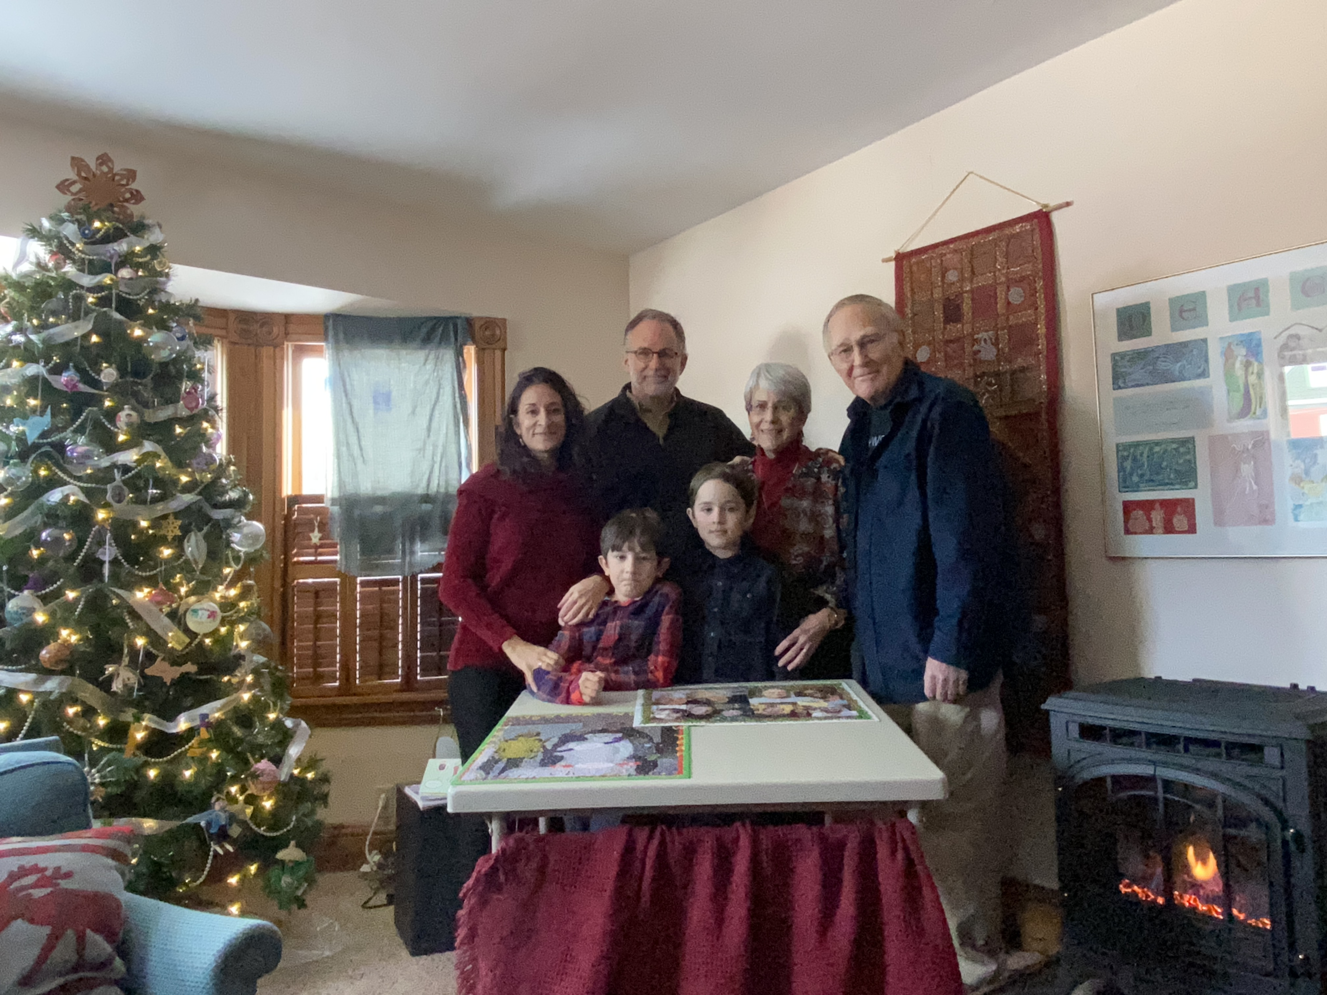
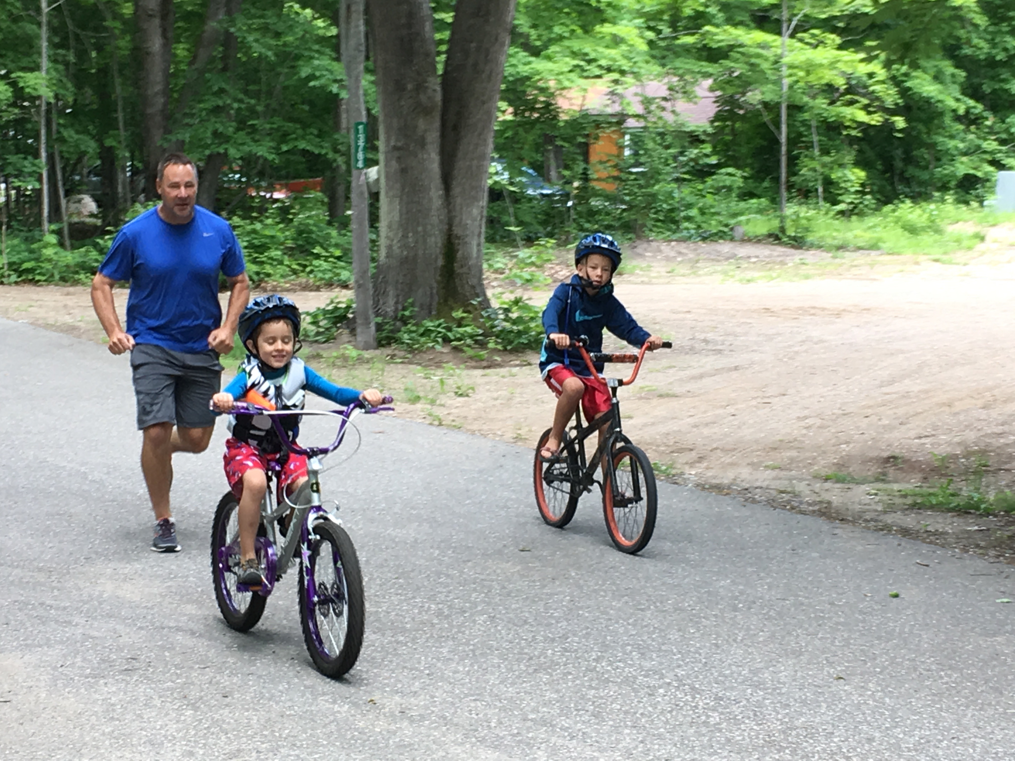
Some of our 2018-2021 family trips
Being a better, more
involved uncle is a very
high priority for me now
April 2018, Phoenix
October 2018, Phoenix
February 2019, Phoenix
June 2018, Northern Michigan
Christmas 2018, Northern Michigan
Christmas 2021, Northern Michigan

Slide 11
Why add tides to high-resolution global circulation models?
Barotropic tidal flow over rough topography in a stratified fluid generates internal tides
Internal tides propagate in an environment with changing stratification and eddies→yields a realistic non-phase-locked (non-stationary/incoherent) internal tides
Non-linear interactions between internal tides and wind-driven near-inertial waves yield a partially resolved supertidal internal gravity wave (IGW) continuum, or Garrett-Munk spectrum, as shown in Müller et al. 2015 (for HYCOM), Rocha et al. 2016 (for MITgcm), and other papers
Global internal wave models help us plan for and interpret SWOT
Remotely generated internal waves should be included in boundary conditions for regional models
Breaking IGWs drive mixing
  can our models help us understand the space-time geography of ocean mixing?
Internal waves impact ocean acoustics
Tides interact with sea ice and floating ice shelves, and will change in a changing climate

Slide 12
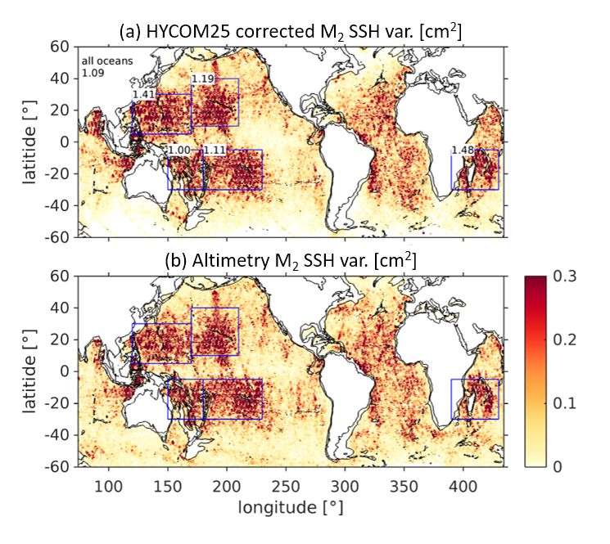
Geographical distribution: phase-locked internal tides
Sea surface height (SSH) variance of the phase-locked principal lunar semidiurnal tide M₂ in non-assimilative HYCOM (top) and altimetry (bottom).
The HYCOM variances have been corrected for the effects of the short duration of the model output record.
Numbers represent the fraction of HYCOM variance to altimetry variance.
Determined by spatially high-passing amplitudes of total tidal SSH (as in Ray and Mitchum 1996)
Buijsman et al., Ocean Modelling, 2020

Slide 13
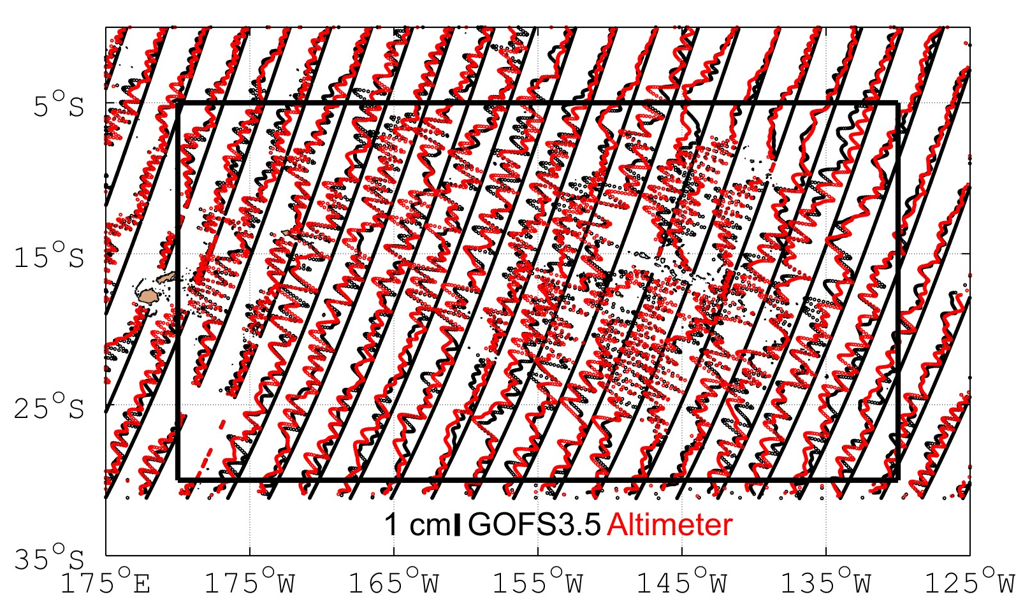
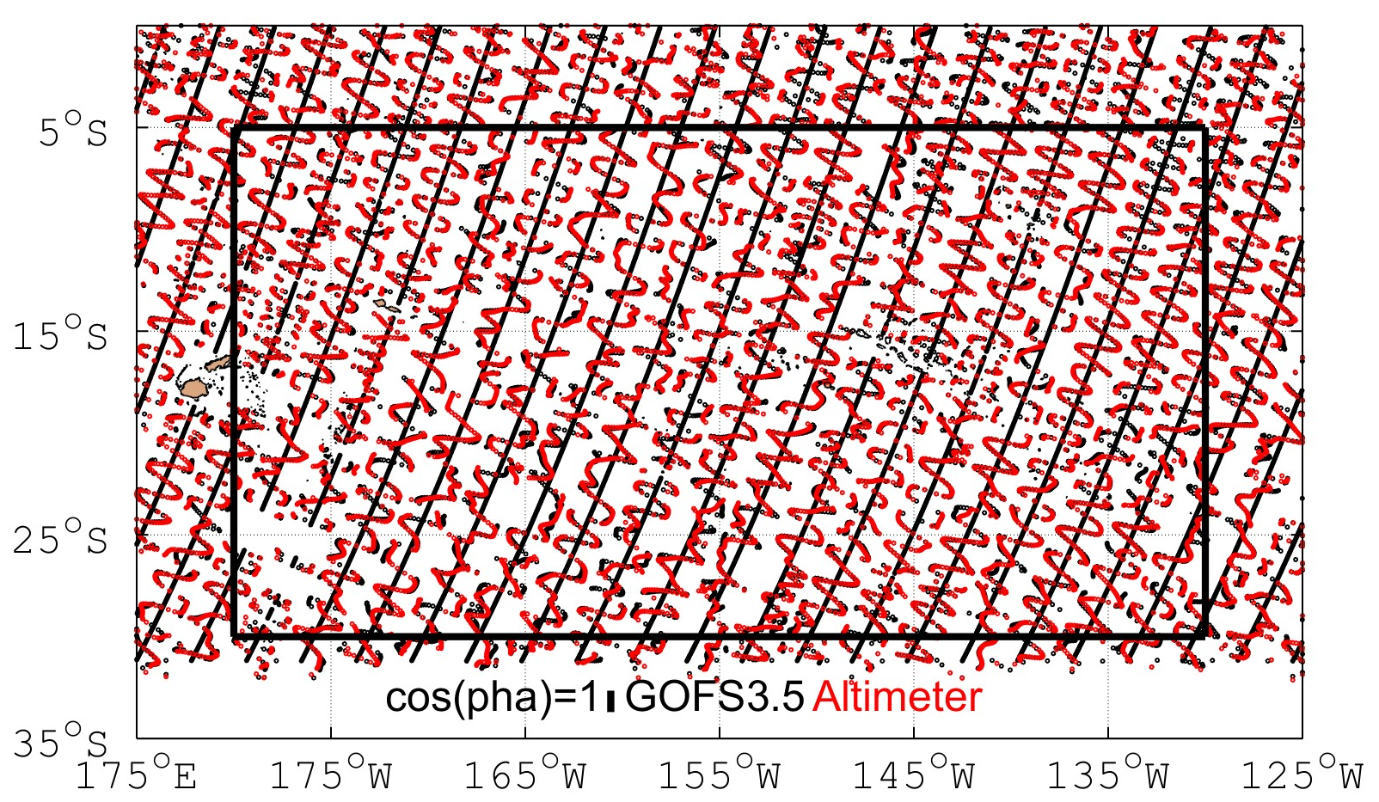
Data assimilative system → Skill in phases
A more difficult test is whether HYCOM can phase-predict the phase-locked internal tides.
Our new HYCOM simulations with data assimilation capture from 43-69% of the M₂ phase-locked internal tide variance in the five hotspot regions identified in Shriver et al. (2012) and shown on previous page.
The model captures 64% of the variance in the south central Pacific shown above.

Slide 14
HYCOM as a correction model
HYCOM could offer a hydrodynamical correction model for phase-locked internal tides, to complement empirical models derived from analysis of nadir and SWOT altimetry.
Can HYCOM do even more? E.g., phase-predict the non-phase-locked internal tides?
First, characterize whether HYCOM has the right geographical patterns of non-phase-locked internal tides…

Slide 15
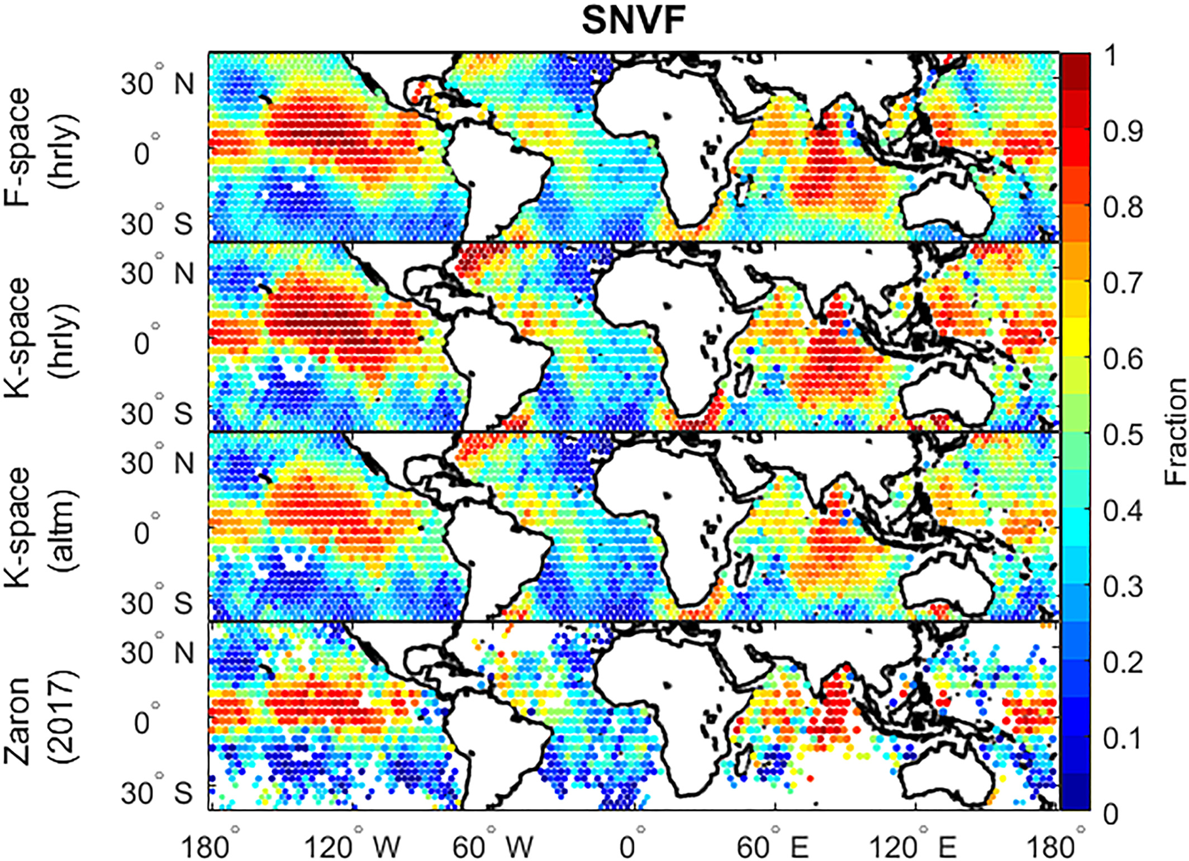
Semi-diurnal non-phase-locked variance fraction (SNVF) in non-assimilative HYCOM vs. altimetry (Nelson et al., 2019)
Large non-phase-locked internal tides in equatorial regions examined in detail in Buijsman et al. (2017)

Slide 16
Can we phase-predict the non-phase-locked internal tides using HYCOM?
Egbert and Erofeeva, 2021: can use HYCOM output in a PCA (principal component analysis) approach that seems promising
  They analyzed the Amazon Shelf region
Ritabrata Thakur is working on extending the Egbert and Erofeeva analysis to the entire globe

Slide 17
Model-observation comparisons
Model-observation comparisons help test the realism of the models. For example:
Luecke et al. (2020): comparison of HYCOM and MITgcm LLC4320 to ~2000 moored observational time series
Ansong et al. (2022a, in prep): comparison of HYCOM, MITgcm LLC4320, MOM6, and NEMO barotropic and internal tides to altimetry
Arbic et al. (2022, in review): comparison of HYCOM and MITgm LLC4320 near-surface kinetic energy to surface drifters

Slide 18
Boundary forcing very-high resolution regional simulations
SWOT mission will motivate running regional models at the highest possible resolutions
”Pilot” project in collaboration with Dimitris Menemenlis, Dick Peltier (University of Toronto) and others.
Another Dimitris Menemenlis “hero run”, done on Canadian supercomputer Niagara (courtesy of collaboration with Dick Peltier).
Use global 1/48° MITgcm LLC4320 simulation to boundary force a 6° by 8° MITgcm patch near Hawai’i, with 8X higher horizontal and 3X higher vertical resolutions (Nelson et al. 2020, Pan et al. 2020)

Slide 19
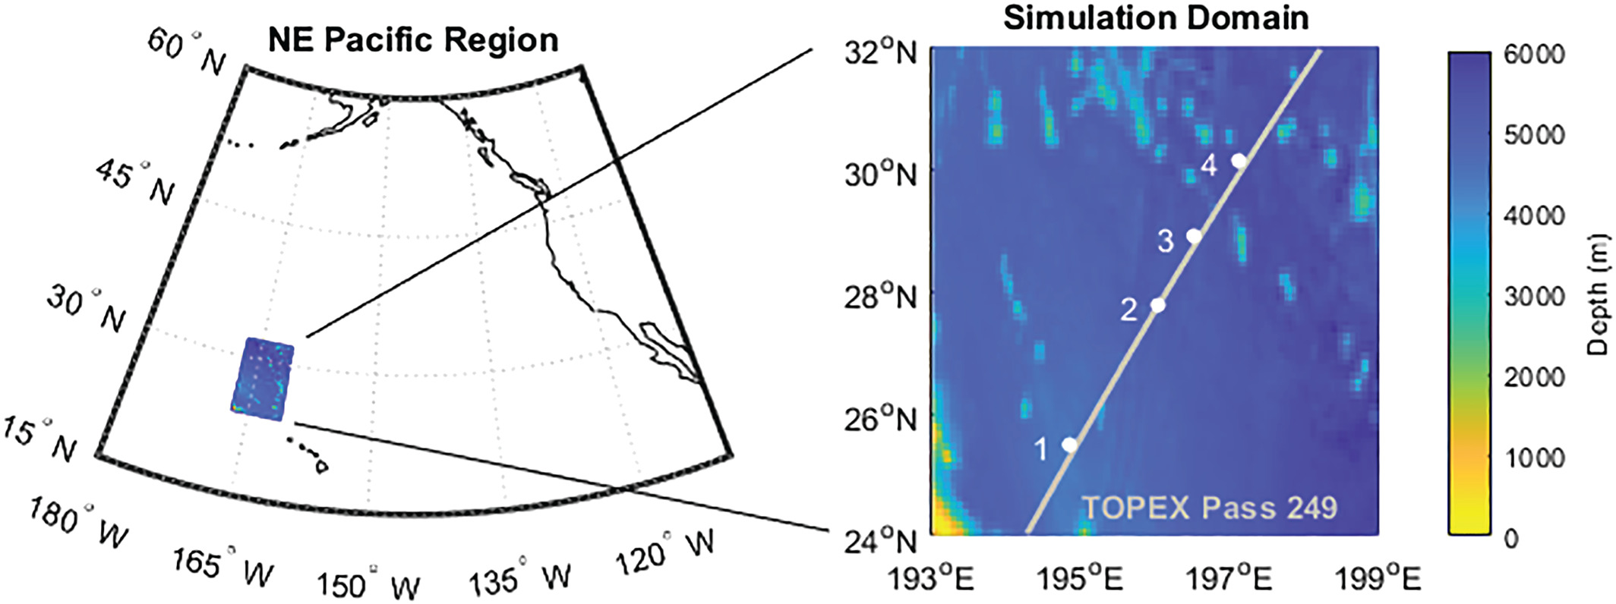
Model domain, high-resolution regional simulation (Nelson et al., 2020)

Slide 20
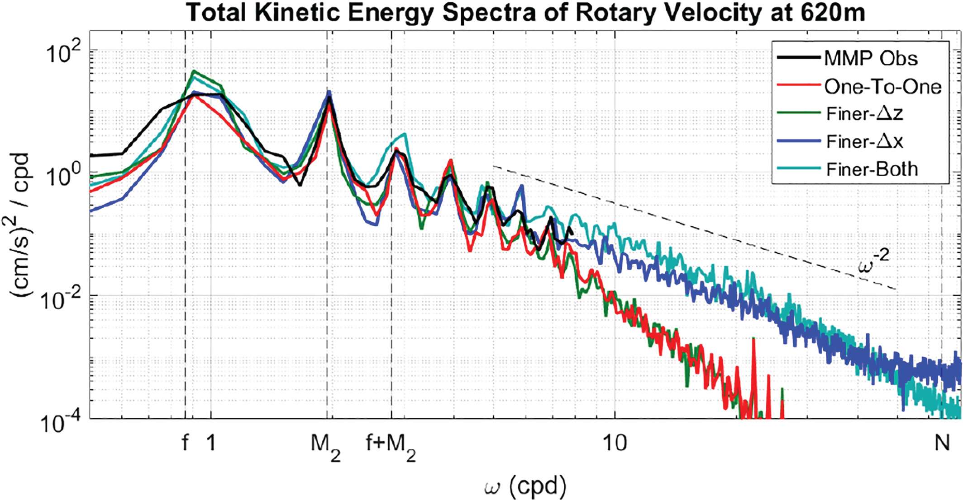
Improved IGW frequency spectra in a regional model forced by the global MITgcm simulation (Nelson et al., 2020)
Mazloff et al.: w/o internal tide boundary conditions, a regional model has an insufficiently energetic IGW spectrum
This work: with internal tide boundary conditions + increase in resolution, IGW continuum energy increases and lies closer to predictions of the Garrett-Munk spectral model

Slide 21
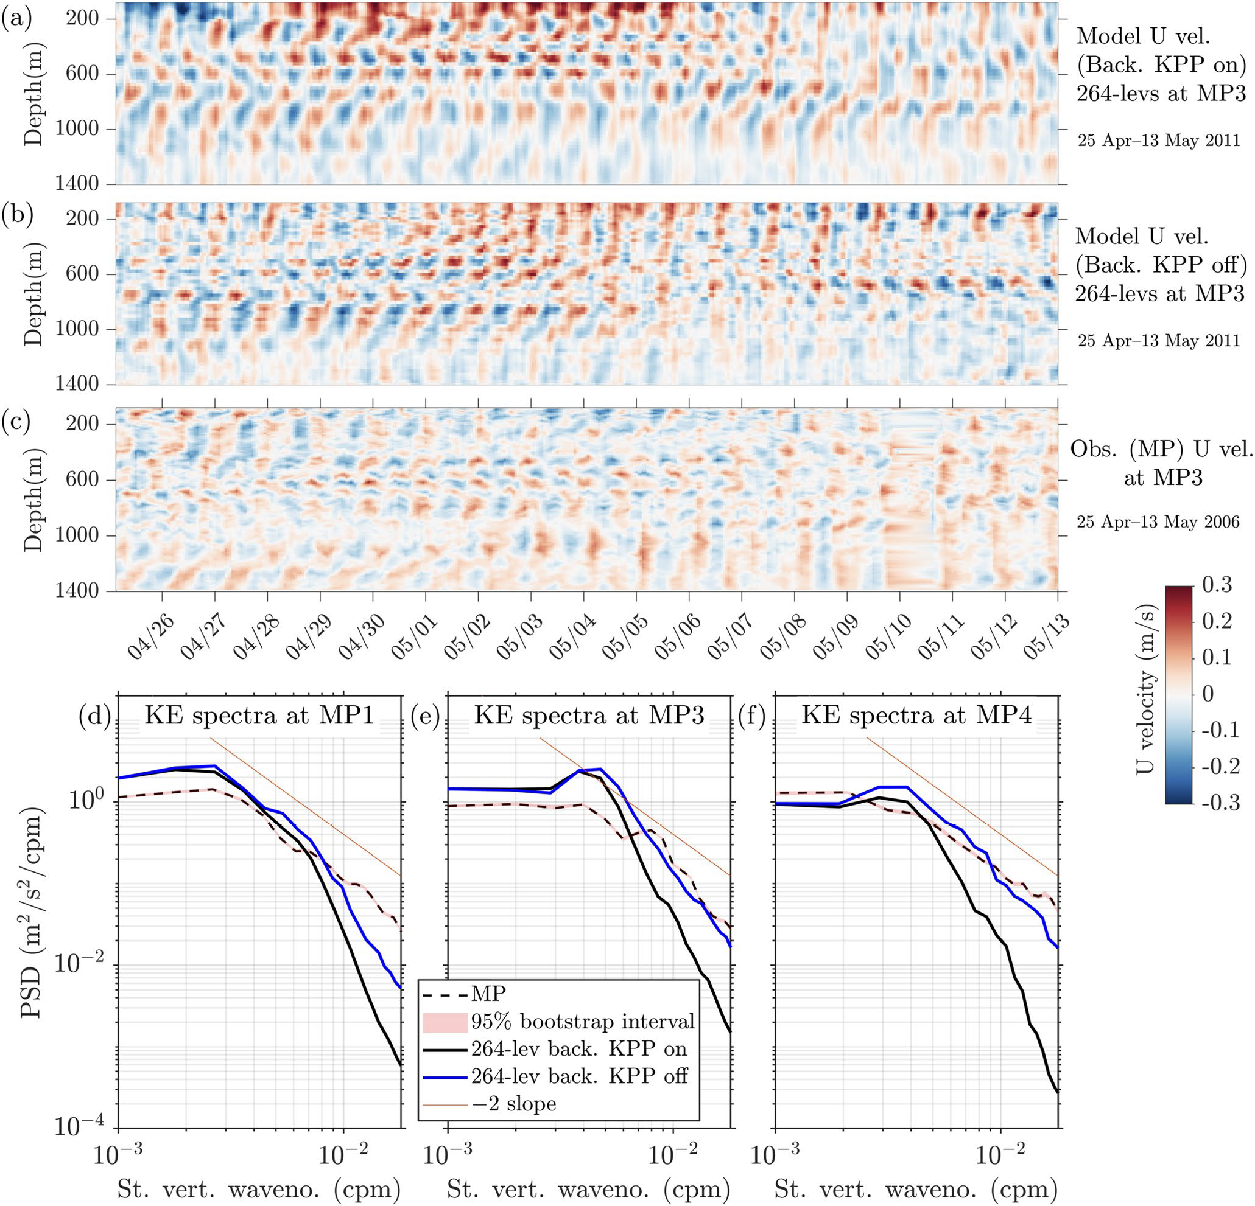
Improved IGW vertical wavenumber spectra in a regional model forced by the global MITgcm simulation (Thakur et al. 2022)
KPP was developed for models that do not resolve internal waves
In models that partially resolve internal waves, turning off the KPP background yields a vertical structure that agrees more closely with observations

Slide 22
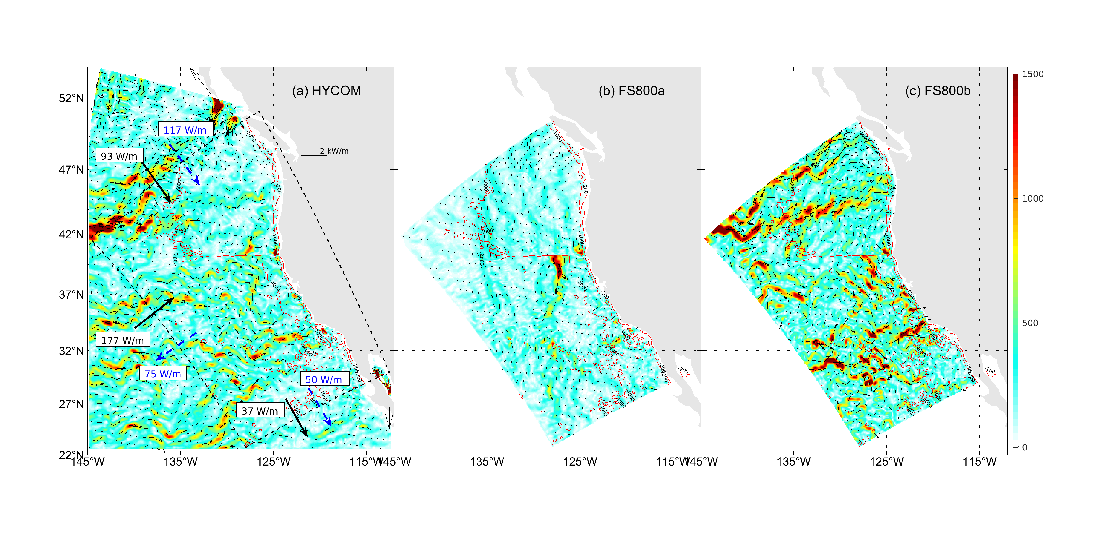
HYCOM/ROMS regional modeling effort in California Current region (Siyanbola et al., submitted)
Left: depth-integrated semidiurnal fluxes for HYCOM
Middle: FS800a - ROMS run without remote internal wave forcing from HYCOM
Right: FS800b - ROMS run with remote internal wave forcing from HYCOM.
Our domain gets more energetic with the inclusion of high-frequency baroclinic forcings at the open boundaries.
See also work by Audrey Delpach

Slide 23
New NOPP project
NOPP project to test global internal wave models with arrays of in-situ instruments (and altimetry)
Waterhouse/Lucas/Send/Andres/Farrar/Wang et al. SIO/WHOI/JPL grants: in-situ arrays.
Buijsman/Arbic/Shriver et al. grant: compare HYCOM to in-situ data.
Chassignet/Ngodock et al. grant: improve assimilation in HYCOM with 4DVAR
Zaron et al. grant: NOAA funding to work with tides in MOM6; complements ongoing MOM6 work already in place

Slide 24
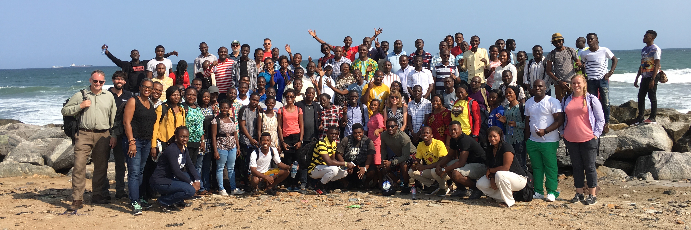
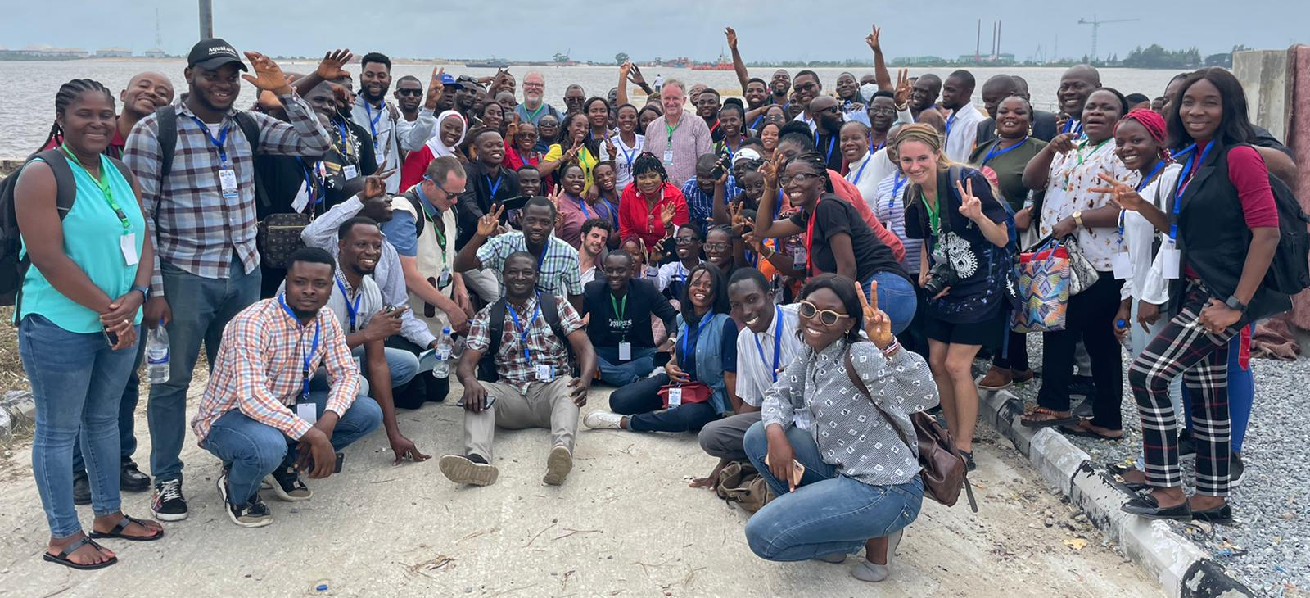
Coastal Ocean Environment Summer School In Nigeria and Ghana (COESSING; https://coessing.org)
We have held an oceanography summer school
in West Africa for one week every August since
2015
2015-2019: in-person school in Ghana
Top: 2018 group photo in Ghana→
2020-2021: online schools
2022: hybrid in-person/online school in
Nigeria
Bottom: 2022 group photo from Nigeria→
We received more positive comments about the
school this year than ever before, and the Nigerian participants are taking it upon themselves to create social media sites (Instagram, LinkedIn, etc.) for the school

Slide 25
Summary
Global internal wave models continue to progress and will be useful and important for SWOT, S-MODE, and OdySea
Lots of work left to do

