Slide 1
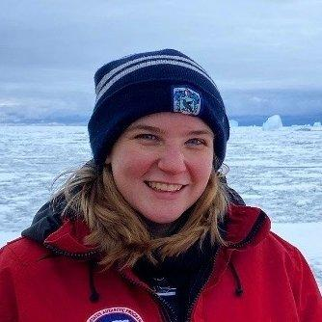
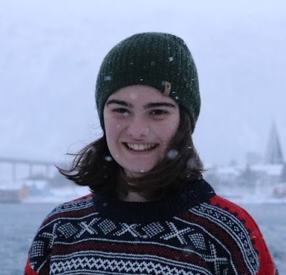
FilaChange Providence
Day 1 Summary
Lily Dove, PhD candidate, Caltech
Jacinta Clay, PhD student, Princeton U.
Aakash Sane, Post-doc, Princeton/GFDL
Momme Hell, Post-doc, Brown U.

Slide 2
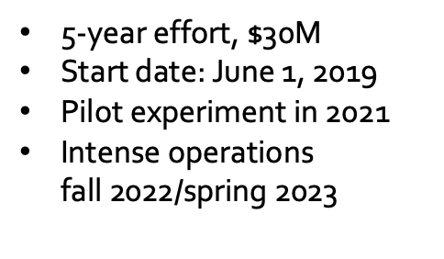
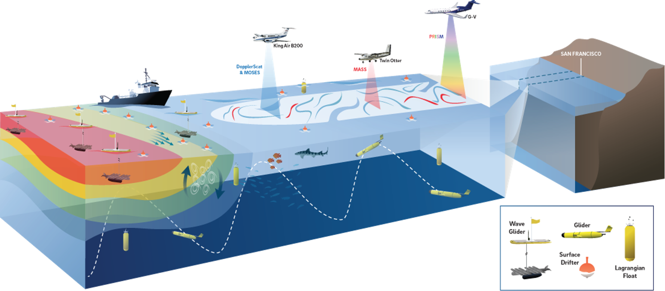
S-MODE - Observing the submesoscale
Tom Farrar, Woods Hole Oceanographic Institution
and Luc Lenain, Eric D’Asaro, Ernesto Rodriguez, … (and many others)
Recent innovations of observational methods allow to test if the kilometer-scale (“submesoscale”) ocean eddies make important contributions to vertical exchange of climate and biological variables in the upper ocean.
Operations include:
6 gliders with ADCPs (UW/APL)
10 gliders with only CTDs (NAVO)
8 Wave Gliders with ADCPs
~4 Saildrones with ADCPs
Research vessel with ADCP
75 drifters
Twin Otter airplane with MASS
B200 airplane with DopplerScatt
Many other measurements (hyperspectral, bioptics, atmospheric)

Slide 3
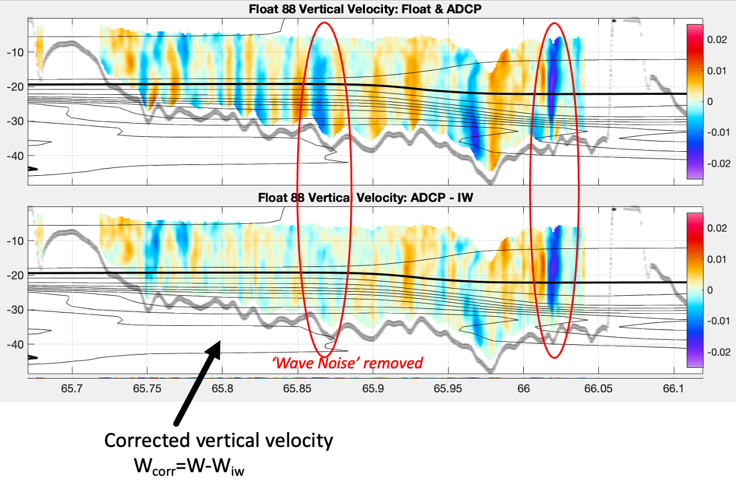
S-MODE - Observing the submesoscale
Tom Farrar, Woods Hole Oceanographic Institution
and Luc Lenain, Eric D’Asaro, Ernesto Rodriguez, … (and many others)
Data from CALYPSO, Eric D’Asaro
Vertical velocity in mixed layer from Floats and ACDP
Relevance for SWOT
S-MODE can be a complementary dataset to the SWOT high-sampling period as it provides vertical and high temporal observations of the sub-mesoscale.
These observations have new challenges like filtering for the relevant dynamical fields from internal waves.

Slide 4
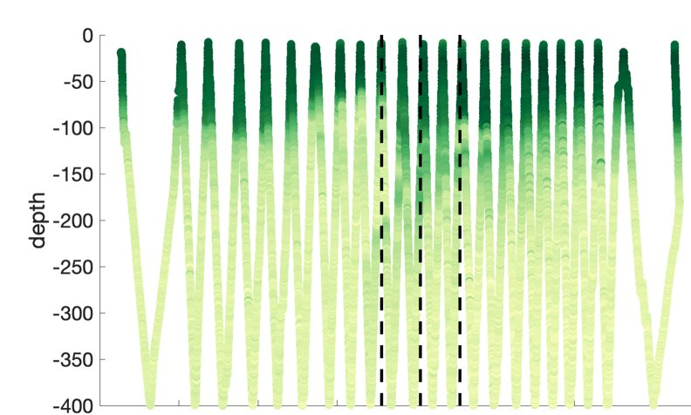
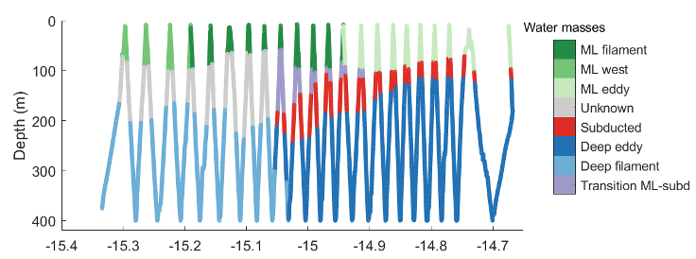
The EXPORTS Edge Experiment
Leah Johnson, APL
Explored the distribution of zooplankton and marine snow beneath/within a singular filament and eddy using a moored profiler and a shadowgraph
Filament
Eddy
Significant Collaborators: Zachary Erickson & Heidi Sosik

Slide 5
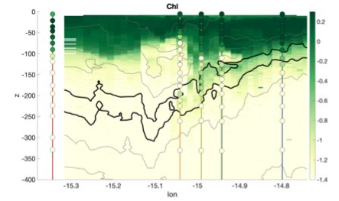
The EXPORTS Edge Experiment
Leah Johnson, APL
Summary of conclusions:
Nutrients deviate from Redfield ratio at depth​
Zooplankton vary across front, some evidence of subduction
Small particles show evidence of vertical advection
SWOT relevance: illustrates submesoscale dynamics relevant for BGC tracers.

Slide 6
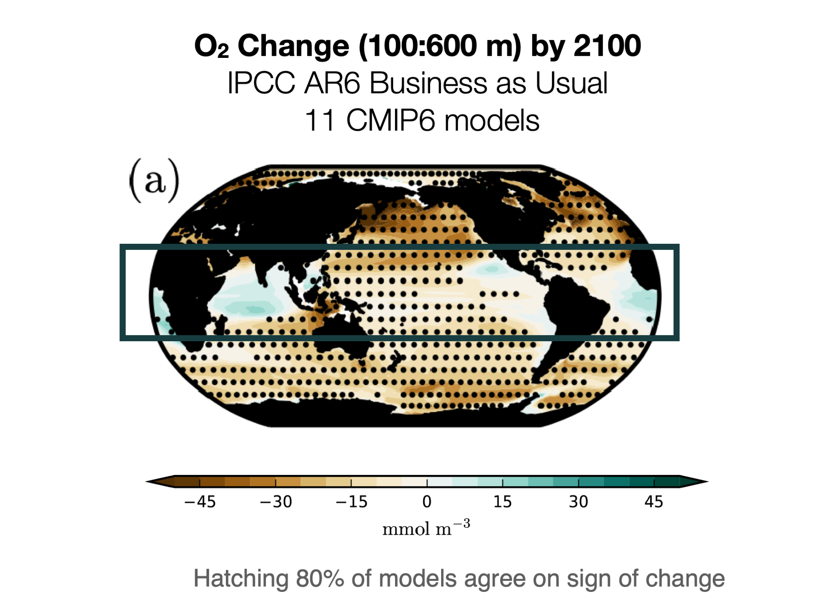
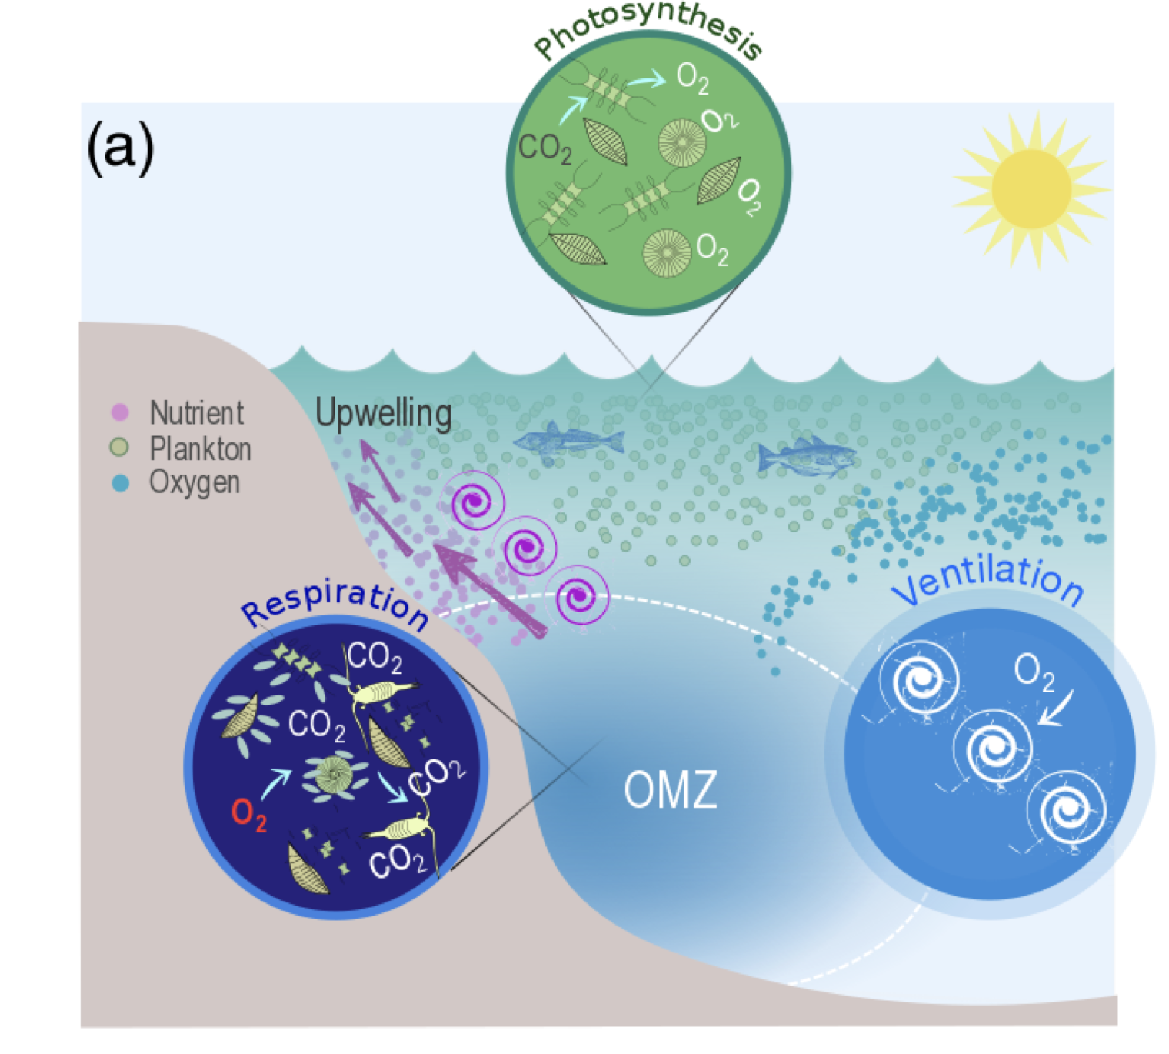
Eddies and climate change: Eddy stirring controls on OMZs
Laure Resplandy, Princeton University
With J. Busecke, S. Ditkovsky, M. Lévy
Global ocean oxygen is decreasing with warming, but responses of biologically important Oxygen Minimum Zones to this change remains unconstrained.
Models suggest that eddy dynamics control OMZ volume and response to climate change in ESMs…but current parameterizations do not capture necessary features at different resolutions.

Slide 7
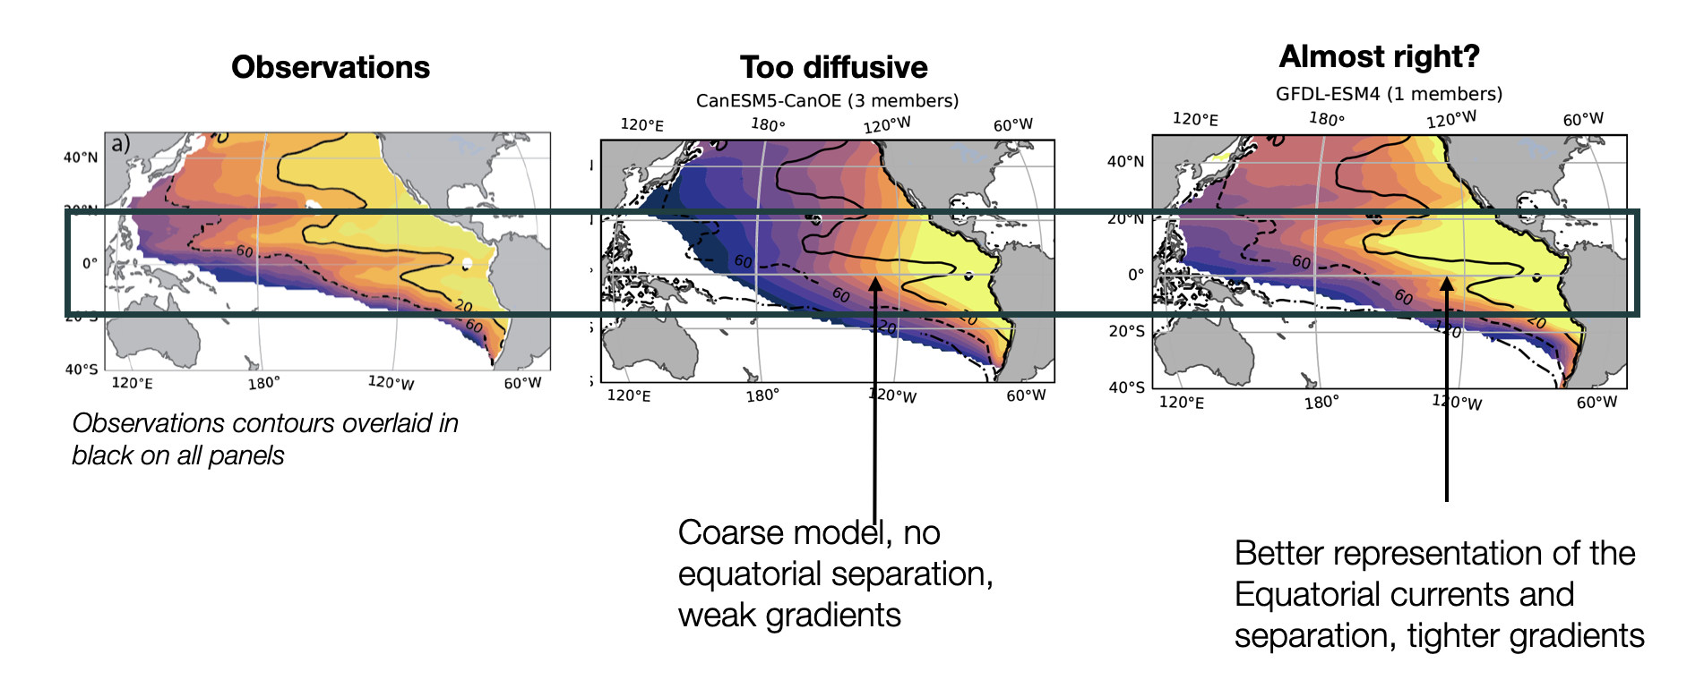
Eddies and climate change: Eddy stirring controls on OMZs
Laure Resplandy, Princeton University
Observed alternating jets and OMZ structure only captured in an eddy-resolving model
More realistic biogeochemical models and eddy dynamics improve OMZ structure and stabilize its response to climate variability

Slide 8
Open Questions
How do we effectively remove internal waves from high-resolution measurements, especially in regions where internal waves are interacting with other features?
Can any aspect of submesoscale subduction be seen as reversible?
What are the true temporal scales of submesoscale subduction - are they somewhat continuous over the lifetime of an eddy or more instantaneous events?
Can high resolution observations be used to constrain the biogeochemical models?

