Slide 1
FilaChange Providence
Tuesday Summary
Ryan Shìjié Dù
PhD student at NYU
ryan_sjdu@nyu.edu
Shikhar Rai
PhD Student at UofR
shikhar.rai@rochester.edu
Sid Kerhalkar
PhD candidate at UMass Dartmouth
skerhalkar@umassd.edu
Anna Lo Piccolo
PhD student at Brown University
anna_lo_piccolo@brown.edu
Loreley Lago
Posdoc at UBA, Argentina
loreley.lago@cima.fcen.uba.ar

Slide 3
Commons Research Objectives and Methods
The energy pathways in the ocean
Direct cascade modulated by near inertial wave (Kar)
Observational evidence of direct and inverse cascade (Balwada)
The influence of balanced and unbalanced motion to the energy cascade (Qiu)
Is the forward cascade an artifact? (Arbic)
The energy pathways away from the ocean through wind work a.k.a Eddy Killing (Rai)

Slide 4
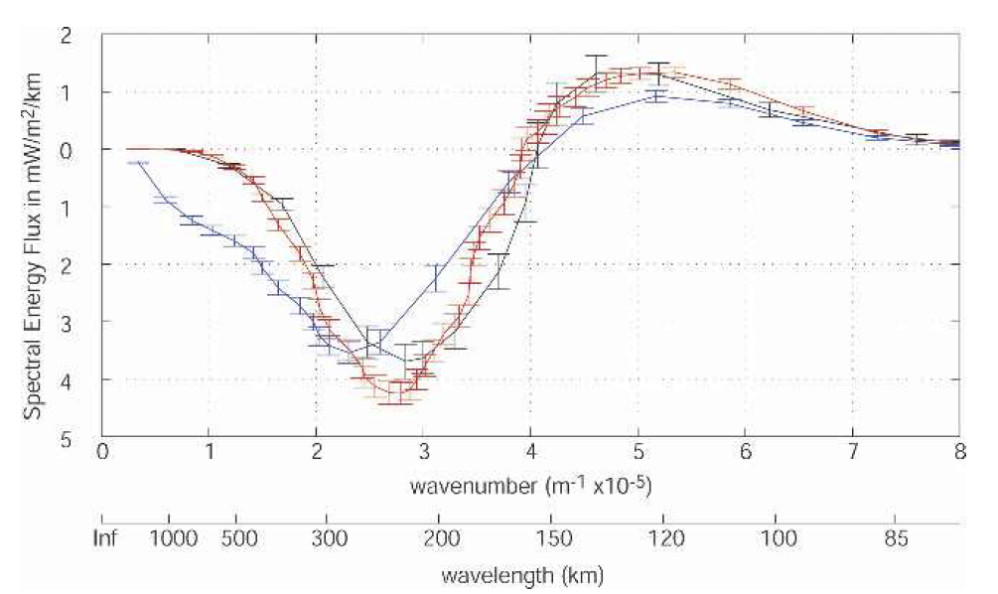
Commons Research Objectives and Methods
Identify important length scale and time scale
Length of energy injection scale/separation scale (Balwada, Qiu)
Length scale of eddy killing (Rai)
Time scale is also important (e.g.: for biogeochemistry) (Follows)
The challenge of SWOT where we have high spatial resolution but low temporal resolution
Scott, R.B., Wang, F., 2005. Direct Evidence of an Oceanic Inverse Kinetic Energy Cascade from Satellite Altimetry. Journal of Physical Oceanography 35, 1650–1666. https://doi.org/10.1175/JPO2771.1

Slide 5
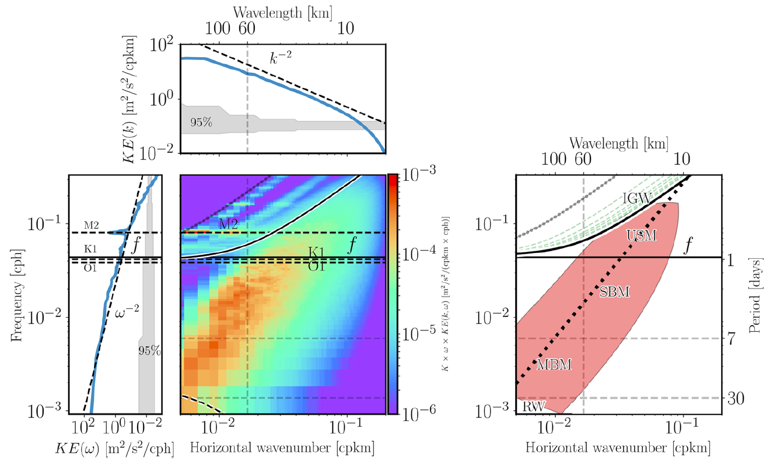
Commons Research Objectives and Methods
Wave mean filtering
via coarse graining (Rai)
via the k-ω spectra (Qiu)
via Helmholz decomposition (Qiu)
Rossby O(1), difficult
Lagrangian vs Eulerian
Torres, H.S., Klein, P., Menemenlis, D., Qiu, B., Su, Z., Wang, J., Chen, S., Fu, L.-L., 2018. Partitioning Ocean Motions Into Balanced Motions and Internal Gravity Waves: A Modeling Study in Anticipation of Future Space Missions. Journal of Geophysical Research: Oceans 123, 8084–8105. https://doi.org/10.1029/2018JC014438

Slide 7
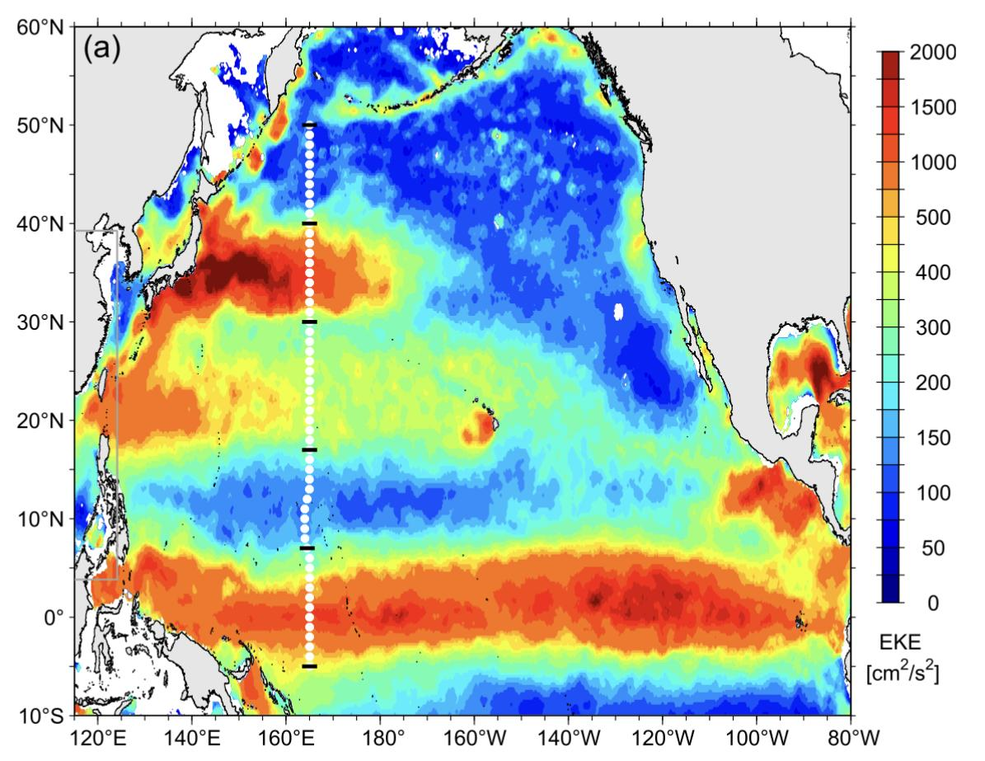
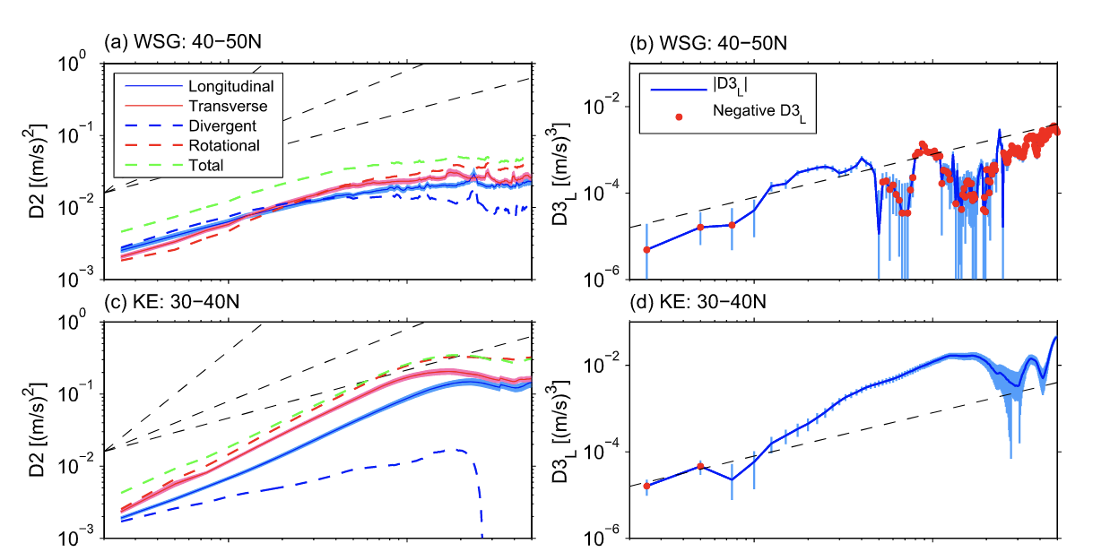
Bi-directional Kinetic energy cascades from repeat ship-board ADCP observations and OGCM simulations. Qiu et. al.
Studied forward and backward cascade, their relative strength and the length scales from repeat ship data
studied 5 different regions according to latitude.
8 ∼ 300 km range does not scale with the baroclinic deformation radius.
Qiu et al. GRL, 2022

Slide 8
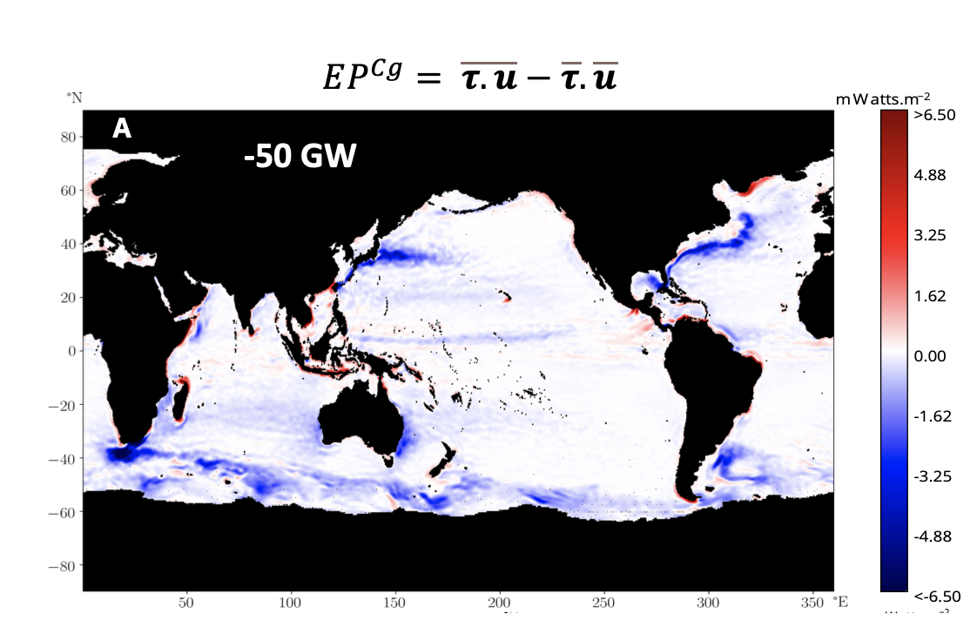
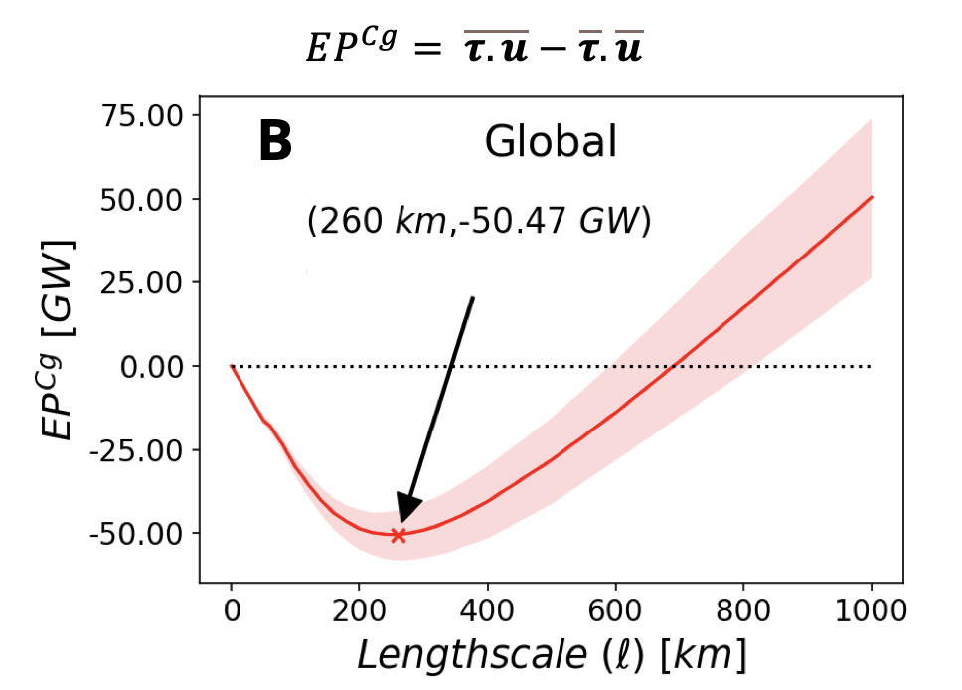
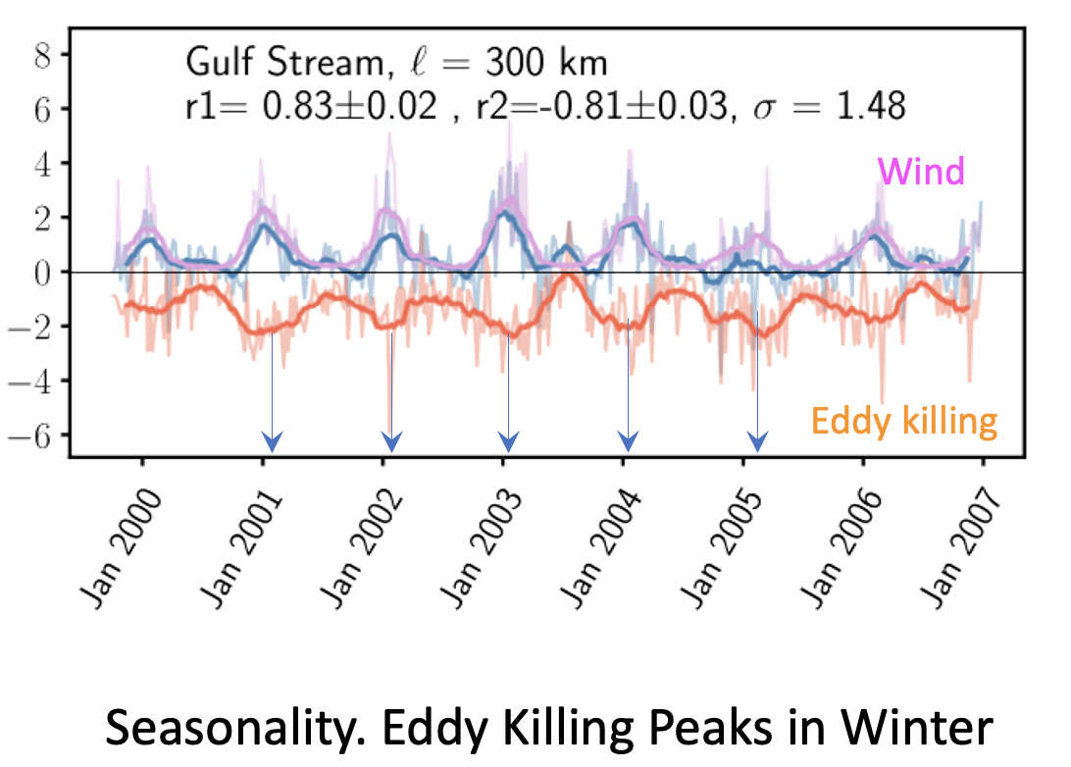
Scale of Eddy Killing from Global Satellite Observations. Rai et.al.
Wind forcing serves as a sink to geostrophic kinetic energy of 50 GW for scales < 260km.
Coarse graining is used to separate length-scales, using data from QuikSCAT, NCEP reanalysis and Altimetry.
Seasonality in eddy killing observed with a peak in winter.

Slide 9
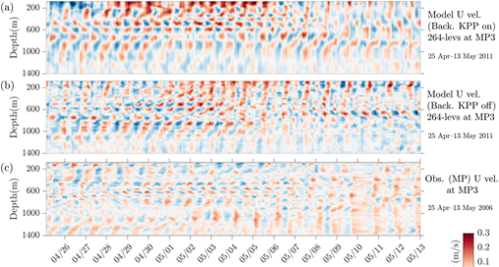
The role of global internal wave modeling in the SWOT mission, Arbic et al.
Diurnal and higher frequency waves are removed from altimetry before any analysis. Essential with higher spatial resolution data from SWOT.
GCMs+Tides is needed to predict non phase-locked internal tides
LLC4320 global run, turning KPP off lead to improved IGW spectra/representation, which could lead to accurate energetics.
Notes:
non-phase-locked (non-stationary/incoherent) internal tides

Slide 10
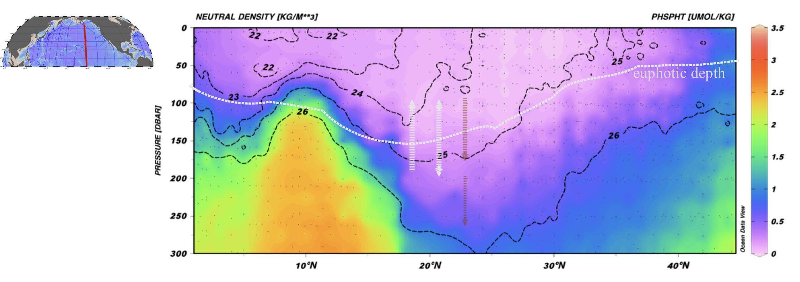
Eddy-driven, isopycnal resupply of nutrients and the productivity of the North Pacific Subtropical Gyre.
Mick Follows (MIT)
Mechanisms that sustain the nutrient inventory and productivity of the central subtropical gyres
Local vertical processes (micro-scale turbulent mixing, sub-mesoscale motions and mesoscale Eddy pumping) transport nutrients to the euphotic zone and deplete the nutricline
How is the nutricline re-supplied?
Isopycnal eddy transports + remineralization of sinking particles are responsible of the recharge of nutrients in subtropical thermocline

Slide 11
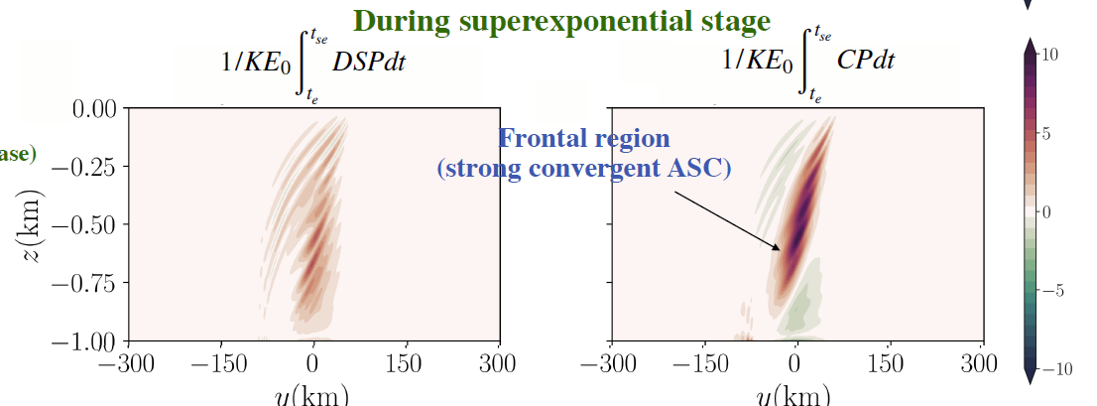
Energy exchanges between a 2D front and internal wave (IW) modes - Kar and Barkan
A quasilinear model: influence of frontal flow on near inertial waves
Minimum frequency IW can efficiently extract energy
Convergence Production (CP) mechanism: wave gain energy from the balanced frontal flow

Slide 12
Future Direction and Challenges
Wave balanced flow separation in submesoscale with O(1) Ro
Assumptions of homogeneity and isotropy (for e.g.: structure functions and Helmholtz decomposition method)
Magnitude (and distributions) of the energy flux is worth investigating
How valid are parameterizations (e.g.: KPP) in current high resolution simulations?

