Slide 1
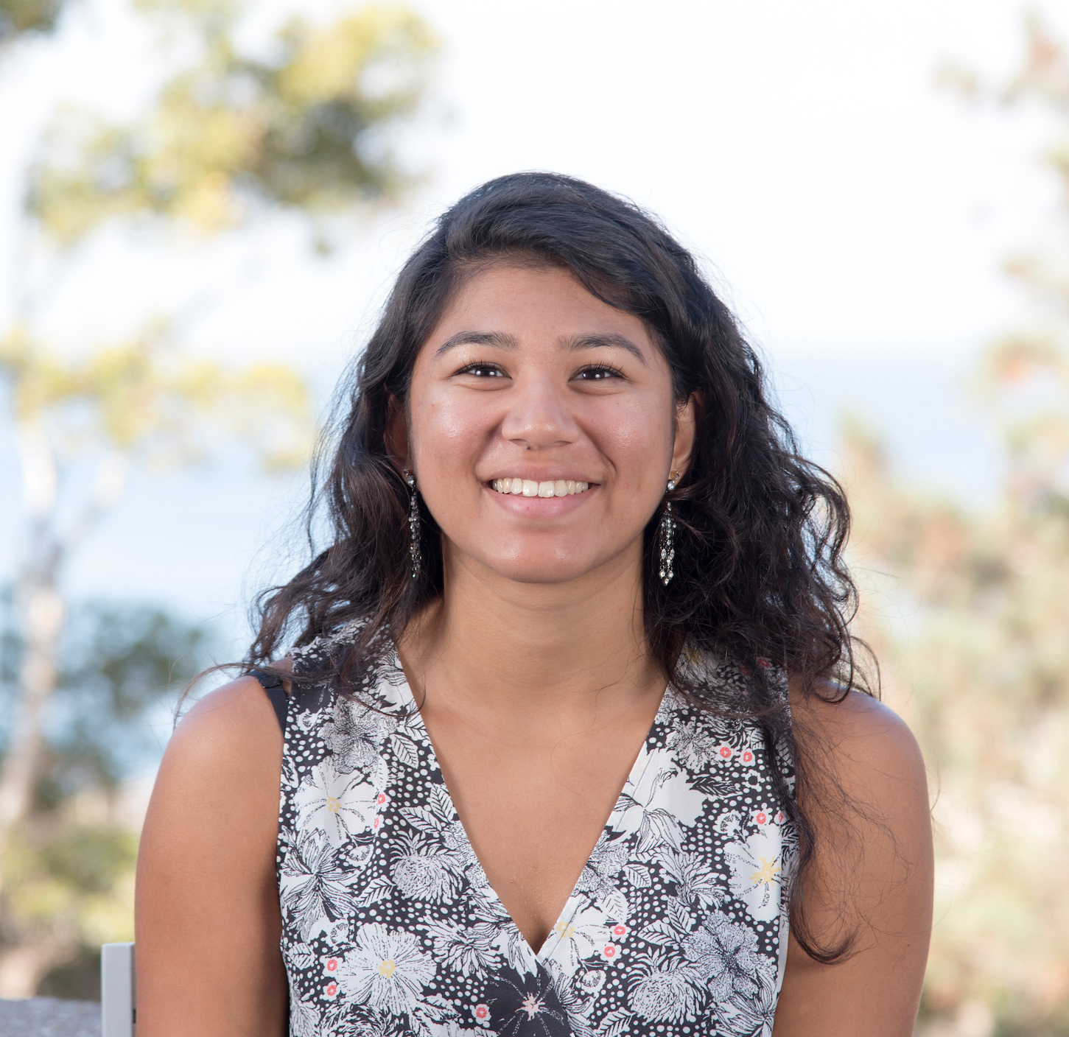
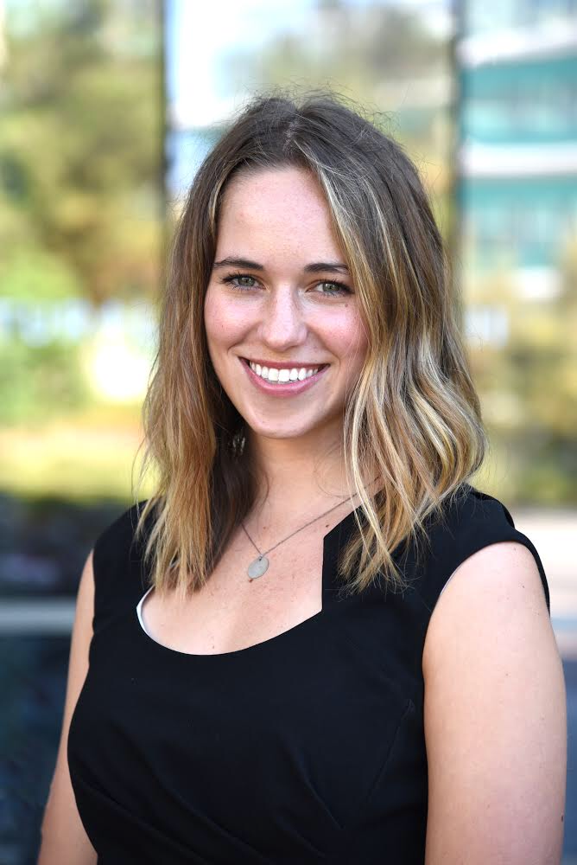
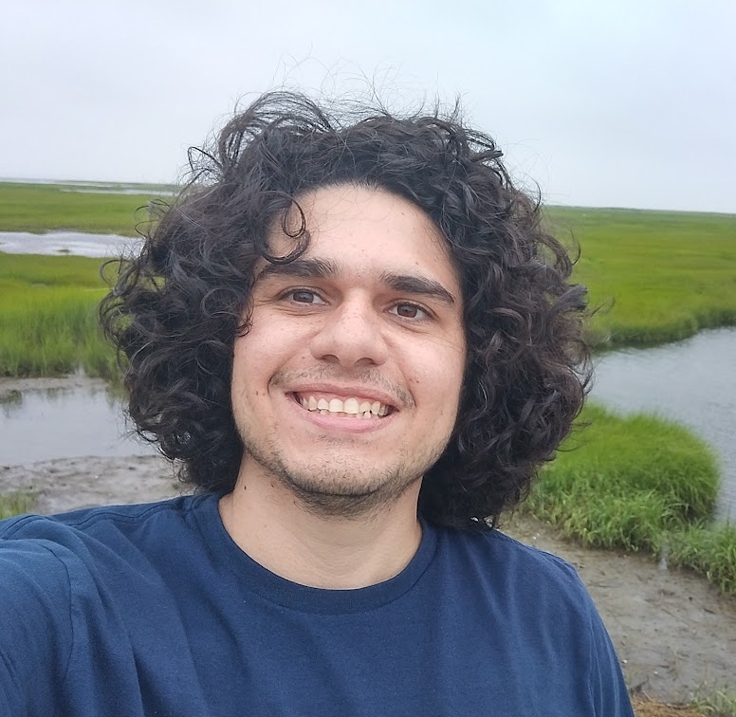
Summary Discussion from Tuesday (31 August) - Providence
FilaChange 2022
1 September 2022
Shailja Gangrade
PhD Candidate
Scripps Institution of Oceanography
Lexi Jones
PhD Candidate
MIT-WHOI Joint Program
Follows Group
Filipe Pereira
PhD Candidate
University of São Paulo
UMass Dartmouth
Iury Simoes-Sousa
PhD Candidate
UMass Dartmouth
Amanda Vanegas Ledesma
PhD Student
Stanford University
Notes:
Felipe (Lexi)
Sheilja (Felipe)
Lexi (Sheilja)
Iury (Amanda)
Sarah (Iury)

Slide 2
https://fox-kemper.com/data/FilaChange/

Slide 3
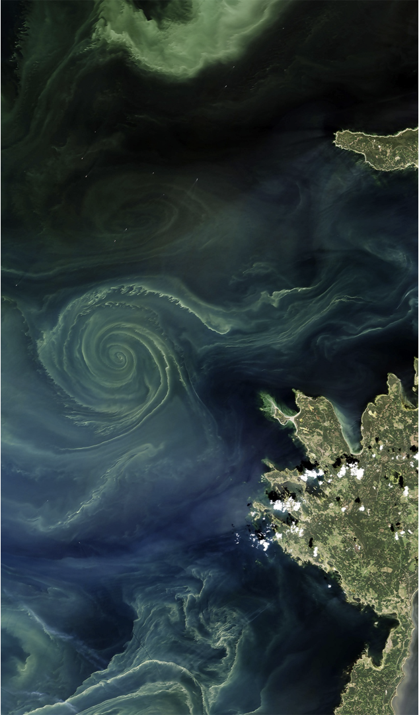
Recurring Themes
Biophysical interactions at (sub)mesoscales (Jones, Pereira, Gangrade, Simoes-Sousa)
Plankton patchiness occurs at scales as fine as hydrographic/physical patchiness (Jones, Pereira, Gangrade)
Utility of both observations and models (all talks)
How do we make better biological-physical measurements? (Jones, Pereira, Gangrade, Gille)
SWOT, ODYSEA will offer higher resolution observations of currents that can inform Lagrangian tracking of water masses and along-front variability.

Slide 4
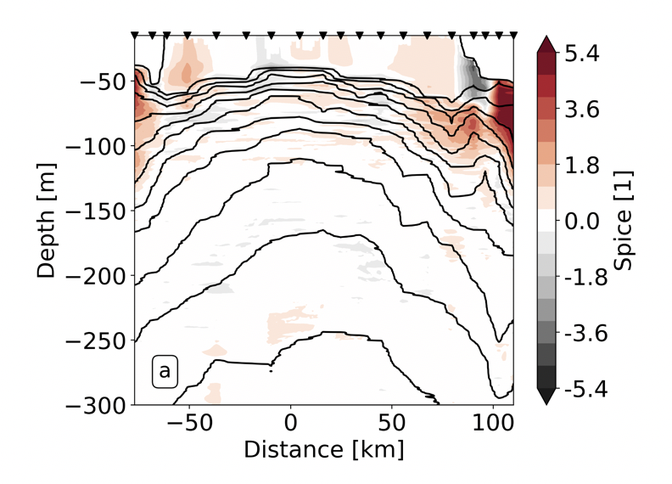
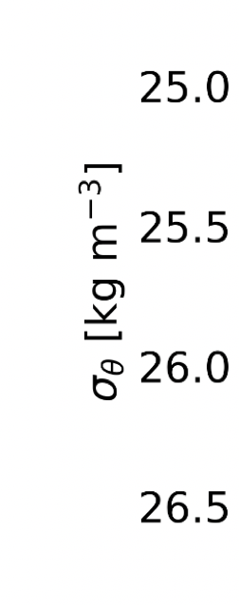
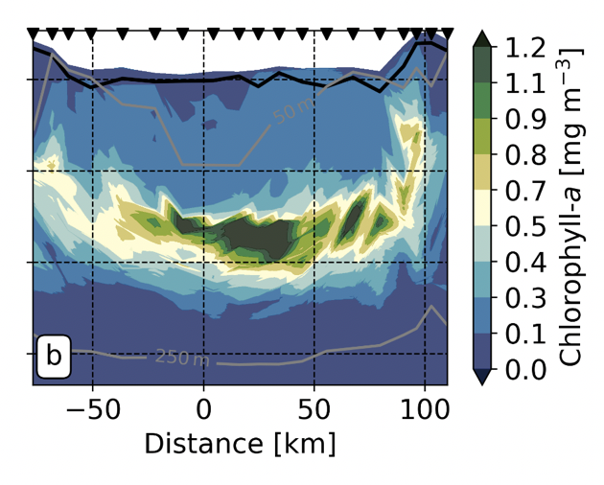
A quasi-stationary meander and its ecological implications: A story told with a single line of measurements in the western South Atlantic
Filipe Pereira (U. of São Paulo), I. Silveira, A.Tandon, C. Luko, M. Chuqui, M. Pompeu, L. Michelazzo, F. Brandini
ILHAS 3 cruise transect sampled a cyclonic meander at high resolution (every 5-10km!).
Combined physical and biogeochemical sampling strategy.
An idealized model of the system complement the observations.
Key Points:
Phytoplankton community structure shift and enhanced primary production below the mixed layer in response to eddy pumping
High-chlorophyll and spicy shelf waters were advected at the surface along the meander edge via submesoscale filaments

Slide 5
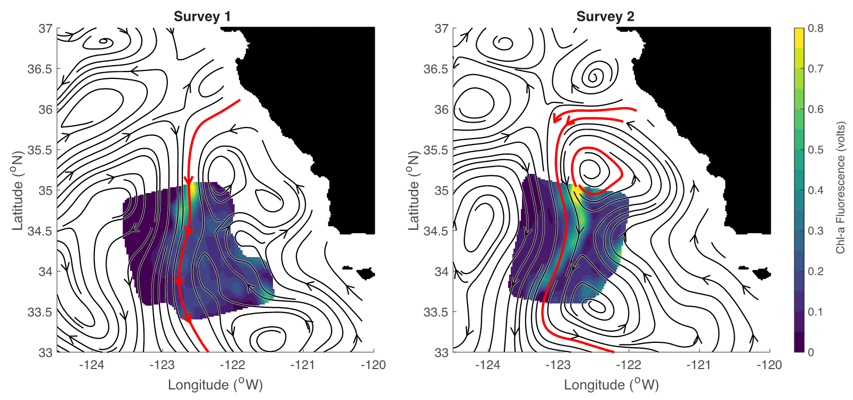
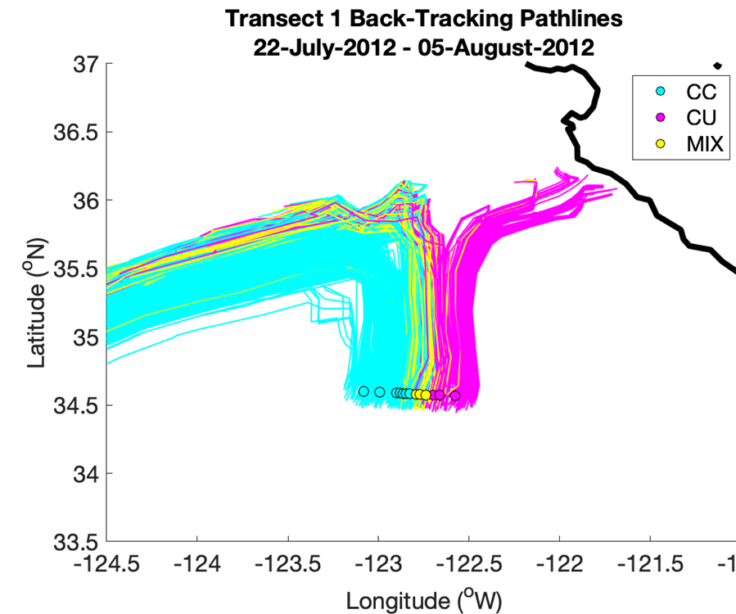
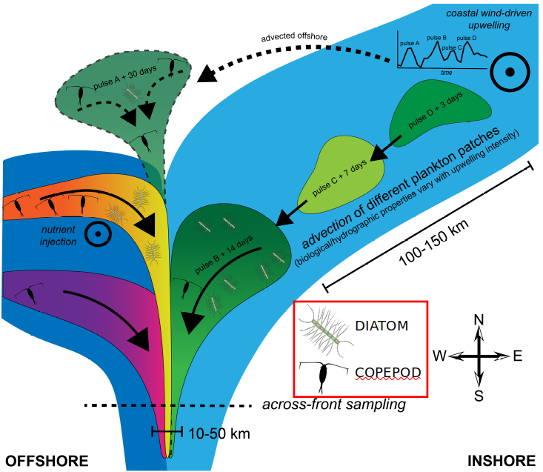
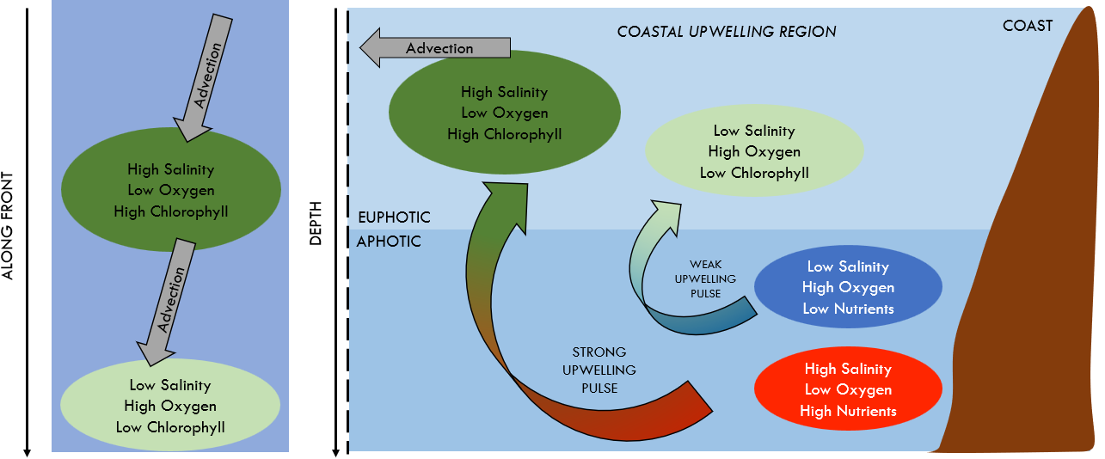
Tracing the origins of finescale plankton patchiness along and across a front
Shailja Gangrade (Scripps), I. Mangolte, M. Lévy, & P. Franks
Along-front patchiness linked to remote coastal dynamics. Uniformity assumptions ignore along-front spatiotemporal dynamics.
Complex “water mass histories” influence planktonic community structure across the front. TS properties and trajectories help understand water mass origins at the front.
Takeaway Messages:
We must sample fronts on fine scales: horizontally, vertically, temporally, and taxonomically.
Finescale observations and analyses will allow us to better estimate horizontal and vertical carbon fluxes and help parametrize carbon flux models.

Slide 6
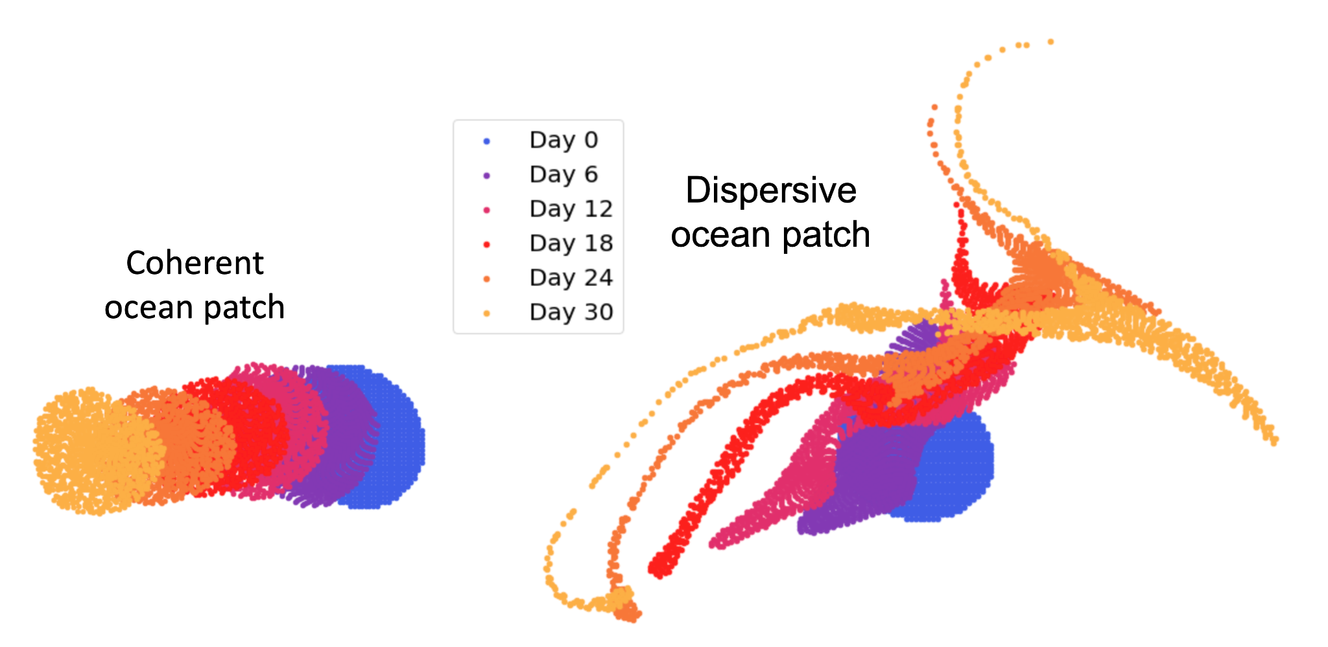
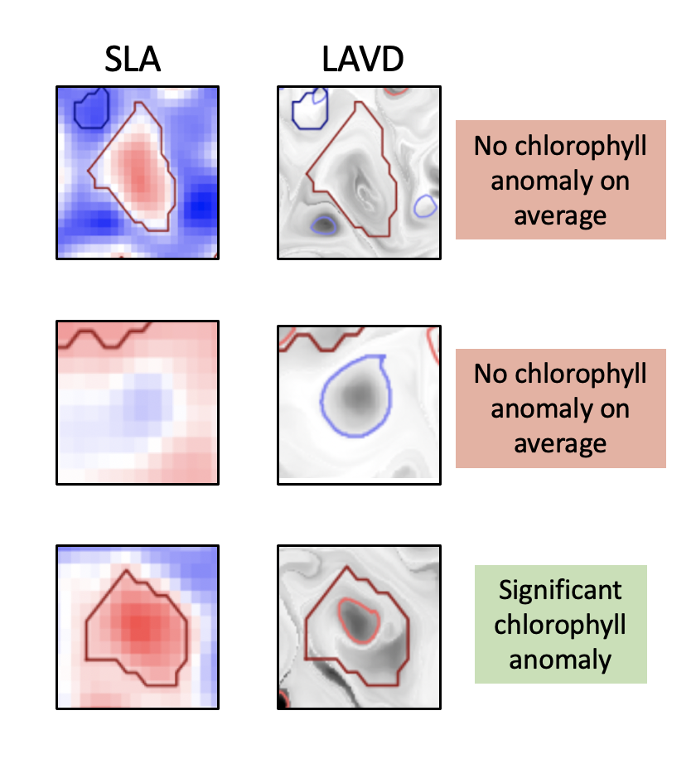
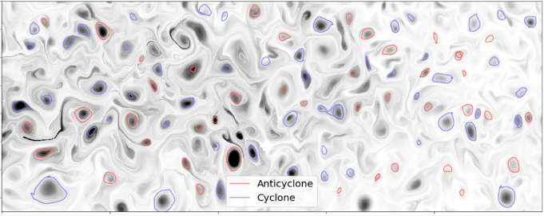
Satellite Chlorophyll Signatures of Eddy Coherency in the North Pacific Subtropical Gyre
Lexi Jones (MIT-WHOI) & Mick Follows
Coherent vs. Leaky Eddy Structure
Eddy Categorization & Relationship with Chlorophyll-a
2 ways to identify eddies:
Sea Level Anomaly (SLA)
LAVD: Lagrangian Average Vorticity Deviation
LAVD Method
(Chl-a anomaly is from the climatological mean)
Key Point 1: We can use both Eulerian and Lagrangian metrics to identify and categorize eddies.
Key Point 2: Coherent eddies are important features of elevated phytoplankton biomass in the NPSG (a generally nutrient-limited region), and thus could have important ecosystem impacts. Note: eddy polarity did not matter in this case.

Slide 7
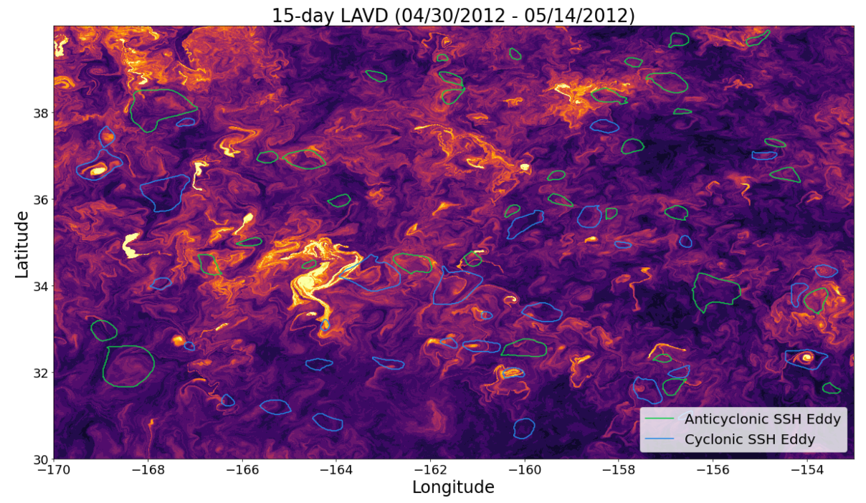
Satellite Chlorophyll Signatures of Eddy Coherency in the North Pacific Subtropical Gyre
Lexi Jones & Mick Follows
MITgcm + LAVD technique
SLA + LAVD technique
Higher resolution velocity fields do not allow for a robust identification of eddy structures.
Maybe higher resolution is not always “better”?

Slide 8
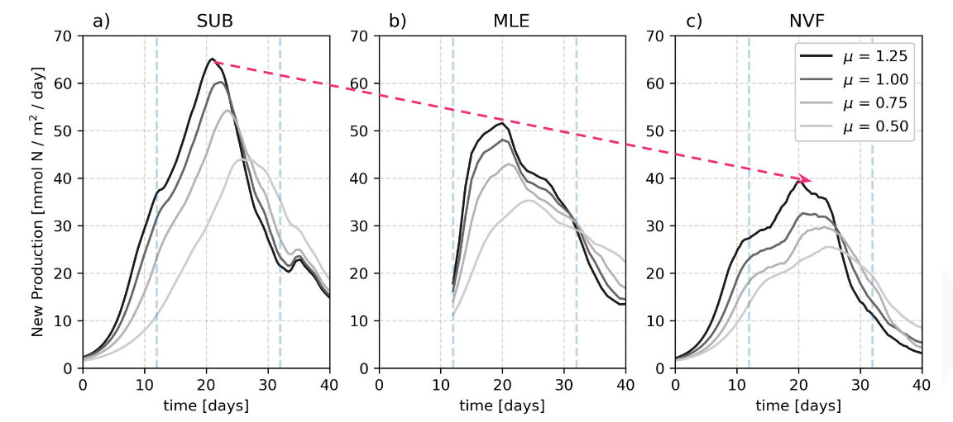
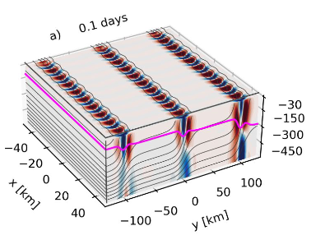
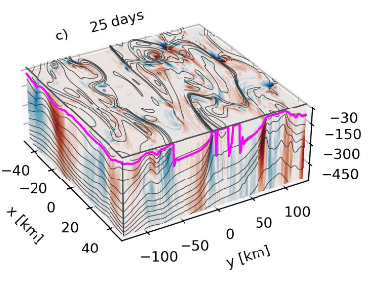
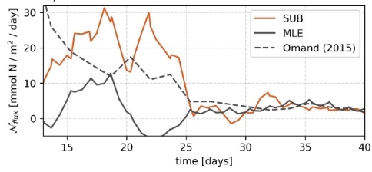
Mixed layer eddies supply nutrients to augment the spring phytoplankton bloom
Iury Simoes-Sousa (UMassD), A. Tandon, F. Pereira, C. Lazaneo and A. Mahadevan
1km
10km
No vertical flux
10km
Mix-layer instabilities modulate the onset of the spring phytoplankton bloom
Simulations include a biochemical model and initial conditions based on data
Summary
Vertical nutrient fluxes driven by mixed-layer eddies appear to have a meaningful contribution to springtime bloom in high latitudes
This contribution is not captured by current mix layer eddies parametrization

Slide 9
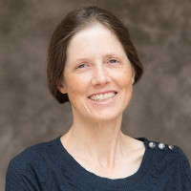
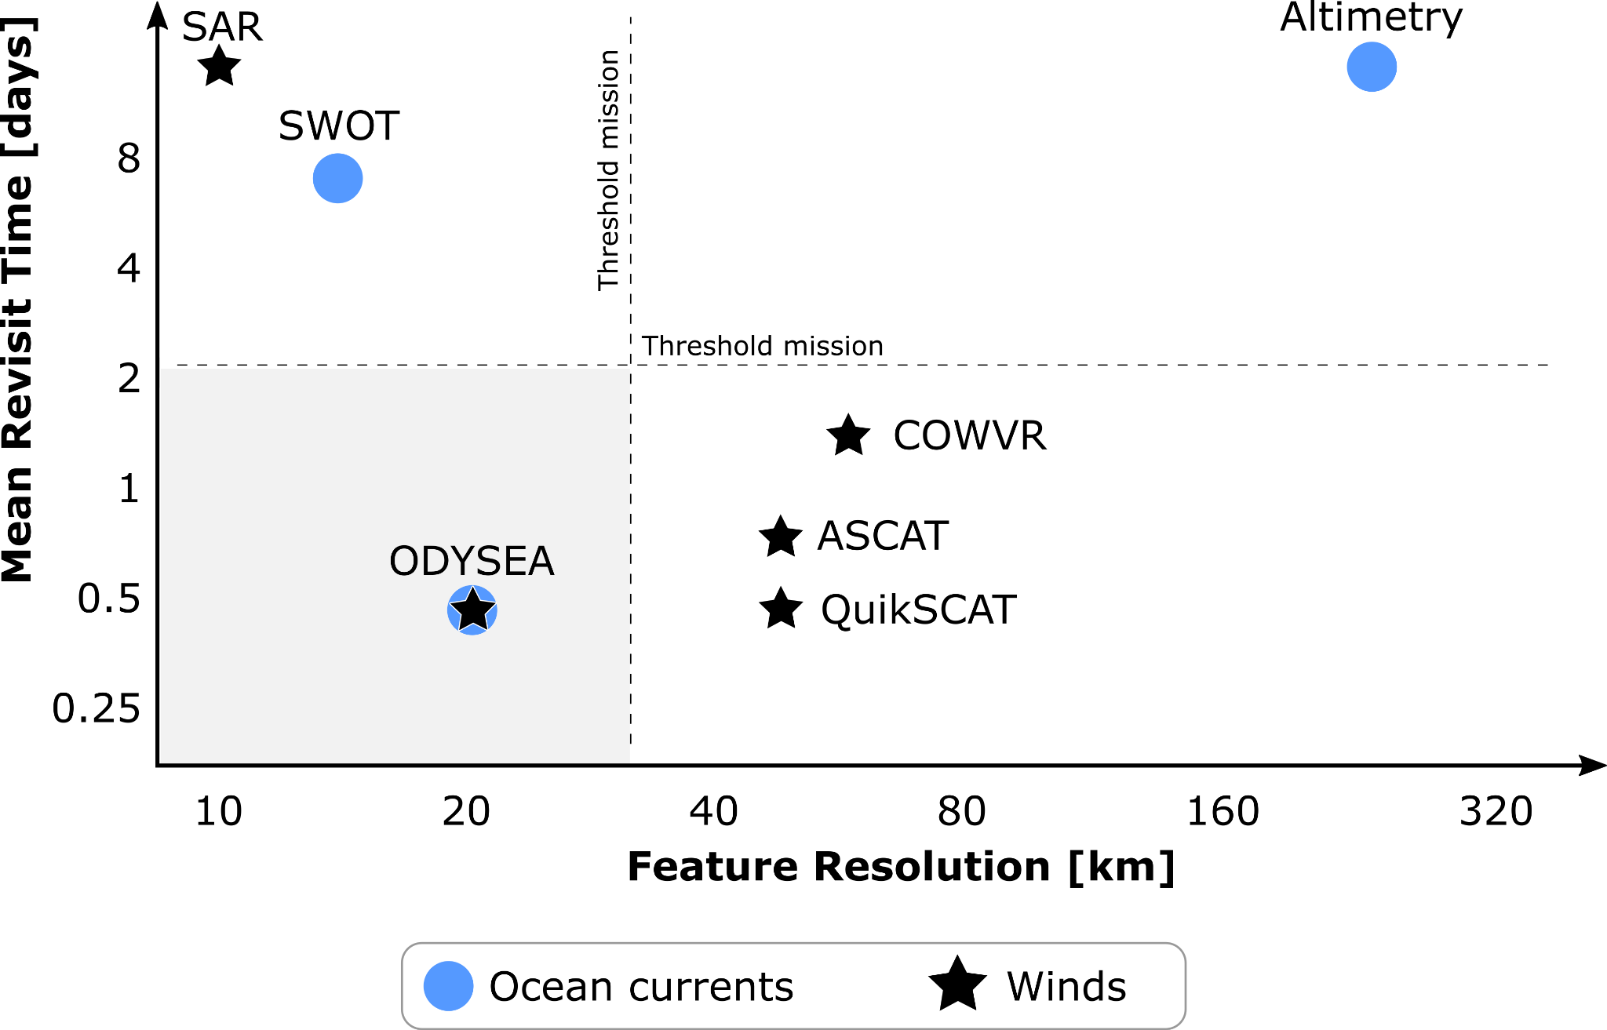
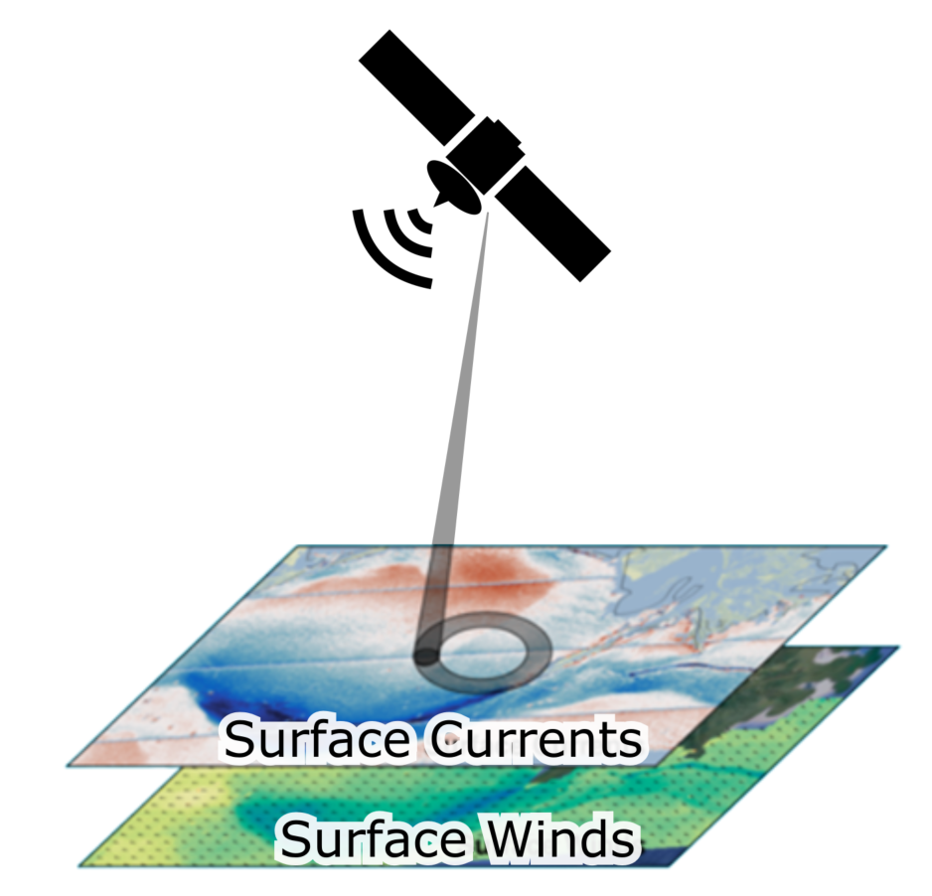
ODYSEA
Sarah Gille
First simultaneous measurements of winds and currents
Science team: Tony Lee, Justin Boland, Fabrice Ardhuin, Mark Bourassa, Paul Chang, Sophie Cravatte, Tom Farrar, Melanie Fewings, Gregg Jacobs,
Florent Lyard, Jackie May, Elisabeth Rémy, Lionel Renault, Ernesto Rodriguez, Clément Ubelmann, Bia Villas Bôas, Alex Wineteer, Zorana Jelenak
Swath using rotating "pencil beam"
Scientific Questions
How ocean currents are affected by wind variability at which scales?
How atmospheric boundary layer is affected by ocean currents?
Notes:
Mention about eddy-killing aplication
Equatorial currents where geostrophy doesn’t work

Slide 11
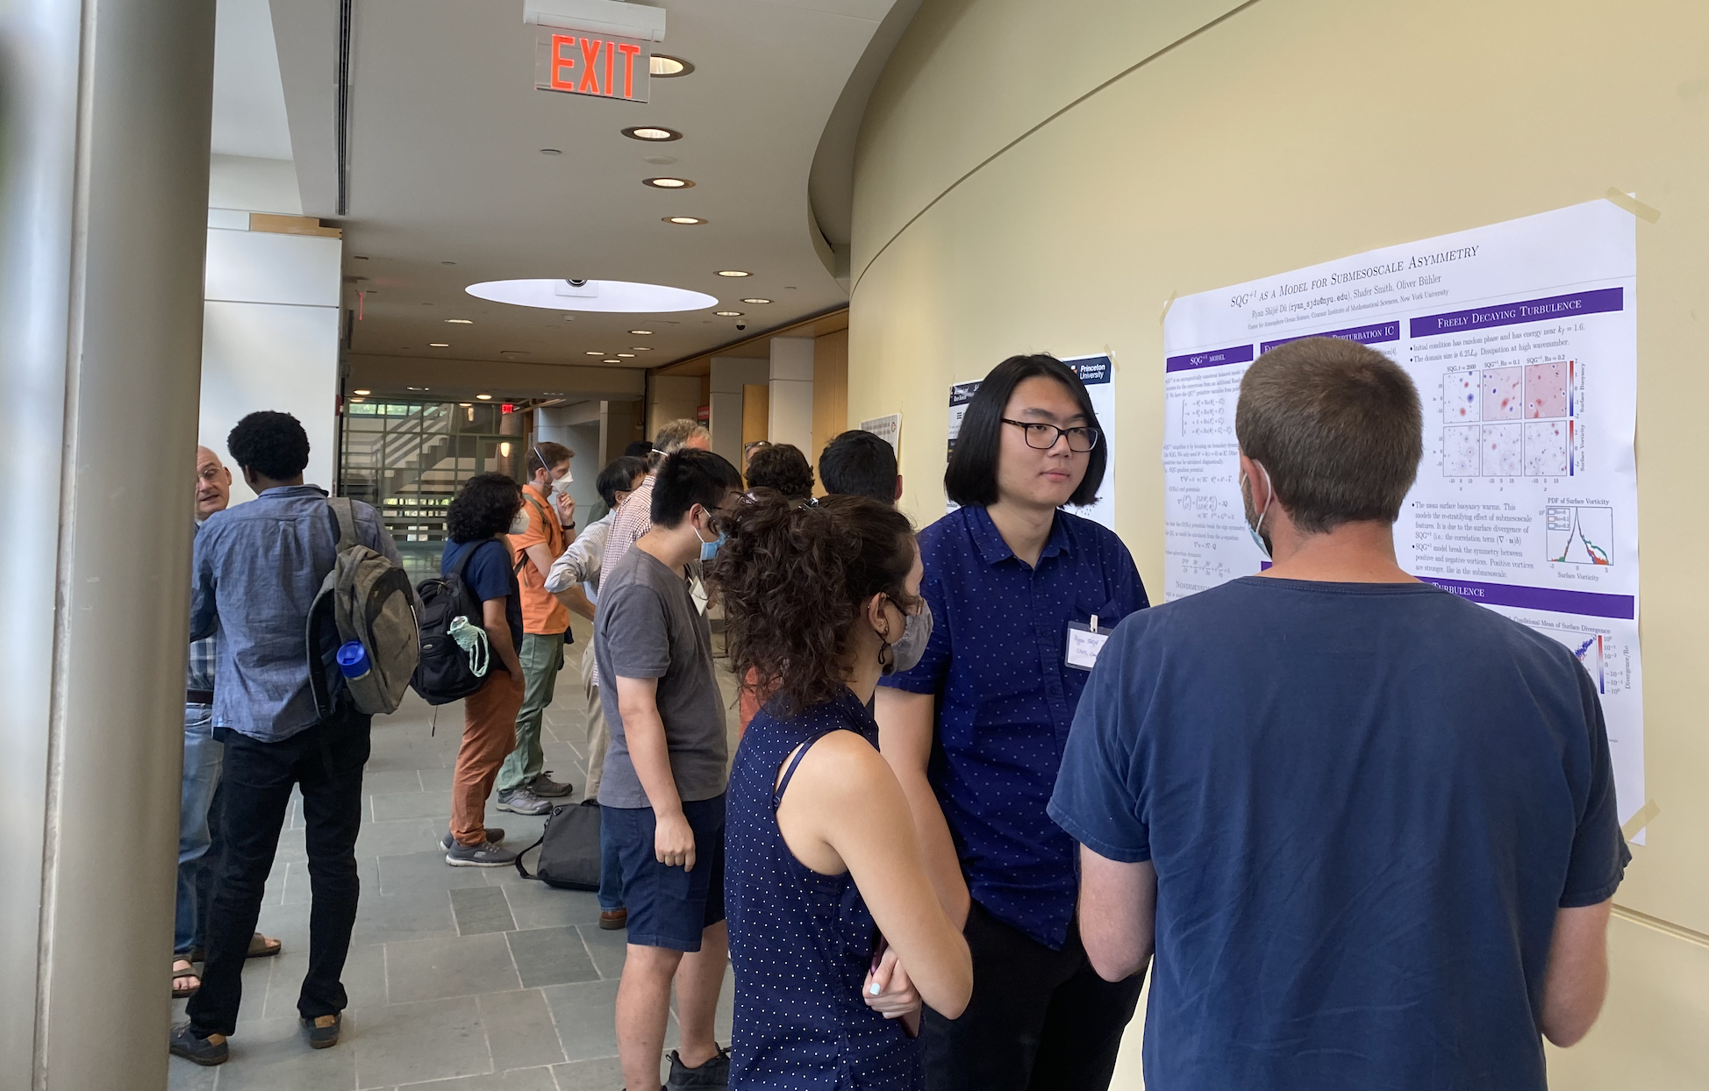
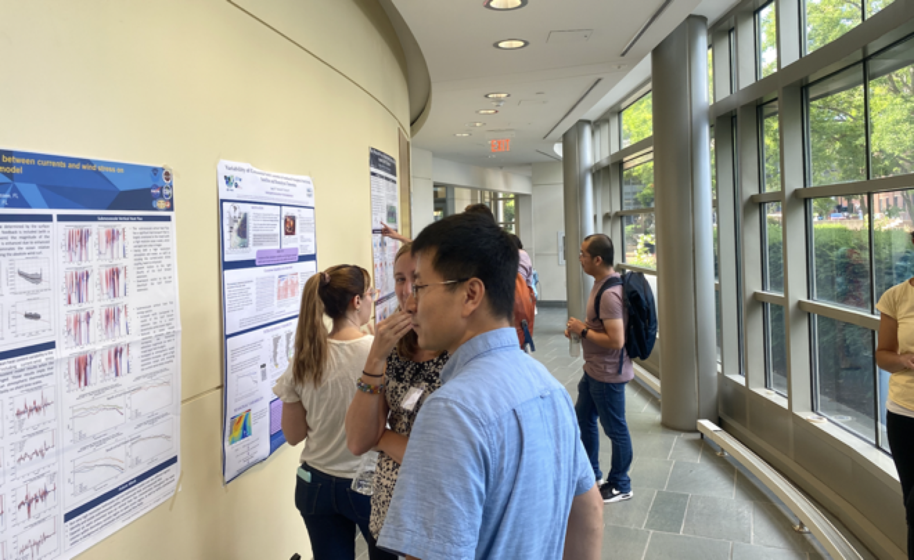
Poster Session

Slide 12
Open Questions
How do we parse apart the effect of different phenomena when we have higher resolution measurements (like those from SWOT/ODYSEA)?
At what time and length scales are biological processes important (e.g., growth of patches in relation to time/distance of lateral advection)?
What physical processes are the biological processes actually responding to?

