Slide 1
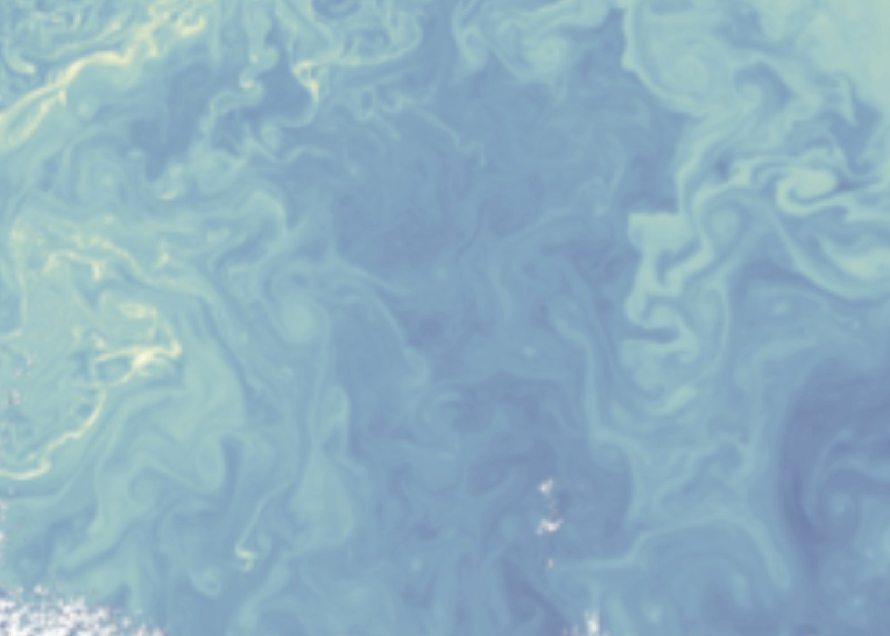
Spatial Patterns of Southern Ocean Ventilation from in situ and Satellite Observations
Lilian Dove, Andrew Thompson, Dhruv Balwada, Alison Gray
dove@caltech.edu
@SoLilyquizing

Slide 2
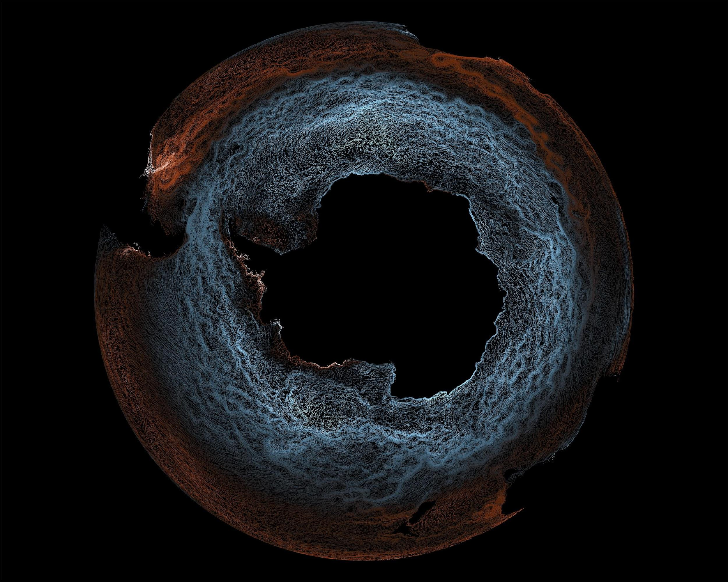
Credit: Riley Brady

Slide 3
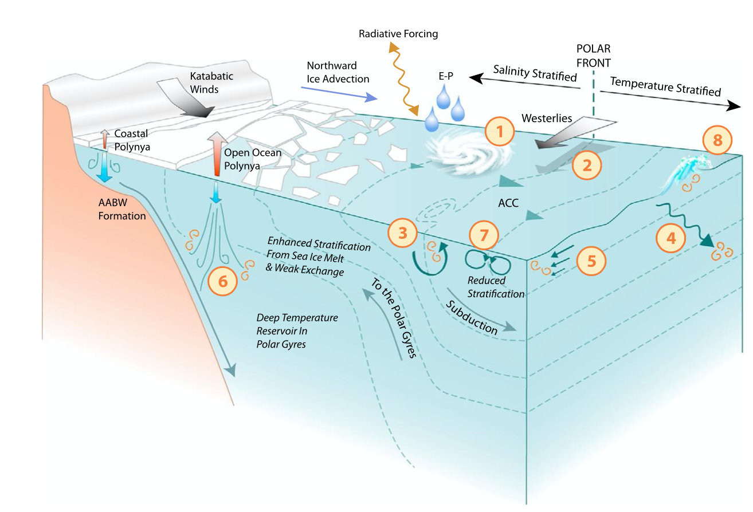
Subject to persistent wind forcing aligned with fronts
Characterized by vigorous eddies leading to strong lateral buoyancy gradients
Reduced stratification, allowing surface waters to have low PV values
Gille+ (2022)
Figure by Katy Sheen
Notes:
Reduced stratification, preconditioning surface waters to have low potential vorticity values;
characterized by vigorous eddies and geostrophic fronts leading to strong lateral buoyancy gradients;
subject to persistent surface wind forcing aligned with the fronts in a manner that reduces stratification through Ekman transport

Slide 4
Submesoscale features are prevalent across the Southern Ocean but remain underobserved
Heterogeneity of (sub)mesoscale structure
Rosso+ (2015)
Notes:
Heterogeneity
Alignment with winds
Contribute up to 50% carbon export (Omand+ 2015)

Slide 5
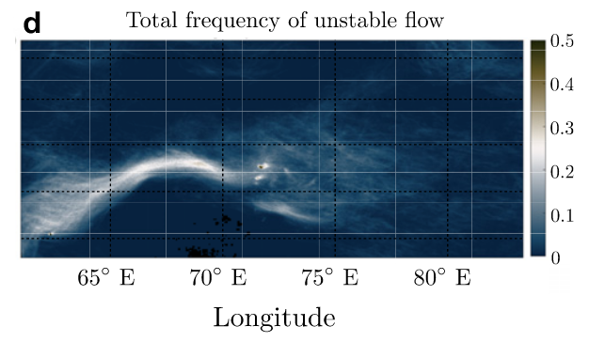
Submesoscale features are prevalent across the Southern Ocean but remain underobserved
Heterogeneity of (sub)mesoscale structure
Rosso+ (2015)
Alignment with wind stress
Bachman and Klocker (2020)
Notes:
Heterogeneity
Alignment with winds
Contribute up to 50% carbon export (Omand+ 2015)

Slide 6
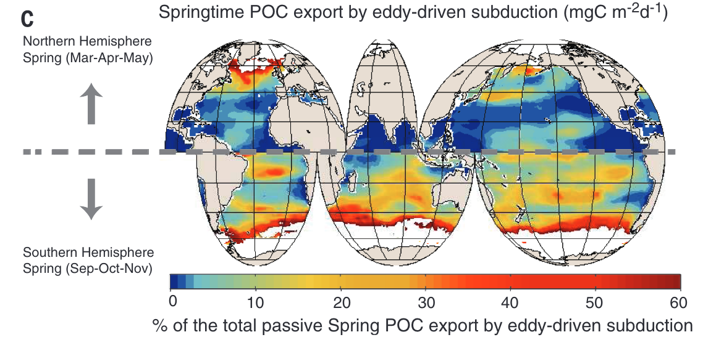
Submesoscale features are prevalent across the Southern Ocean but remain underobserved
Heterogeneity of (sub)mesoscale structure
Rosso+ (2015)
Alignment with wind stress
Carbon export
Bachman and Klocker (2020)
Omand+ (2015)
Notes:
Heterogeneity
Alignment with winds
Contribute up to 50% carbon export (Omand+ 2015)

Slide 7
Submesoscale features are prevalent across the Southern Ocean but remain underobserved
Heterogeneity of (sub)mesoscale structure
Rosso+ (2015)
Alignment with wind stress
Carbon export
Bachman and Klocker (2020)
Omand+ (2015)
Notes:
Heterogeneity
Alignment with winds
Contribute up to 50% carbon export (Omand+ 2015)

Slide 8
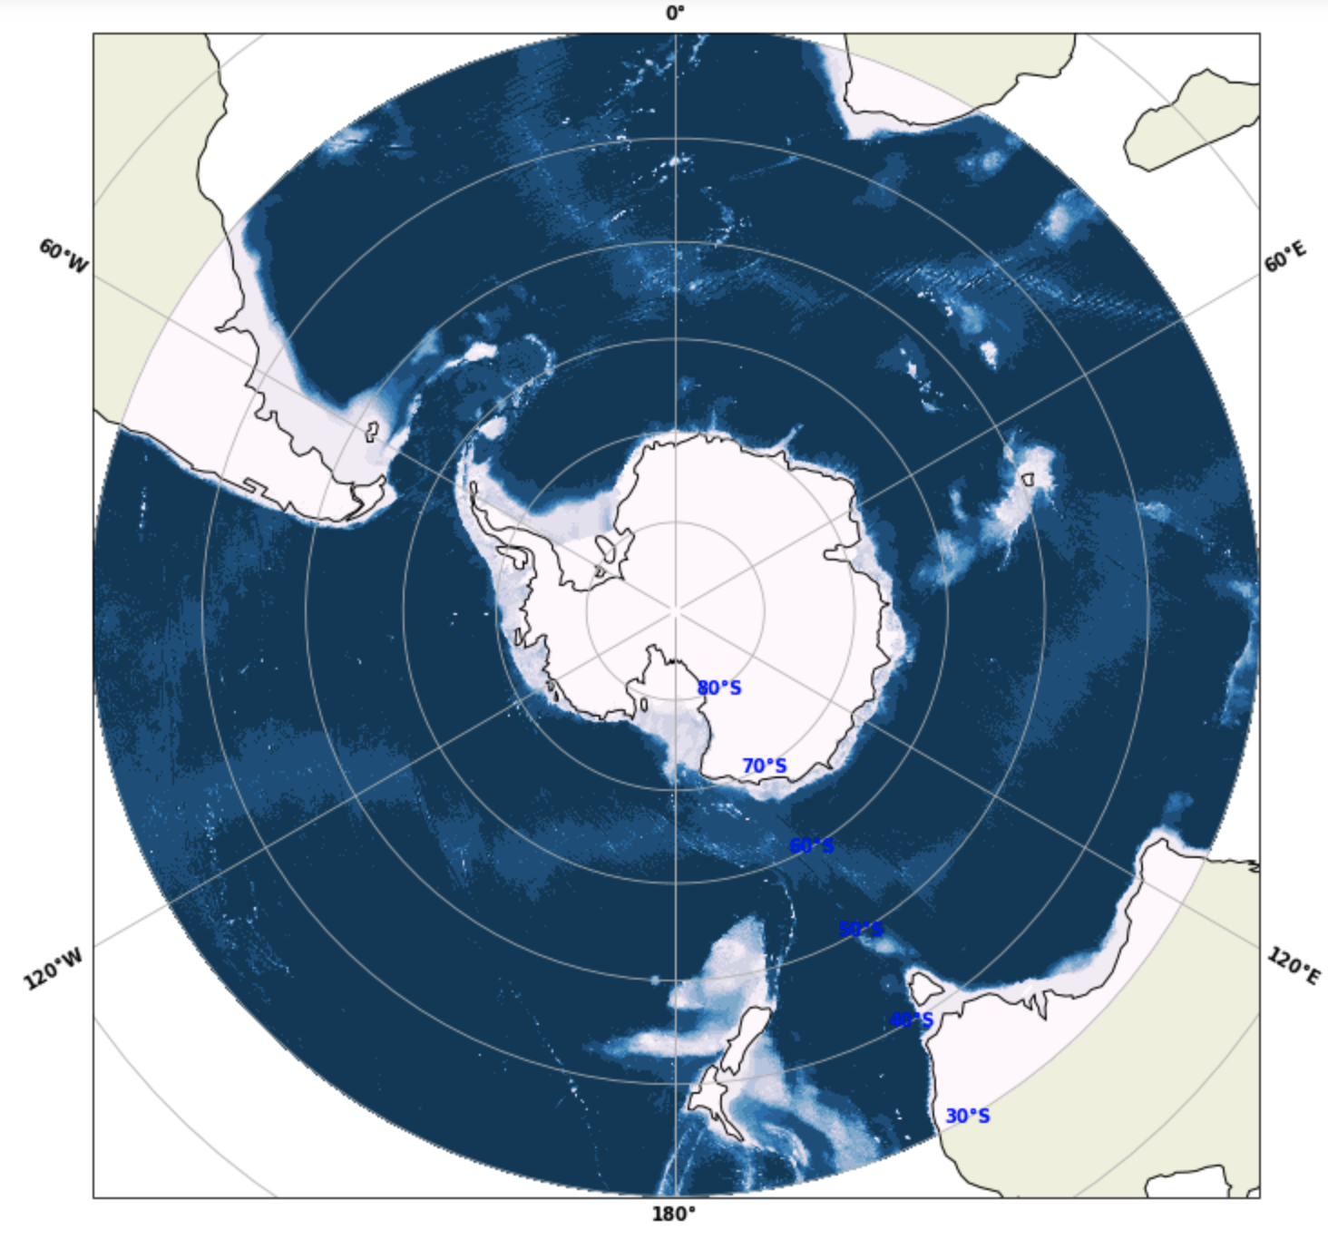
Crozet Plateau
Drake Passage
Kerguelen Plateau
Depth [m]
East Pacific Rise
Campbell Plateau

Slide 9
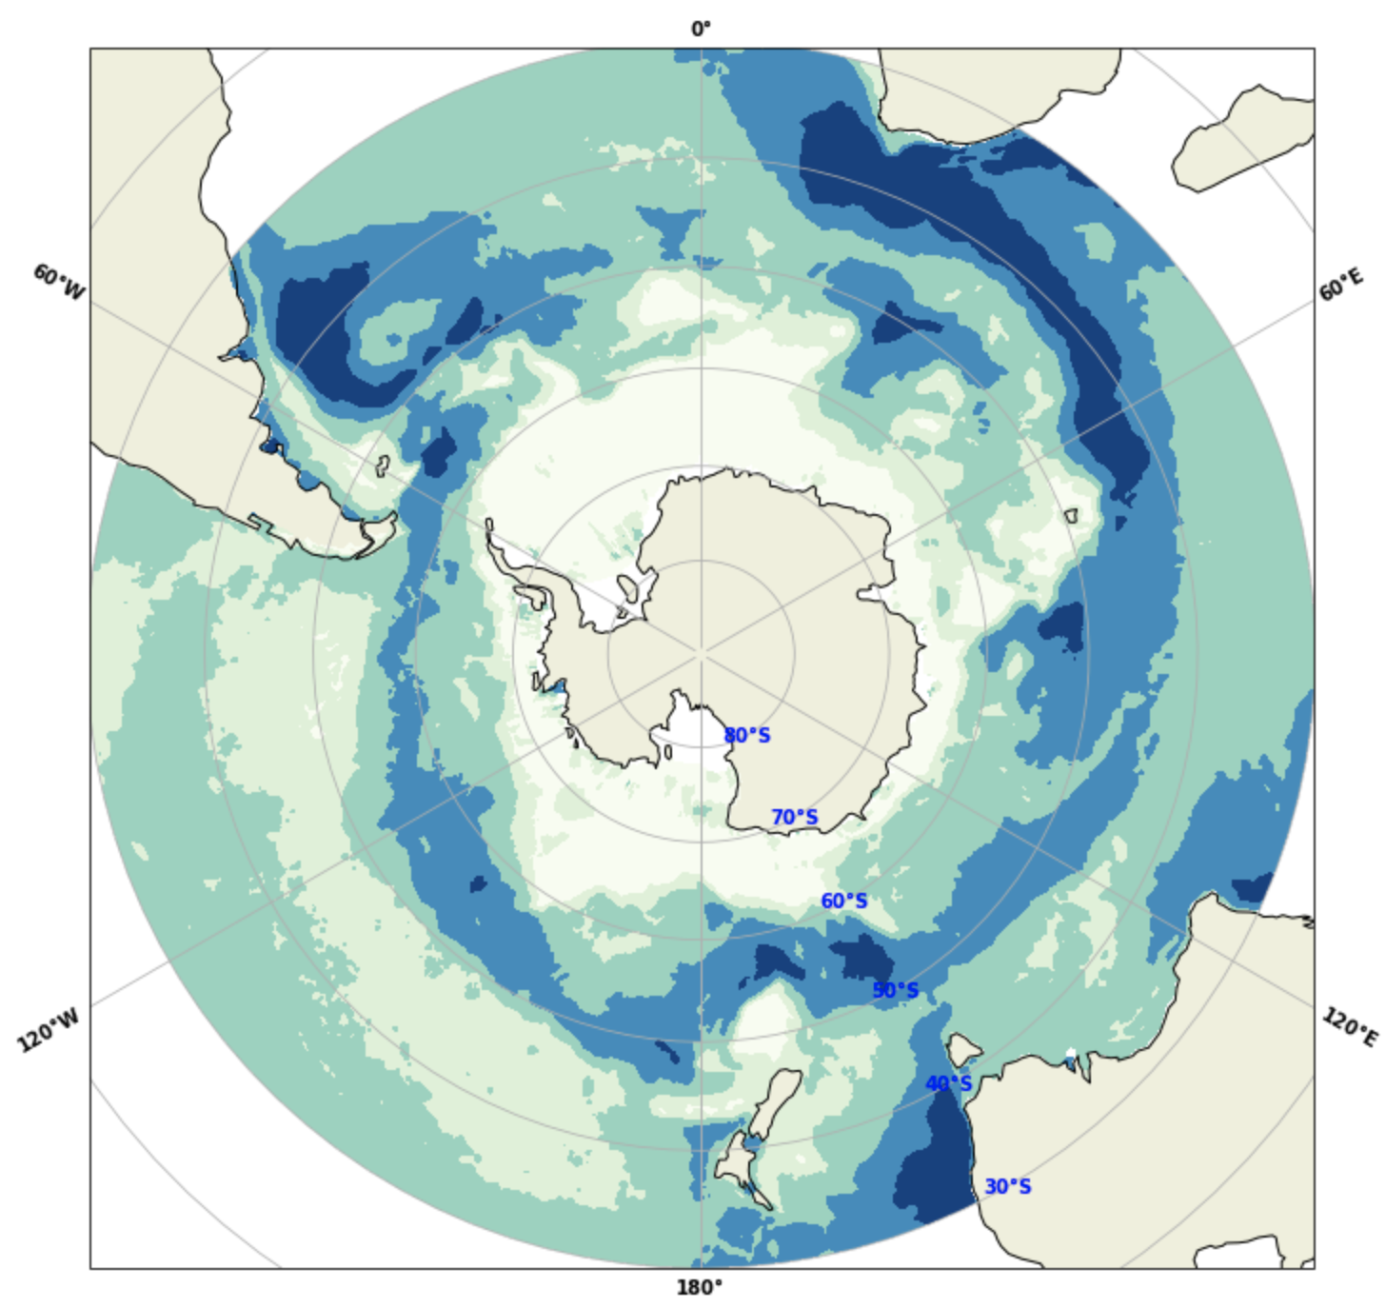
log₁₀ Eddy Kinetic Energy

Slide 10
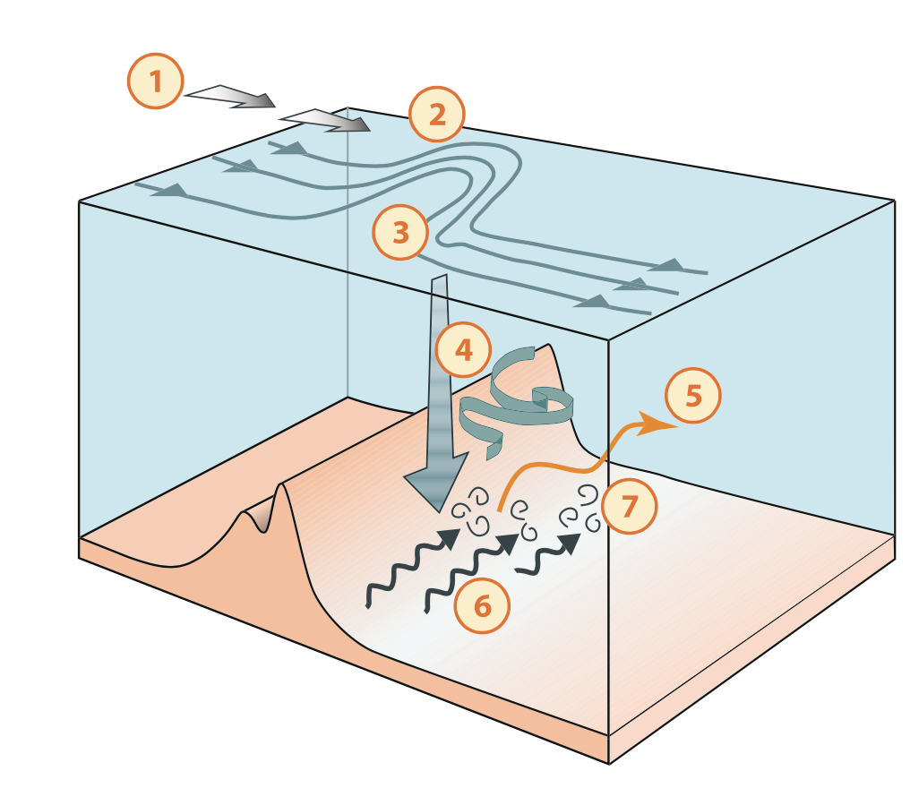
Geostrophic currents in the ACC approach a topographic feature
Gille+ (2022)
Figure by Katy Sheen
Notes:
I’ll quickly go over the dynamics that result in these high EKE regions.

Slide 11
Geostrophic currents in the ACC approach a topographic feature
Streamlines deflect to the north to conserve potential vorticity
Gille+ (2022)
Figure by Katy Sheen

Slide 12
Geostrophic currents in the ACC approach a topographic feature
Streamlines deflect to the north to conserve potential vorticity
Eddy kinetic energy is enhanced
Gille+ (2022)
Figure by Katy Sheen

Slide 13
Geostrophic currents in the ACC approach a topographic feature
Streamlines deflect to the north to conserve potential vorticity
Eddy kinetic energy is enhanced
Enhanced eddy fluxes stir tracers laterally
Gille+ (2022)
Figure by Katy Sheen

Slide 14
Geostrophic currents in the ACC approach a topographic feature
Streamlines deflect to the north to conserve potential vorticity
Tracer variance is injected along density surfaces
Eddy kinetic energy is enhanced
Enhanced eddy fluxes stir tracers laterally
Gille+ (2022)
Figure by Katy Sheen

Slide 15
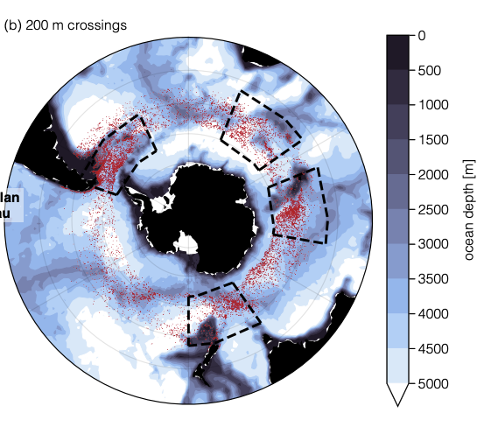
Numerical modeling has connected EKE hotspots to regions of enhanced upwelling of old, carbon-rich waters.
Number of outcrops (log₁₀)
Viglione+ (2016)
Brady+ (2021)

Slide 16
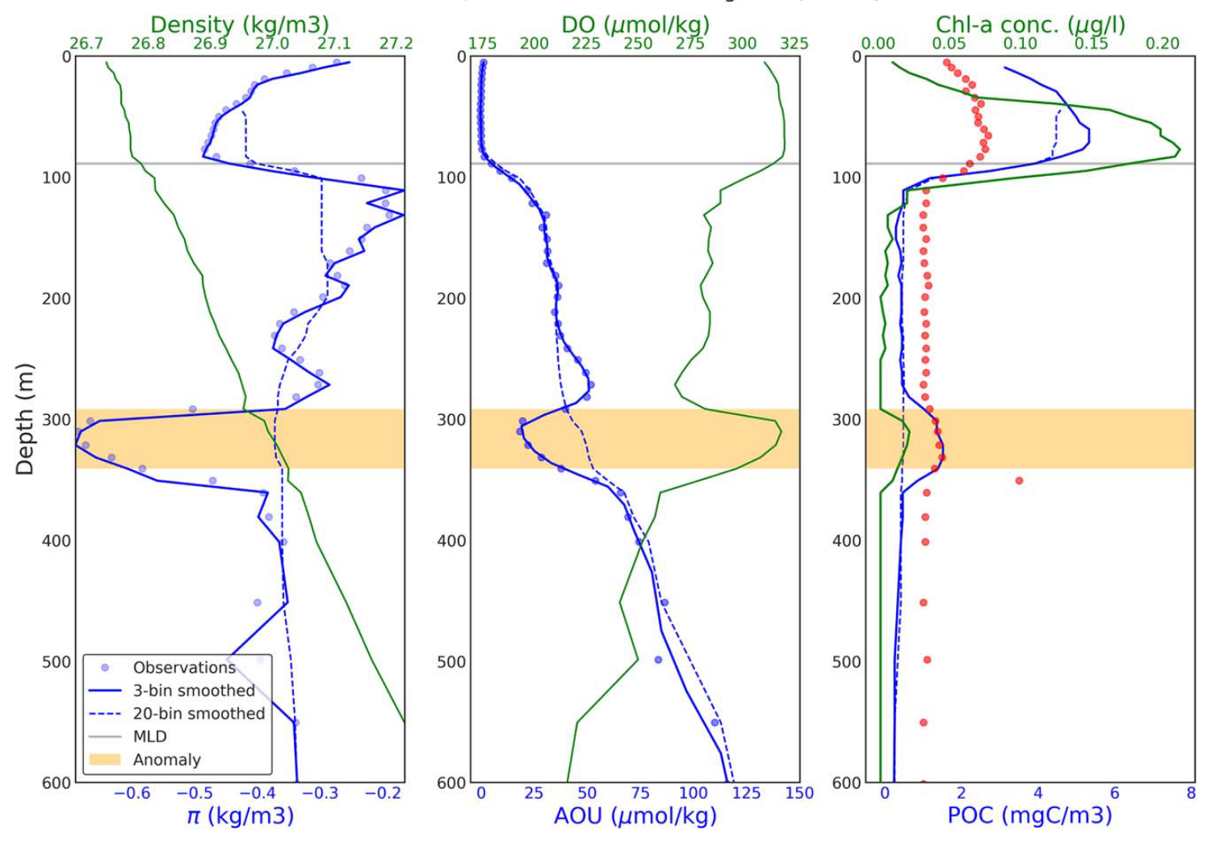
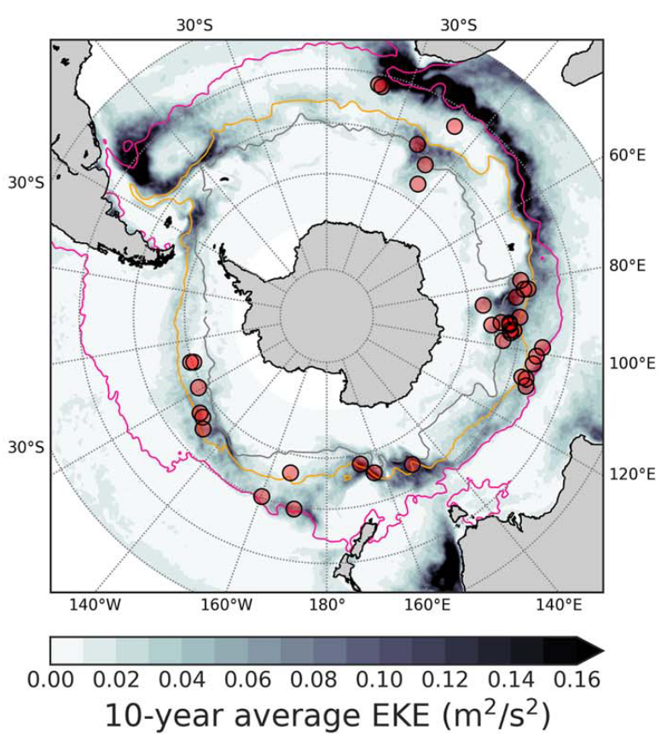
Argo floats have shown evidence of subduction from the surface in EKE hotspots
surface signature
surface signature
Llort+ (2018)

Slide 17
What scales of variability can we observe in one high eddy kinetic energy region of the ACC?

Slide 18
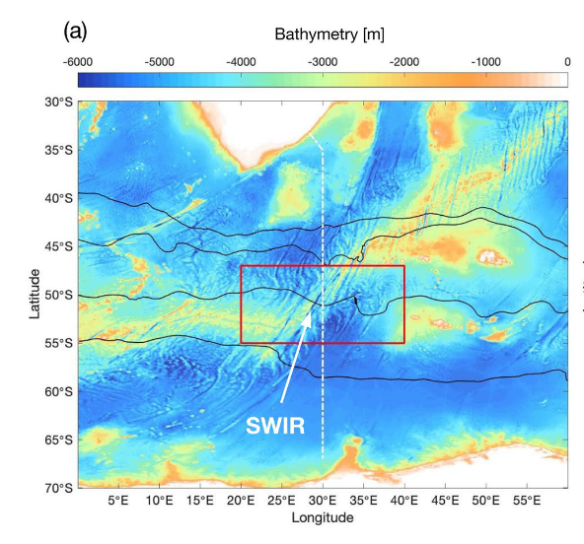
S
N
Africa
S
N
Antarctica
Dove+ (2021)
Dove+ (2021)

Slide 19
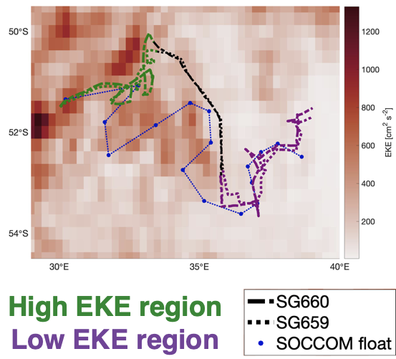

Slide 20
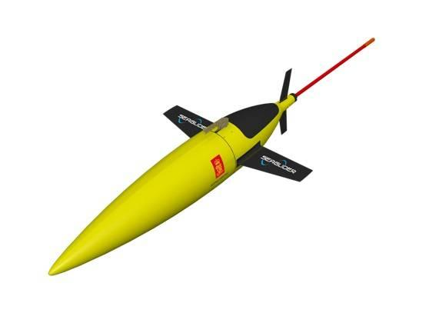
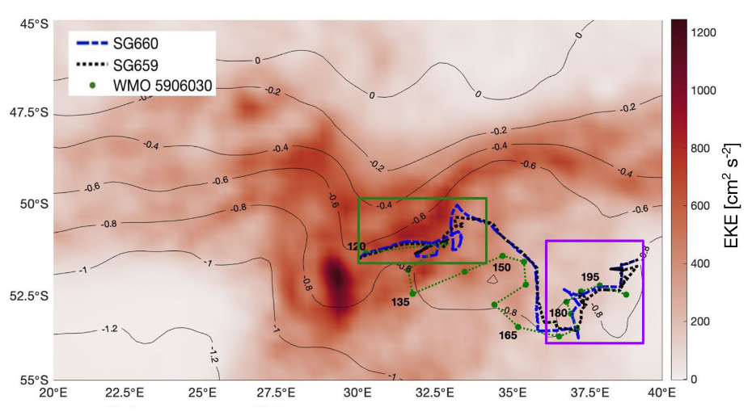
High EKE region
Low EKE region

Slide 21
float sample

Slide 22
float sample

Slide 23
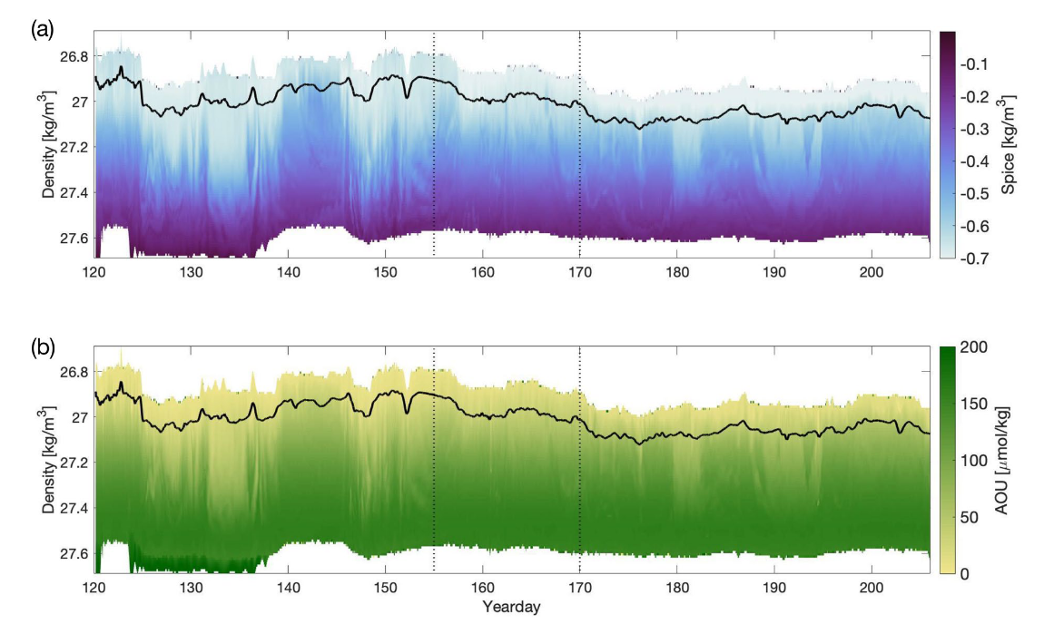
warm, salty
cool, fresh
“old” waters
recently at the surface

Slide 24
warm, salty
Injection of high oxygen (low AOU), low spice waters to depth at edges of eddies
cool, fresh
“old” waters
recently at the surface

Slide 25
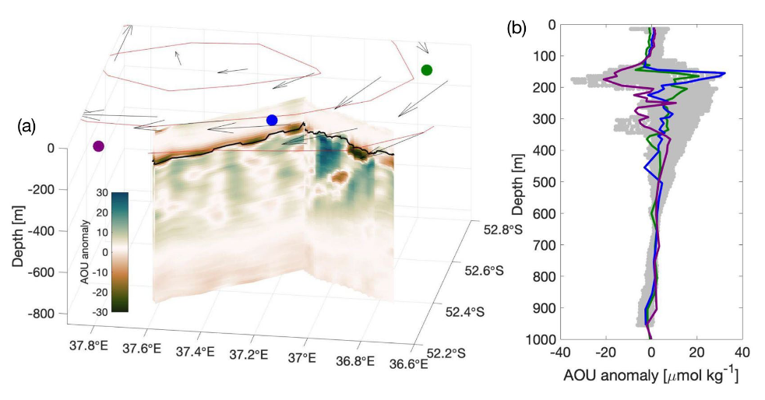

Slide 26
Low AOU anomaly waters at depth at the edge of an eddy observed by gliders

Slide 27
Floats may not be capturing full variability in high EKE regions of the ACC
Low AOU anomaly waters at depth at the edge of an eddy observed by gliders

Slide 28
AOU = O_{2,saturated} - O_{2,measured}
BML
Low AOU: more recently ventilated
Δh
depth
High AOU: less recently ventilated

Slide 29
AOU = O_{2,saturated} - O_{2,measured}
BML
Δh
Subduction along density surfaces can lead to low AOU water at depth
depth

Slide 30
AOU = O_{2,saturated} - O_{2,measured}
BML
Δh
Subduction along density surfaces can lead to low AOU water at depth
depth
ΔAOU = AOU(BML+Δh) - AOU(BML)

Slide 31
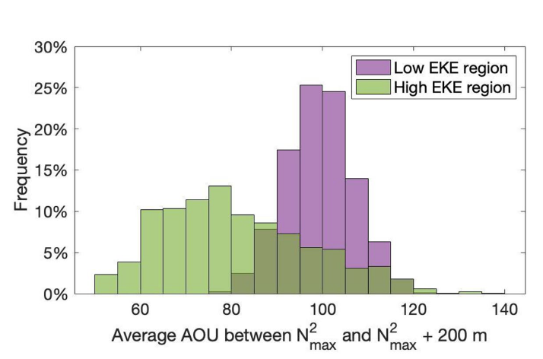
BML
Δh
depth
ΔAOU at Δh = 200 m
ΔAOU = AOU(BML+Δh) - AOU(BML)

Slide 32
Can we expand these findings from a single high-EKE region to the full ACC?

Slide 33
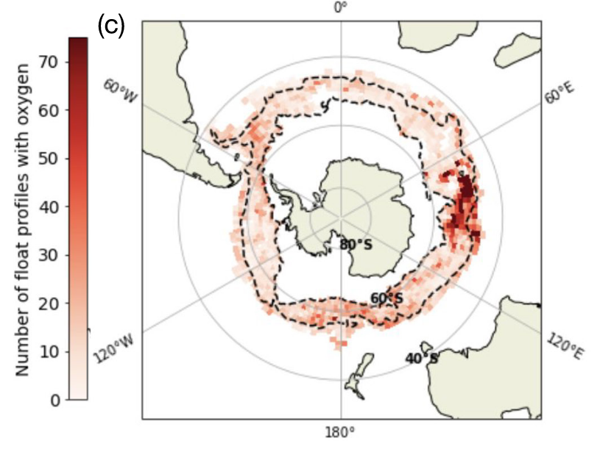
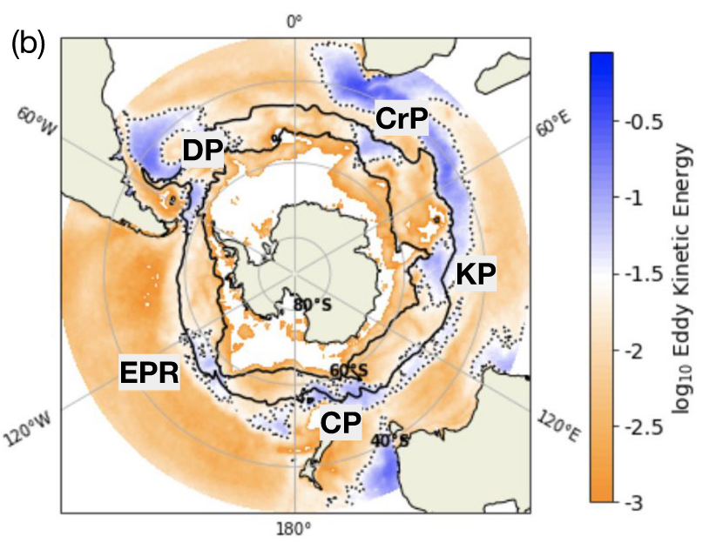
Dove+ (2022)

Slide 34
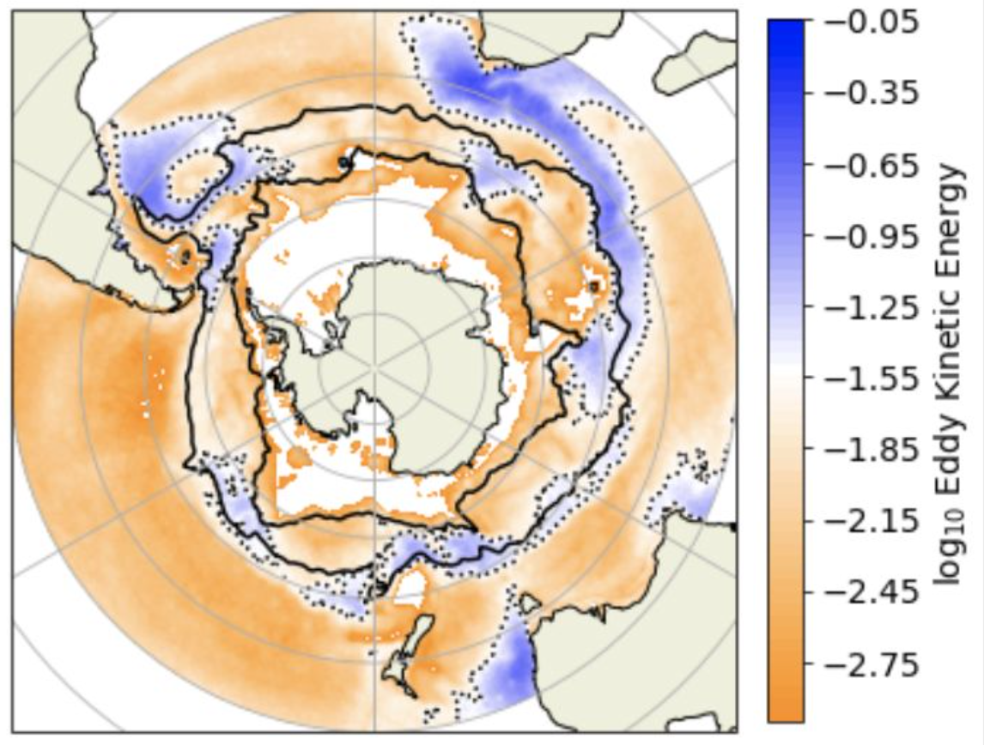
BML
Δh
depth
ΔAOU = AOU(BML+Δh) - AOU(BML)
Notes:
This is a probability density function of delta AOU at a delta h of 100. This is for all profiles in our defined ACC.
At a delta h of 100 m, we do not see too much of a difference between the PDFs for the high and low EKE regions.

Slide 35
BML
Δh
depth
ΔAOU = AOU(BML+Δh) - AOU(BML)
Notes:
However, when we look at a delta h of 400 m, we see there begins to be a separation of the PDFs. The high-EKE profiles have an average lower delta AOU than their low-EKE counterparts.
At a delta h of 700 m, the difference between the high- and low-EKE PDFs fades. This suggests this is a difference seen in primarily the intermediate depths.

Slide 36
BML
Δh
depth
ΔAOU = AOU(BML+Δh) - AOU(BML)
Notes:
However, when we look at a delta h of 400 m, we see there begins to be a separation of the PDFs. The high-EKE profiles have an average lower delta AOU than their low-EKE counterparts.
At a delta h of 700 m, the difference between the high- and low-EKE PDFs fades. This suggests this is a difference seen in primarily the intermediate depths.

Slide 37
BML
Δh
depth
ΔAOU = AOU(BML+Δh) - AOU(BML)
Notes:
On the right, I am showing a plot of the median delta AOU of the PDFs of the high and low EKE regions with delta h. This again emphasizes that the disparity between the two is within the intermediate depths, which are particularly important in the Southern Ocean because these are the water masses associated with ventilation and transport into the low latitudes.

Slide 38
What can floats tell us about processes on the submesoscale-mesoscale continuum?
Notes:
Going to walk through three potential processes: ACC density structure, along-isopycnal stirring, submesoscale vertical velocities

Slide 39
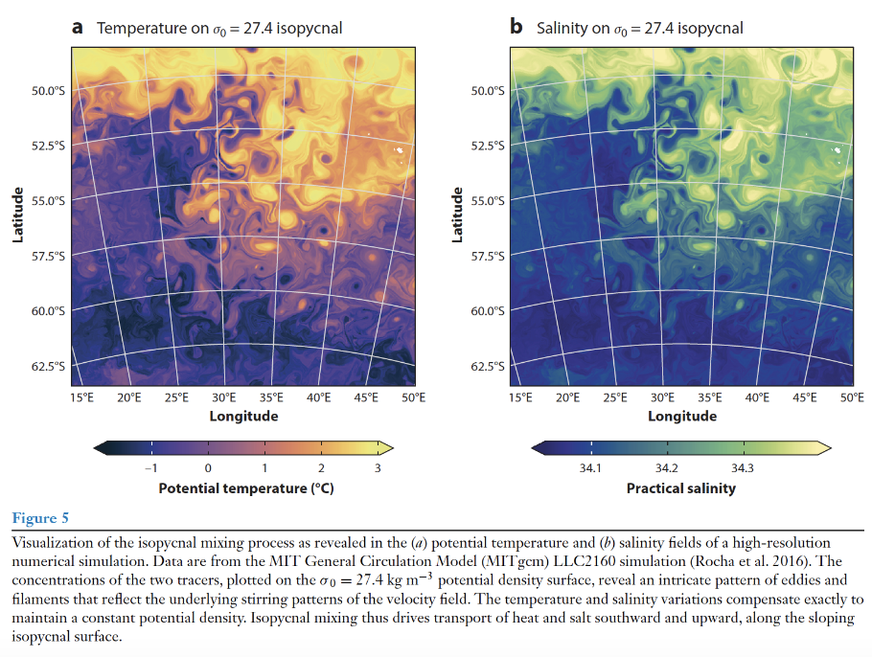
Processes that impact AOU distribution: ACC density structure
Morrison+ (2022)
Notes:
The first process that can impact the subsurface distribution of AOU is the restructuring of the ACC structure by the standing meanders themselves. In this figure from Morrison et al (2022), one can see that the density structure of the ACC is steered by the flow. Importantly, in the high-EKE region downstream of the topography, one can get less dense values as a result of bringing in waters from the north.

Slide 40
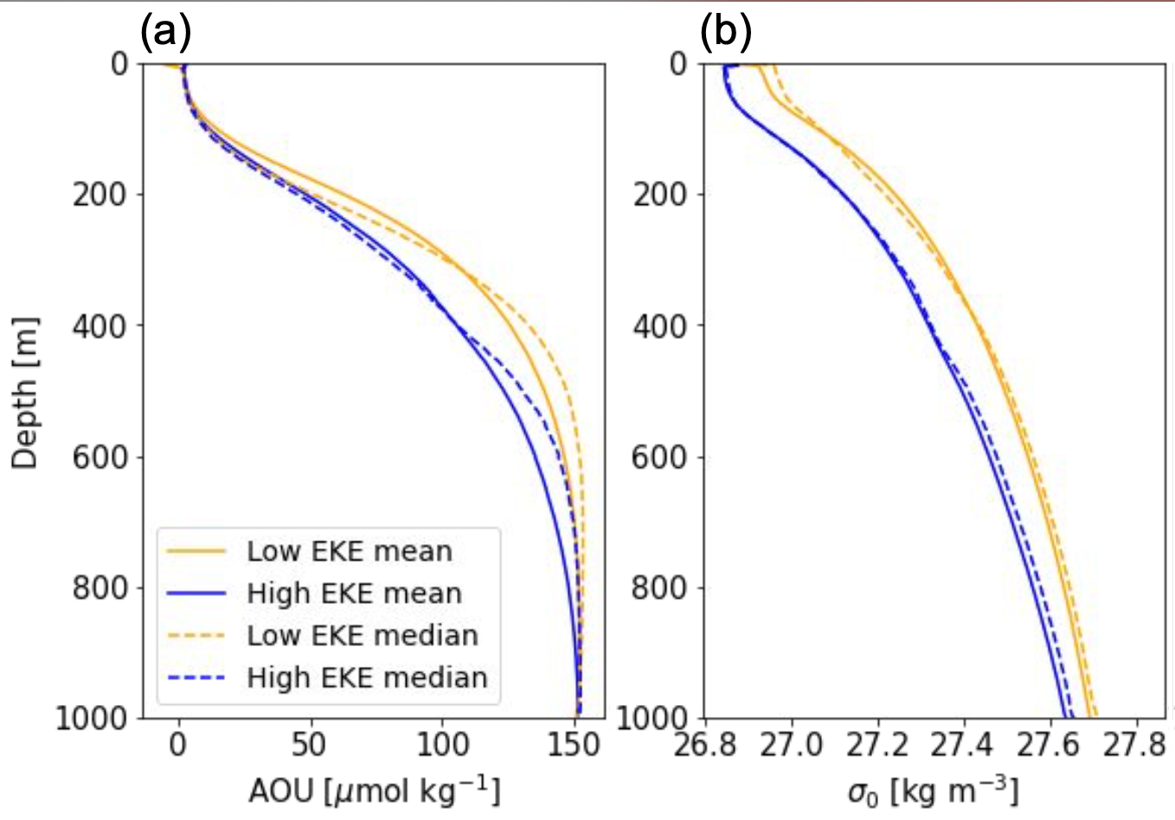
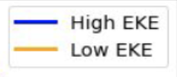
Processes that impact AOU distribution: ACC density structure
Morrison+ (2022)
At a given depth, waters in high-EKE regions are less dense
Notes:
When we look at the float data, we find this pattern; that regions of high-EKE are less dense than their low-EKE counterparts. This is important because this may have an impact on the **

Slide 41
Processes that impact AOU distribution: Along-isopycnal stirring
low ρ
Along-isopycnal mixing
high ρ
Notes:
The second process which may impact the distribution of subsurface AOU is along-isopyncal mixing. One can imagine if there is a gradient of AOU along an isopycnal, like in the Southern Ocean, where density surfaces tilt upwards and reach the surface, one can get reduced AOU values at depth as a result of stirring along that isopycnal.

Slide 42
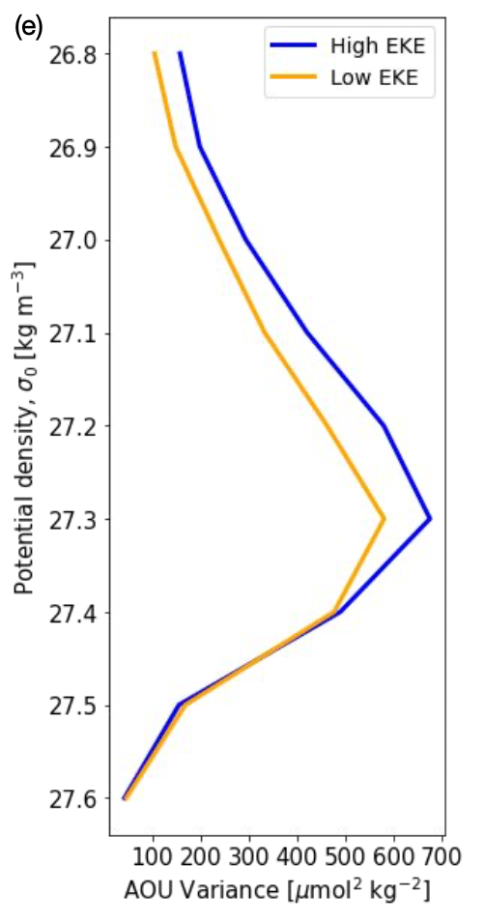
Processes that impact AOU distribution: Along-isopycnal stirring
low ρ
Along-isopycnal mixing
high ρ
High-EKE regions have larger along-isopycnal variance on density classes associated with intermediate depths.
Notes:
When we look at the variance of AOU on isopycnals, we see that the the distributions of the variance have similar shapes in the high- and low-EKE regions, with variance peaking at 27.3 kg m^3, a density surface correlated with AAIW. The AOU variance larger in the high-EKE regions, particularly in surface and intermediate waters, suggesting that along-isopycnal mixing is playing a role in the subsurface AOU distributions.

Slide 43
Processes that impact AOU distribution: Submesoscale vertical velocities

Slide 44
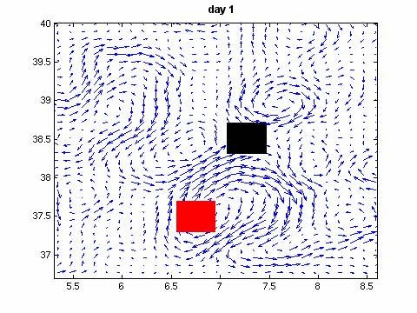
Finite-size Lyapunov Exponents
Derived using a remotely-sensed sea level anomaly field
Values tell us about the strain experienced by Lagrangian particles in a velocity field
Notes:
New slide with still of day ~5
Emphasize remote sensing

Slide 45
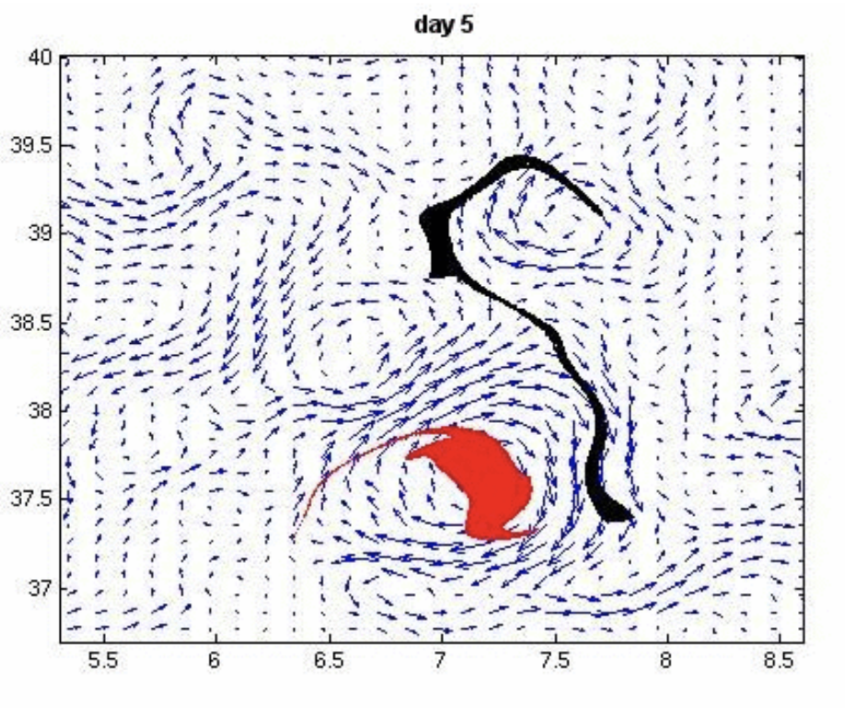
Finite-size Lyapunov Exponents
Derived using a remotely-sensed sea level anomaly field
Values tell us about the strain experienced by Lagrangian particles in a velocity field
Red: low strain, low magnitude FSLE
Black: high strain, high magnitude FSLE
Notes:
New slide with still of day ~5
Emphasize remote sensing

Slide 46
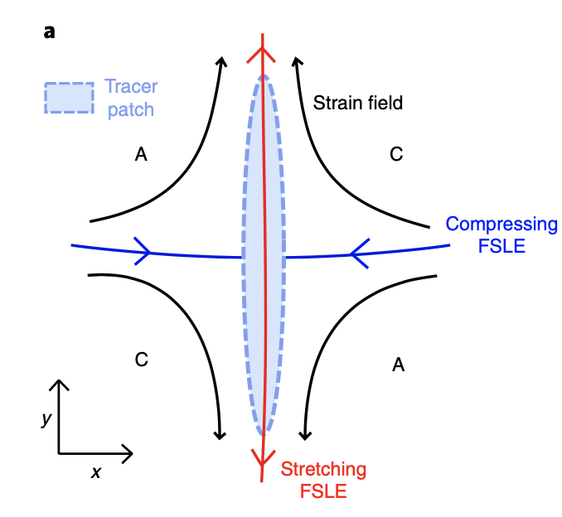
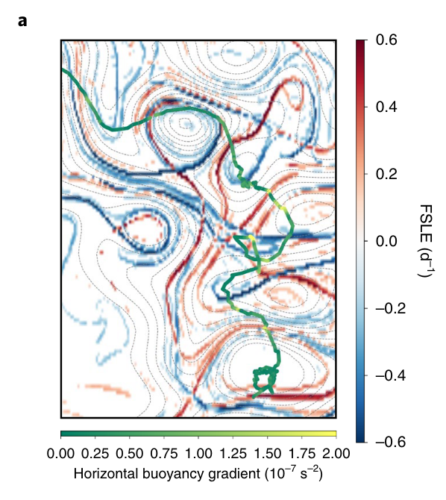
Processes that impact AOU distribution: Submesoscale vertical velocities
Siegelman+ (2020)
FSLEs from satellite-derived flow fields have been empirically correlated with lateral gradients of buoyancy at the submesoscale
Siegelman+ (2020)
Notes:
FSLE values have been correlated empirically with lateral gradients of buoyancy at the submesoscale. These lateral gradients of buoyancy are a reservoirs of potential energy that can give rise to instabilities that increase the efficiency of tracer transport between the surface and interior ocean.

Slide 47
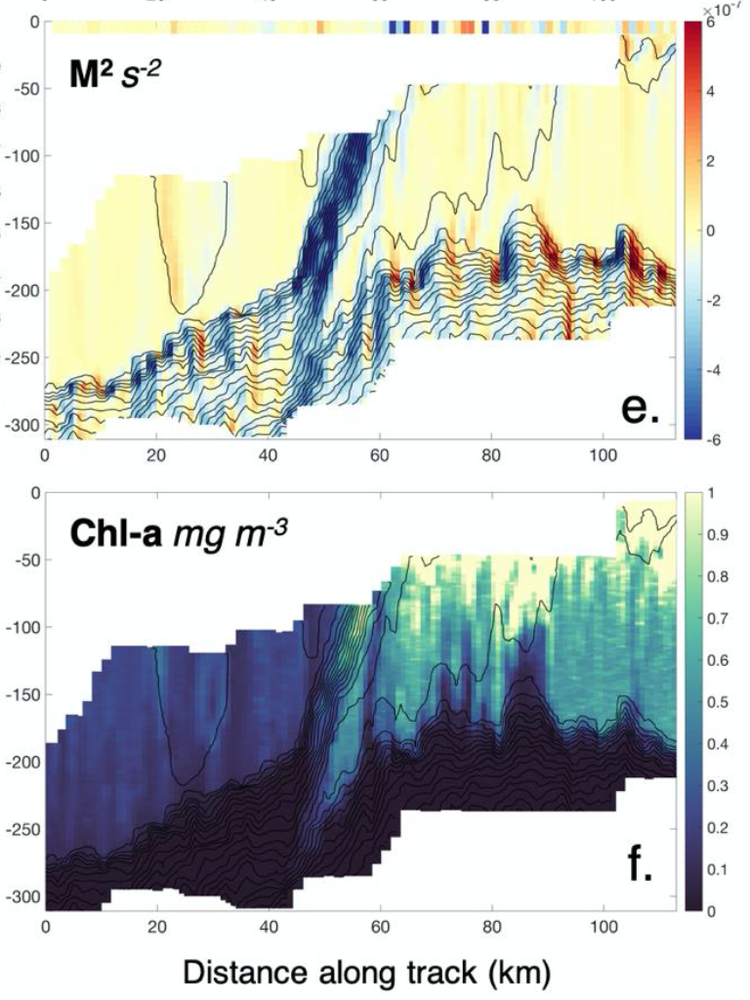
Processes that impact AOU distribution: Submesoscale vertical velocities
Archer+ (2020)
Siegelman+ (2020)
Notes:
The third process I will discuss is vertical velocities at the submesoscale.
I won’t be able to go into on this, but what is important to know is that there is a remotely-derived product called the finite-size Lyapunov exponent, which measures the strain of a given mesoscale field. FSLE values have been correlated empirically with lateral gradients of buoyancy at the submesoscale. These lateral gradients of buoyancy are a reservoirs of potential energy that can give rise to instabilities that increase the efficiency of tracer transport between the surface and interior ocean.

Slide 48
Processes that impact AOU distribution: Submesoscale vertical velocities
Greater strain (stronger fronts)
High-EKE regions are more likely to be associated with greater strain as measured by FSLEs
Notes:
Strain, as diagnosed by FSLEs seen on the left, undergoes abrupt transitions in standing meander regions. The maximum stretching FSLE has a log-normal distribution within both low- and high-EKE regions, as seen on the right. However, in the high-EKE region, the median value is shifted to larger magnitudes and the distribution has a longer tail, which we link to stronger and more frequent small-scale surface density gradients.

Slide 49
Processes that impact AOU distribution: Submesoscale vertical velocities
Difference in AOU between low- and high-EKE region
Greater strain
Individual high-EKE regions may contribute heterogeneously to Southern Ocean ventilation
Notes:
Individual high EKE regions have different FSLE distributions. The EKE associated with the Kerguelen region has the most negative, or strongest, maximum stretching FSLE values.
We wanted to see if there was a way to correlate FSLE, and therefore lateral buoyancy gradients at the submesoscale, to AOU ventilation. To do this, we compared the the median difference in ∆AOU between the high- and neighboring low-EKE region. For this metric, a negative value indicates a greater volume of low-AOU water in the high-EKE region. The high EKE region with the largest magnitude FSLE mode value (implying strongest stirring), Kerguelen Plateau, is associated with the largest value of this difference.
While five EKE regions dominate the high-EKE regions in the ACC, this analysis suggests that contributions of low ∆AOU waters to depth may be localized to only one or two intense standing meanders, namely Kerguelen Plateau and Campbell Plateau.

Slide 50
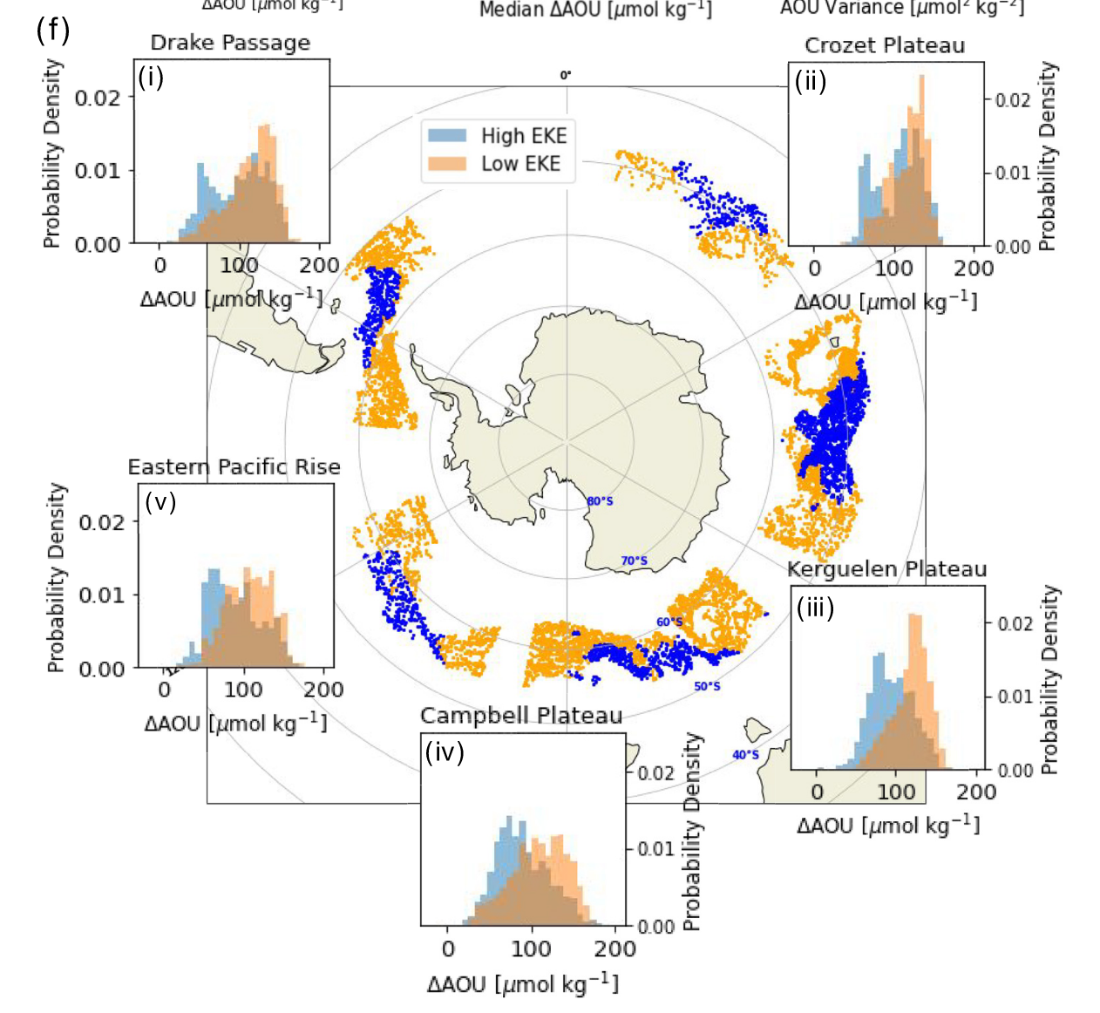
Ventilation in the Southern Ocean
Localized to EKE hotspots downstream of flow-topography interactions
Controlled by ACC density structure as well as by processes at the (sub)mesoscale
Requires more observations to constrain!

Slide 51
Summary
Submesoscale vertical velocities
Frontogenesis
Flow- topography interactions
Mesoscale eddy kinetic energy
Lateral stirring along tilted isopycnals
Ventilation and CO₂ fluxes
Interested in reading more?
Dove, L.A., A.F. Thompson, D. Balwada, A.R. Gray, Observational Evidence of Ventilation Hotspots in the Southern Ocean, JGR: Oceans (2021)
Dove, L.A., D. Balwada, A.F. Thompson, A.R. Gray, Enhanced Ventilation in Energetic Regions of the Antarctic Circumpolar Current, GRL (2022)

Slide 52
Extra slides

Slide 53
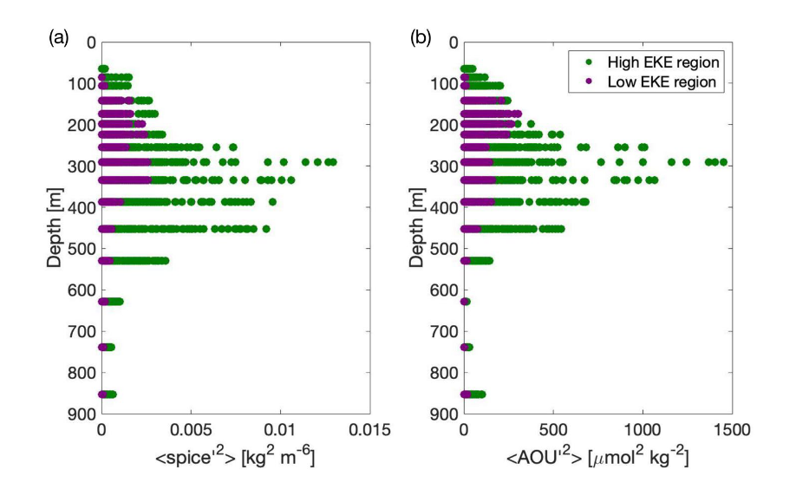

Slide 54
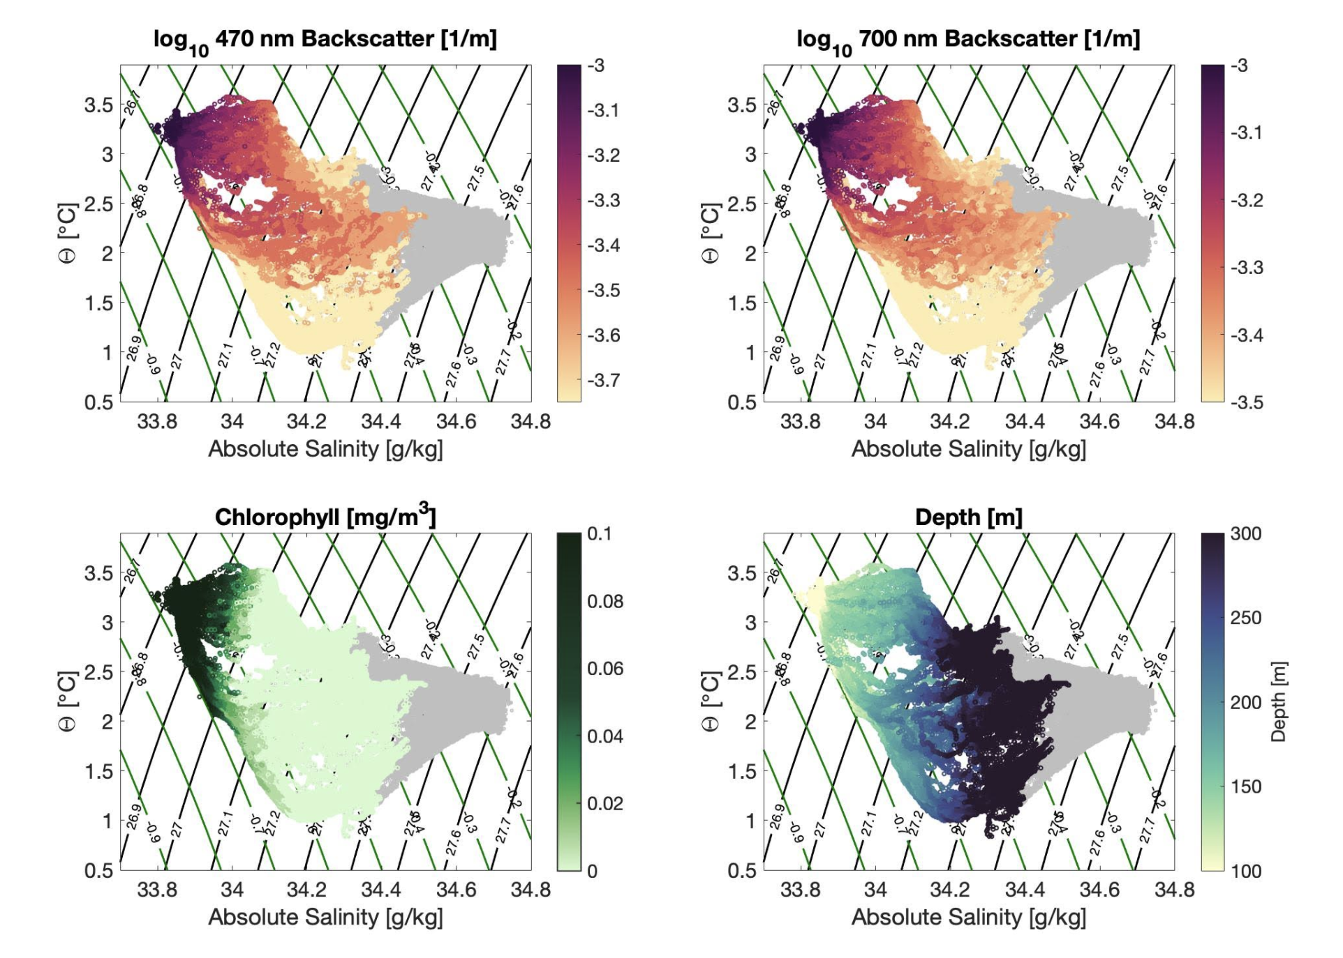

Slide 55
