Slide 1






Tracing the origins of finescale plankton patchiness along and across a front
31 August 2022
Providence, RI
Shailja Gangrade¹, Inès Mangolte², Marina Lévy², & Peter J.S. Franks¹
“Shell-ja Gung-rah-day”
¹ Scripps Institution of Oceanography, University of California San Diego (UCSD), La Jolla, California, USA
² Sorbonne Université, Laboratoire d’Océanographie et du Climat (LOCEAN), Institut Pierre-Simon Laplace (IPSL), Paris, France
@ShailjaGangrade

Slide 2
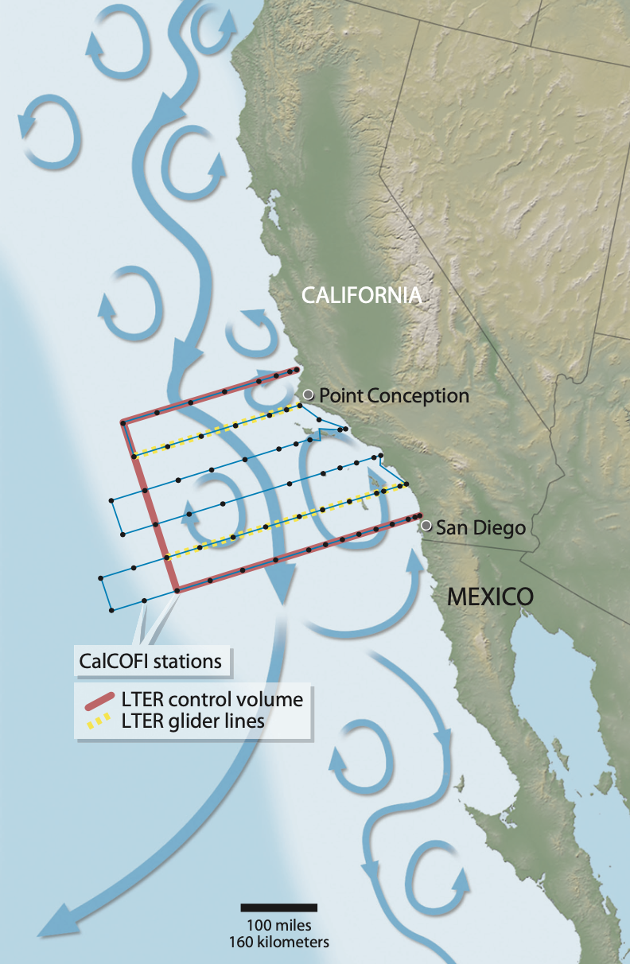
Mesoscale Fronts in the California Current System (CCS)
CCS is a dynamic eastern boundary upwelling system
Wind-driven upwelling at the coast
Transport driven by a mosaic of mesoscale fronts, filaments, eddies
Fronts at regions of strong horizontal density gradients; many are associated with mesoscale eddies
(Ohman et al., 2013)
Notes:
The CCE is located within a dynamic eastern boundary upwelling system
Mosaic of fronts, filaments, and eddies
Most recent extensive studies of fronts occurred in 2008 (A-Front) and 2012 (E-Front)
PERSISTENT BIOLOGICAL FEATURES AT FRONTS ON AVERAGE
There is a persistent phytoplankton patch… now here’s …. Transition to next slide.
Assessed nutrient supply, export fluxes, and gradients in biomass and community composition (Ohman et al., 2013)
Frontal features detected by satellites have increased over time (Kahru et al., 2012)

Slide 3
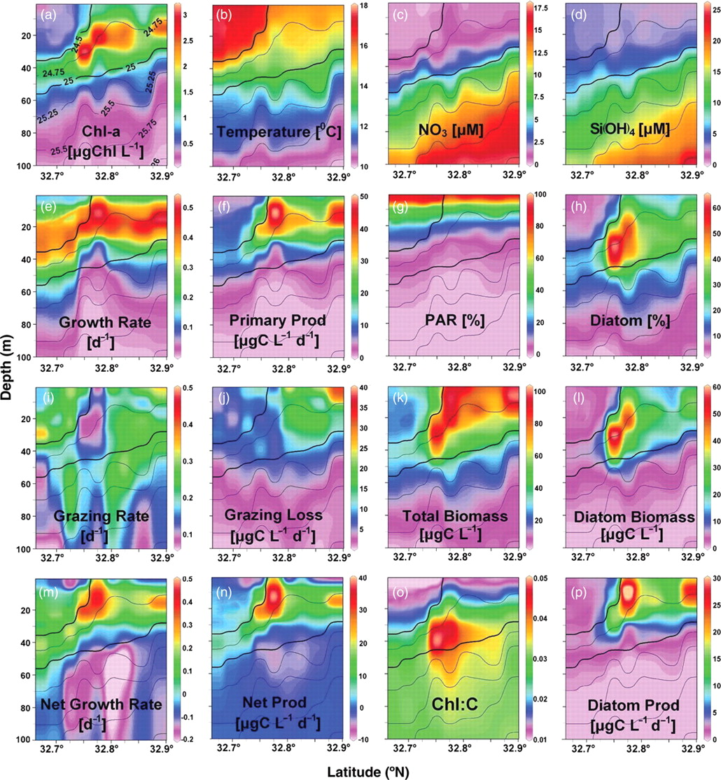
Common Assumptions at Fronts
Along-front flow
Along-front flow
Along-front uniform
High Chl-a
Cooler
Low Chl-a
Warmer
Single cross-frontal transect is “representative”
Biogeochemical tracers are at steady state
(Li et al., 2012)
20-30 km
Notes:
Here is one particular transect from Li et al. that shows that biological featurea (high chl) on the colder side of the front; because these features are so persistent, people tend to assume – sometimes implicitly
In order to study spatiotemporally dynamic fronts, some common assumptions are made.
*** all these fronts have strong along front velocities 50-80 km/d → residence time in any frontal feature may not be that long → could have important consequences when we consider these assumptions.

Slide 4
What to consider when investigating Biological and Hydrographic Patchiness at Fronts
Axis of patchiness
  Along the front
  Across the front
Dimensions / Resolution
  Space
    Horizontal
    Vertical
  Time
  Taxonomic
Along-front flow
Along-front flow
Low Chl-a
High Chl-a
Cooler
Warmer
Adapted from Li et al., 2012
Notes:
Here is one particular transect from Li et al. that shows that biological featurea (high chl) on the colder side of the front; because these features are so persistent, people tend to assume – sometimes implicitly
In order to study spatiotemporally dynamic fronts, some common assumptions are made.
*** all these fronts have strong along front velocities 50-80 km/d → residence time in any frontal feature may not be that long → could have important consequences when we consider these assumptions.

Slide 5
What to consider when investigating Biological and Hydrographic Patchiness at Fronts
Axis of patchiness
  Along the front
  Across the front
Dimensions / Resolution
  Space
    Horizontal
    Vertical
  Time
  Taxonomic
Along-front flow
Along-front flow
Low Chl-a
High Chl-a
Cooler
Warmer
Adapted from Li et al., 2012

Slide 6
Along-front sampling of “E-Front”
Survey 1 (July 30-August 3)
Survey 2 (August 22-August 25)
Monterey Bay
Monterey Bay
Monterey Bay
Monterey Bay
Morro Bay
Morro Bay
Morro Bay
Morro Bay
Pt. Conception
Pt. Conception
Pt. Conception
Pt. Conception
anticyclonic
cyclonic
cyclonic
anticyclonic
Front was relatively stationary over 1-month sampling period
Along-front velocities = 0.5 m/s (~50 km/d)
Residence time of waters in frontal survey region ~3-4 days
Gangrade & Franks, in review
Notes:
CCE LTER Process cruise sampled this eddy-associated front offshore of Pt Conception in 2012
Satellite-derived SLA anomaly → anticyclonic eddy to the west and cyclonic eddy to the east
SHOW SURVEYS
SeaSoar sampling – towed vehicle that undulated between surface and ~300 m depth
LOPC/CTD/Fluorometer on SeaSoar
Survey 1 against flow, south to north
Three weeks later → Survey 2 with flow
Cross-frontal transects + some along-front resolution
ALONG FRONT VELOCITIES
RESIDENCE TIME

Slide 7
Along-front decrease in chlorophyll
high phytoplankton
biomass
high phytoplankton
biomass
decreasing
biomass
decreasing
biomass
low phytoplankton
biomass
low phytoplankton
biomass
3+ weeks apart
Were these the same stationary patch?
Were these two different patches?
Gangrade & Franks, in review
Notes:
A striking feature of both SeaSoar surveys was the presence of a patch of high phytoplankton biomass at the northern boundary of each survey. The biomass decreased in the along-front direction (north-to-south), leading to strong along-front chlorophyll gradients.
Consider whether this was at steady state

Slide 8

Stationary Patch Hypothesis (SPH)
Pulsatile Patch Hypothesis (PPH)
$$t_{1}$$
North
$$t_{2}$$
$$t_{3}$$
$$t_{1}$$
North
$$t_{2}$$
$$t_{3}$$
$$C$$
$$C$$
$$C$$
$$C$$
$$c$$
$$C$$
Loss
Loss
Loss
$$C$$
$$c$$
$$c$$
$$c$$
$$c$$
$$c$$
South
South
Notes:
Loss maintaining the along-front gradient in the face of strong along front advection; in situ dynamics don't change much over time in this steady-state system.
For PPH, If we sampled at t1 and t2 we might see two different patches at the northern end.
In my upcoming publication on this work, I delve into the SPH in more detail, but for this presentation, I will focus on investigating the PPH. And once of the major motivations is that we can consider the residence of waters in the front.

Slide 9

If residence times of waters at the front were only a few days…
Where did these waters originate, and how did they get into the front?
Notes:
Looking "advection histories"

Slide 10
Streamlines trace backward to coastal upwelling origins of patches
Survey 1
Survey 2
Monterey Bay
Monterey Bay
Monterey Bay
Monterey Bay
Upwelling region ~36 ºN
Upwelling region ~36 ºN
Cyclonic eddy east of front
Morro Bay
Morro Bay
Morro Bay
Morro Bay
Use these satellite-derived velocities to trace water parcels backward-in-time from front to identify:
Geographic source regions
Temporal origins
Gangrade & Franks, in review
Notes:
We can use streamlines to see that waters at the front came from offshore and inshore, flowing into front
What we want to do is find our where the water parcels in the front came from…
HIGHLIGHT STREAMLINE
We tracked the particles to see where they came from when they would have entered the front
Use streamlines → pick a streamline in each to highlight (red)
We tracked the backward in time to identify the source regions
Then tracked the forward time to see when they entered the front
AVISO

Slide 11
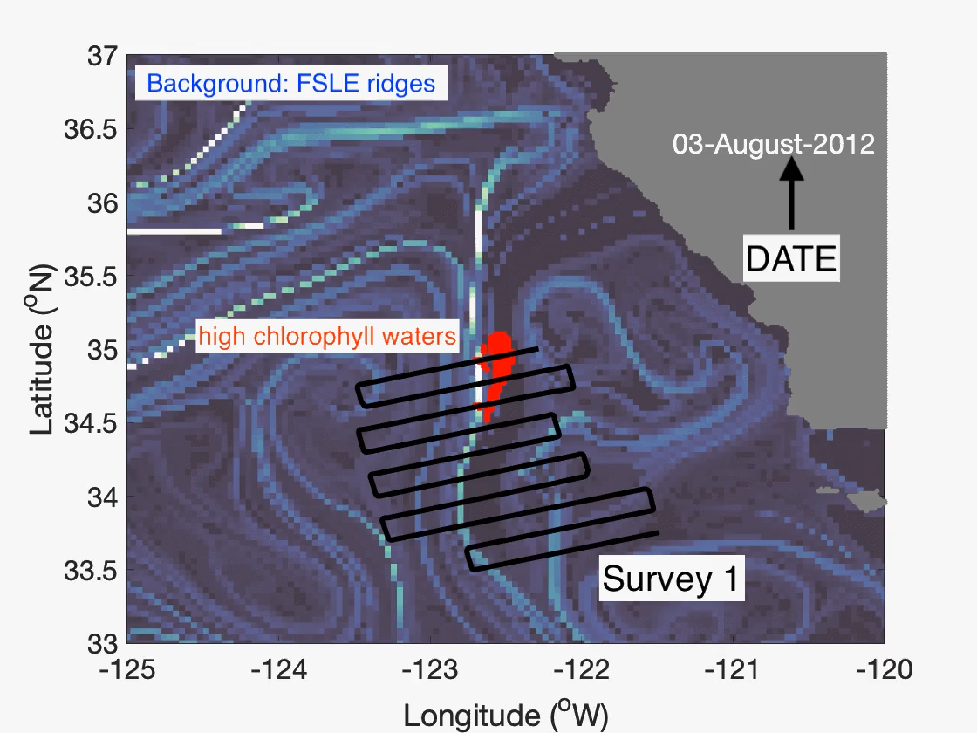
High-chlorophyll waters in Survey 1 originated in a narrow coastal upwelling region
Gangrade & Franks, in review
Notes:
FSLE represent regions of strong convergence; where streamlines converge – water parcels will follow these ridges.
We’ve identified the origins of the high chlorophyll, high oxygen, high biomass patches.

Slide 12
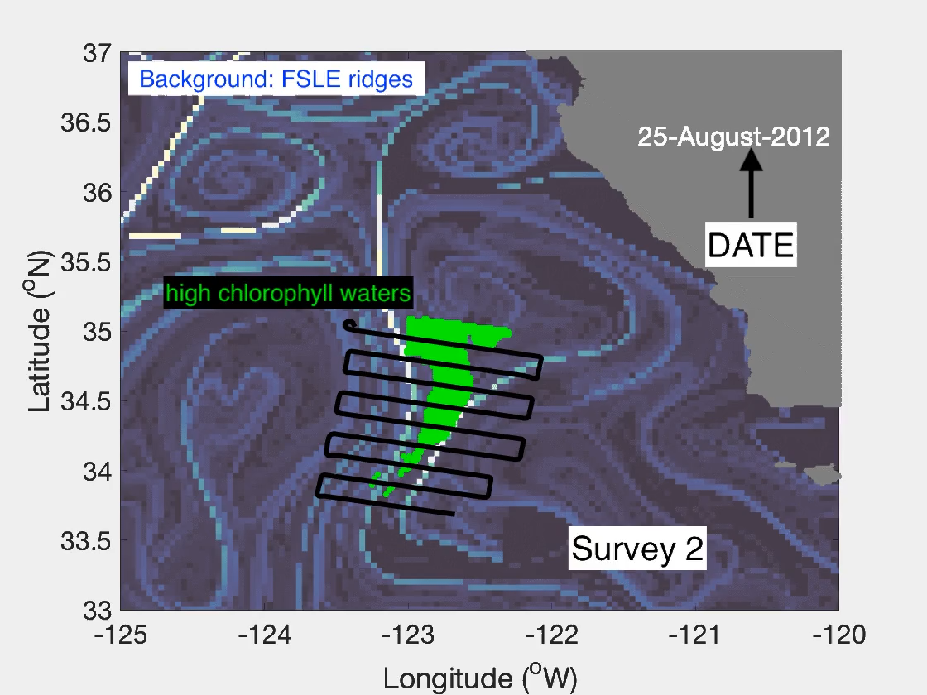
High-chlorophyll waters in Survey 2 originated in a broader coastal upwelling region
Gangrade & Franks, in review
Notes:
Used ezgif.com to change playback speed.

Slide 13
Survey 1
Survey 2
coastal filament
~ 36ºN
coastal region
~ 36ºN
cyclonic
eddy
The high-chlorophyll waters at the front in Survey 1 and 2 had different spatial and temporal origins.
Gangrade & Franks, in review

Slide 14
How are these origins linked to
wind-driven upwelling?

Slide 15
11-14 days
16 days
Distinct upwelling pulses are associated with the different survey patches
Upwelling pulses preceded sampling by ~ 2 weeks
Gangrade & Franks, in review
Notes:
So what’s special about these dates?

Slide 16
Distinct upwelling pulses contributed to different phytoplankton patches that advected through the front.
Are biogeochemical properties of waters at the front consistent with this hypothesis?

Slide 17
Chlorophyll, oxygen, particle load at front correlated with salinity
Therefore, phytoplankton patches are tracers of water masses that upwelled at the coast and advected through the front
Gangrade & Franks, in review
Notes:
Biogeochemical variables are highly correlated with salinity (water mass tracer)
Hydrography is correlated with biogeochemical properties – would not be predicted by SPH.
This is consistent with the interpretation that patches of chlorophyll, indicates patches of water masses advecting through the front.
Nutrient righ high salinity water - aloowing for higher chlorophyll.

Slide 18
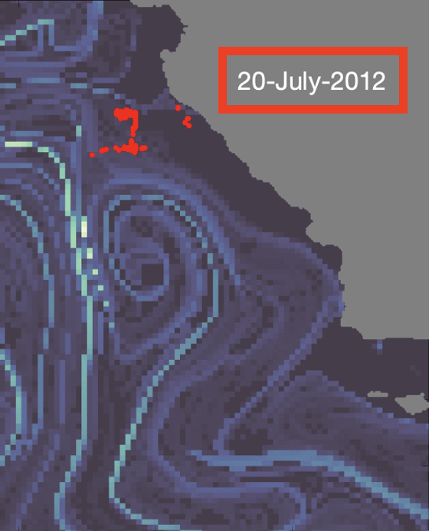
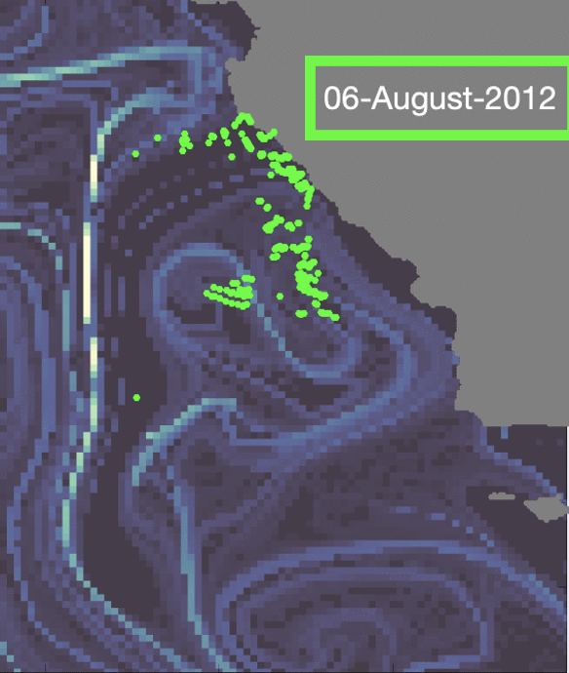
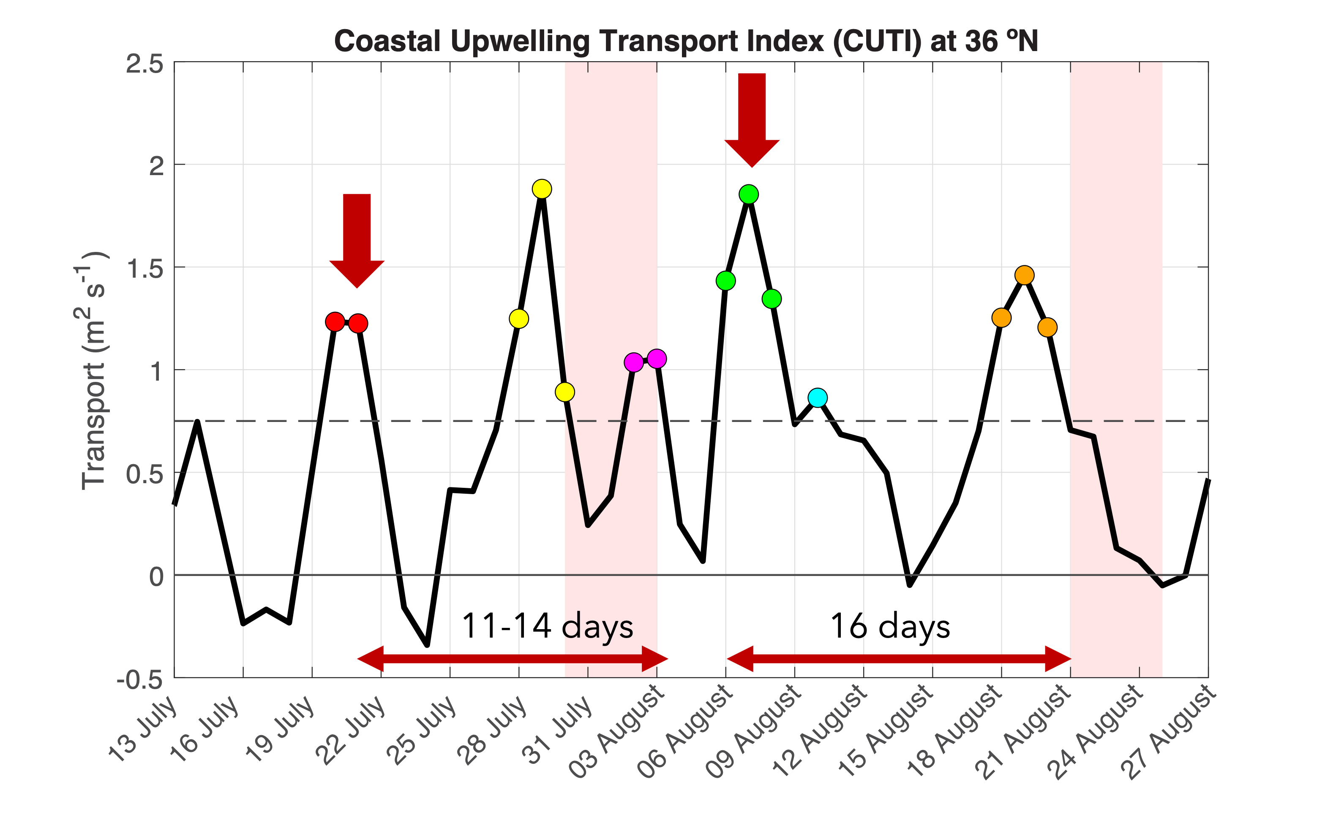
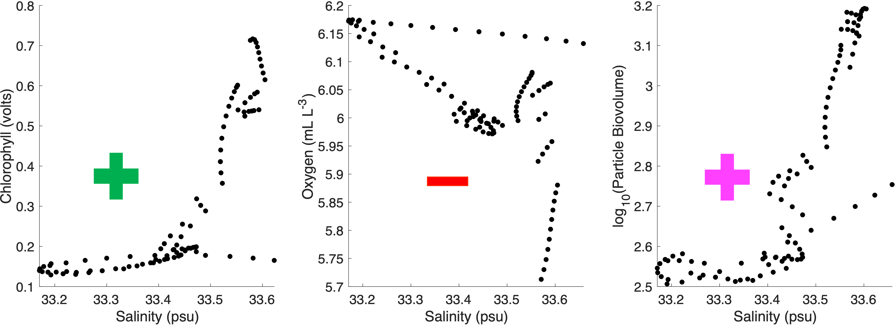
Summarizing the evidence
Phytoplankton patches in Survey 1 and 2 had different spatial & temporal origins
These origins are aligned with distinct upwelling pulses
Biogeochemistry at the front is correlated with salinity & consistent with the advection of different patches

Slide 19
Stationary Patch Hypothesis (SPH)
Pulsatile Patch Hypothesis (PPH)
$$t_{1}$$
North
$$t_{2}$$
$$t_{3}$$
$$t_{1}$$
North
$$t_{2}$$
$$t_{3}$$
$$C$$
$$C$$
$$C$$
$$C$$
$$c$$
$$C$$
Loss
Loss
Loss
$$C$$
$$c$$
$$c$$
$$c$$
$$c$$
$$c$$
South
South
Notes:
Loss maintaining the along-front gradient in the face of strong along front advection

Slide 20
Upwelling pulses of different intensities make distinct phytoplankton patches
COASTAL UPWELLING REGION
COAST
High Salinity
Low Oxygen
High Chlorophyll
Low Salinity
High Oxygen
Low Chlorophyll
DEPTH
EUPHOTIC
APHOTIC
WEAK
UPWELLING
PULSE
Low Salinity
High Oxygen
Low Nutrients
STRONG
UPWELLING
PULSE
High Salinity
Low Oxygen
High Nutrients
Notes:
Upwelling sourc edepth
Nutrients vary
Stronger winds → stronger upwelling pulses → reaches deeper
Patches were different -> coincidentally sampled

Slide 21
The phytoplankton patches then advect through the front
COASTAL UPWELLING REGION
COAST
Advection
Advection
High Salinity
Low Oxygen
High Chlorophyll
Low Salinity
High Oxygen
Low Chlorophyll
High Salinity
Low Oxygen
High Chlorophyll
ALONG FRONT
DEPTH
EUPHOTIC
APHOTIC
WEAK
UPWELLING
PULSE
Low Salinity
High Oxygen
Low Nutrients
Advection
STRONG
UPWELLING
PULSE
High Salinity
Low Oxygen
High Nutrients
Low Salinity
High Oxygen
Low Chlorophyll
Notes:
Add summary before
Patches were different -> coincidentally sampled

Slide 22
Conclusions about along-front patchiness
This front is patchy and non-uniform in the along-front direction
Along-front variability of biogeochemical properties can be linked to upwelling dynamics hundreds of kilometers away
Mesoscale advective features, such as filaments and eddies, transported waters from upwelling regions to this front in ~2 weeks
Applying along-front uniformity or steady-state assumptions ignore potential along-front gradients and spatiotemporal dynamics at fronts that occur at very fine scales (tens of km)
Advection
High Salinity
Low Oxygen
High Chlorophyll
ALONG FRONT (150-200 km)
Advection
Low Salinity
High Oxygen
Low Chlorophyll
Notes:
WHICH ARE HAPPENING ON VERY FINE SCALES (10s of KM)

Slide 23
Biological community structure was not resolved for data used in this along-front analysis.
+ taxonomic resolution
+ spatial resolution / axis
Let’s look across the front.
Notes:
Let’s look hydrographic and biological patchiness across the front.

Slide 24
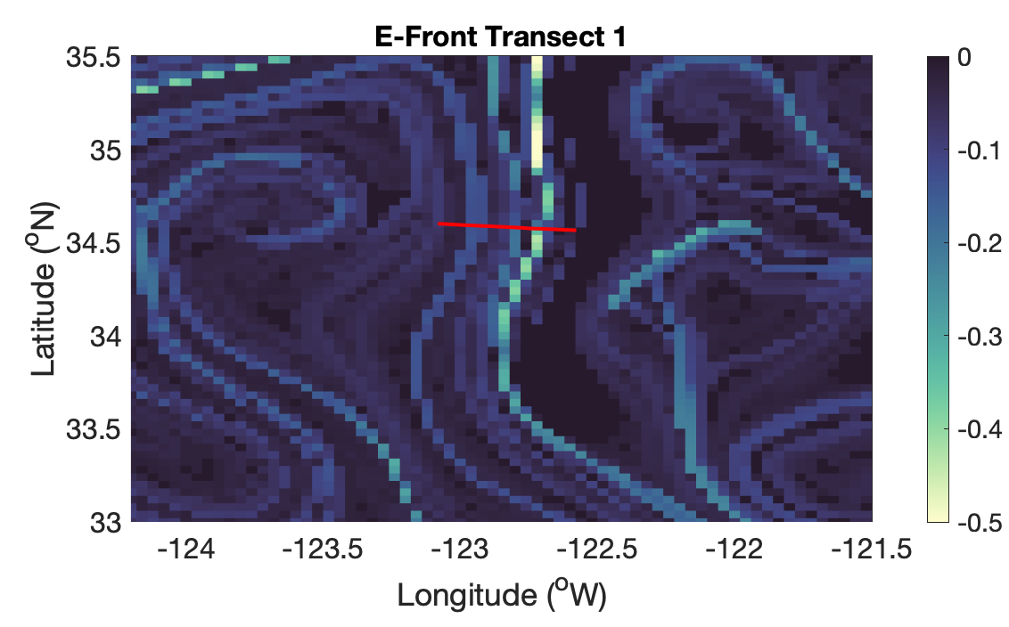
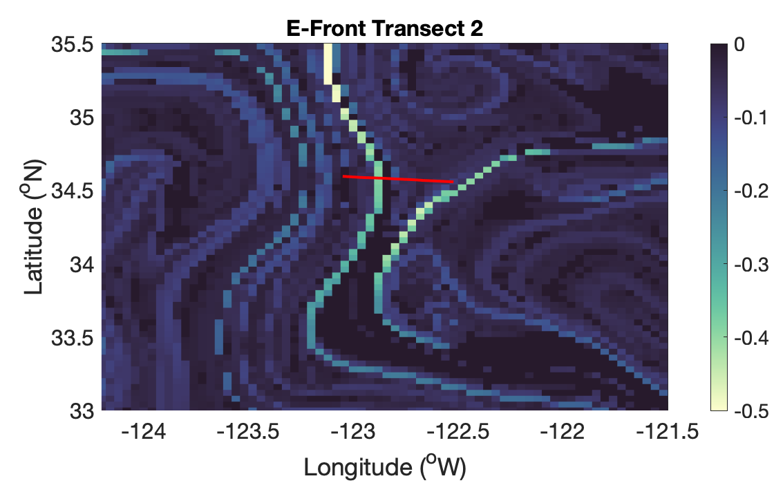
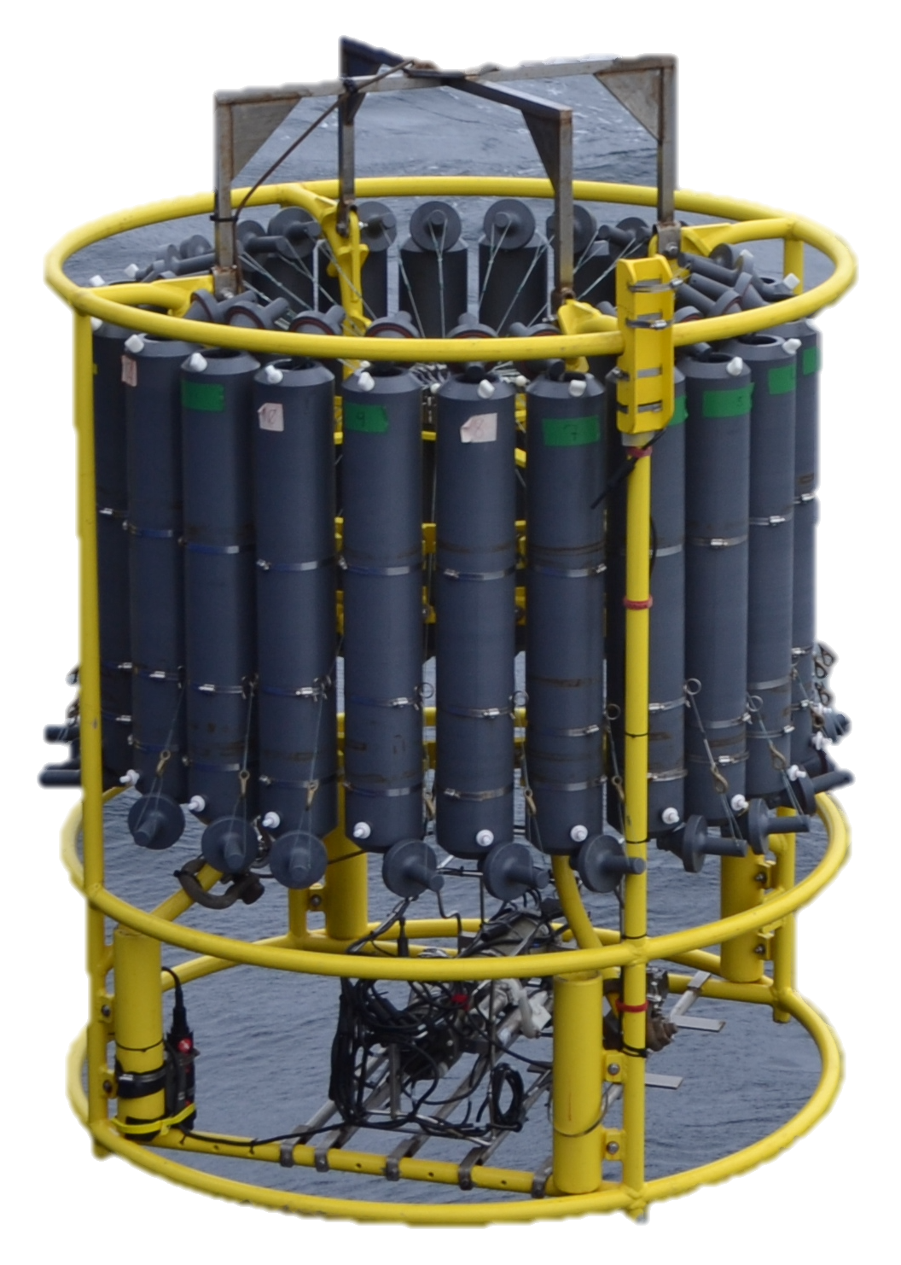
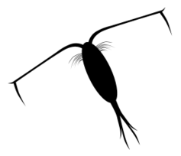
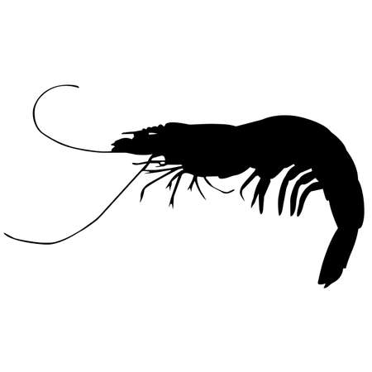
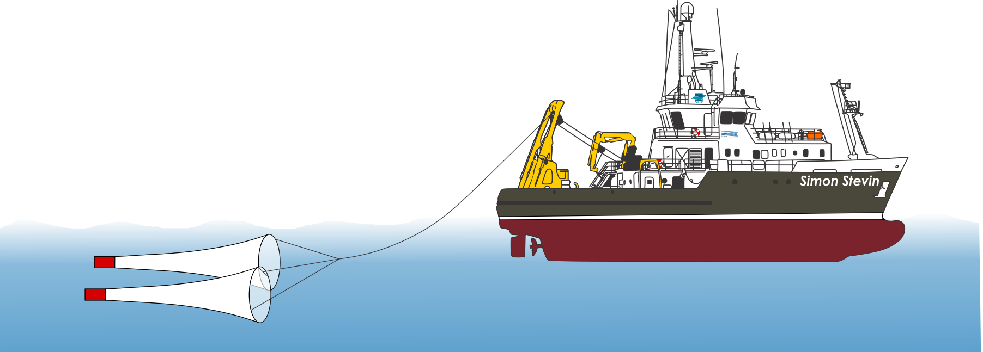
Chronology of Sampling at E-Front
SeaSoar Survey 1
(July 30-August 3)
“E1” Transect
(August 5)
“E2” Transect
(August 21)
SeaSoar Survey 2
(August 22-August 25)
3-5 km horizontal, 1 m vertical resolution
Data: CTD / Bongo Nets (integrated, 0-100 m) / Bottle Samples (surface)
Notes:
High-resolution horizontal/vertical scales --> 5 km between samples.
NEED A MOTIVATING QUESTION / TRANSITION
So, we saw evidence of phytoplankton patches coming from inshore and advecting into/along the front. But what do we see in terms of community structure of plankton across the front?
We identified phytoplankton patches along the front, and traced their origins. Can we identify phytoplankton and zooplankton patches across the front? and trace their origins?

Slide 25
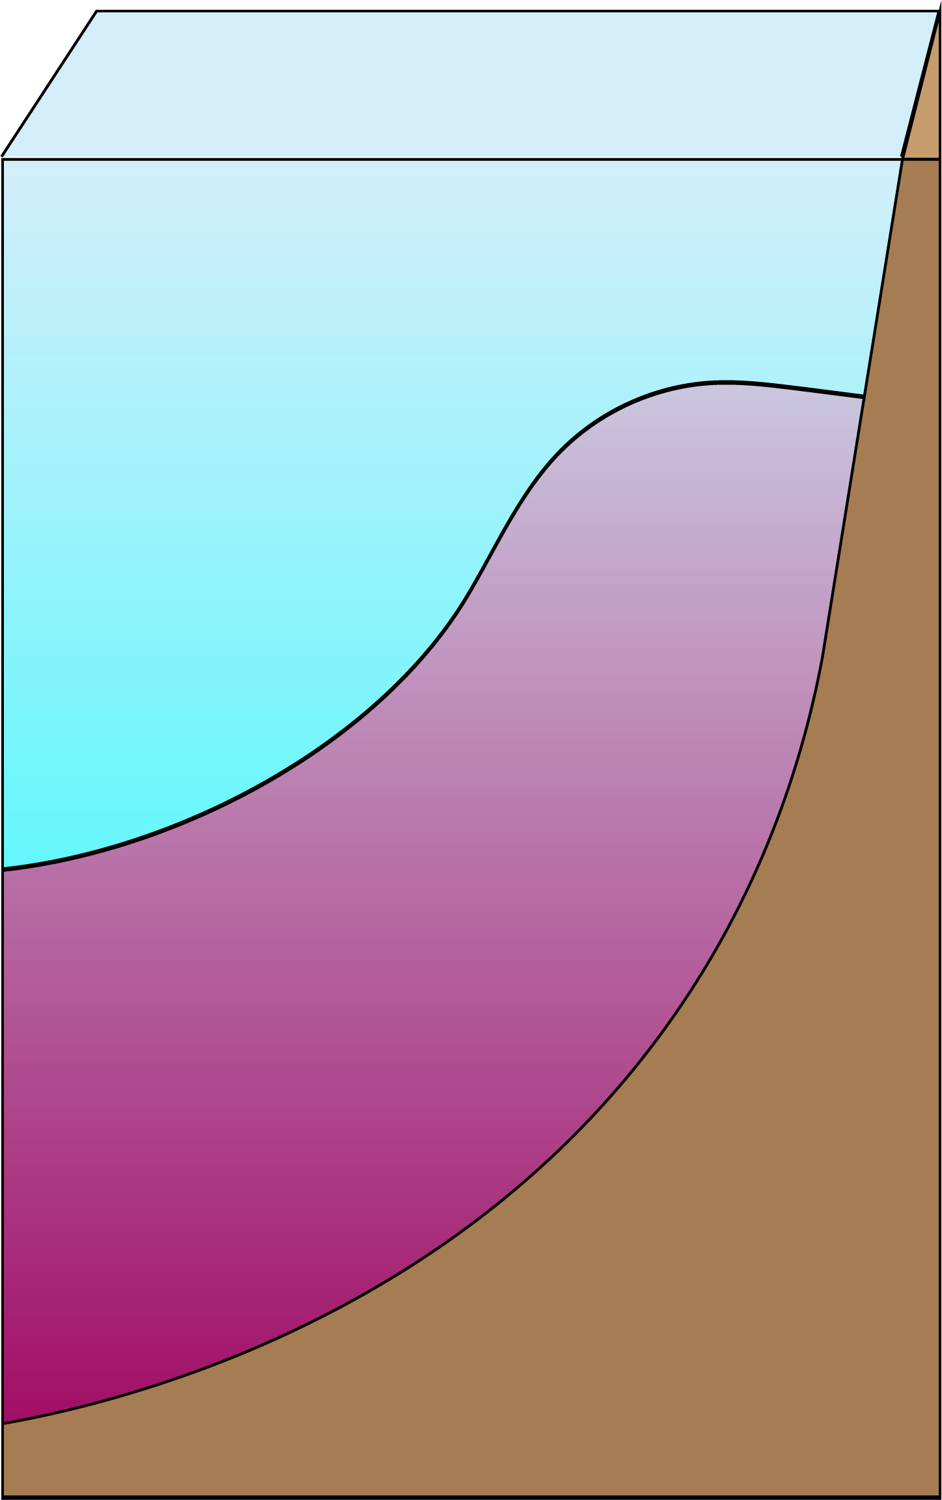
Can “water mass histories” influence the taxonomic and spatial structure of the planktonic community across the front?
Defining some parameters of “water mass histories”:
Source water mass associations
  Plankton may be associated with waters of certain temperature-salinity ranges (California Current, California Undercurrent, etc.)
Notes:
Taxonomic vs. spatial structure...
Simplify title - what can influence the plankton community across the front?
- We are look at all the properties
- Then list them
- So no we will look at each

Slide 26
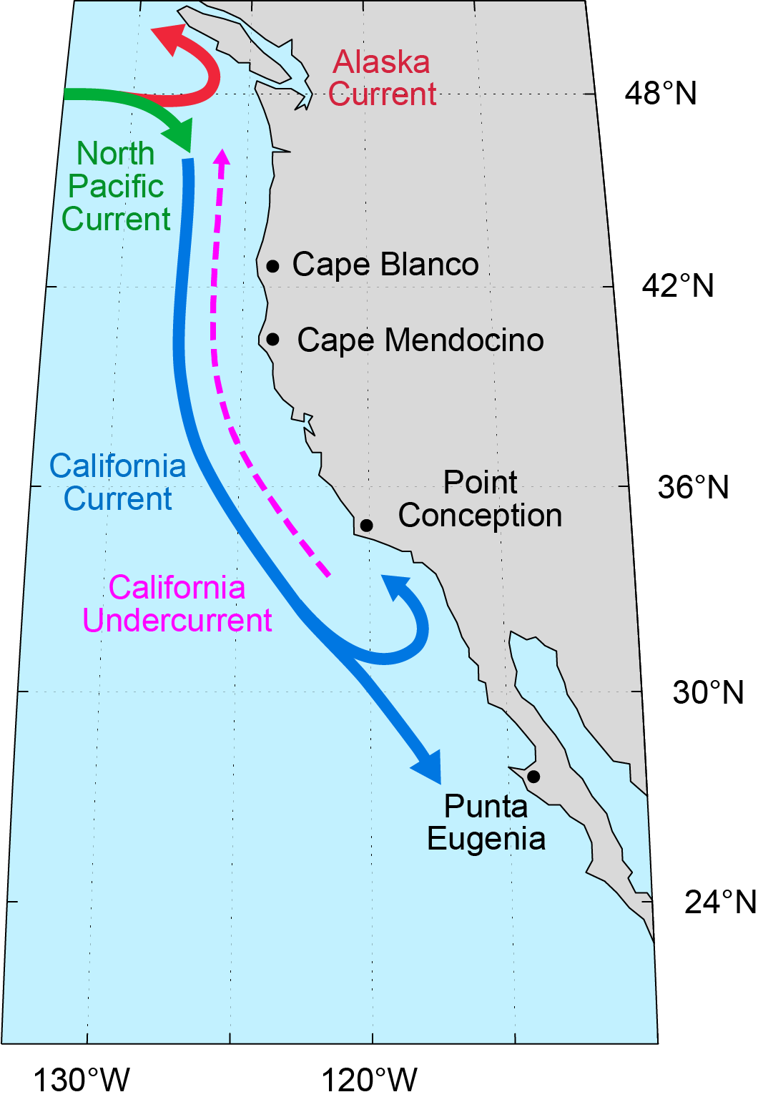
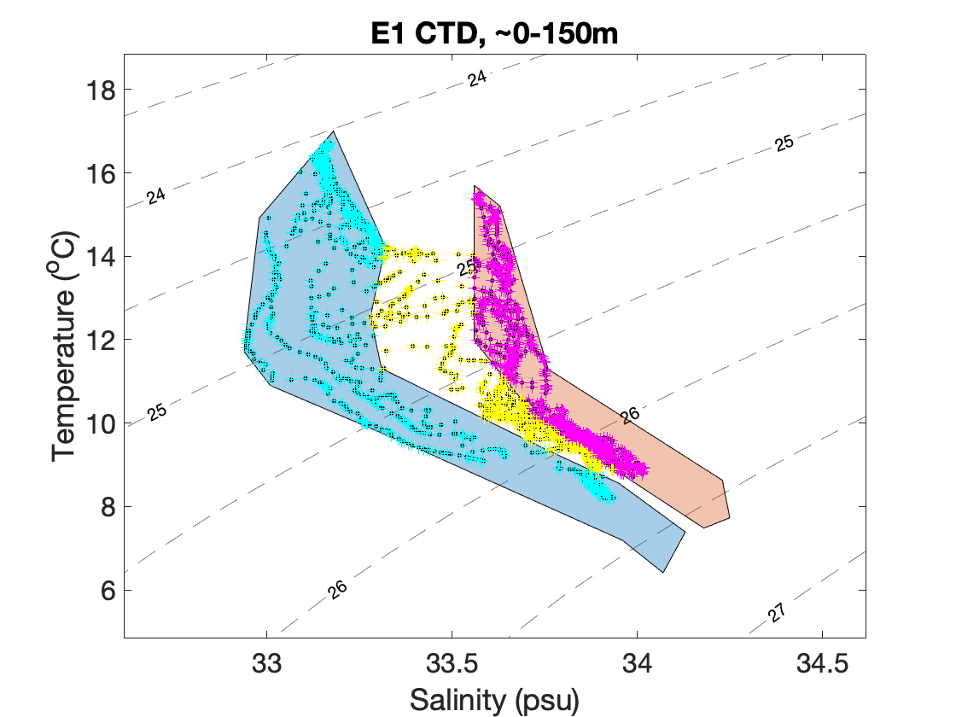
Source water masses: California Undercurrent, California Current, and mixed waters are present across the front
MIX
CU
CC
CC = California Current
CU = California Undercurrent
Gangrade, Mangolte, et al. in prep
Notes:
*** PUT A MAP OF CC AND CU ***
Note: trajectories beyond a few weeks are not as statistically robust (due to random diffusivities, and compounding errors).
Association between biology and the hydrography across the front
CU waters --> inshore origin –> high diatom/medium copepods – biologically rich
CC waters → offshore origin → low diatom/copepods – biologically poor
Mixed CC/CU profiles → convergence → enhanced copepods → biological maximum
#1. diatom rich, nauplii rich , copepod adult poor
#4. ageostrophic nutrient injection, high diatom, low copepod
#2/#4 you don’t know which contribute to the biological patterns - vertical layering/mixing

Slide 27
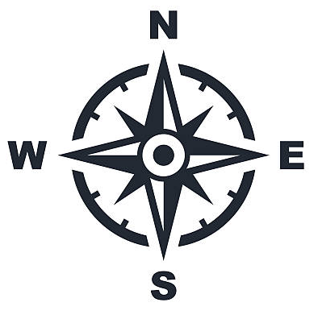
Can “water mass histories” influence the taxonomic and spatial structure of the planktonic community across the front?
Defining some parameters of “water mass histories”:
Source water mass associations
  Plankton may be associated with waters of certain temperature-salinity ranges (California Current, California Undercurrent, etc.)
Geographic origins
  Waters may advect from inshore, offshore, or alongshore regions
Notes:
Taxonomic vs. spatial structure...
Simplify title - what can influence the plankton community across the front?
- We are look at all the properties
- Then list them
- So no we will look at each

Slide 28
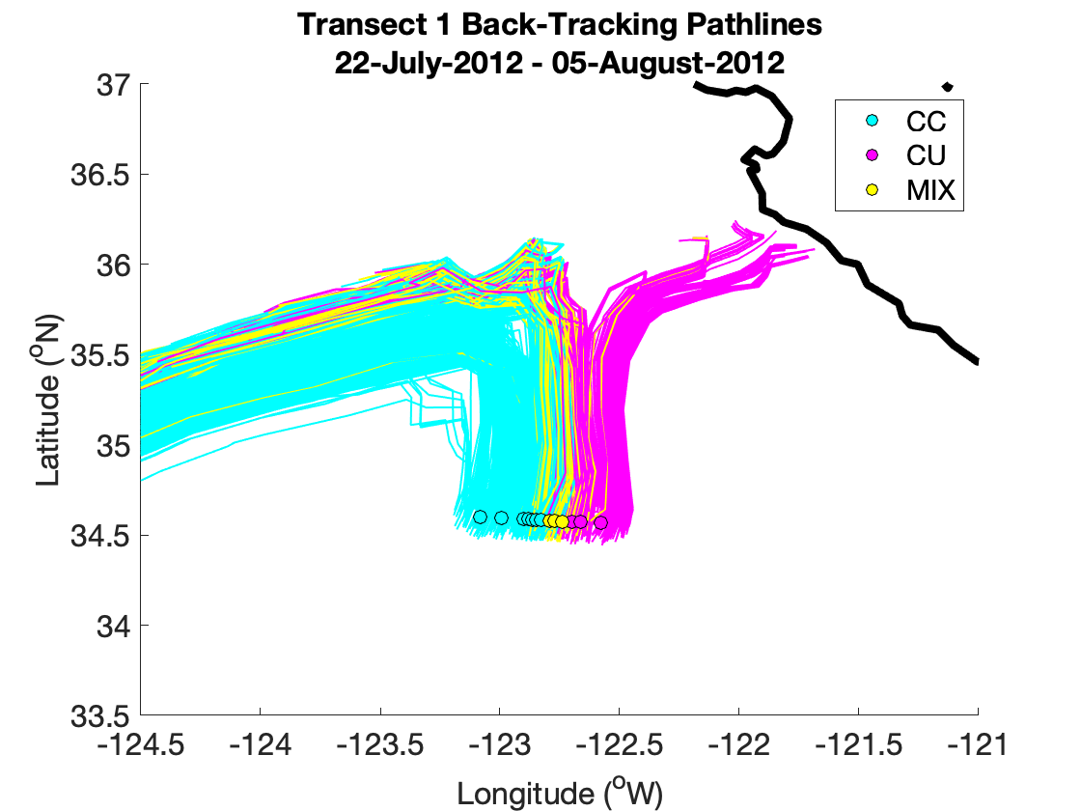
Geographic origins: waters originate from inshore and offshore of the front
Water mass at highest proportion from 0-100 m in each profile.
Offshore origins
Backward in time geostrophic surface trajectories
Inshore origins
(likely linked to coastal wind-driven upwelling)
E1 Transect
Gangrade, Mangolte, et al. in prep
Notes:
*** PUT A MAP OF CC AND CU ***
Note: trajectories beyond a few weeks are not as statistically robust (due to random diffusivities, and compounding errors).
Association between biology and the hydrography across the front
CU waters --> inshore origin –> high diatom/medium copepods – biologically rich
CC waters → offshore origin → low diatom/copepods – biologically poor
Mixed CC/CU profiles → convergence → enhanced copepods → biological maximum
#1. diatom rich, nauplii rich , copepod adult poor
#4. ageostrophic nutrient injection, high diatom, low copepod
#2/#4 you don’t know which contribute to the biological patterns - vertical layering/mixing

Slide 29
Can “water mass histories” influence the taxonomic and spatial structure of the planktonic community across the front?
Defining some parameters of “water mass histories”:
Source water mass associations
  Plankton may be associated with waters of certain temperature-salinity ranges (California Current, California Undercurrent, etc.)
Geographic origins
  Waters may advect from inshore, offshore, or alongshore regions
Horizontal stirring and vertical mixing
  Waters advect along front within several days; they can mix, subduct, and/or layer vertically across the front
Notes:
Taxonomic vs. spatial structure...
Simplify title - what can influence the plankton community across the front?
- We are look at all the properties
- Then list them
- So no we will look at each

Slide 30
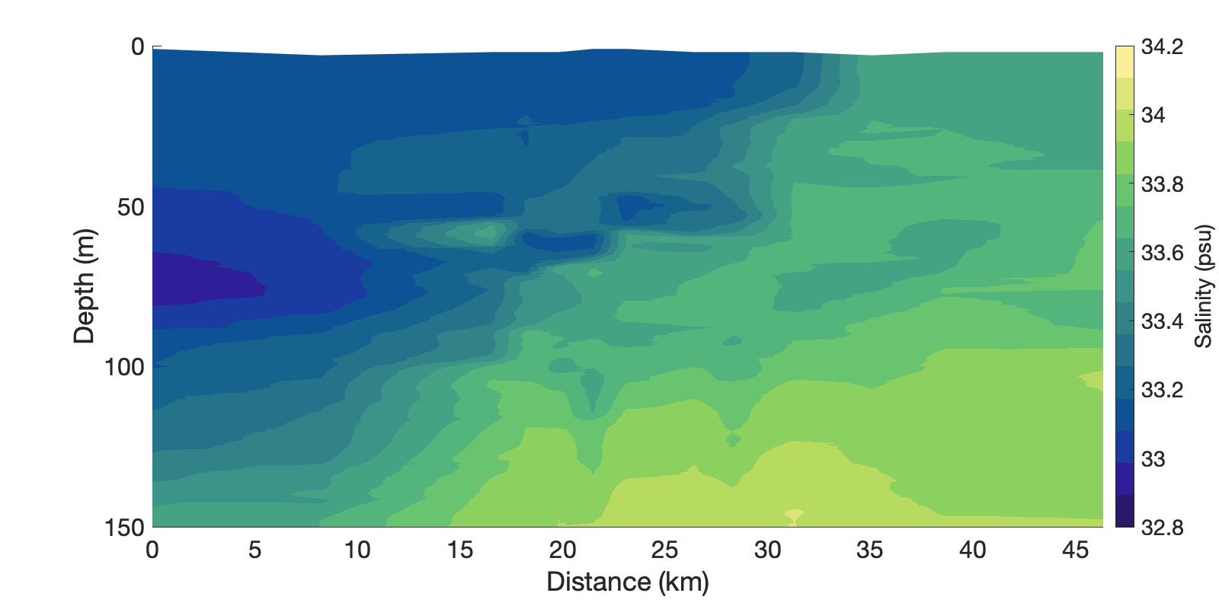
Mixing: vertical layering of distinct water masses across front
Abutment between low salinity and high salinity
Gangrade, Mangolte, et al. in prep
Notes:
Knowing that a single cross-frontal transect does not tell the whole story.

Slide 31
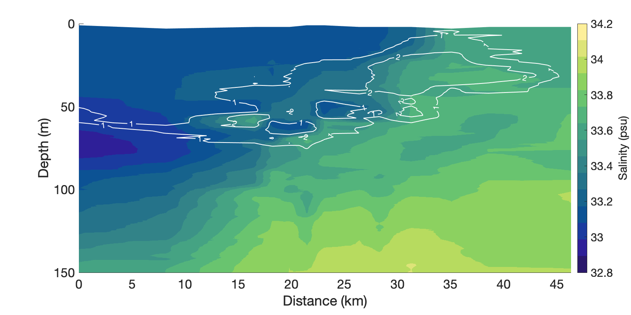
Mixing: vertical layering of distinct water masses across front
High chl a fluorescence is associated with tongues of high salinity (de Verneil et al. 2019)
Gangrade, Mangolte, et al. in prep

Slide 32
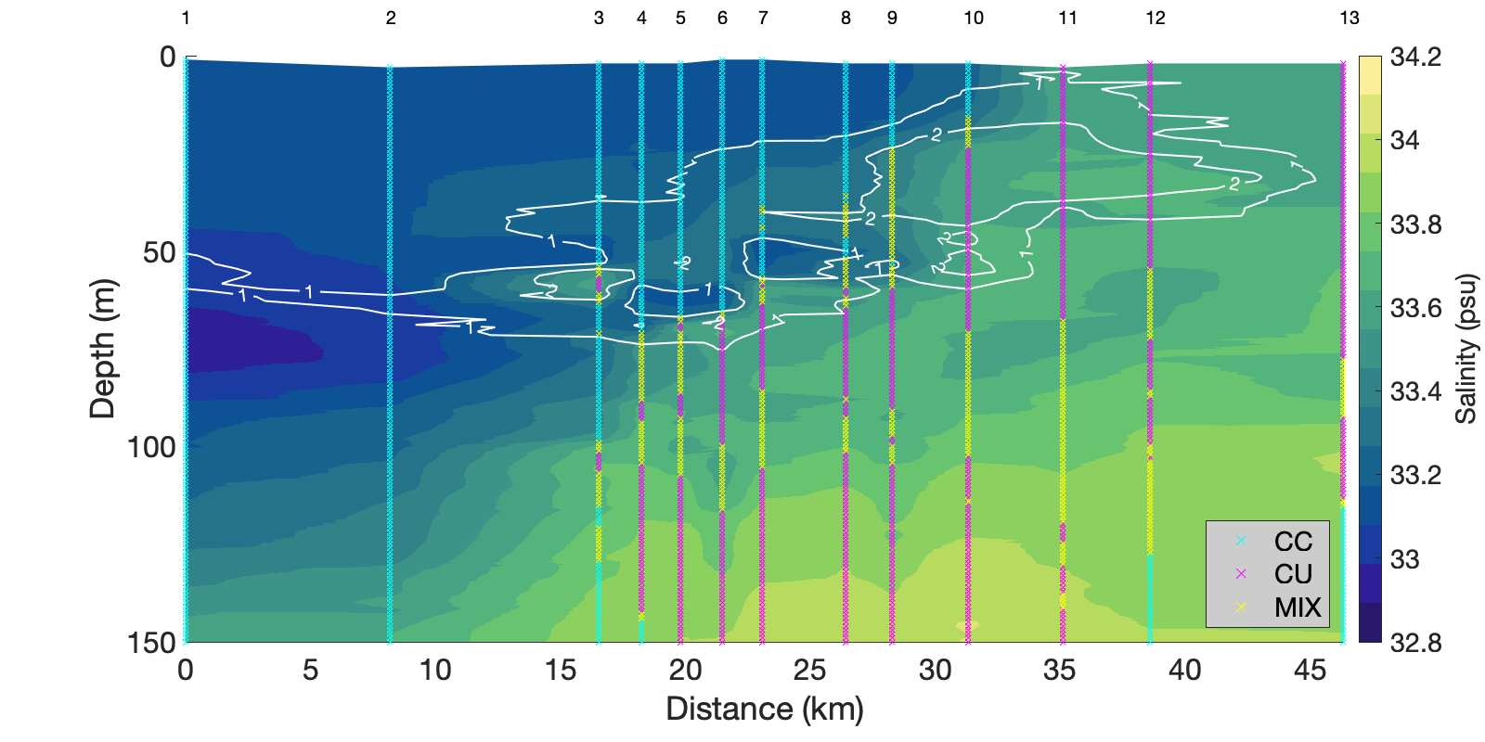
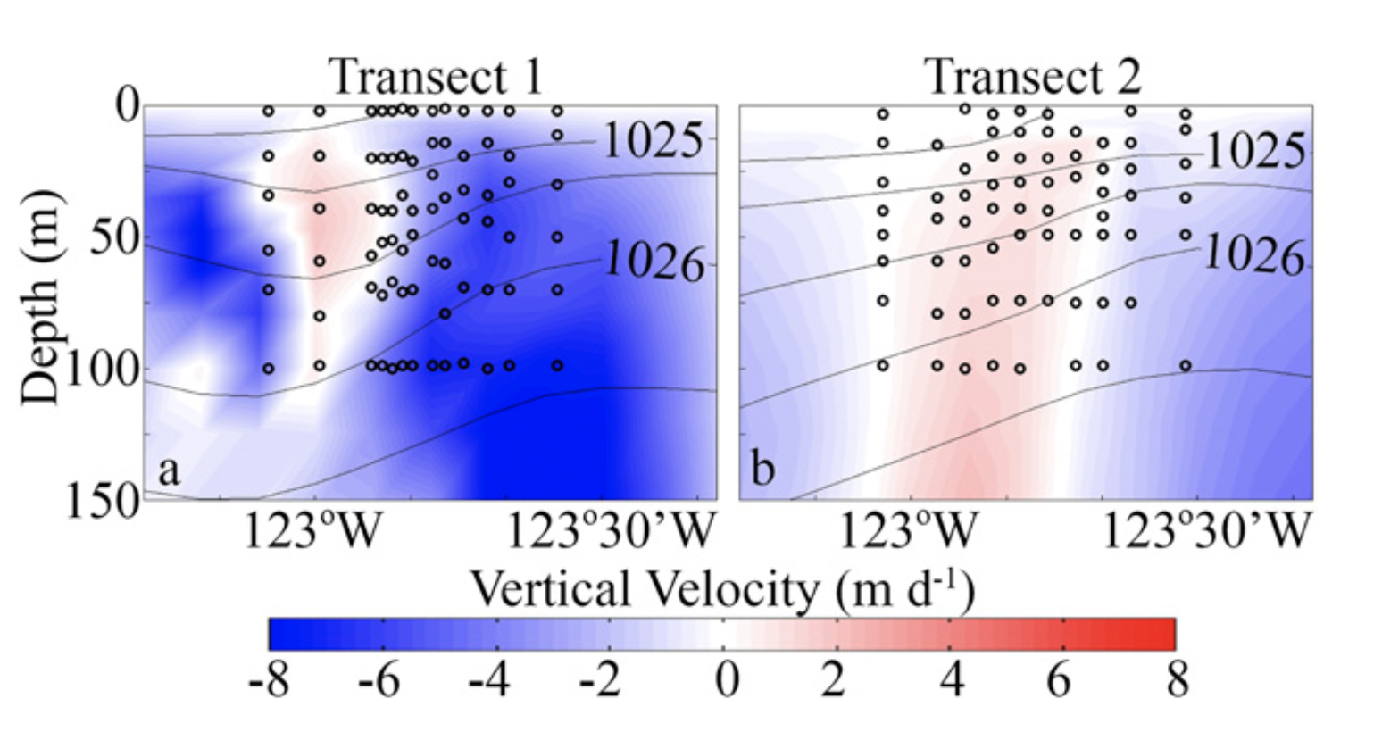
Mixing: vertical layering of distinct water masses across front
MIX
Vertical profiles go through distinct water masses
CU
CC
CC = California Current
CU = California Undercurrent
Stukel et al., 2017
modeled vertical velocities
Gangrade, Mangolte, et al. in prep

Slide 33
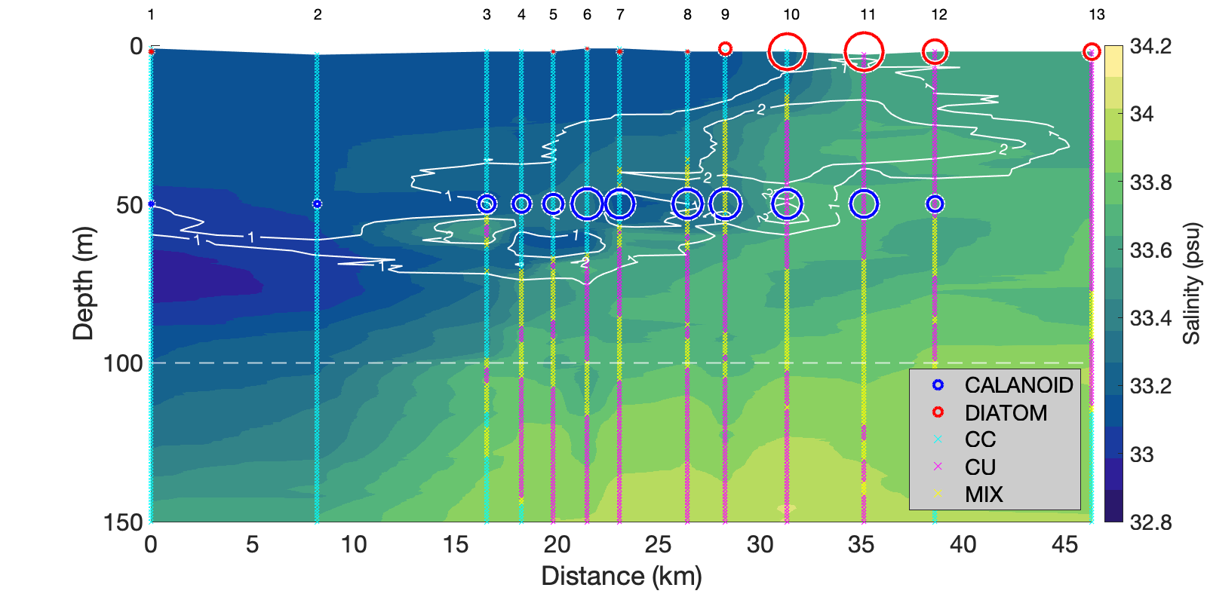
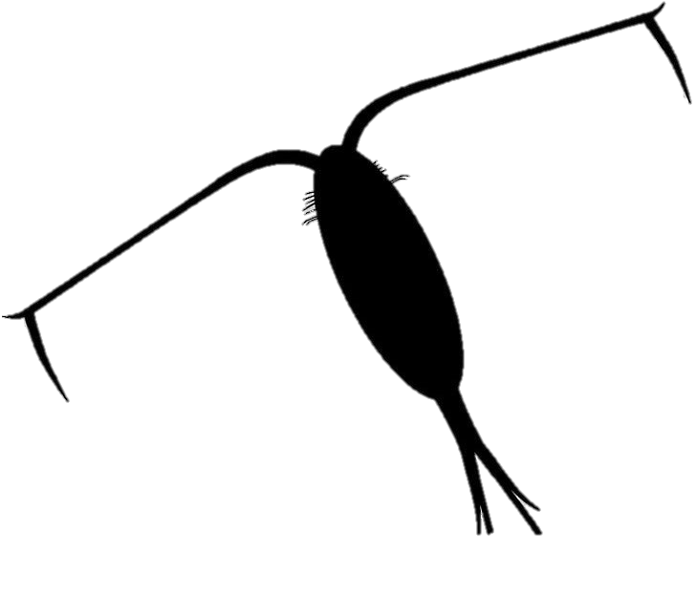
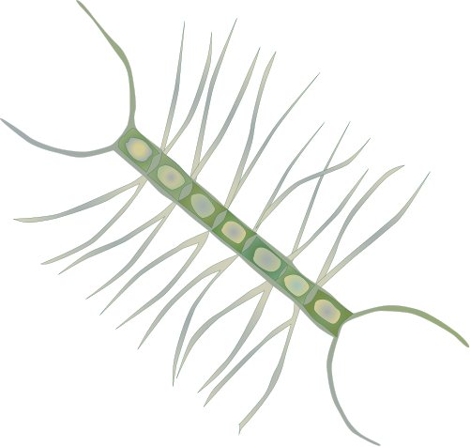
Mixing: vertical layering of distinct water masses across front
Two Trophic Levels
COPEPOD:
Vertically integrated (0-100m) abundances
DIATOM:
Surface abundances
Gangrade, Mangolte, et al. in prep

Slide 34
Can “water mass histories” influence the taxonomic and spatial structure of the planktonic community across the front?
Defining some parameters of “water mass histories”:
Source water mass associations
  Plankton may be associated with waters of certain temperature-salinity ranges (California Current, California Undercurrent, etc.)
Geographic origins
  Waters may advect from inshore, offshore, or alongshore regions
Horizontal stirring and vertical mixing
  Waters advect along front within several days; they can mix, subduct, and/or layer vertically across the front
Time since nutrient injection (“age”)
  Nutrients may enter euphotic zone through coastal wind-driven upwelling, or ageostrophic circulation; nutrients may stimulate phytoplankton growth
Notes:
Taxonomic vs. spatial structure...
Simplify title - what can influence the plankton community across the front?
- We are look at all the properties
- Then list them
- So no we will look at each

Slide 35
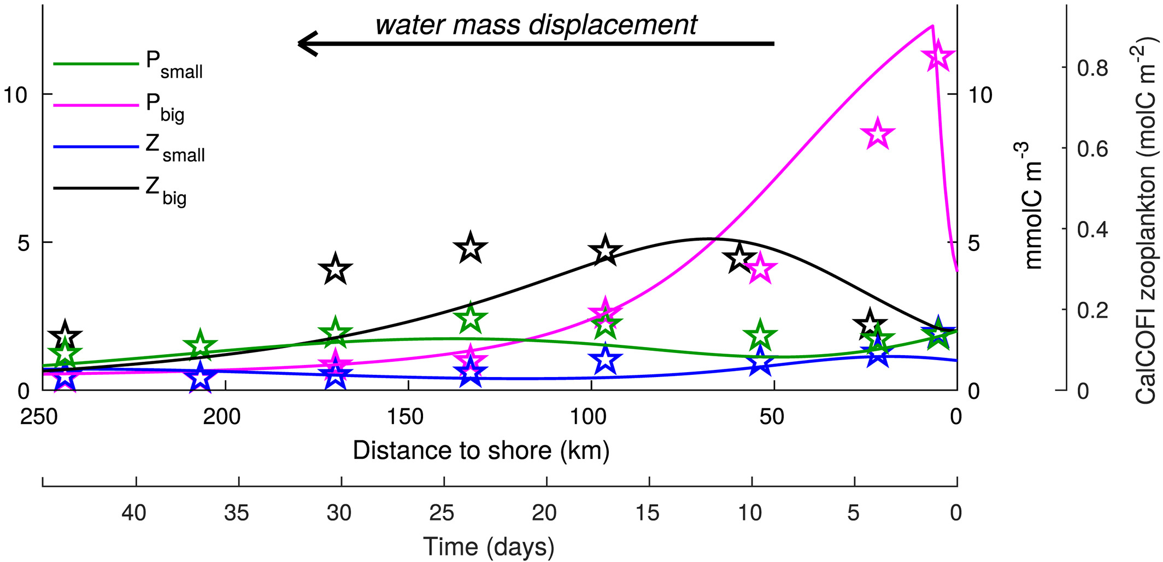
Timing: Diatom and copepod abundances peak at different times
Phytoplankton (big)
Zooplankton (big)
Plankton abundance (different scales)
0 50 100 150 200 250
0 5 10 15 20 25 30 35 40 45
Adapted from Messié & Chavez, 2017

Slide 36
Can “water mass histories” influence the taxonomic and spatial structure of the planktonic community across the front?
Defining some parameters of “water mass histories”:
Source water mass associations
  Plankton may be associated with waters of certain temperature-salinity ranges (California Current, California Undercurrent, etc.)
Geographic origins
  Waters may advect from inshore, offshore, or alongshore regions
Horizontal stirring and vertical mixing
  Waters advect along front within several days; they can mix, subduct, and/or layer vertically across the front
Time since nutrient injection (“age”)
  Nutrients may enter euphotic zone through coastal wind-driven upwelling, or ageostrophic circulation; nutrients may stimulate phytoplankton growth
Notes:
Taxonomic vs. spatial structure...
Simplify title - what can influence the plankton community across the front?
- We are look at all the properties
- Then list them
- So no we will look at each

Slide 37
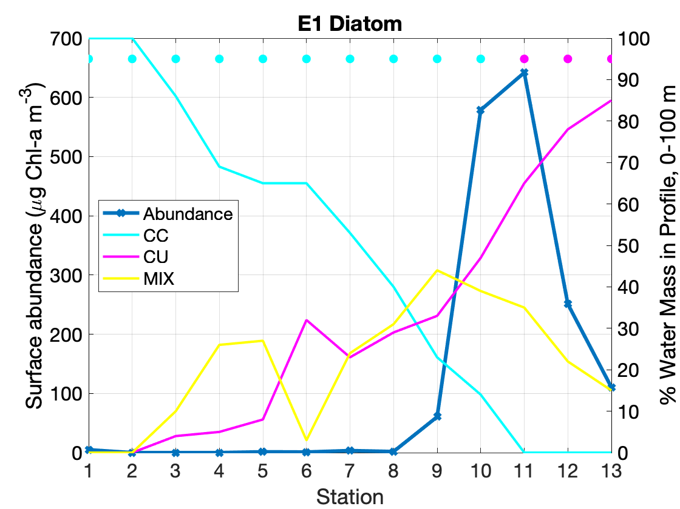
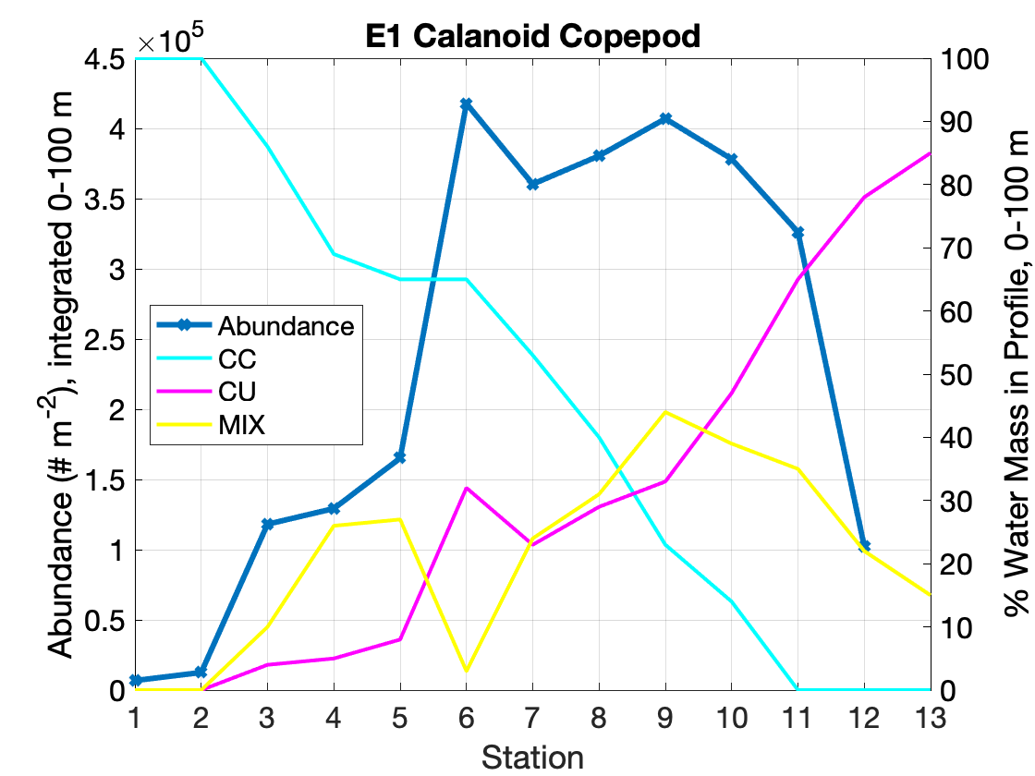
Diatom and copepod abundances across the front reflect water masses with different possible “histories”
offshore
inshore
offshore
inshore
DIATOM
~ 2-3 days doubling time
CALANOID
COPEPOD
~ 1 month generation time (adults)
Gangrade, Mangolte, et al. in prep
Notes:
Association between biology and the hydrography across the front
CU waters --> inshore origin –> high diatom/medium copepods – biologically rich
CC waters → offshore origin → low diatom/copepods – biologically poor
Mixed CC/CU profiles → convergence → enhanced copepods → biological maximum

Slide 38
Diatom and copepod abundances across the front reflect water masses with different possible “histories”
offshore
inshore
offshore
inshore
CU waters = HIGH diatom abundance
Recently upwelled (< 1 month ago)
CC waters = LOW diatom abundance (except St. 10)
Older waters (more time since nutrient injection)
Nutrient poor
CC waters = HIGH diatom abundance (St. 10)
Experienced nutrient injection relatively recently
CU waters = LOW-MEDIUM copepod abundance
Recently upwelled (< 1 month ago)
CC waters = LOW-MEDIUM copepod abundance
Older waters (more time since nutrient injection)
Nutrient poor, biologically poor
MIX waters = HIGH copepod abundance
CU upwelled >=1 month ago and/or CC experienced nutrient injection along trajectory
Gangrade, Mangolte, et al. in prep
Notes:
Association between biology and the hydrography across the front
CU waters --> inshore origin –> high diatom/medium copepods – biologically rich
CC waters → offshore origin → low diatom/copepods – biologically poor
Mixed CC/CU profiles → convergence → enhanced copepods → biological maximum

Slide 39
Trajectories suggest these different possible water mass histories…
Water mass at highest proportion from 0-100 m in each profile.
#2. CU / MIX waters from old upwelling (> 1 month)
Diatom abundant?
Copepod rich
#4. CC waters with local nutrient injection
Diatom abundant?
Copepod rich
#1. CU waters from coastal wind-driven upwelling
Diatom rich
Copepod poor
#3. CC waters from offshore oligotrophic regions
Diatom poor
Copepod poor
E1 Transect
Gangrade, Mangolte, et al. in prep
Notes:
** The note on the slides **
Trajectories are helpful because you can constrain things better.
Conclusion...
Note: trajectories beyond a few weeks are not as statistically robust (due to random diffusivities, and compounding errors).
Association between biology and the hydrography across the front
CU waters --> inshore origin –> high diatom/medium copepods – biologically rich
CC waters → offshore origin → low diatom/copepods – biologically poor
Mixed CC/CU profiles → convergence → enhanced copepods → biological maximum
#1. diatom rich, nauplii rich , copepod adult poor
#4. ageostrophic nutrient injection, high diatom, low copepod
#2/#4 you don’t know which contribute to the biological patterns - vertical layering/mixing

Slide 40
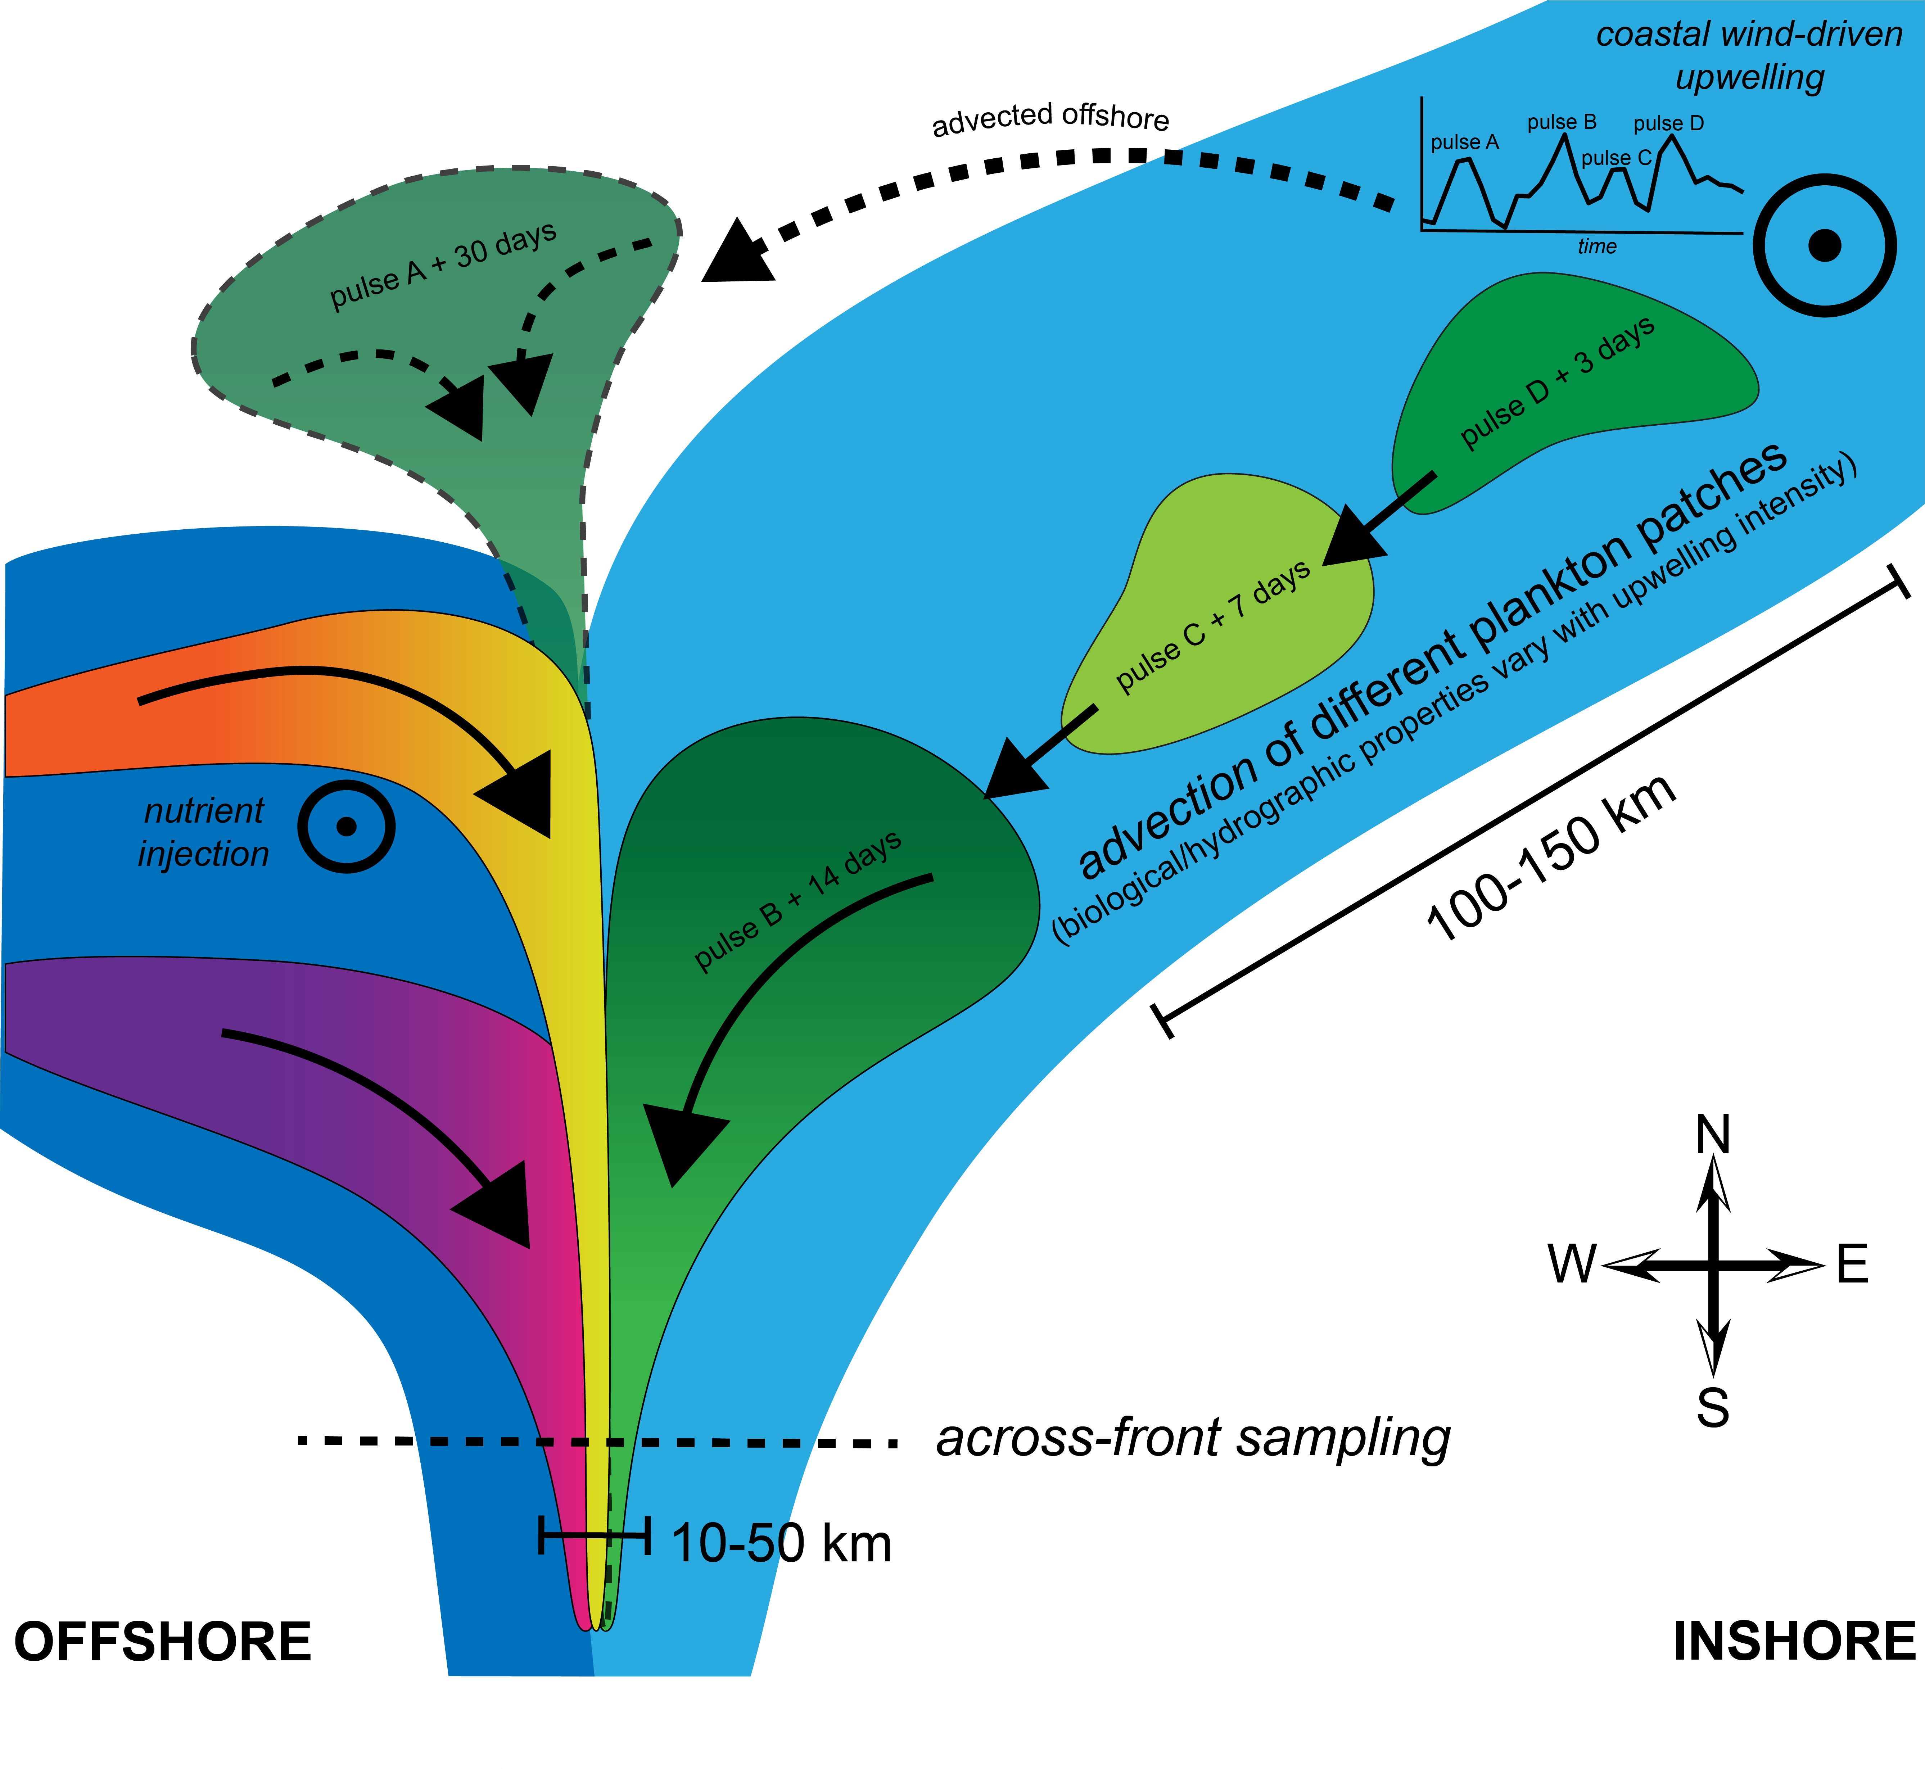
Complex “water mass histories” influence planktonic community structure across the front.
Timing matters.
Vertically resolved plankton measurements are needed to investigate further.
But, temperature-salinity properties + trajectories (spatial and temporal) help understand the origins of the water masses at the front.
Future work will investigate spatial structure of additional taxa & planktonic life stages in relation to water mass histories.
DIATOM
COPEPOD
Gangrade, Mangolte, et al. in prep
Notes:
Given what we know about along-front patchiness and upstream links to coastal wind-driven upwelling, we can now reframe our hypotheses regarding patterns in biological community structure across this same front…
Vertical integrated → SAMPLING THROUGH MULTIPLE COMMUNITIES
The spatial and temporal pathways of waters determine community structure.
Understanding the advection histories of water masses (their trajectories) offers insight on the spatial and temporal origins of the community structures, which are independent of in situ frontal processes

Slide 41
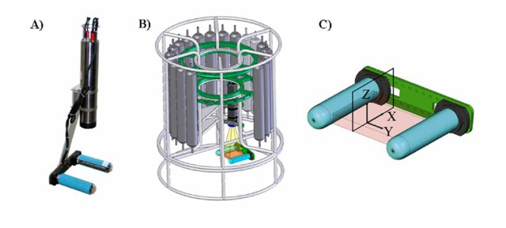
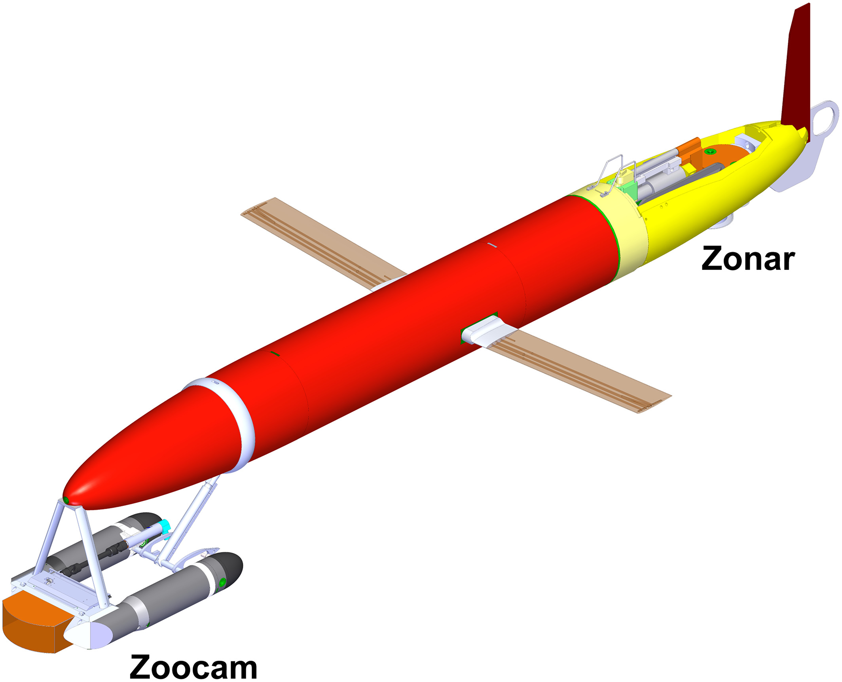
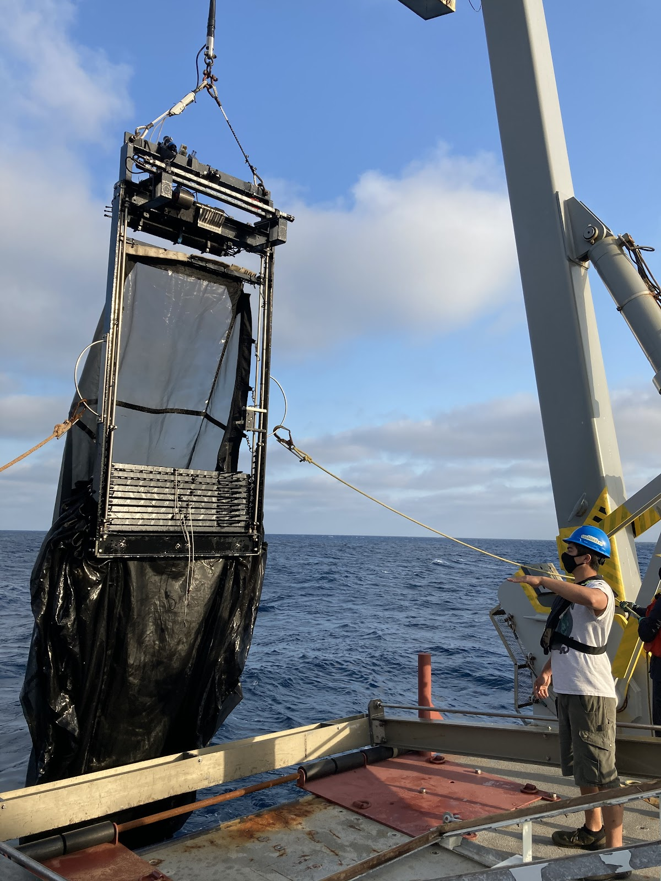
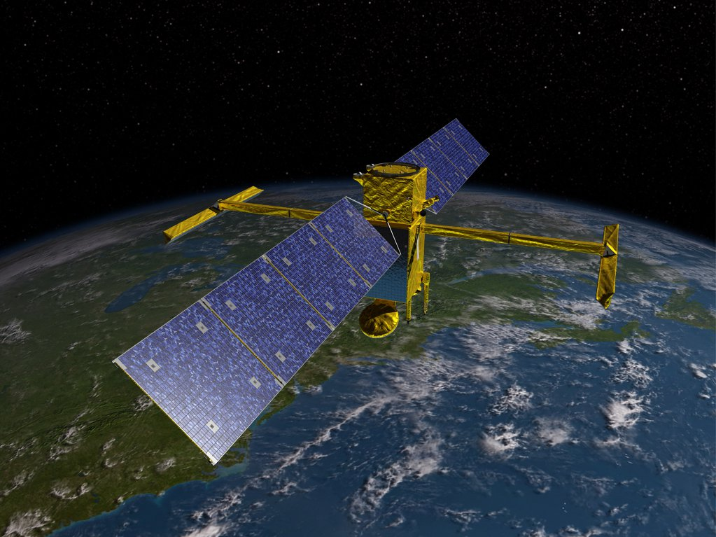
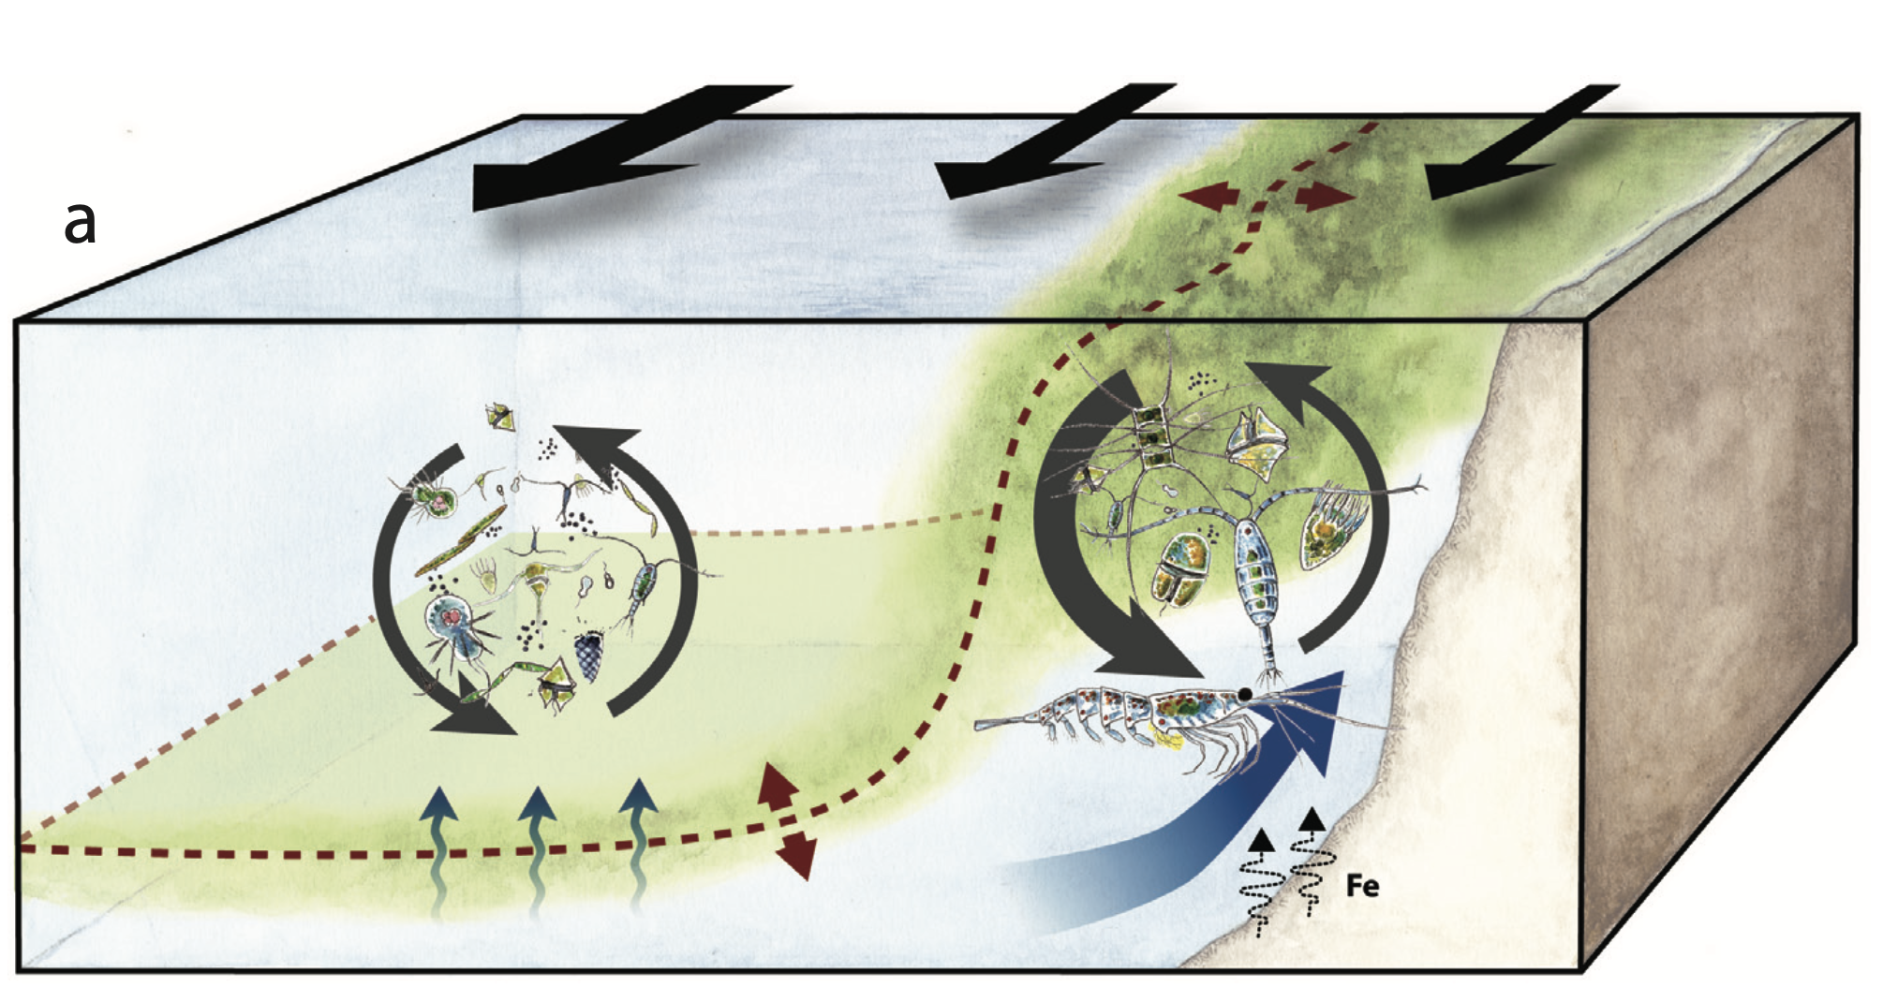
Takeaway Messages
We must sample fronts on fine scales: horizontally, vertically, temporally, and taxonomically
  Biological scales can be as fine or finer than the hydrographic scales, and people don’t typically sample them properly
  Finer sampling will allow us to gain insights into physical-biological coupling and emergent community structures that we cannot resolve using spatially averaged samples
Finescale observations and analyses will allow us to better estimate horizontal and vertical carbon fluxes and help parametrize carbon flux models
  These biogeochemical fluxes can inform climate change modeling
CCE LTER, Picheral et al., 2010; Ohman et al., 2019; NASA JPL
Ohman et al., 2013
Notes:
(Improve scaling metrics – the diatom-rich, carbon-flux important proportion may be quite small at the front)
*** Better mechanistic understanding to better understand the functioning of fronts (to generalize).
*** Satellites are useful – we need a mechanistic understanding.

Slide 42

Acknowledgments
Special thanks to:
My coauthors: Inès, Marina, & Peter
Crew and scientists on CCE LTER P1208 Cruise (data collection)
Alain de Verneil, Mark Ohman, and David Jensen for help with data processing
The Franks Lab and CCE LTER students/postdocs for support and feedback
Image credits: Tracey Saxby, Integration and Application Network (ian.umces.edu/media-library), Flanders Marine Institute, CCE LTER, CalCOFI, B. Inman
Notes:
Thank these sources of support. And especially Peter Franks, the Franks lab, Alain de Verneil, Mark Ohman, and Dave Jensen.

Slide 43
Relevant (upcoming) publications:
Gangrade & Franks, in review. Upwelling pulses make phytoplankton patches: observations and implications in the California Current System. Journal of Geophysical Research: Oceans.
Mangolte et al., in prep. Multi-trophic planktonic cross-frontal patchiness in the California Current Ecosystem.
Gangrade, Mangolte, et al., in prep. Submesoscale biological patchiness at fronts reflect water mass histories: evidence and mechanisms.

Slide 44
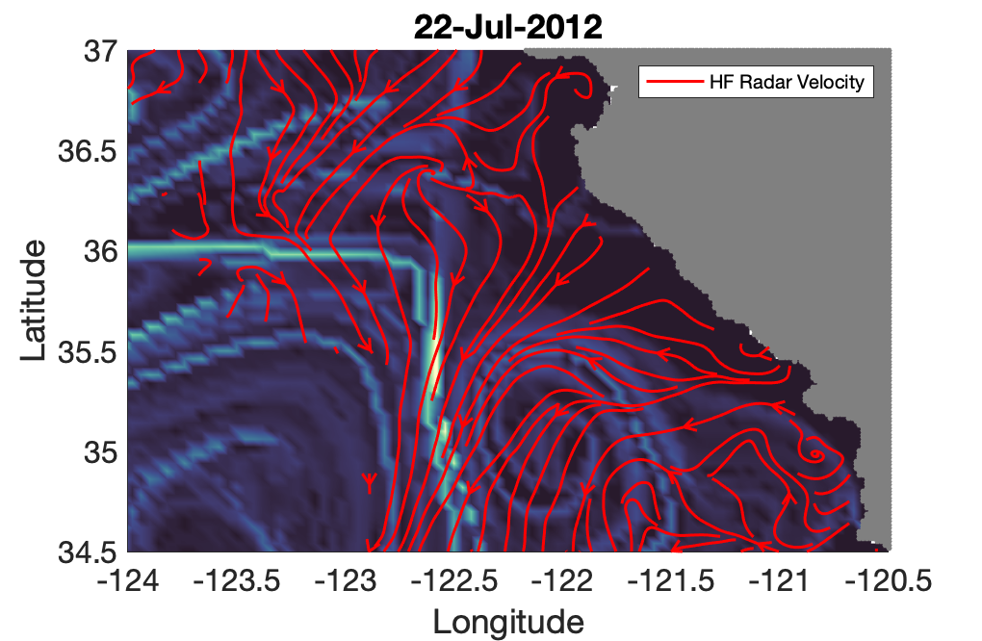
HF Radar Data Comparison
SCCOOS and CeNCOOS operate 62 HF radars along California's coast.
Daily-averaged hourly, 6-km HF radar surface currents

Slide 45
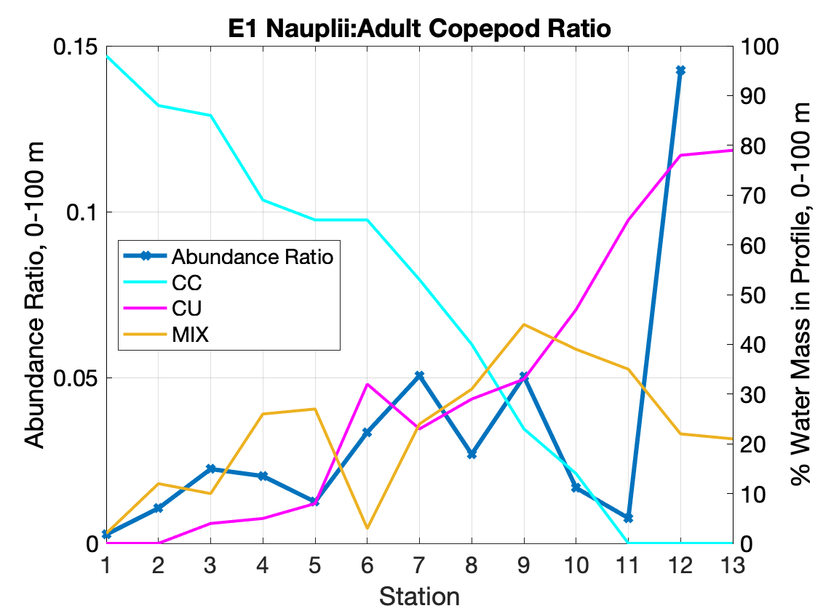
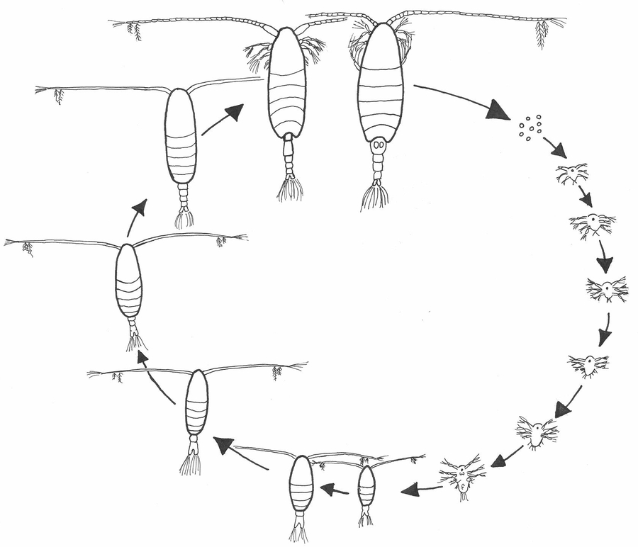
Adult
Egg
Copepodite
Nauplius
NMFS NOAA

Slide 46
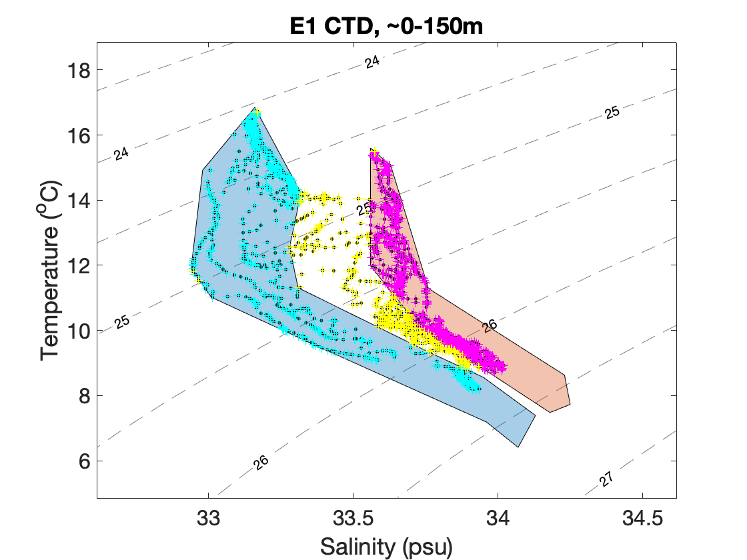
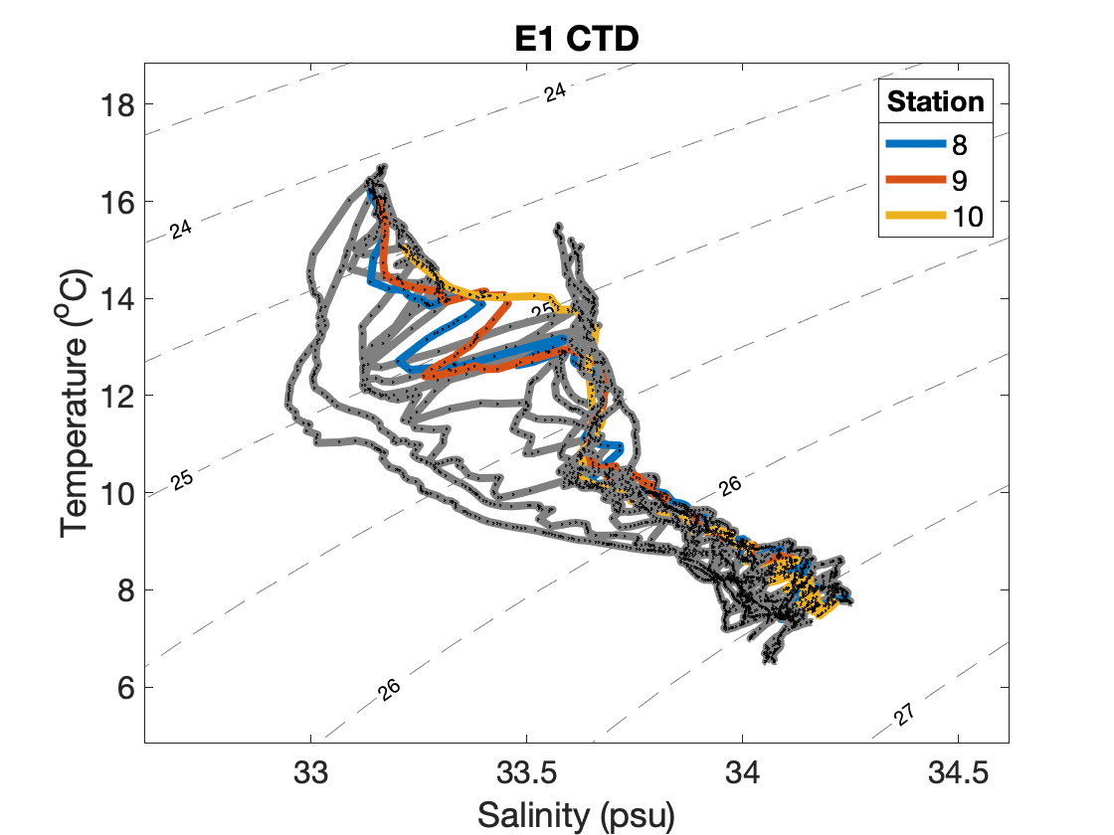
Hydrography: looking at vertical profiles in T-S space
MIX
CU
CC
Vertical profiles cross through different layers of water masses
Vertical shear processes must be involved in this layering
Gangrade, Mangolte, et al. in prep
Notes:
Waters that are sampled veritcally, just 10s of m apart, can be different water masses.

Slide 47
Messié & Chavez, 2017

Slide 48
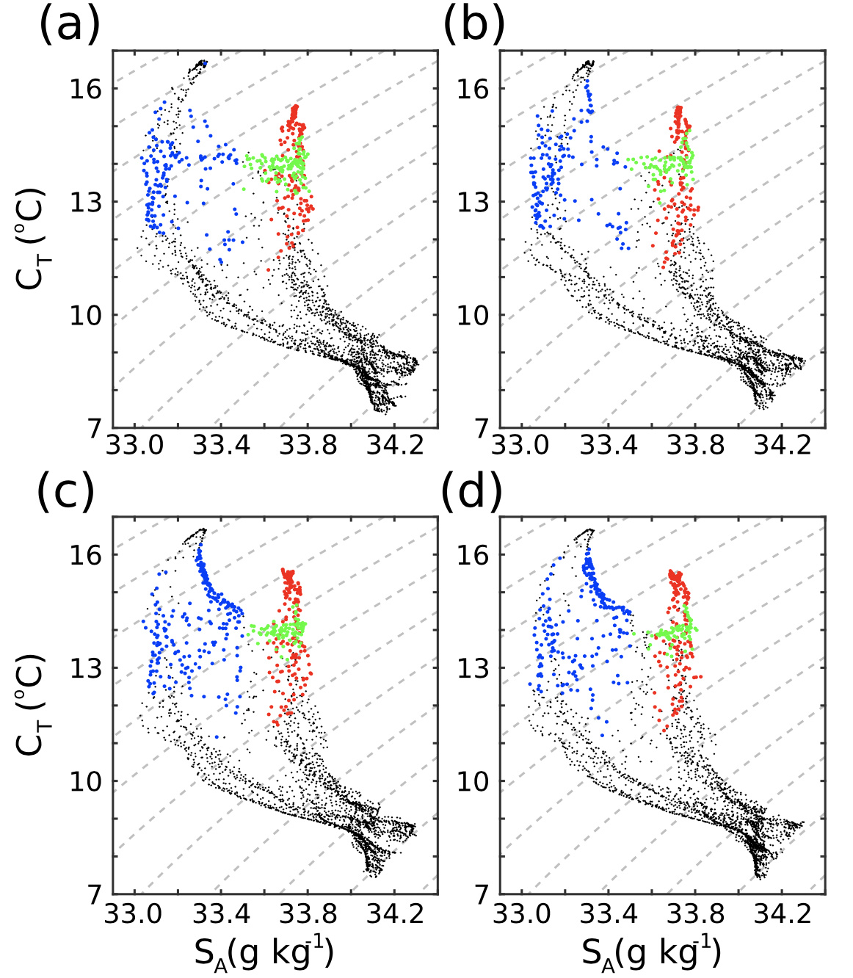
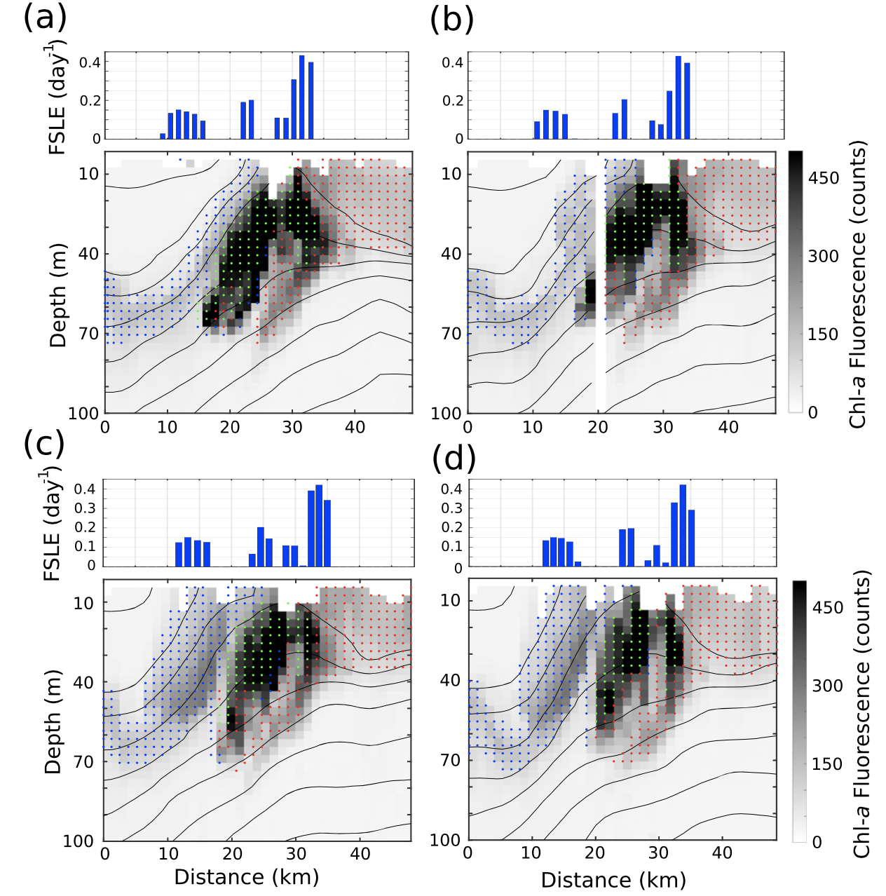
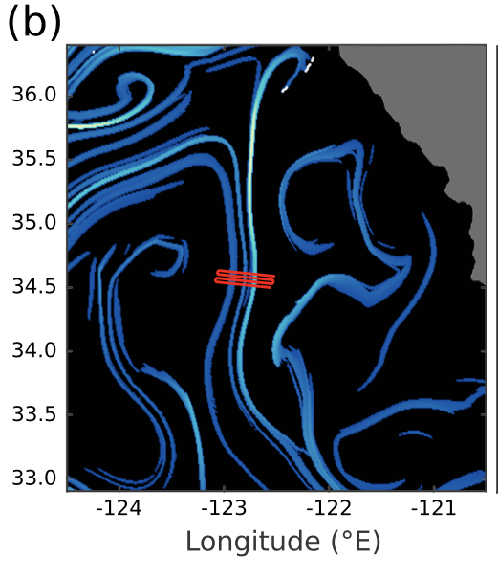
Evidence of fine-scale phytoplankton patches
Tilting & layering of high chlorophyll tongues
Inshore properties, inshore trajectory
Inshore properties, offshore trajectory
Offshore properties, offshore trajectory
“offshore properties”: lower salinity
“inshore properties”: higher salinity
CU
CC
CC = California Current
CU = California Undercurrent
de Verneil et al., 2019

Slide 49
Abbreviated Abstract
In 2012, sampling of a mesoscale front in the California Current System revealed elevated plankton biomass at the front. However, by investigating frontal patchiness at finer scales than previously studied, we find that this front exhibited sub-mesoscale biological and hydrographic patchiness both along and across the front, as well as vertical layering of distinct water masses. Source-water trajectories using altimetry-derived velocities and coastal upwelling indices reveal that these water mass pathways determine planktonic community structure: upwelling pulses make phytoplankton patches, and patches converge at the front from both inshore and offshore – with different properties. Such fine-scale gradients allow us to reinterpret frontal dynamics and demonstrate the need for higher-resolution sampling.

