Slide 1
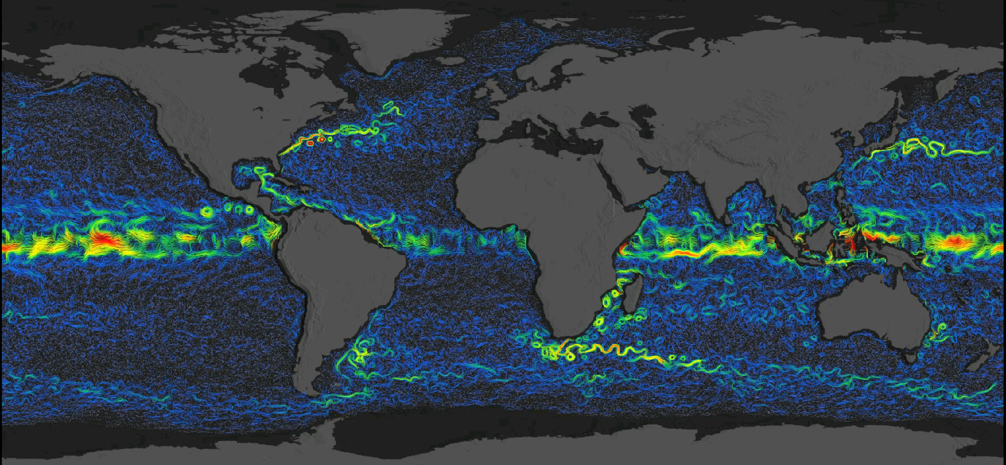
ODYSEA: Ocean Dynamics and Surface Exchange with the Atmosphere: Winds and currents satellite concept
Sarah Gille (SIO/UCSD, sgille@ucsd.edu)
and the ODYSEA science team (Tony Lee, Justin Boland, Fabrice Ardhuin, Mark Bourassa, Paul Chang, Sophie Cravatte, Tom Farrar, Melanie Fewings, Gregg Jacobs, Florent Lyard, Jackie May, Elisabeth Rémy, Lionel Renault, Ernesto Rodriguez, Clément Ubelmann, Bia Villas Bôas, Alex Wineteer, Zorana Jelenak)
Earth and Space Research OSCAR Product: https://www.esr.org/research/oscar/additional-information/

Slide 2
Earth System Explorer Program
New NASA line of medium-class competed spaceflight missions, recommended by the 2017 Earth Decadal Survey
Seven solicited “Targeted Observable” categories
ODYSEA responds to the “Ocean Surface Winds and Currents” category
2017 Earth Decadal Survey
2

Slide 3
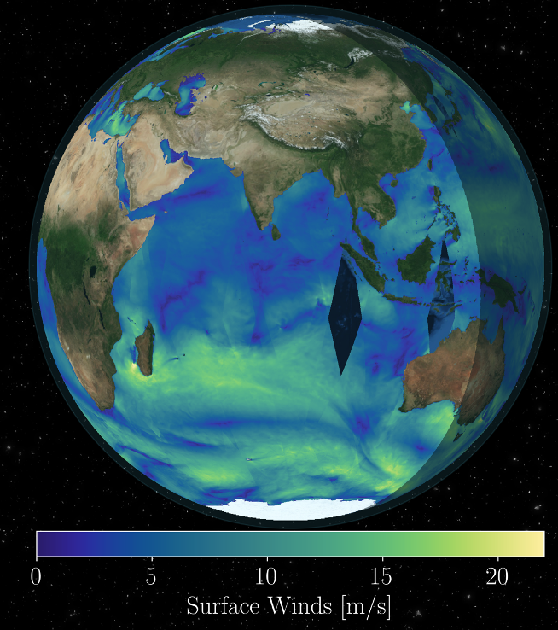
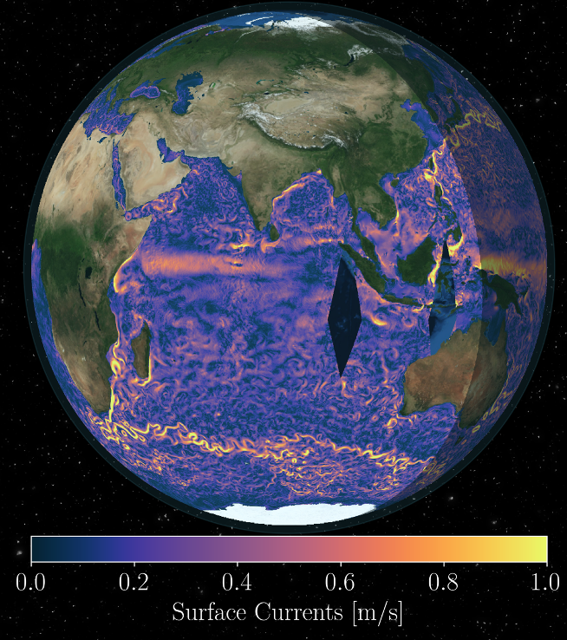
ODYSEA Overview
ODYSEA fulfills a longstanding Earth Science community goal by providing the first-ever measurements of ocean currents from space and the first simultaneous measurements of winds and currents. These are fundamental to understanding how energy is transferred between two major components of Earth’s system: the ocean and atmosphere.
Ocean Surface Winds
Ocean Surface Currents
+
3

Slide 4
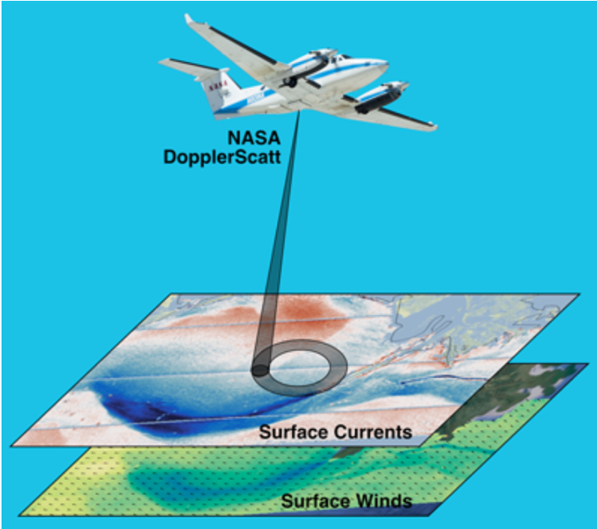
Doppler Scatterometry Principles
A wide swath is achieved using a rotating “pencil beam”
Wind measurement as in traditional scatterometry; e.g., QuikSCAT
Velocity measurement from Doppler shifts from different look directions
Measurement principle similar to coastal HF-radar (or police radar guns)
Both measurements are achieved with a single Ka-band radar instrument

Slide 5
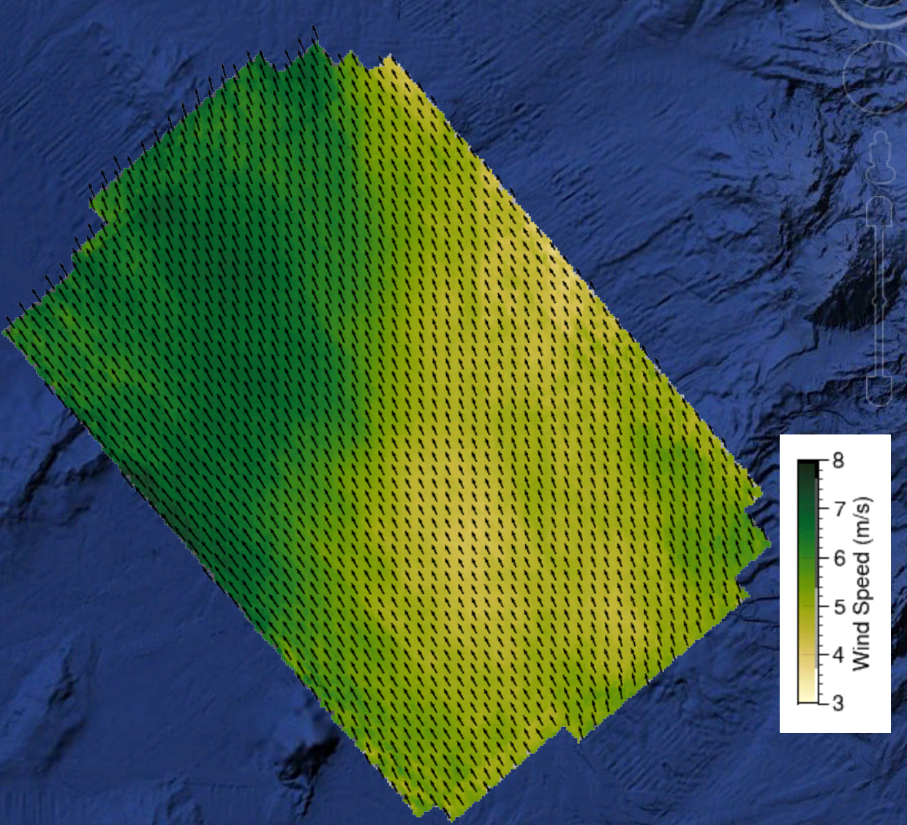
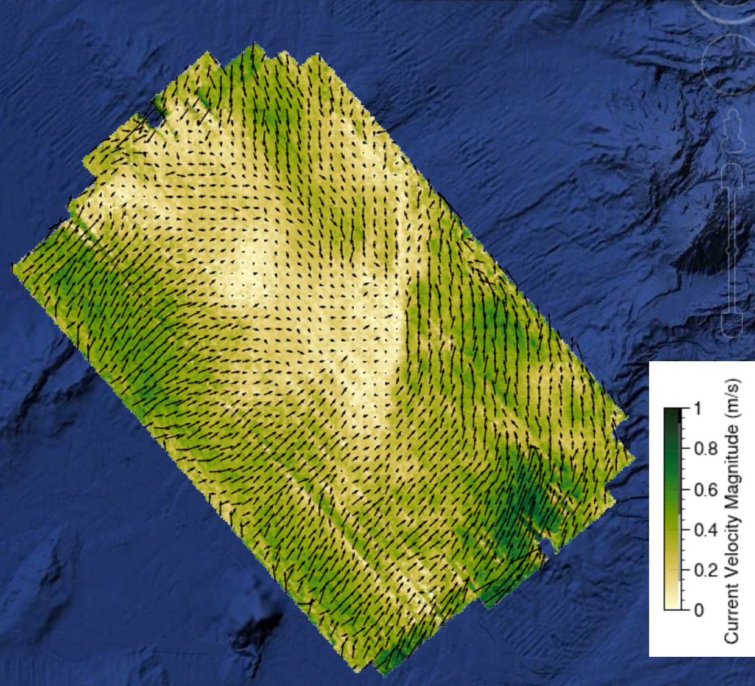
Doppler Scatterometry Enables High-Resolution Measurements Over Large Areas not Feasible with Other Existing Sensors
Ocean Surface Winds
Ocean Surface Currents
*Quick-look data not calibrated or optimally processed

Slide 6
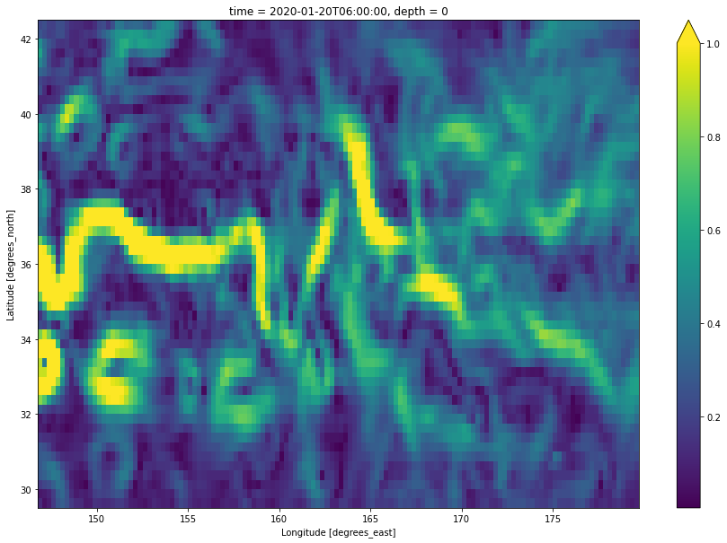
What we gain: Fine-scale currents
NOW: GlobCurrent observational product
200 km resolution
Weekly sampling

Slide 7
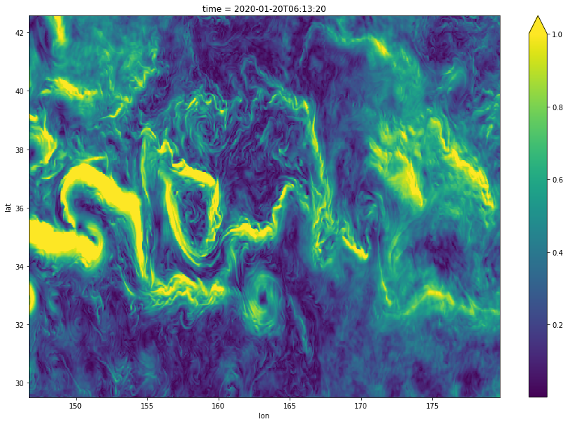
What we gain: Fine-scale currents
NOW: GlobCurrent observational product
200 km resolution
Weekly sampling
ODYSEA resolution (MITgcm at 1/24° resolution)
25 km resolution
Daily sampling

Slide 8
What we gain: Daily global wind coverage
ASCAT coverage:
550 km swath;
25 km resolution

Slide 9
What we gain: Daily global wind coverage
ASCAT coverage:
550 km swath;
25 km resolution
ODYSEA coverage:
1700 km swath (more like QuikScat)
5 km resolution

Slide 10
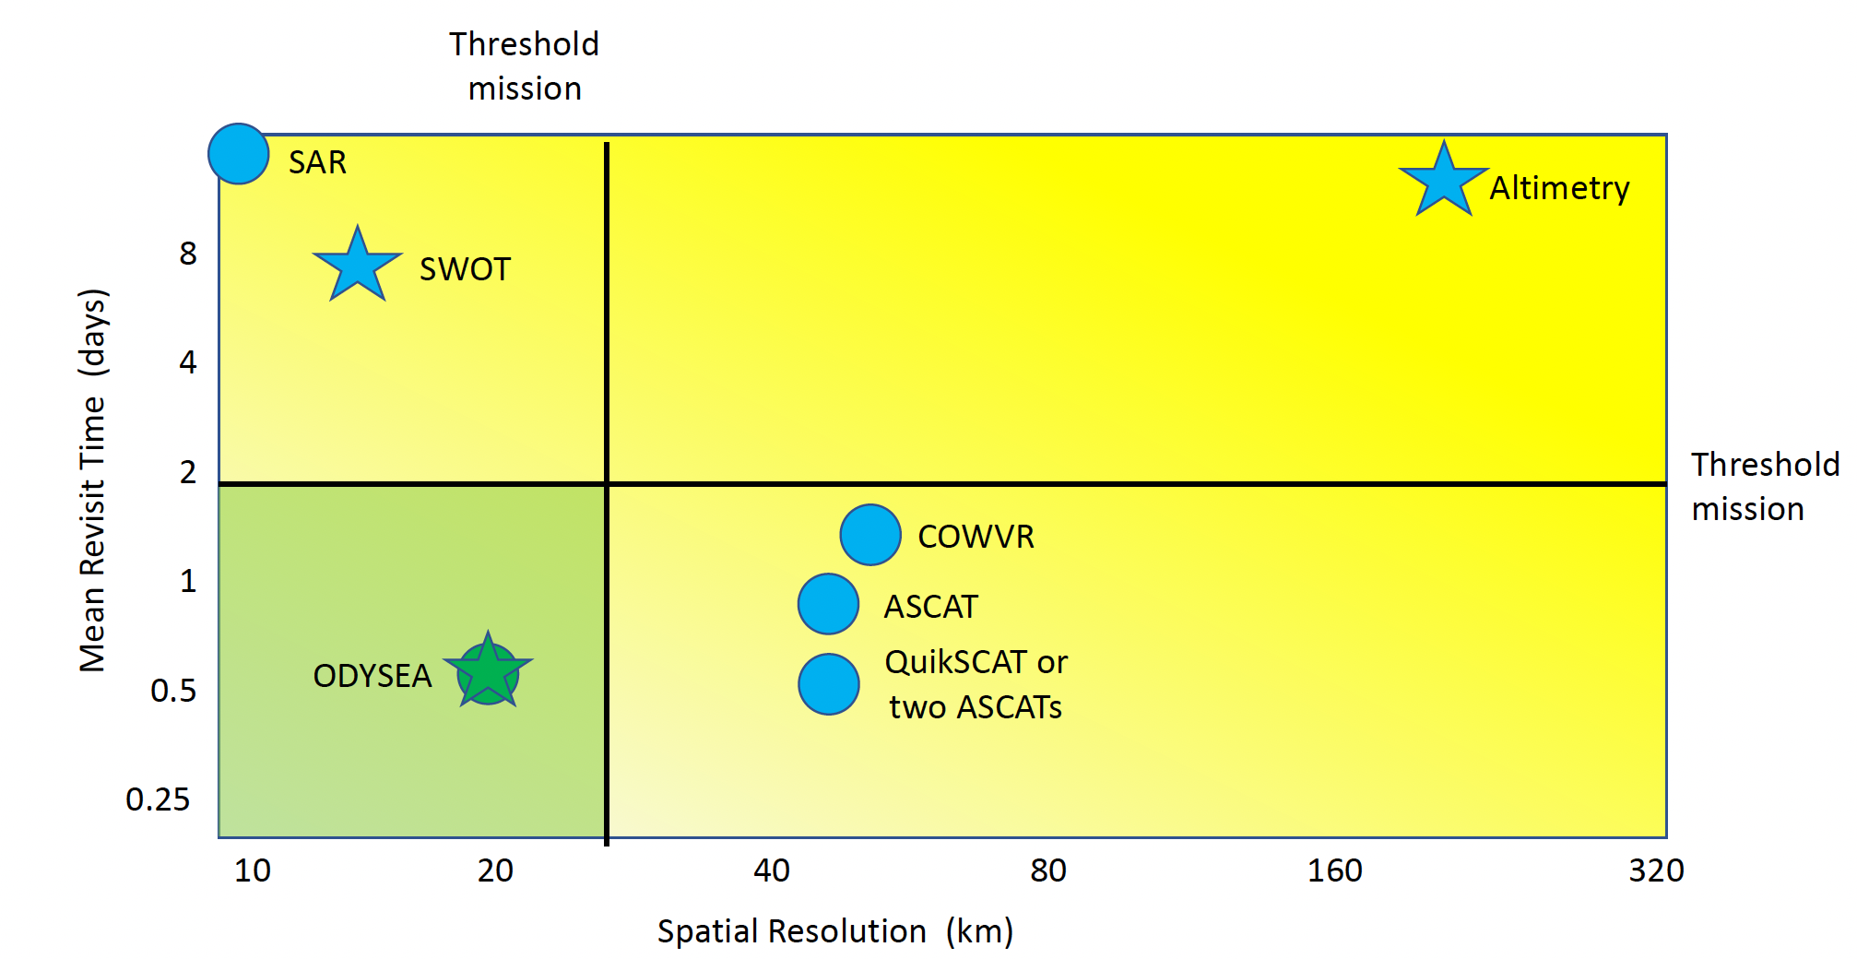
New territory with ODYSEA
Threshold mission
5 10 20 40 80 160 320
Threshold mission
Spatial Resolution (km)
Currents
Wind
Resolution is feature resolution rather than wavelength resolution.

Slide 11
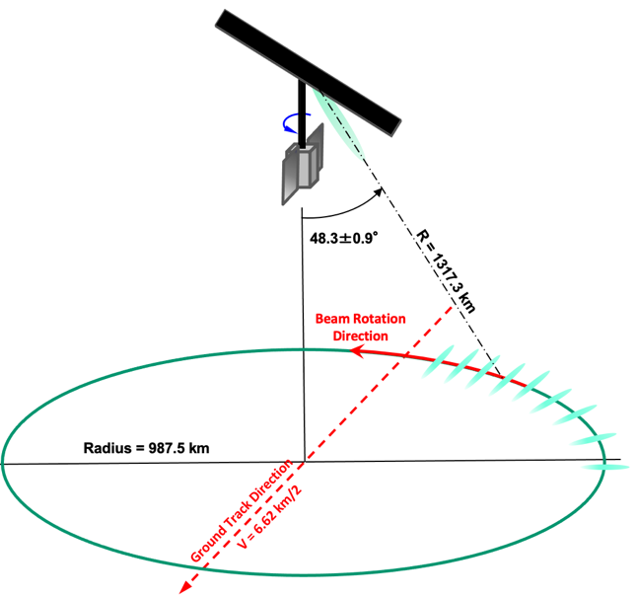
ODYSEA Mission Overview
There are no sensors in orbit that measure total surface currents
There are no US operational sensors that measure winds, and existing sensor constellation needs additional sensors to sample changing winds.
Scaling DopplerScatt to space fills both of these needs
90% global coverage < 1 day (2x/day in many places)
650 km sun-synchronous terminator (6am/6pm) orbit
Capability for near-real time ocean wind and currents data products (<6 hour latency)
Intend to serve Near Real-Time data products to operational agencies (Navy, NOAA, Air Force)

Slide 12
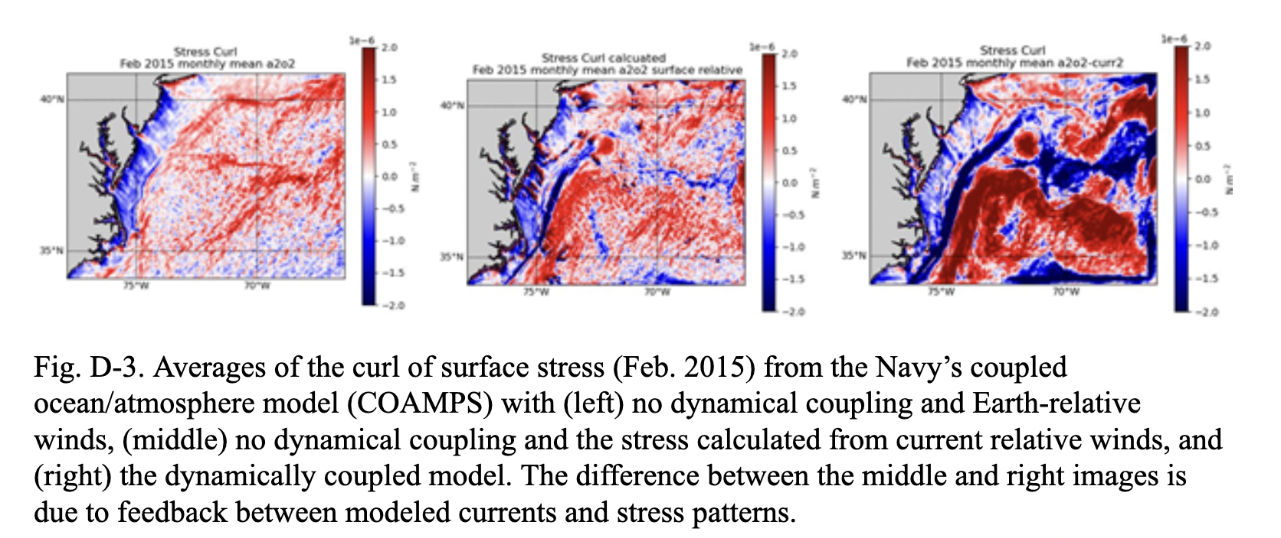
ODYSEA Science Questions (working version)
Coupled winds and currents: How do winds drive currents, and how do currents drive winds?
Currents: How do ocean currents respond to changing winds, given varying background stratification?

Slide 13
Science objectives: 1. Coupled winds and currents
What governs the momentum exchange between the atmosphere and the ocean?
What scales matter?
Transient component of ”wind work”.
(Flexas et al, JGR-Oceans, 2019)

Slide 14
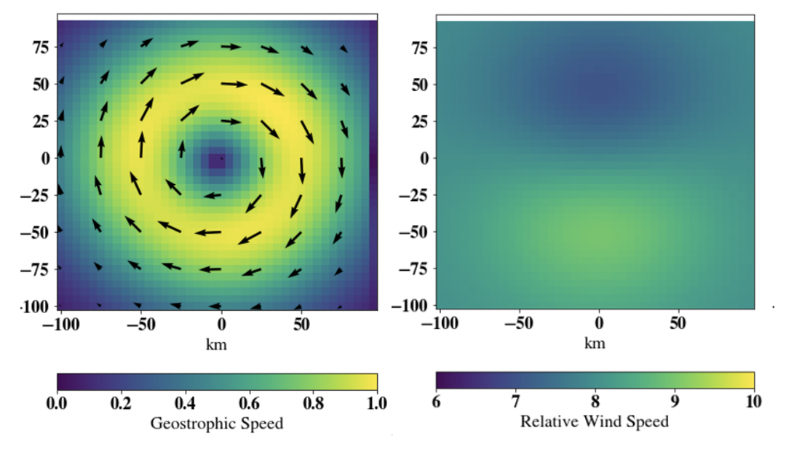
Science objectives: 1. Coupled winds and currents
Uniform wind
Eddy
Relative wind
Weaker
When do winds drive the ocean? Can wind “kill” eddies?
When does the ocean drive the atmosphere? Do surface currents shape the profile of winds in the atmospheric boundary layer?
Stronger
(See for example Renault et al 2016, 2017)

Slide 15
Coupled processes fuel atmospheric convection
May and Bourassa, 2022

Slide 16
Science objectives: 2. Ocean currents
What are the relative roles of narrow filaments compared with large-scale flows?
What are the relative roles of geostrophic and Ekman currents?
Quantify mechanisms that transport heat, freshwater, nutrients, larvae, and debris within the surface ocean.
Earth and Space Research OSCAR Product: https://www.esr.org/research/oscar/additional-information/

Slide 17
Science objective: 2. Currents on the equator
Observational gap in the tropics: Geostrophy breaks down at the Equator and drifters diverge off the equator
How does wind drive Equatorial circulation?
What spatial scales matter for off-equatorial divergence?
Animation by Clément Ubelmann using Mercator Glorys 1/12 simulation

Slide 18
Is the upper ocean accelerating as stratification increases?
Hypothesis: for a given wind condition, shallow summer mixed layers coincide with faster surface velocities.
(Wunsch, JPO 2020;
See also Peng et al, Science Advances, 2022)

Slide 19
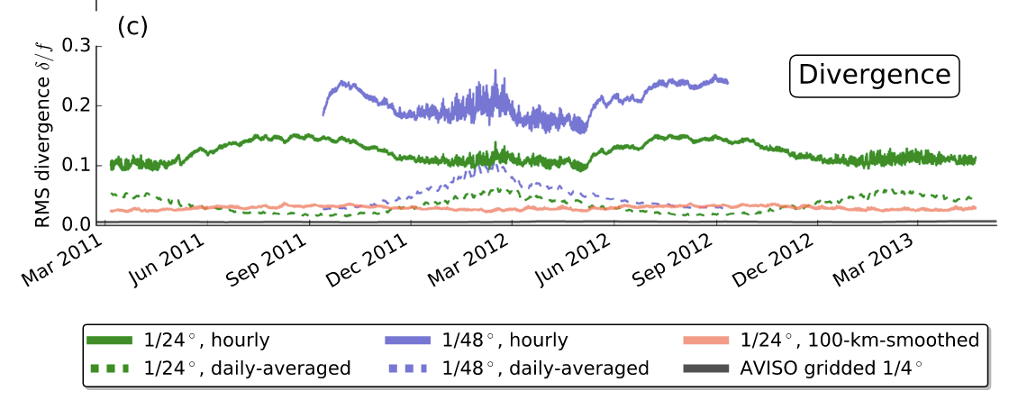
Or seasonal sub-mesoscale dynamics govern velocity?
Kuroshio Extension submesoscale motions energized in late winter/spring
Divergence out of phase in hourly vs daily fields, implying that timescale matters.
Available potential energy lower in summer due to stratification.
Rocha et al, GRL, 2016

Slide 20
Applications: Better atmosphere and ocean predictions
Assimilation to improve knowledge of current state
Ocean currents: search and rescue, tracking oil spills, fisheries management, Navy operations,
Atmosphere: sub-seasonal to seasonal weather forecasts
Helber et al, 2020, DOI: 10.1109/IEEECONF38699.2020.9389362

Slide 21
ODYSEA 1-day sample data products

Slide 22
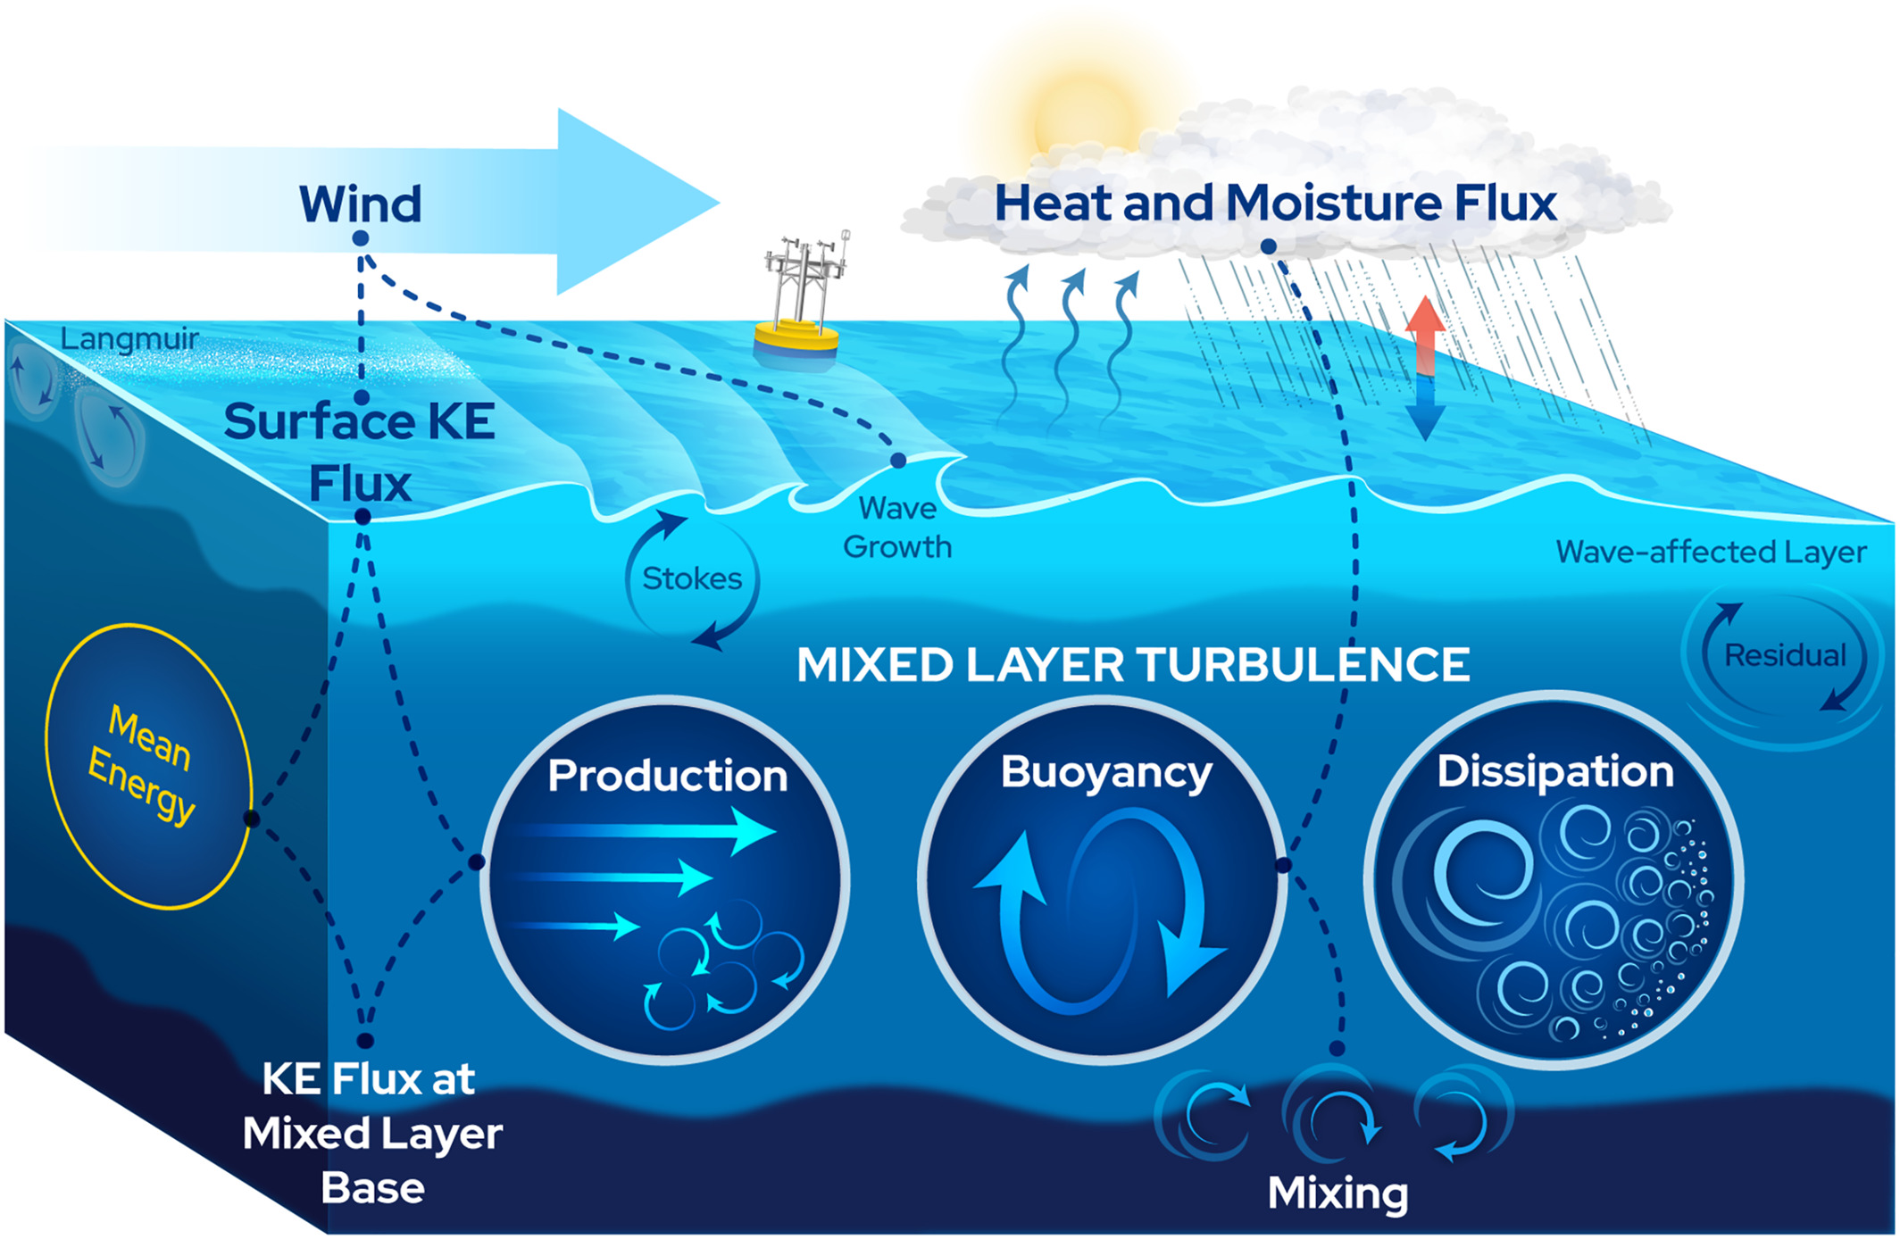
Join the discussion
ODYSEA needs to be a community effort that builds on the best ideas
ODYSEA proposal expected to be joint between JPL and CNES, with involvement from NOAA and Navy and with industry partners supplying spacecraft
Webinar Tuesdays at 8 am Pacific time/11 am Eastern/5 pm CET
Next talk, Tuesday September 6th (Patrice Klein, Caltech)
Informal format: one talk plus discussion
Sign up with our form: https://forms.gle/WBzfZh1Y2mFKgPmx6
Parsing the kinetic energy budget of the ocean surface mixed layer (Zippel et al, GRL, 2022)

