Slide 1
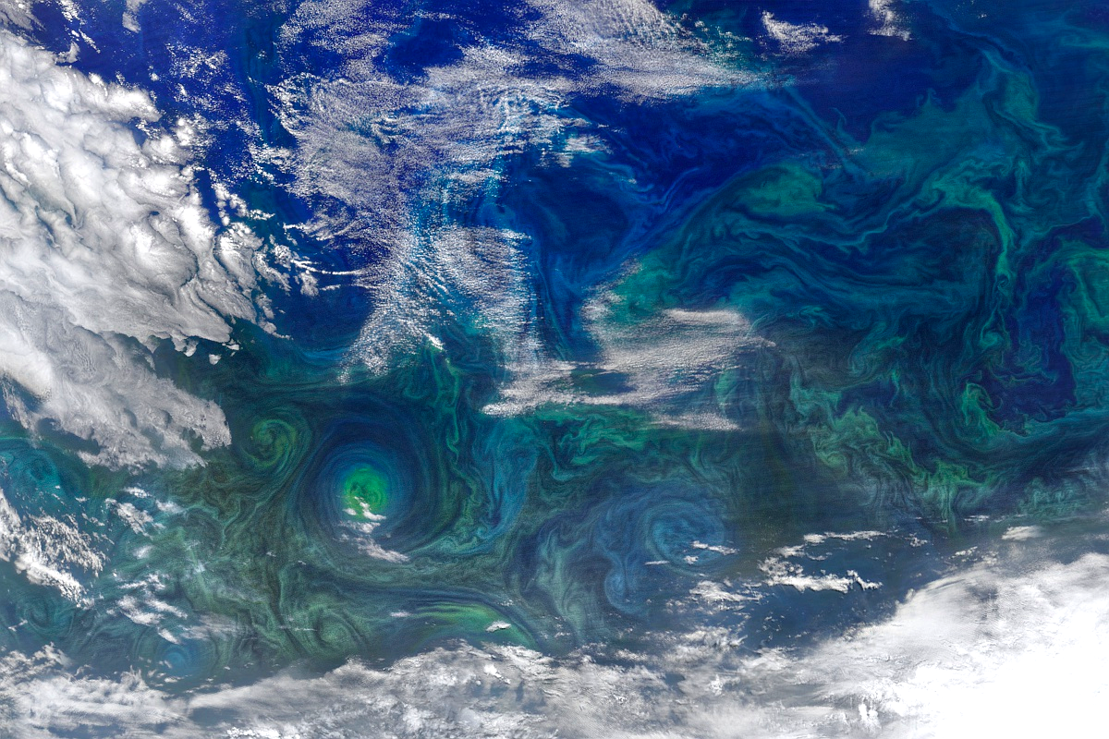
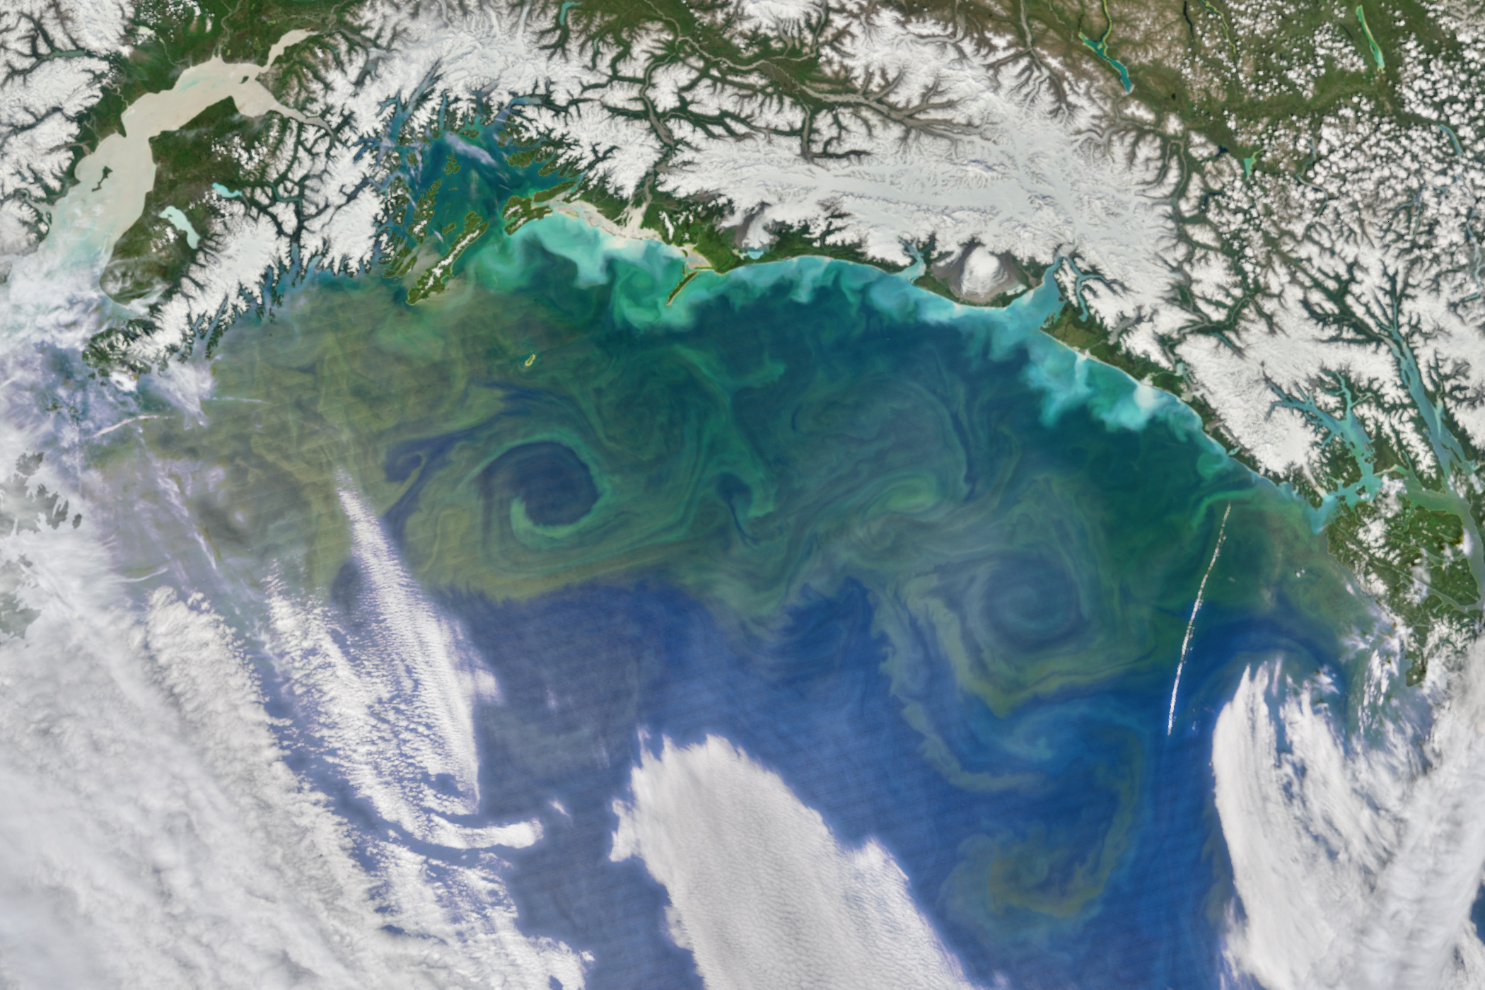


Satellite Chlorophyll Signatures of Eddy Coherency in the North Pacific Subtropical Gyre
Alexandra (Lexi) Jones^{1,2} and Mick Follows¹
¹MIT Department of Earth, Atmospheric and Planetary Sciences
²WHOI Biology Department

Slide 2

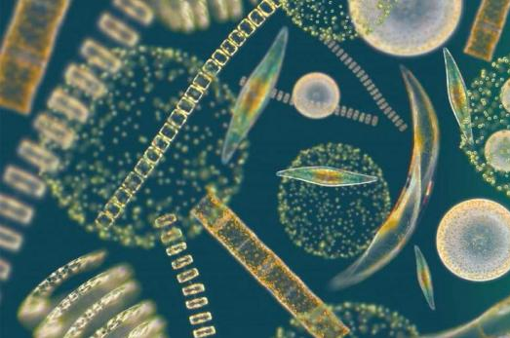
Phytoplankton
1
Underpin the marine food web
Responsible for ~50% of global primary production
Reduce atmospheric CO₂ and supply oxygen
Mediate large stores of carbon in ocean
Artist: Rachel Ignotofsky
Introduction
Hypotheses
Methods
Results

Slide 3
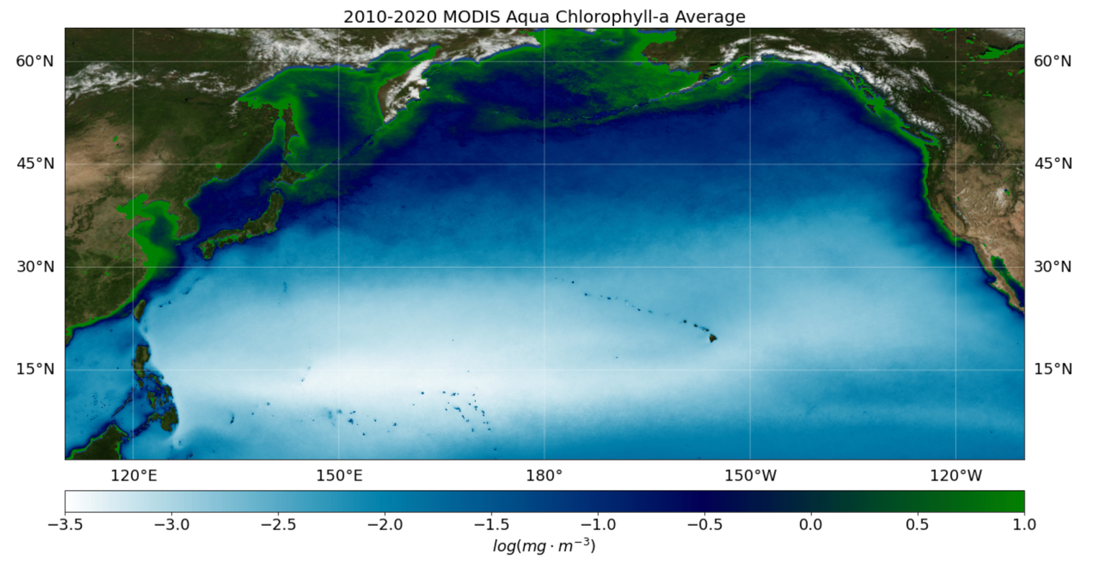
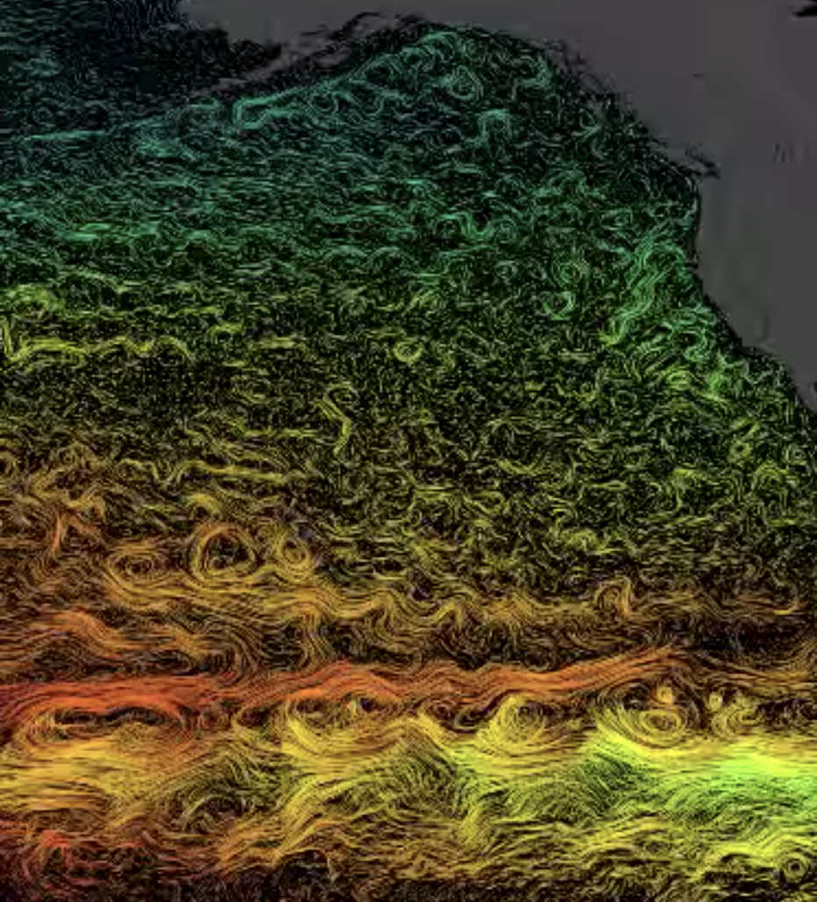
North Pacific Subtropical Gyre (NPSG)
2
Satellite Chlorophyll-a 2010–2020 Average
Earth’s largest ecosystem
Known as a “biological desert”
Studies in the late 1980s found higher growth and production rates than thought possible (e.g. Laws et al. 1987; Marra & Heinemann 1987)
Introduction
Hypotheses
Methods
Results
Notes:
Figure 1 overlay: https://youtu.be/c-oq_14TKjo (MITgcm)
Figure 2:
Dynamic topography contour map of the North Pacific surface water in dyn-cm relative to 1000dbar based on historical shipboard observations
Cutout is the satellite-based SSH anomalies in summer 2016

Slide 4
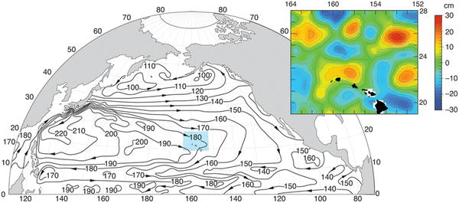
North Pacific Subtropical Gyre (NPSG)
2
Satellite Chlorophyll-a 2010–2020 Average
Dynamic Height Contours
SLA
Figure: Karl & Church, 2017
Earth’s largest ecosystem
Known as a “biological desert”
Studies in the late 1980s found higher growth and production rates than thought possible (e.g. Laws et al. 1987; Marra & Heinemann 1987)
Episodic nutrient injections are driving high rates of new production and primary production variability (Hayward, 1991)
A cyclonic eddy passes Station Aloha every 5-7 days
Introduction
Hypotheses
Methods
Results
Notes:
Figure 1 overlay: https://youtu.be/c-oq_14TKjo (MITgcm)
Figure 2:
Dynamic topography contour map of the North Pacific surface water in dyn-cm relative to 1000dbar based on historical shipboard observations
Cutout is the satellite-based SSH anomalies in summer 2016

Slide 5
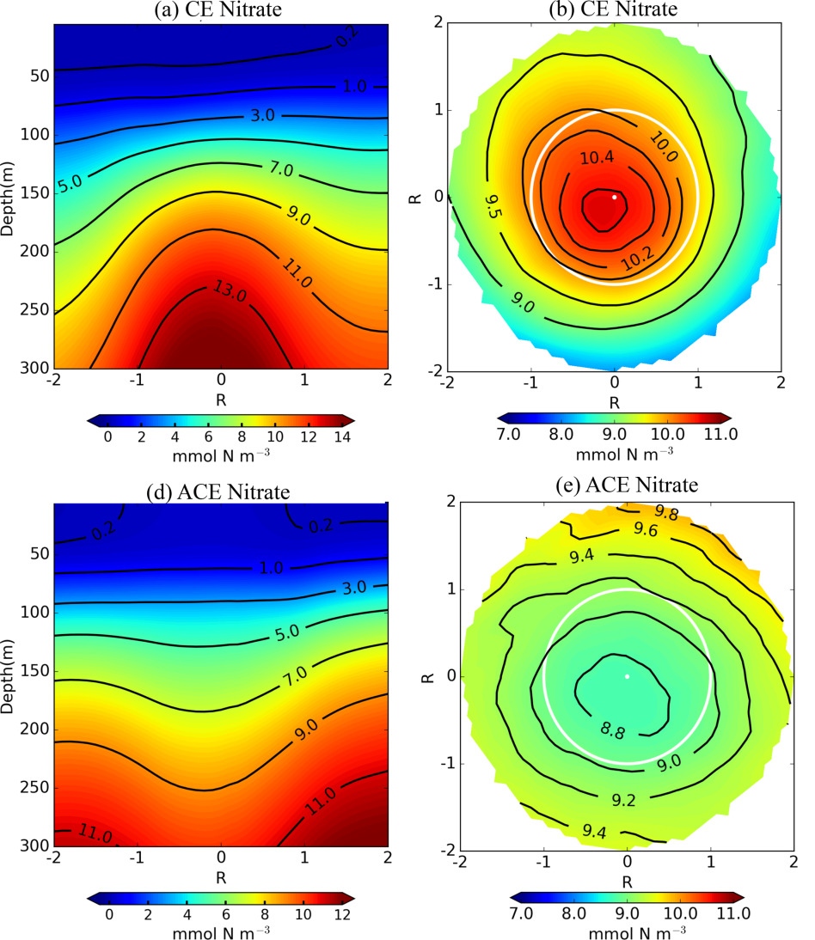
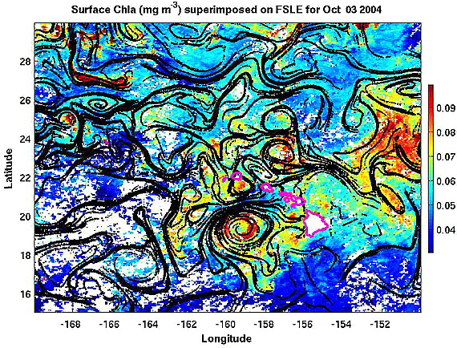
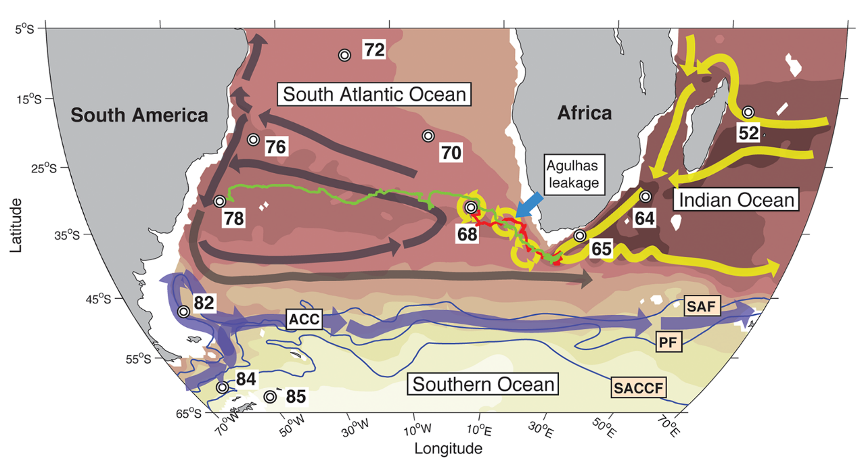
3
Biological Relevance of Eddies
Horizontal stirring and mixing shapes spatiotemporal distributions
Disrupt isopycnal layers and alter nutrient concentrations
Trap and transport ecosystems
Figure: Villar et al. 2015
Figure: Calil & Richards, 2010
Figure: Zhang et al. 2017
Introduction
Hypotheses
Methods
Results
Notes:
Figure 1: Large top 20% FSLE values represent unstable manifolds
Figure 3:
Numbers are sampling stations
Red = trajectory of young ring, green = trajectory of old ring
Arrows and background colors represent a schematic of the mean ocean circulation (dynamic height)
Paper found that South Atlantic plankton diversity was altered compared with Indian Ocean source populations, affected by the Agulhas choke point; also claim selection is at work and found groups were affected differently based on their sizes

Slide 6
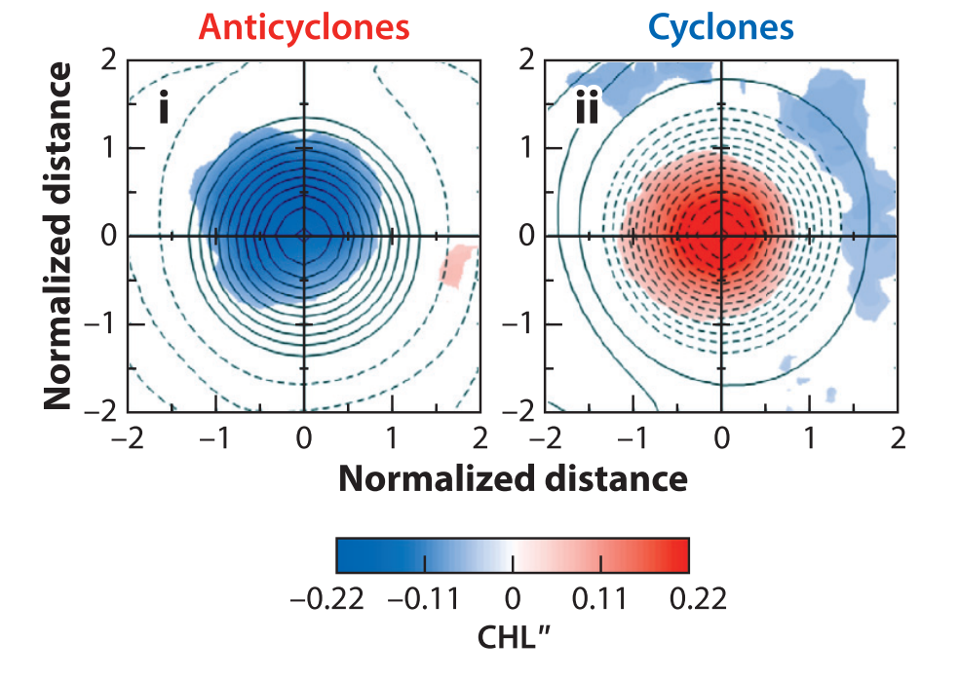
Eddy Polarity
4
Anticyclones
Cyclones
Negative surface chl anomaly
Positive surface chl anomaly
Figure: McGillicuddy 2016
Introduction
Hypotheses
Methods
Results

Slide 7
4
Eddy Polarity
Anticyclones
Cyclones
Negative surface chl anomaly
Positive surface chl anomaly
Positive sea level anomaly
Negative sea level anomaly
Shoaled chl-max
Decreased chl-max
Uplifted isopycnal layers
Deepened isopycnal layers
HIGH
NUTRIENTS
HIGH
NUTRIENTS
Figures: McGillicuddy 2016; adapted from B. Barone
Introduction
Hypotheses
Methods
Results

Slide 8
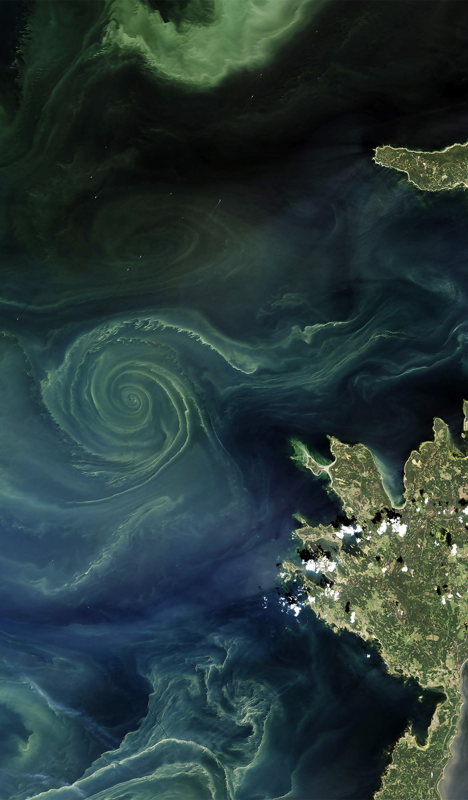
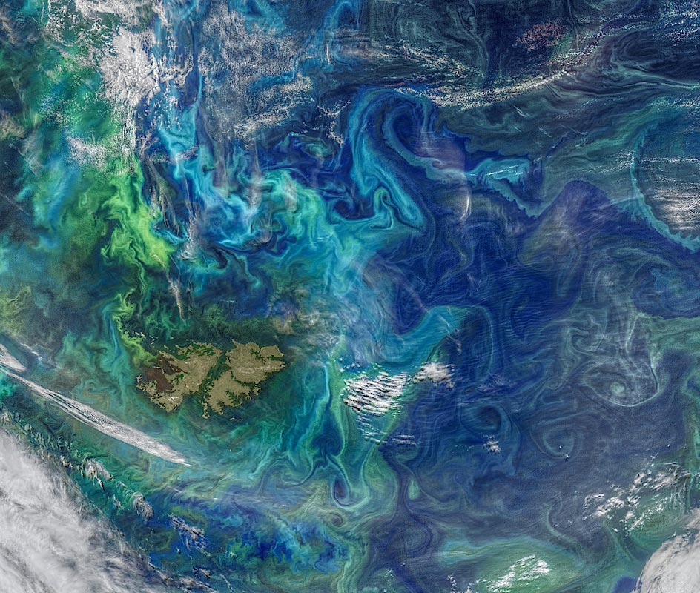
Individual eddies are complex! They have varying levels of filamentation and evolve through time.
Notes:
Figure Sources:
https://eos.org/features/interpreting-mosaics-of-ocean-biogeochemistry
https://scitechdaily.com/nasa-taking-to-the-air-and-sea-to-study-ocean-eddies/
https://earthobservatory.nasa.gov/images/88238/bloom-in-the-gulf-of-Alaska
https://cosmosmagazine.com/geoscience/a-phytoplankton-vortex-in-the-baltic-sea/

Slide 9
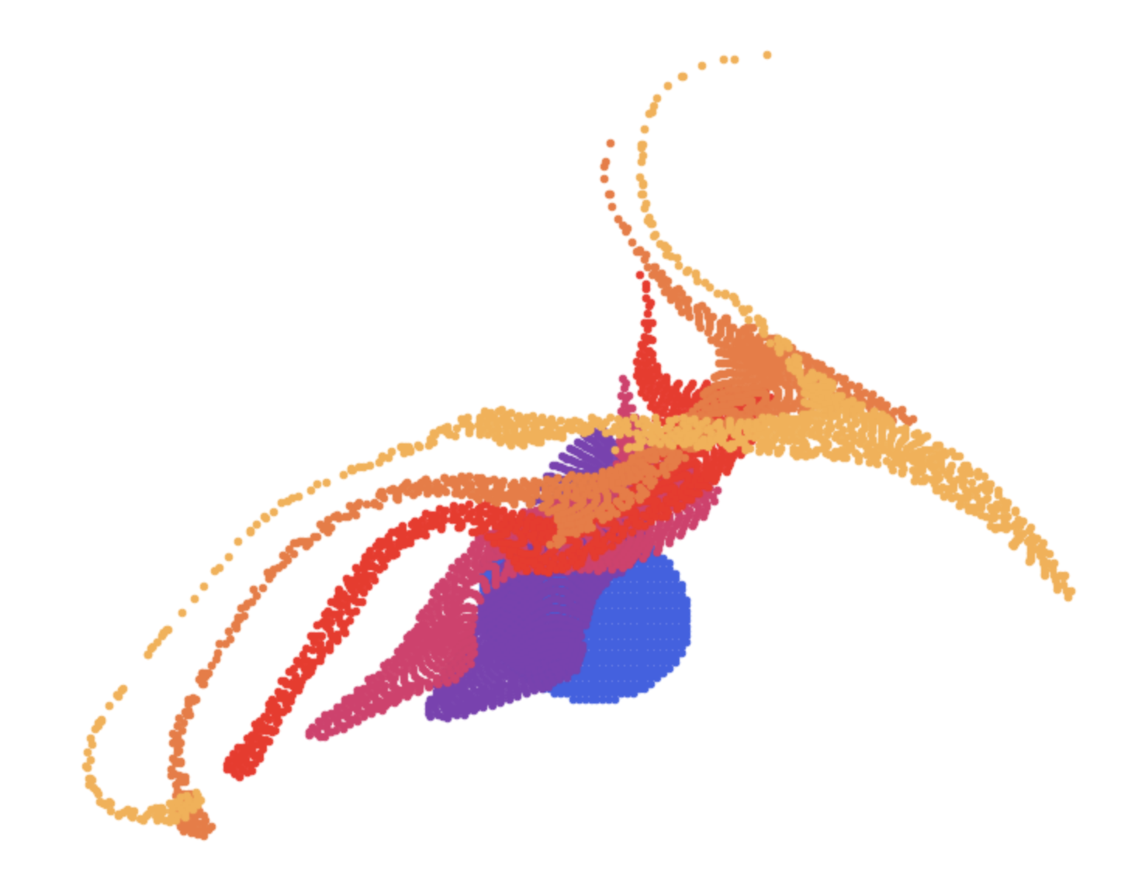
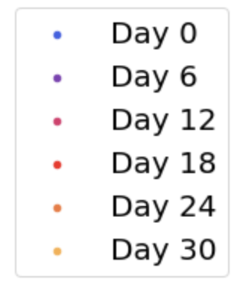
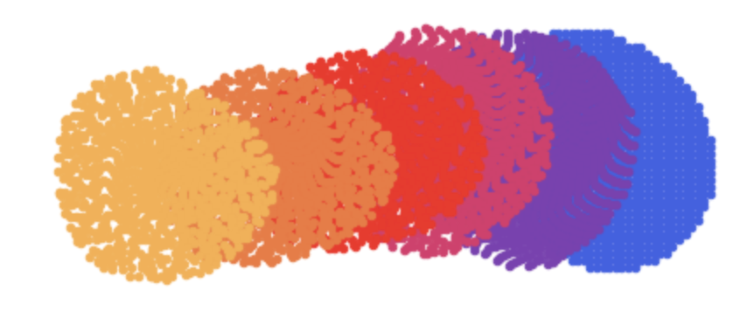
Eddy Coherency
6
Dispersive ocean patch
Coherent ocean patch
The NPSG hosts a diverse variety of coherent and leaky eddies at any given time.
Introduction
Hypotheses
Methods
Results

Slide 10
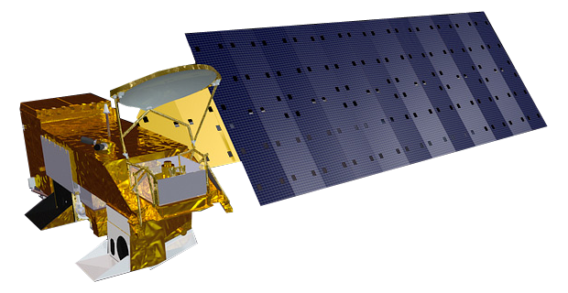
Motivating Questions
7
1) Do satellite observations capture a biological response to eddy coherency?
2) How does the biological response to eddies evolve over an eddy lifetime?
Introduction
Hypotheses
Methods
Results
Notes:
https://phys.org/news/2017-11-southern-ocean-massive-bloom-tiny.html
Motivation: The phytoplankton response to eddies is currently unpredictable and poorly understood. For example, we observe blooms in some eddies but not others, or certain phytoplankton groups are found in some but not others. One reason for this is that eddies are complex structures that vary in their physical characteristics such as orientation (cyclonic vs anticyclonic), area, amplitude, or longevity. Coherency is a measure of the trapping ability of eddies, another characteristic that varies across eddies and is largely unexplored from a biological perspective.

Slide 11



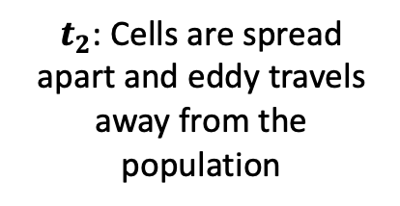
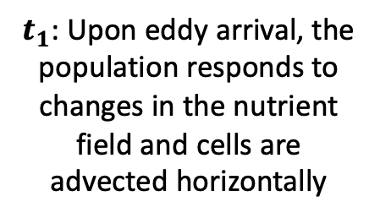
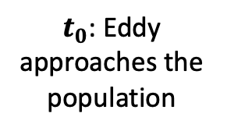


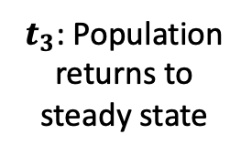
Phytoplankton Populations in a Leaky Eddy
8
Dispersal
Isopycnal surface
$$z$$
$$∆t$$
$$∆t$$
$$∆t$$
$t_{0}$: Eddy approaches the population
$t_{1}$: Upon eddy arrival, the population responds to changes in the nutrient field and cells are advected horizontally
$t_{2}$: Cells are spread apart and eddy travels away from the population
$t_{3}$: Population returns to steady state
Hypothesis: Leaky eddies are a “bump in the rug”, where induced blooms are rapidly dispersed, and the eddies have limited capacity to transport populations.
(Thank you, John Cullen, for the bump in the rug metaphor)
Introduction
Hypotheses
Methods
Results

Slide 12

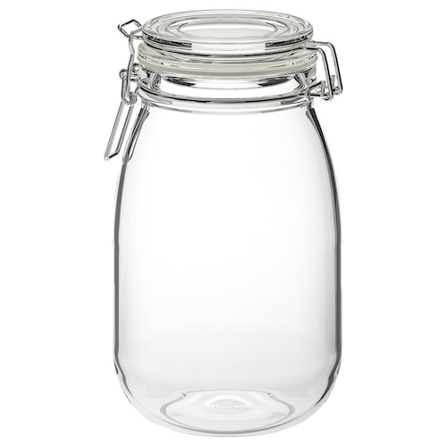
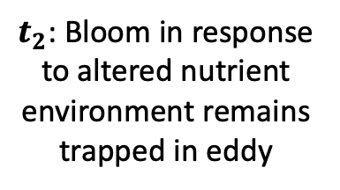

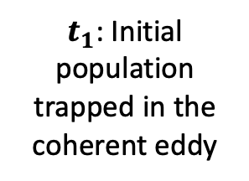
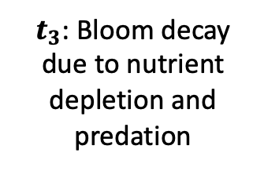
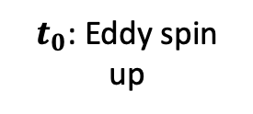



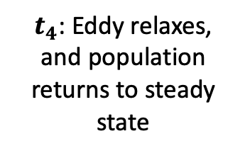
Phytoplankton Populations in a Coherent Eddy
9
$$z$$
Isopycnal surface
$$∆t$$
$$∆t$$
$$∆t$$
$$∆t$$
$t_{0}$: Eddy spin up
$t_{1}$: Initial population trapped in the coherent eddy
$t_{2}$: Bloom in response to altered nutrient environment remains trapped in eddy
$t_{3}$: Bloom decay due to nutrient depletion and predation
$t_{4}$: Eddy relaxes, and population returns to steady state
Hypothesis: Coherent eddies foster an environment for phytoplankton to bloom in a concentrated ocean patch (”closed jar”) and transport populations through time and space.
Introduction
Hypotheses
Methods
Results

Slide 13
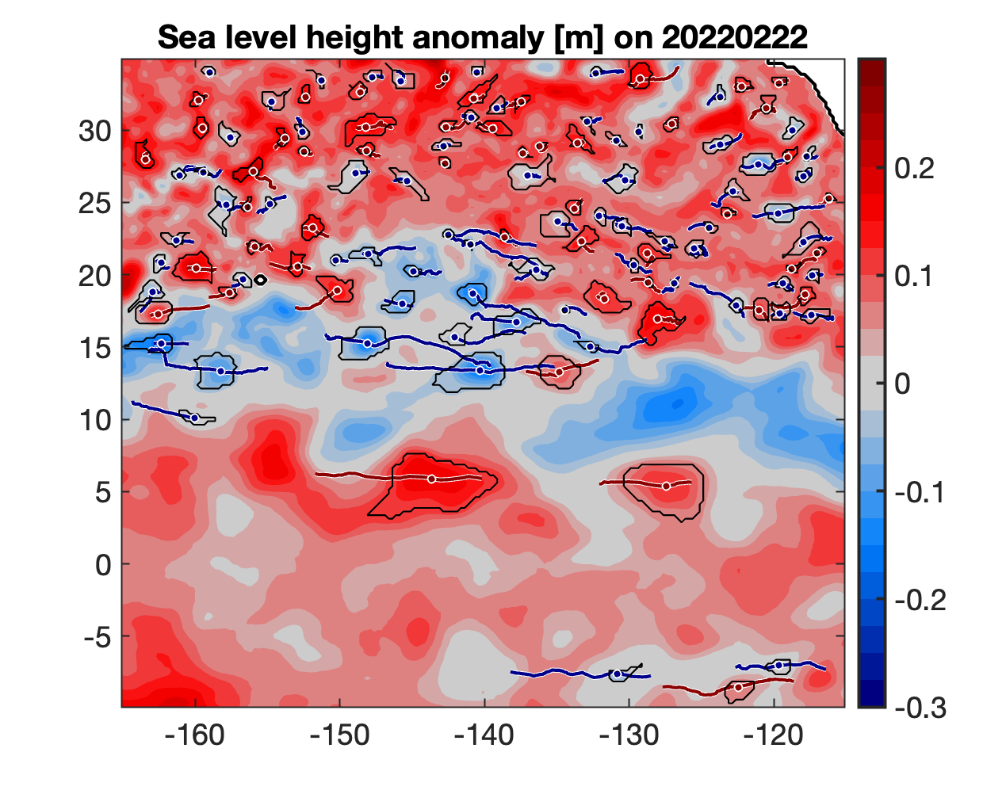
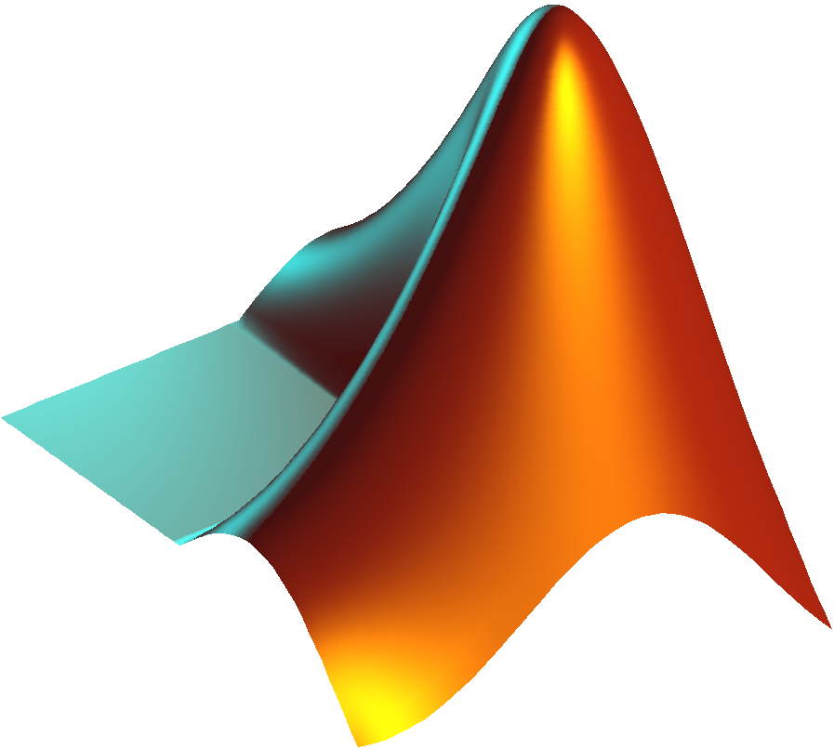

Sea Level Anomaly Eddy Boundaries
10
MATLAB software OceanEddies used to track and identify SSH eddies (Faghmous et al., 2015)
Boundaries identified as closed contours surrounding a local SLA extremum
github.com/ifrenger/OceanEddies
Introduction
Hypotheses
Methods
Results

Slide 14
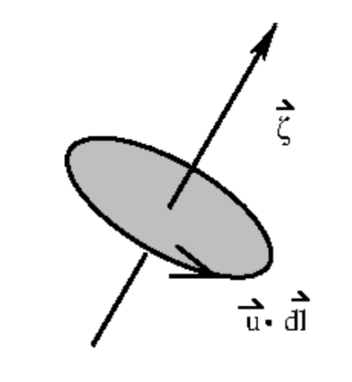
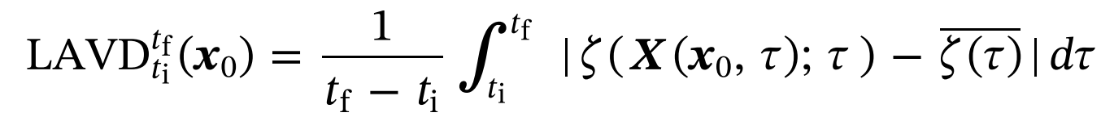
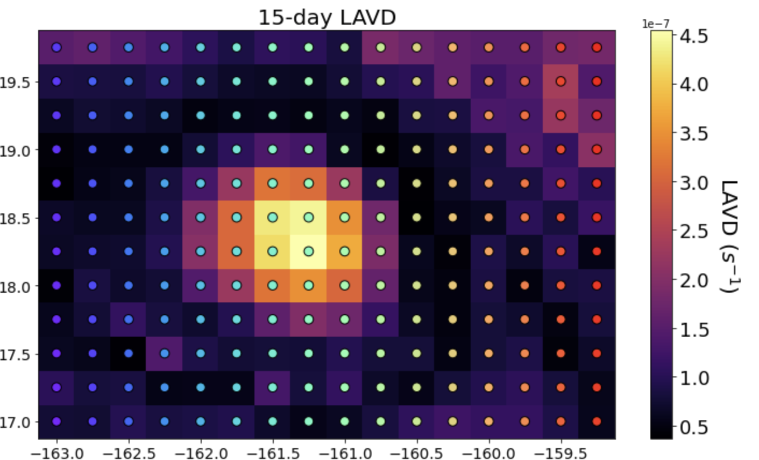
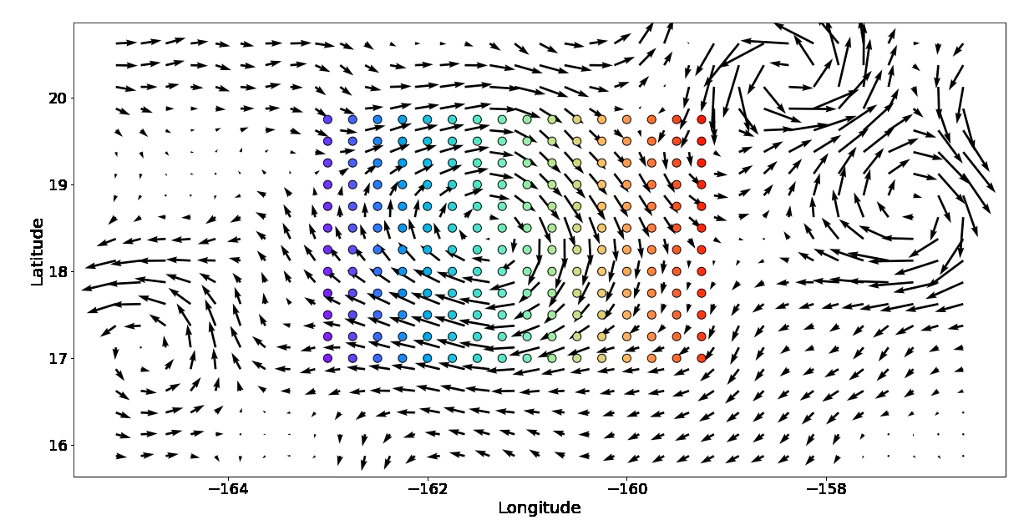

Lagrangain Average Vorticity Deviation
11
Relative vorticity measures the ‘swirl’ of fluid: $ζ=\frac{∂v}{∂x}−\frac{∂u}{∂y}$
Lagrangian Averaged Vorticity Deviation (LAVD; Haller et al., 2016):
Vorticity
Average over the time steps
Vorticity of a particle at a given location and timestep
Average vorticity across the spatial domain at the timestep
Introduction
Hypotheses
Methods
Results
Notes:
~~ Relevant LAVD Literature ~~
Haller et al., 2016: https://doi.org/10.1017/jfm.2016.151
Tarshish et al., 2018: https://doi.org/10.1016/j.ocemod.2018.07.001
Abernathy and Haller, 2018: https://doi.org/10.1175/JPO-D-17-0102.1
Sinha et al., 2019: https://doi.org/10.1029/2018MS001508
Liu et al., 2019: https://doi.org/10.1029/2019JC015576
He et al. 2020: https://doi.org/10.1007/s00343-021-0392-7

Slide 15
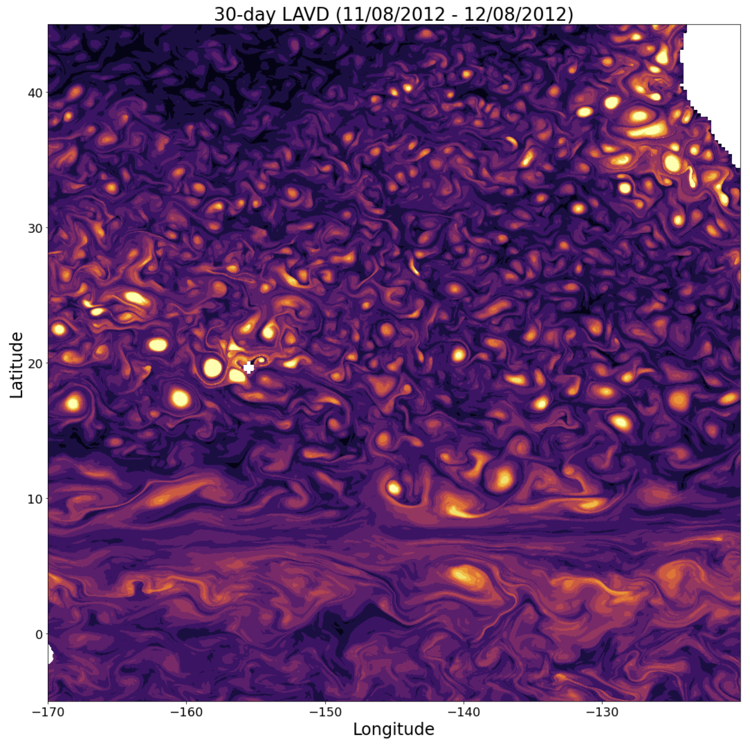


North Pacific LAVD
12
30-day particle simulation
Yellow circles represent consistently high-vorticity fluid patches
github.com/OceanParcels/parcels
(Delandmeter and van Sebille, 2019)
Introduction
Hypotheses
Methods
Results

Slide 16
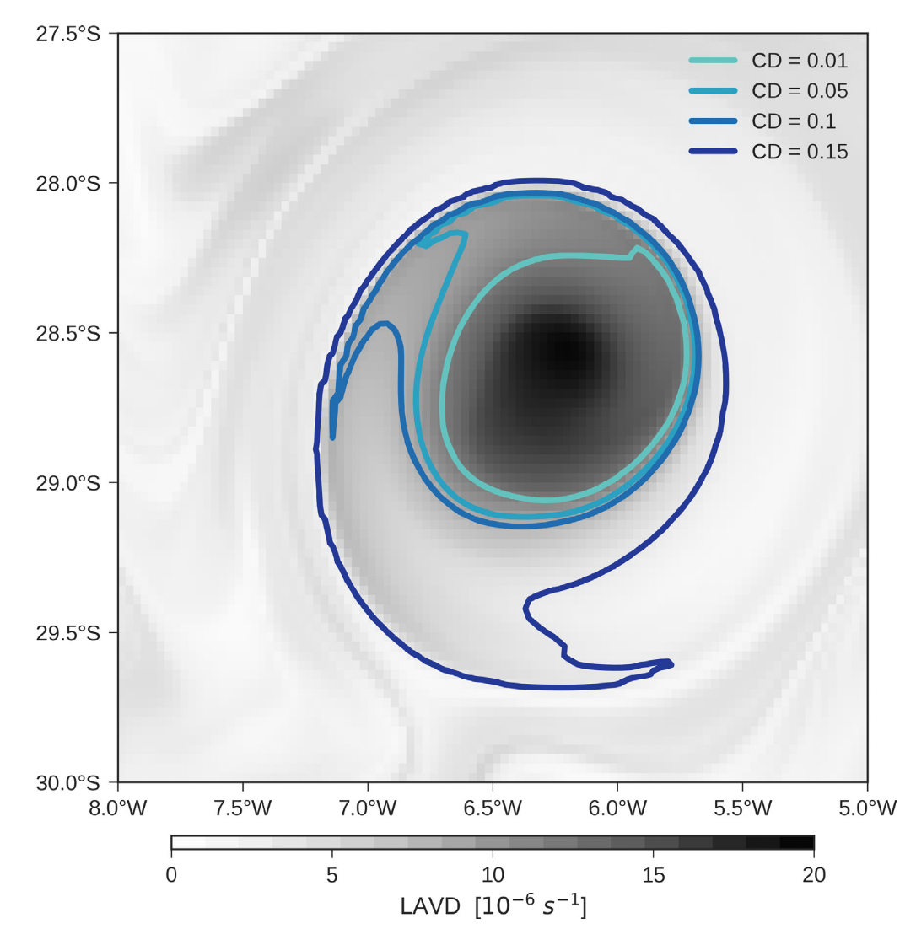
Coherent Eddies
13
Rotationally coherent Lagrangian vortex (RCLV) definition: “impermeable material region marked by a high concentration of vorticity” (Haller et al. 2016)
The boundaries identified as closed circular contours surrounding a local LAVD maxima
https://github.com/ocean-transport/floater
Figure: Tarshish et al., 2018
Introduction
Hypotheses
Methods
Results
Notes:
Coherent eddy identification from an LAVD field is analogous to Eulerian eddy identification with a SLA field.

Slide 17
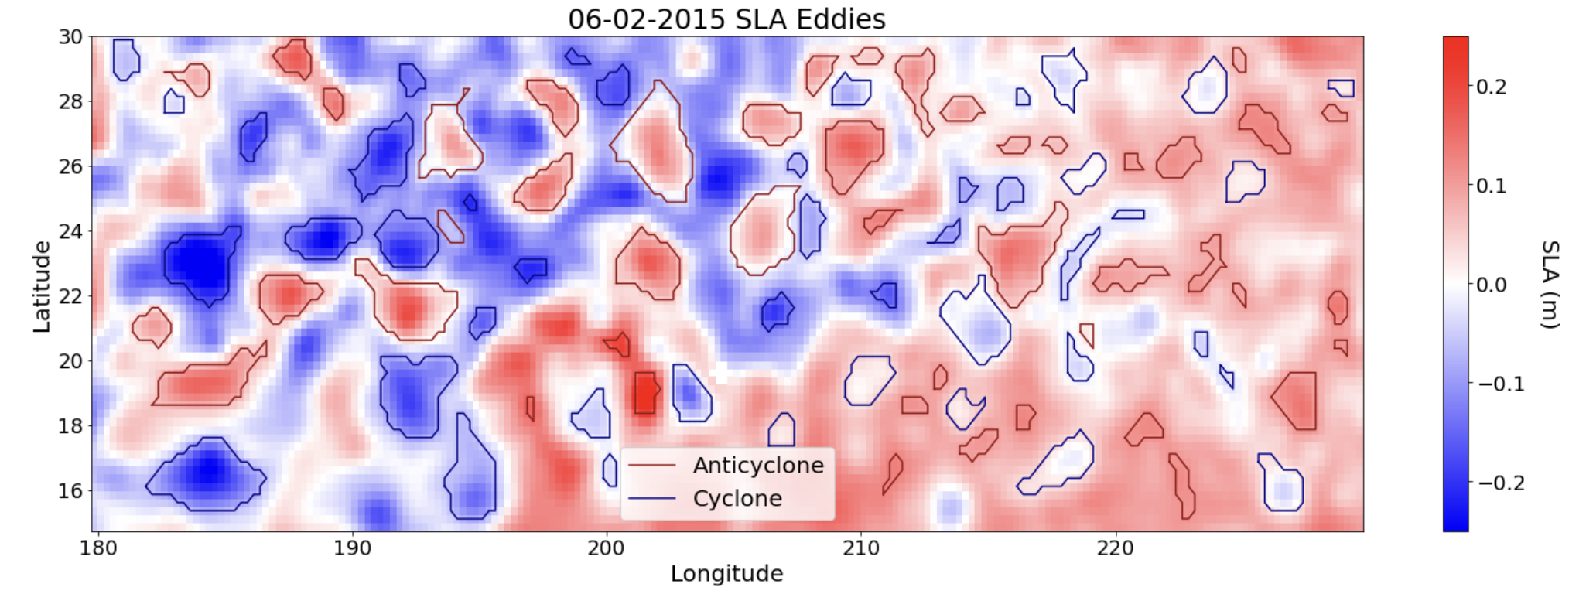
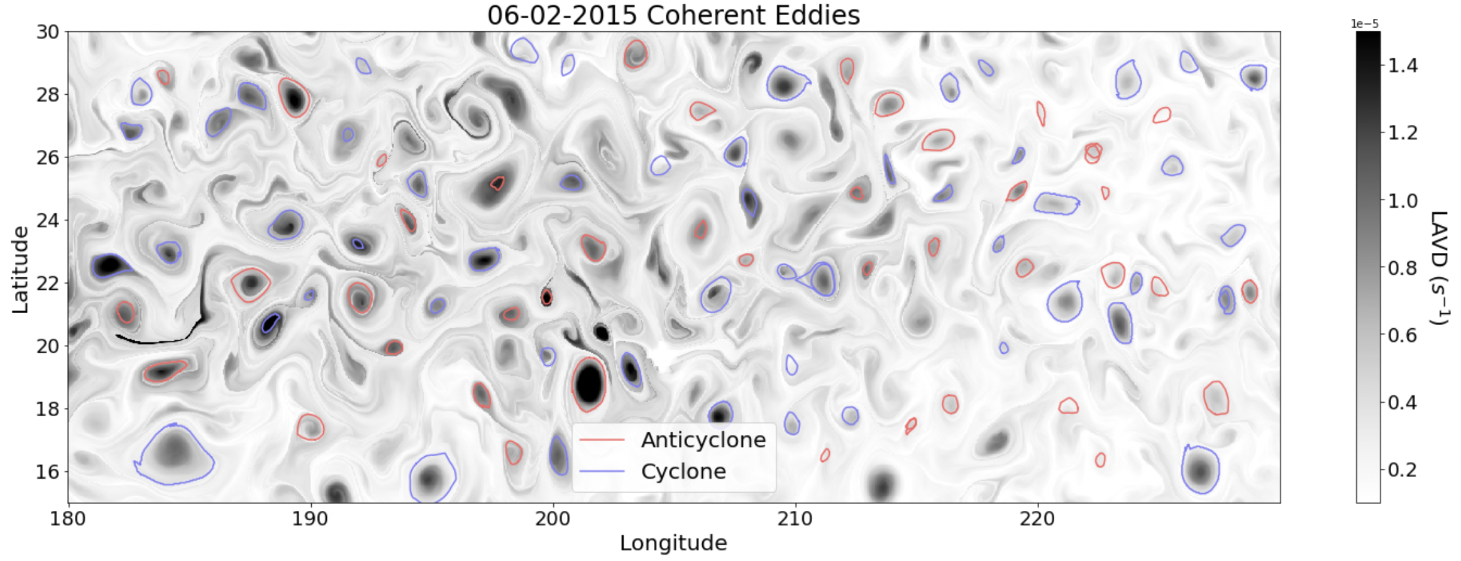
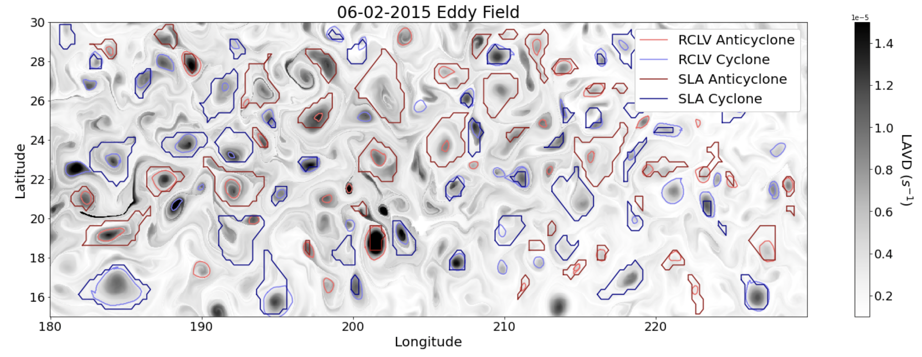
Eddy Boundaries
14
SLA Eddies
LAVD field and Coherent Eddies
Eddy Field
Introduction
Hypotheses
Methods
Results

Slide 18
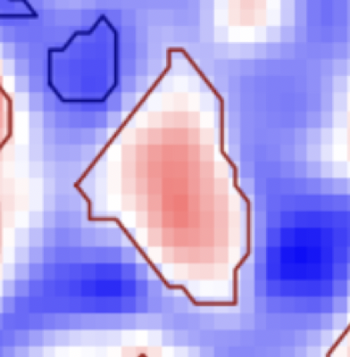
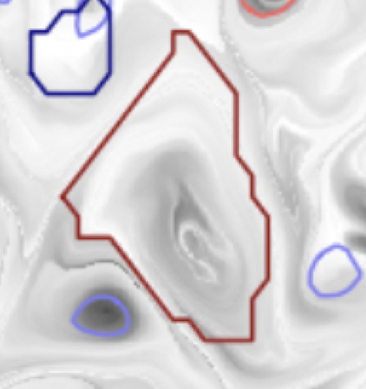
Eddy Categorization
15
SLA
LAVD
1. Leaky
  Eddy was detected from satellite SLA, but has no coherent structure
Introduction
Hypotheses
Methods
Results
Notes:
-> Sometimes coherent eddies are detected in the SLA later in the eddy’s lifetime, or these coherent structures are part of a decaying eddy that once had a SLA signature

Slide 19
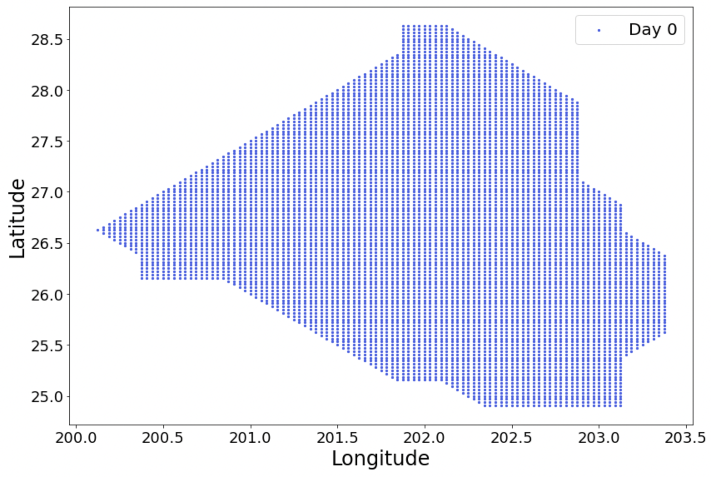
Leaky Eddy Backward Particle Trajectories
16
Where did the fluid parcels come from?
SLA (Day 0)
LAVD
Introduction
Hypotheses
Methods
Results

Slide 20
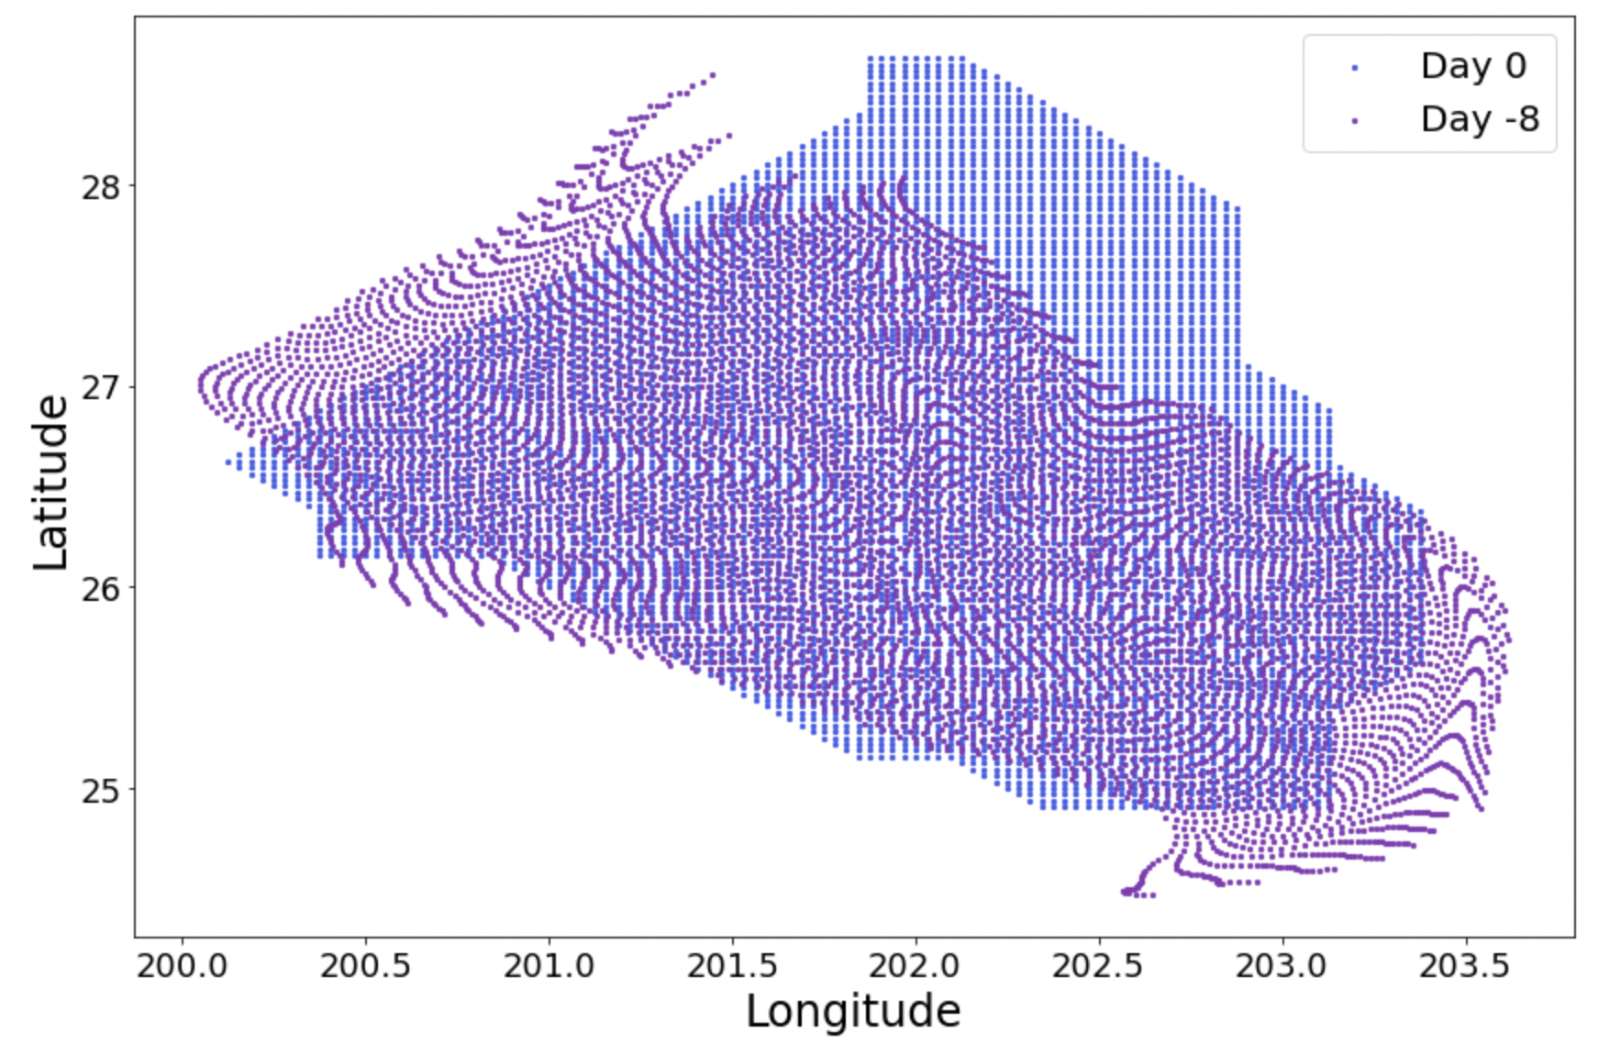
Leaky Eddy Backward Particle Trajectories
17
SLA (Day 0)
LAVD
Introduction
Hypotheses
Methods
Results

Slide 21
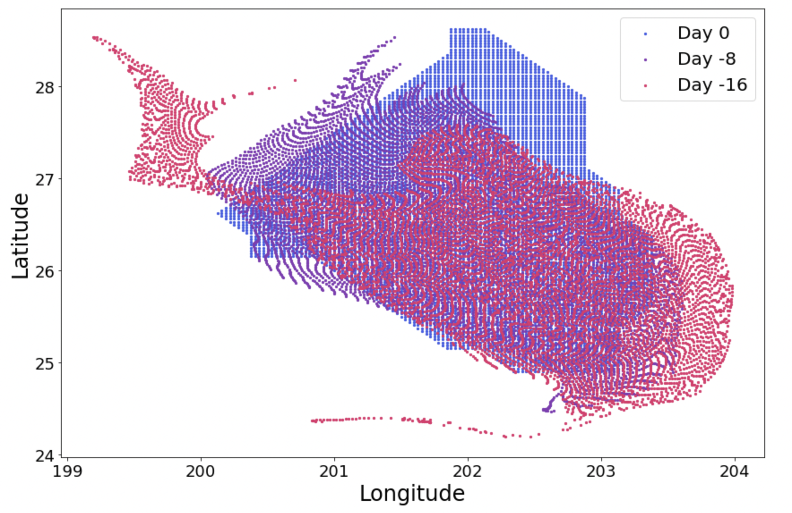
Leaky Eddy Backward Particle Trajectories
18
SLA (Day 0)
LAVD
Introduction
Hypotheses
Methods
Results

Slide 22
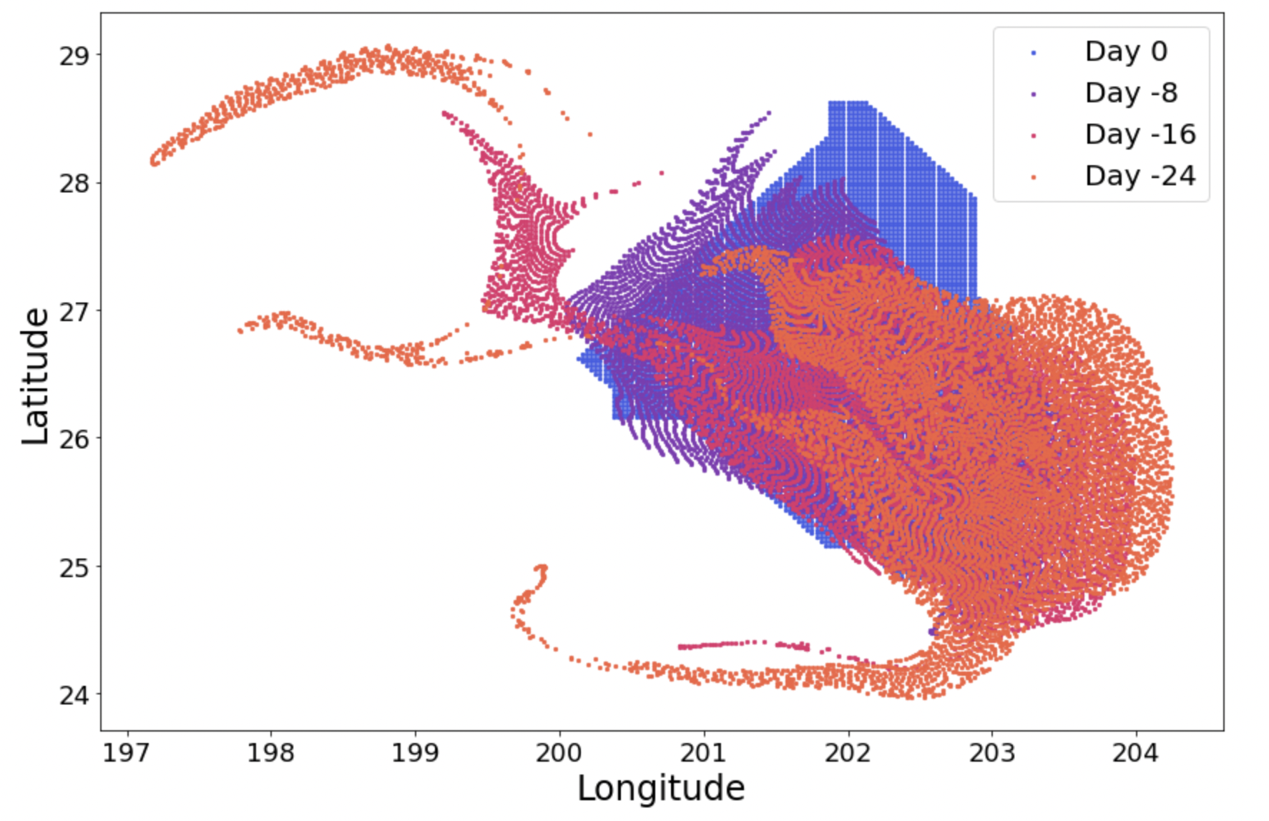
Leaky Eddy Backward Particle Trajectories
19
SLA (Day 0)
LAVD
Introduction
Hypotheses
Methods
Results

Slide 23
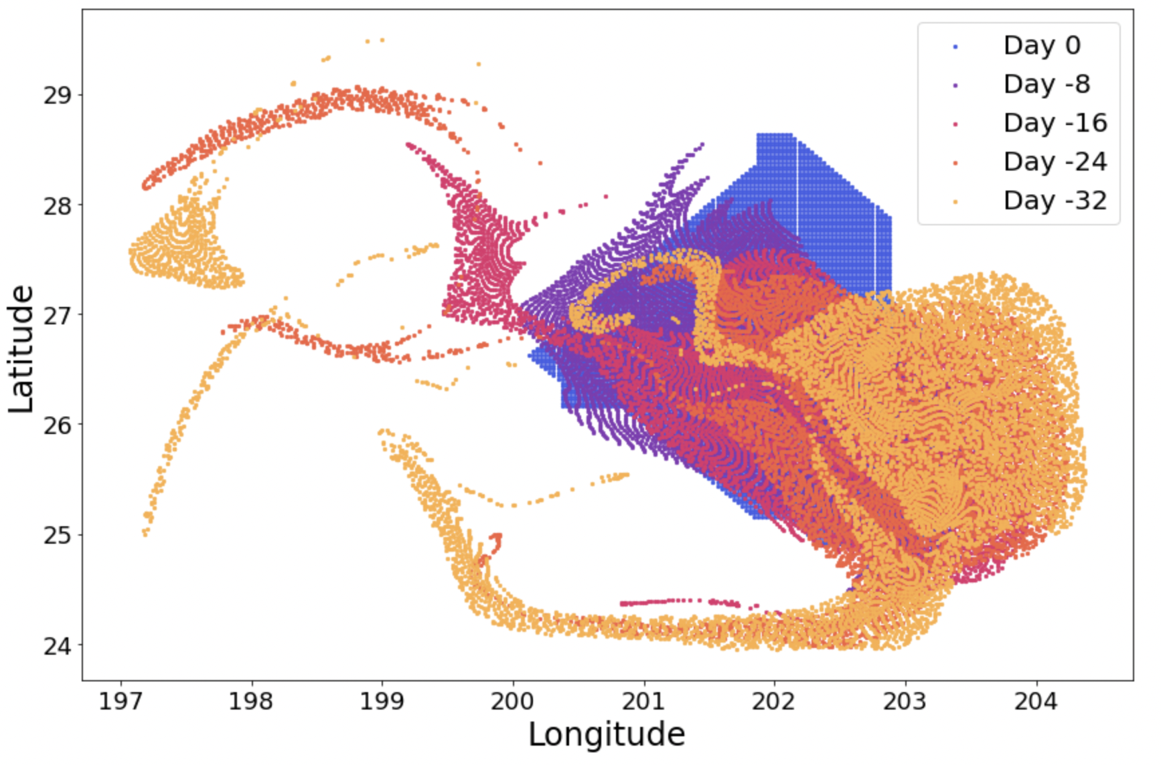
Leaky Eddy Backward Particle Trajectories
20
SLA (Day 0)
LAVD
Water parcels that end up inside the eddy in 32 days
Introduction
Hypotheses
Methods
Results

Slide 24
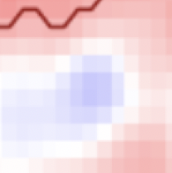
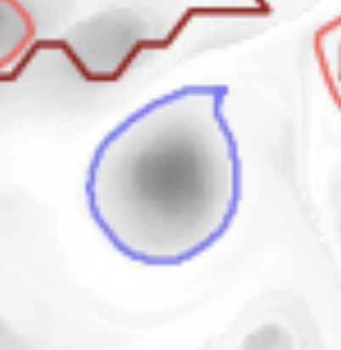
Eddy Categorization
21
SLA
LAVD
1. Leaky
  Eddy was detected from satellite SLA, but has no coherent structure
2. Coherent
  Coherent structure was detected in LAVD field, but eddy was not detected from satellite SLA
Introduction
Hypotheses
Methods
Results

Slide 25
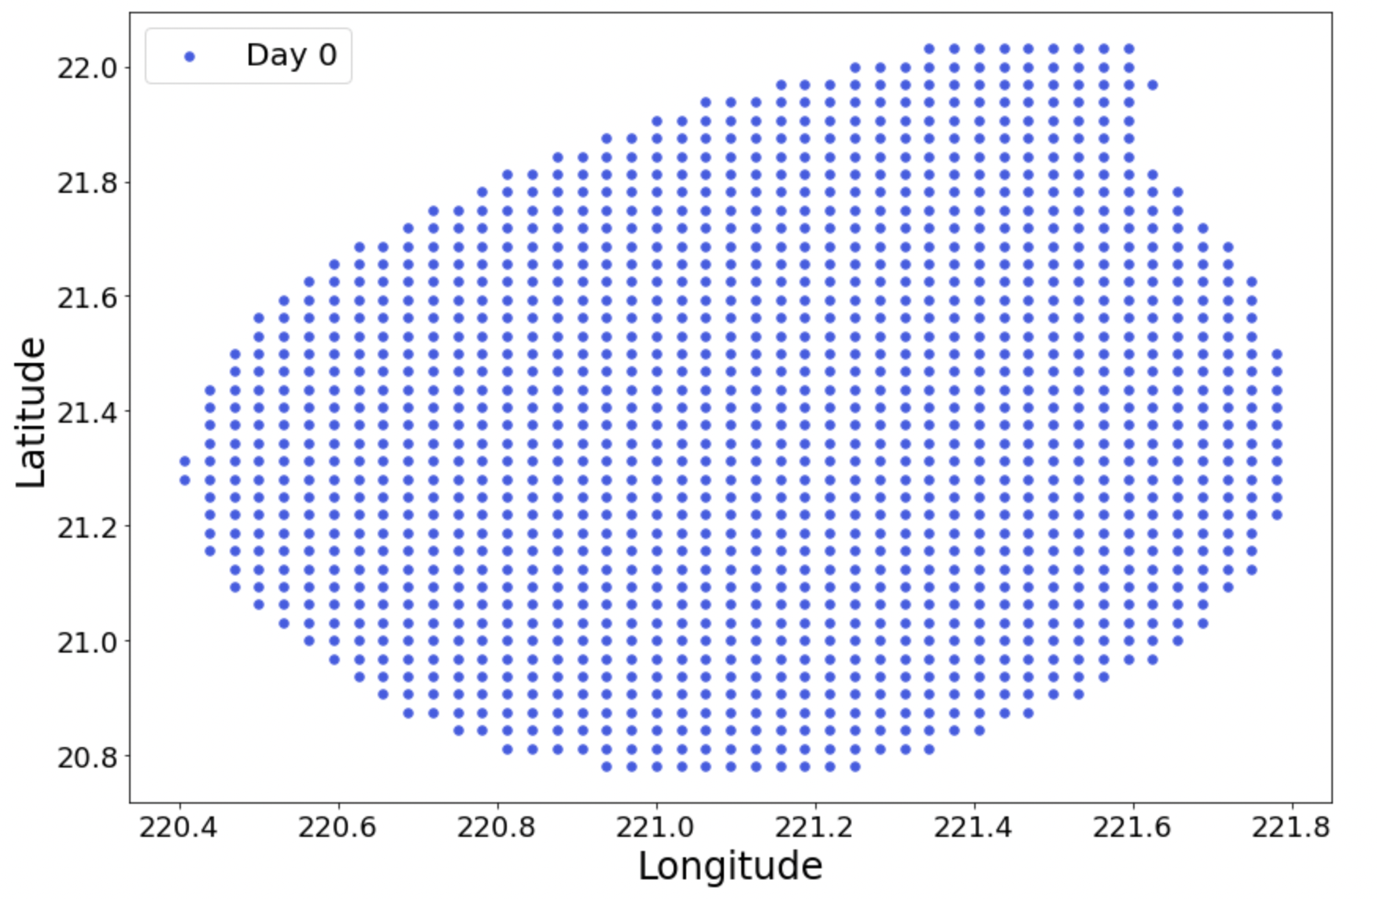
Coherent Eddy Backward Particle Trajectories
22
SLA (Day 0)
LAVD
Introduction
Hypotheses
Methods
Results

Slide 26
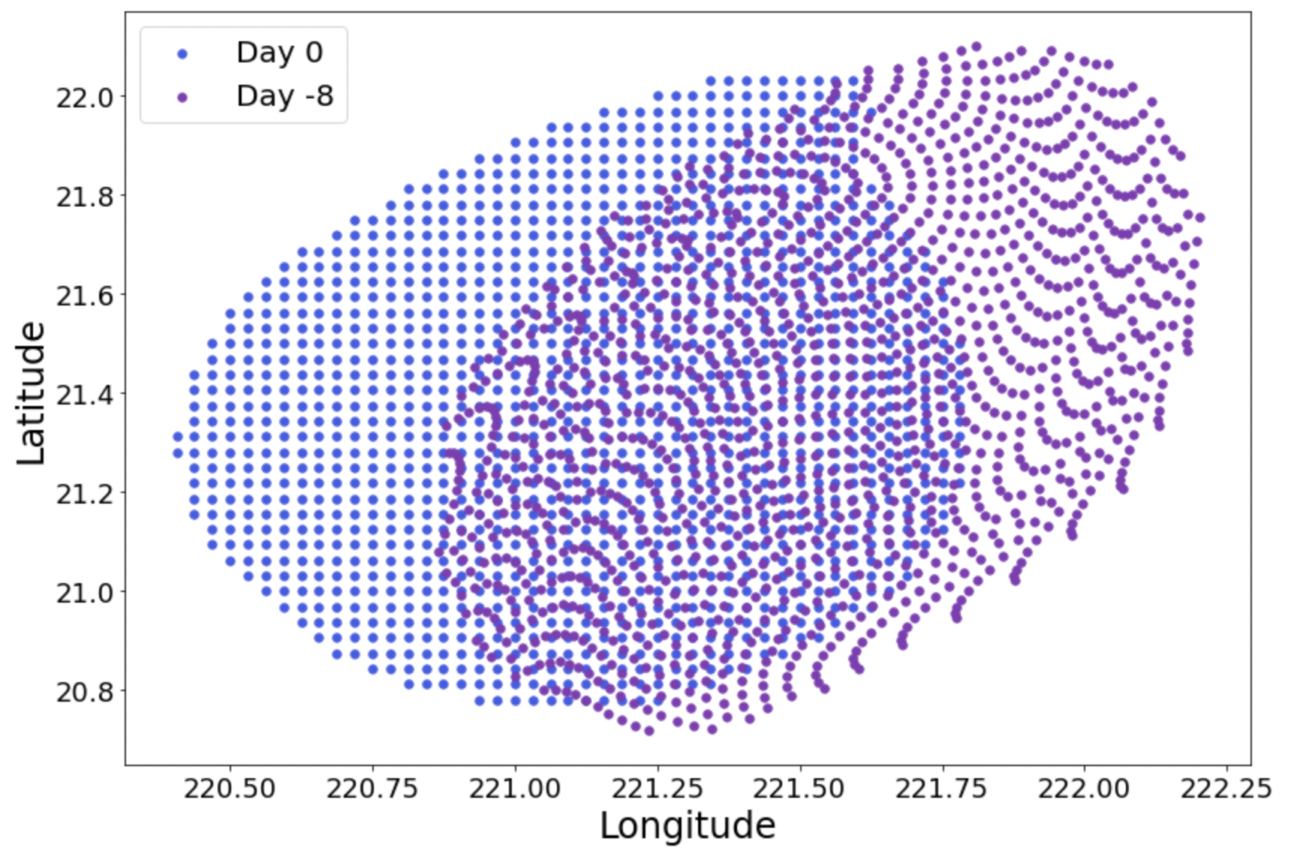
Coherent Eddy Backward Particle Trajectories
23
SLA (Day 0)
LAVD
Introduction
Hypotheses
Methods
Results

Slide 27
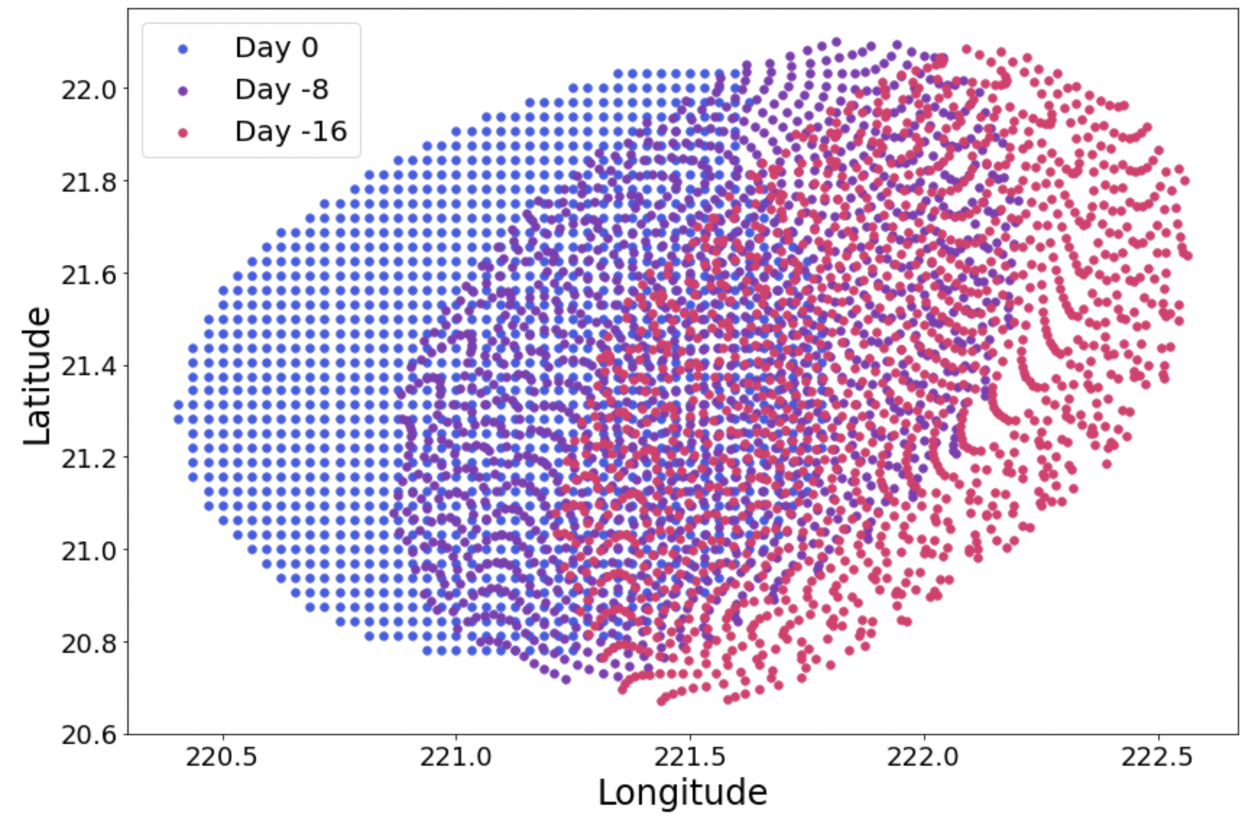
Coherent Eddy Backward Particle Trajectories
24
SLA (Day 0)
LAVD
Introduction
Hypotheses
Methods
Results

Slide 28

Coherent Eddy Backward Particle Trajectories
25
SLA (Day 0)
LAVD
Introduction
Hypotheses
Methods
Results

Slide 29

Coherent Eddy Backward Particle Trajectories
26
SLA (Day 0)
LAVD
Introduction
Hypotheses
Methods
Results

Slide 30


Eddy Categorization
27
SLA
LAVD
1. Leaky
  Eddy was detected from satellite SLA, but has no coherent structure
2. Coherent
  Coherent structure was detected in LAVD field, but eddy was not detected from satellite SLA
3. Overlapping
  Eddy detected from satellite SLA and has a coherent structure
  The coherent boundaries are typically nested inside of the SLA boundaries
Introduction
Hypotheses
Methods
Results

Slide 31

Overlapping Eddy Backward Particle Trajectories
28
SLA (Day 0)
LAVD
Introduction
Hypotheses
Methods
Results

Slide 32

Overlapping Eddy Backward Particle Trajectories
29
SLA (Day 0)
LAVD
Introduction
Hypotheses
Methods
Results

Slide 33

Overlapping Eddy Backward Particle Trajectories
30
SLA (Day 0)
LAVD
Introduction
Hypotheses
Methods
Results

Slide 34

Overlapping Eddy Backward Particle Trajectories
31
SLA (Day 0)
LAVD
Introduction
Hypotheses
Methods
Results

Slide 35

Overlapping Eddy Backward Particle Trajectories
32
SLA (Day 0)
LAVD
Introduction
Hypotheses
Methods
Results

Slide 36

Coherent Eddy Atlas
33
To understand the biological response as an eddy evolves, we need to track coherent eddies through time
Day 48
Day 0
Introduction
Hypotheses
Methods
Results

Slide 37

Pipeline
CMEMS 1/4° daily surface current vectors
34
CMEMS 1/4° daily SLA
Lagrangian trajectories, LAVD, contours
OceanEddies
Tracking algorithm
SLA eddy atlas
OC-CCI 1/24° 8-day avg surface chl-a
Lagrangian eddy atlas
Chl-a anomaly data by feature type
Introduction
Hypotheses
Methods
Results

Slide 38




Results
35
Upper extreme
Increased chl-a in coherent cores of SSH eddies is not from advection or trapping alone
The combination of coherency and the structure driving a change in sea level fosters conditions for an increase in chl-a
+1$σ$
Mean
Median
-1$σ$
Lower extreme
Introduction
Hypotheses
Methods
Results
Notes:
Note: We are exploring the option of switching the chl product we are using for this project to the cloud free CMEMS L4 Global Ocean Chlorophyll (https://resources.marine.copernicus.eu/product-detail/OCEANCOLOUR_GLO_CHL_L4_REP_OBSERVATIONS_009_082/INFORMATION)

Slide 39

Results
36
Leaky cyclonic eddies on average do not have anomalously high chl, whereas coherent cyclonic eddies do until age ~120 days
This supports the “bump in the rug” and “closed jar” hypotheses
Introduction
Hypotheses
Methods
Results

Slide 40

Results
37
Leaky anticyclonic eddies on average do not have anomalously high chl, whereas coherent anticyclonic eddies do
We suspect different ecological phenomena are at play in long-lived coherent anticyclones
Introduction
Hypotheses
Methods
Results

Slide 41





Could it be… diazotrophs?
38
Diazotroph abundance correlated with eddy kinetic energy and high sea level anomaly at stations across the North Pacific
N₂ fixation rates were anomalously high in the centers of two anticyclones north of Hawaii, linked to Crocosphaera
Rates of N₂ fixation often increased at Station Aloha during periods of positive sea level anomaly
Introduction
Hypotheses
Methods
Results

Slide 42
Next Steps
39
Key Takeaways
Mesoscale eddies identified with Eulerian metrics are not coherent fluid masses
Eddies identified from both SLA and Lagrangian coherency metrics have anomalously high chl-a
The ”bump in the rug” and ”closed jar” hypotheses explain some of the chl response, but not the complete story
Scale up
  Expand the coherent eddy atlas to span a decade
Eddy evolution
  Better understand how chl-a evolves along Lagrangian trajectories in eddies and their peripheries
Ocean color algorithms
  Test performance at the mesoscale
  Estimate what phytoplankton are contributing to the biomass in eddies
Notes:
NOTE: Samples collected were from surface waters from the Underway system

Slide 43
Thanks for listening! Questions?
Email me (Lexi Jones): jonesae@mit.edu
Image: South Atlantic; NASA Ocean Color, VIIRS, 01/04/2020

Slide 44
Extra Slides

Slide 45


Effects of Velocity Field Resolution
Daily velocity fields
Hourly velocity fields
Figure: Sinha et al., 2019

Slide 46


MITgcm LAVD
1/200° particle resolution in 1/48° MITgcm velocity fields (6,800,000 total)
LAVD + RCLV methodology breaks down @ high res (spatial & temporal) / with ageostrophic flow
Compare satellite LAVD from this region

Slide 47

North Pacific Coherent Eddies
1
Trajectories of 30-day RCLVs (1993-2015)
– 46,486 total –
Figure: Abernathey and Haller, 2018

Slide 48


Hawaiian Lee Eddies
The long-lived coherent anticyclonic eddies responsible for the anomalously high chl-a after ~144 days were both generated in the lee of Hawaii
Few in situ observations of phytoplankton communities of anticyclones in this area
Eddy ID 171 2012-02-26
(Age 8)
Eddy ID 171 2012-06-25
(Age 128)
Eddy ID 171 2012-09-05
(Age 200)
Eddy ID 60
2012-05-16 (Age 8)
Eddy ID 60
2012-09-05 (Age 120)
Eddy ID 60
2012-11-16 (Age 192)
Notes:
Image source: https://fishingbooker.com/blog/which-hawaiian-island-is-the-best-for-you/

Slide 49


Chl-a Anomaly by Eddy Age
Chl anomalies are higher earlier in the eddy lifetime

