Slide 1
A quasi-stationary meander and
its ecological implications:
A story told with a single line of measurements in the western South Atlantic
Filipe Pereira^{1,2,*}, Ilson Silveira¹, Amit Tandon², Caique Luko^{1,3},
Mateus Chuqui¹, Mayza Pompeu¹, Luan Michelazzo¹, Frederico Brandini¹
*pereiraf@usp.br
¹University of São Paulo, ²University of Massachusetts Dartmouth,
³Scripps Institution of Oceanography
FilaChange
2022
Providence, USA, 31 August 2022

Slide 2
Outline
Introduction
Sampling strategy
The Cape São Tomé Eddy
Upper ocean features
Ecological response
Highlights
More questions

Slide 3
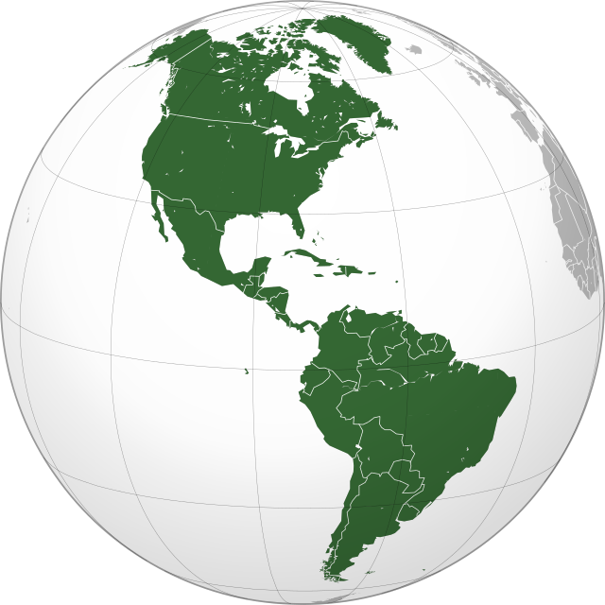
About me

Slide 4
About me
BSc in Oceanography - University of São Paulo
Advisors: Ilson Silveira, Amit Tandon, Glenn Flierl

Slide 5
About me
BSc in Oceanography - University of São Paulo
PhD Candidate - Dual Degree USP/UMassD
Advisors: Ilson Silveira, Amit Tandon

Slide 6
About me
BSc in Oceanography - University of São Paulo
PhD Candidate - Dual Degree USP/UMassD
Physical oceanographer with an ecologist’s heart
Observationalist and modeler

Slide 7
About me
BSc in Oceanography - University of São Paulo
PhD Candidate - Dual Degree USP/UMassD
Physical oceanographer with an ecologist’s heart
Observationalist and modeler
Interests:
Mesoscale and submesoscale dynamics
Physical-biological interactions
Plankton ecology and biogeography

Slide 8
Introduction

Slide 9
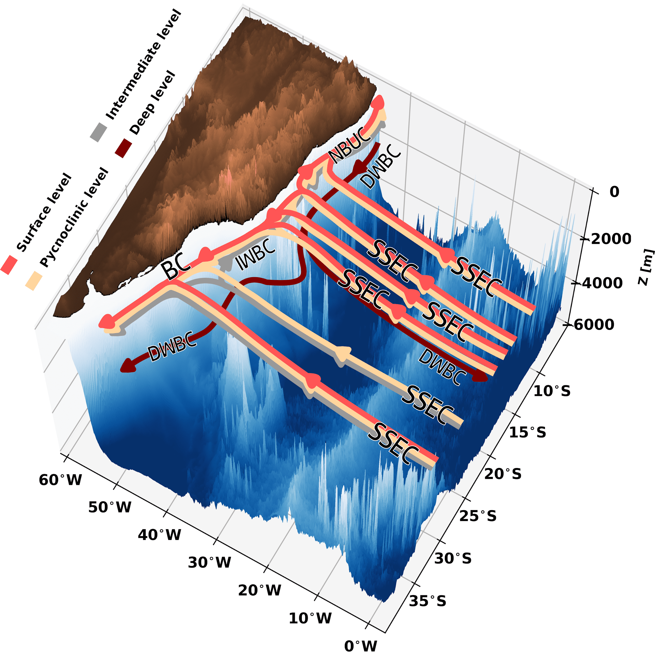
1. Introduction
The western boundary currents off SE Brazil
Brazil Current (BC):
surface level (0-500 m).
Warmer and saltier waters poleward.
Intermediate Western Boundary Current (IWBC):
intermediate level (500-1500 m).
Colder and fresher waters equatorward.
Luko et al. (2021)

Slide 10
1. Introduction
The western boundary currents off SE Brazil
Brazil Current (BC):
surface level (0-500 m).
Warmer and saltier waters poleward.
Intermediate Western Boundary Current (IWBC):
intermediate level (500-1500 m).
Colder and fresher waters equatorward.
First-baroclinic-mode jet.
Luko et al. (2021)

Slide 11
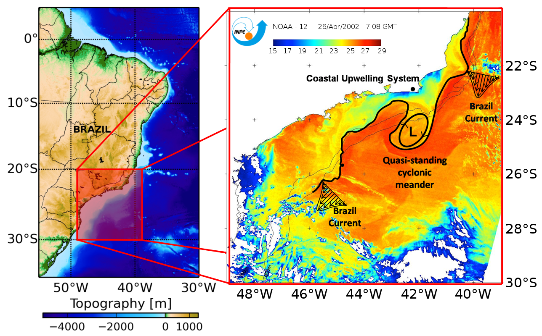
1. Introduction
Quasi-stationary meanders
Continental margin changes direction between 20°S e 23°S.
Formation of large mesoscale meanders - Baroclinic Instability.
Observed off Cape Frio (23°S), and Cape São Tomé (22°S), quasi-stationary nature.
Cyclonic rings are frequently shed.
Likely to condition the pelagic ecosystem and contribute to cross-shelf exchange.
Cape São Tomé
Cape Frio
Courtesy of Gilberto Watanabe

Slide 12
1. Introduction
Problem
Direct measurements are scarce.
Topographically generated.
Global numerical models fail in reproducing these phenomena properly.
Cape São Tomé
Cape Frio
Courtesy of Gilberto Watanabe

Slide 13
Scientific Questions
What impact do these meanders have on the vertical and horizontal distribution of nutrients and phytoplankton?
Are these features oases of enhanced primary production in the oligotrophic western South Atlantic at mid-latitudes?

Slide 14
Sampling strategy

Slide 15
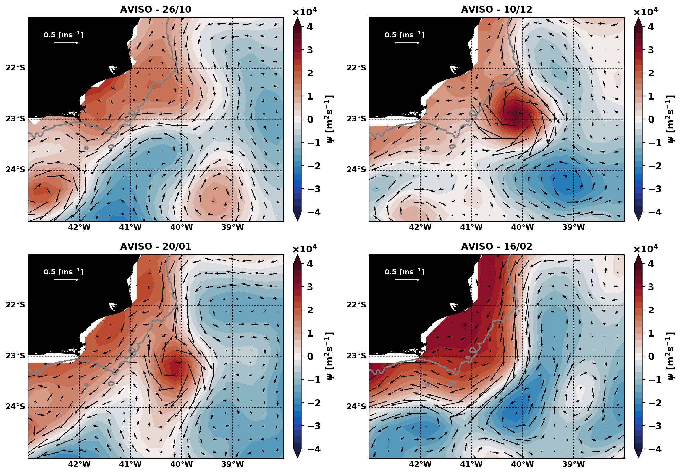
2. Sampling strategy
The ILHAS 3 cruise
A strong cyclonic mesoscale feature observed from October 2019 to February 2020;

Slide 16
2. Sampling strategy
The ILHAS 3 cruise
ILHAS 3
A strong cyclonic mesoscale feature observed from October 2019 to February 2020;
Detected and surveyed during the ILHAS 3 cruise – December 2019.

Slide 17
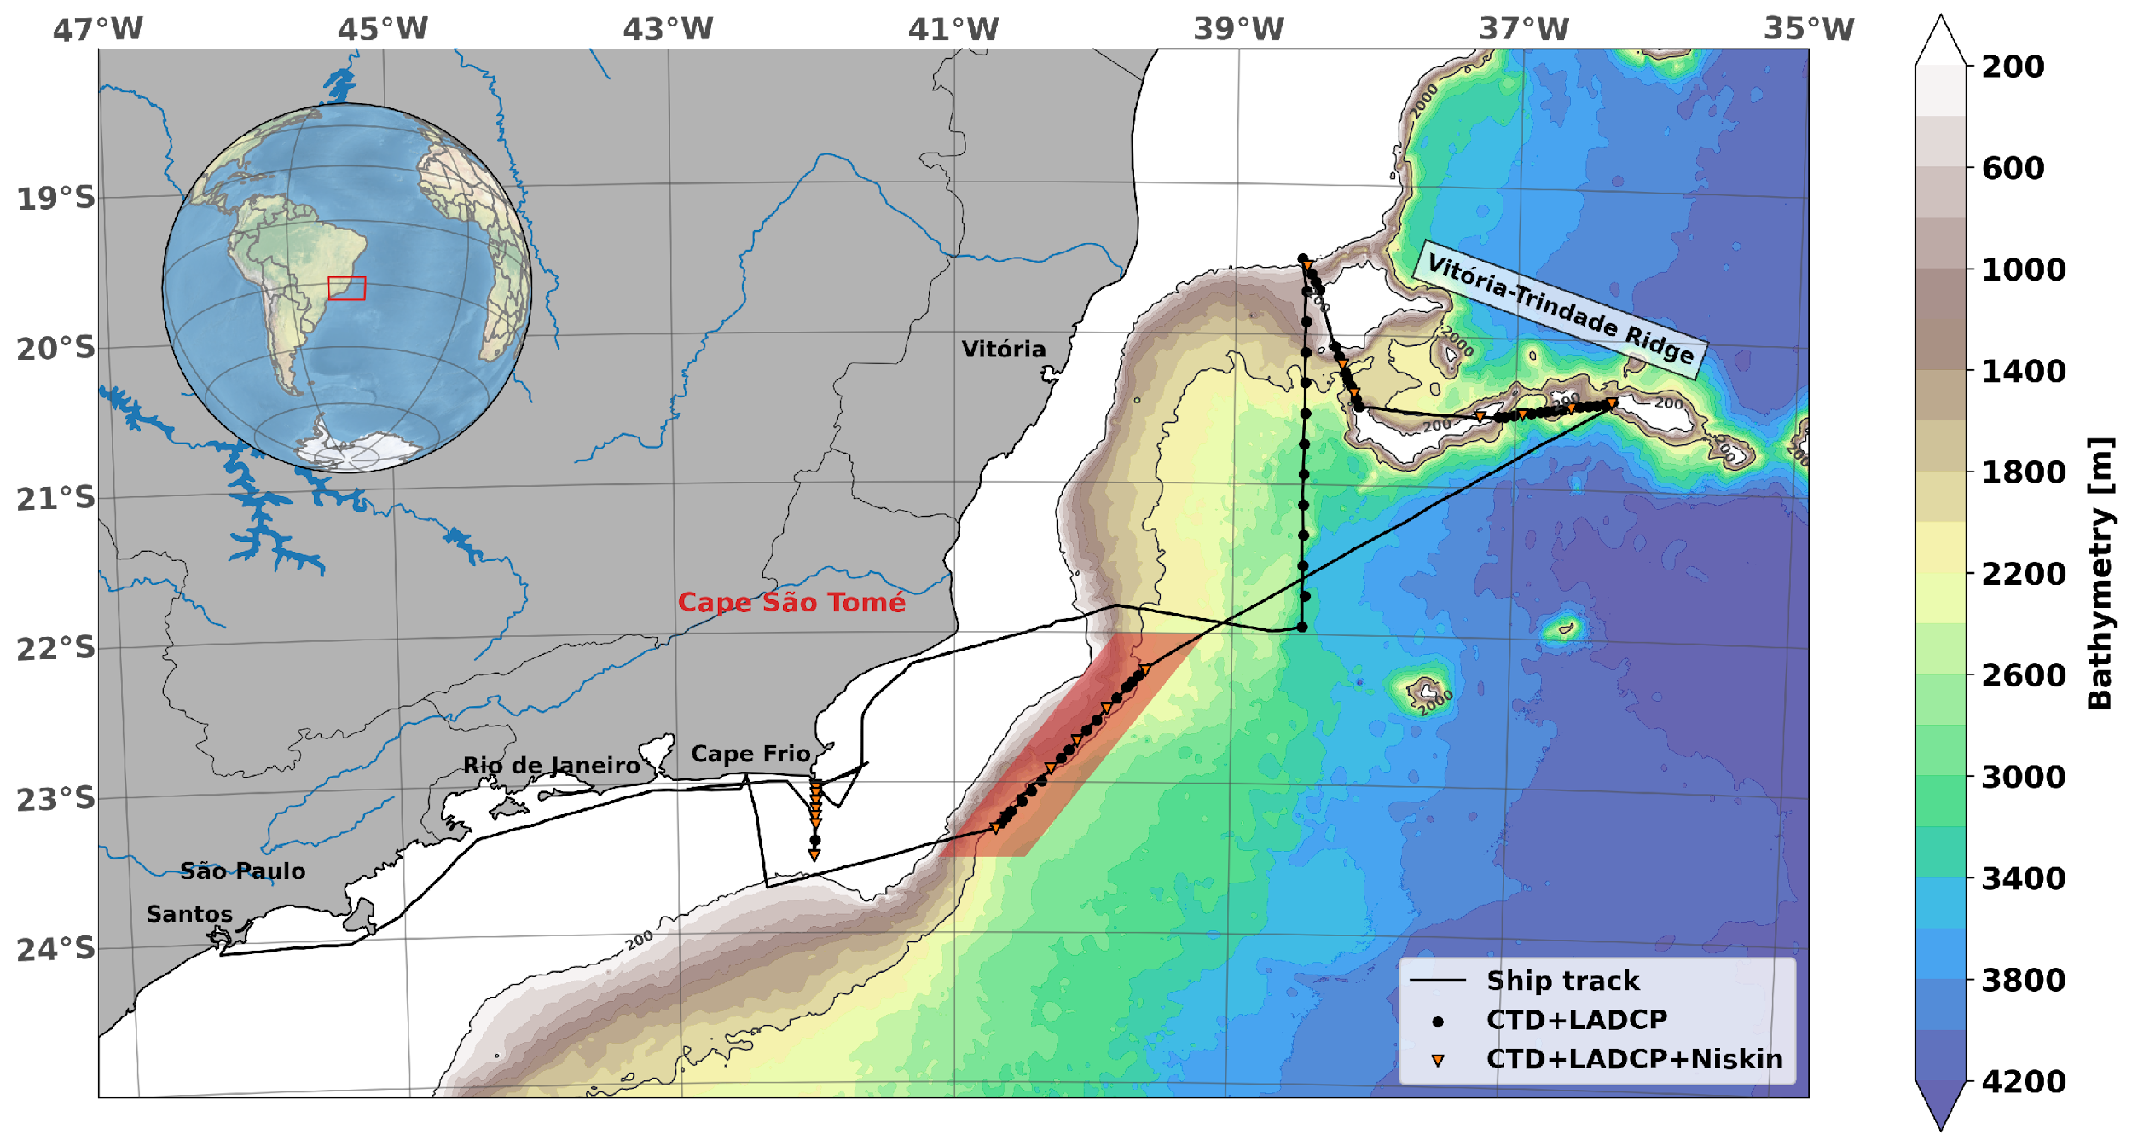
2. Sampling strategy
The ILHAS 3 cruise

Slide 18
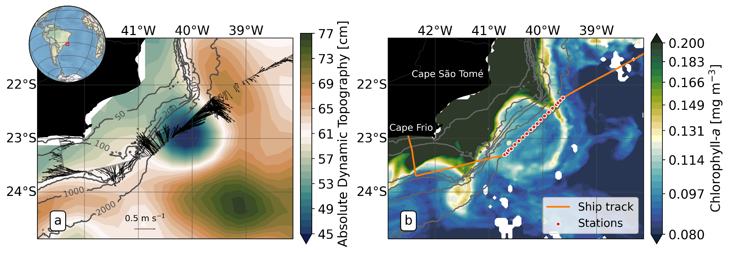
2. Sampling strategy
The Cape São Tomé Eddy
Traditional CTD stations; shipboard and lowered ADCPs.

Slide 19
The Cape São Tomé Eddy

Slide 20
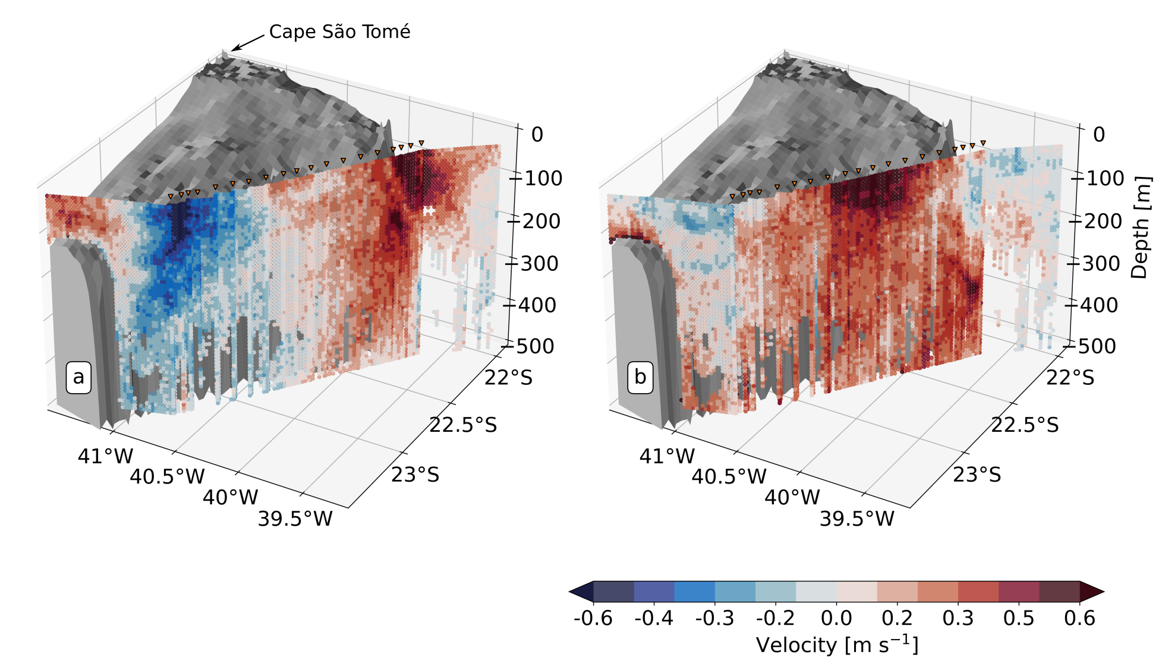
2. The Cape São Tomé Eddy

Slide 21
2. The Cape São Tomé Eddy
Cross-track component

Slide 22
2. The Cape São Tomé Eddy
Along-track component
Cross-track component

Slide 23
2. The Cape São Tomé Eddy
Along-track component
Cross-track component

Slide 24
2. The Cape São Tomé Eddy
Along-track component
Cross-track component

Slide 25
2. The Cape São Tomé
The system is surface intensified.
The flow is compressed against the slope - enhanced along-track velocity.
Cross-track component
Along-track component

Slide 26
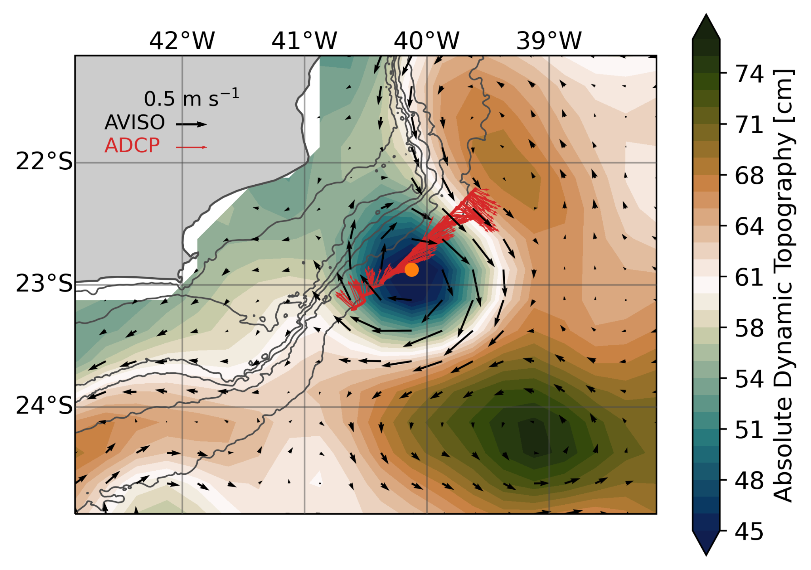
2. The Cape São Tomé
The system is surface intensified.
The flow is compressed against the slope - enhanced along-track velocity.
Cross-track component
Along-track component

Slide 27
2. The Cape São Tomé
Isopycnals dome towards the center.
Characteristic minimal salinity of the AAIW in the South Atlantic.
Lower salinity signature in the northeastern portion.

Slide 28
2. The Cape São Tomé
Isopycnals dome towards the center.
Characteristic minimal salinity of the AAIW in the South Atlantic.
Lower salinity signature in the northeastern portion.

Slide 29
2. The Cape São Tomé
?
Isopycnals dome towards the center.
Characteristic minimal salinity of the AAIW in the South Atlantic.
Lower salinity signature in the northeastern portion.

Slide 30
Upper ocean features

Slide 31
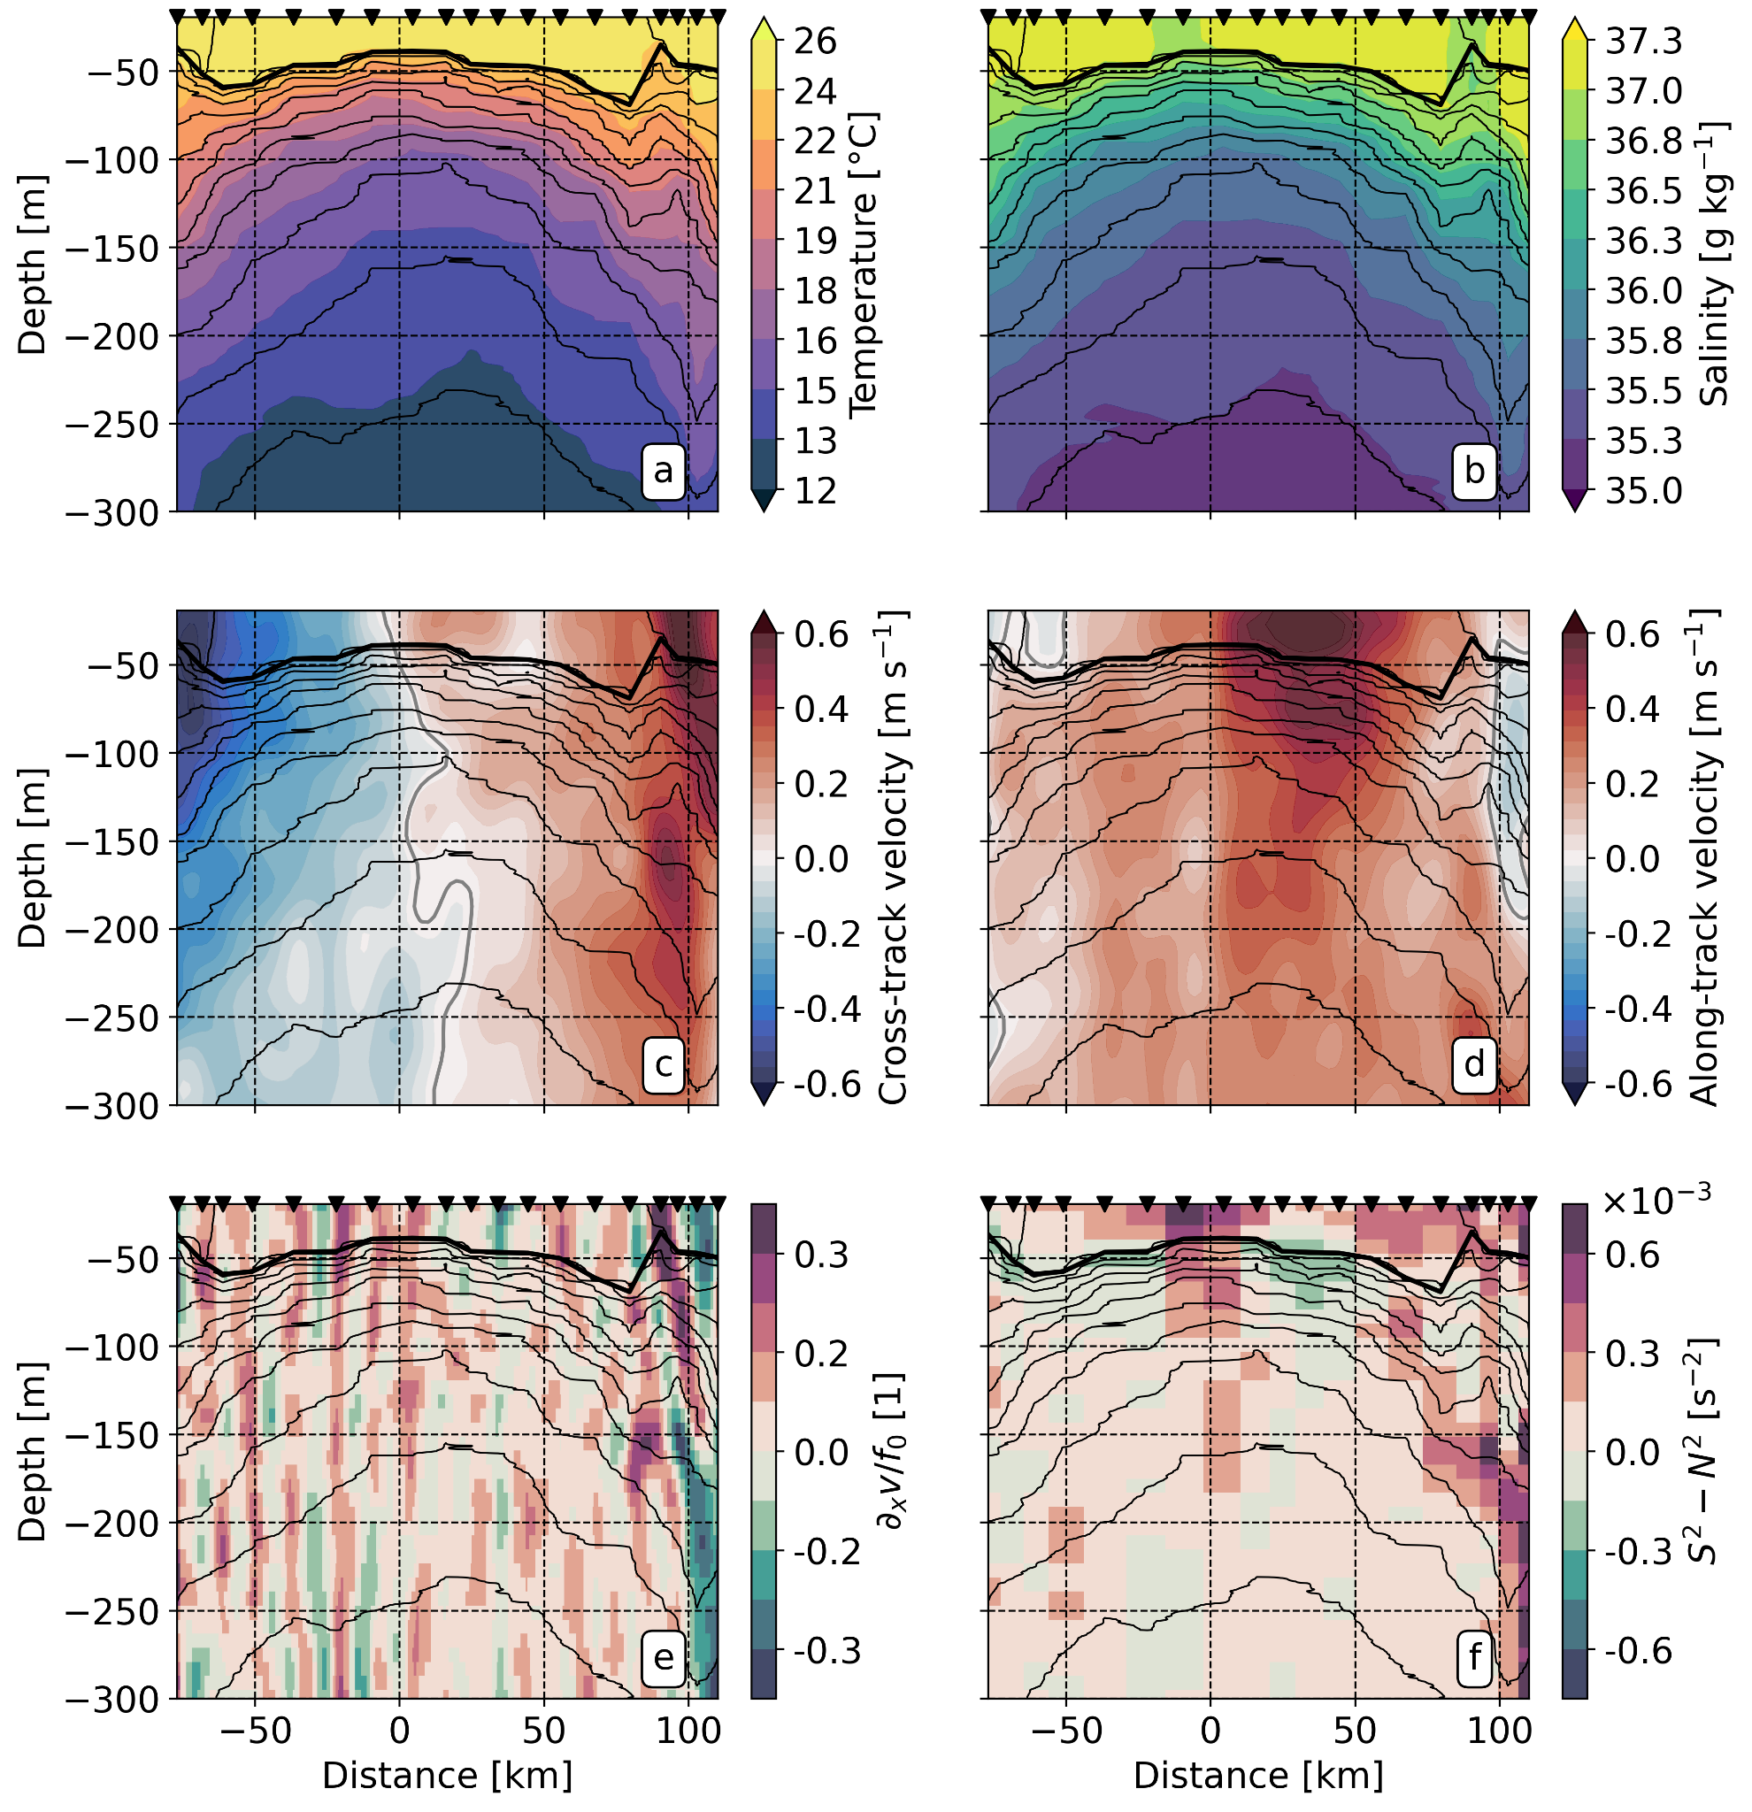
3. Upper ocean features
Lower salinity signature associated with a convex-shaped feature at subsurface.
Subsurface enhanced cross-track velocity.
Convergence in the along-track component.

Slide 32
3. Upper ocean features
Lower salinity signature associated with a convex-shaped feature at subsurface.
Subsurface enhanced cross-track velocity.
Convergence in the along-track component.

Slide 33
3. Upper ocean features
Lower salinity signature associated with a convex-shaped feature at subsurface.
Subsurface enhanced cross-track velocity.
Convergence in the along-track component.
Deformation scale O(10) km

Slide 34
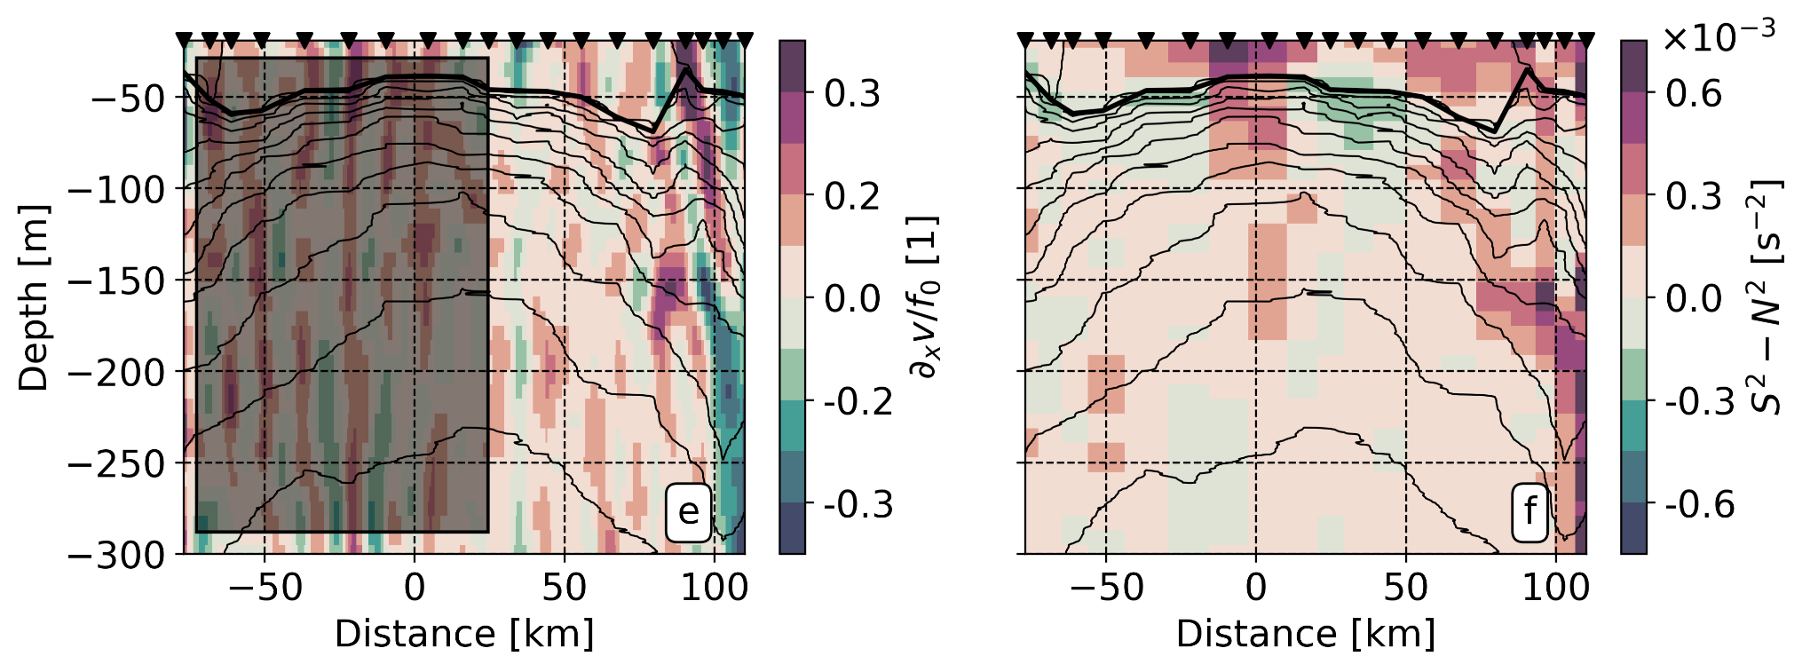
3. Upper ocean features
Enhanced shear leads to O(1) Rossby number associated.
Banded vorticity structure at surface and subsurface - baroclinic structure.
Enhanced vertical shear - more likely to mixing events.

Slide 35
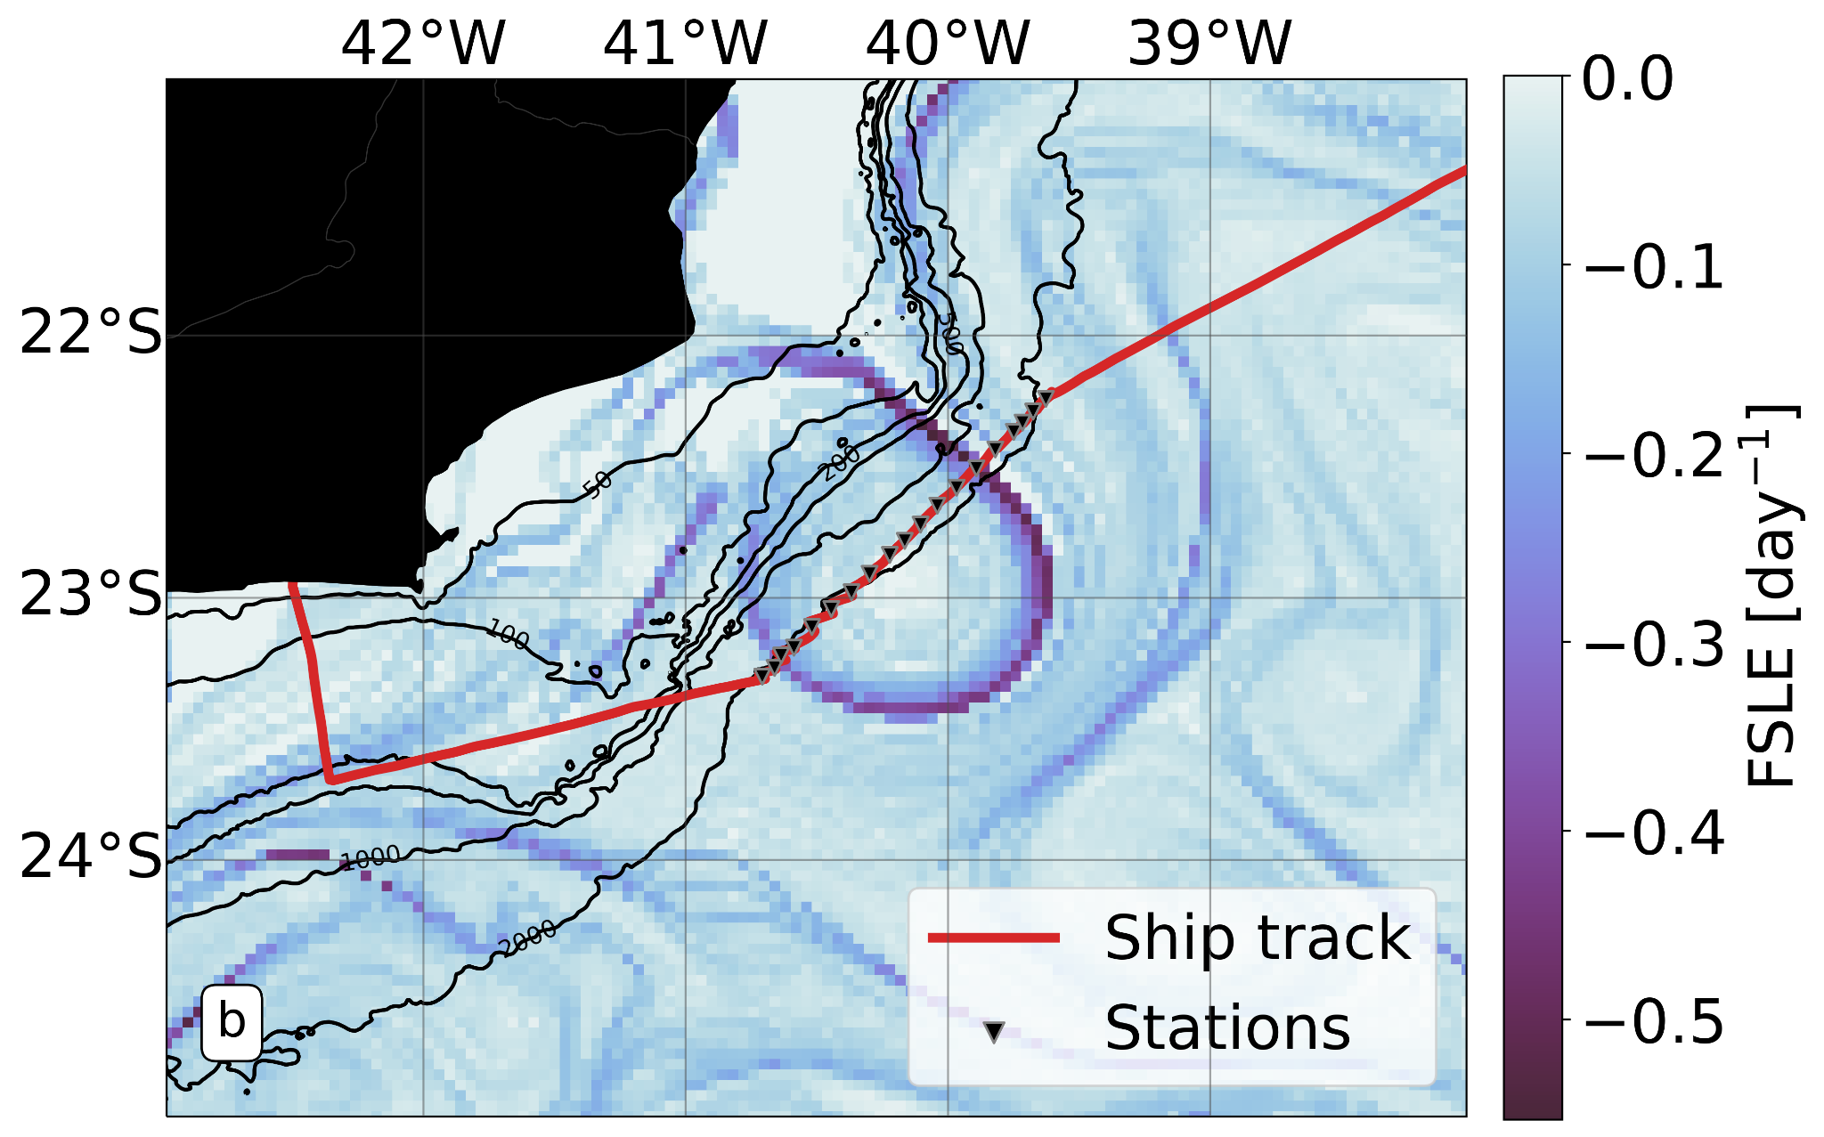
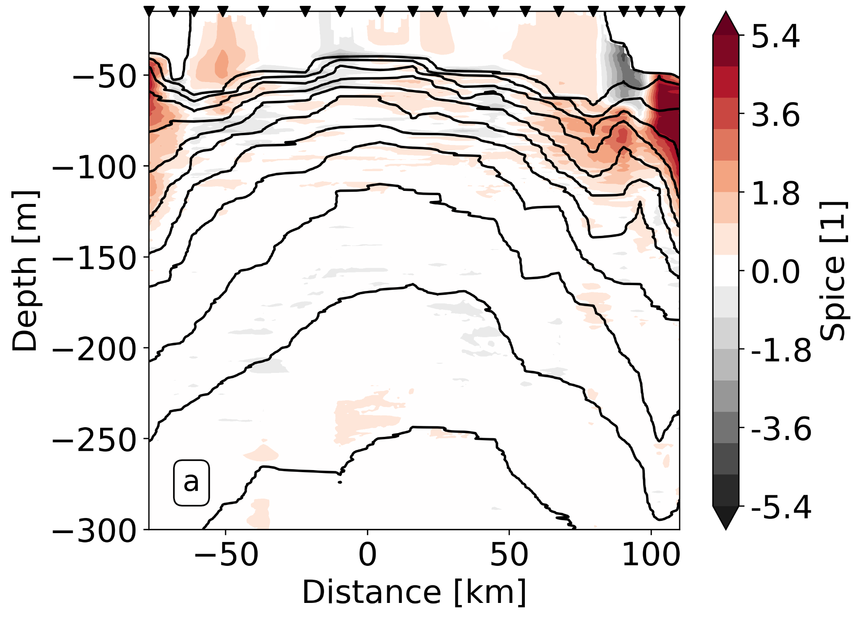
3. Upper ocean features
Minty waters in the top 100 m on the northeastern edge. Shelf water signature.
Filamentary structure surrounds the meander due to mesoscale deformation.
The convex-shaped structures on the edges are the buoyancy signature of this filament.

Slide 36
3. Upper ocean features
2km CROCO simulation
Luko et al, Submitted to JPO

Slide 37
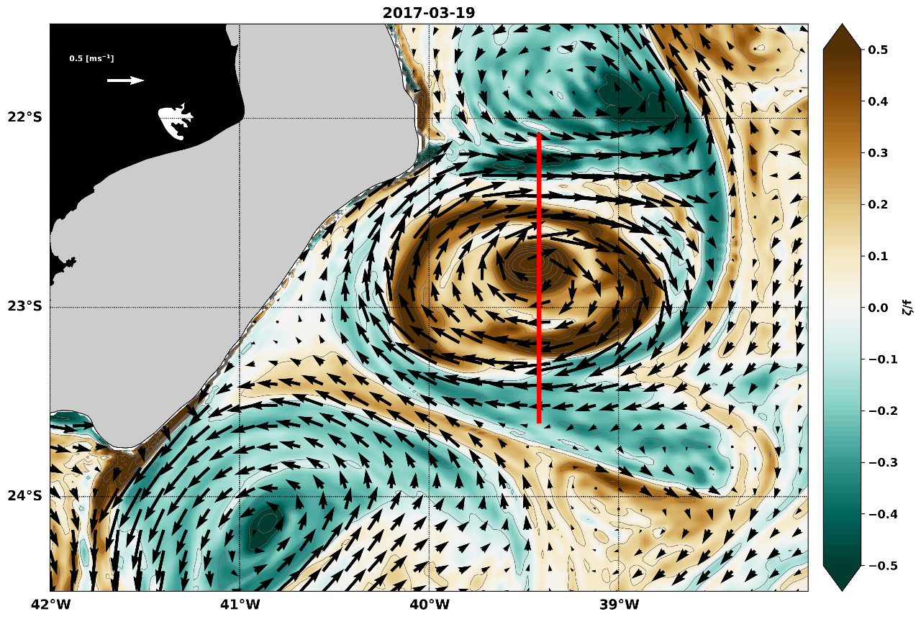
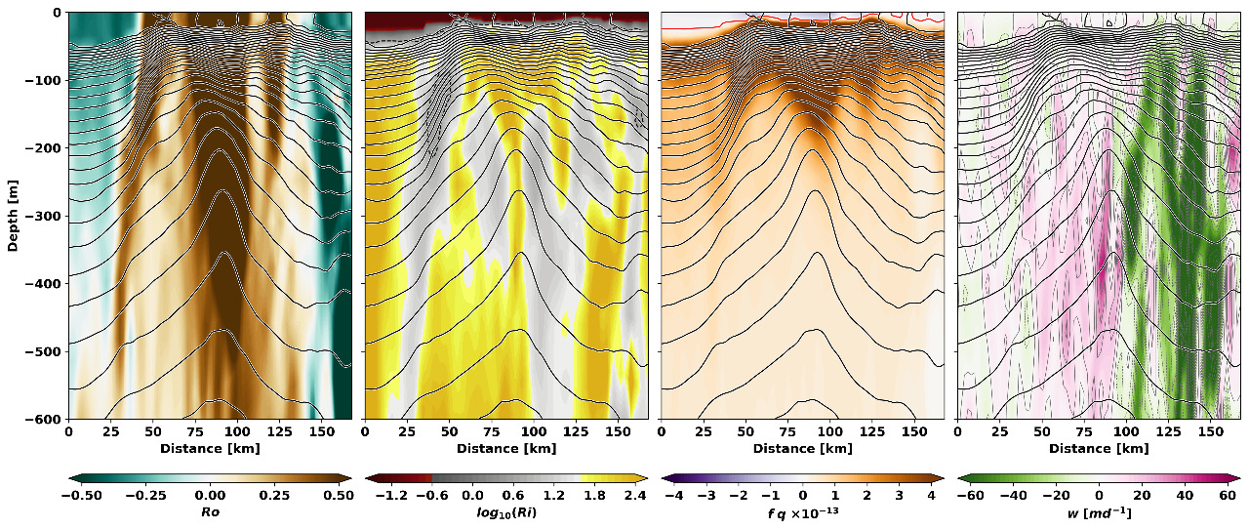
3. Upper ocean features
Numerical evidence of the convex-shaped isopycnals associated with high Rossby number at the meander northern edge.
Luko et al, Submitted to JPO

Slide 38
Ecological response

Slide 39
3. Ecological response
Deep Chlorophyll Maximum presents the expected signature for a cyclonic mesoscale structure - eddy pumping
North/South asymmetry with much higher concentrations on the northern sector.
Enhanced oxygen just above the DCM.

Slide 40
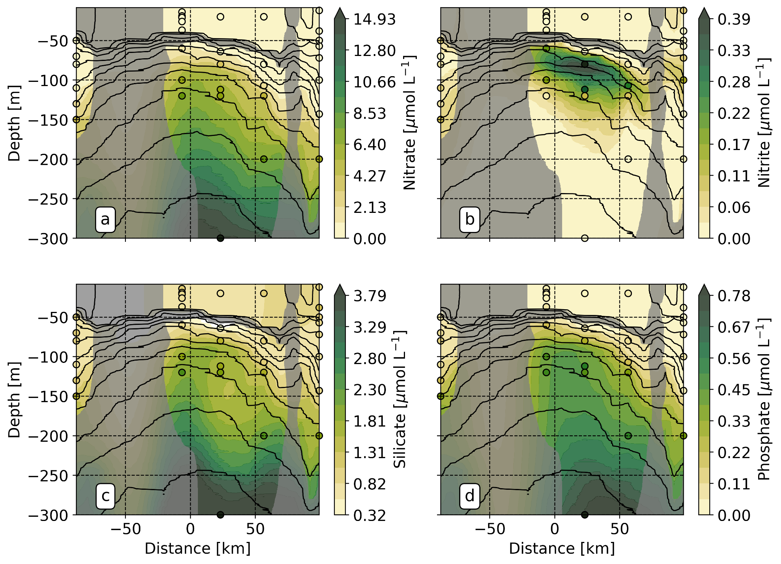
3. Ecological response

Slide 41
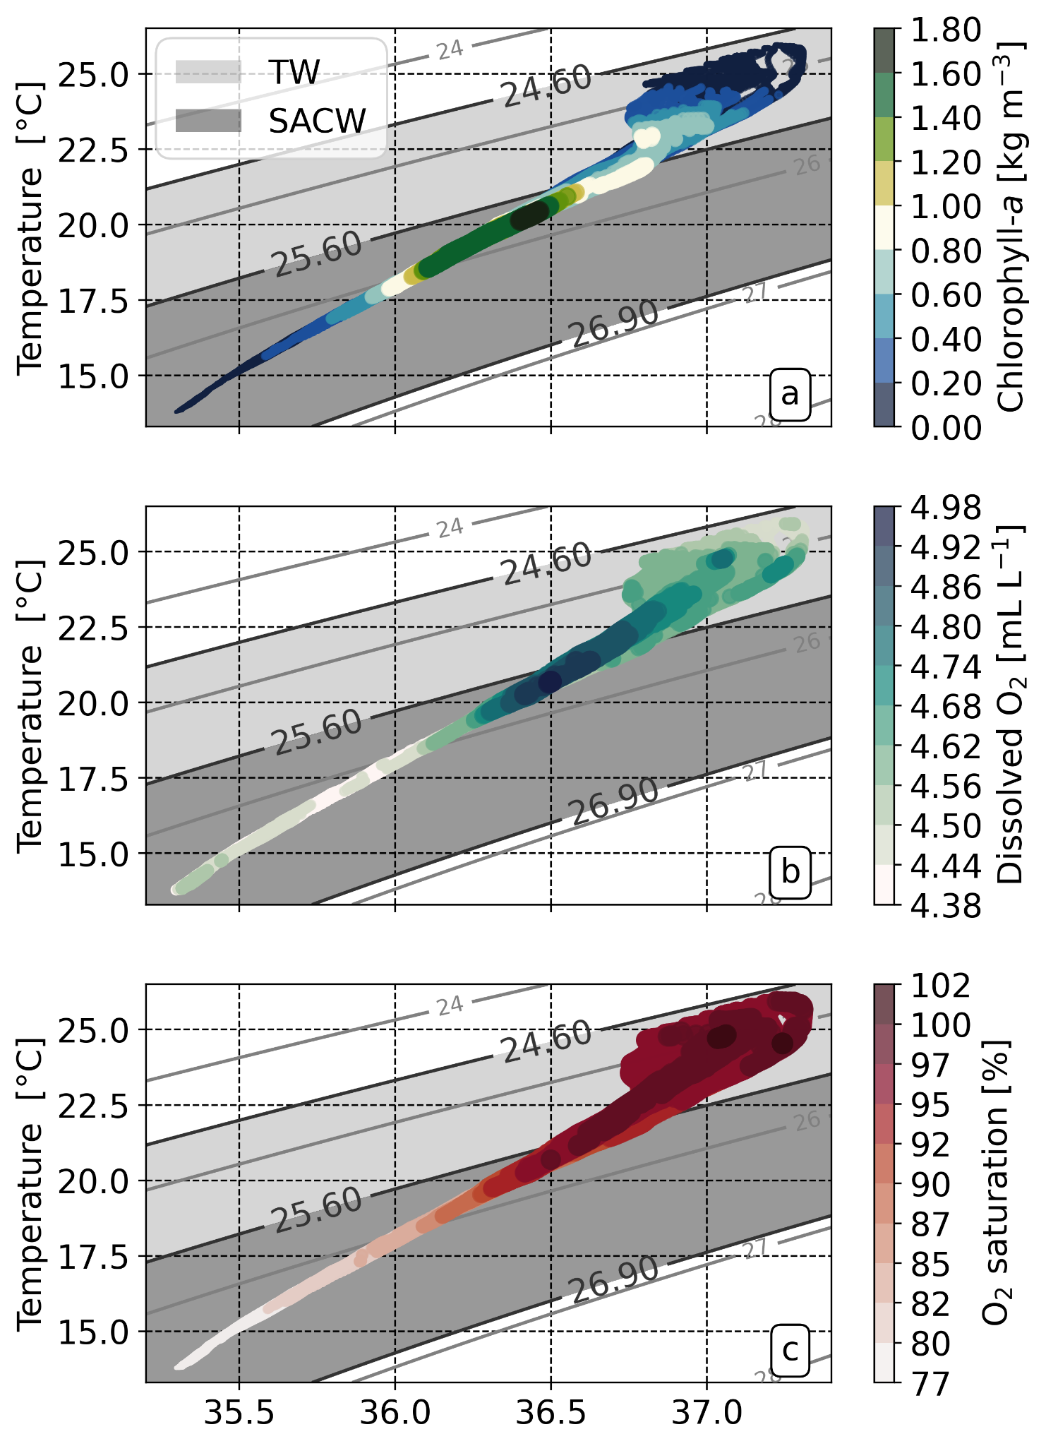
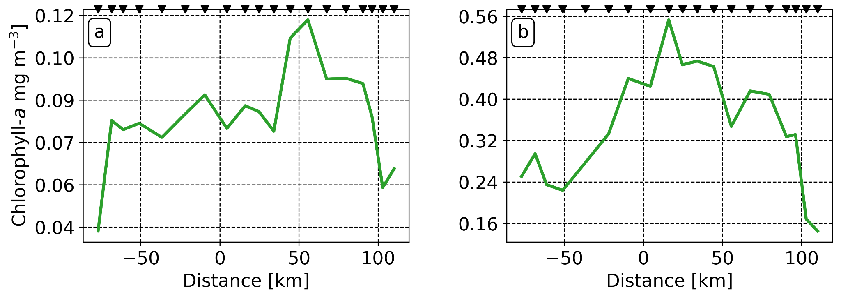
3. Ecological response
within ML
below ML
Mixed layer presents a pattern related to satellite images, due to eddy stirring.
Deep Chlorophyll Maximum presents the expected signature for a cyclonic mesoscale structure - eddy pumping.
North/South asymmetry with much higher concentrations on the northern sector.

Slide 42
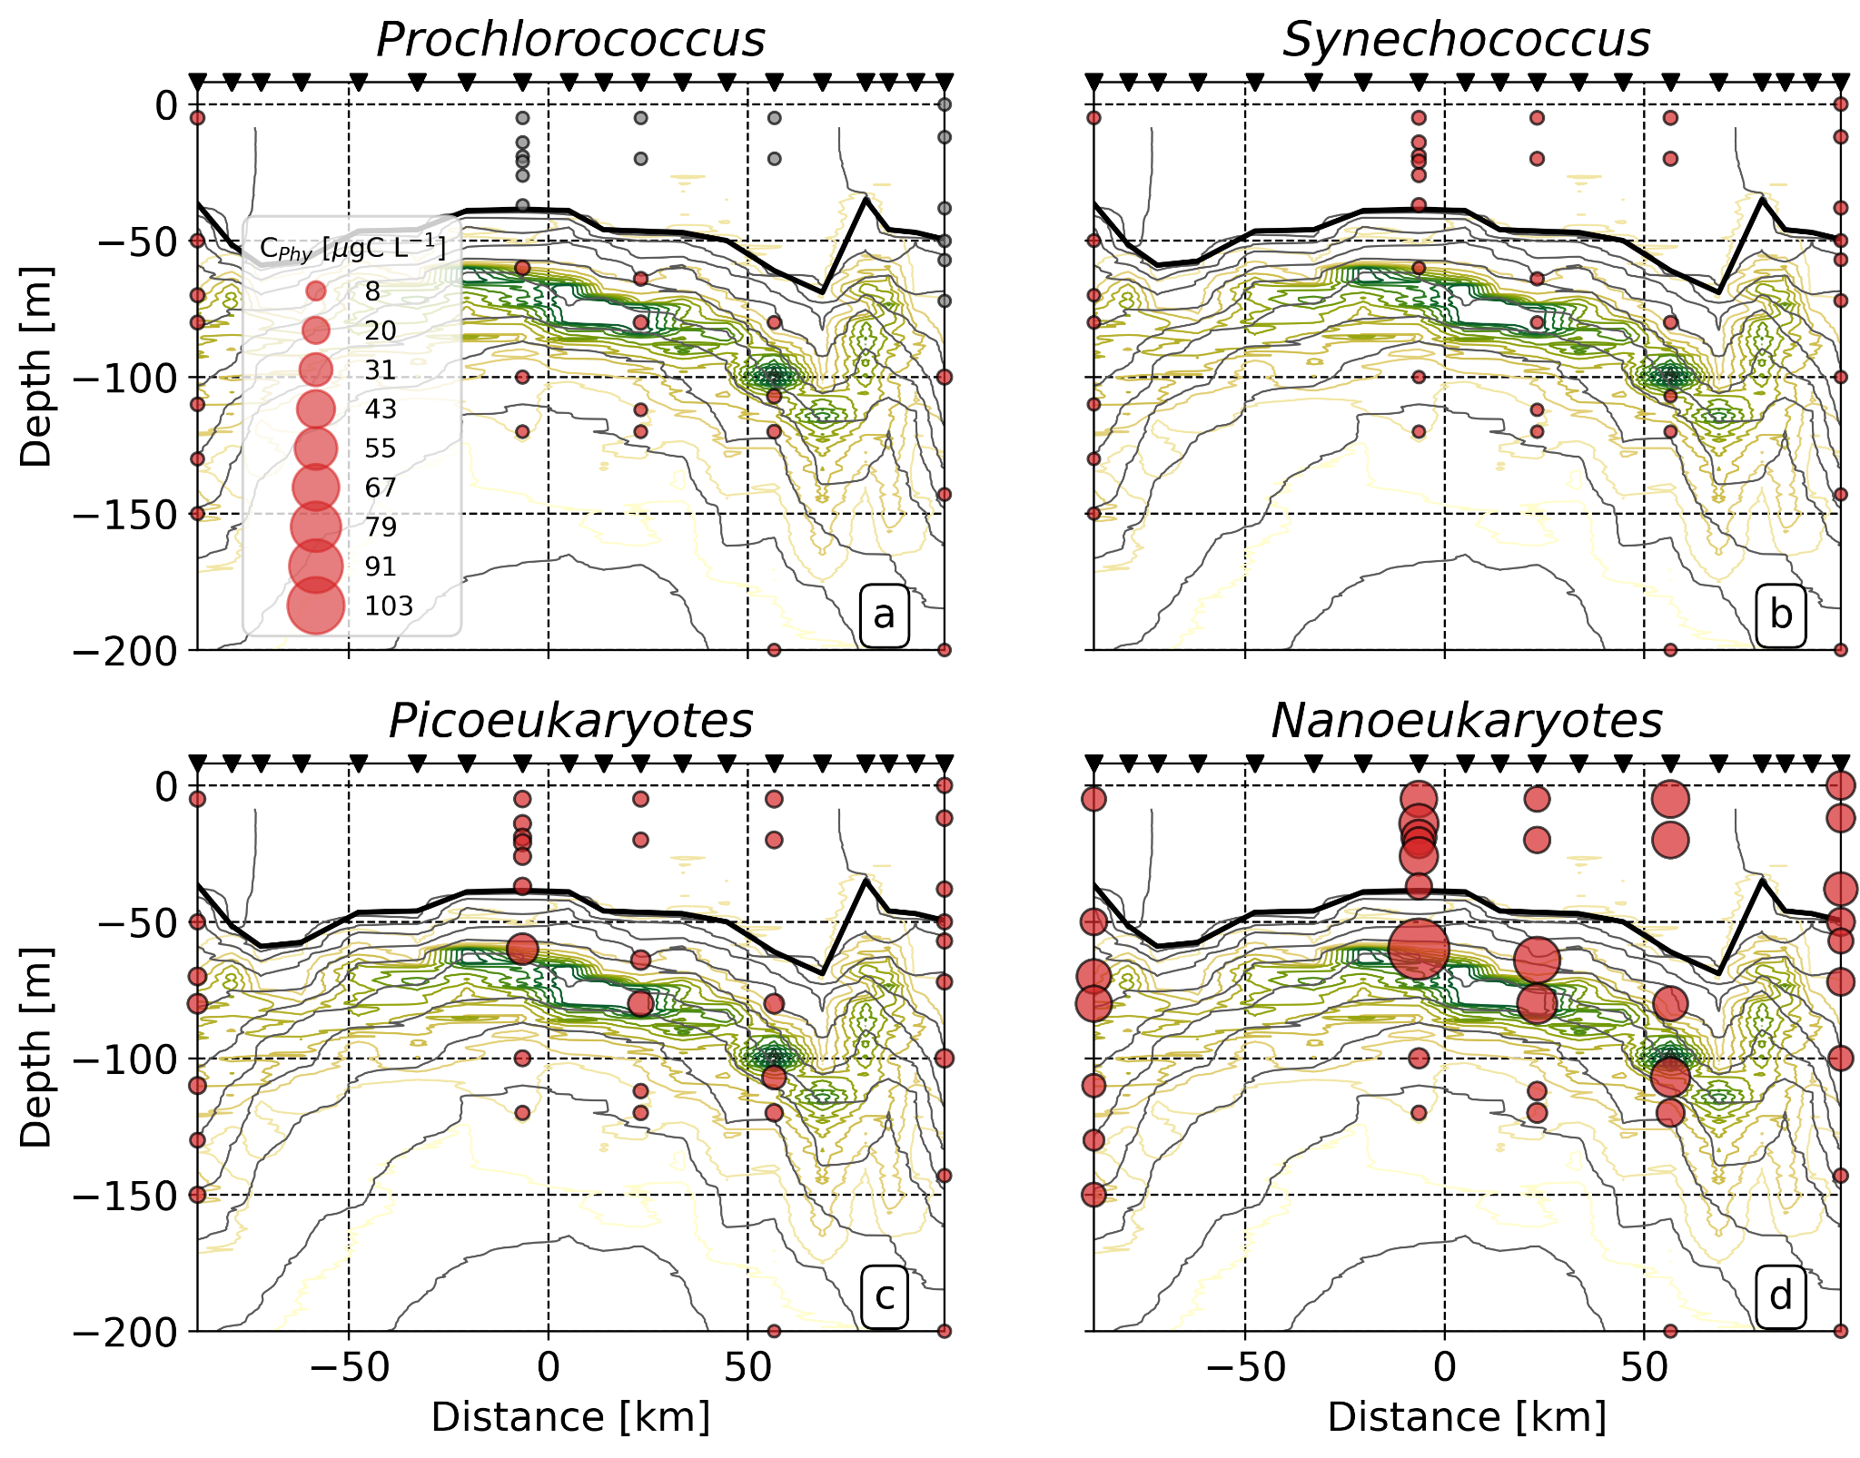
3. Upper ocean features
System is expected to be dominated by cyanobacteria
Shelf waters by picoeukariotes
Larger cells are favored -
Eddy pumping evidence.

Slide 43
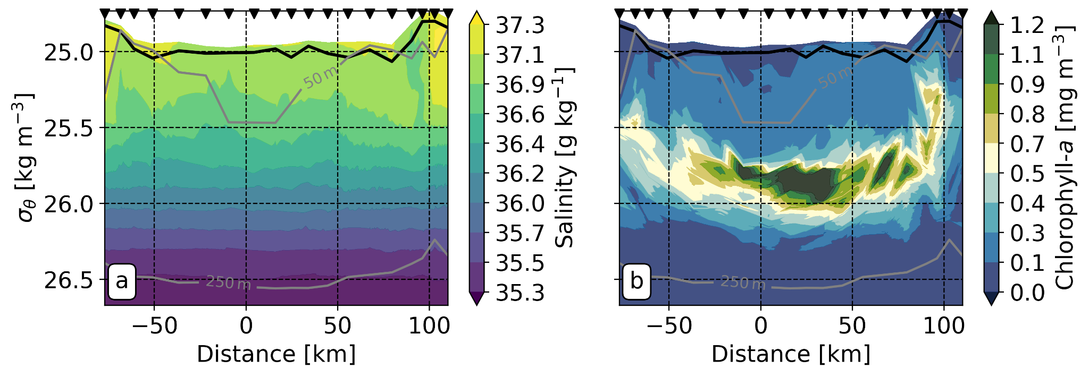
3. Ecological response
Cross-isopycnal patch of lower salinity associated with the filament.
The filament induces cross-isopycnal chlorophyll ejections upward from the DCM, Does it hit a “wall”?

Slide 44
Highlights
Most phytoplanktonic response to the mesoscale meander in summer occurs beneath the mixed layer which is not visible from satellite imagery.
The meander enhances primary production below the mixed layer and transports shelf waters via mesoscale stirring at surface.
Phytoplankton responds to eddy pumping within the meander but to a different dynamic regime along the rim due to submesoscale filaments.

Slide 45
More questions
How representative is the surveyed meander of the quasi-stationary meander?
How does the ecosystem respond downstream to the filament?
How does the vertical distribution of phytoplankton changes from season to season?
Does eddy-pumping play a smaller role in the winter season?

Slide 46
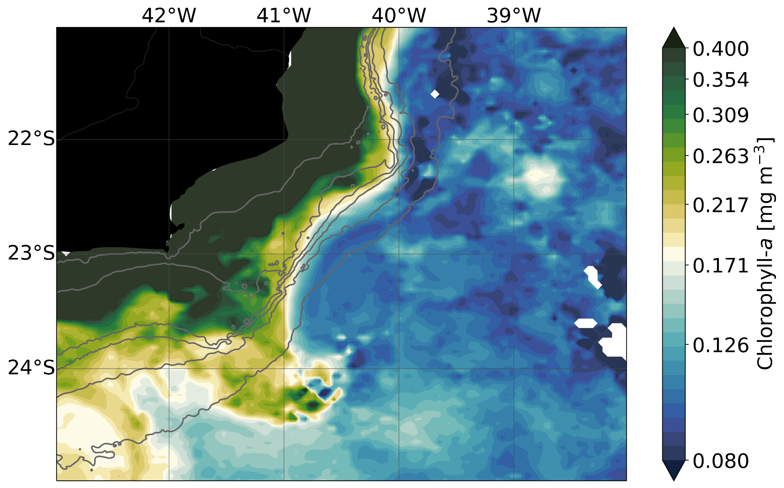
More questions
Summer
Summer
Winter

Slide 47
Acknowledgments
São Paulo Research Foundation
Filipe Pereira
pereiraf@usp.br
R/V Alpha Crucis’ crew
Peter Franks, Kelley McBride, Shailja Gangrade, Christian Buckingham, Alice Pietri, Iury Simoes-Sousa

Slide 48
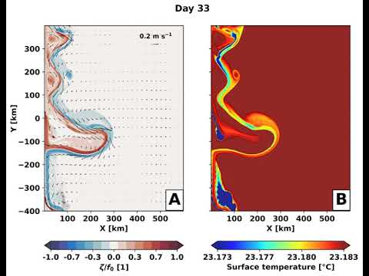

Slide 49
N uptake Grazing Z death P death
10-km experiment
1-km experiment

