Slide 1
FilaChange 2022
Mixed layer eddies supply nutrients to enhance the spring phytoplankton bloom
Iury Simoes-Sousa, Amit Tandon, Filipe Pereira, Cauê Z. Lazaneo and Amala Mahadevan
(UMassD) (UMassD) (USP/UMassD) (USP) (WHOI)
August 2022

Slide 2
Outline
Introduction
Experimental Setup
Initial Conditions and Forcing
Unstable Fronts
Coarse-grained Simulations
Springtime Bloom
Nutrient Fluxes
Summary and Acknowledgments

Slide 3
About me

Slide 4
About me - Interests and Collaborations
Programming and software dev - Python, Julia, Matlab, FORTRAN, SQL, …
Open-source projects - xarray, geopandas, argopy, Oceananigans.jl
Combining big datasets - altimetry, moorings, Argo, drifters, hydrography
Sub/mesoscale eddy dynamics - Cesar Rocha, Ilson Silveira, Glenn Flierl
Air-sea interaction - Emily Shroyer, Simon deSzoeke, Debasis Sengupta
Biophysical processes - Amala Mahadevan (check iuryt/Bioceananigans.jl)
Turbulence and near-inertial waves - Sam Kelly
– 2023 –
PhD in Computational Science and Engineering
(Prof. Amit Tandon)
UMass Dartmouth
Follow me
@iuryt
@iurytss

Slide 5
Introduction

Slide 6
Springtime in Land

Slide 7
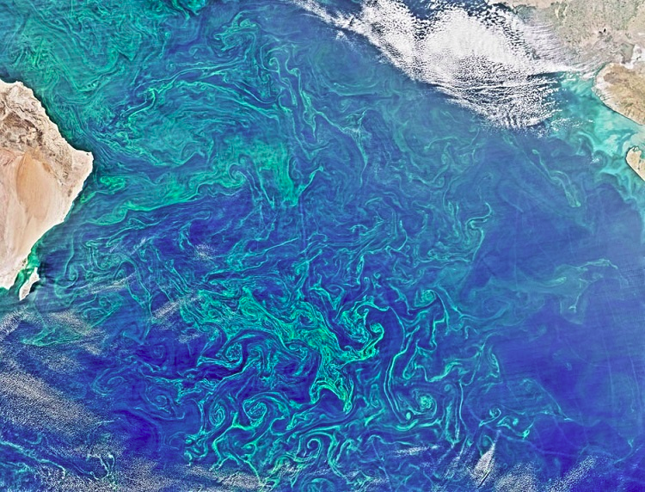
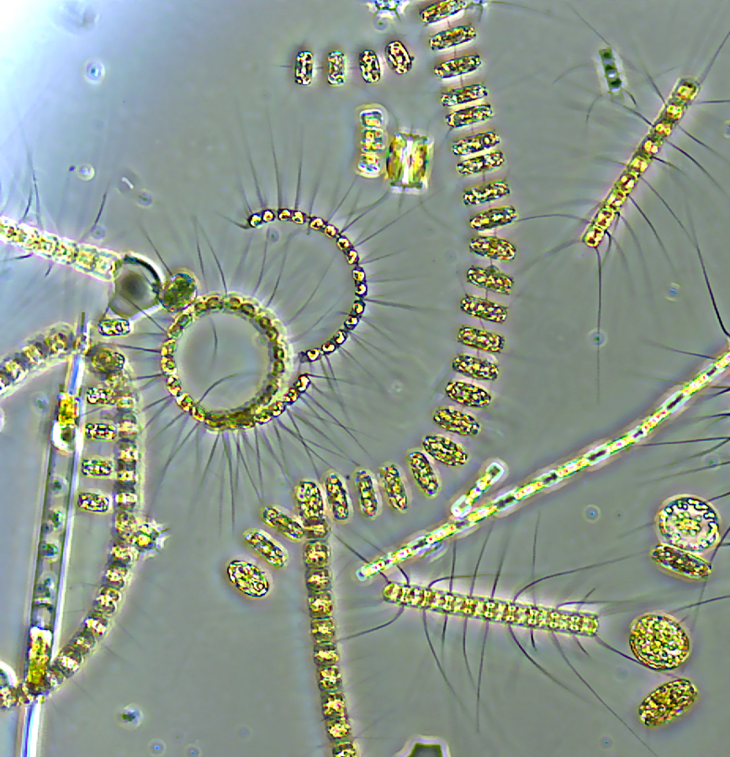
Springtime in Ocean
1% of photosynthetic biomass
50% of global CO² uptake!

Slide 8
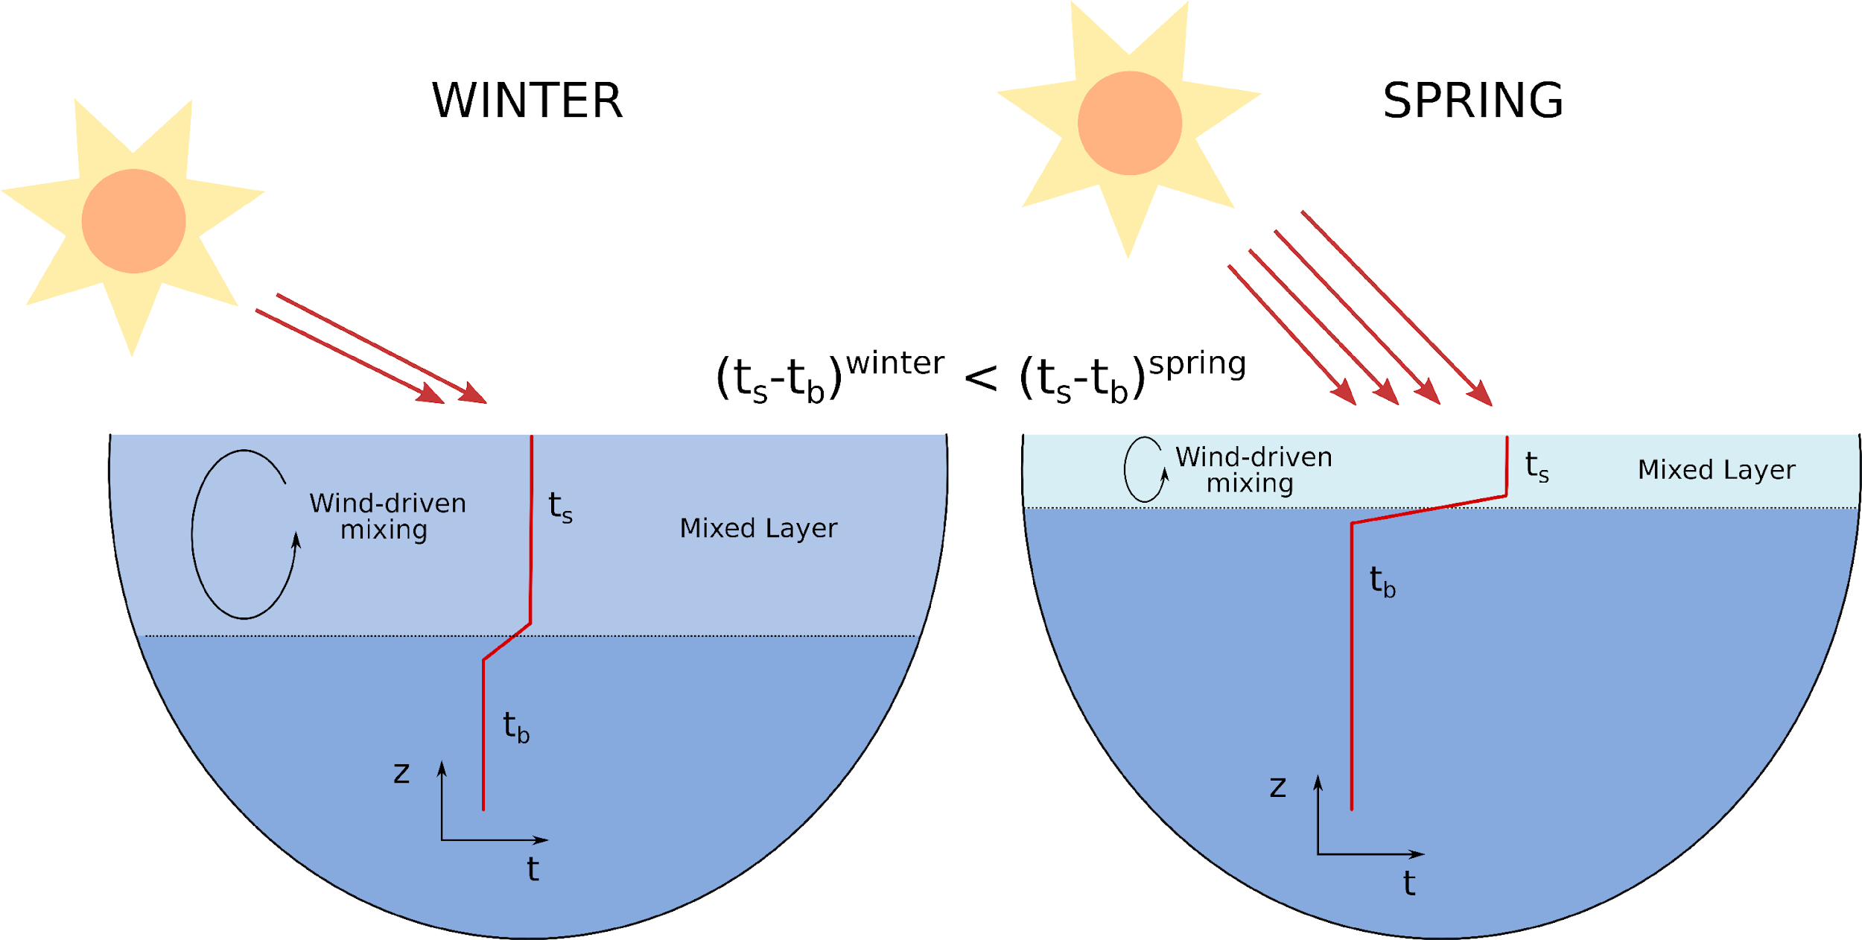
Classic theory for phytoplankton springtime blooms

Slide 9
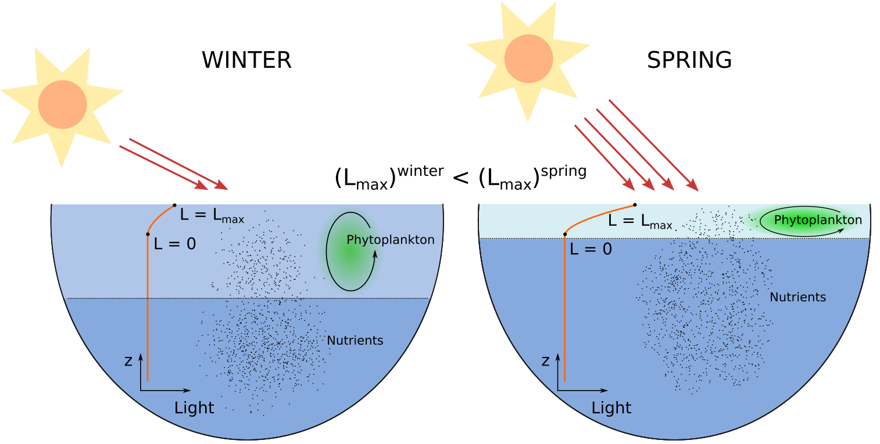
Classic theory for phytoplankton springtime blooms
Sverdrup (1953)

Slide 10
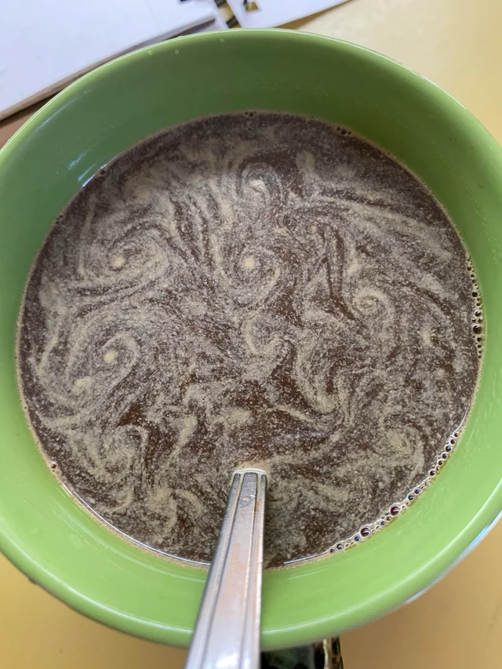
But the ocean is full of eddies and filaments

Slide 11
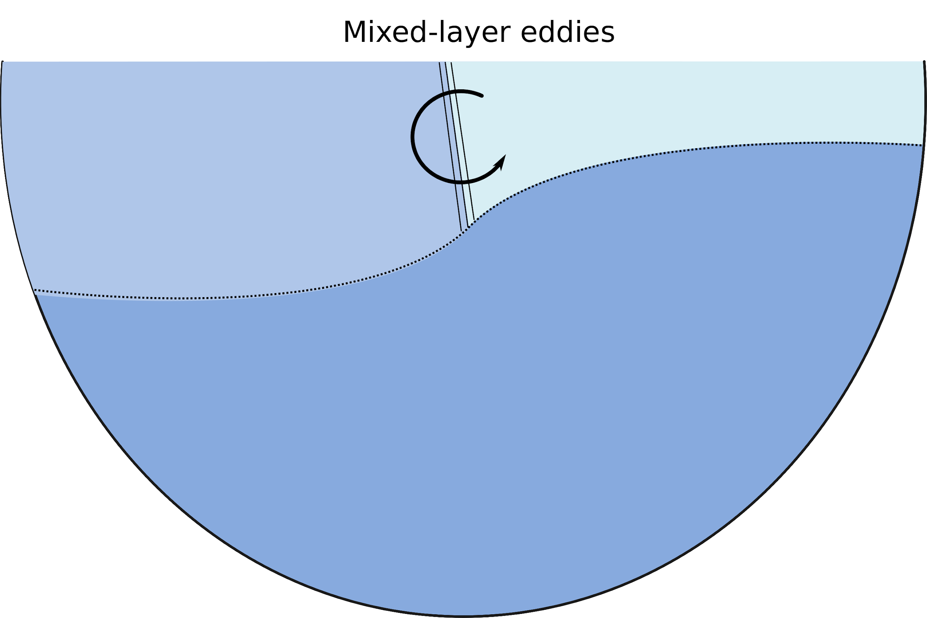
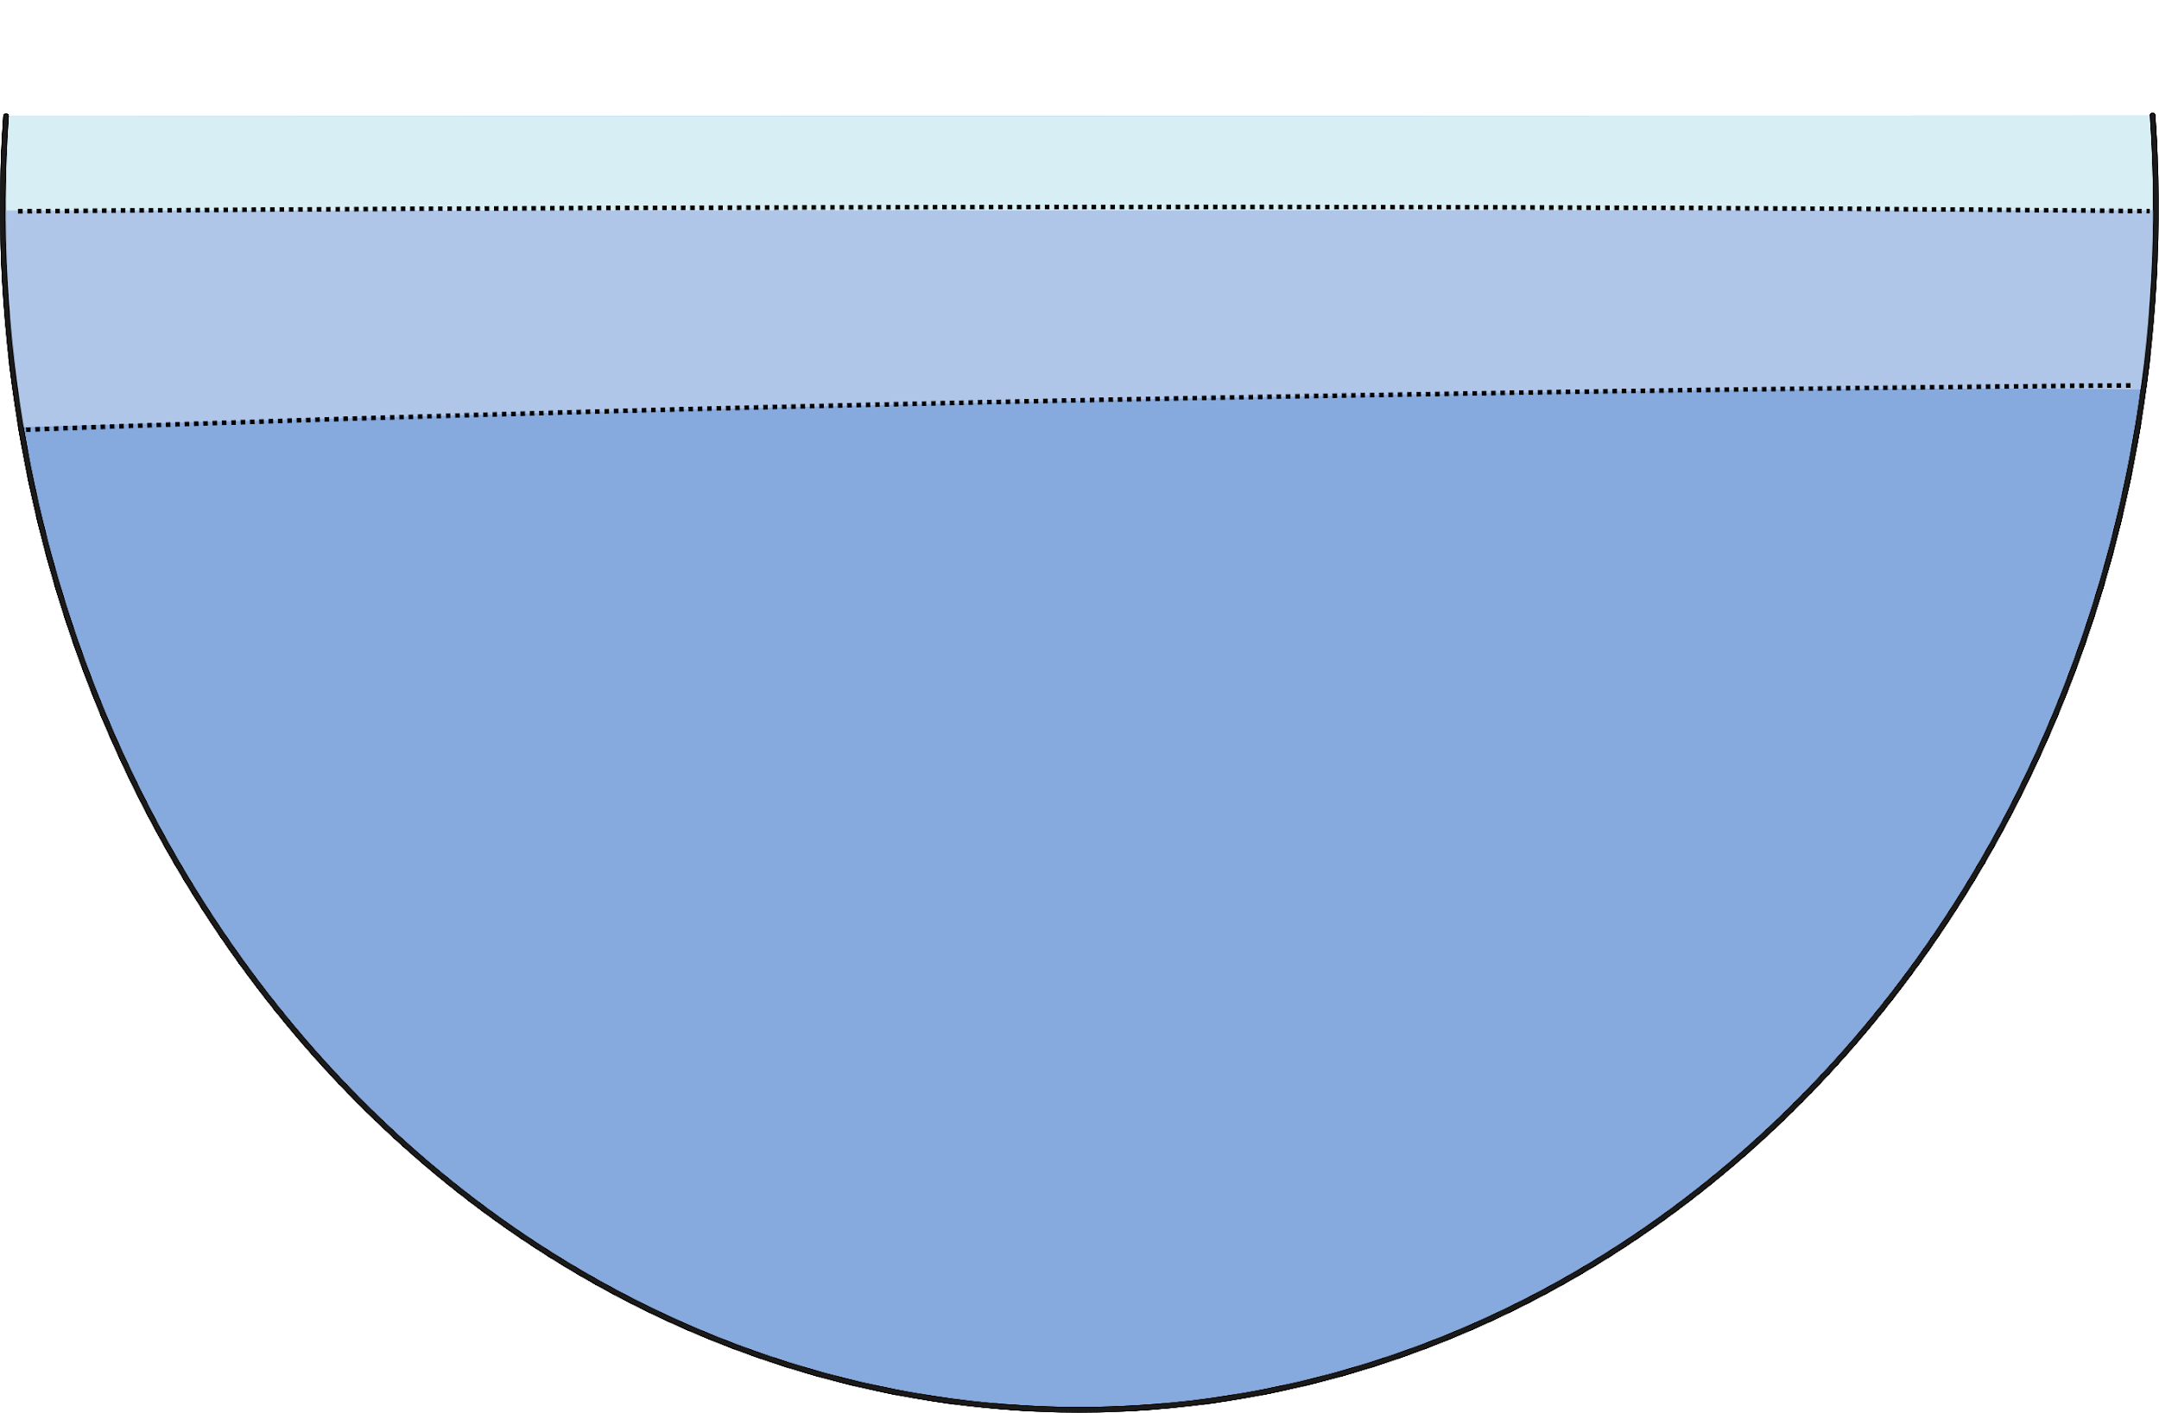
Mixed-layer eddies
Mixed-layer eddies drain the potential energy from fronts and enhance stratification!

Slide 12
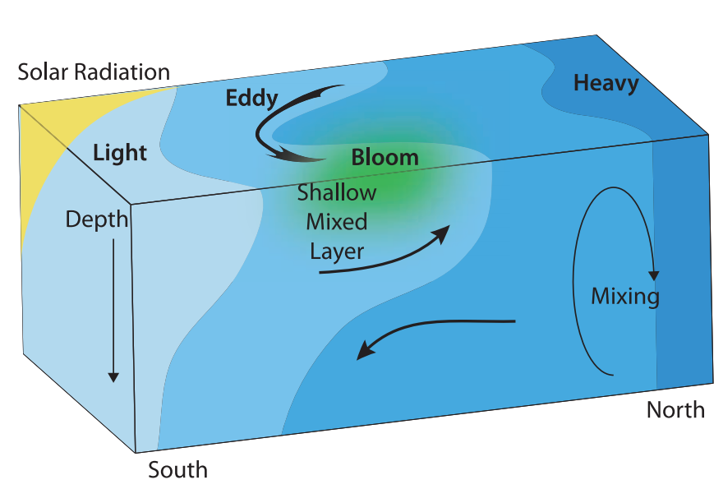
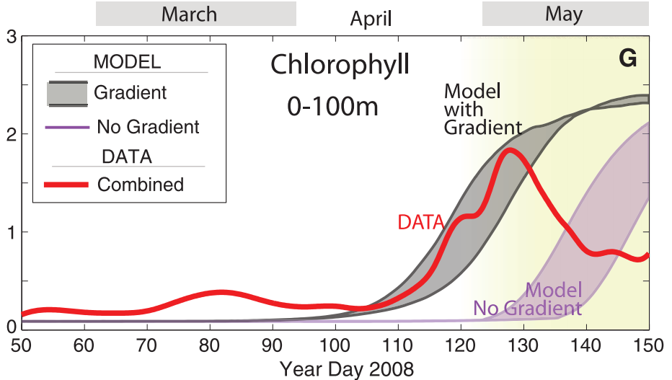
Mixed-layer eddies and springtime blooms
Mixed-layer instabilities anticipate phytoplankton bloom by 20-30 days!
Mahadevan et al. (2012)

Slide 13
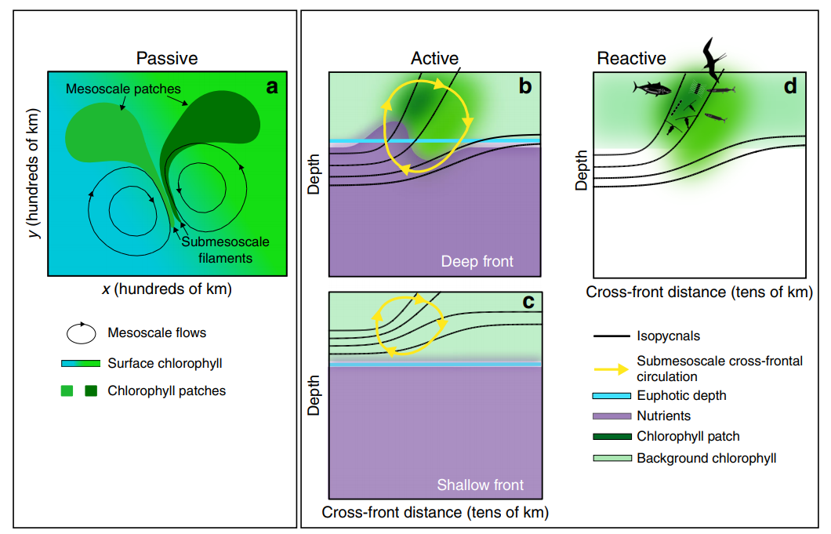
Mixed-layer eddies and springtime blooms
Submesoscale fronts can also influence the diversity and structure of the food web!
Levy et al. (2018)

Slide 14
Scientific Questions
What is the contribution of the vertical nutrient fluxes driven by mixed-layer eddies to the springtime bloom in high latitudes?
Do existing mixed-layer eddies parameterizations (Fox-kemper et al., 2008; Omand et al., 2015) capture this contribution?

Slide 15
Scientific Questions
What is the contribution of the vertical nutrient fluxes driven by mixed-layer eddies to the springtime bloom in high latitudes?
Do existing mixed-layer eddies parameterizations (Fox-Kemper et al., 2011; Omand et al., 2015) capture this contribution?

Slide 16
Experimental Setup

Slide 17
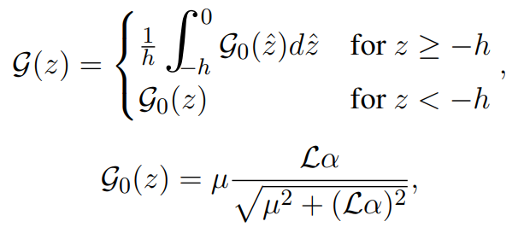
Biogeochemical model - Phytoplankton equation

Slide 18
Biogeochemical model - Phytoplankton equation
(Bagniewski et al., 2011; Gruber et al., 2006; Freilich and Mahadevan, 2019)

Slide 19
Biogeochemical model - Phytoplankton equation
Light-limiting growth averaged over the mixed layer
(Fasham et al., 1990)

Slide 20
Biogeochemical model - Phytoplankton equation
Maximum growth rate
(varied from 0.5-1.25 day⁻¹)

Slide 21
Biogeochemical model - Phytoplankton equation
Light attenuation due to phytoplankton shading

Slide 22
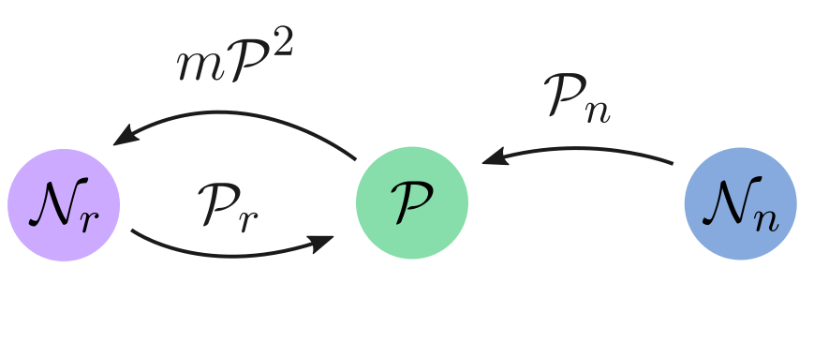
Biogeochemical model - Nutrients equations
death
new
production
recycled
production

Slide 23
Biogeochemical model - Nutrients equations
death
new
production
recycled
production

Slide 24
Initial Conditions and Forcing

Slide 25
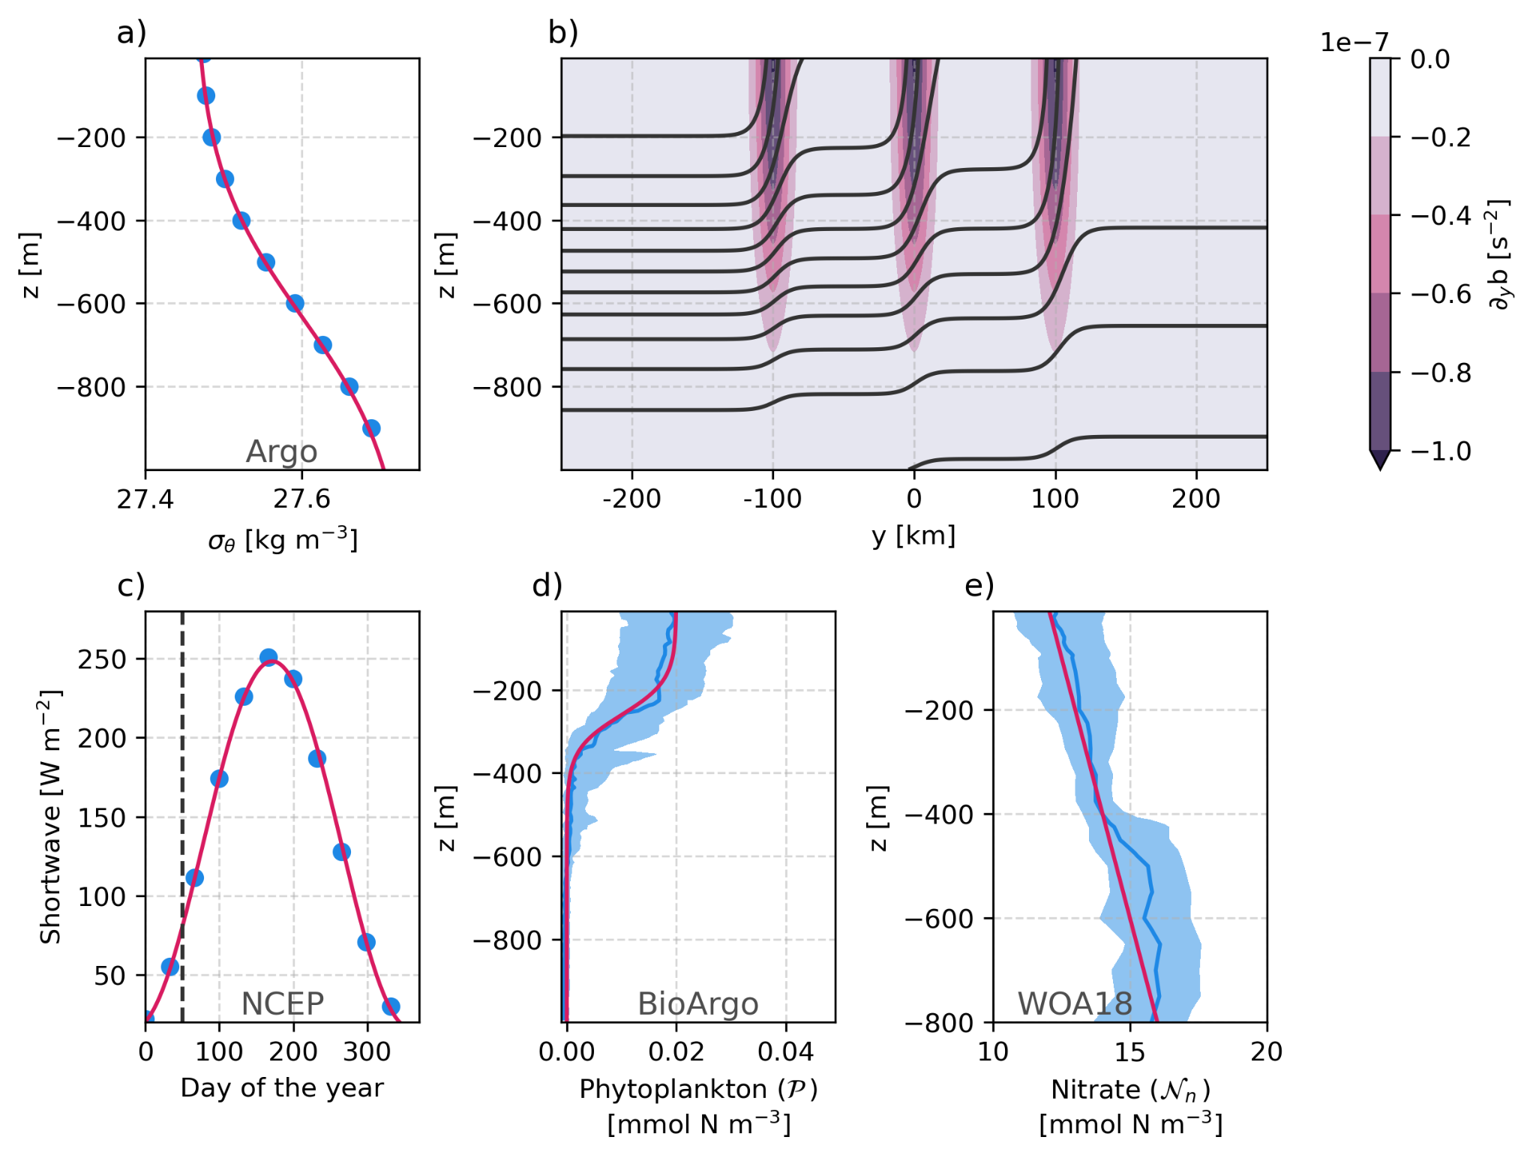
Initial conditions based on data
60°N
(North Atlantic)

Slide 26
Initial conditions based on data - Background stratification

Slide 27
Initial conditions based on data - Fronts and domain
1km resolution
50 levels (1000 m)
Y: 500 km (bounded+sponges)
X: 100 km (periodic)
F-plane (60°N)

Slide 28
Initial conditions based on data - Available light

Slide 29
Initial conditions based on data - Initial phytoplankton and nitrate

Slide 30
Unstable Fronts

Slide 31
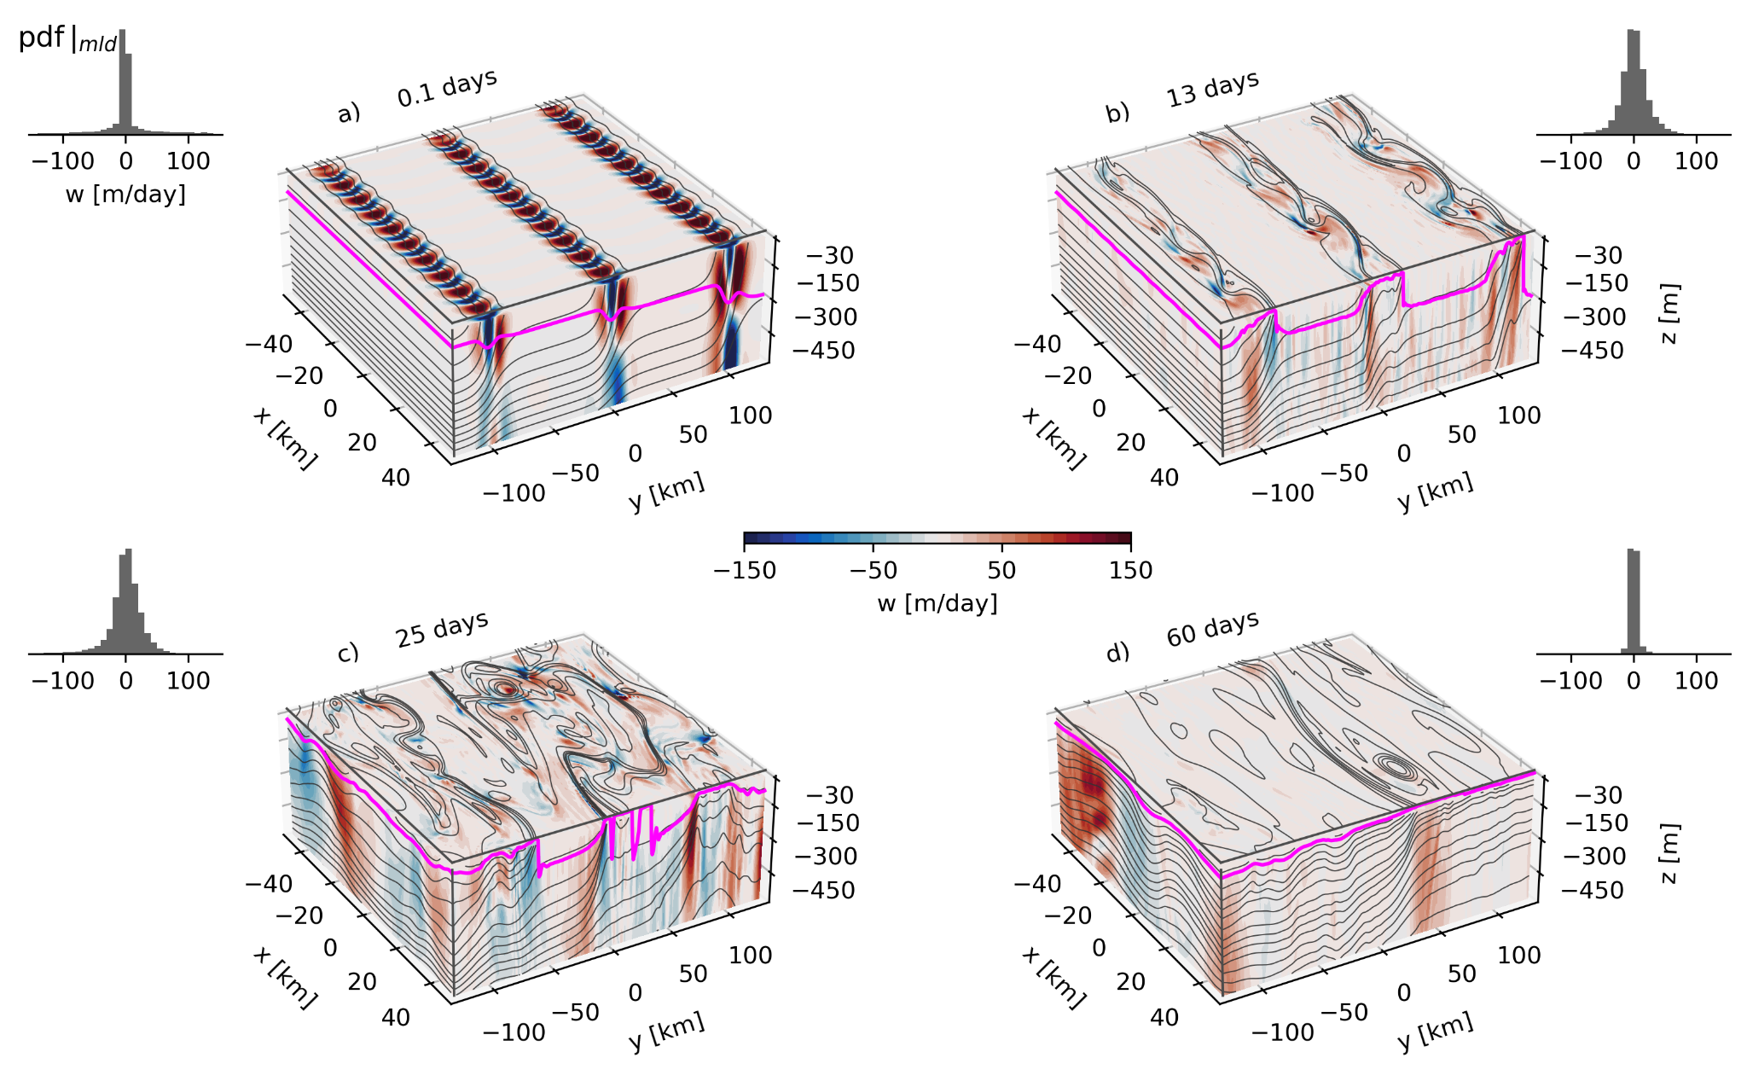
3D snapshots - Vertical velocity

Slide 32
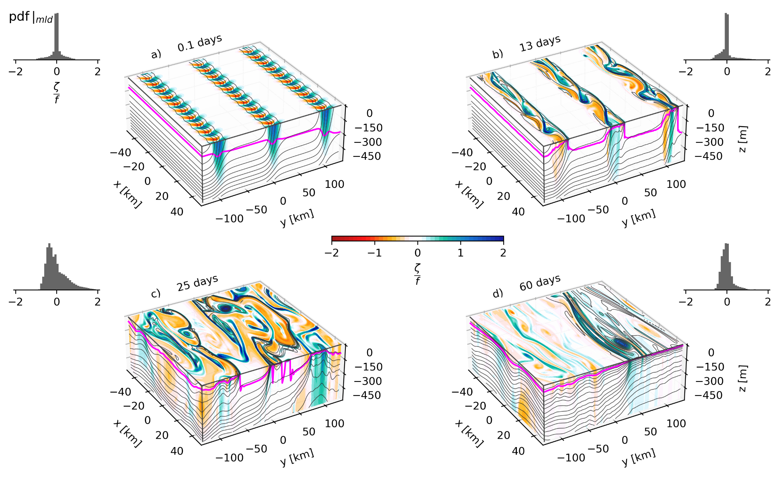
3D snapshots - Rossby number

Slide 33
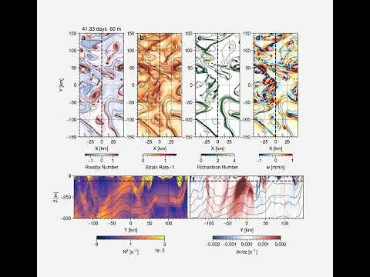

Slide 34
Coarse-grained simulations

Slide 35
Coarse-grained simulations
10 km
Mixed-layer eddies parameterization (MLE)
1 km
Submesoscale simulation (SUB)
Start at t=12 days
Coarse-grained SUB fields
Parameterize restratification
Fox-Kemper et al. (2011)
10 km
No vertical flux (NVF)
Prescribe coarse-grained restratification from SUB
Use thermal wind (0 at the bottom) for lateral advection

Slide 36
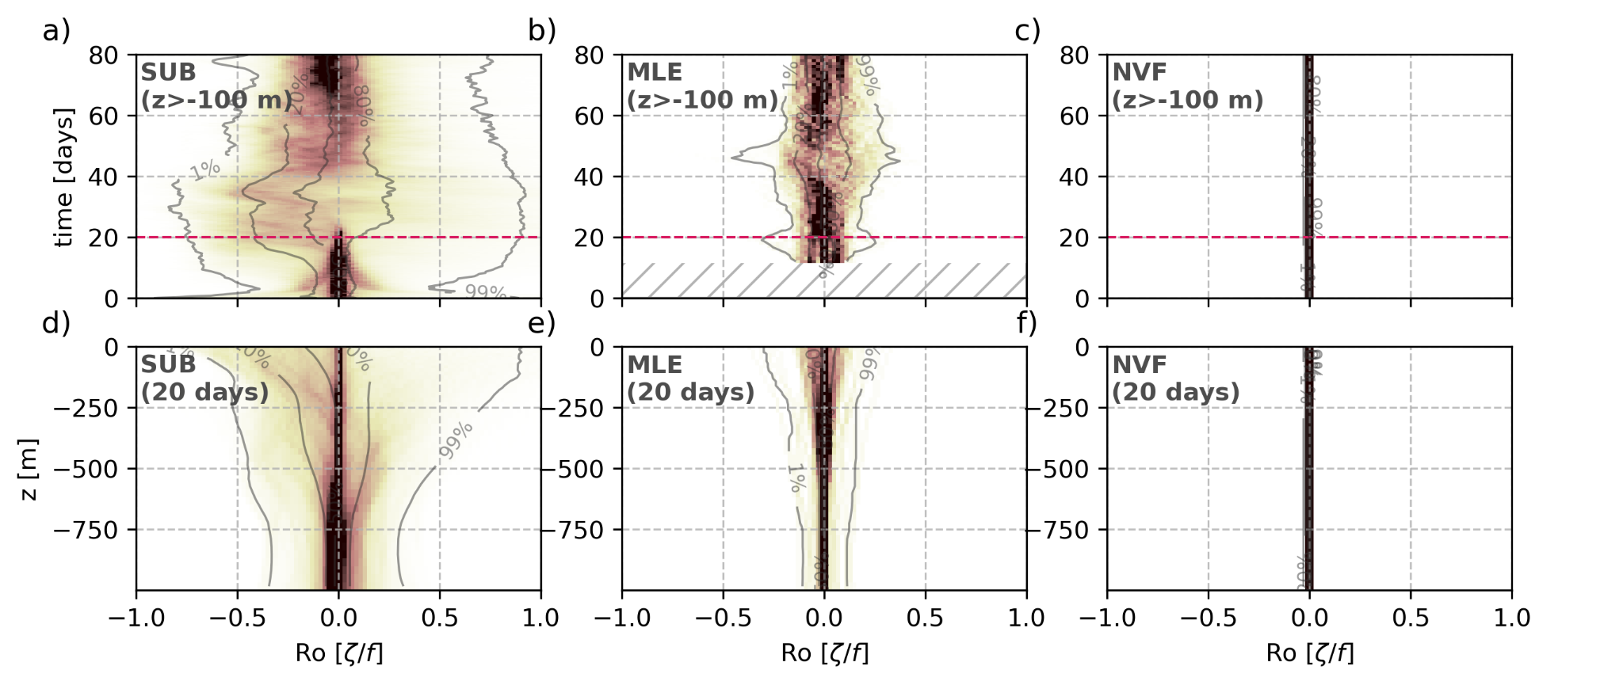
Comparing physics - Rossby Number

Slide 37
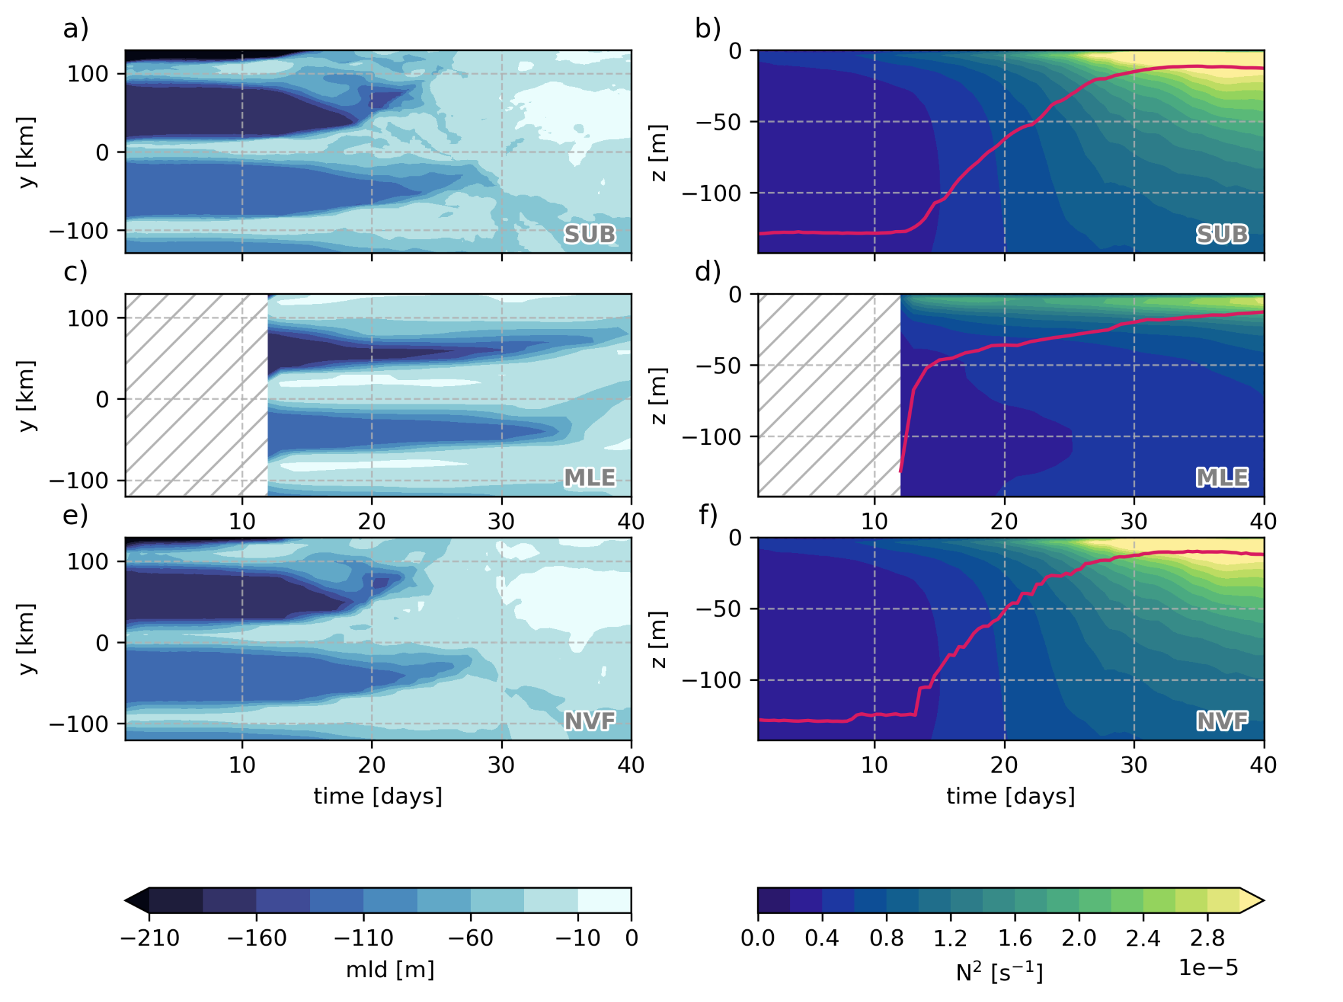
Comparing physics - Restratification

Slide 38
Springtime bloom

Slide 39
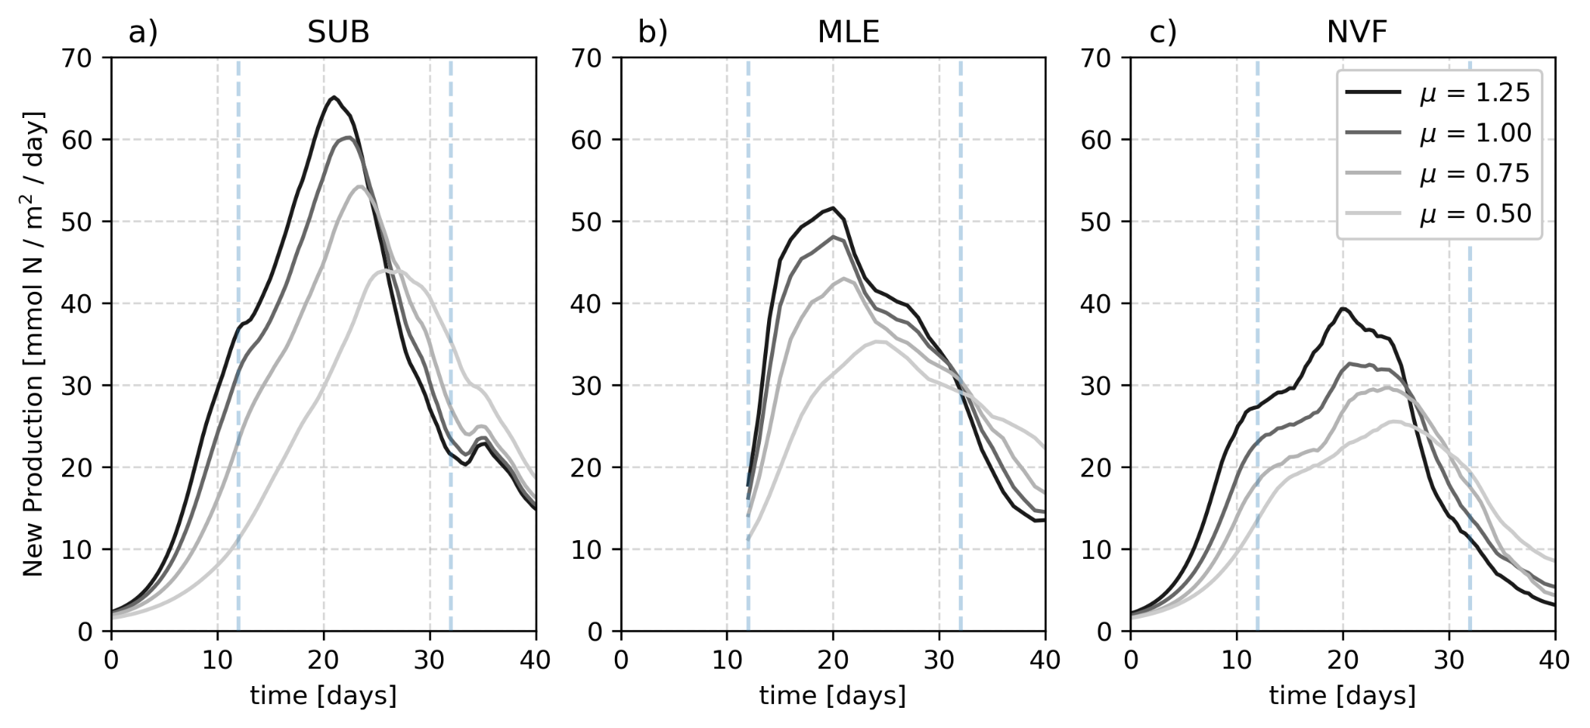
Mean vertically integrated new production

Slide 40
Mean vertically integrated new production

Slide 41
Mean vertically integrated new production

Slide 42
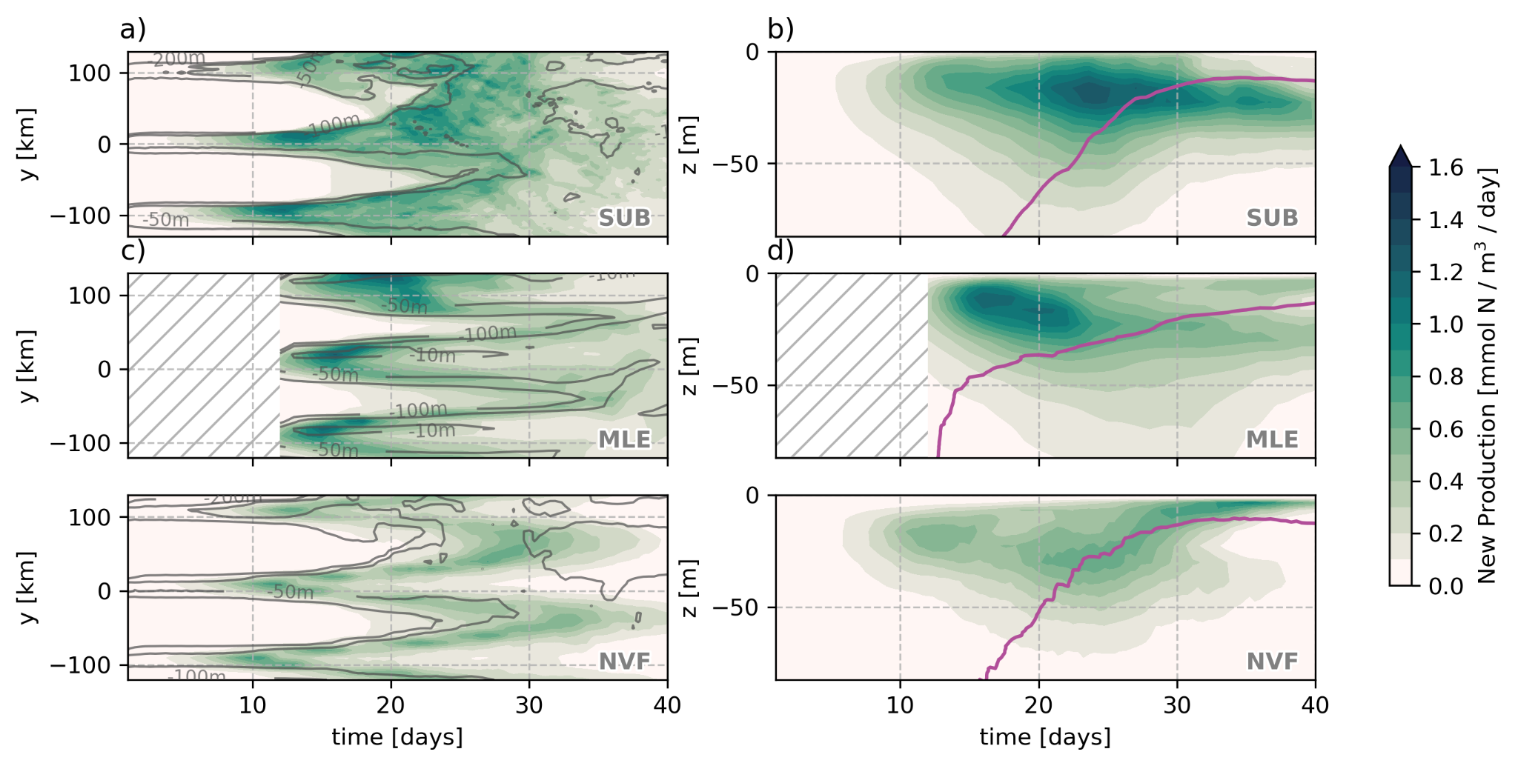
Cross-front and vertical distribution of new production

Slide 43
Nutrient fluxes

Slide 44
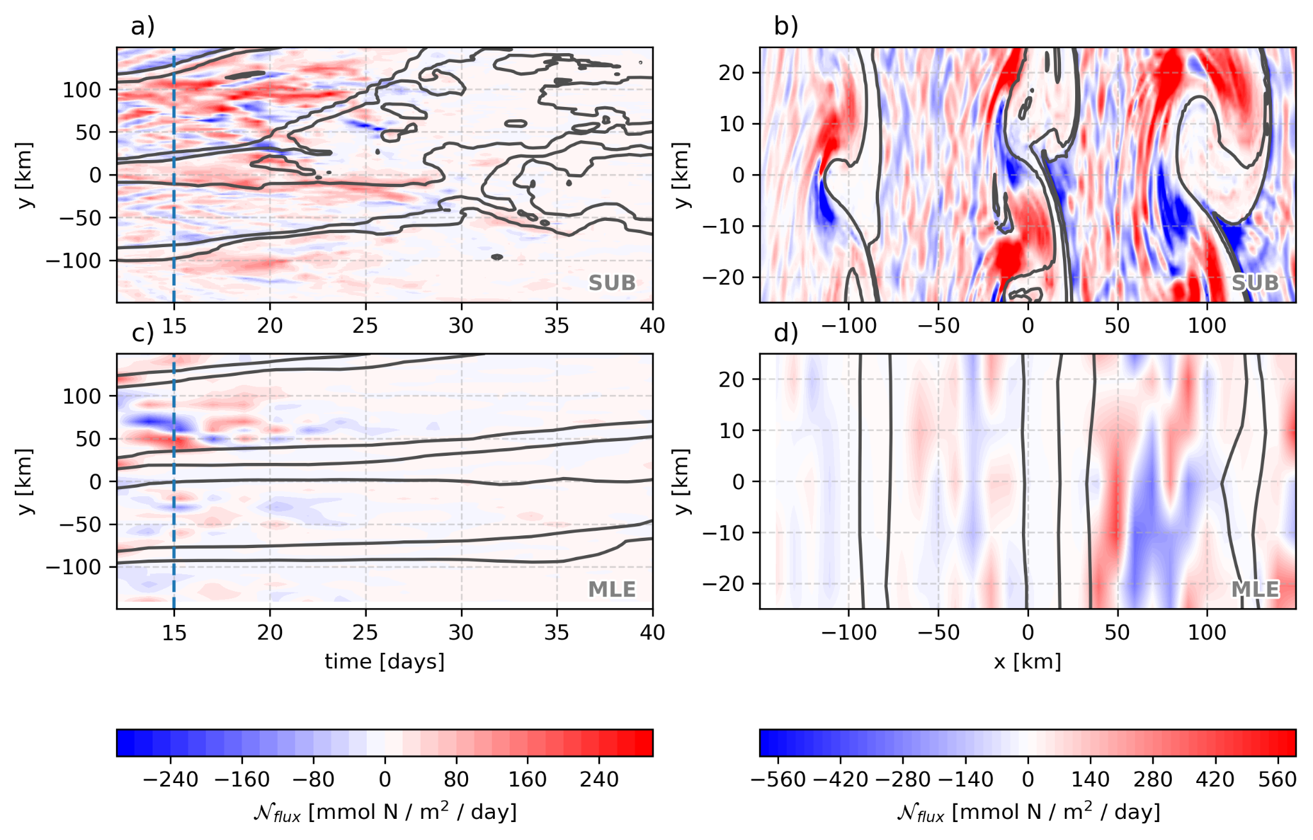
Cross-front and vertical distribution of new production

Slide 45
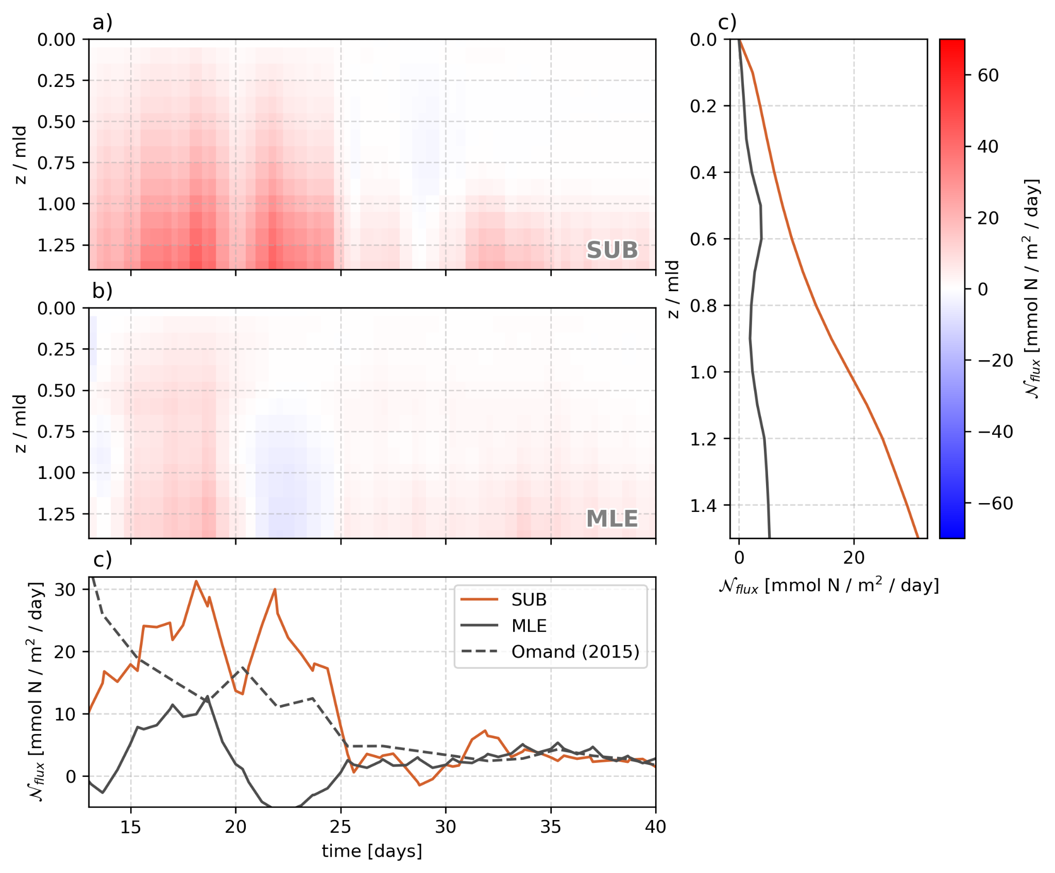
Cross-front and vertical distribution of new production

Slide 46
Summary and Acknowledgements

Slide 47
Summary
To date:
Although having similar/same restratification, new production is reduced by 12-39%
The main difference is the vertical flux of nutrients
Differences slightly higher for an optimum maximum nitrate uptake
MLE parameterization doesn’t capture vertical fluxes at the MLD
Omand (2015) parameterization does a better job with some caveats
To later:
How does this scenario change for year-long simulations and surface heat and momentum fluxes?
More complex biogeochemical model?

Slide 48
Acknowledgments
Open-source:
FFmpeg
xgcm
xhistogram
Oceananigans.jl
Special thanks:
All code for simulations and analysis:
GitHub
@iuryt/Bioceananigans.jl (public)
@iuryt/NorthAtlanticBloom.jl (private)
(available by publication)
Chris Hill
Gregory Wagner
Glenn Flierl

Slide 49
Backup slides

Slide 50
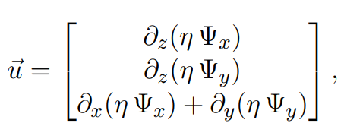
Mixed-layer eddies parameterization (MLE)

