Slide 1
Retrieveing submesoscale SSH variations from SWOT altimetry
Max Yaremchuk
Precision Assessment of Remotely Sensed data with Error Correlations
(PARSEC)
  FilaChange International Conference, September 1, 2022

Slide 2
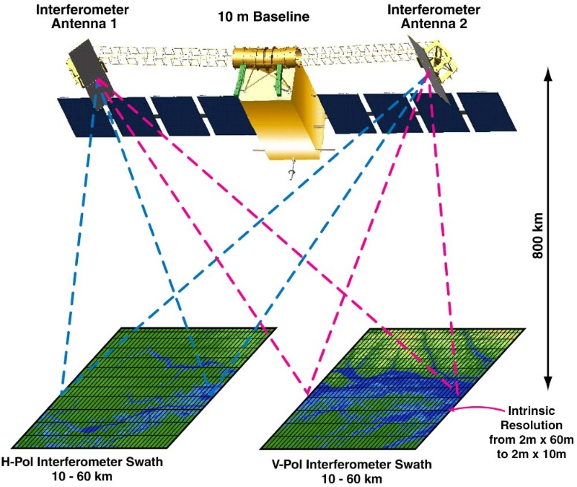
MOTIVATION
Wide-swath altimeters will deliver immense data streams
along the 120 km wide swaths at unprecedently high
(1 km) resolution and accuracy (2-3 cm) at the expense
of additional error sources that are spatially correlated.
2. Need to adapt DA systems to accurate and computationally
efficient processing of the spatially correlated errors.
Sources of errors:
Instrumental uncertainties (uncorrelated)
2. Geometry/orientation of the interferometer:
a. Roll/phase (orientation wrt ocean surface)
b. Thermal expansion (baseline)
c. Timing
3. State of the atmosphere (vapor/aerosols)
ρ_{y} ~1000 km
ρ_{x} ~100 km
spatially
correlated

Slide 3
OUTLINE
0. Precision and error covariance in the DA systems
1. JPL model of the SWOT error covariance matrix
2. Separable/sparse approximation to the precision matrix
3. Numerical testing
a) assessment of the approximation errors
b) ensemble simulations in 2dVar framework
4. Summary

Slide 4
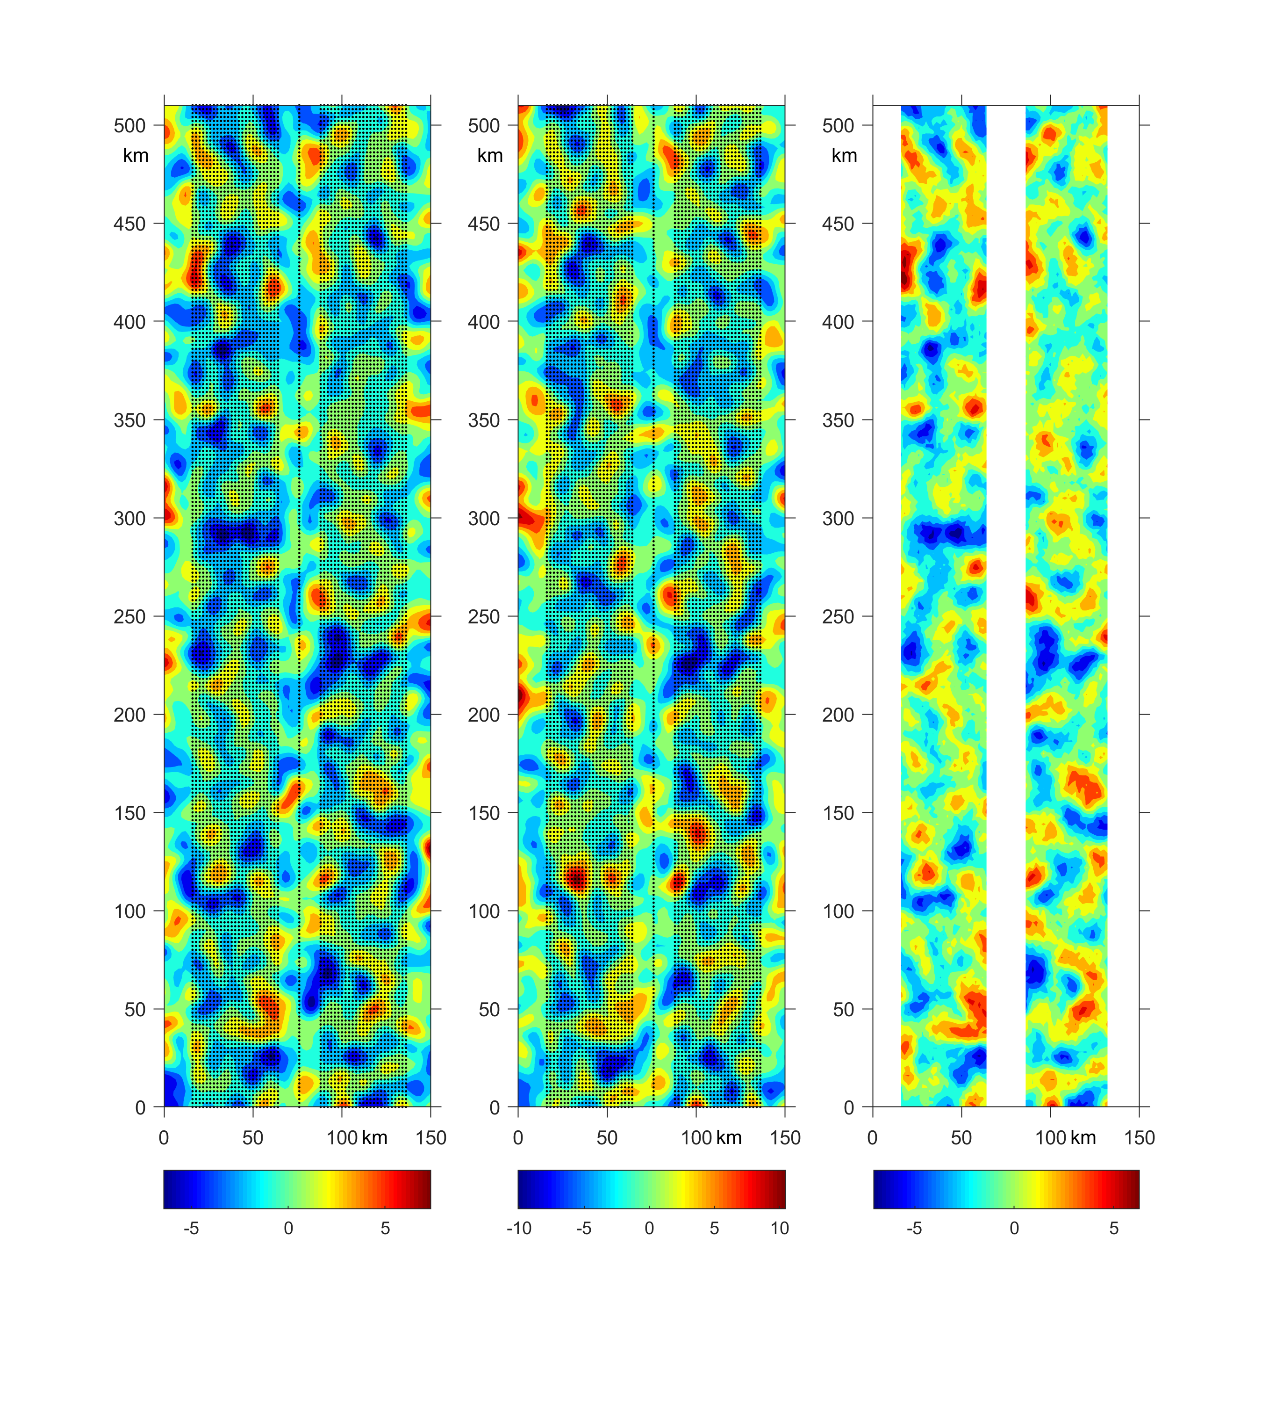
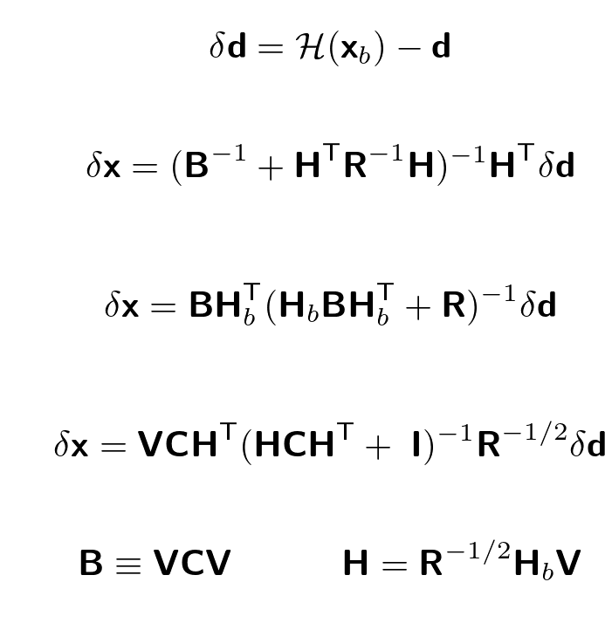
BACKGROUND: precision vs covariance
R is too large (10⁶ x 10⁶ ) for computationally efficient use in operations
primal
b
b
b
dual
dual
normalized
Feb 15, 2017
(NCODA)
transition between the areas of different resolution (1 vs 30 km) is too sharp
to employ (slowly varying) decorrelation scale in the background covariance models

Slide 5
BACKGROUND: JPL error model
Jet Propulsion Laboratory SWOT error covariance model:
R = R_{K}(SWH) + R_{G} + R_{E}(WV) + R_{E}(Ae) + …
degenerate matrices
Not implemented yet
ocean
satellite
geometry
atmosphere
SWOT operational use is scheduled to start in FY23 on an
asynchronous orbit with 21-day revisit time on average.
At 1 km resolution the size of R is ~ 10⁶ x 10⁶ for a
transatlantic swath segment
Recently, a lot of research has been carried out to
assimilate simulated SWOT data using various ways to
normalize the increments (ad hoc approximations to R⁻¹)
L~2000 km
120km

Slide 6
BACKGROUND (SWOT errors)
Correct handling of the new SSH data with increased accuracy (~1 cm) and resolution (~500m) requires accurate estimates of the impact of all error constituents on the precision.
2 minutes
R_{K}^{1/2}(SWH)δn
R_{G}^{1/2}δn
R_{W}^{1/2}(WV)δn
Very important at tactical scale domains
(~100 km) whose dynamics is governed by
submesoscale eddies (10 km, 1-2 days)

Slide 7
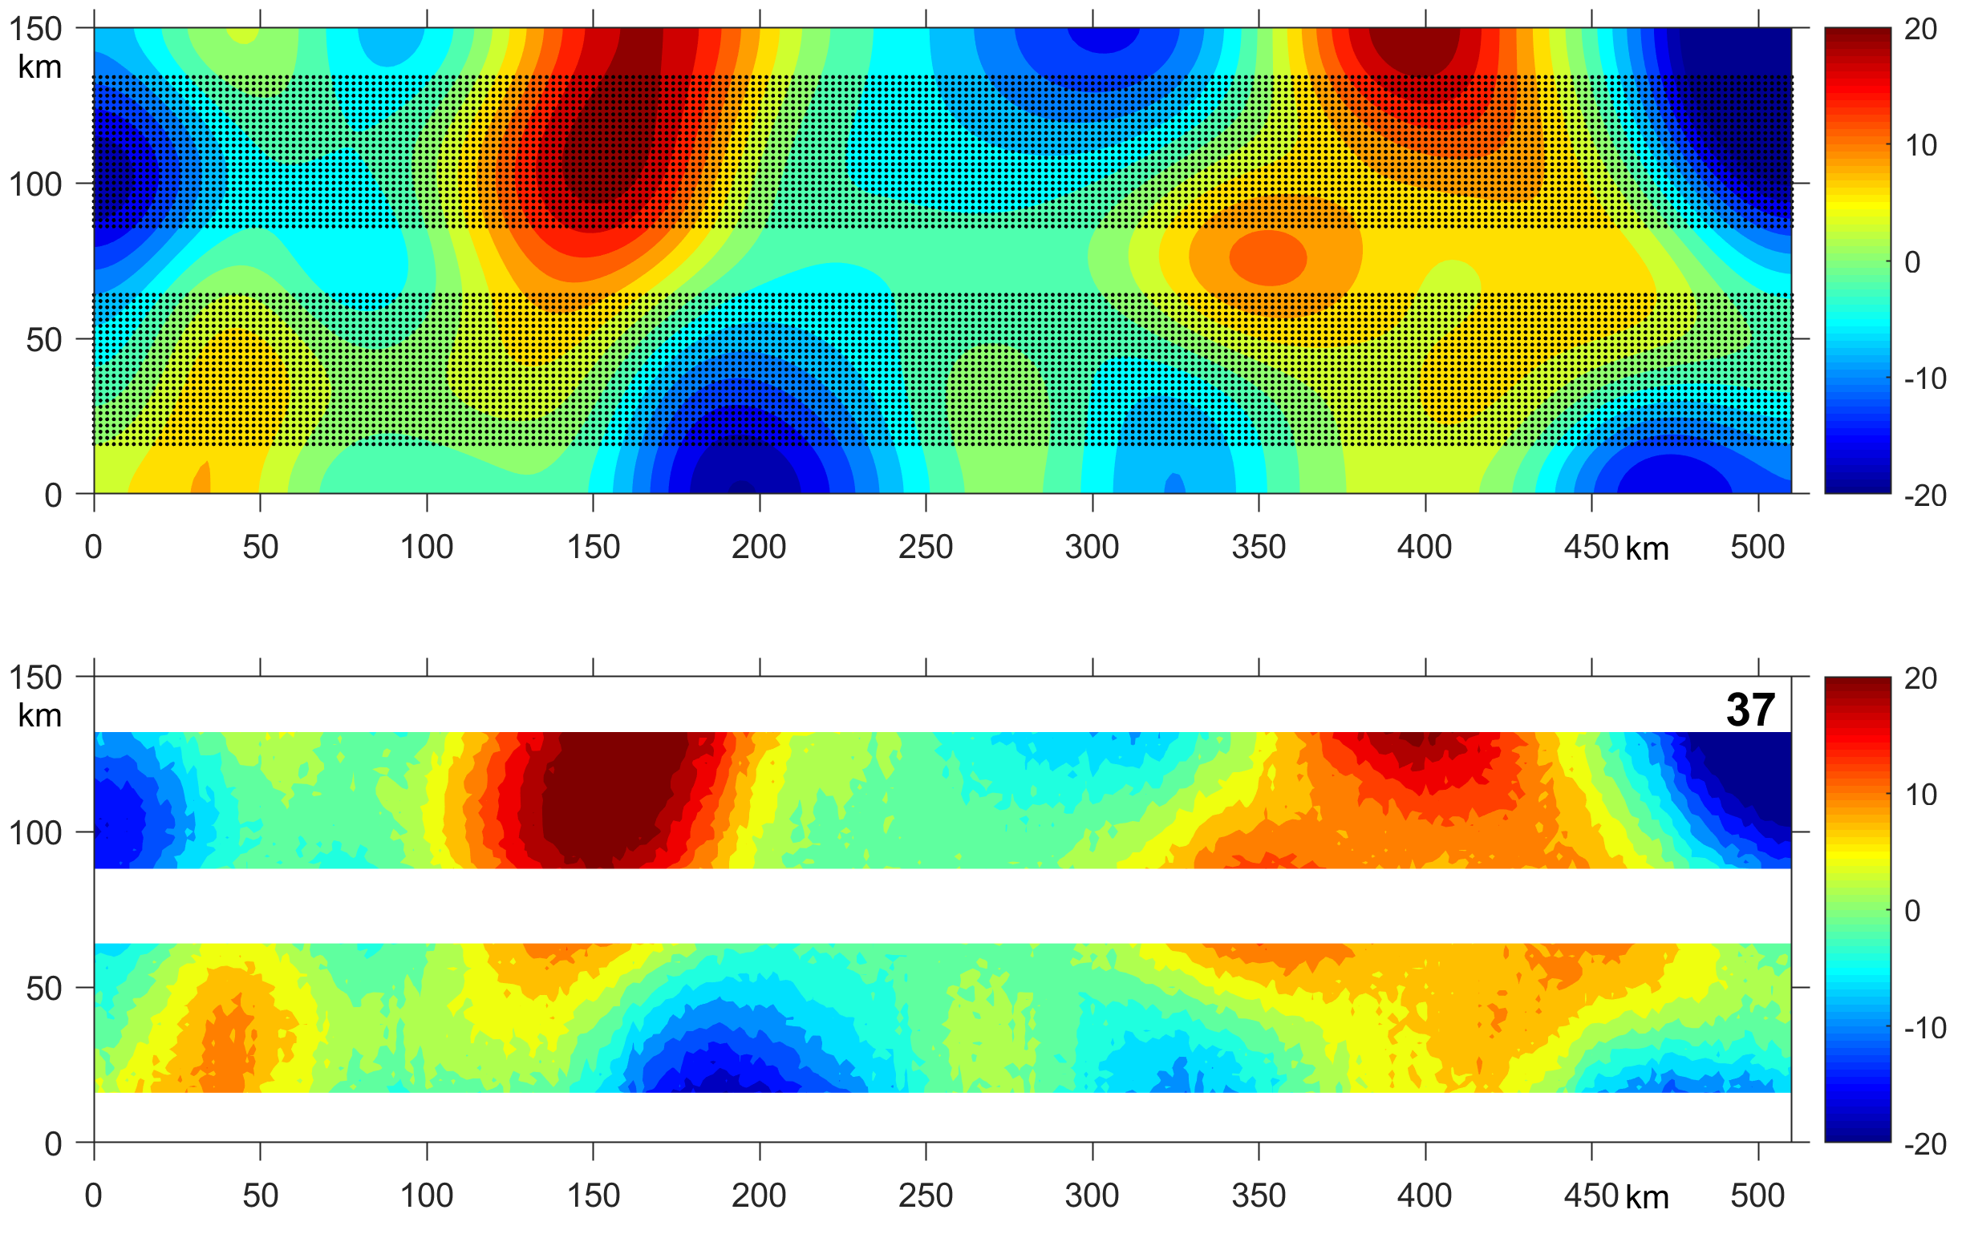
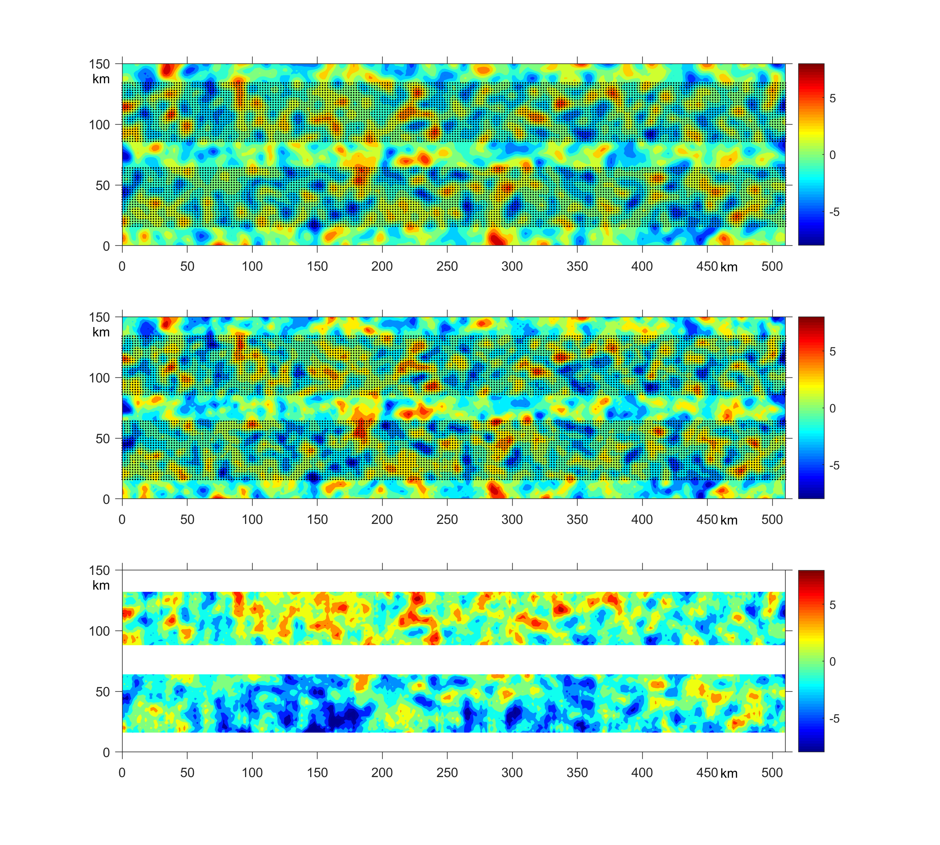
BACKGROUND: SWOT filtering at mesoscale
L~1000 km
120km

Slide 8
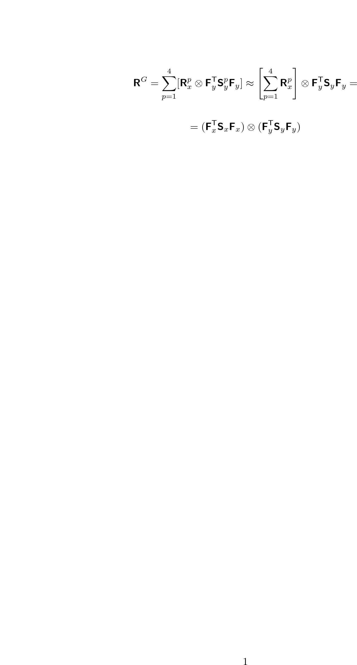
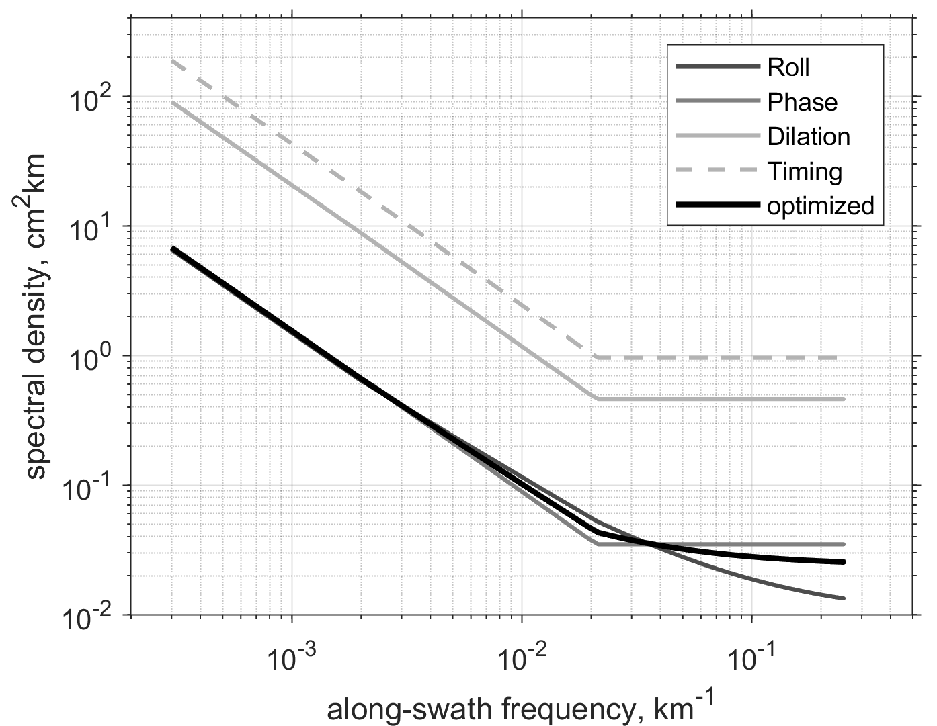
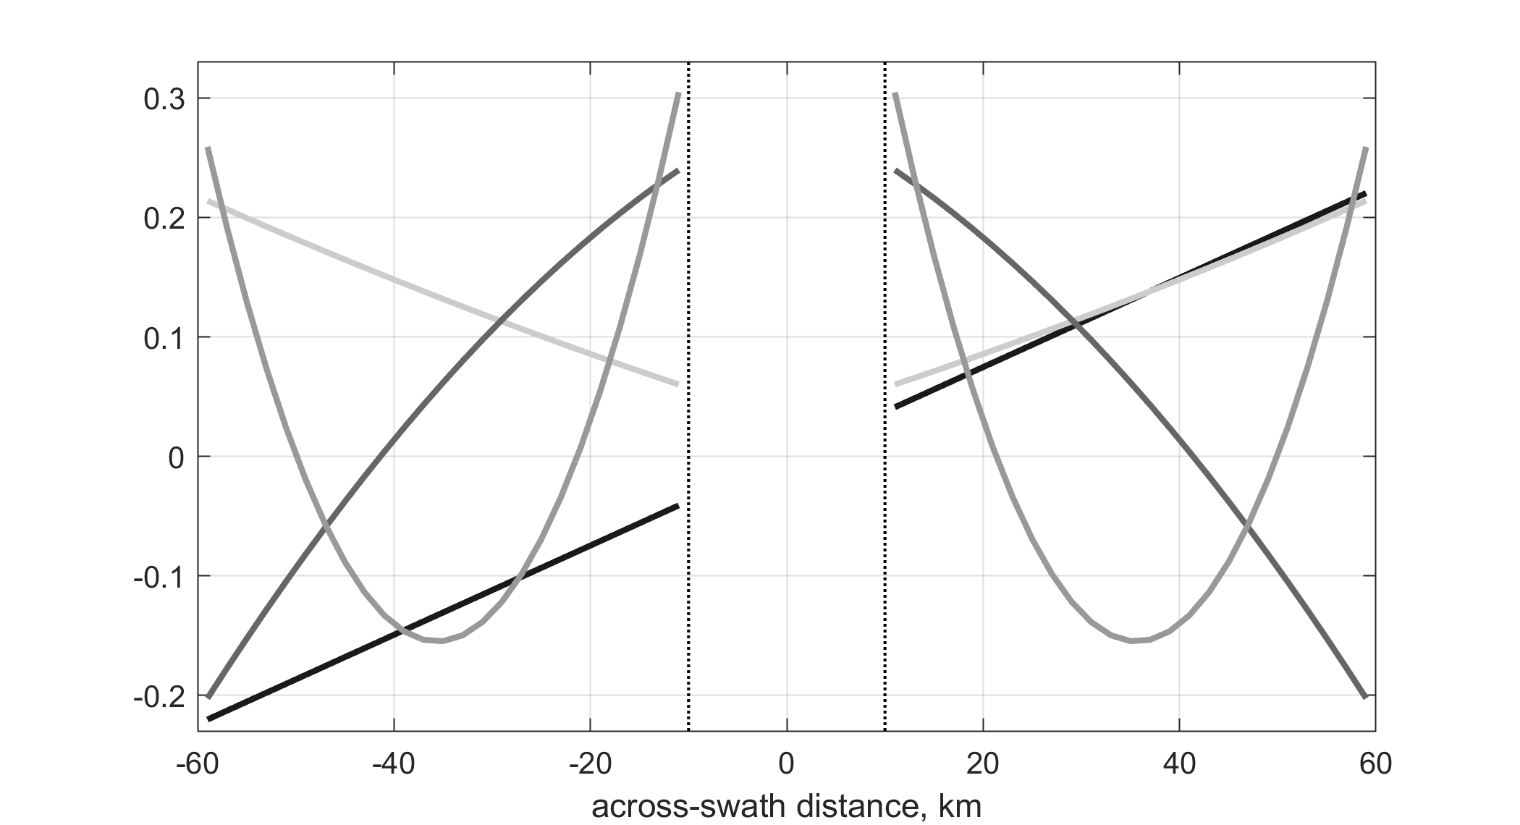
Structure of the JPL error covariance model
R = R^{K}(SWH) + R^{G} + R^{E}(WV)
2 minutes
along-swath error spectra
R^{K}
R^{G}
across-swath eigenmodes structure
4 x 4
500 x 500

Slide 9
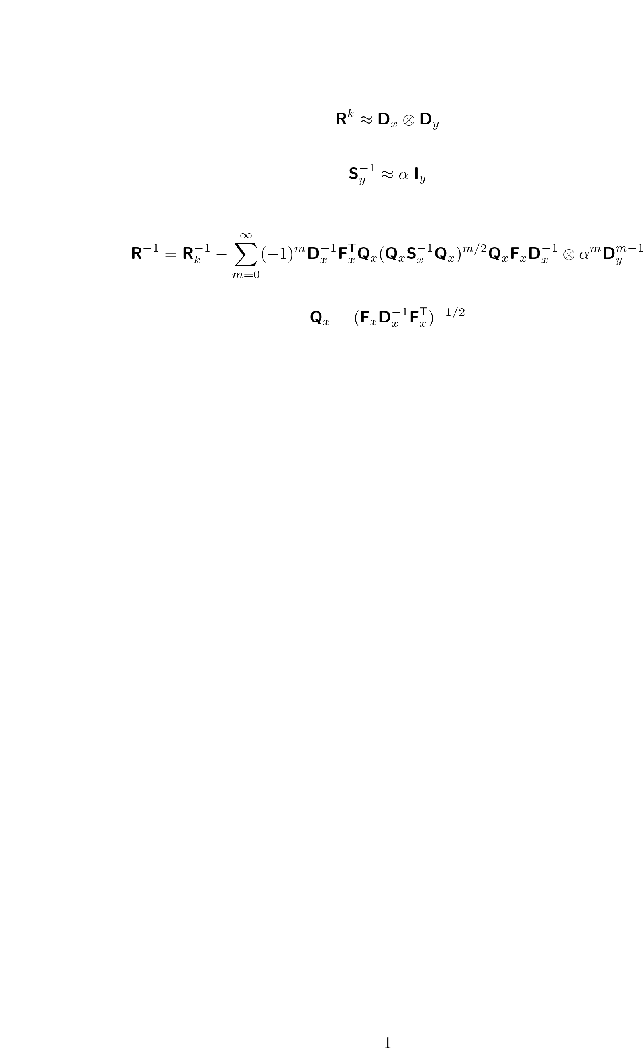
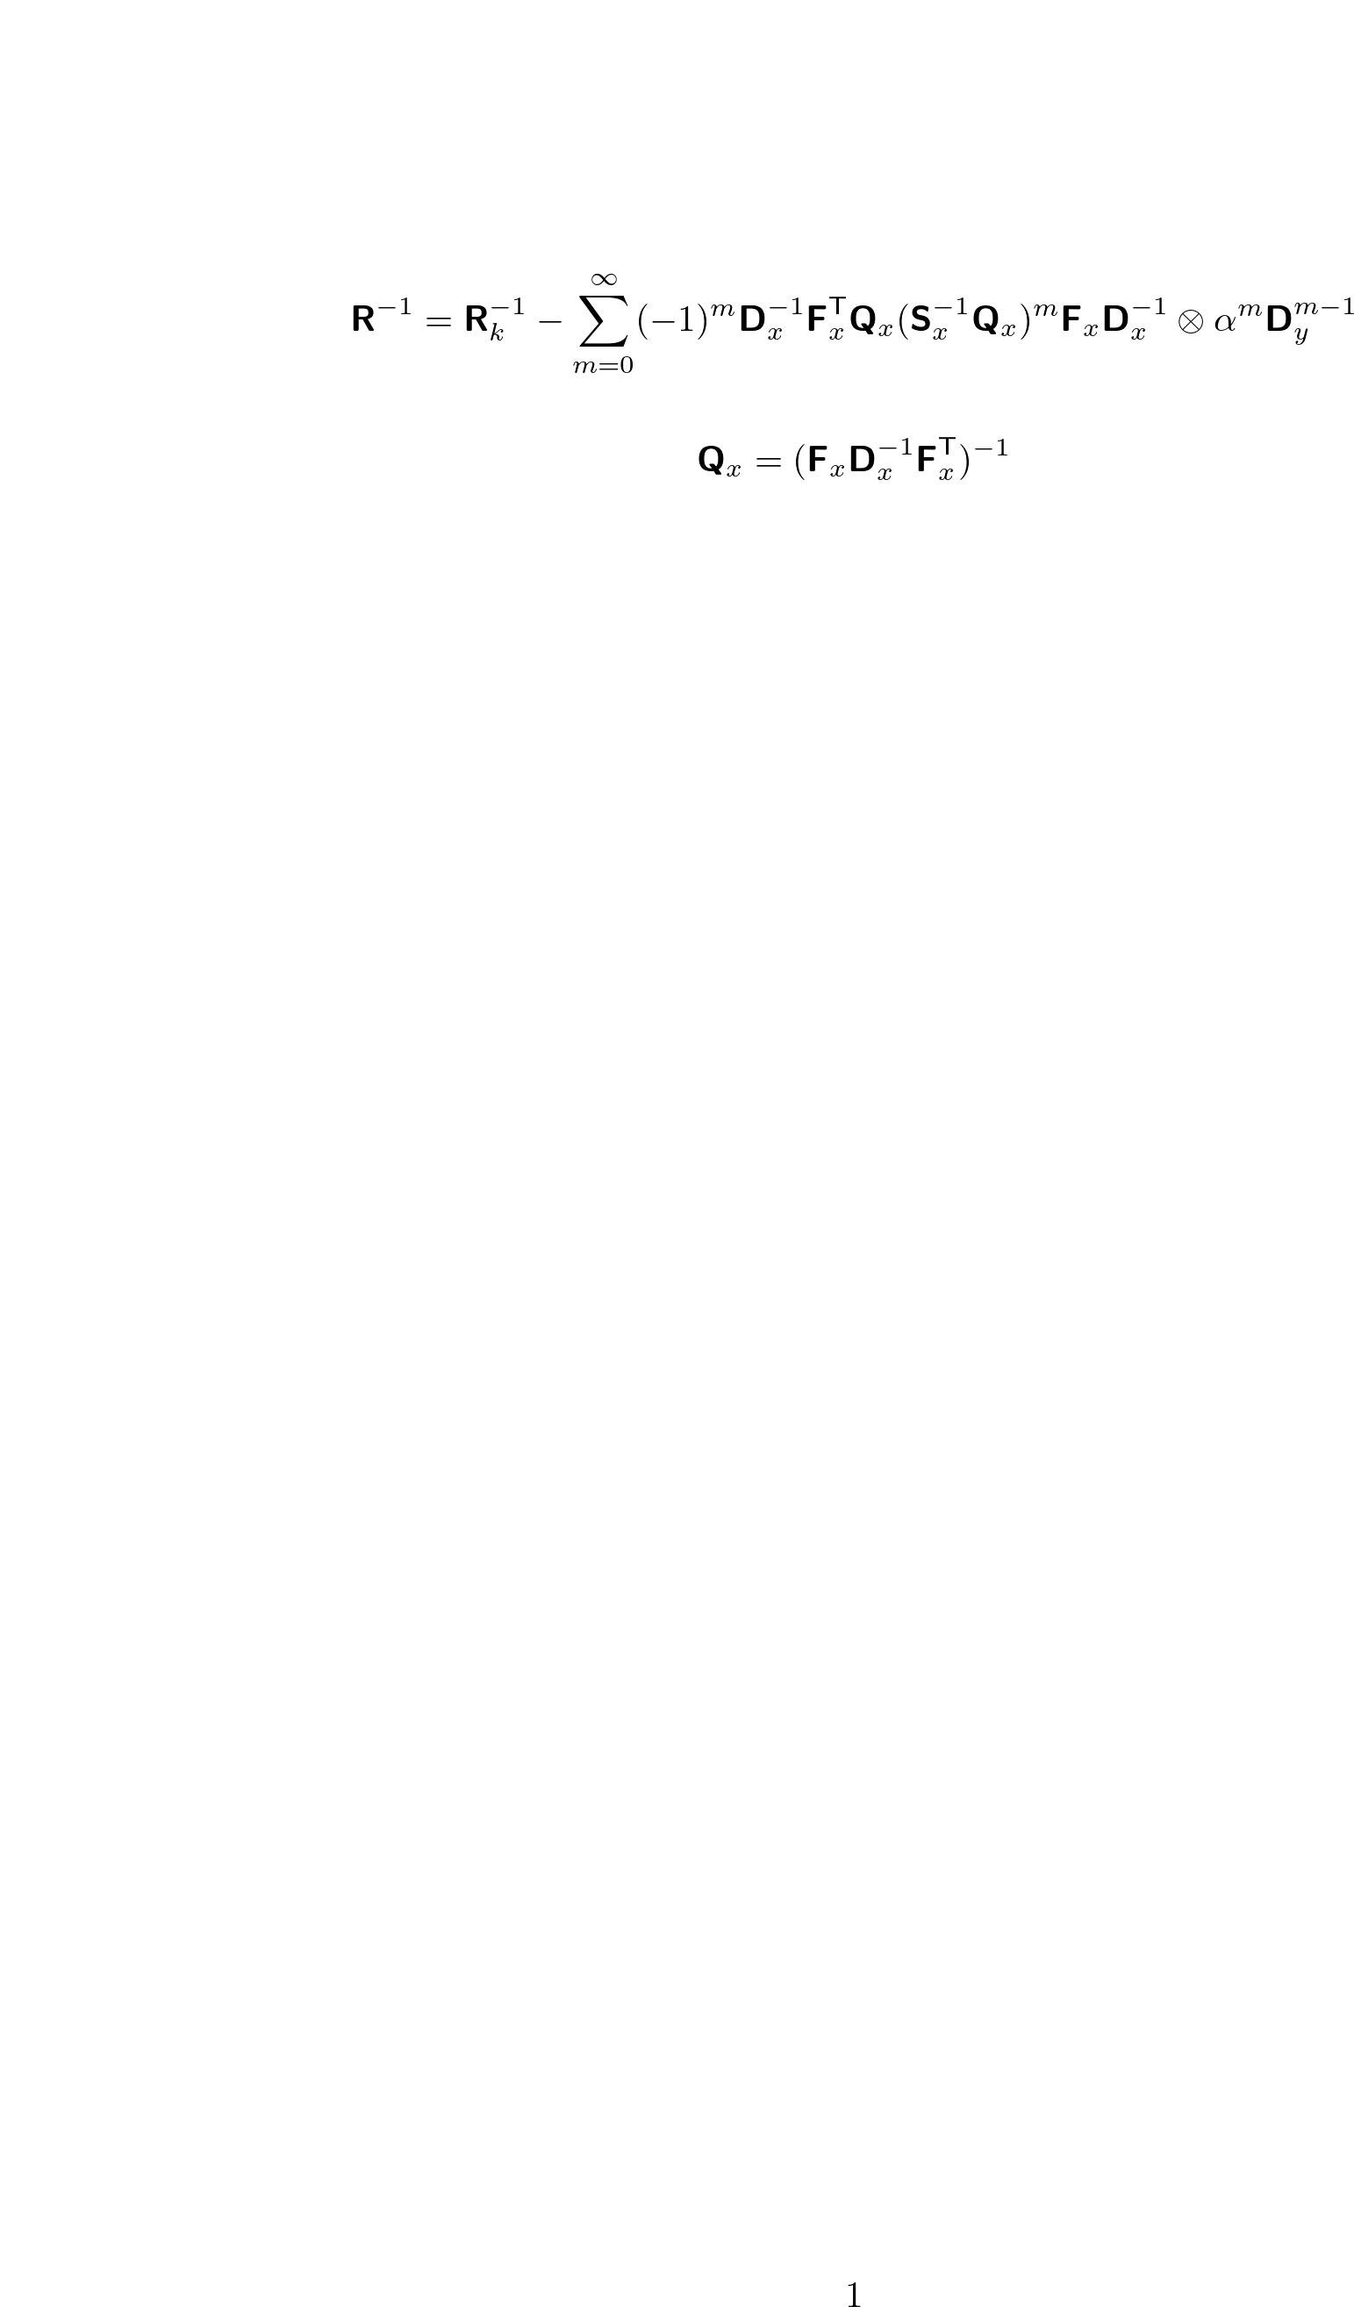
Sparse approximation of the precision matrix
Assumptions:
SWH variations are negligible
across the swath
submesoscale
inverse spectrum is nearly flat
(white noise approximation)
projection of the SWH-modulated KaRIn precision matrix D_{x}⁻¹
on the 4 geometry error modes of the satellite interferometer

Slide 10
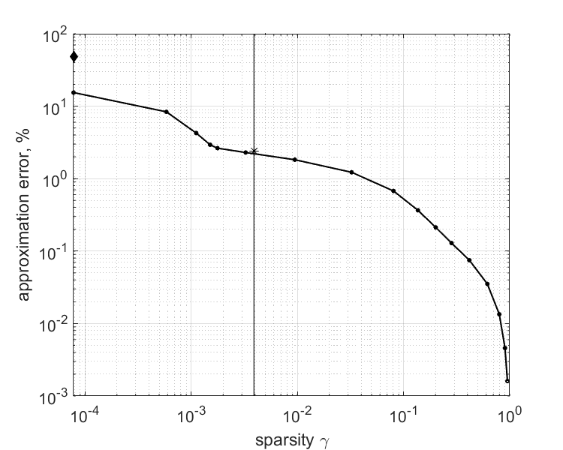
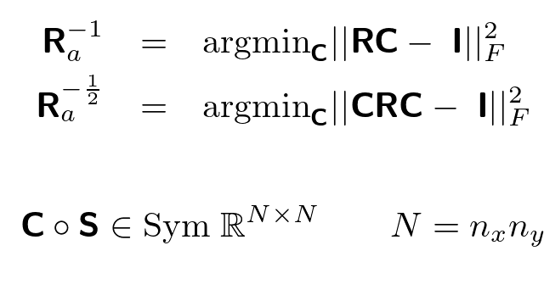
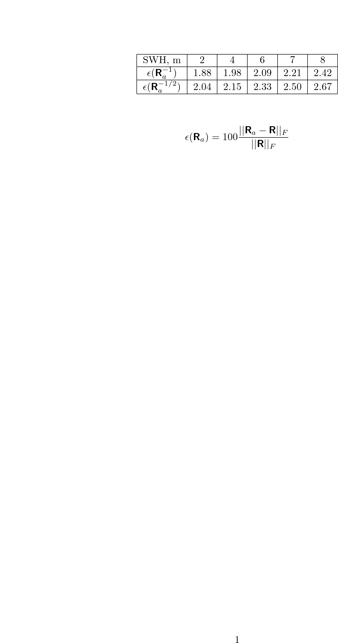
Block-diagonal approximation errors
“Educated guess” for
approximation algorithms
inverse of diag R (err= 57% )
= C
diag R⁻¹ ( 22% )
prescribed
sparsity pattern
block-diagonal
approximation ( 2%)
Approximation errors, %
of the precision matrix approximation
γ=nnz(R⁻¹)/N²

Slide 11
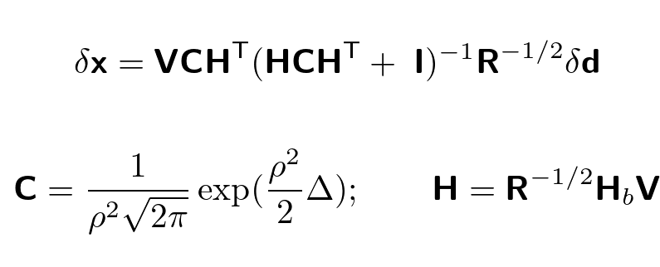
Numerical test (setting)
reconstructed sub- mesoscale field
(truth)
a member of the SWOT observation ensemble
Solve the ensembles of 2dVar problems
using various approximations to R^{-1/2}
2. Compute the rms difference of the solutions
from the background (true) state

Slide 12
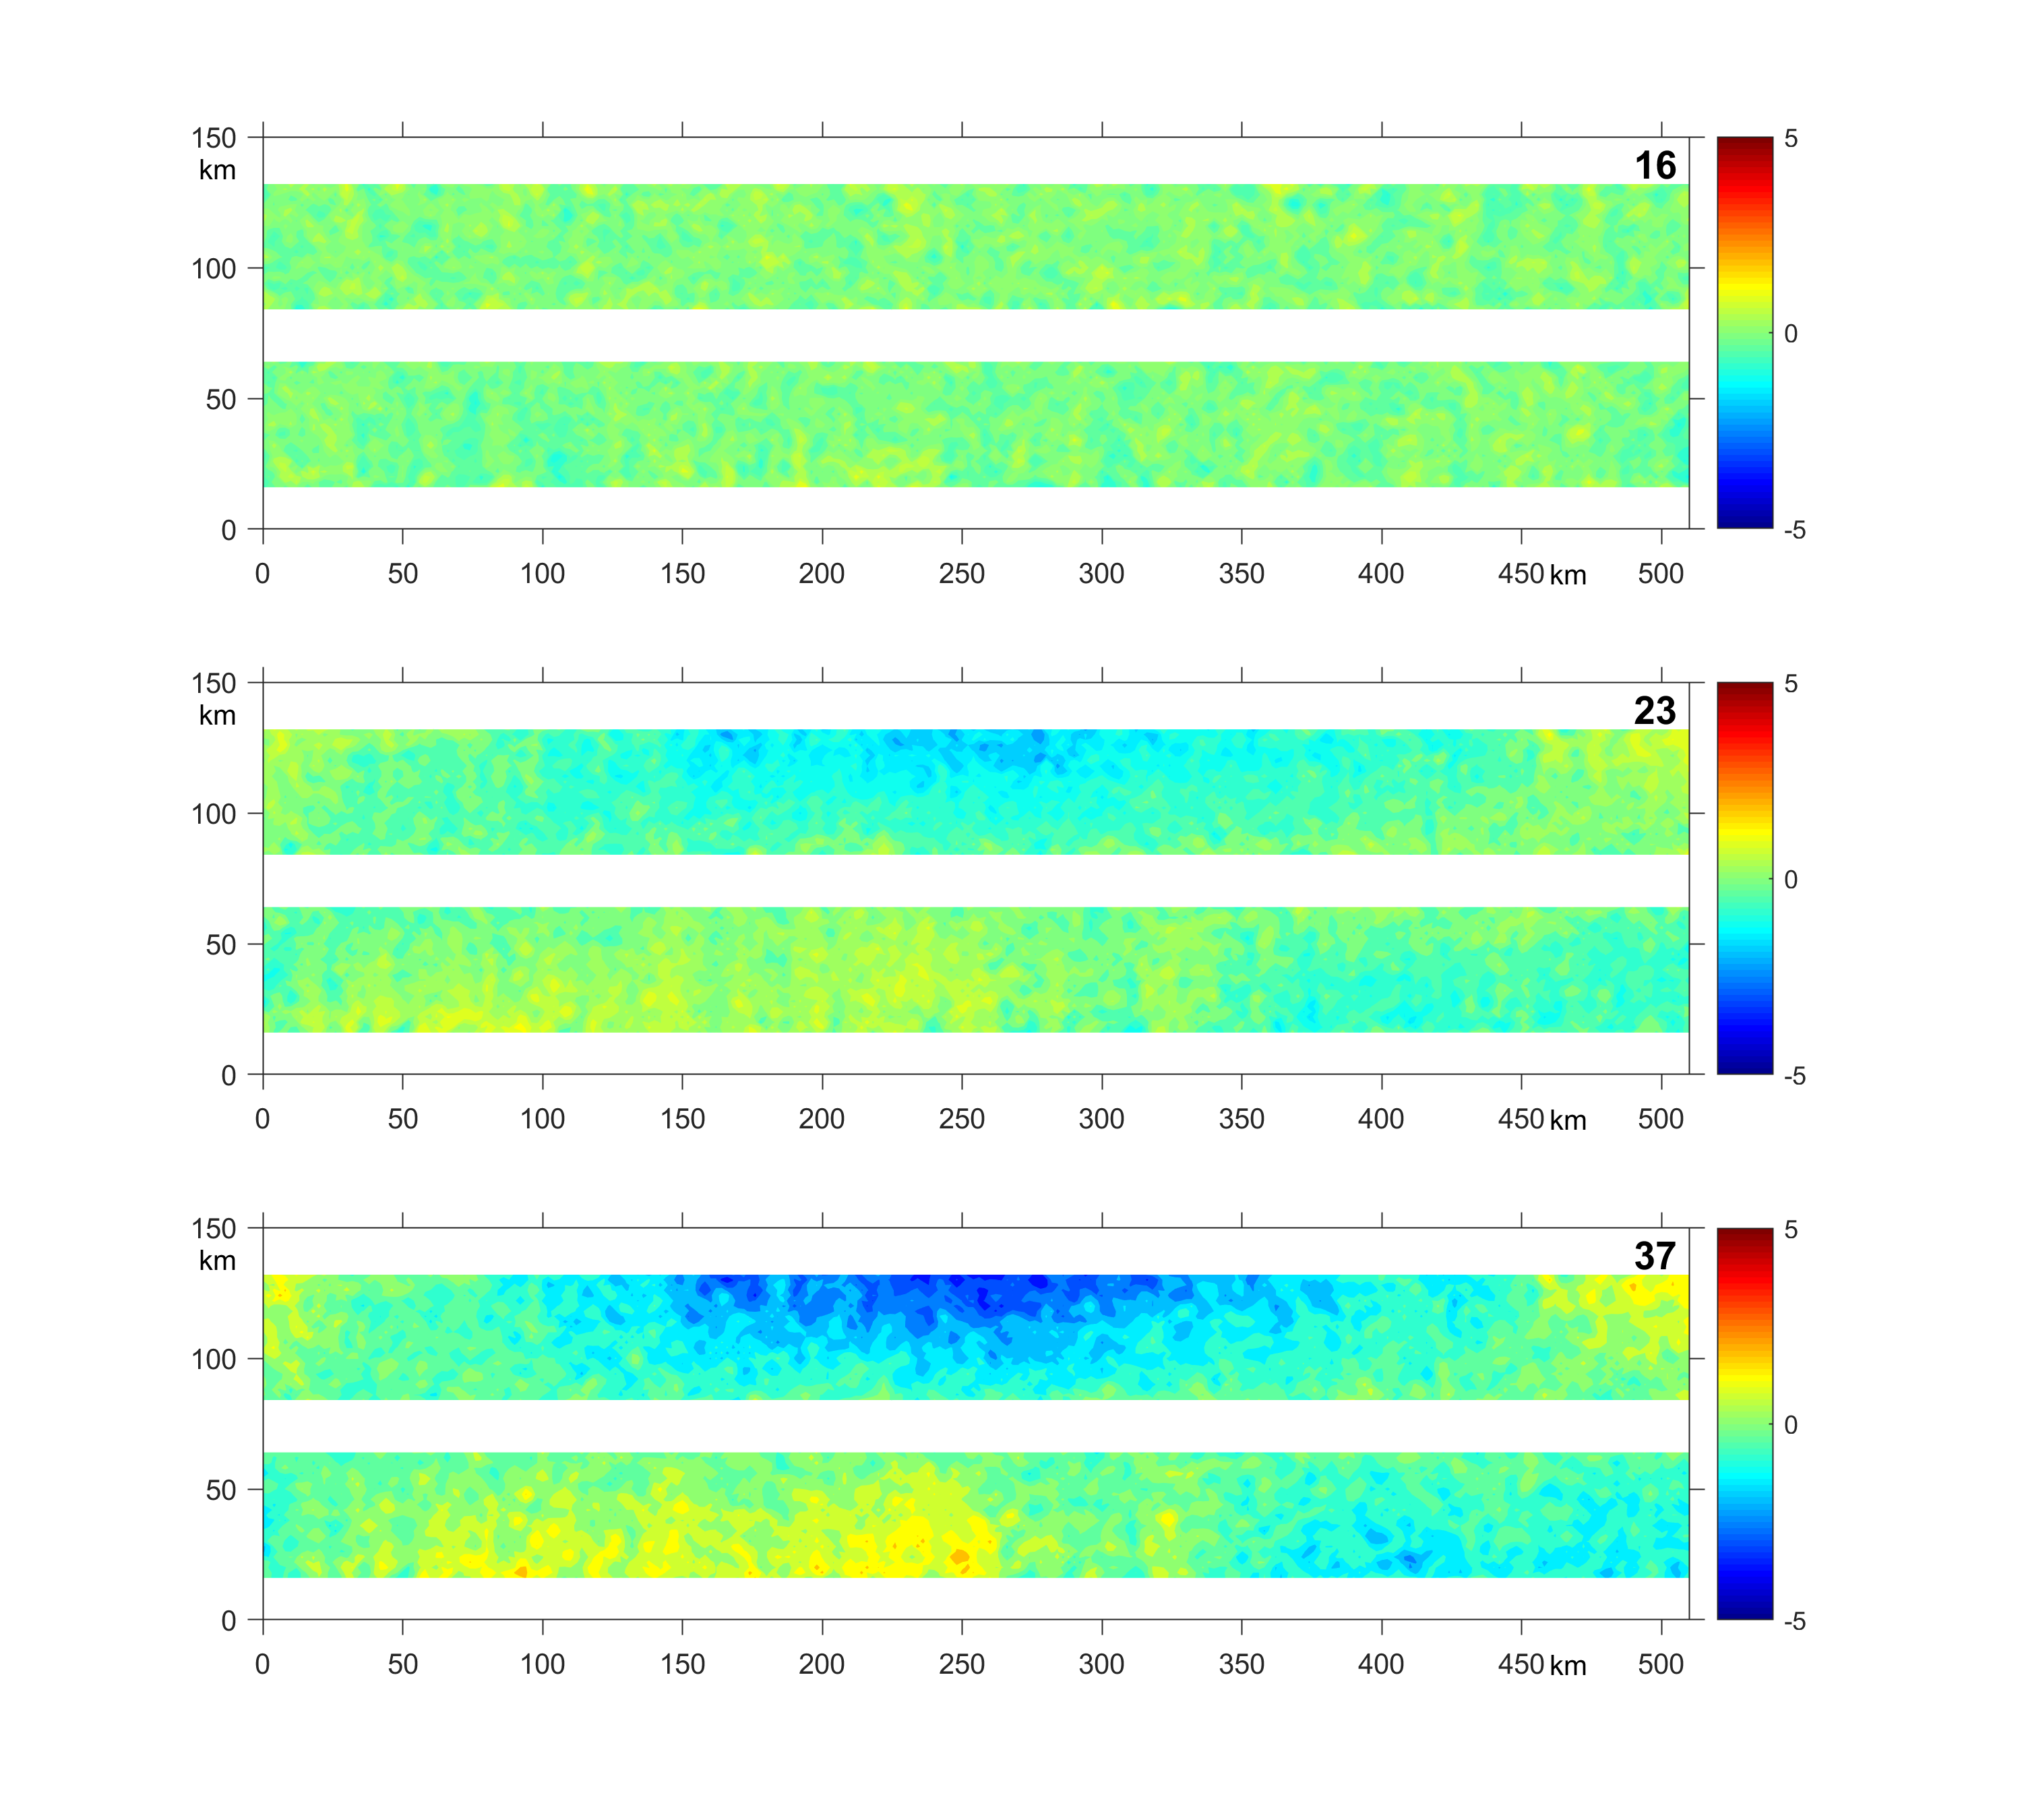
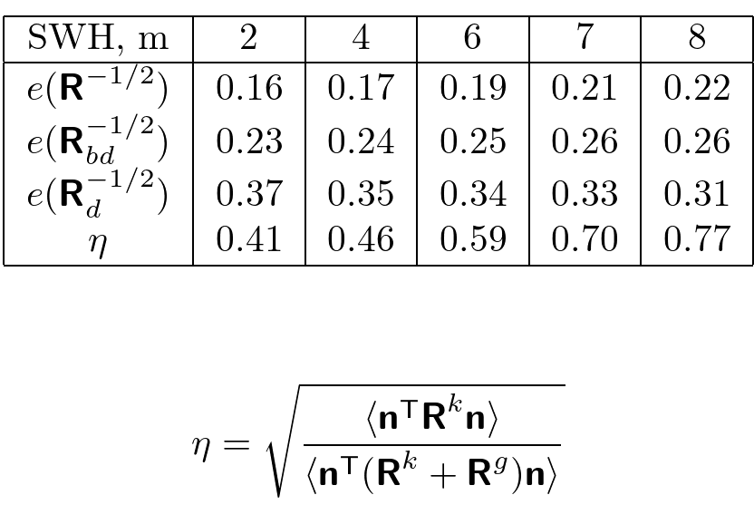
Numerical testing (results)
Approximation errors
exact R^{-1/2}
Dependence on SWH
block-diagonal approximation
Relative contribution of the KaRIn noise:
diagonal approximation

Slide 13
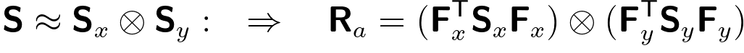
Including atmospheric uncertainties
atmosphere
R = R_{K}(SWH) + R_{G} + R_{a}(vapor) + R_{a}(dry) + …
admits sparse
approximation
of the inverse
R_{a} rank-deficient
R_{a} invertible
Asymptotic regimes:
|R_{K}+R_{G}| << |R_{a}|
|R_{K}+R_{G}| >> |R_{a}|
|R_{a} → R_{a} – δR_{a}
|δR_{a}| = |PR_{a}P - P(R_{a} P+ R_{a})| << |R_{a}|; P=D^{T}D
4. separability of the spectra:

Slide 14
Conclusions and future work
A sparse approximation for the SWOT precision matrices is proposed and tested with OSSEs in the framework of variational assimilation of simulated SWOT data on a 512-km long swath segment at 2 km resolution
Experiments demonstrate efficiency of the block-diagonal approximation which improves from 1.3 to 1.6 with reduction of the sea surface roughness (significant wave height) from 7 to 2 m.
Test the approximation in more realistic settings using the output of hi-resolution NCOM in several regions
Explore other sparsification methods in the effort to improve the numerical efficiency and accuracy of the approximation
Include wet/dry atmosphere error covariances
Develop code for normalizing the innovations

Slide 15
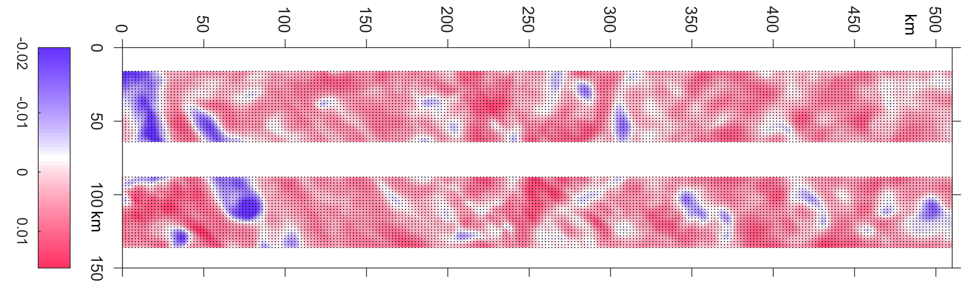
Questions?
high-pass (<10 km) filtered swath segment from NCOM simulation in West Pacific region
to Kuroshio

