Slide 1
The role of global internal wave modeling in the SWOT mission
Brian K. Arbic, University of Michigan
Thanks to numerous colleagues from 30+ papers on global internal wave modeling, and to ONR, NSF, NASA, DOE, and NOAA for funding support
Abbreviated abstract: SWOT will measure sea surface height at smaller spatial scales than current-generation nadir altimeters can measure. Just as the success of nadir altimeters was enabled by accurate mapping and removal of barotropic tide signals, the success of SWOT depends on accurate mapping and removal of smaller-scale internal tide and internal gravity wave signals. A new class of global high-resolution models, simultaneously forced by atmospheric fields and the tidal potential, has proven invaluable for SWOT studies including preliminary mapping efforts, planning SWOT Cal/Val field campaigns, and others.
Related publications:
Arbic, B.K., and 26 co-authors (2018), A primer on global internal tide and internal gravity wave continuum modeling in HYCOM and MITgcm. In New frontiers in operational oceanography, E. Chassignet, A. Pascual, J. Tintore, and J. Verron, Eds., GODAE OceanView, 307-392, https://doi.org/10.17125/gov2018.ch13
Arbic, B.K. (2022), Incorporating tides and internal gravity waves within global ocean general circulation models: A review. Progress in Oceanography, 206, 102824, https://doi.org/10.1016/j.pocean.2022.102824
And references therein
Arbic - 1

Slide 2
Data and methods
Until 2010, global high-resolution ocean general circulation models did not include tides.
At this point, several modeling centers run global high-resolution models with simultaneous atmospheric and tidal forcing:
--US Navy HYCOM group
--NASA JPL MITgcm simulations
--DOE MPAS-Ocean group
--NOAA MOM6 group
--Mercator (Toulouse) and Grenoble NEMO groups
--Others
Such models have several ongoing uses for SWOT:
--mapping internal gravity waves including phase-locked and non-phase-locked internal tides
--planning for field campaigns including the SWOT Cal/Val
--including remotely generated internal waves in boundary forcing of ultra-high-resolution regional models
Arbic - 2

Slide 3
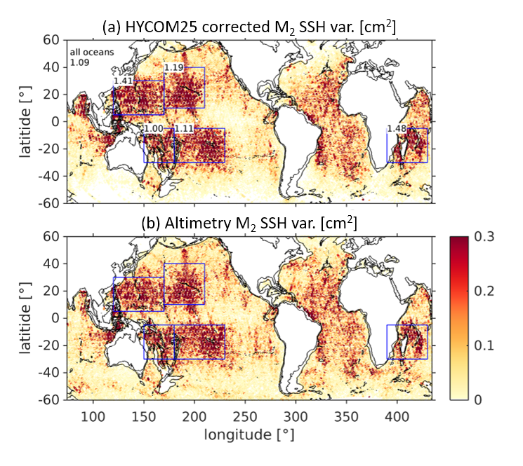
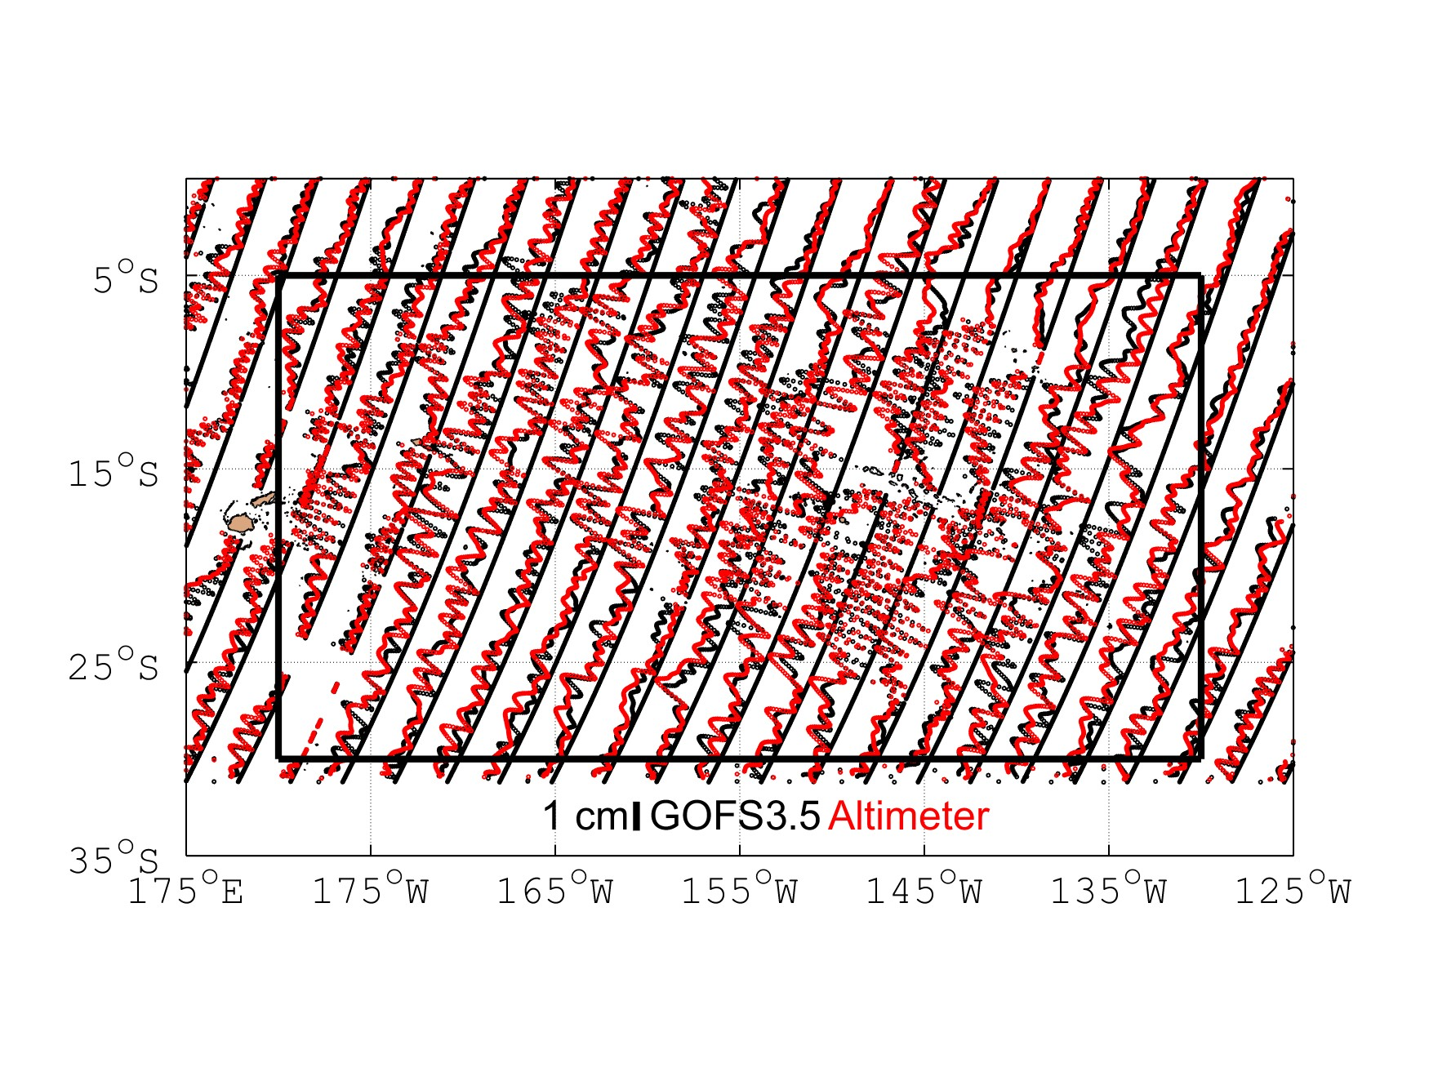
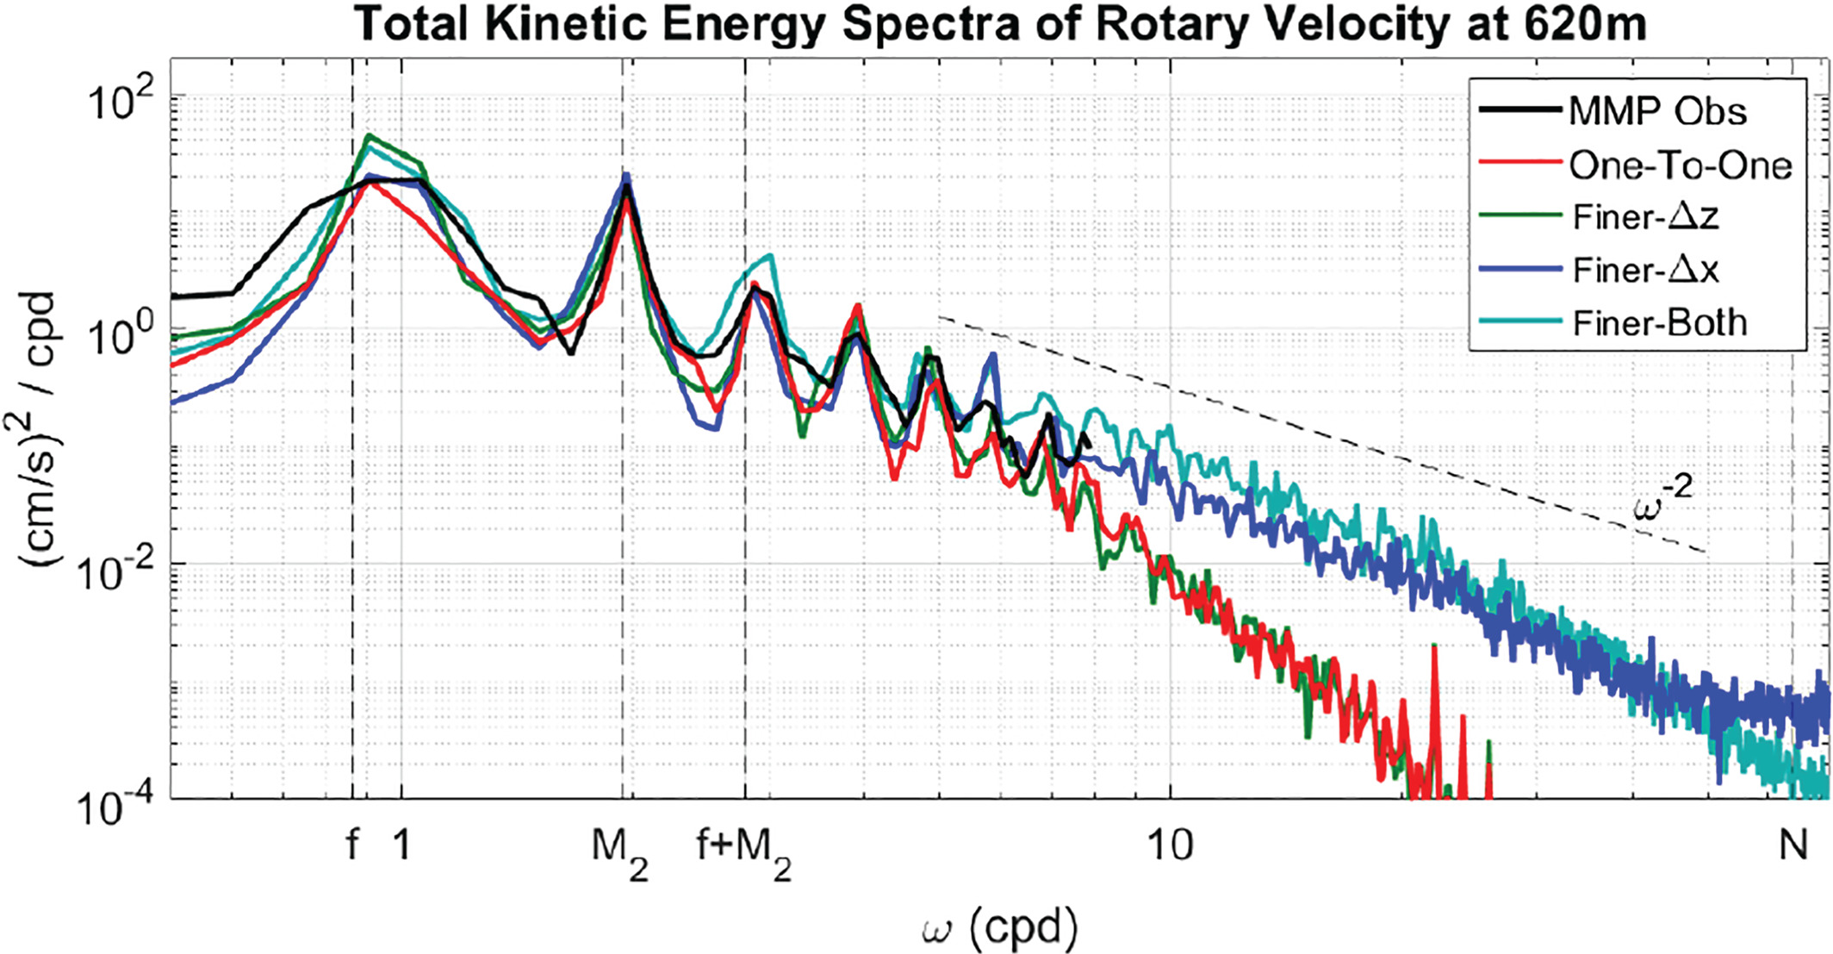
Sample results
The high-frequency (supertidal) part of the
frequency spectrum of the internal gravity
wave continuum in a regional model lies
closer to the -2 predictions of the Garrett-
Munk model when finer grid spacing is applied
in both the vertical (z) and horizontal (x)
directions. Results from the regional model
run with the same grid spacings as the global
model are identified as “One-to-one”. “MMP
Obs” denotes observations from Moored
McLane Profilers. (Nelson et al. 2020, JGR
Oceans)
Amplitude (shown below) and phase
(not shown) of phase-locked internal
tides in assimilative HYCOM (GOFS 3.5)
Compares well with along-track nadir
altimetry on a “wiggle-to-wiggle” level
HYCOM could potentially serve as
an internal tide correction model (Nelson
et al., in preparation)
Geographical pattern of phase-
locked internal tides in non-
assimilative HYCOM compares
well with altimetry (Buijsman
et al. 2020, Ocean Modelling)
Arbic - 3

Slide 4
Discussion and conclusions
A growing number of centers are running high-resolution global simulations with
simultaneous atmospheric and tidal forcing.
These simulations carry the eddies and currents of the general circulation along with
barotropic tides, phase-locked and non-phase locked internal tides, near-inertial waves,
and the high-frequency internal gravity wave continuum, all at the same time.
These simulations are useful for many studies including preparation studies for
the SWOT mission. For instance, these simulations can be used to map the
relative amplitudes of internal wave versus eddying motions as a function
of horizontal scale (wavenumber).
Arbic - 4

