Slide 1
How can fine scales modulate the impact of climate change on open ocean ecosystems ?
Clara Azarian
Abbreviated abstract: Climate change is often studied at large scales (>100 km), however pelagic ecosystems are driven by fine scale processes (1-100 km). To study climate change impacts on open ocean ecosystems at scales relevant for conservation, we need to better understand how fine scales modulate the impact of climate change. To do this, one option is to focus on extreme events such as marine heatwaves. Here we present a case study over the Southern Indian Ocean (20°-120°E 70°-30°S), characterizing marine heatwaves subsurface characteristics and their projections under two scenarios, using both observations, reanalyses and global climate models (CMIP6).
Related publications:
Azarian C., Bopp L., Pietri A., d’Ovidio F., « Current and projected patterns of warming and marine heatwaves in the Southern Indian Ocean » in prep
Azarian - 1

Slide 2
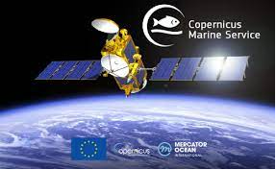
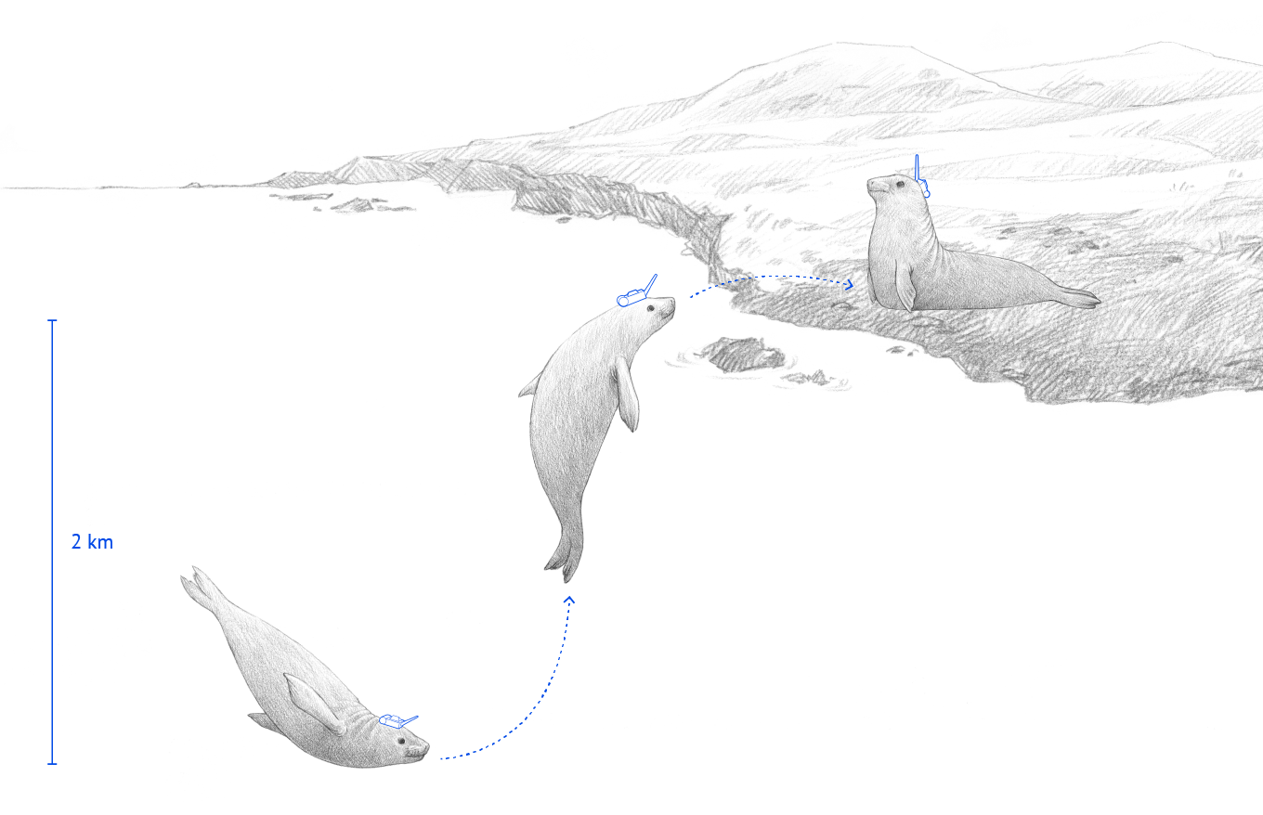
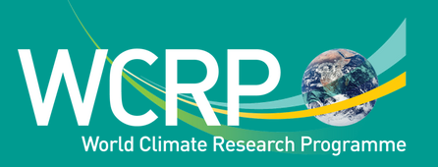
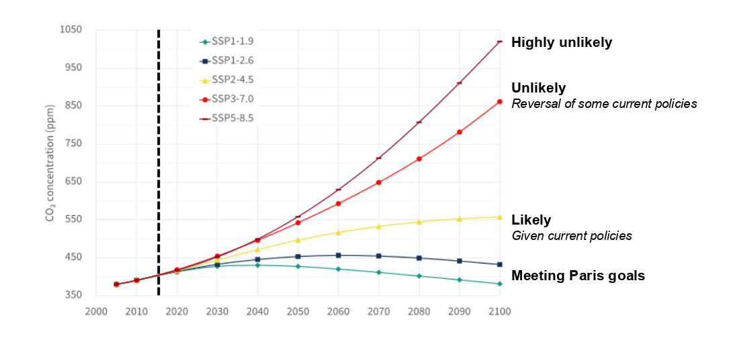
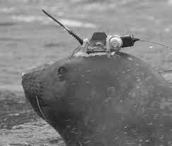
Data and methods
OSTIA observations
1/20° horizontal resolution
In situ hydrographic profiles from elephant seals
MERCATOR reanalysis
2004-2017
1/12° horizontal resolution
CMIP6 global climate models
Adapted from SSP Database - Version 2.0 and Hausfather and Peters, 2020
Azarian - 2
Notes:
Not going to go into the details of the methodology for the results but I will be happy to answer any questions on them after the presentation

Slide 3
Results
Case study on the Southern Indian Ocean :
Marine heatwaves are particularly intense in areas of high mesoscale activity
Temperature anomalies extend deeper under marine heatwaves east of Kerguelen Plateau (~ 200 m).
East of Kerguelen Plateau : marine heatwaves are associated with a lesser probability of presence of winter waters.
Marine heatwaves are expected to intensify over the subantarctic, especially under the Shared Socio-Economic Pathway 2-4.5 (« modest mitigation » scenario).
Azarian - 3

Slide 4
Discussion and conclusions
Global patterns of climate change are known but better understanding of the impacts on pelagic ecosystems requires considering fine scale dynamics
To do so :
Improvement of climate models representation of fine scale processes
Focusing on extreme events (e.g. Southern Indian Ocean case study)
MHW are local statistical indicators that can be related to ecologically significant physical features (Polar Front meander) and to larger-scale processes (warming)
Linking science and society :
Evaluate climate change risk for ecosystems at scales relevant for conservation
Develop indicators to provide levers of actions for policy-makers to consider climate change in conservation and management
Azarian - 4

