Slide 1

Direct observational evidence of an oceanic dual kinetic energy cascade and its seasonality
Dhruv Balwada, Jin-Han Xie, Raffaele Marino, & Fabio Feraco
@BalwadaDhruv
Abbreviated abstract: The oceanic forward cascade at the submesoscales and its coexistence with the inverse cascade have never been observed. Here we present the first evidence of a dual KE cascade in the Ocean by analyzing in-situ velocity measurements from surface drifters. Our results show that KE is injected at two dominant scales and transferred to both large and small scales, with the downscale flux dominating at scales smaller than ~1-10 km. The cascade rates are modulated seasonally, with stronger KE injection and downscale transfer during winter.
Related publications:
Direct observational evidence of an oceanic dual kinetic energy cascade and its seasonality,
Dhruv Balwada, Jin-Han Xie, Raffaele Marino, & Fabio Feraco,
Science Advances, 2022 (in press)
Balwada - 1

Slide 2
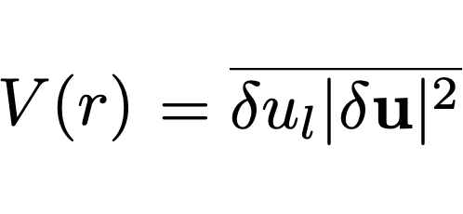
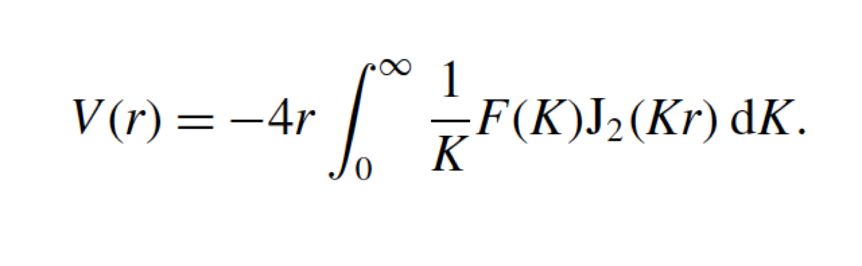

Data and methods
GLAD
Surface drifter observations:
Grand LAgrangian Deployment (GLAD), Summer 2012
LAgrangian Submesoscale ExpeRiment (LASER), Winter 2016
Third order structure function informs us about the energy transfers as a function of scale:
LASER
We devised a method to directly estimate the spectral flux from the third order structure function by carefully inverting the following equation:
Balwada - 2

Slide 3
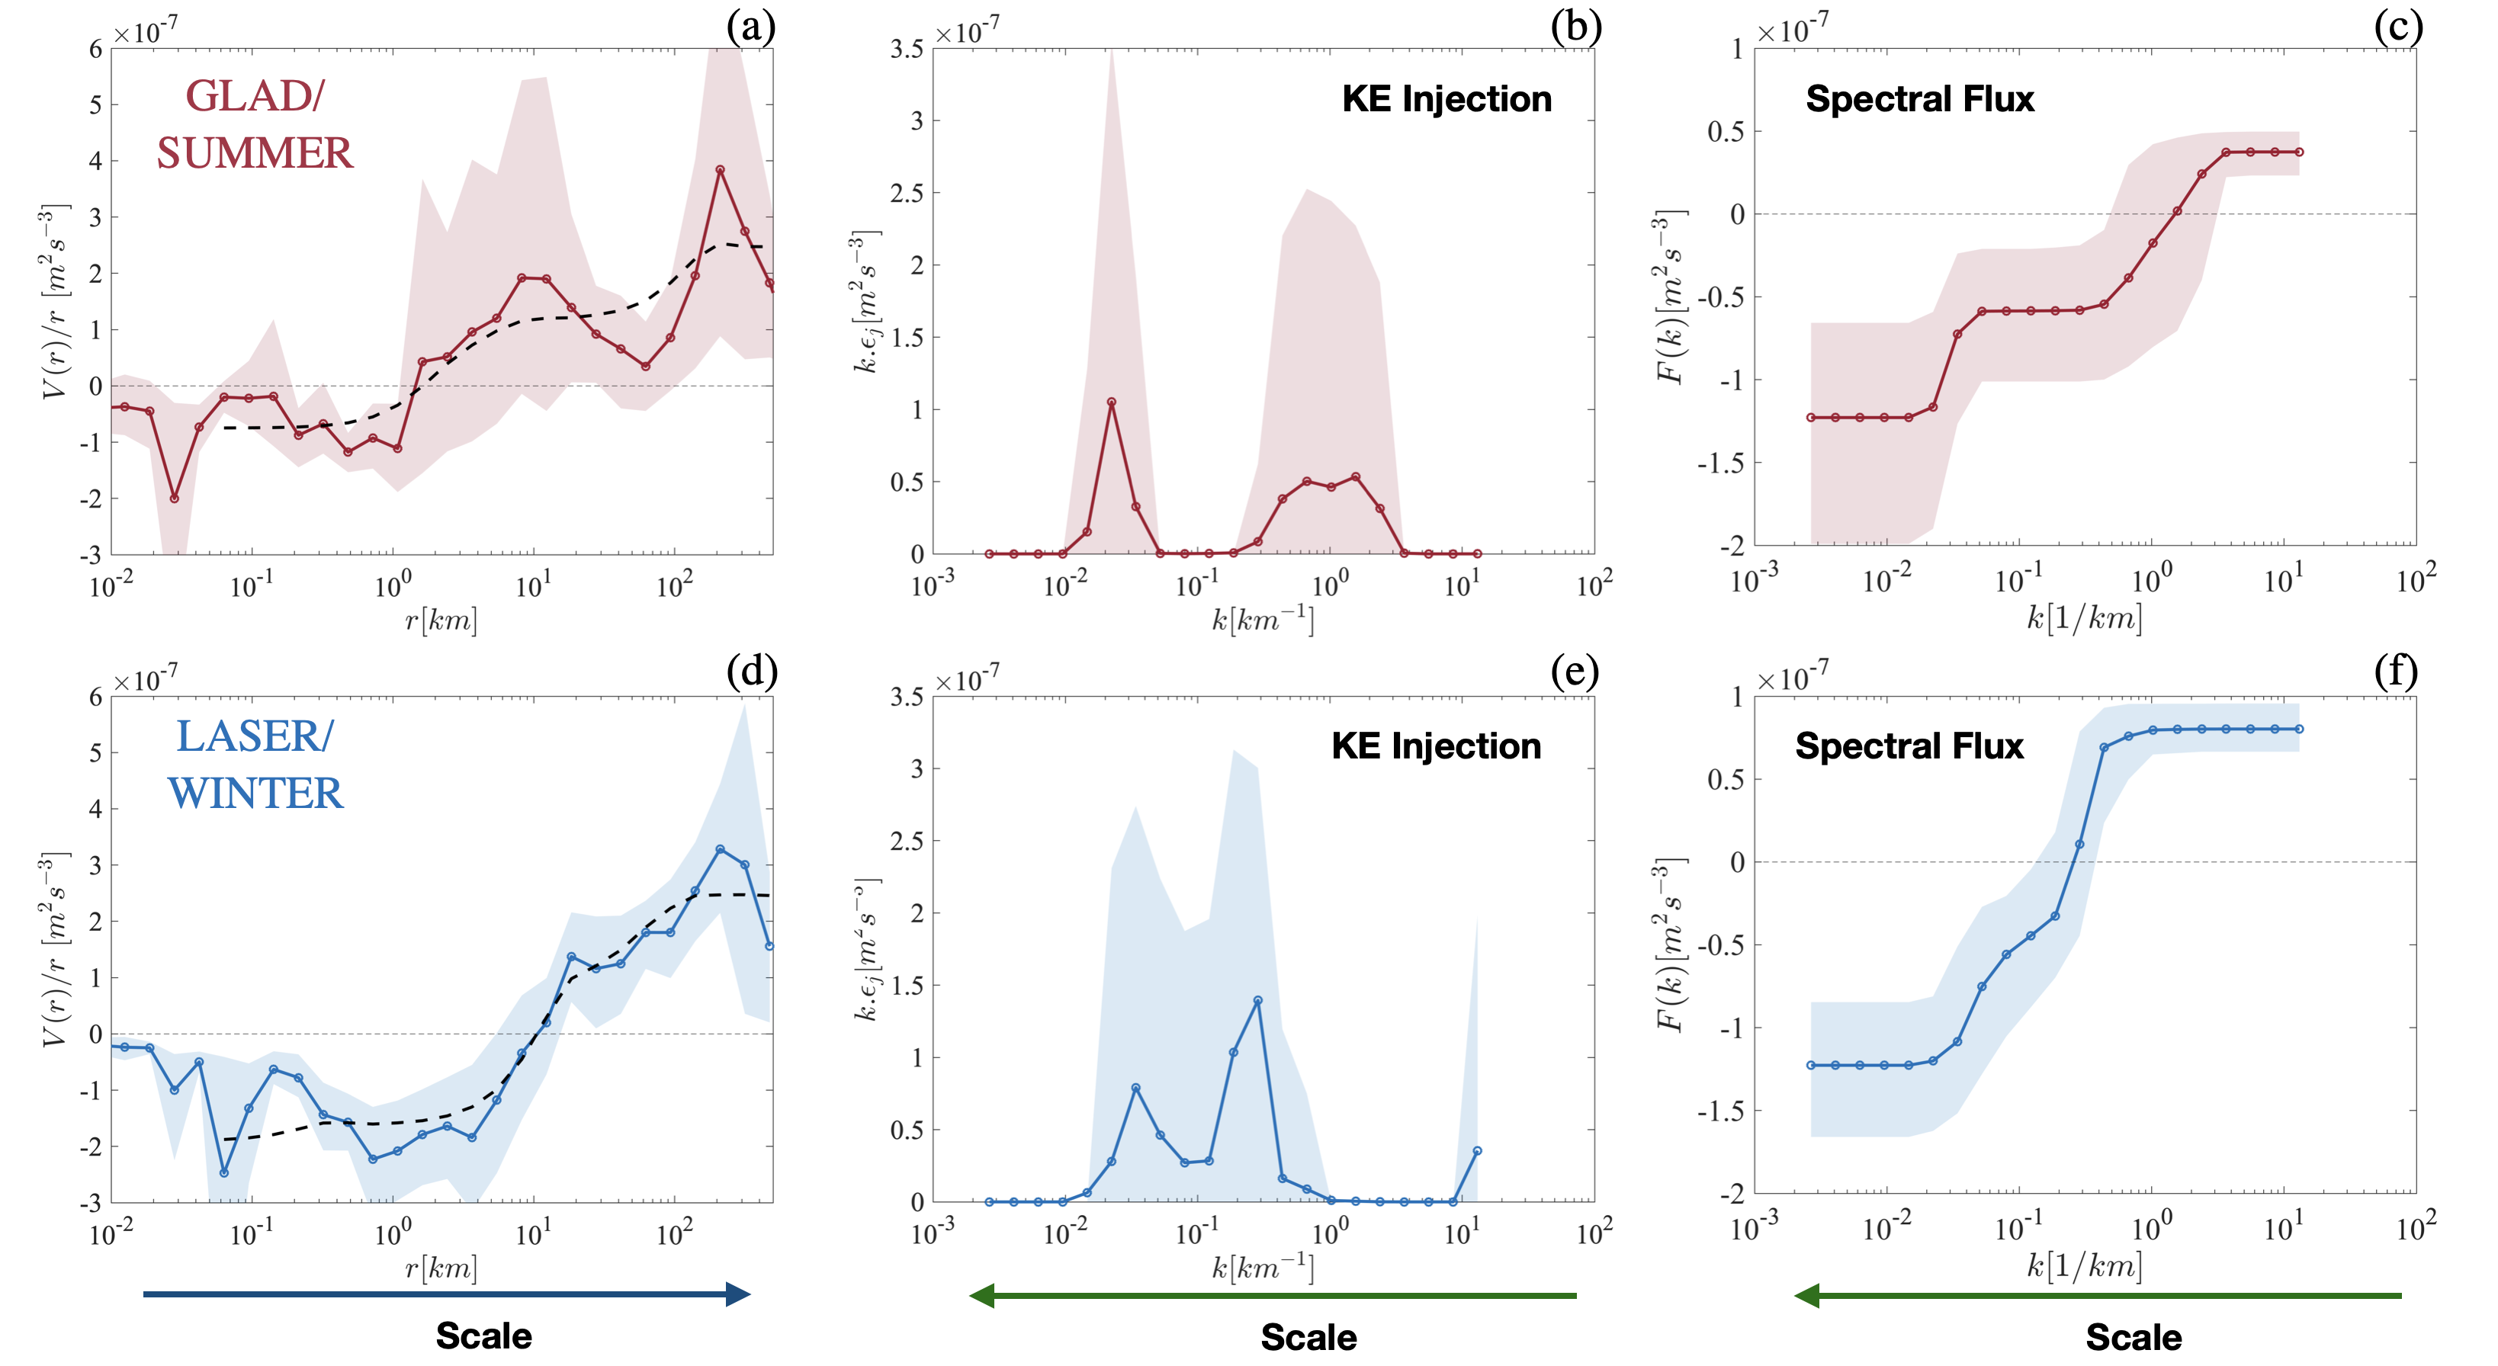
Results
Balwada - 3

Slide 4
Discussion and conclusions
We present the first observational evidence of a dual energy cascade.
Energy is injected near the interior and mixed layer deformation radii.
Seasonal modulation in the scale and strength of the energy injections and fluxes.
25-40% of the energy cascades forward to smaller scales.
Balwada - 4

