Slide 1
Finescale turbulence and mixed-layer dynamics: implications for Lagrangian dispersion
Stefano Berti Univ. Lille, ULR 7512, Unité de Mécanique de Lille Joseph Boussinesq (UML), 59000, Lille, France
Guillaume Lapeyre LMD/IPSL, CNRS, École Normale Supérieure, PSL Research University, 75005 Paris, France
Abbreviated abstract: In the ocean, submesoscale turbulence plays an important role for the surface energy exchanges and for biogeochemistry. Its dynamics should strongly depend on mixed-layer instabilities, which give rise to energetic small scales over the whole depth of the mixed layer. The transport properties of oceanic flows at depth, essential to understand the coupling between surface and interior dynamics, however, are still only partially known. We numerically study Lagrangian pair dispersion in turbulent flows from a quasi-geostrophic model including both thermocline and mixed-layer instabilities, focusing on the identification of different regimes. We find that dispersion is local at the surface. In the absence of a mixed layer it very soon changes to nonlocal at small depths, while in the opposite case this only occurs below the mixed layer. We further discuss the effect of vertical shear on particle spreading and address the correlation between the dispersion properties at the surface and at depth, which is relevant to assess the possibility of inferring the dynamical features of deeper flows from the more accessible surface ones.
Related publications:
S. Berti, G. Lapeyre, Lagrangian pair dispersion in upper-ocean turbulence in the presence of mixed-layer instabilities, Phys. Fluids 33, 036603 (2021)
Berti - 1

Slide 2
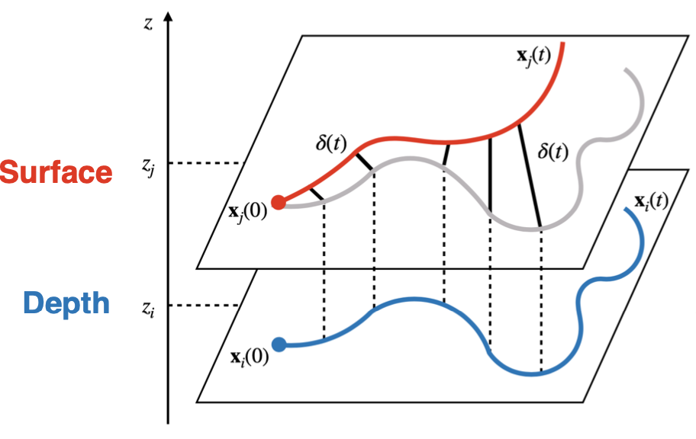
Data and methods
Model. We adopt a QG model consisting of two coupled fluid layers (aimed to represent the mixed layer and the thermocline) with different stratification. Such a model can give rise to both meso and submesoscale instabilities and subsequent non-linear turbulent dynamics that compare well with observations of wintertime submesoscale flows. We perform numerical simulations of turbulent dynamics within this framework, adopting realistic parameter values for the midlatitude ocean. To assess the role of mixed-layer, submesoscale instabilities we compare the results in three different cases, in which one of the two layers is absent, or both are simultaneously present.
Lagrangian pair dispersion. After characterizing the statistical properties of the flows, we carry out Lagrangian advection experiments by placing large numbers of tracer particles at different (fixed) depths in each flow. We analyze pair dispersion by means of both fixed-time and fixed-scale indicators, like the finite-size Lyapunov exponent (FSLE), accounting for a scale-by scale dispersion rate. By comparing the results with the theoretical predictions based on kinetic energy spectra, we identify the different dispersion regimes occurring at different horizontal scales and at different depths in the three turbulent dynamics obtained from the model.
Inter-depth dispersion. We then focus on the vertical correlation of horizontal dispersion properties, to measure the dynamical link between the surface and the interior. For this purpose we consider the relative motion between particles seeded at different depths, which amounts to examining the evolution of pairs of trajectories starting from the same initial position, on the horizontal, but with dynamics governed by different flows. We analyze the spreading process using a generalization of the FSLE, known as FSLE-II. Interestingly, the comparison of the two types of FSLE allows the identification of a threshold length scale above which the differences in the underlying turbulent dynamics do not affect the statistical properties of the dispersion process.
Berti - 2

Slide 3
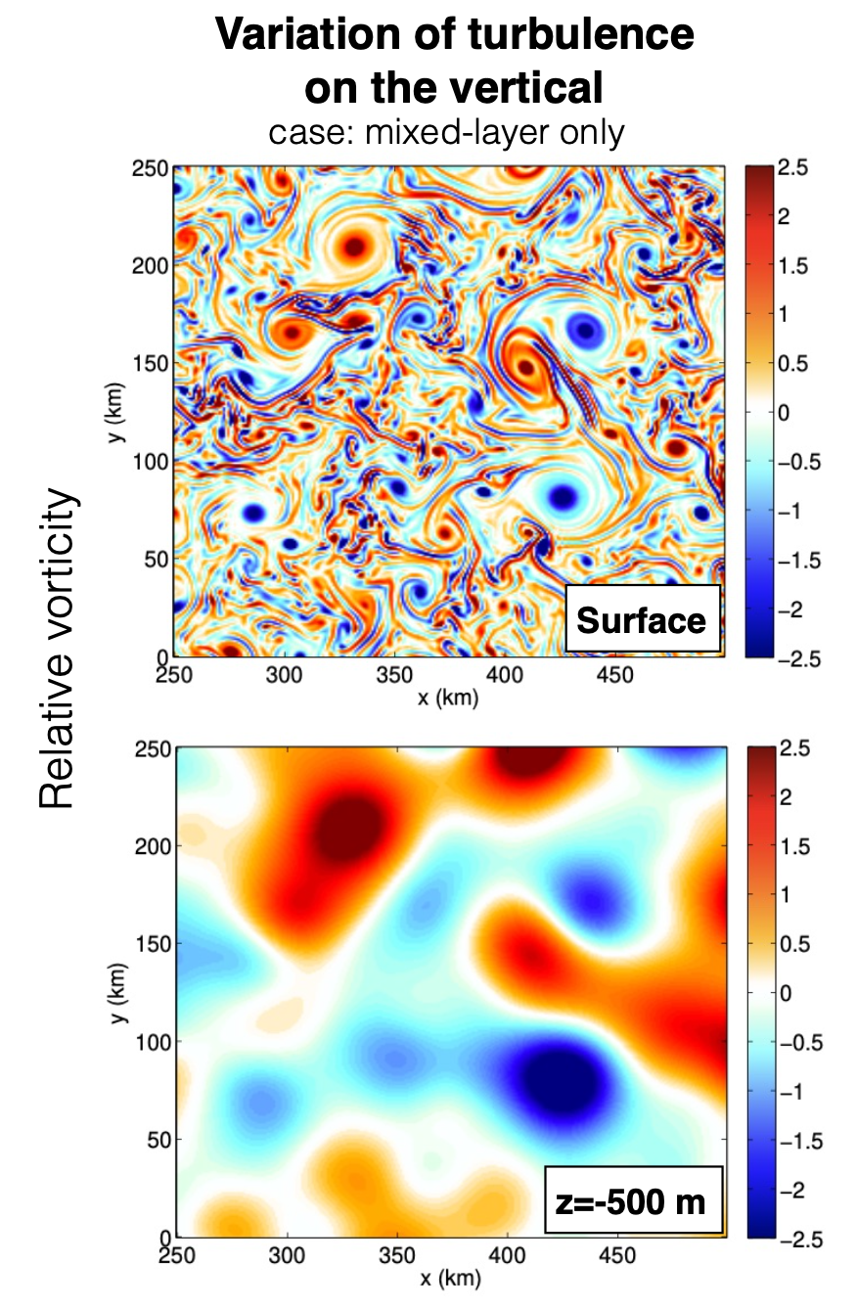
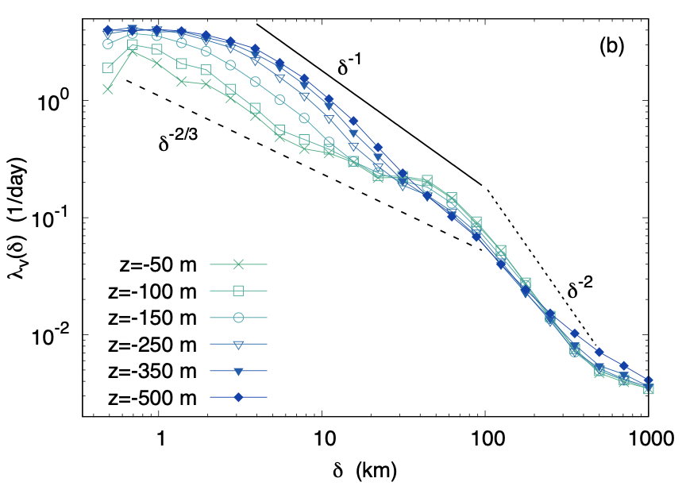
Results
Turbulent flow properties and horizontal dispersion. Surface flows are in all cases characterized by energetic submesoscales. However, in the absence of a mixed layer, the latter rapidly decay at depth. In its presence, instead, the whole mixed layer possesses energetic fine scales, whose decay now only occurs below the mixed-layer base. Such dynamics have an impact on relative dispersion, in terms of a transition from a local regime (controlled by eddies of size comparable to the pair separation distance) to a nonlocal one (controlled by the largest flow features). At the surface dispersion is always local. Below, it rapidly changes to nonlocal, in the absence of a mixed layer, while in its presence the transition is moved to larger depth.
Vertical correlation of horizontal dispersion properties. The analysis of the inter-depth dispersion (FSLE-II) reveals that, when the mixed layer is present, motions are correlated along the vertical, as highlighted by the small change with depth of the indicator’s scale-dependence (-2/3 law). Below the mixed layer the vertical shear due to turbulence partially controls the link surface/interior (-1 law). In the absence of a mixed layer, dispersion properties rapidly decorrelate from those at the surface and the inter-depth dispersion is largely controlled by the vertical shear.
FSLE-II
case: ML
Berti - 3

Slide 4
Discussion and conclusions
We explored Lagrangian pair dispersion in upper-ocean turbulence in the presence, or not, of a mixed layer. We focused on the identification of different dispersion regimes and on the possibility to relate the characteristics of the spreading process at the surface and at depth. The latter question is particularly relevant to assess the possibility of inferring the dynamical features of deeper flows from the experimentally more accessible (e.g., by satellite altimetry) surface ones, and to provide information on the coupling between the surface and interior dynamics.
Tracer particles were advected by turbulent flows characterized by energetic submesoscales close to the surface, both in the presence and in the absence of mixed-layer instabilities. The main effect of the mixed layer is to energize the full upper part of the water column and, hence, to strongly impact the vertical variation of the statistical features of turbulence.
Our analysis at different depths and in different models allowed to identify two general behaviors, and a clear transition, between the two, with depth. The spreading process is local at the surface. In the absence of a mixed layer it very soon changes to nonlocal at small depths, while in the opposite case this only occurs at larger depths, below the mixed layer.
We further investigated the dispersion properties of inter-depth pairs. In the absence of a mixed layer, the relative motions of such particles are found to get rapidly modified with increasing depth. In its presence, instead, a similar phenomenon occurs only below the mixed layer. The change is sharper when the mixed layer is absent, but the relation between dispersion at depth and at the surface appears in this case to be largely controlled by the vertical shear. In the presence of mixed-layer instabilities, the statistical properties of the spreading process at the surface can, instead, be considered a good proxy of those in the whole mixed layer.
Based on the above findings, we believe that this study provides evidence of the interest for future satellite altimetry, as the SWOT mission that should provide surface velocity fields at unprecedented high resolution, also in light of understanding subsurface ocean dynamics.
Berti - 4

