Slide 1
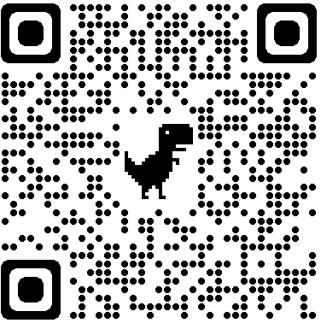
Design of in situ sampling strategies to reconstruct fine-scale ocean currents in the context of SWOT satellite validation
Bàrbara Barceló-Llull and Ananda Pascual (IMEDEA (CSIC-UIB), Spain)
@bbarcelo_ocean @anandapascual1
Abbreviated abstract: The upcoming SWOT satellite mission aims to provide SSH measurements in 2D with an effective resolution of 15-30 km. Our study provides recommendations for the design of in situ experiments aimed at reconstructing fine-scale (~20 km) ocean currents, such as those that will be conducted for SWOT validation. A set of Observing System Simulation Experiments (OSSEs) has been developed to evaluate different CTD sampling strategies and their impact on the reconstruction of SSH fields and horizontal velocities. The analysis focuses on the western Mediterranean Sea and on the subpolar northwest Atlantic.
*The EuroSea project has received funding from the European Union’s Horizon 2020 research and innovation programme under Grant Agreement No. 862626.
Related publications:
Barceló-Llull et al. (2021)
Report of this study
Barceló-Llull and Pascual - 1

Slide 2
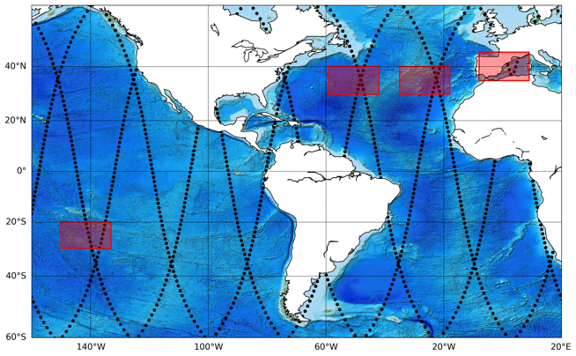
Data and methods
Study regions
Models
Configurations
Mediterranean
eNATL60 | 1.5 km, hourly
WMOP | 2 km, daily
CMEMS | 4 km, daily
Ref. | CTD casts, z_{max}: 1000 m, dx: 10 km, summer ~ PRE-SWOT sampling strategy (Barceló-Llull et al., 2021)
#1 | z_{max}: 500 m
#2 | dx: 5, 8, 12, 15 km
#3 | uCTD
#4 | Winter
#5 | Gliders
Atlantic
eNATL60 | 1.5 km, hourly
CMEMS | 8 km, daily
To simulate CTD observations and as the “ocean truth” (test sensitivity)
Reconstruction method:
spatio-temporal optimal interpolation
Focus on SWOT scales of ~20 km
Barceló-Llull and Pascual - 2

Slide 3
Results
Ref. configuration
Atlantic
Mediterranean
Ref. configuration good sampling strategy in summer
High seasonality
The sampling of the upper 500 m depth captures 40-50% of the ocean truth max. horizontal velocity magnitude, while with profiles down to 1000 m this percentage increases to ~90%
Ref. configuration good sampling strategy
Low seasonality
Faster alternatives:
#1 z_{max}: 500m, 3.1 days
#3 uCTD, dx: 6km, z_{max}: 500m, 1.8 days
Codes for this analysis are open and free in Github
Barceló-Llull and Pascual - 3

Slide 4
Discussion – Round table
Next
challenges
Consolidated results
in ocean fine-scales
Incoming opportunities
How can we sample, reconstruct and understand 3D circulation at scales < 20 km?
How does the circulation at these scales impact the distribution of tracers (nutrients, heat, carbon)?
In situ experiments as PRE-SWOT can capture, through CTD and ADCP observations, the fine-scale currents that drive drifter displacement and modulate biochemical spatial variability.
FaSt-SWOT: Multi-platform experiment during the SWOT fast-sampling phase in 2023.
Objective: evaluate and understand the 3D pathways associated with fine-scale structures (~20 km).
How can we relate SWOT observations with the circulation at deeper layers?
What is the w associated to the detected structures in SWOT observations?
Barceló-Llull et al. (2021)
Barceló-Llull and Pascual - 4

