Slide 1

Predators and prey in a sea of (sub)mesoscale features
Alice Della Penna, Joan Llort, Sebastien Moreau, Ramkrushnbhai Patel, Rudy Kloser, Peter Gaube, Peter Strutton, Philip W. Boyd, Pascal Rivière
@AliDrifting
Abbreviated abstract: Open ocean ecosystems are embedded in a dynamic environment populated by (sub)mesoscale (1-100 km, days to months) features such as meanders, fronts, and eddies. These features can impact apex predators’ (marine mammals, seabirds, and sharks) movement and foraging behaviour directly and by structuring abundance and accessibility of their prey. Here we show results from recent studies focused on the impact of (sub)mesoscale features on micronekton (fish, squids and crustaceans – key prey items of megafauna).
Related publications:
Della Penna, A., & Gaube, P. (2020). Mesoscale eddies structure mesopelagic communities. Frontiers in Marine Science, 7, 454.
Della Penna, A., et al. (in revision). The impact of a Southern Ocean cyclonic eddy on mesopelagic micronekton
Della Penna et al.

Slide 2
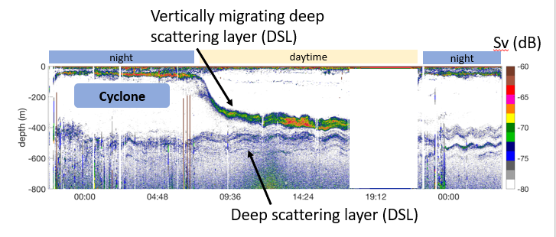
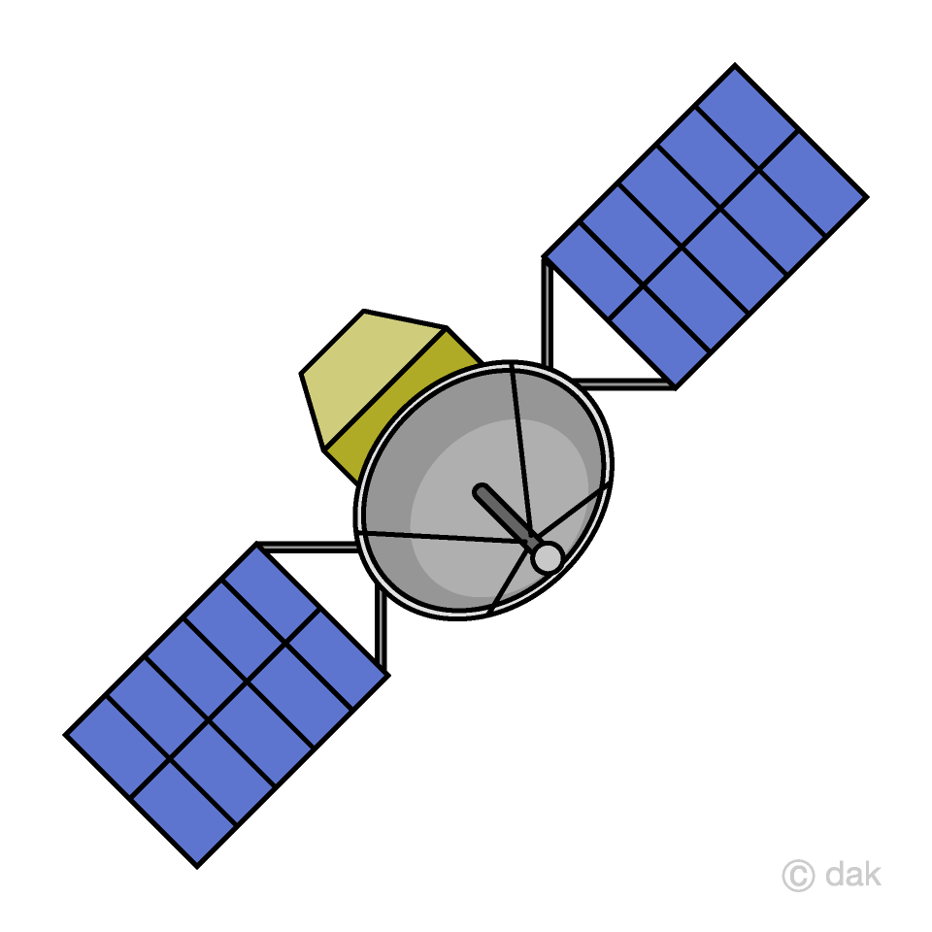

Data and methods
We analyse the distribution of acoustic backscatter in the North Atlantic and Southern Ocean.
We use active acoustics (18 kHz, 38 kHz) to detect the distribution of acoustically reflective micronekton.
Satellite altimetry and in situ observations of near-surface properties complement these observations and allow us to map the acoustic data in respect to the distribution of (sub-)mesoscale features.
Eddy periphery
Out
Eddy core
Della Penna et al.

Slide 3
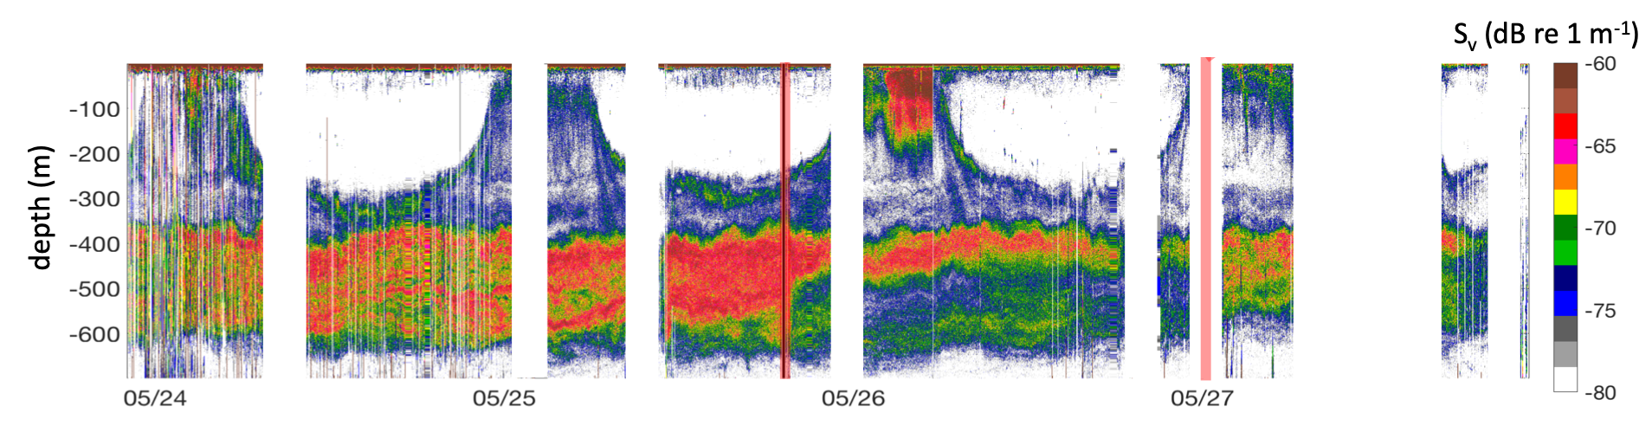
Results
Anticyclones in the North Atlantic are associated to stronger mesopelagic backscatter.
The sampled Southern Ocean cyclone is acoustically more similar to waters from the Polar Front Zone compared to the surrounding Sub-Antarctic waters.
In both regions, eddy peripheries are associated with sharp gradients of acoustic backscatter in the top 1,200 m, but other submesoscales scale features may not always match a strong gradient in mesopelagic backscatter.
Inside the eddy core (anticyclone, NA)
periphery
ambient
Della Penna et al.

Slide 4
Discussion and conclusions
Mesoscale eddies can present unique properties compared to the ambient waters, in terms of mesopelagic biomass or community composition, as well as distribution through the water column.
Possible impact of trapping?
From a marine predator perspective, this might mean that eddies contain more/less nutritious or more/less accessible (e.g., shallower) prey compared to the surrounding waters.
Changes in the locations where eddy are more frequent, their lifetimes and their retention will affect marine megafauna.
Lagrangian studies monitoring eddies and submesoscale fronts at their peripheries for an extended time periods would be an ideal approach to understand how different mechanisms underpin the observed patterns.
Della Penna et al.

