Slide 1
Spatial patterns of Southern Ocean submesoscale subduction from in situ and satellite observations
Lilian A. Dove, Andrew F. Thompson, Dhruv Balwada, Alison R. Gray
@SoLilyquizing
Abbreviated abstract: Numerical models suggest that standing meanders of the Antarctic Circumpolar Current are thought to be places of enhanced ventilation as a result of the coupling of lateral stirring along isopycnals at the mesoscale and submesoscale vertical velocities in the surface ocean. Here, we show observations from gliders and BGC-Argo floats that confirm the presence of these ventilation hotspots that may play an outsized role in carbon and heat fluxes.
Related publications:
Dove et al. (2021) Observational Evidence of Ventilation Hotspots in the Southern Ocean, Journal of Geophysical Research: Oceans
Dove et al. (2022) Enhanced Ventilation in Energetic Regions of the Antarctic Circumpolar
Current, Geophysical Research Letters
Dove - 1

Slide 2
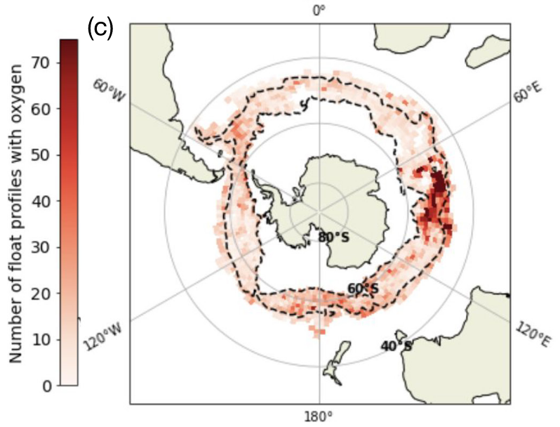
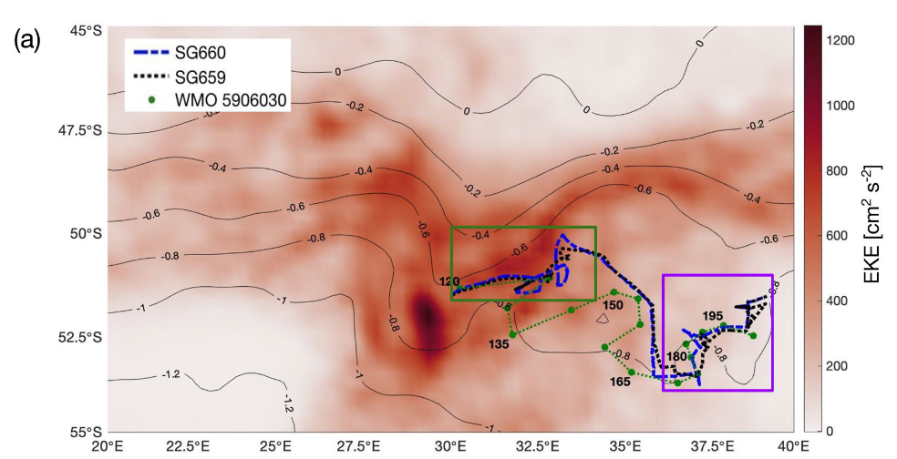
Data and methods
Numerical models suggest that eddy kinetic energy hotspots resulting from flow-topography interactions may be regions of enhanced ventilation, but observations of these regions remain sparce.
We use observational data from Seagliders, BGC-Argo floats, and satellite altimetry to consider the role submesoscale processes within standing meanders play in ventilation of the Southern Ocean.
Brady et al. (2021)
Dove - 2

Slide 3
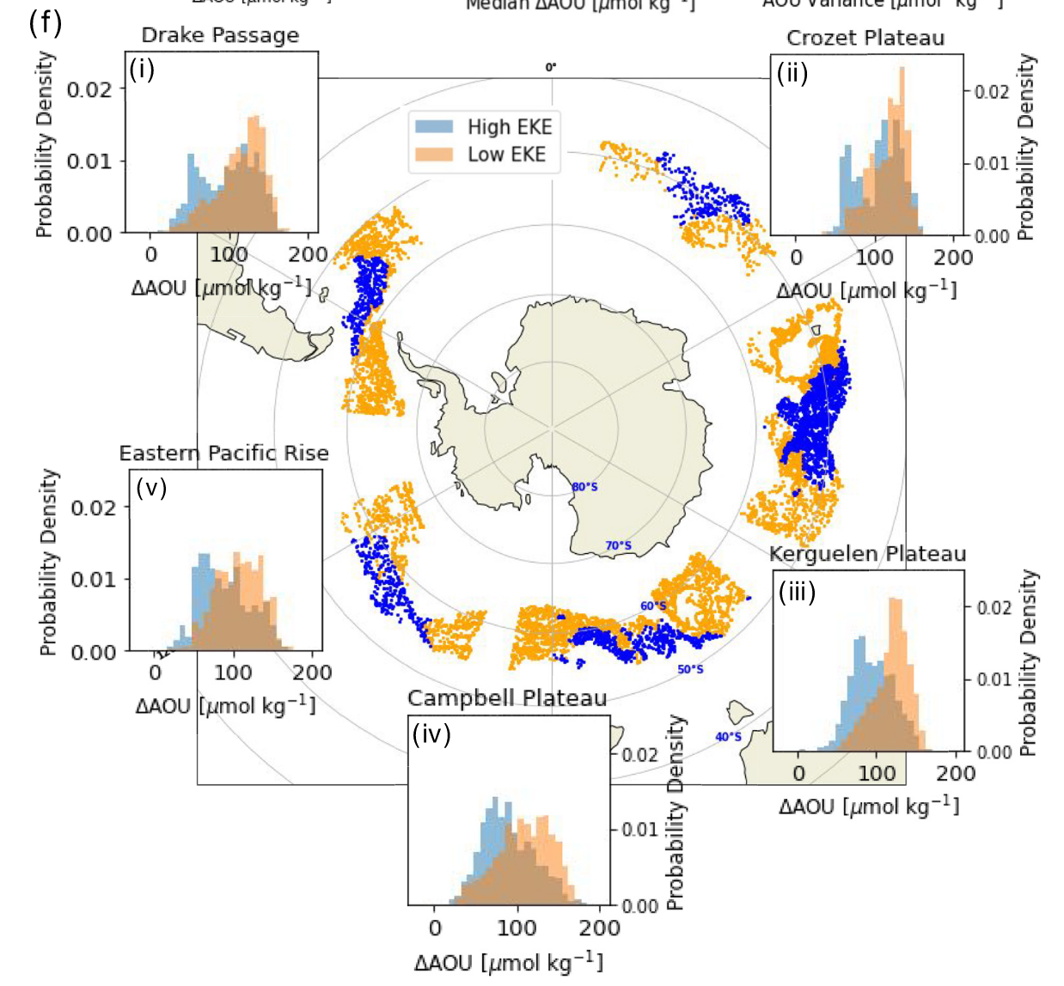
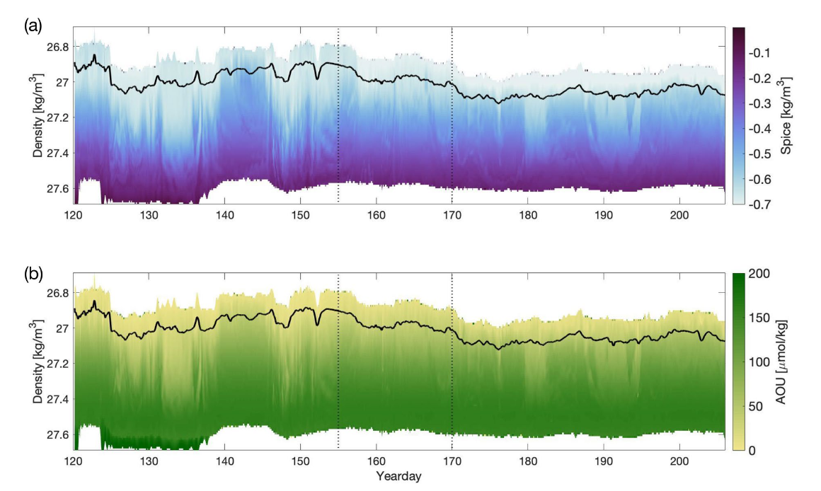
Results
Observations from Seagliders from a high-EKE region of a standing meander of the ACC (Crozet Plateau) reveal enhanced frontal gradients at the submesoscale as well as heightened tracer variability at depth.
Looking across the Southern Ocean using BGC-Argo floats, there is reduced AOU in high-EKE regions of the ACC, suggesting enhanced ventilation.

Slide 4
Discussion and conclusions
The coupling of the lateral stirring along isopycnals at the mesoscale and submesoscale vertical velocities in the surface ocean lead to enhanced ventilation in standing meanders. In regions of enhanced ventilation in the Southern Ocean, stirring brings high DIC waters up to the base of the mixed layer, which can then enter the surface ocean through submesoscale motions, impacting CO₂ outgassing and uptake.

