Slide 1
Assessment of the effect of small-scale SST features on air-sea interactions in the North-West tropical Altantic ocean
Pablo Fernández, Sabrina Speich, Claudia Pasquero, Agostino N. Meroni, Matteo Borgnino.
@pablo_fdez_fdez
Abbreviated abstract: This study explores the coupling between the ocean and the marine atmospheric boundary layer at different spatial scales in the North-West tropical Atlantic ocean. The results show that at scales smaller than 100 km (meso and sub-mesoscale) the ocean actively forces the atmosphere. At larger scales the ocean passively responds to an atmospheric forcing. The small-scale coupling information is then used to test a linear latent heat flux (LHF) upscaling algorithm. A validation exercise between satellite (SeaFlux) and reanalysis (ERA5) upscaled LHFs and the high-resolution WRF LHF output shows that, despite the non-linearities associated specially to sub-mesoscale processes, the linear algorithm significantly improves the estimation of LHF.
Related publications:
Meroni, A. N., Giurato, M., Ragone, F., & Pasquero, C. (2020). Observational evidence of the preferential occurrence of wind convergence over sea surface temperature fronts in the Mediterranean. Quarterly Journal of the Royal Meteorological Society, 146(728), 1443-1458.
Fernández - 1

Slide 2
Data and methods
SeaFlux
ERA5
MUR-JPL
Satellite based observations (scatterometers, radiometers) blended with in-situ observations.
Hourly data from 2008 to 2018.
25 km spatial resolution (low resolution)
Reanalysis.
Hourly data from 2008 to 2018.
0.25° x 0.25° spatial resolution (low resution).
Satellite-based SST observations.
Data data from 2008 to 2018.
0.01° x 0.01° spatial resolution (high resolution).
WORK STRUCTURE
Use of COARE3.5 to compute turbulent fluxes.
Assess the LHF (and controlling variables) sensitivity to SST.
Filter the small (mesoscale) out of the large scale features in SST and near-surface atmospheric variables.
Incorporate the small-scale SST impacts into LHF.
Fernández - 2

Slide 3
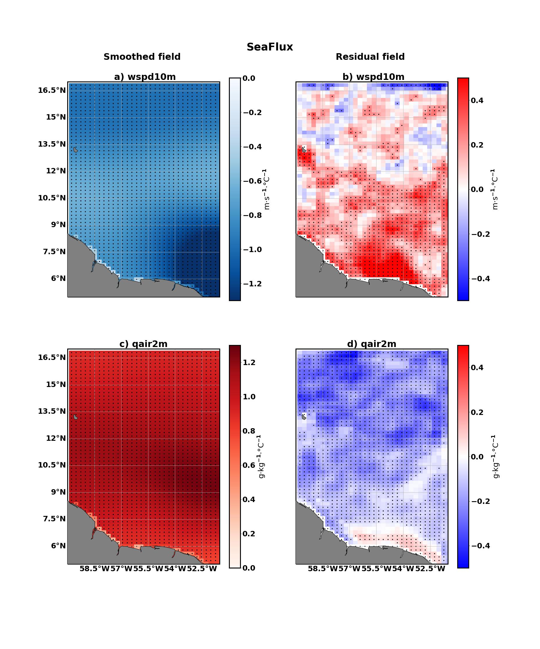
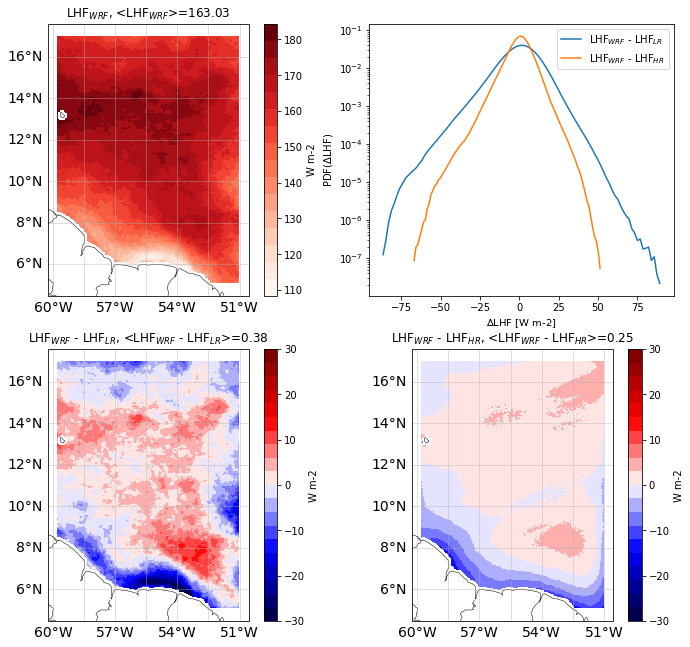
Results
MAIN FEATURES
The coupling coefficients between SST and near-surface specific humidity or wind speed change in sign depending on the spatial scale considered.
When the upscaling algorithm is applied to LHF, narrower PDFs and lower LHF differences arise when compared with a physically-consistent LHF dataset as that provided by WRF.
Fernández - 3

Slide 4
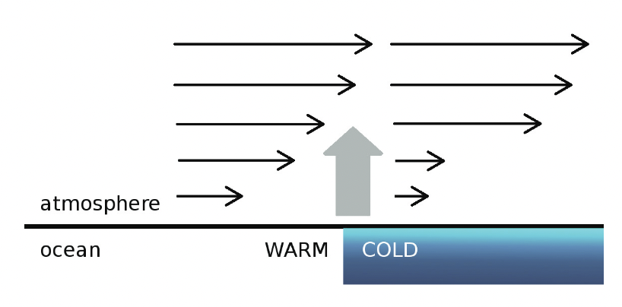
Discussion and conclusions
Small scale → Ocean actively influencing the atmosphere (modification of stability and buoyancy in the MABL).
Large scale → Ocean passively responding to the atmospheric forcing (in terms of air-sea fluxes).
DOWNWARD MOMENTUM MIXING (DMM) (wspd – SST relation)
INTERACTION MECHANISMS PROPOSED
THICKENING OF THE MABL (qair – SST relation)
SHORTCOMINGS AND ONGOING RESEARCH LINES
Linear upscaling algorithm disregarding the non-linear submesoscale processes.
Explore the influence of cean surface currents with saildrone fluxes.
Separation of the thermodynamic and dynamic contributions in the change of LHF with SST.
Separation between Eddy corridor region – Open Ocean.
Simplified schematics of the small-scale MABL-SST relation (Meroni et al., 2020)
Fernández - 4

