Slide 1
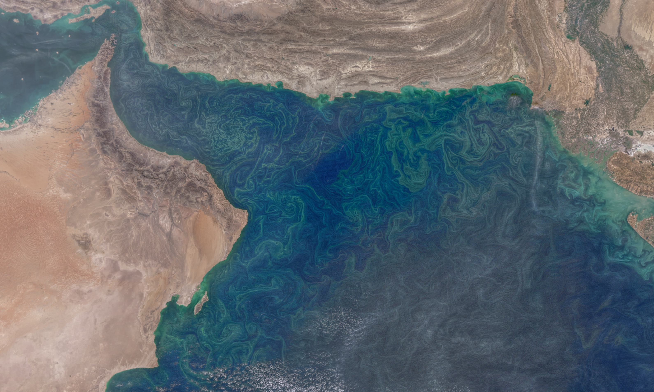






Submesoscale drivers of upper ocean mixed layer variability in the Gulf of Oman
Estel Font, Bastien Y. Queste and Sebastiaan Swart
@esteelfont estel.font.felez@gu.se
Abstract: High-resolution glider data collected in the Gulf of Oman (2015-16) are used to assess the effect of surface forcing and submesoscale processes on upper ocean stratification. Episodic wind events (Shamals) drive rapid latent heat loss which leads to deepening of the mixed layer, whereas submesoscale instabilities act mainly to restratify the upper ocean via mixed layer eddies. Intraseasonal upper ocean variability has downstream effects on phytoplankton bloom dynamics and ventilation. Further work using ADCP glider data (2021-22) determines regional hotspots and drivers of EKE and their ventilation potential.
Related publications:
Font, E., Queste, B. Y., & Swart, S. (2022). Seasonal to intraseasonal variability of the upper ocean mixed layer in the Gulf of Oman. Journal of Geophysical Research: Oceans, 127, e2021JC018045 https://doi.org/10.1029/2021JC018045
Font - 1

Slide 2
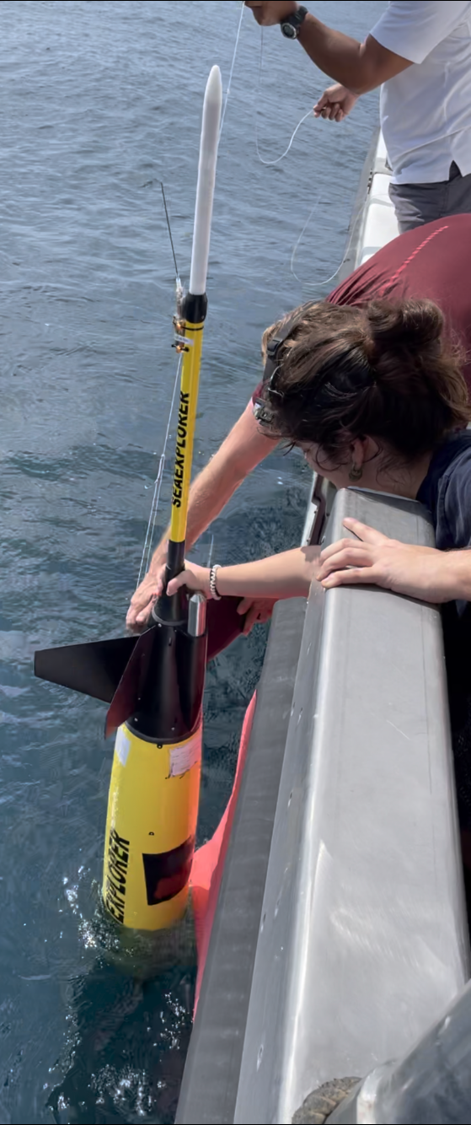

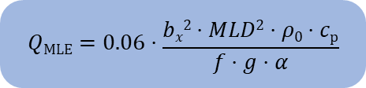



Data and methods
Ocean glider observations reveal ML variability that cannot be explained by seasonal warming alone in the Gulf of Oman during winter and spring.
Buoyancy flux is used to determine the stability of the upper ocean:
$B= g⋅[ \frac{α ⋅QNet}{ρ0⋅cp }$ $− β⋅SA⋅(E−P)]$
  The glider observations revealed submesoscale buoyancy fronts within the ML. Submesoscale processes are parametrized as equivalent heat fluxes:
𝑄_{MLE}: Mixed layer eddies
𝑄_{EBF} : Ekman buoyancy flux
$$QMLE=0.06⋅\frac{bx2⋅MLD2⋅ρ0⋅cp}{f⋅g⋅α}$$
$QSMS=QMLE$ + $QEBF$
$$QEBF=\frac{bx⋅τy⋅cp}{f⋅g⋅α}$$
Font - 2

Slide 3
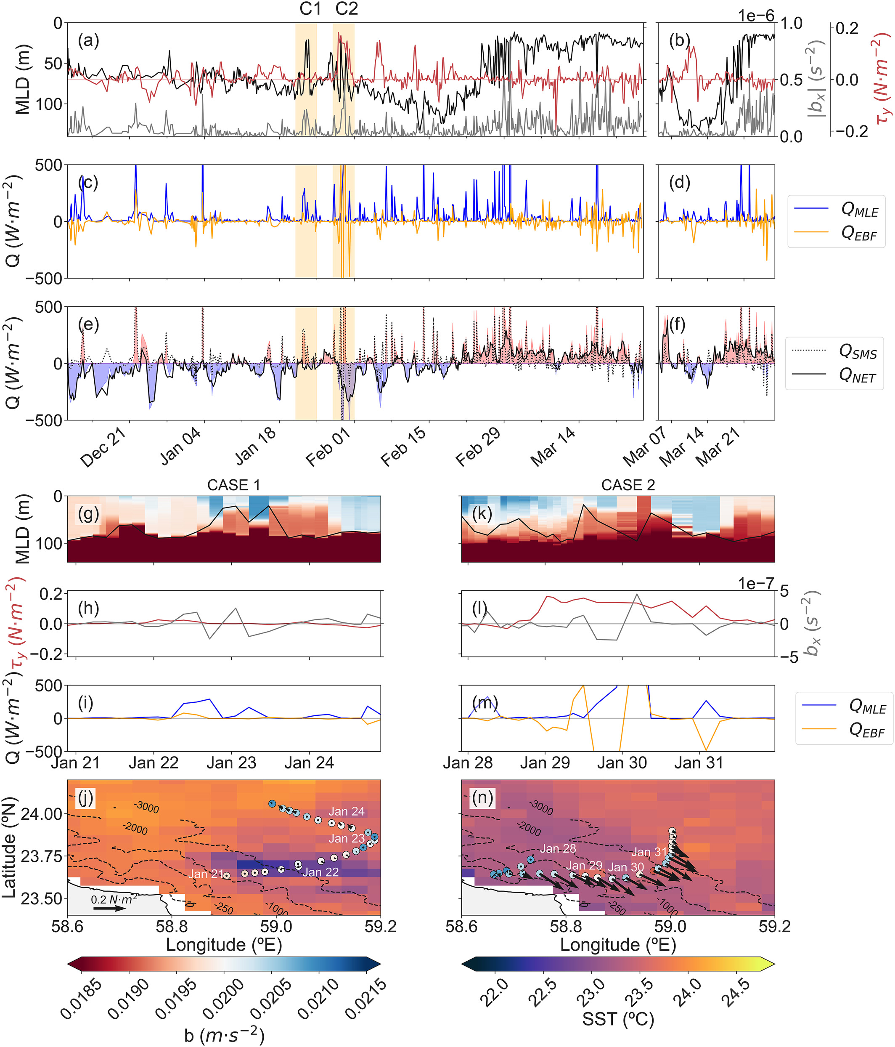
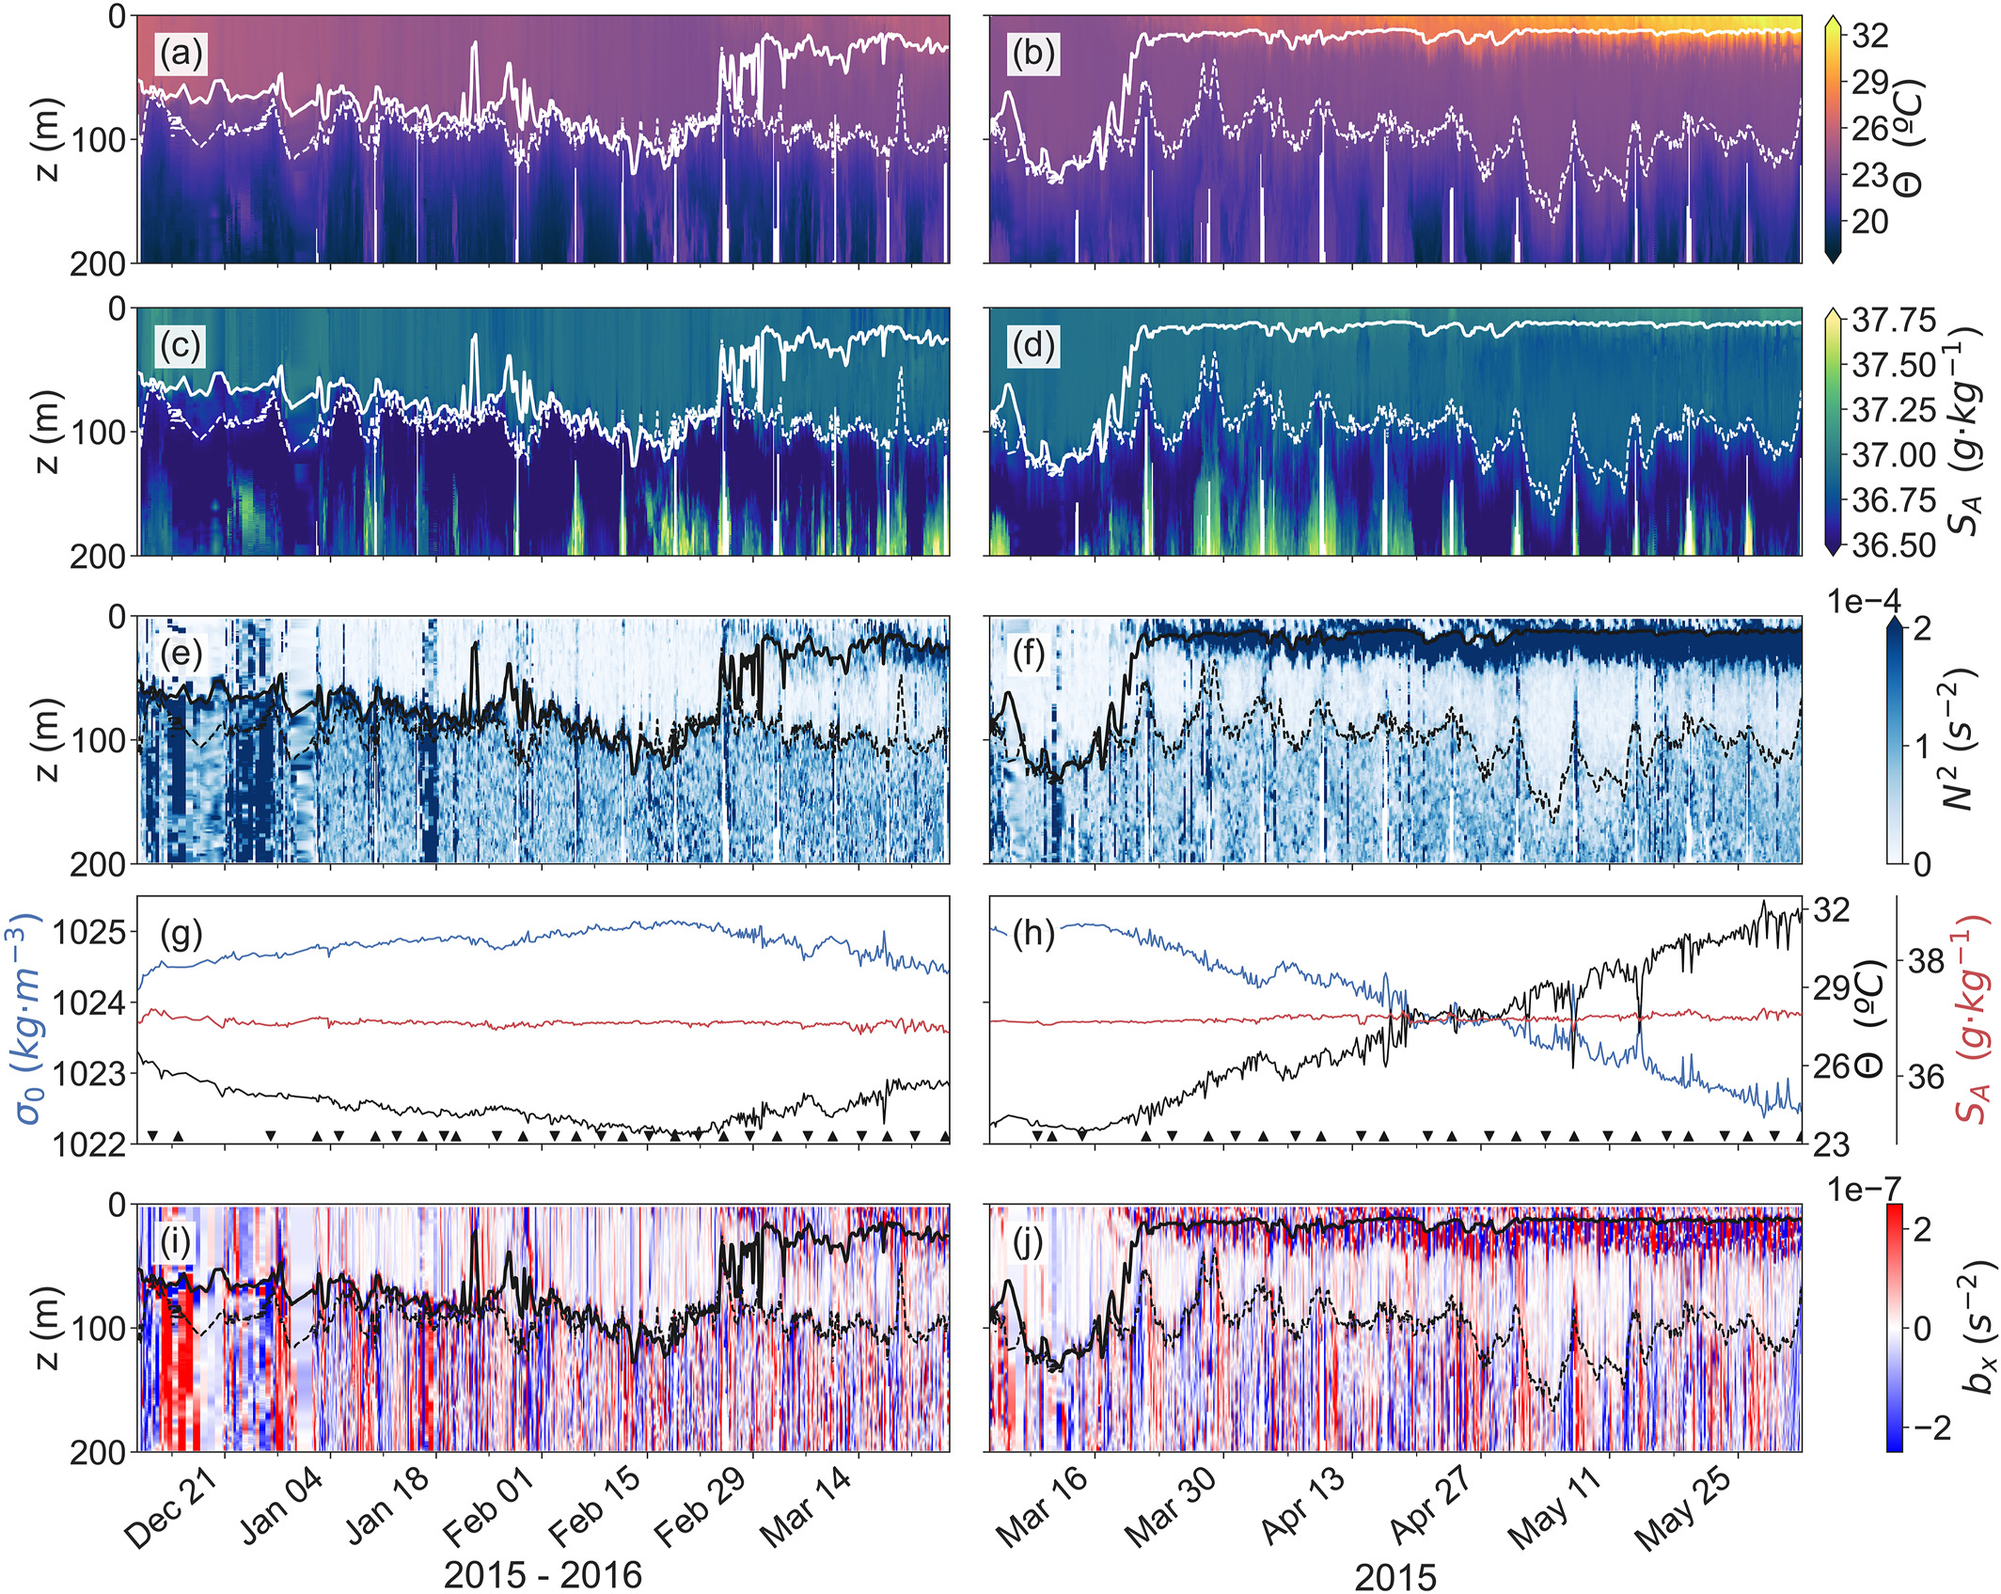
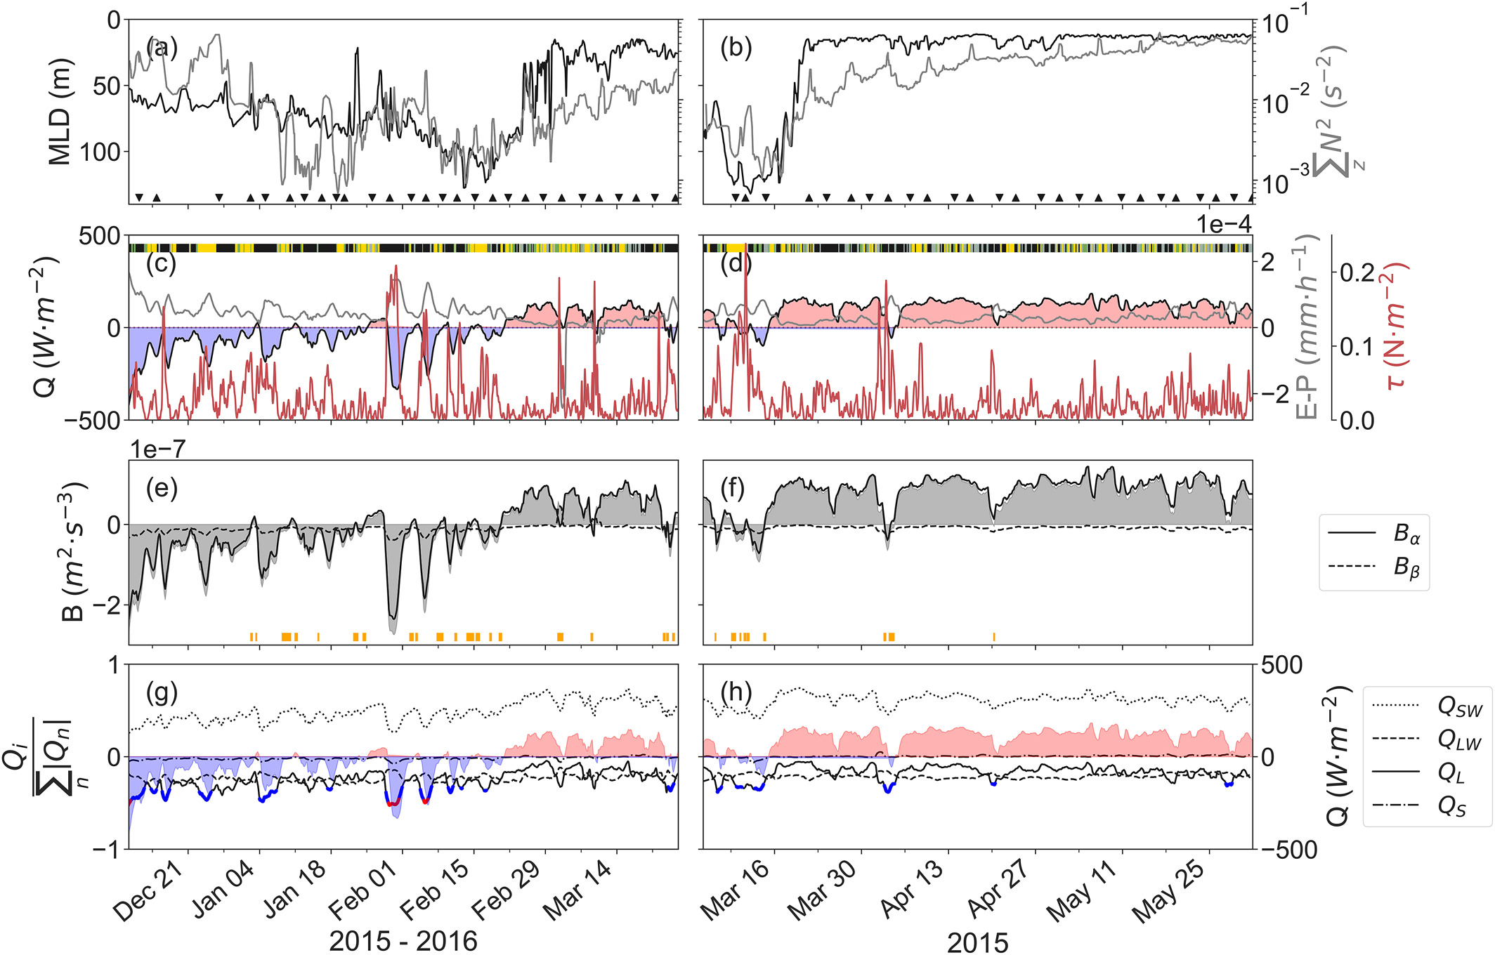
Results
The thermal component drives the seasonal and intrasesonality of the surface buoyancy flux.
Shamal winds are intense and dry winds from the NW and dominate the intra-seasonal variability of the mixed layer via strong latent heat flux loss.
𝑄_{SMS} primarily contribute to stratify the winter ML through both MLEs and EBF, accounting for : 68% of the total positive heat budget and opposing surface cooling 11% of the time. 𝑄_{MLE} account for 85% of the positive 𝑄_{SMS}.
Spring restratification timing may be conditioned by the presence of fronts.
Font - 3

Slide 4
Discussion and conclusions
Ongoing work and further perspectives: Current work focusses on determining hotspots of EKE and their potential for ventilation in the whole water column.
The seasonal evolution of the MLD and the restratification in the GoO is mainly driven by shortwave radiation.
Wind-driven processes cause latent heat loss that promotes the submonthly MLD variability. The primary drivers of Q_{L} are intense and dry north-westerly winds (Shamals).
Submesoscale buoyancy fronts within the ML have the energy to restratify and work against the atmospheric surface forcing fluxes at shorter timescales.
Spring restratification timing may be conditioned by the presence of fronts promoting restratification via baroclinic instability (MLEs).
What are the processes/ instabilities driving EKE hotspots?
What is the contribution of these instabilities on driving ventilation to the regional oxygen minimum zone?
Font - 4

