Slide 1

Ecological processes modulate biogeochemical fluxes in an eddying ocean
Mara A. Freilich, Glenn Flierl, Amala Mahadevan
@maratimes
Abbreviated abstract: Vertical transport of biogeochemical tracers shapes the distribution and diversity of phytoplankton. While vertical velocity is known to be enhanced by submesoscale dynamics, we show that there are two key characteristics that modulate the influence of submesoscale vertical motion on primary production. The first is that vertical motion is increasingly oriented along sloping isopycnal surfaces at the submesoscale, increasing its importance for passive tracer transport. Secondly, the timescale of submesoscale vertical motion is match with the timescale of plankton growth. This generates a growth-transport feedback that enhances nutrient supply.
Related publications:
Freilich, M.A., Flierl, G., Mahadevan, A. (2022). Diversity of growth rates maximizes phytoplankton productivity in an eddying ocean, Geophysical Research Letters, e2021GL096180.
Freilich, M.A. and Mahadevan, A. (2019). Decomposition of vertical velocity for nutrient transport in the upper ocean, Journal of Physical Oceanography, 49 (6), 1561-1575.
Freilich - 1

Slide 2
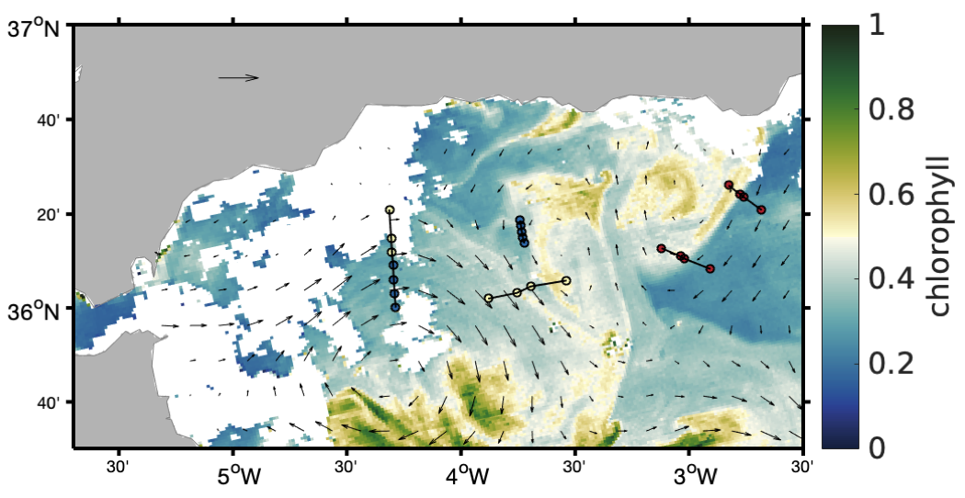
Data and methods
High resolution (fine taxonomic resolution and 1 km spatial scale biological sampling)
Linear biological model!
Freilich - 2

Slide 3
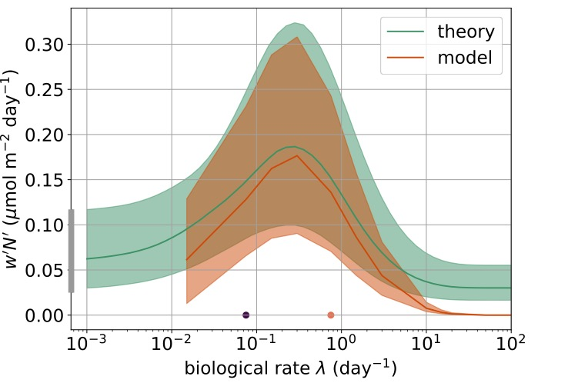
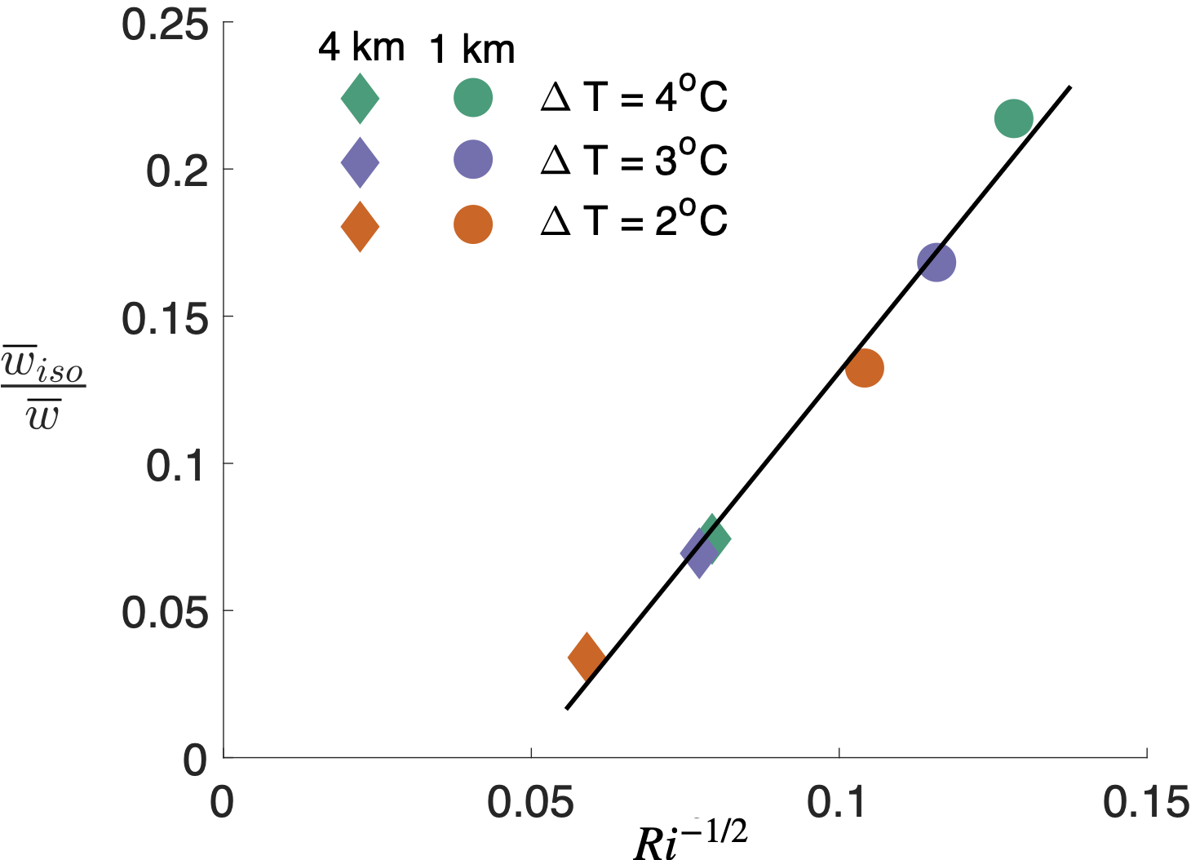
Results
At the submesoscale (higher model resolution and larger lateral buoyancy gradients), vertical velocity becomes increasingly along sloping isopycnal surfaces (w_{iso} increases relative to the total vertical velocity, which includes motion of buoyancy surfaces).
However, the implications of vertical motion for nutrient flux (w’N’) varies non-linearly with the growth rate of phytoplankton.
Theoretical prediction
See also: Claret, M. (2012). Potential vorticity conserving flows and vortex-wave interaction: the role of vertical velocity and isopycnal diffusion on plankton heterogeneity (Doctoral dissertation).
Freilich - 3

Slide 4
Discussion and conclusions
The timescale of vertical velocity determines bio-physical coupling. Submesoscale timescales are particularly important for biological productivity.
There is a transition in the characteristics of vertical velocity at submesoscale with particular importance for tracer transport – including nutrients and, in some regions, heat.
Parameterization of ecosystem processes in models must carefully consider the coupling between biological and physical processes, including the ways that the choice of biological parameters may need to be informed by the types and timescales of vertical motion that are resolved.
Submesoscale flows can drive significant local and regional changes in community composition and biodiversity due to non-linear dynamics. Finescale variability in vertical velocity characteristics on water mass trajectories could favor phytoplankton with a diversity of growth rates.
Freilich - 4

