Slide 1

Tracing the origins of fine-scale plankton patchiness along and across a front
Shailja Gangrade, Inès Mangolte, Marina Lévy, & Peter J.S. Franks
@ShailjaGangrade
Abbreviated abstract: In 2012, sampling of a mesoscale front in the California Current System revealed elevated plankton biomass at the front. By investigating at finer scales, we now find sub-mesoscale biological and hydrographic patchiness both along and across the front, as well as vertical layering of distinct water masses. Source-water trajectories using altimetry-derived velocities and coastal upwelling indices reveal that unique water mass pathways determine planktonic community structure: upwelling pulses make phytoplankton patches, and patches converge from both inshore and offshore. Thus, we reinterpret frontal dynamics and demonstrate a need for higher-resolution sampling.
Related (upcoming) publications:
Gangrade, S. & Franks, P.J.S. , in review. Upwelling pulses make phytoplankton patches at fronts: observations and implications in the California Current System. Journal of Geophysical Research: Oceans.
Mangolte, I. et al., in prep. Multi-trophic planktonic cross-frontal patchiness in the California Current Ecosystem.
Gangrade - 1

Slide 2
Data and methods
Satellite-derived data:
Sea level anomalies (mesoscale structure)
Geostrophic velocities (used in Lagrangian trajectories)
Finite-size Lyapunov exponents (outline regions of water mass convergence)
In situ cruise data:
SeaSoar Surveys (CTD, Chl-a fluorescence) supply measurements of along- and across-front biological & hydrographic structure
Cross-frontal transects (bongo net tows and CTD casts provide planktonic community structure measurements)
Gangrade - 2

Slide 3
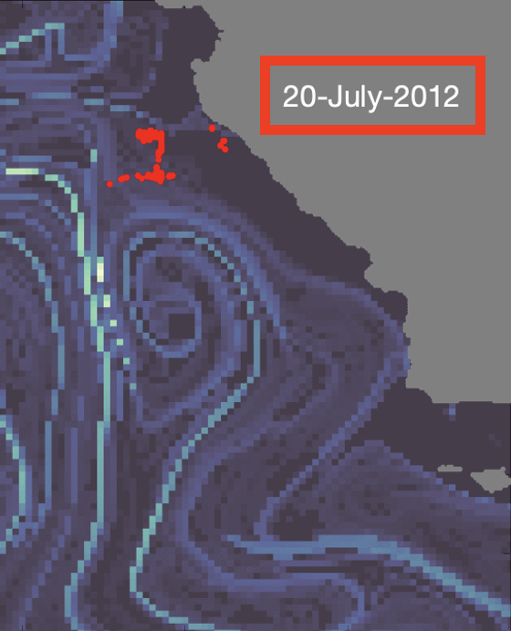
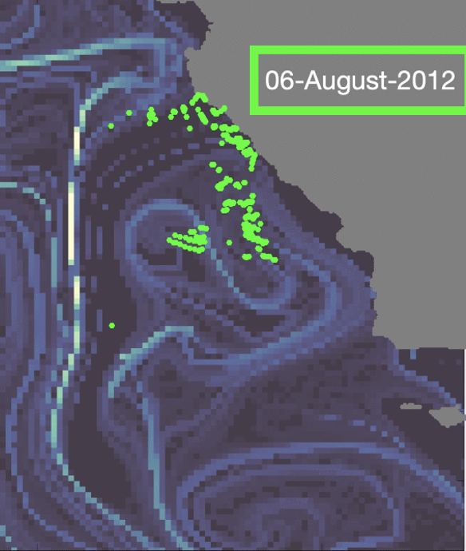
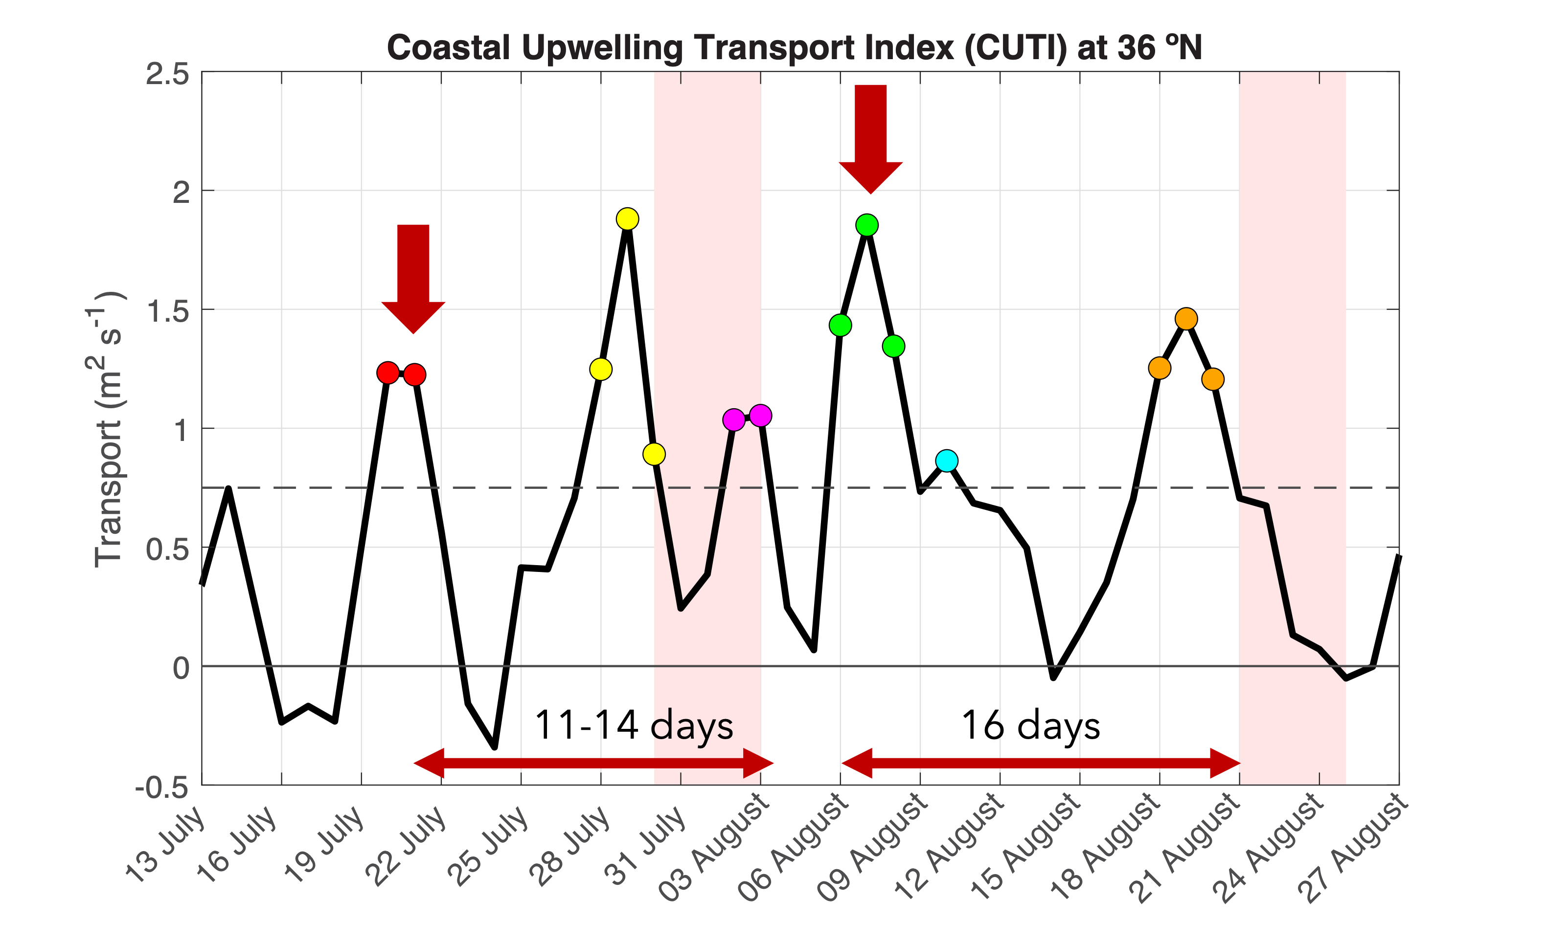
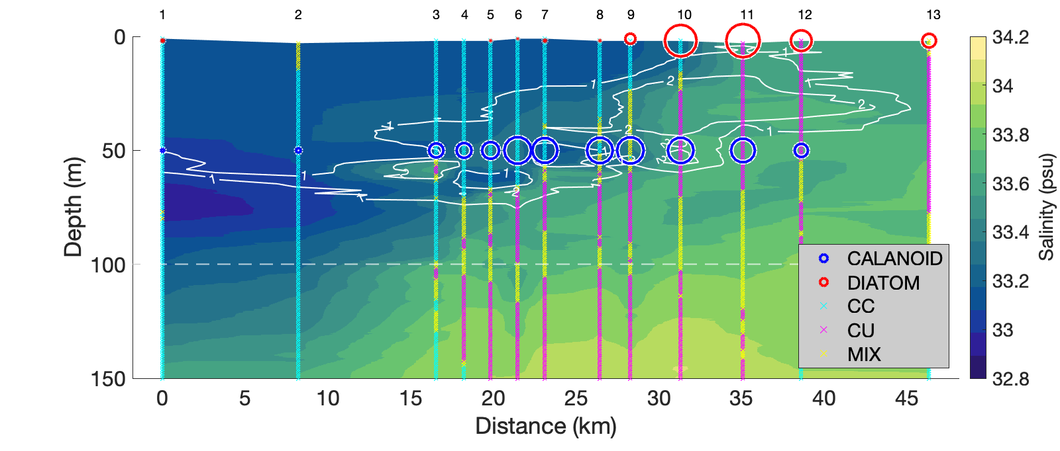
Results
Phytoplankton patches in Survey 1 and 2 (sampled 3+ weeks apart) had different spatial & temporal origins. The residence time of these patches in the front was only a few days.
These inshore patch origins are aligned with distinct upwelling pulses.
Vertical sampling across the front reveals the convergence and layering of California Current (CC) and California Undercurrent (CU) water masses. Surface CU waters are mostly diatom-rich, while surface CC waters are mostly diatom-poor. Calanoid copepod abundances are highest in profiles with mixed CC/CU characteristics.
1.
Tracked locations of high Chl-a waters.
2.
3.
Gangrade - 3

Slide 4
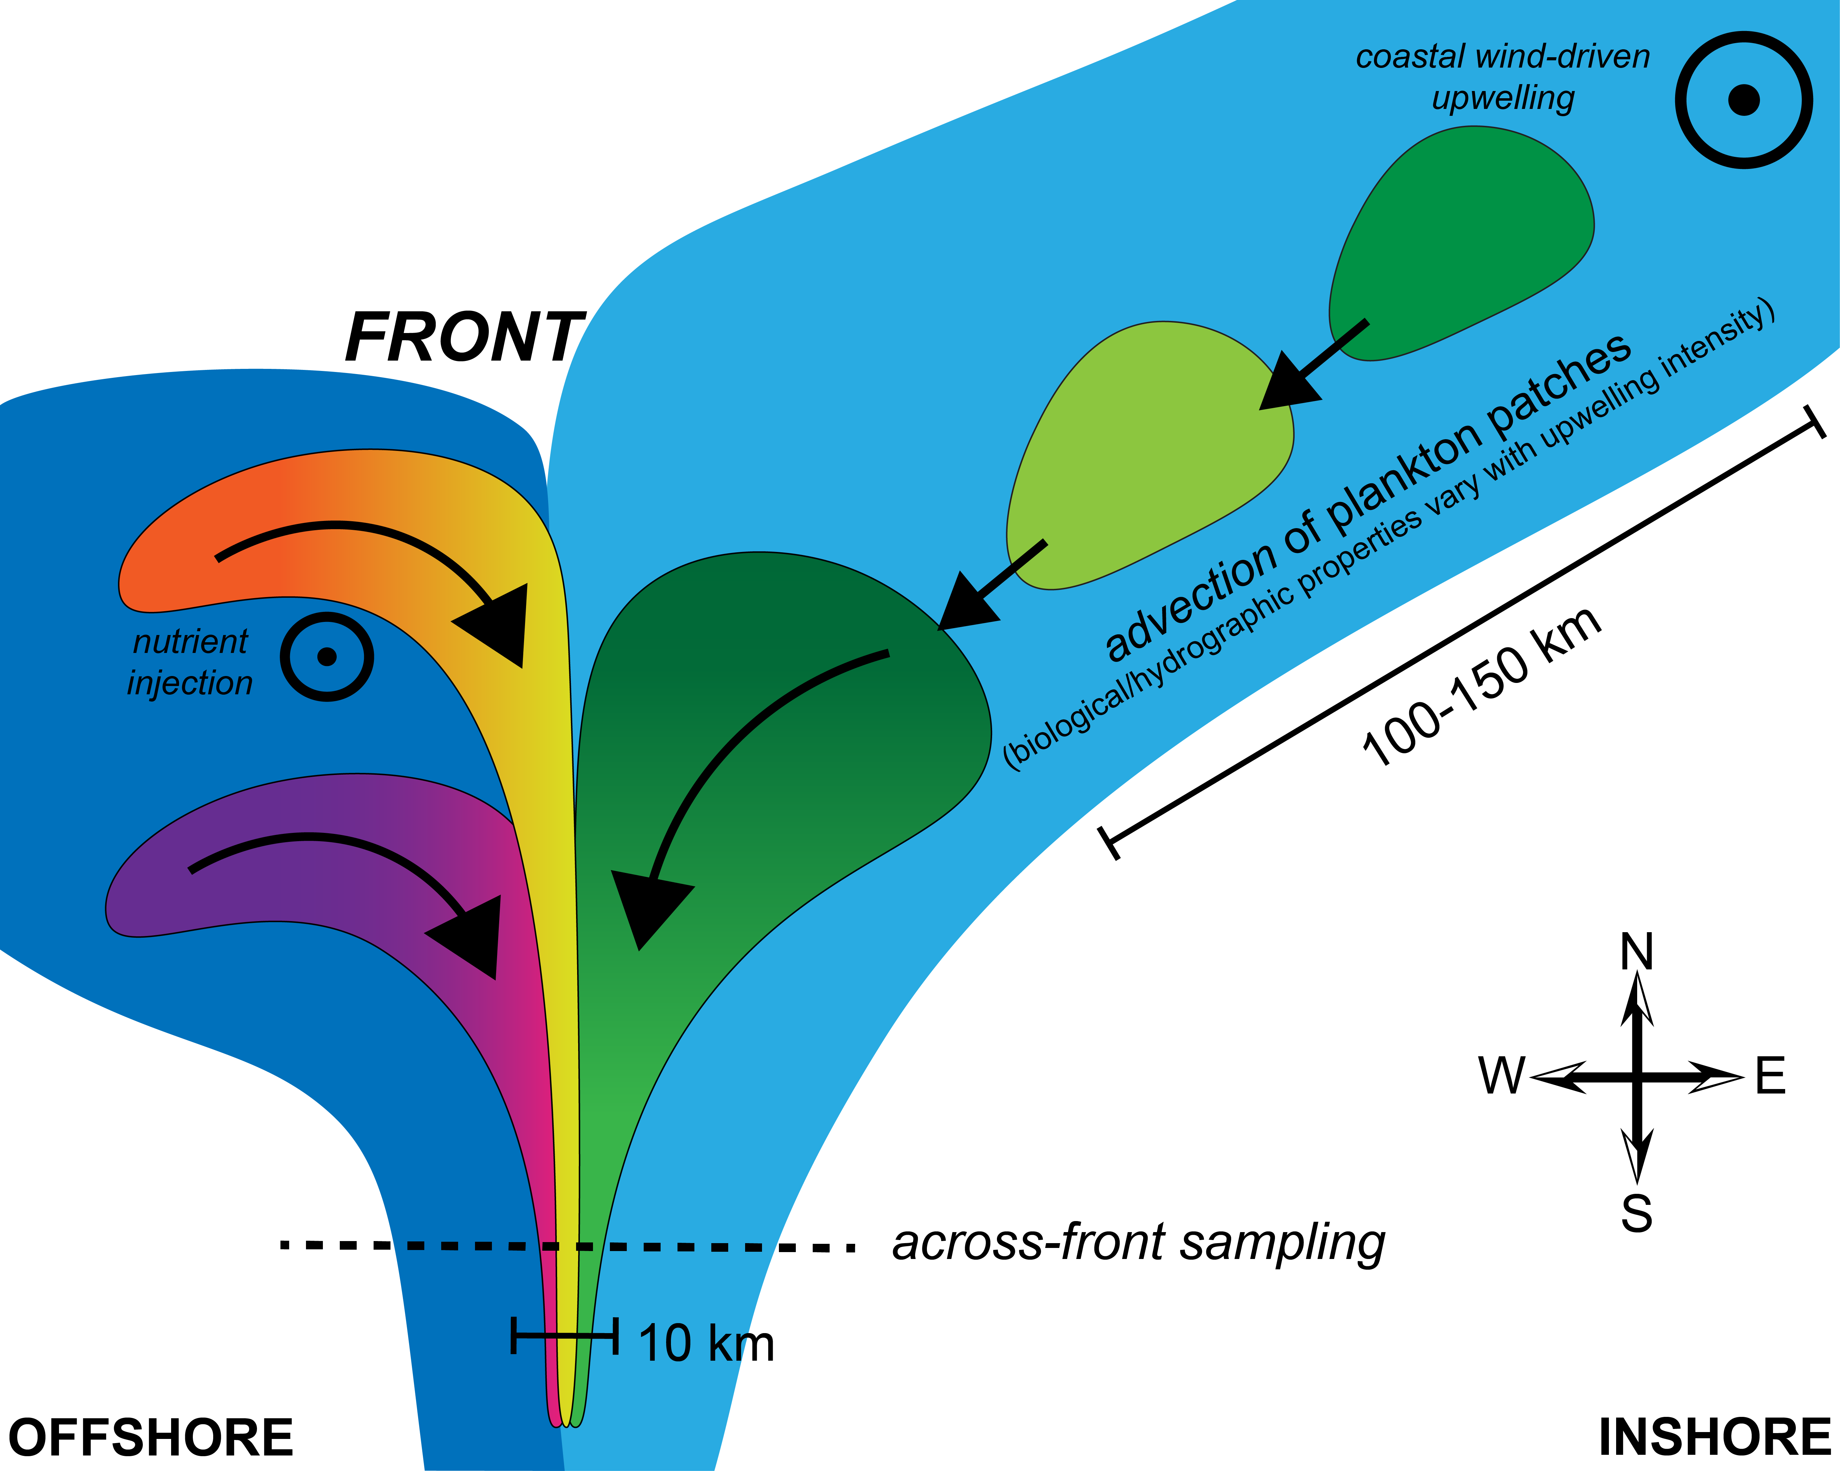
Discussion and conclusions
Frontal flows are strong, so plankton populations do not remain in a front for long.
The spatial and temporal pathways of waters determine planktonic community structure at, along, and across fronts. Thus, elevated biomass at fronts is not primarily due to in situ dynamics.
We must sample fronts on fine scales–horizontally, vertically, temporally, and taxonomically—to gain insights into physical-biological coupling and emergent community structures that we cannot resolve using spatially averaged samples.
Gangrade - 4

