Slide 1
A deep-learning approach to extract internal tides scattered by geostrophic turbulence
H. Wang¹, Nicolas Grisouard^{1,@}, H. Salehipour², A. Nuz¹, M. Poon¹, A. L. Ponte³
¹Department of Physics, University of Toronto, Toronto, ON, Canada; ²Autodesk Research, Toronto, ON, Canada; ³Ifremer Brest, Plouzané, France
@nicosouard ( ), nicolas.grisouard@utoronto.ca
Abbreviated abstract: Internal tides are oceanic internal waves that oscillate approximately at tidal frequencies. However, their scattering by the turbulent oceanic eddy field is somewhat time-dependent. Satellite altimeters suffer from a sampling that is too coarse in time to capture this time dependence, but next-generation altimeters will produce 2D pictures of sea surface height. We present a deep-learning algorithm that can produce snapshots of the internal tide's signature based on a raw sea surface height snapshot containing both eddies and waves.
Related publications:
Wang, H., N. Grisouard, H. Salehipour, A. Nuz, M. Poon, A. L. Ponte. 2022, Geophys. Res. Lett., 49:e2022GL099400 (https://doi.org/10.1029/2022GL099400)
Ponte, A. L.; S. Le Gentil; N. Grisouard, 2020, Borealis, V2 (https://doi.org/10.5683/SP2/HU58SG)
Grisouard - 1
Cette photo par Auteur inconnu est soumise à la licence CC BY-SA

Slide 2
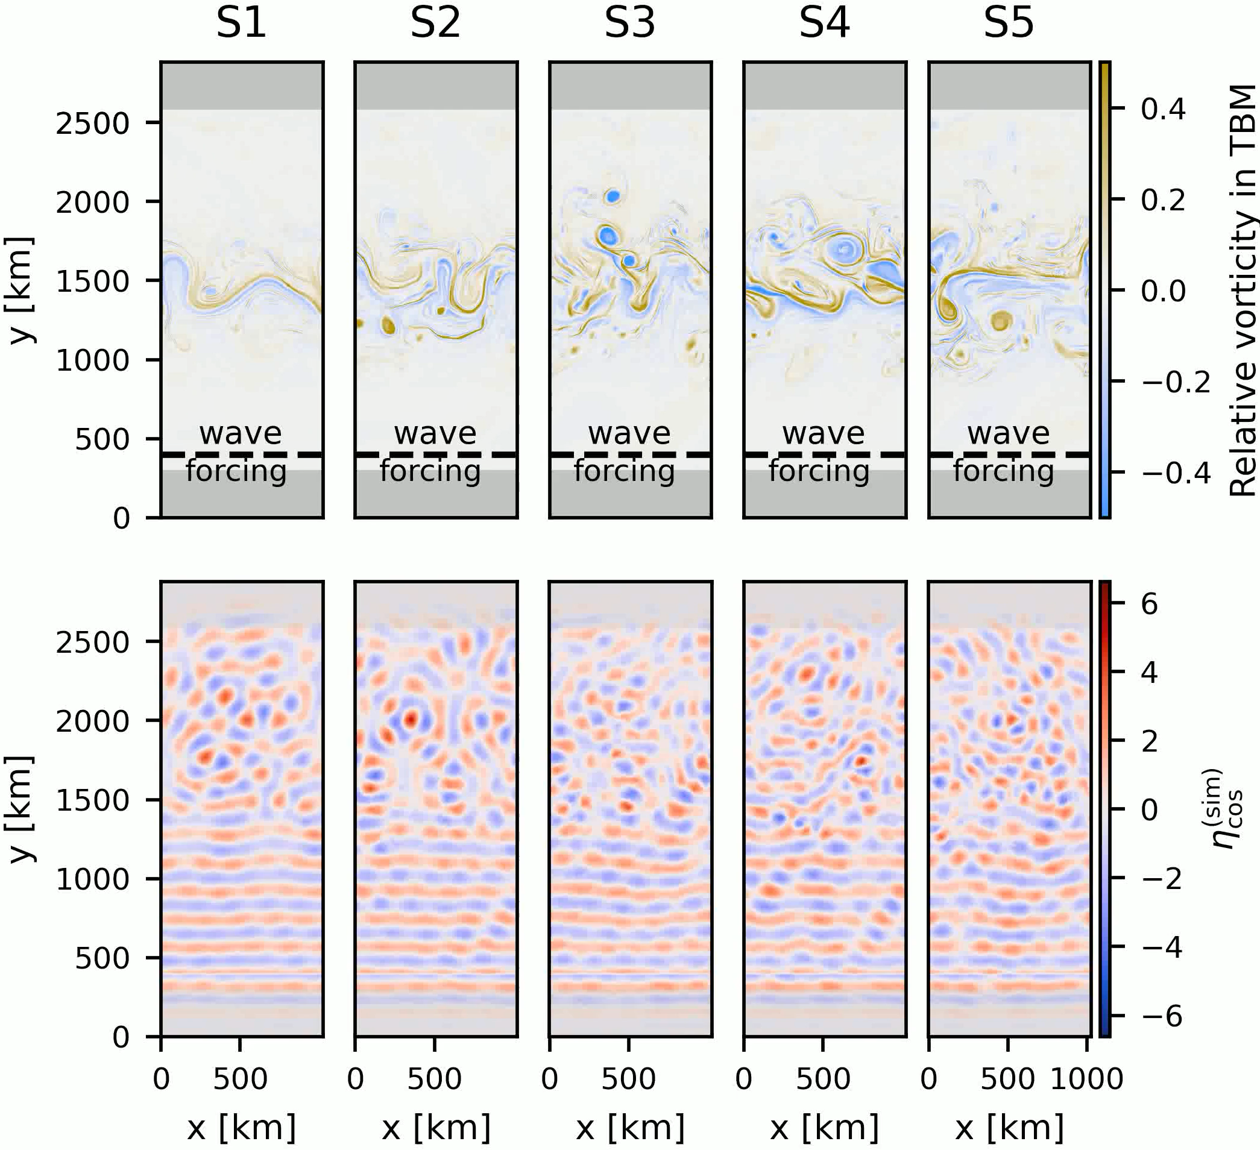
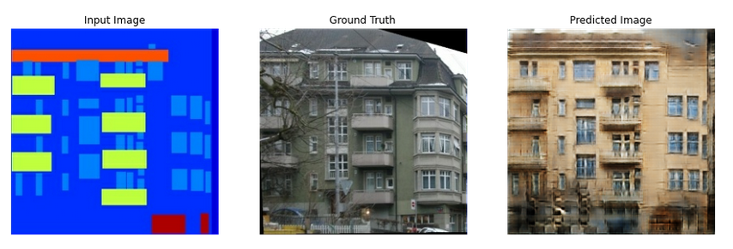
Data and Method
Data:
Re-entrant Boussinesq channel (CROCO output; Ponte & Klein),
Unstable zonal jet in middle (5 levels of intensity),
Mode-1 internal tide (IT), northward beam
Extract $η_{cos }^{(sim)},$ IT’s signature in sea surface height (SSH)
Method:
Train conditional Generative Adversarial Network on pairs of {raw SSH, IT SSH}: learn association raw SSH → IT SSH
Testing: give algorithm raw SSH (input), let it generate internal tide “deep fake” SSH, compare (compute correlation) with actual IT signature (truth)
IT beam
Testing: create “plausible” image conditional on input
Training: learn conditional probability density functions
⬌ ;; ⬌ ; …
Grisouard - 2
Isola et al. 2017

Slide 3
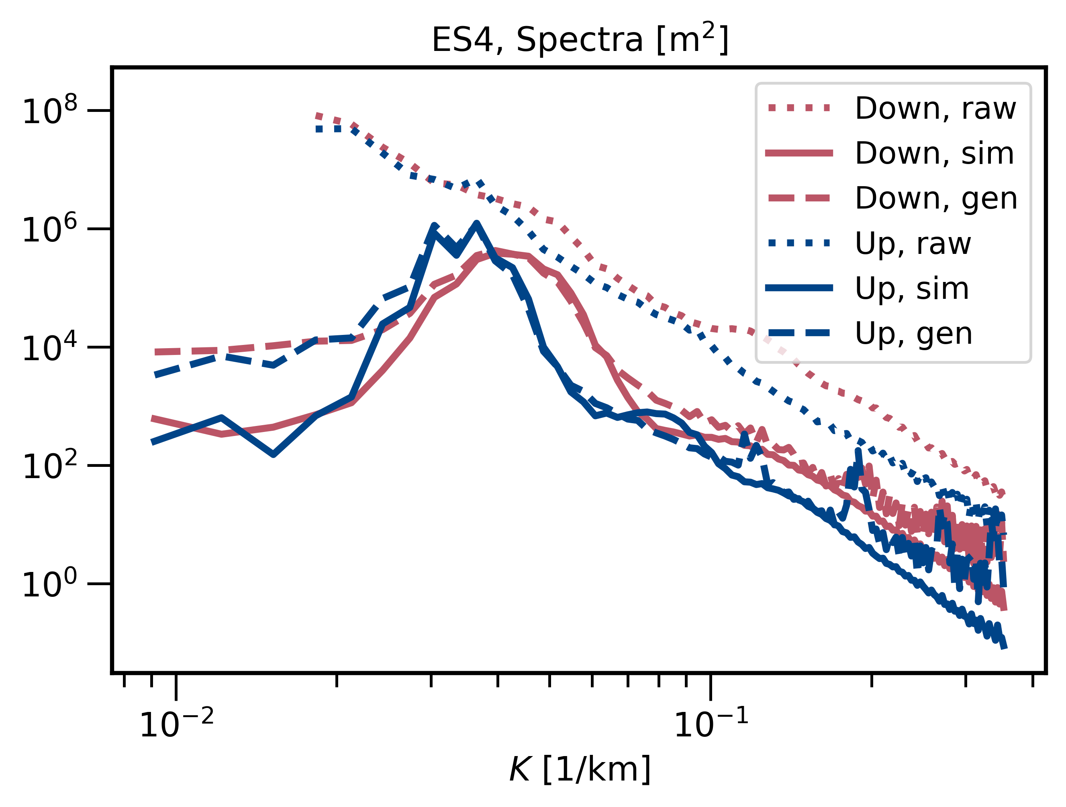
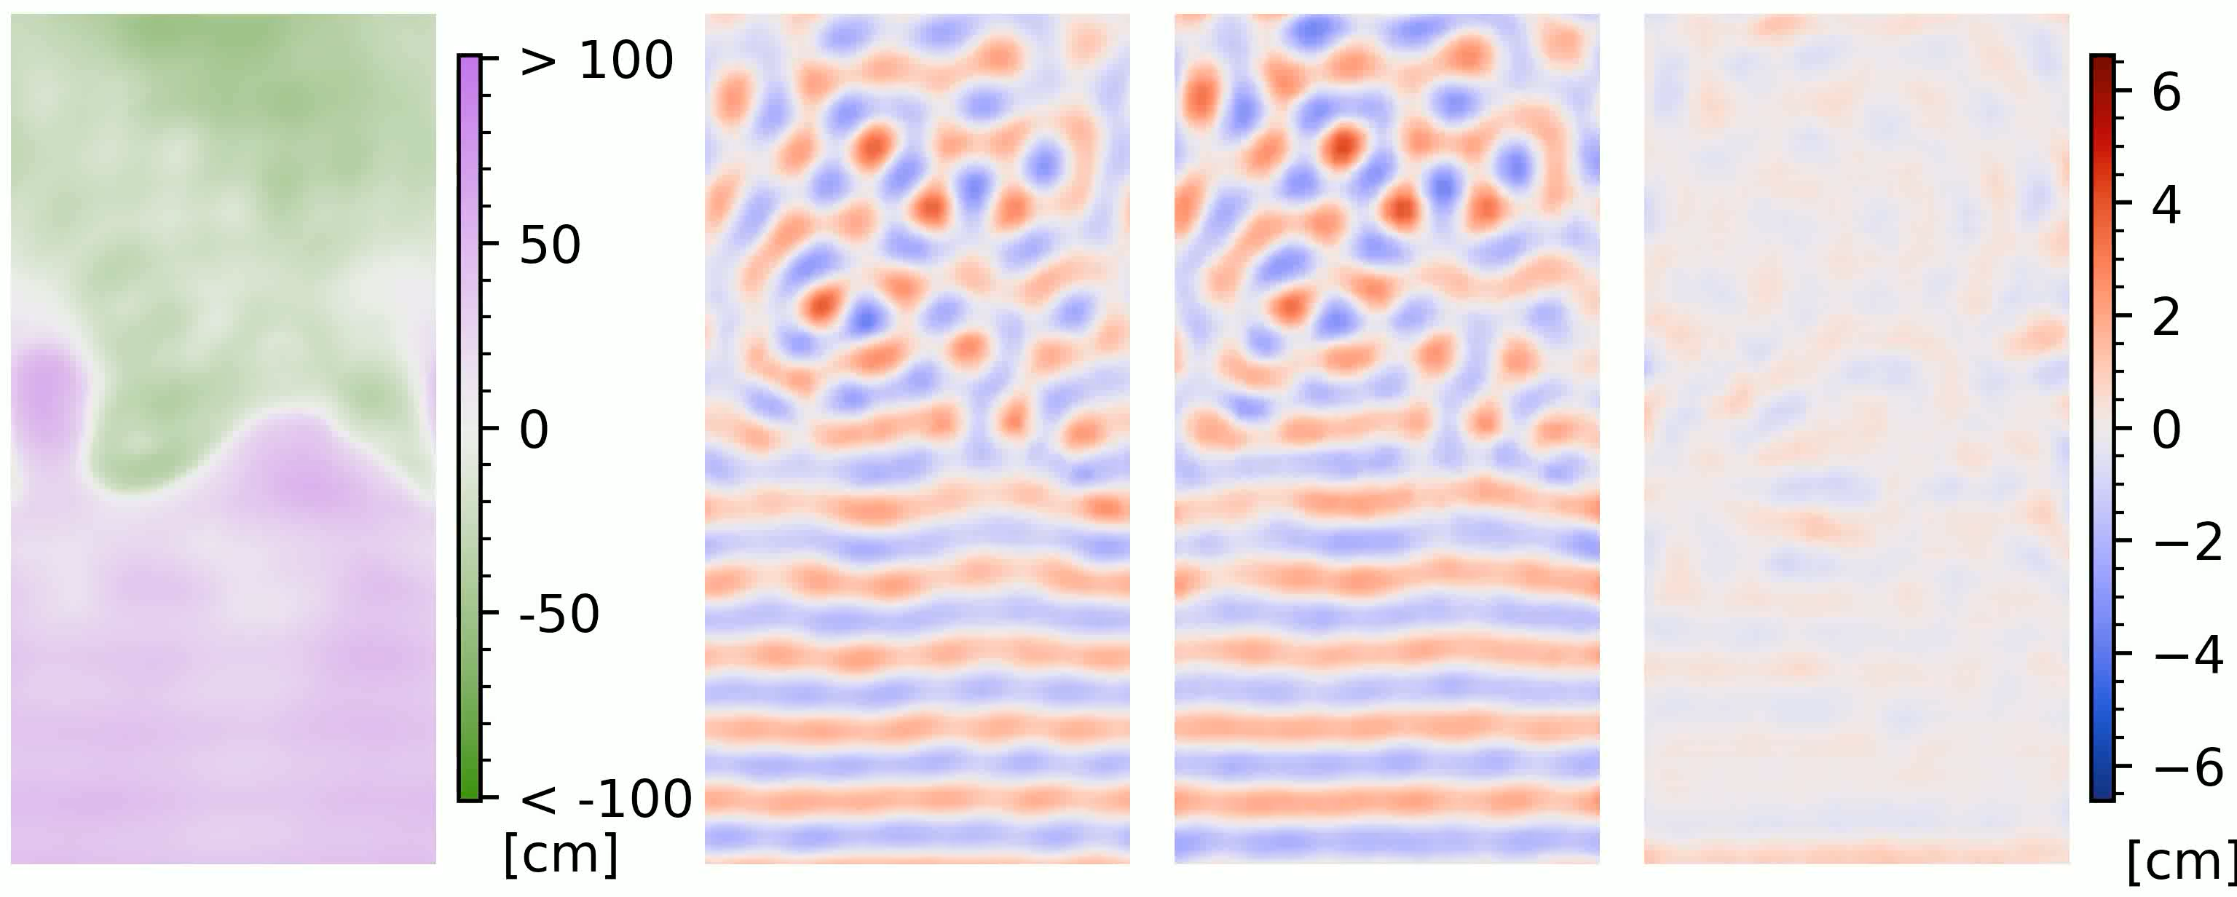
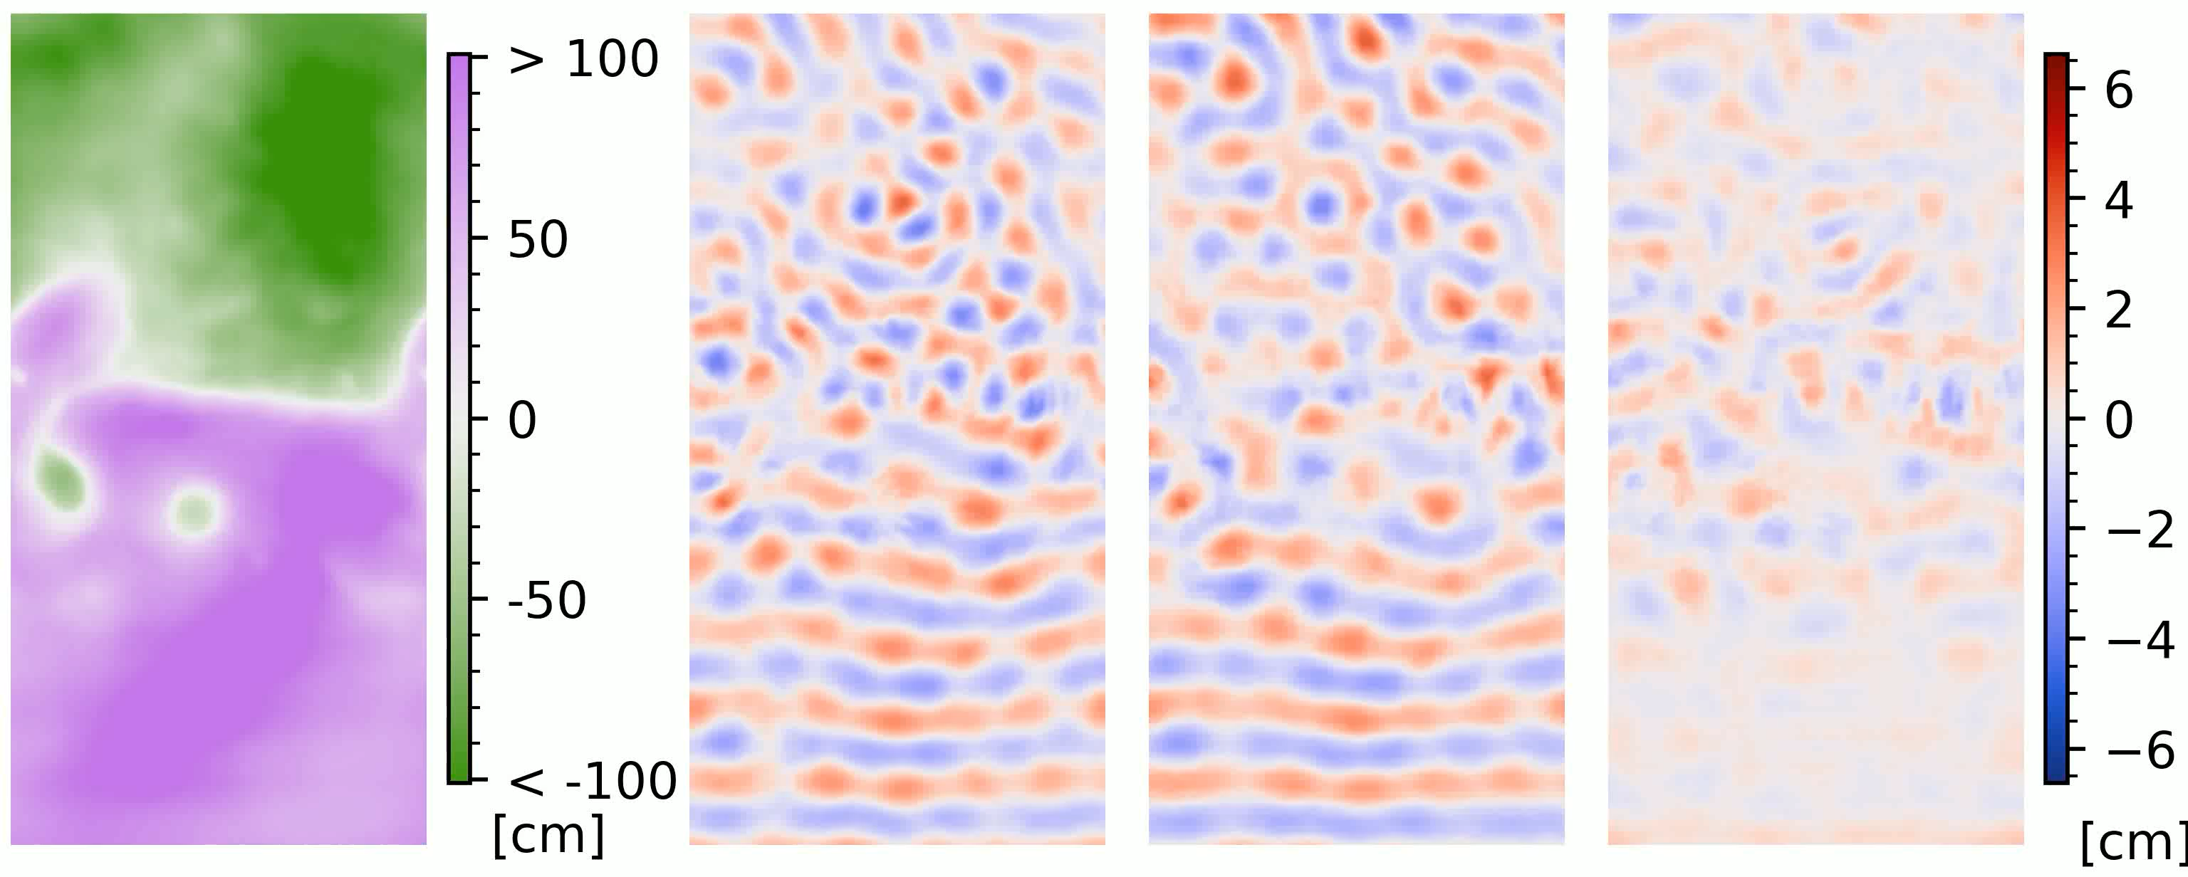
Results
We test on turbulence levels not seen during training
Correlations usually >0.7, often >0.8–0.9
Generated spectra very often close to true spectra
Difficulty to accurately generate increases with turbulence level
Measures to limit/detect overfitting, yet difficult to rule out
Best-case scenario (testing on least energetic turbulence) SSH input IT SSH (truth) Generated Difference
Worst-case scenario (testing on most energetic turbulence) SSH input IT SSH (truth) Generated Difference
Grisouard - 3

Slide 4
Discussion and conclusions
Time-dependent IT scattering is a fine scale problem: Increasing level of turbulence ↔︎ higher Ro ↔︎ submesoscales
Fine scales evolve faster, stronger time-dependence: harmonic analysis fails
First image-based deep-learning algorithm to extract IT patterns
No temporal information needed
Strong performance when turbulence level is low (meso/submesoscale Ro’s), decreasing as Ro’s increase
Method relies on 4 assumptions:
We have many well-resolved pics [reasonable]
We have no temporal data at all [can relax]
There exists a functional relationship IT SSH = f(raw SSH) [open question]
We have pre-disentangled data to train with [work in progress]
In progress:
More advanced architectures
Method to generate spectrally-accurate pics
Training/testing on realistic model output (with Brian Arbic’s group)
Grisouard - 4

