Slide 1
Quantified impact of fronts on surface chlorophyll in the Gulf Stream region from satellite data
Clément Haëck, Marina Lévy, Laurent Bopp
Abbreviated abstract: We quantify some of the impacts of sub-mesoscale fronts on phytoplankton growth: increased vertical nutrient supply and locally reduced stratification, by computing an heterogeneity index from satellite SST in the North-Atlantic and using it to identify weak, ephemeral fronts and strong, permanent fronts.
Weak fronts lead to an enhancement of Chlorophyll-a concentrations substantially weaker than strong fronts, but because they are much more frequent they contribute more significantly to the regional Chl-a budget. In the region North of the Gulf-Stream, we detect earlier and longer spring blooms in fronts than in background conditions.
Haëck - 1

Slide 2
Data and methods
Data:
- SST: ESA SST CCI and C3S reprocessed sea surface temperature analyses (4km, L4)
- Chl: ACRI-ST Copernicus-GlobColour Chlorophyll-a (4km, L3)
Methods:
We compute an Heterogeneity Index (HI) from satellite SST and based on its values, detect weak fronts (medium HI) and strong fronts (high HI). This method is adapted from Liu and Levine (2016, GRL 43-4).
We split the study area in three regions. The South region is defined as below 32°N. The remaining two regions (North and intermediate) are split by selecting a threshold temperature for each day.
Haëck - 2

Slide 3
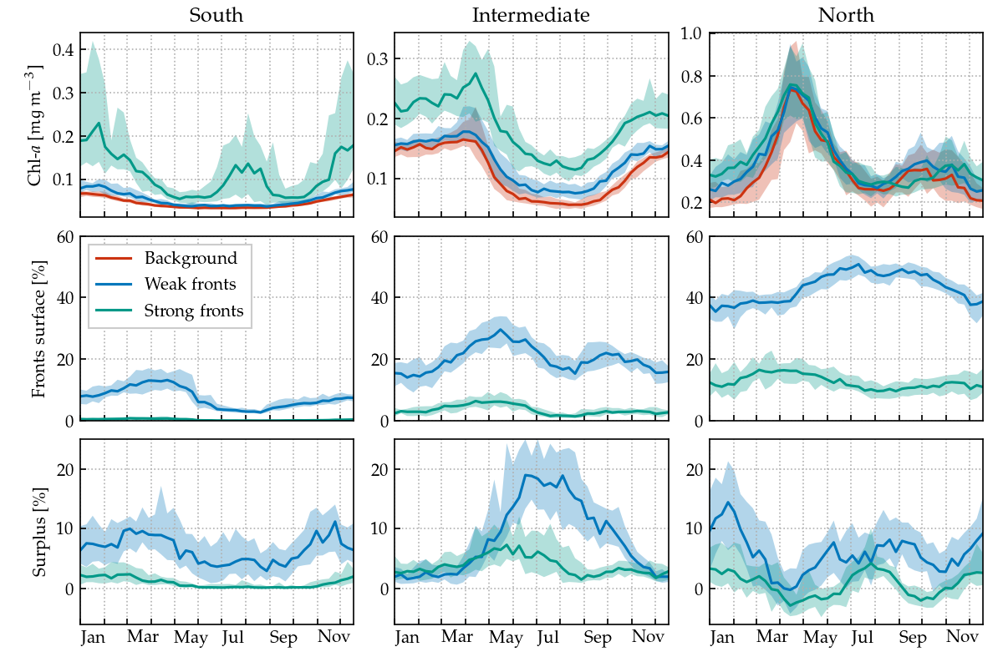
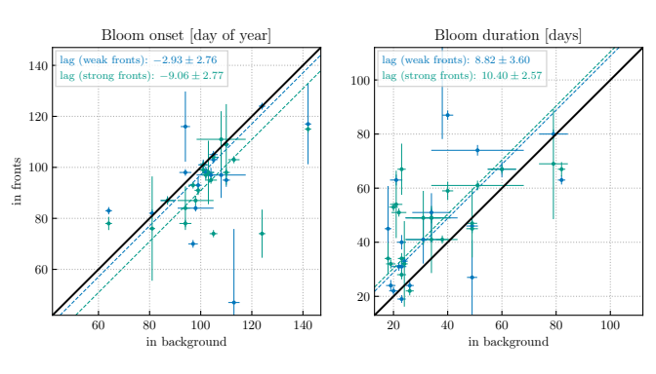
Results
Climatology of different variables in the fronts and the backgound in the 3 regions: (top) median value of Chl-a, (middle) fraction of surface occupied by fronts, and (bottom) relative increase of the total Chl-a quantity caused by fronts.
Difference in the spring bloom timing in fronts and in the background.
Haëck - 3

Slide 4
Discussion and conclusions
Quantified the Chl response to fronts in the Gulf-Stream region:
Increase in concentration by 18% (weak fronts)
80% (strong fronts)
Increase in quantity by 5-8% (weak fronts)
0-4% (strong fronts)
Detected, from satellite, blooms in fronts with:
earlier onset (by 5.9±1.9 days)
and longer duration (by 9.6±2.5 days)
Haëck - 4

