Slide 1
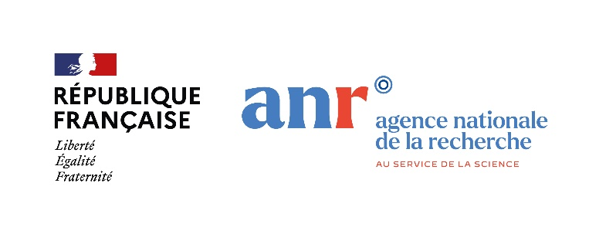
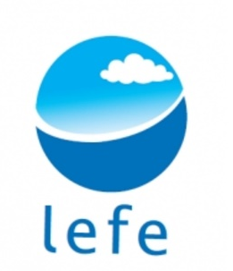
Diazotrophs' diversity and activity mapped across fine-scale structures of the Gulf stream and associated eddies
Authors
@choerstm, Stéphanie Barillion, Olivier Grosso, @Mar_Benavides
Abbreviated abstract:
Fine-scale ocean dynamics contribute to the distribution of resources for plankton to thrive. While such physical structures are well studied remotely, the biological coupling in situ remains unknown. We combined satellite observations and in situ samplings of diazotrophs, hypothesizing that fine-scale structures significantly impact diazotroph-mediated nitrogen inputs to the ocean. While biological sample processing is still pending, we provide preliminary insights into the complexity of biological—physical coupling across the Gulf Stream and associated eddies.
Related publications:
N/A
Hoerstmann - 1

Slide 2
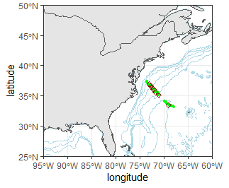
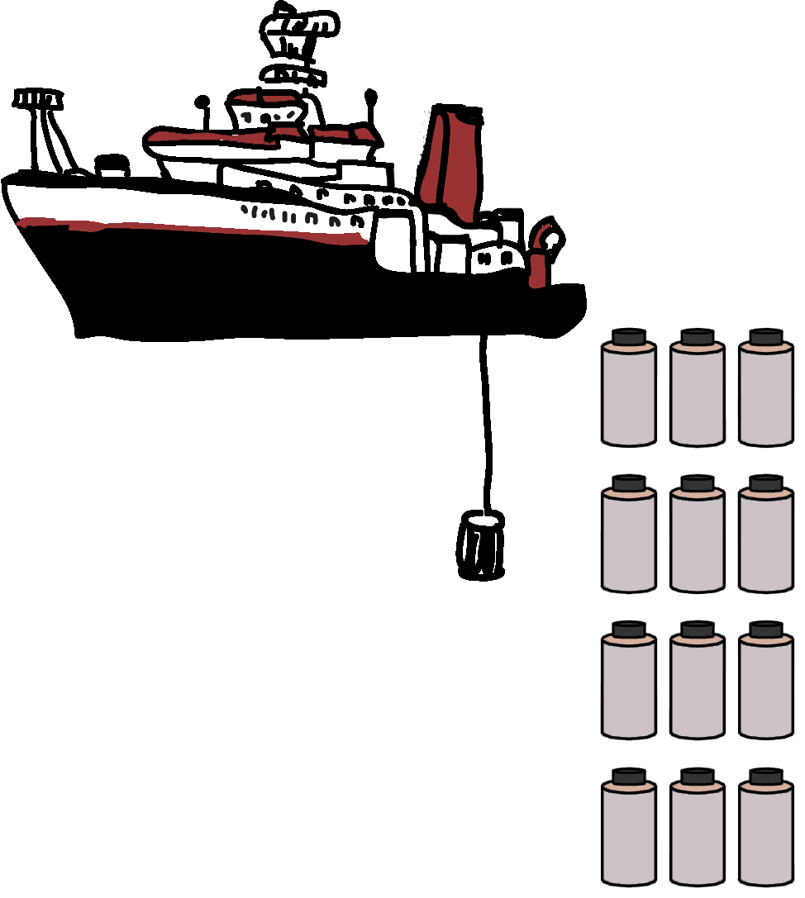
Data and methods
High spatial resolution sampling (every hour; green circles) in combination with CTD stations (red squares) across the Gulf Stream and two eddies on board the RV Atlantic Explorer between 21.07.2022 and 29.07.2022.
Cruise track was adjusted using the software package SPASSO (Doglioli et al. 2013) to follow the targeted eddies at the center and across the edges.
Track here the eddy during the campaign!
(for mobile: download/view)
CTD stations: 4 depths with N₂ fixation experiments and corresponding DNA samples (qPCR, meta-omics)
+
underway sampling: surface samples with N₂ fixation experiments and DNA
Hoerstmann - 2

Slide 3
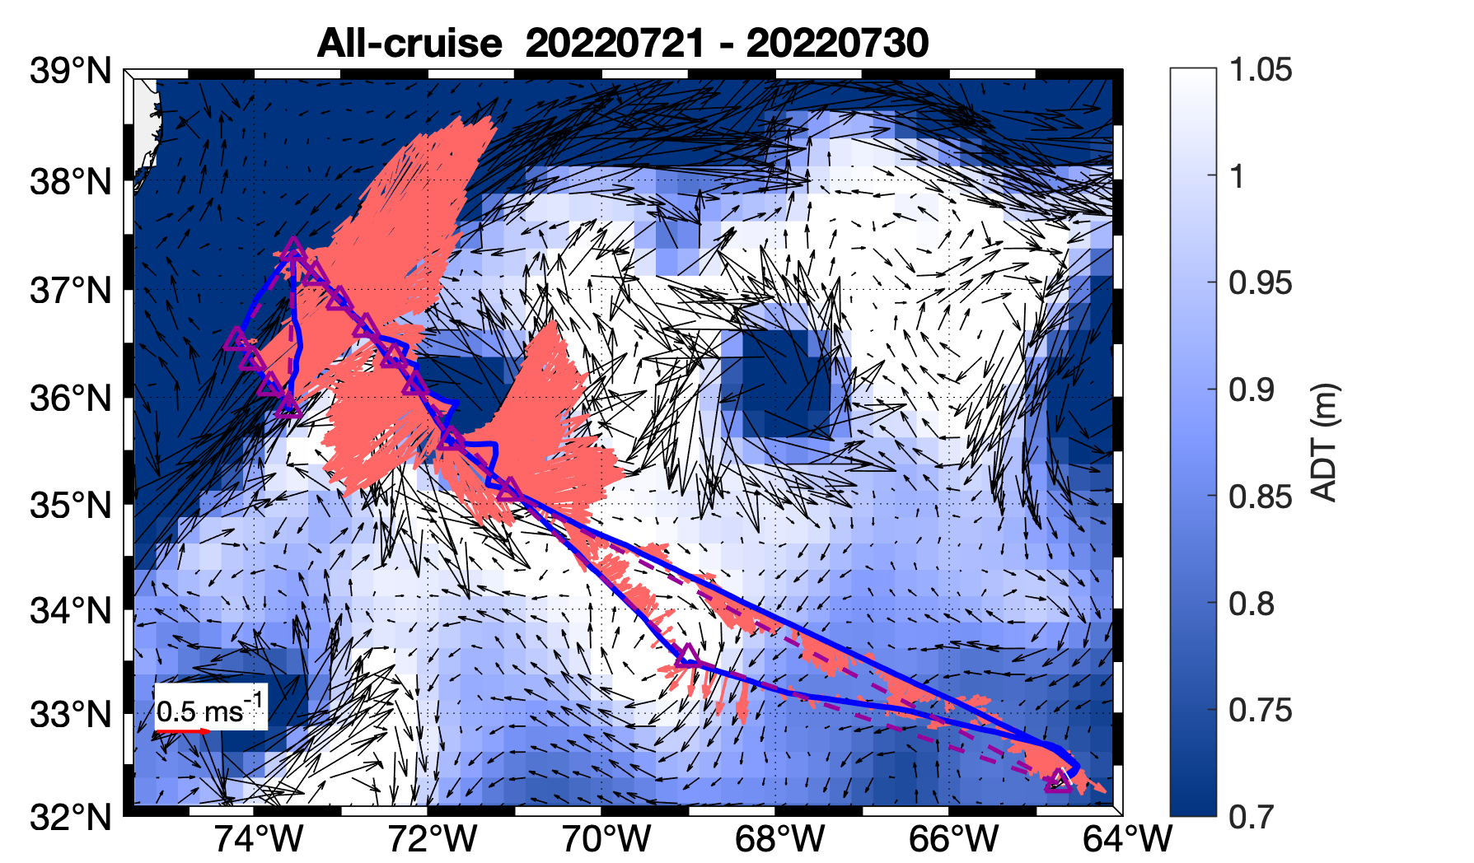
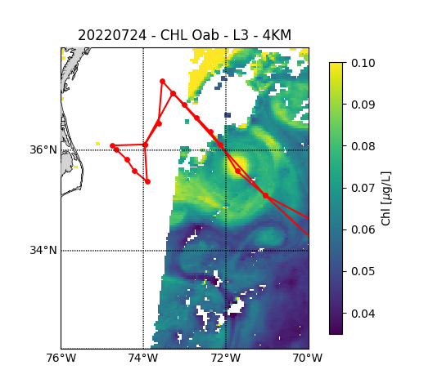
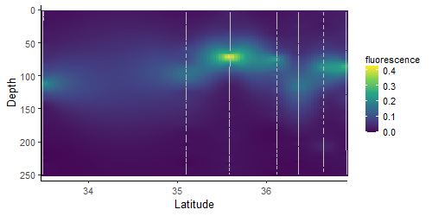
Results
A)
The Gulf stream forms a unique environment between the shelf and North Atlantic gyre carrying warm water masses rapidly northwards with eddies spinning off to the east and west.
The cylonic eddy creates upwelling of cold, nutrient rich water, fueling phytoplankton production (Fig. B, C), with potentially negative effects on diazotroph abundance and activity.
B)
C)
Fig. A: Sampling area with horizontal current velocities: red arrows show ship-based ADCP measured. Blue contours show absolute dynamic topography (ADT) derived from satellite observations. Yellow box outlines the cyclonic eddy and green box outlines the samples across the Gulf Stream
Fig. C: Autofluorescence measured across the northern transect (Fig. B, orange line) including the eddies and the edge of the Gulf Stream
Fig. B: satellite derived chl. concentrations. Orange line indicates the transect in Fig. C.
Hoerstmann - 3

Slide 4
Discussion and conclusions
Hydrodynamic structures can contrastingly impact planktonic community assembly and activity:
Gulf Stream: large horizontal spatial displacement and creates a barrier between communities to the east and west.
Cyclonic eddy: preserving a „microbial fingerprint“ of the water mass of origin (Bolaños et al. 2020), while physical processes such as eddy stirring, trapping, and eddy pumping act as environmental selection processes for diversity and activity.
Diazotrophs’ responses across the Gulf stream and eddies can include:
phylogenetic changes: e.g., favorable conditions for nitrogen fixing symbionts
abundance and activity: the cyclonic eddy may cause a decrease abundance and activity, as other sources of nitrogen are available.
Hoerstmann - 4

