Slide 1
Title
Eddy stirring signatures in a standing meander of the Antarctic Circumpolar Current
Authors
Maya Jakes, Helen Phillips, Annie Foppert, Nathan Bindoff, Steve Rintoul, Ajitha Cyriac
Abbreviated abstract:
Topography-flow interactions generate hotspots of eddy stirring and cross-frontal exchange, reducing the ability of the Antarctic Circumpolar Current (ACC) to act as a barrier to poleward heat transport. Using sub-surface observations from EM-APEX floats and surface information from satellite altimetry, we explore the dynamics of an energetic meander of the ACC near Macquarie Ridge. We explore potential factors influencing the observed fine-scale thermohaline variability, which indicates enhanced local eddy stirring and may facilitate cross-frontal exchange.
Related publications:
Jakes - 1

Slide 2
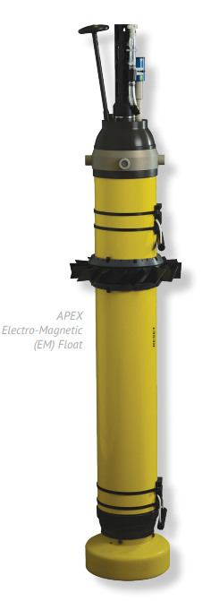
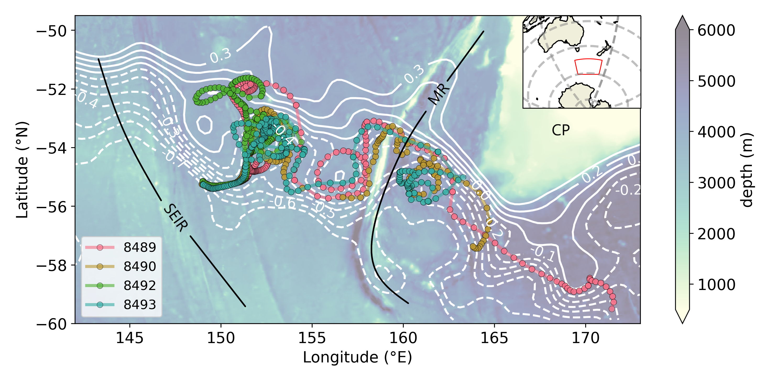
Data and methods
Data
EM-APEX floats
High resolution measurements of T, S, u and v from the surface to 1600 m along the float trajectories
Travel through a standing meander of the ACC
Satellite Altimetry
Spatial and temporal variability of the meander during the time of float deployment and interaction of the floats with mesoscale features
Methods
Calculation of thermohaline anomalies along isopyncals to investigate eddy stirring.
Relative velocities from the floats to absolute velocities and rotated to along-stream and cross-stream.
Investigation into the generation mechanisms of observed thermohaline anomalies by exploring the finescale structure of cross-stream velocities and vertical velocities from the floats.
Jakes - 2

Slide 3
Results
Broad T-S diagrams – high thermohaline variability along isopycnals
We observe strong temperature anomalies with interleaving features characteristic of eddy stirring
Anomalies are amplified within strong jets
Coincide the strong vertical velocities
No clear relationship to cross-stream velocities
Jakes - 3

Slide 4
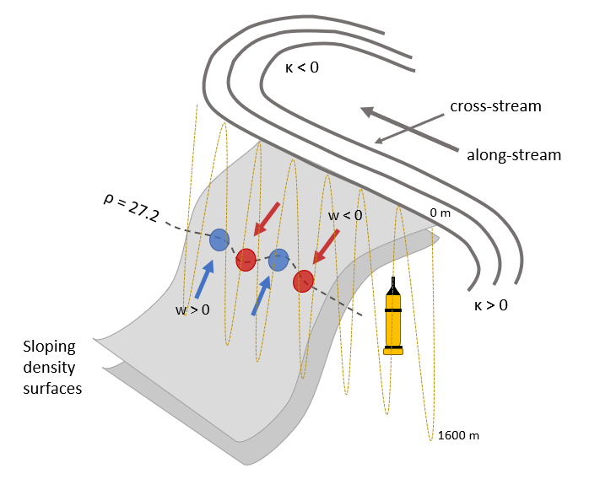
Discussion and conclusions
Difficulty attributing the generation of these anomalies to specific finescale dynamical processes
No relationship to cross-stream velocities
Sign of anomalies do not match up with sign of vertical velocities. Different scales?
How are the temperature anomalies generated and how do they relate to cross-frontal exchange?
Cascade of tracer variance to smaller and smaller scales?
Why are the temperature anomalies stronger where the speed is stronger?
Greater distance the tracer has been stirred?
Larger cross-stream T-S gradients / steeper isopycnals?
Float movement across streamlines?
Jakes - 4

