Slide 1
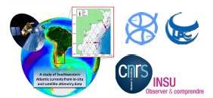
Variability of Continental Shelf Currents in Southern Patagonia from In-situ, Satellite and Reanalysis Timeseries
Lago, L. S., Saraceno, M., Piola, A. R.
@LoreleyOce
Abbreviated abstract: The Patagonia continental shelf in the SW Atlantic Ocean is known for its strong biological activity. Direct velocity measurements. In the outer shelf, meridional velocities present an intra-seasonal signal also present in the SLA of the region. Gridded altimetry SLA allowed the analysis of the circulation forcing for periodicities higher than 20 days, while the fast waves that propagate from S to N affecting the outer shelf circulation are better represented by GLORYS reanalysis. High resolution data from the 90-day SWOT repeat phase will improve our knowledge of fast waves.
Lago - 1

Slide 2
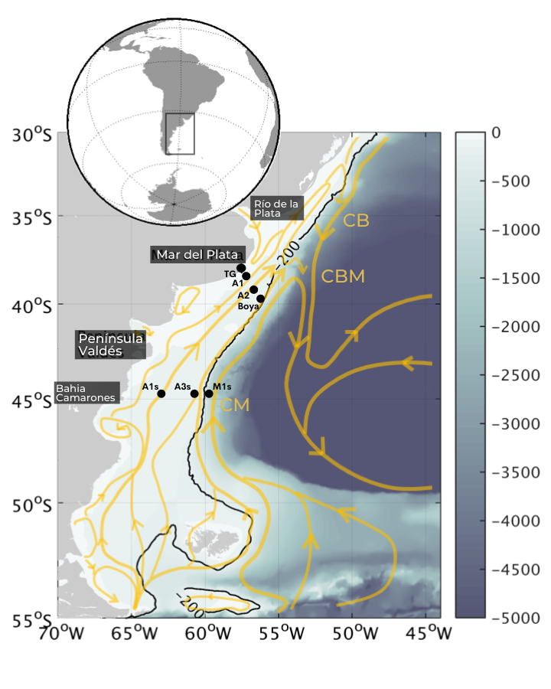
Data
In-situ data: CASSIS project http://www.cima.fcen.uba.ar/malvinascurrent/es/
High-resolution in-situ timeseries are available at 2 spots along 44.7ºS. They are the longest in-situ velocity measurements available in the region of study! (18 months)
Acoustic Doppler Current Profilers (ADCPs) provide velocity hourly data every 4 meters in the vertical.
Lago - 2

Slide 3
Data
Satellite data: Sea level anomaly (SLA) Multi-satellite product.
Daily gridded data (1/4º resolution)
Reanalysis data: GLORYS SLA
Daily gridded data (1/12º resolution)
https://marine.copernicus.eu
Lago - 3

Slide 4
Results
Forcing in the outer shelf are not clear, the in-situ data was gathered within a transition area, between the higher frequency dynamics of the continental shelf and the lower frequency dynamics of the shelf-break region.
SLA over the continental shelf is related to the meridional circulation in the outer shelf. SLA variability is dominated by the seasonal and intra-seasonal oscillations.
Intra-seasonal SLA is better represented by the GLORYS reanalysis than by the multi-satellite gridded product. It is characterized by fast-propagating waves that originate in the Chile continental shelf and continue northward through the Argentine continental shelf.
VIDEO
Lago - 4

Slide 5
Discussion
These fast-propagating waves can travel 2000 km in 4 days. Once they enter the Patagonia continental shelf they propagate faster, exceeding the reanalysis temporal resolution. These oscillation modulate the meridional circulation of the outer.
The spatial resolution of upcoming SWOT mission will enable the analysis of the wave-train patterns associated to the intra-seasonal dynamics of the Patagonia continental shelf. Also, the 1-day repeat period data could help tracking the fast waves observed in the region.
Lago - 5

