Slide 1
Particle dispersion and clustering in surface ocean turbulence with ageostrophic dynamics
Michael Maalouly, Gilmar Mompean, Stefano Berti
@Michael_409
Univ. Lille, ULR 7512, Unité de Mécanique de Lille Joseph Boussinesq (UML), 59000, Lille, France
Abbreviated abstract: Ocean submesoscales are key to physical and biogeochemical budgets. A crucial question, in this range of scales, concerns the role of non-geostrophic flow components. We numerically investigate a model of submesoscale turbulence including frontal ageostrophic motions, focusing on Lagrangian statistics. We find that the ageostrophic flow does not affect relative dispersion, but it produces temporary particle clustering, an interesting result for the comparison with future satellite altimetry data.
Related publications:
Particle dispersion and clustering in surface ocean turbulence with ageostrophic dynamics (in preparation)
Maalouly - 1

Slide 2
Data and methods
Next order in $Ro$ surface quasi-geostrophic $(SQG)$ equations are used to model ocean submesoscales. This model is known as $SQG^{+1}$. It accounts for both the geostrophic flow $(u_{g},v_{g})$ and the ageostrophic flow $(u_{ag},v_{ag})$ (Muraki et al., 1999; Hakim et al., 2002; Smith et al., 2002; Lapeyre, 2017).
The governing equation used to model the flow is the following:
$\frac{∂θ}{∂t}+u.∇θ=forcing+dissipation$ where $(u,v)=(u_{g}+u_{ag}Ro,v_{g}+v_{ag}Ro)$ and $Ro=\frac{U}{Lf}$
$θ:$ surface temperature
$u:$ horizontal velocity
These equations are solved using a pseudo-spectral method. When the flow reaches a statistically steady state Lagrangian tracer particles are added. Hence, both Eulerian and Lagrangian statistics are gathered.
The resolution is $512×512$ with periodic boundary conditions.
Maalouly - 2

Slide 3
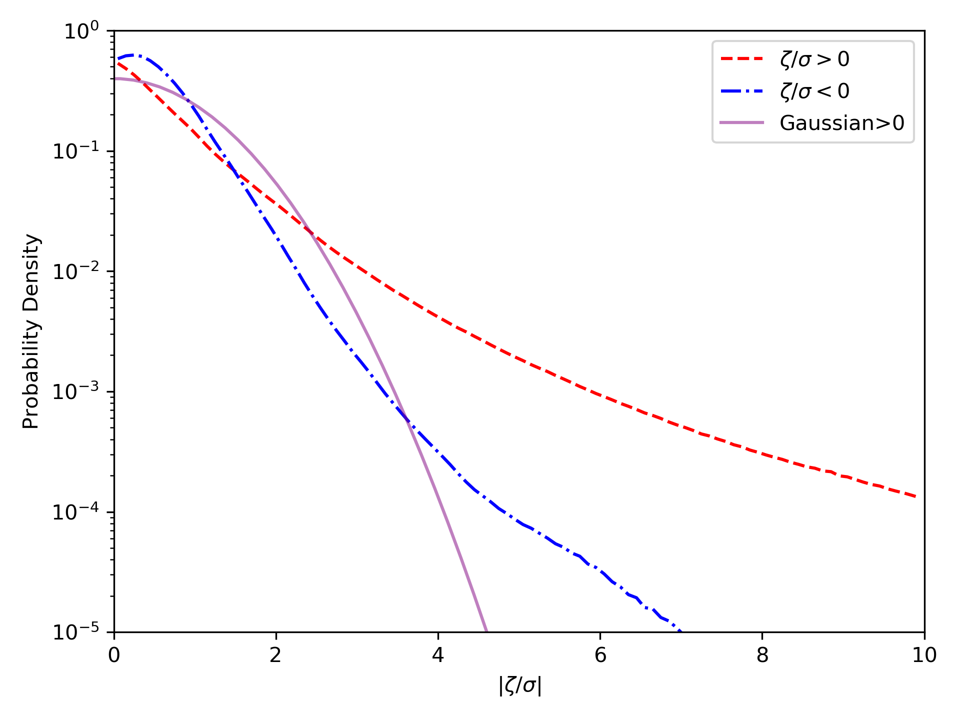
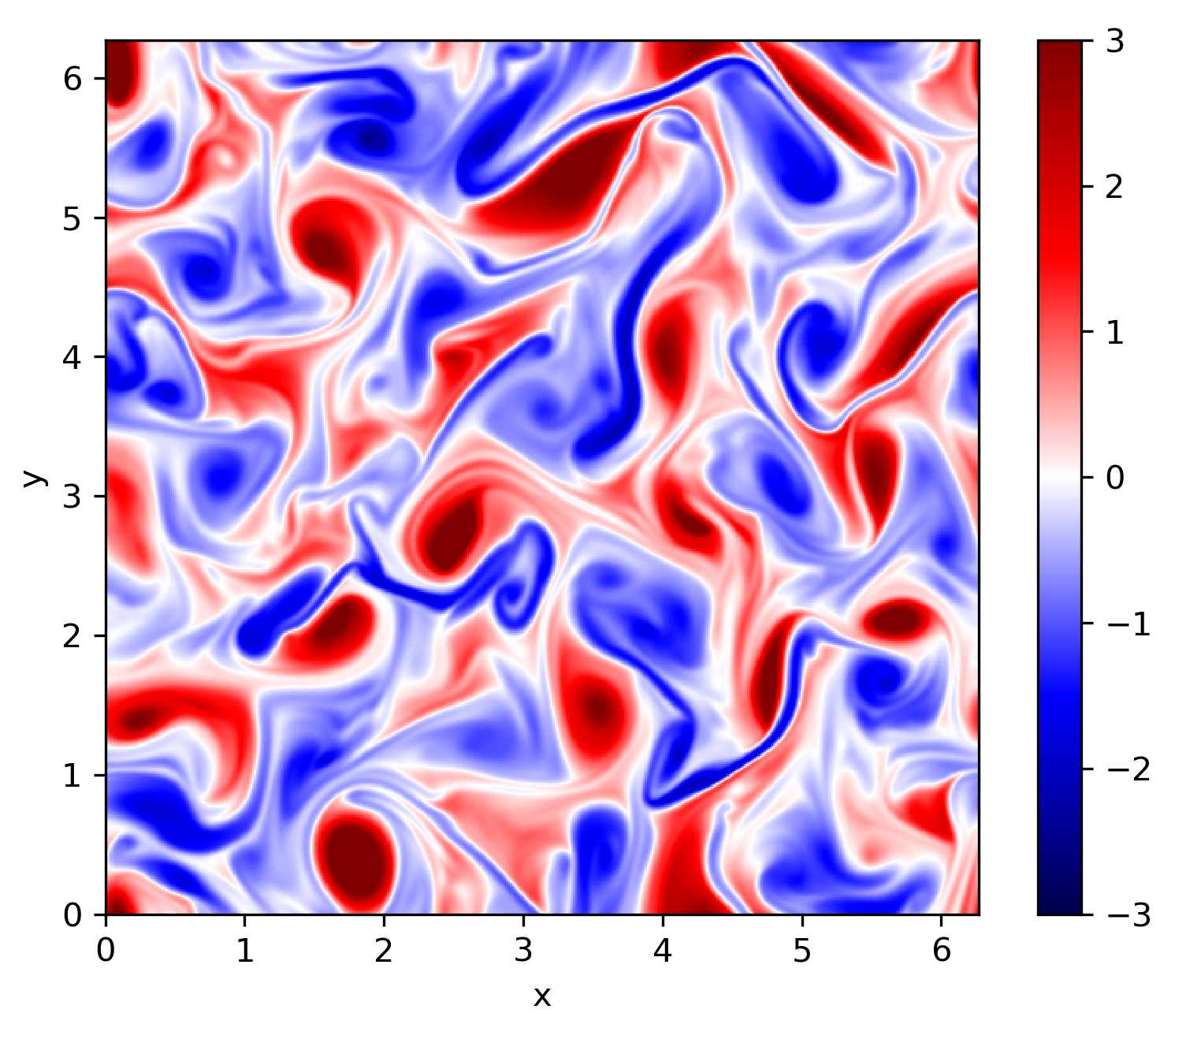
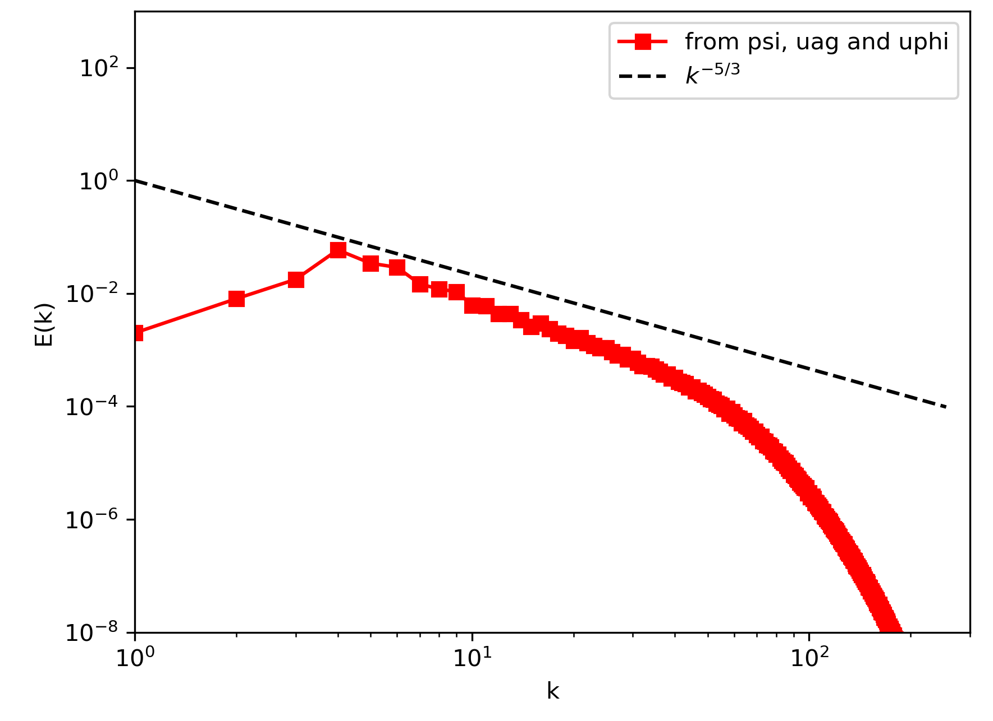
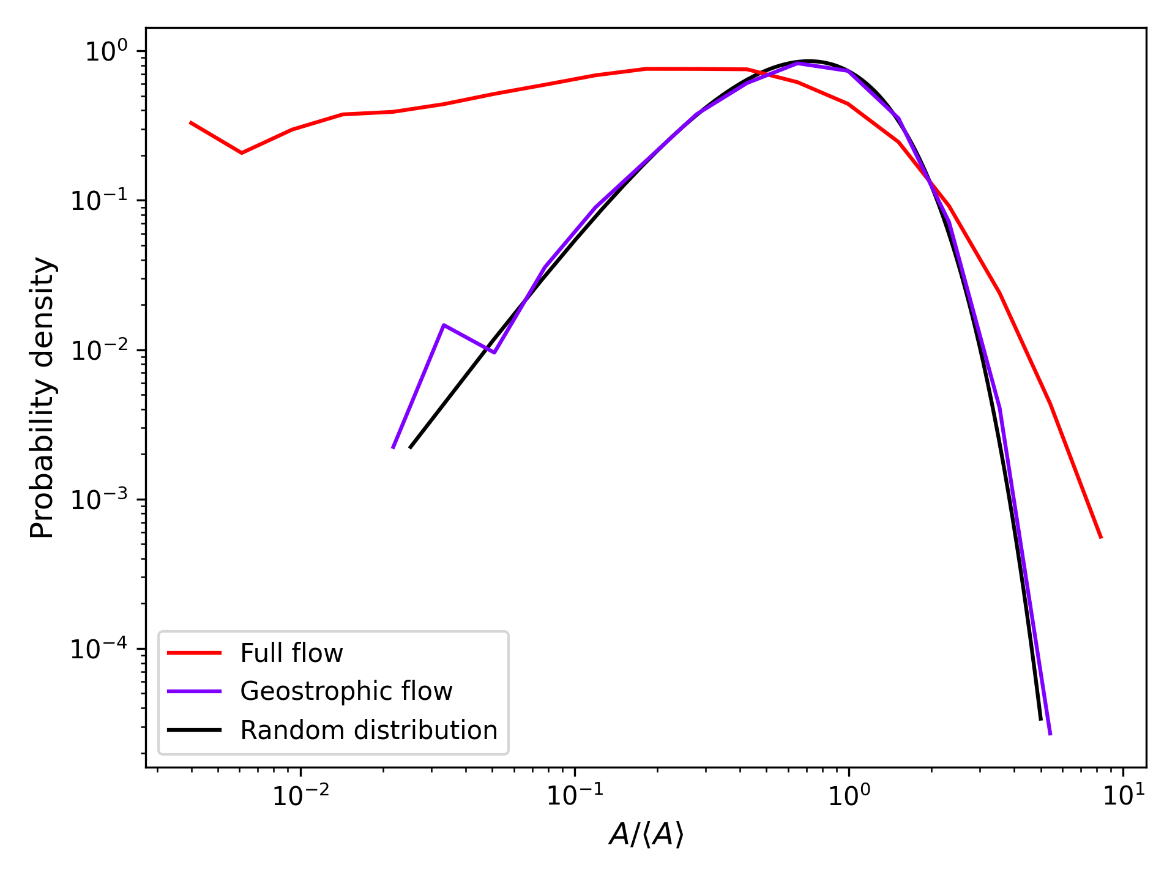
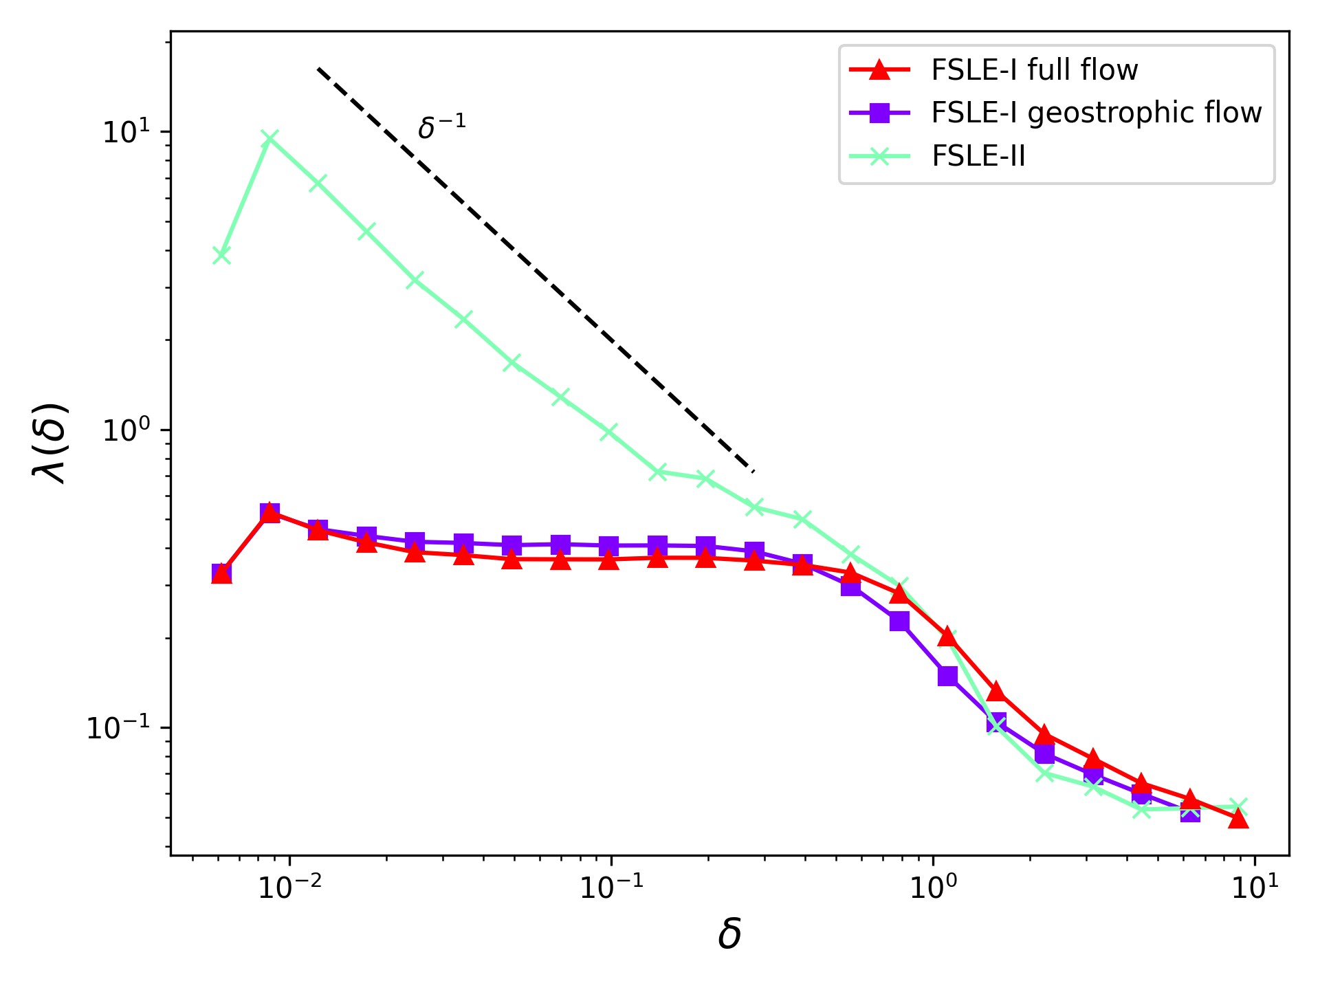
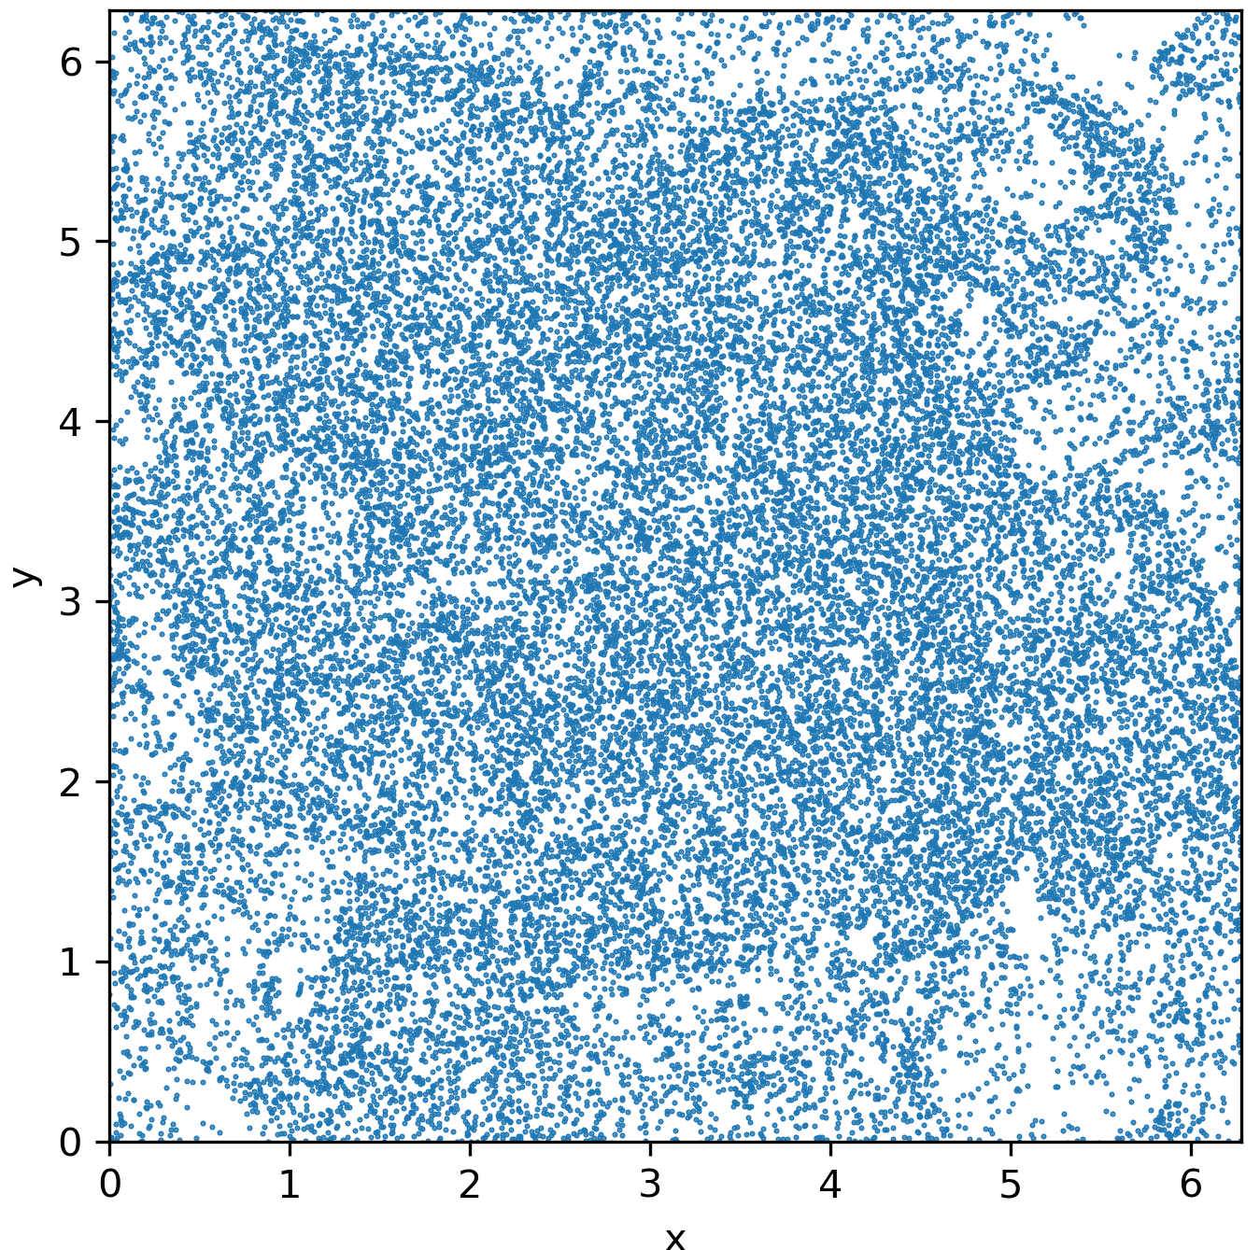
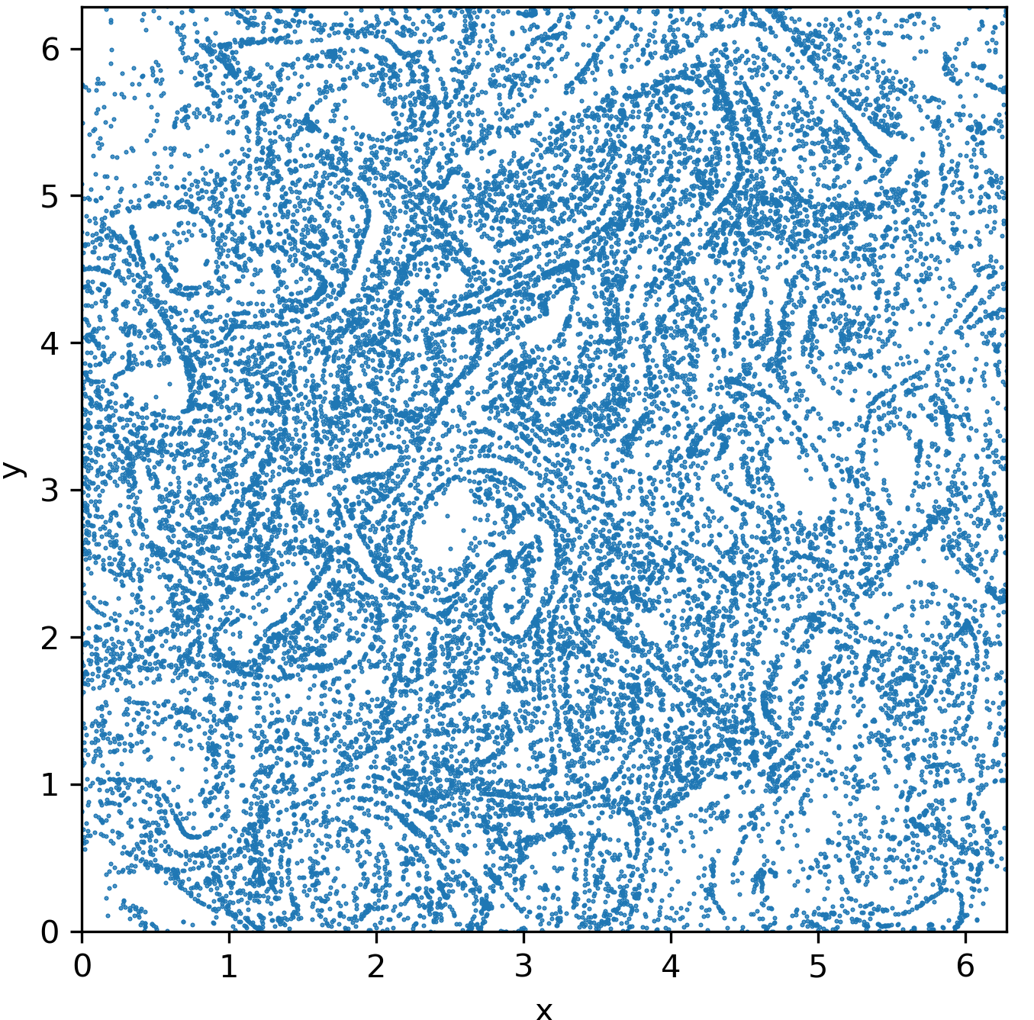
Results
Simulations at various $Ro$ have been performed but only the results for $Ro=0.1$ are presented here.
Time averaged vorticity PDF
Time averaged kinetic energy spectrum
Temperature field snapshot at $t=20$
The vorticity PDF shows an asymmetry with positive vorticity dominating, which is in line with previous submesoscale studies (Hakim et al., (2002); Roullet & Klein, 2010).
The spectrum is slightly steeper than the $k^{-5/3}$ power law.
Probability Density
E(k)
$k^{-5/3}$
$|ζ/σ|$
k
Particle distribution snapshot at $t=20$
Voronoi cell area PDF
FSLE-I and FSLE-II comparison
$δ^{-1}$
Clustering
Probability Density
$λ(δ)$
$$λ(δ)=\frac{ln\sqrt{2}}{⟨τ(δ)⟩}$$
$$Ro=0.1\text{(geostrophic flow)}$$
$$Ro=0.1\text{(full flow)}$$
$δ$
$A/⟨A⟩$
$δ$
Maalouly - 3

Slide 4
Discussion and conclusions
Eulerian statistics:
Asymmetry in the vorticity PDF indicating cyclonic dominance.
Turbulent flows with a wide range of energetic scales.
Nonzero divergence of the horizontal flow.
The asymmetry and divergence increase with $Ro$.
Lagrangian statistics:
Very weak effect of ageostrophic motions (i.e. increasing $Ro$) on relative dispersion statistics.
Clustering increases with $Ro$.
Surface currents from SWOT data may be appropriate for pair dispersion statistics applications but accessing finer details (e.g. clustering) could be more difficult.
Work in progress:
Understating the relation between particle distribution and flow properties.
Improving the understanding of the effect of ageostrophic motions.
Maalouly - 4

