Slide 1

Multi-trophic cross-frontal patchiness of plankton communities in the California Current Ecosystem
Inès Mangolte, Marina Lévy, Mark Ohman
Abbreviated abstract: We found that a majority of fronts sampled in the California Current Ecosystem are associated with a distinct frontal plankton community caracterized by an enhanced biomass of not only diatoms and copepods but many other groups of plankton such as chaetognaths, rhizarians and appendicularians. In addition, the distribution of plankton communities across fronts is far more complex than previously thought, and exhibits patchiness at a finer scale (typically 1-10 km) than the width of the front itself (typically 10-30 km). Such patchiness suggests that additional processes, such as horizontal transport and biotic interactions, are at play, in conjunction with the nutrient injections. The coupling between transport and local effects could be further investigated using lagrangian trajectory analysis.
MANGOLTE - 1

Slide 2
Data and methods
4 CCE-LTER (California Current Ecosystem Long Term Ecological Research) Cruises with high resolution transects targeting fronts : 2008 (1 transect), 2011 (2 transects), 2012 (2 transects), 2017 (3 transects) → identification of 10 density fronts
3 biological sampling methods : Flow Cytometry (heterotrophic bacteria and cyanobacteria), HPLC (6 phytoplankton groups), ZooScan (15 groups of meso-zooplankton)
MANGOLTE - 2

Slide 3
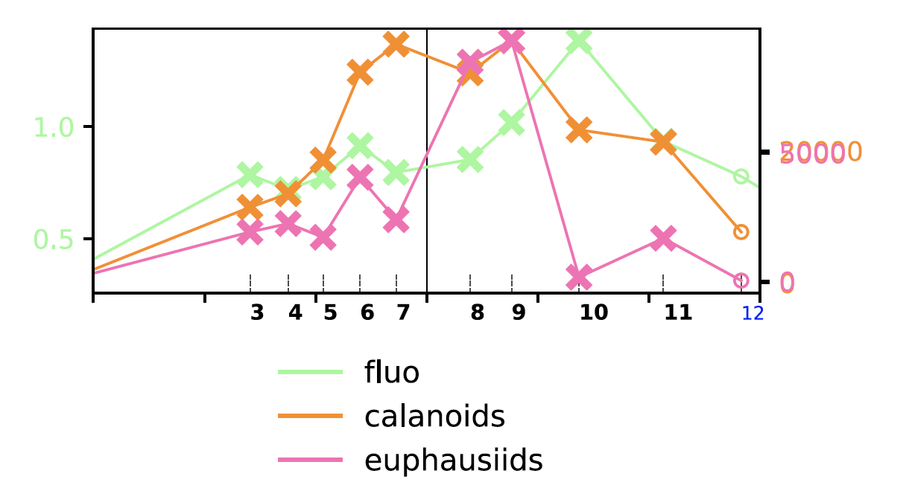
Results
Maximum of total biomass at most fronts (“peaks”)
Maximum of biomass for most plankton groups (“winners”), but not all
Fine scale horizontal patchiness : peaks of variable widths (1-10 km) and position (+/- 10 km for “center” of the front).
MANGOLTE - 3

Slide 4
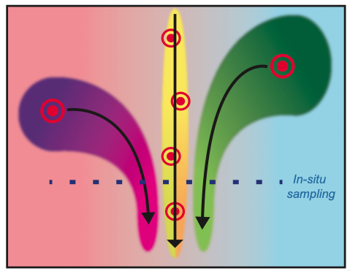
Discussion and conclusions
Importance of taxonomic and horizontal resolution to describe the structure of plankton communities at fronts
Complexity of the structure suggests coupling between active (frontal nutrient input), passive (transport) and reactive (biotic interactions such as predation) processes at very fine scales (1-10 km)
Lagrangian approach necessary to determine the role of transport
MANGOLTE - 4

