Slide 1
SeaSTAR: ESA Earth Explorer 11 candidate mission to measure small-scale ocean surface dynamics
Christine Gommenginger, Adrien Martin & the International SeaSTAR team
@ACHMartin
Abbreviated abstract:
SEASTAR is a dedicated ocean mission to address scientific needs for new synoptic imaging of ocean current and wind vectors at 1km resolution.
It focus on key interfaces of the Earth system makes SEASTAR relevant to a large and growing community of ocean, atmosphere, cryosphere, coastal and climate scientists and operators.
Related publications:
Gommenginger et al., "SEASTAR: A Mission to Study Ocean Submesoscale Dynamics and Small-Scale Atmosphere-Ocean Processes in Coastal, Shelf and Polar Seas", Frontiers in Marine Science , 2019, https://doi.org/10.3389/fmars.2019.00457.
Villas Bôas, et al., "Integrated Observations of Global Surface Winds, Currents, and Waves: Requirements and Challenges for the Next Decade", Frontiers in Marine Science , 2019, https://doi.org/10.3389/fmars.2019.00425.
SeaSTAR - 1

Slide 2
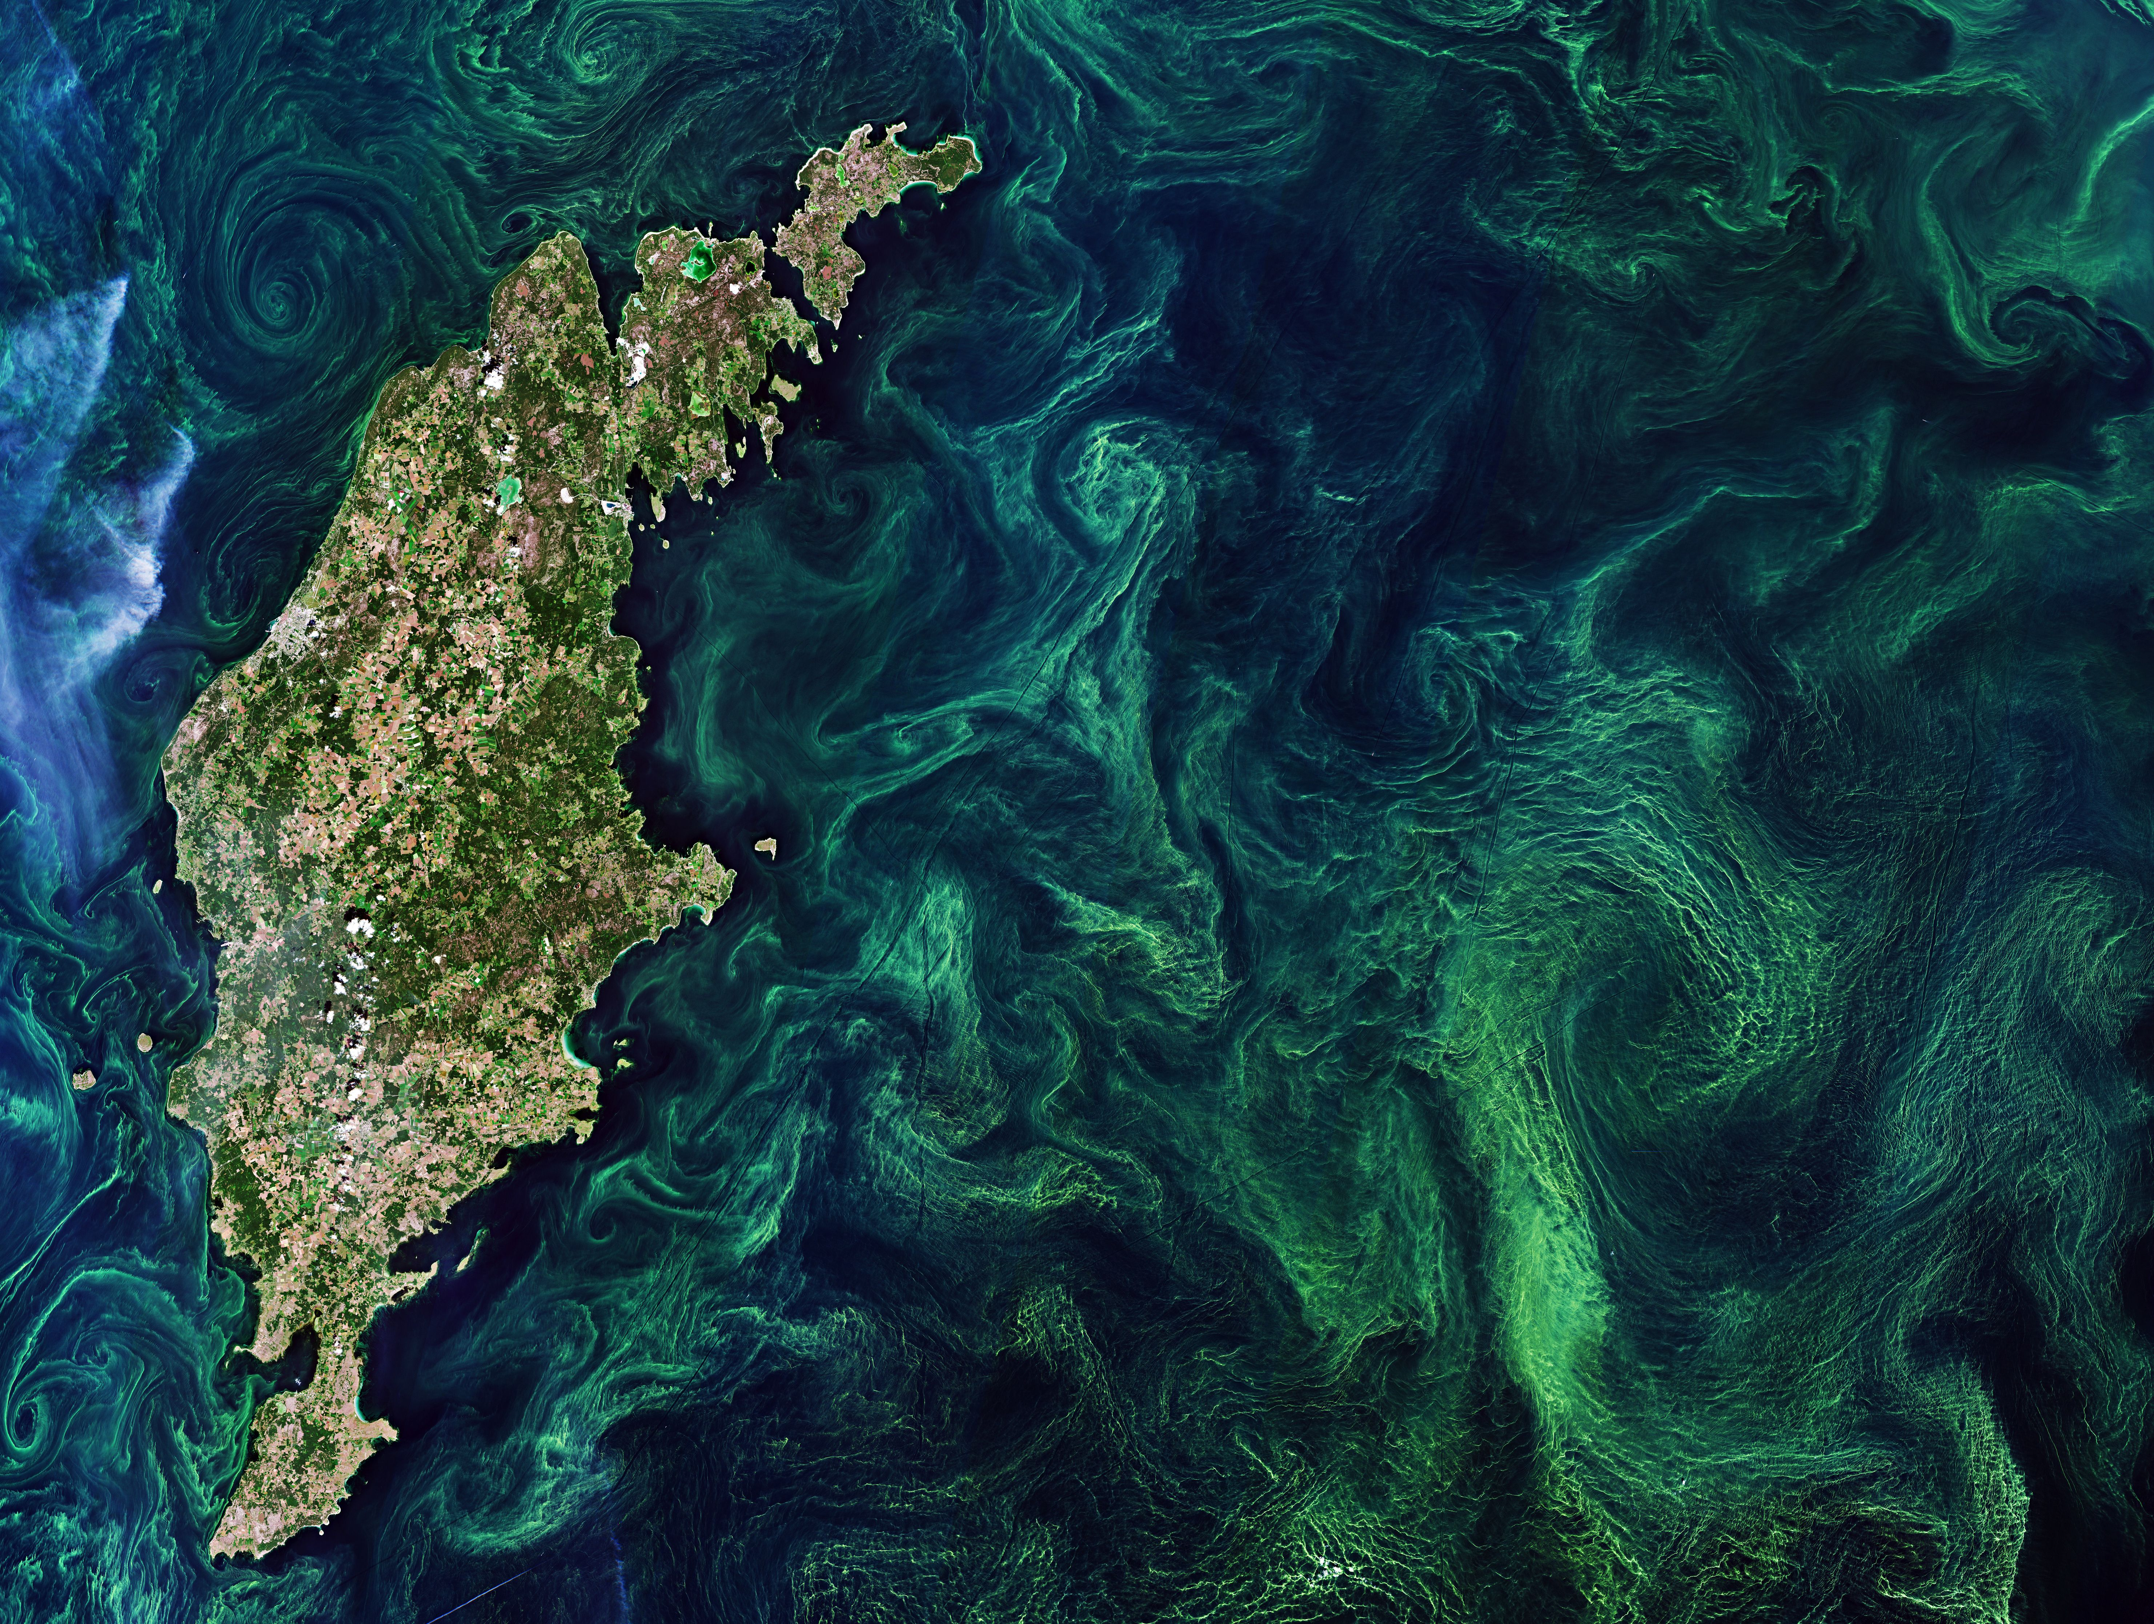
SeaSTAR Science Drivers
Sentinel-2 Baltic Sea
July 2019
Sentinel-2 Baltic Sea
July 2019
High-resolution satellite images often show small ocean eddies, swirls and filaments at scales below 10 km
Frequent near jets, large eddies and in coastal and polar seas
Fingerprints of dynamic vertical exchanges at the sea surface
Numerical models indicate these small-scale phenomena play a critical role on ocean circulation and the global climate system
Impact on vertical exchanges e.g. heat, CO2, nutrients…
Impact on horizontal dispersion & pathways e.g. debris, oil…
There are very few observations of ocean dynamics at these scales
Challenging & expensive with traditional means
No existing spaceborne capability to quantify their magnitude, spatial distribution and temporal variability.
10 km
SeaSTAR - 3

Slide 3
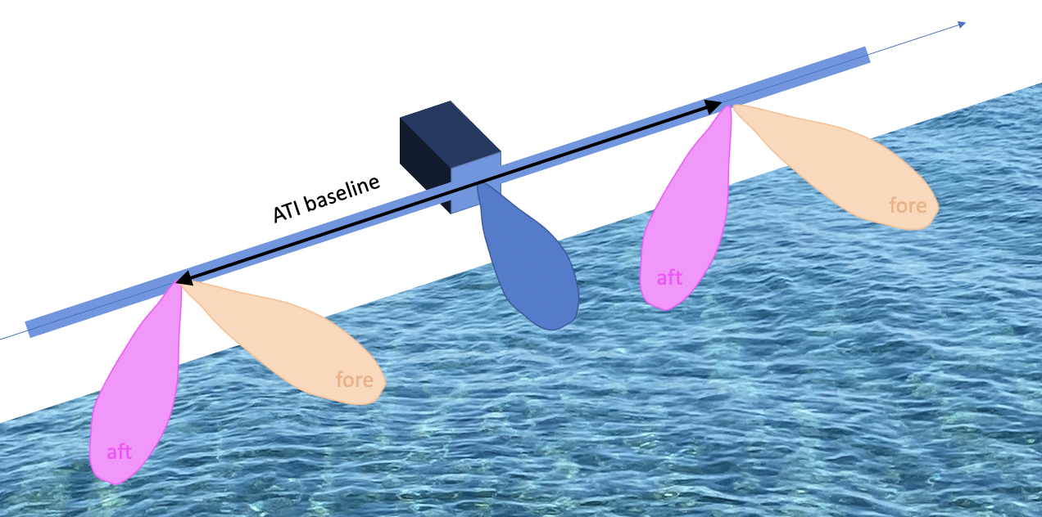
SeaSTAR Primary Science Objectives
A/ To measure 2D fields at 1 km resolution of:
TOTAL surface current vectors
Wind vectors
Over all coastal seas, shelf seas and marginal ice zones
B/ To deliver high-order derivative (eg vorticity, strain, divergence, …)
© NOC
SeaSTAR - 2

Slide 4
Summary & Take-home message
Science requirements for the SEASTAR are currently being consolidated to provide input to industry system studies
Now is the time to compile a wish list to make sure we maximise scientific return and community engagement.
A number of points are currently under discussion
We welcome feedback/comments in person or by email to cg1@noc.ac.uk and/or admartin@noc.ac.uk https://projects.noc.ac.uk/seastar/
Two hurdles (Autumn 2023, July 2025) before launch in 2031/32 but …
There are plenty of opportunities to make progress on small scale ocean dynamics
e.g. airborne campaigns, ocean campaigns, modelling
SeaSTAR - 4

