Slide 1
Influence of fine-scale physical structures on the distribution of phytoplankton in subsurface layers
Laurina Oms, Andrea Doglioli, Gérald Grégori
Abbreviated abstract:
Ocean circulation is an important factor to consider in the distribution of phytoplanktonic organisms. The behavior of their communities have major consequences on a global scale. Observations in situ, satellite observations and numerical modelling have shown that the fine-scale ocean circulation strongly influences phytoplankton dynamics. Most of these results concern the surface layer. However, along the water column, phytoplankton layers are formed where production can be very high. The core of the work presented here is therefore the study of the subsurface layers at fine scales. Cytometric and physical data from PROTEVSMED-SWOT (2018) and CALYPSO (2022) campaigns adopting a Lagrangian approach are analyzed. The results show that the subsurface phytoplankton layers are also forced by the type of physical structure present. At the surface as at the subsurface, on both sides of a front we observe a bimodal distribution of phytoplankton communities, while in an eddy we observe a patch distribution of phytoplankton communities. These results demonstrate the thinness with which biological and physical processes of interest must be followed to understand the functioning and the history of living organisms, especially in a three-dimensional space.
Related publications:
Tzortzis, Roxane, Doglioli, Andrea M, Barrillon, Stéphanie, Petrenko, Anne A, d’Ovidio, Francesco, Izard, Lloyd, Thyssen, Melilotus, Pascual, Ananda, Barceló-Llull, Bàrbara, Cyr, Frédéric, Tedetti, Marc, Bhairy, Nagib, Garreau, Pierre, Dumas, Franck, & Gregori, Gérald. 2021. Impact of moderately energetic fine-scale dynamics on the phytoplankton community structure in the western Mediterranean Sea. Biogeosciences, 18(24), 6455–6477. doi :10.5194/bg-18-6455-2021
Oms - 1

Slide 2
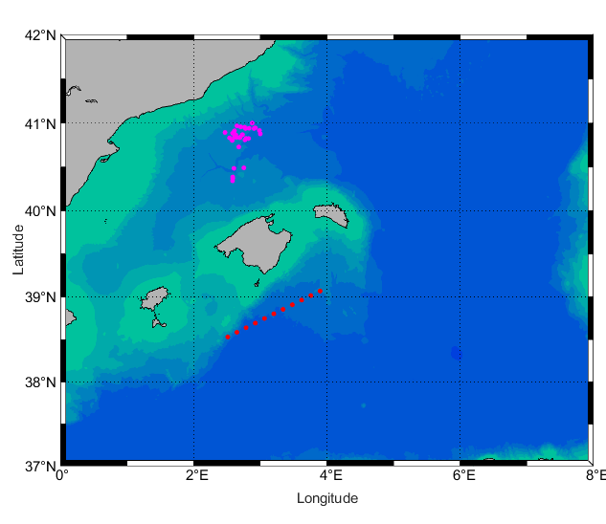
Data and methods
Adaptive Lagrangian strategy :
Follow in time and space physical and biological structures
Towed fish (Seasoar/EcoCTD) :
Characterize properties of water masses (Salinity, Temperature, Density)
Cytometric analysis on surface layer sample and on CTD sample (subsurface layer) :
Determine phytoplankton communities
Spain
CALYPSO 2022
B.I
PROTEVSMED-SWOT 2018
B.I : Balearic Islands
Frontal region
VS
Swirling region
Comparison between 2 different physical structures
Oms - 2

Slide 3
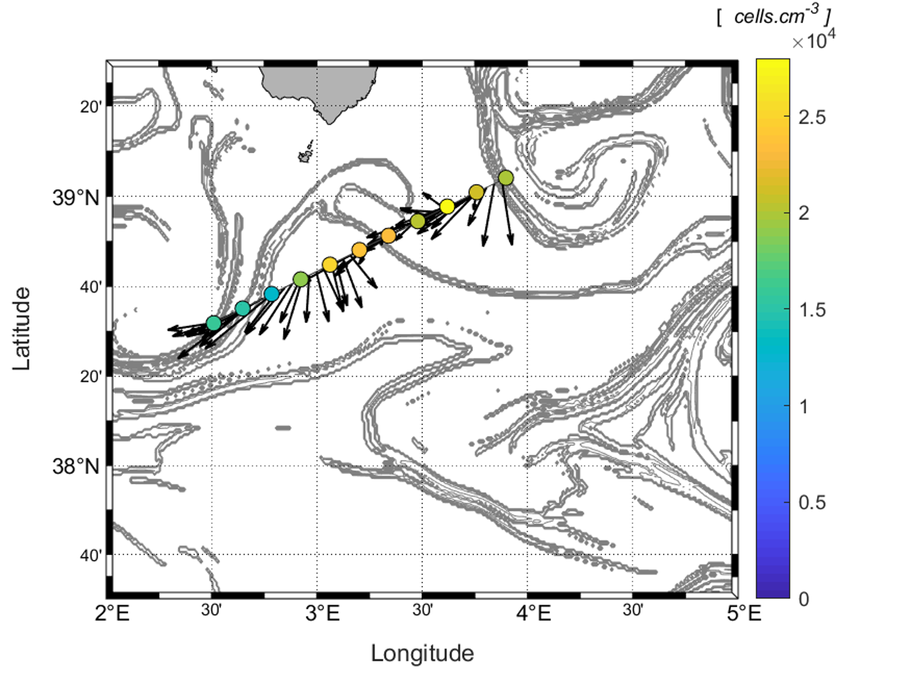
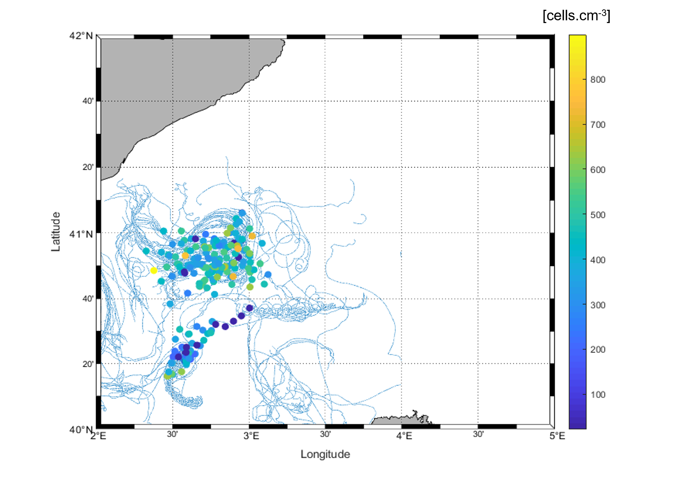
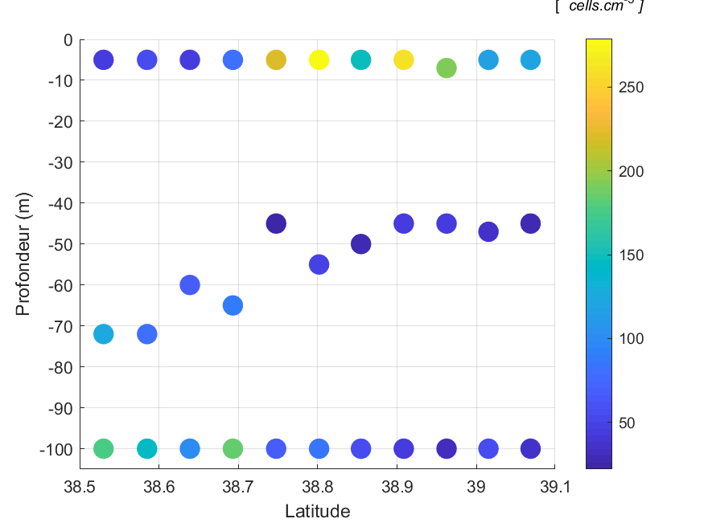
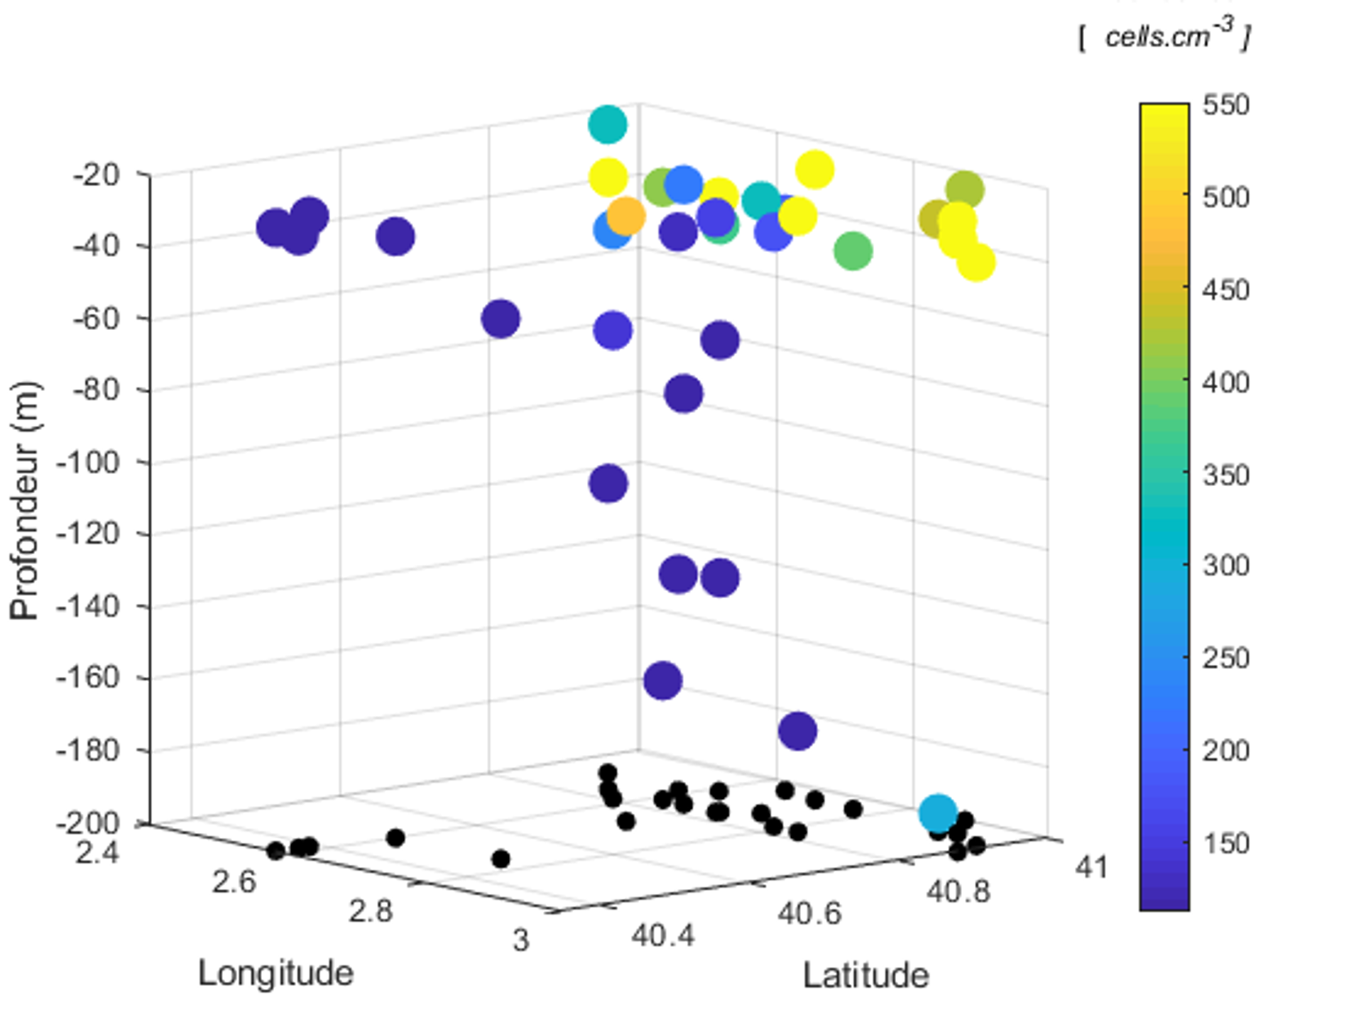
Results
bimodal ecological models
patch
ecological models
Frontal region
Swirling region
Phytoplankton abundances at :
synechococus
nanophytoplankton
Eddy transporting different water masses
SURFACE
Front separating 2 water masses
drifter trajectories
stirring rate
nanophytoplankton
SUBSURFACE
Depth (m)
Depth (m)
microphytoplankton
Oms - 3

Slide 4
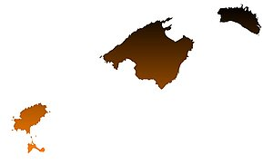
Discussion and conclusions
Around Balearic Islands
Frontal region
Separation of communities by water body type:
formation of bimodal ecological models
Swirling region
Mosaic distribution of communities according to water mass transport:
formation of ecological micro-habitats
What next ?
Objective: To understand the common history of water masses and organisms
In the framework of CALYPSO:
Estimation of vertical velocities, biogeochemical/genomic data
Continue the 3D study of biophysical coupling:
Multidisciplinary BIOSWOT project (physical, biogeochemical, genomic, ecological, numerical modelling)
Oms - 4

