Slide 1

Bi-directional Kinetic Energy Cascades from Repeat Ship-Board ADCP Observations & OGCM simulation
Bo Qiu (bo@soest.Hawaii.edu), Toshiya Nakano, Shuiming Chen & Patrice Klein
Abbreviated abstract: Ocean circulation receives its energy input at basin scales while dissipates at microscopic mixing scale. How this energy is transferred across different lengthscales is of paramount importance for understanding the ocean circulation equilibration and variability. Advancement in high-resolution numerical simulations in recent years has significantly improved our understanding of kinetic energy (KE) cascades from basin to kilometer scales, although observational evidence to verify the simulated processes remains limited. Using repeat ship-board velocity measurements along 165°E across the equatorial, subtropical and subarctic Pacific Ocean, we show that the length scale separating the inverse and forward cascades, Ls, falls in the 8∼300 km range and it does not scale with the baroclinic deformation radius. Balanced and unbalanced oceanic motions co-exist in this range but contribute oppositely to the directional energy cascades. Ls is observed to depend on the relative strengths of these motions, as well as by their interaction.
Related publications: Qiu, B., T. Nakano, S. Chen, and P. Klein, 2022: Bi-directional energy cascades in the Pacific Ocean from equator to subarctic gyre. Geophys. Res. Lett., 49, e2022GL097713. Supporting Information.
Qiu, B., S. Chen, P. Klein, J. Wang, H. Torres, L.-L. Fu and D. Menemenlis, 2018: Seasonality in transition scale from balanced to unbalanced motions in the world ocean. J. Phys. Oceanogr., 48, 591-605.
Qiu - 1

Slide 2
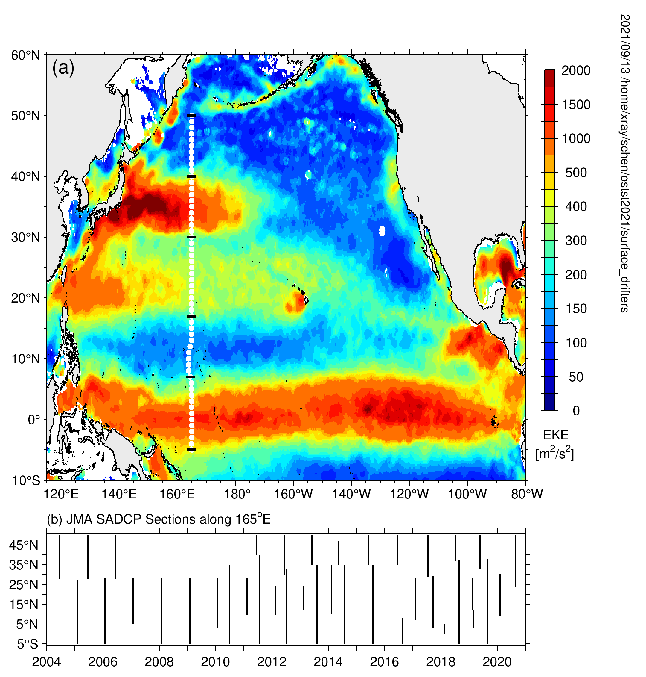
Data and methods
EKE map from surface drifter data
To explore bi-directional KE cascades observationally, we
analyzed the repeat ship-board ADCP data along 165°E from
3°S to 50°N obtained by JMA
39 cruises spanning 2004-2020 were utilized; upper ocean u/v
data (40-800m) were QC-processed & averaged to 2.5km grid
To ensure dynamic homogeneity, ADCP u/v data are sub-
divided into 5 geographic bands & energy cascades in each
band are quantified by using 2nd- & 3rd-order velocity structure
functions (SFs)
For quasi-2D turbulence, 3rd-order SF is related to spectral KE
flux, П(k):
–
Qiu et al. (2022, GRL)
F > 0 ( < 0 ) implies a forward (an inverse) cascade & the F value provides the KE dissipation rate ε
Qiu - 2

Slide 3
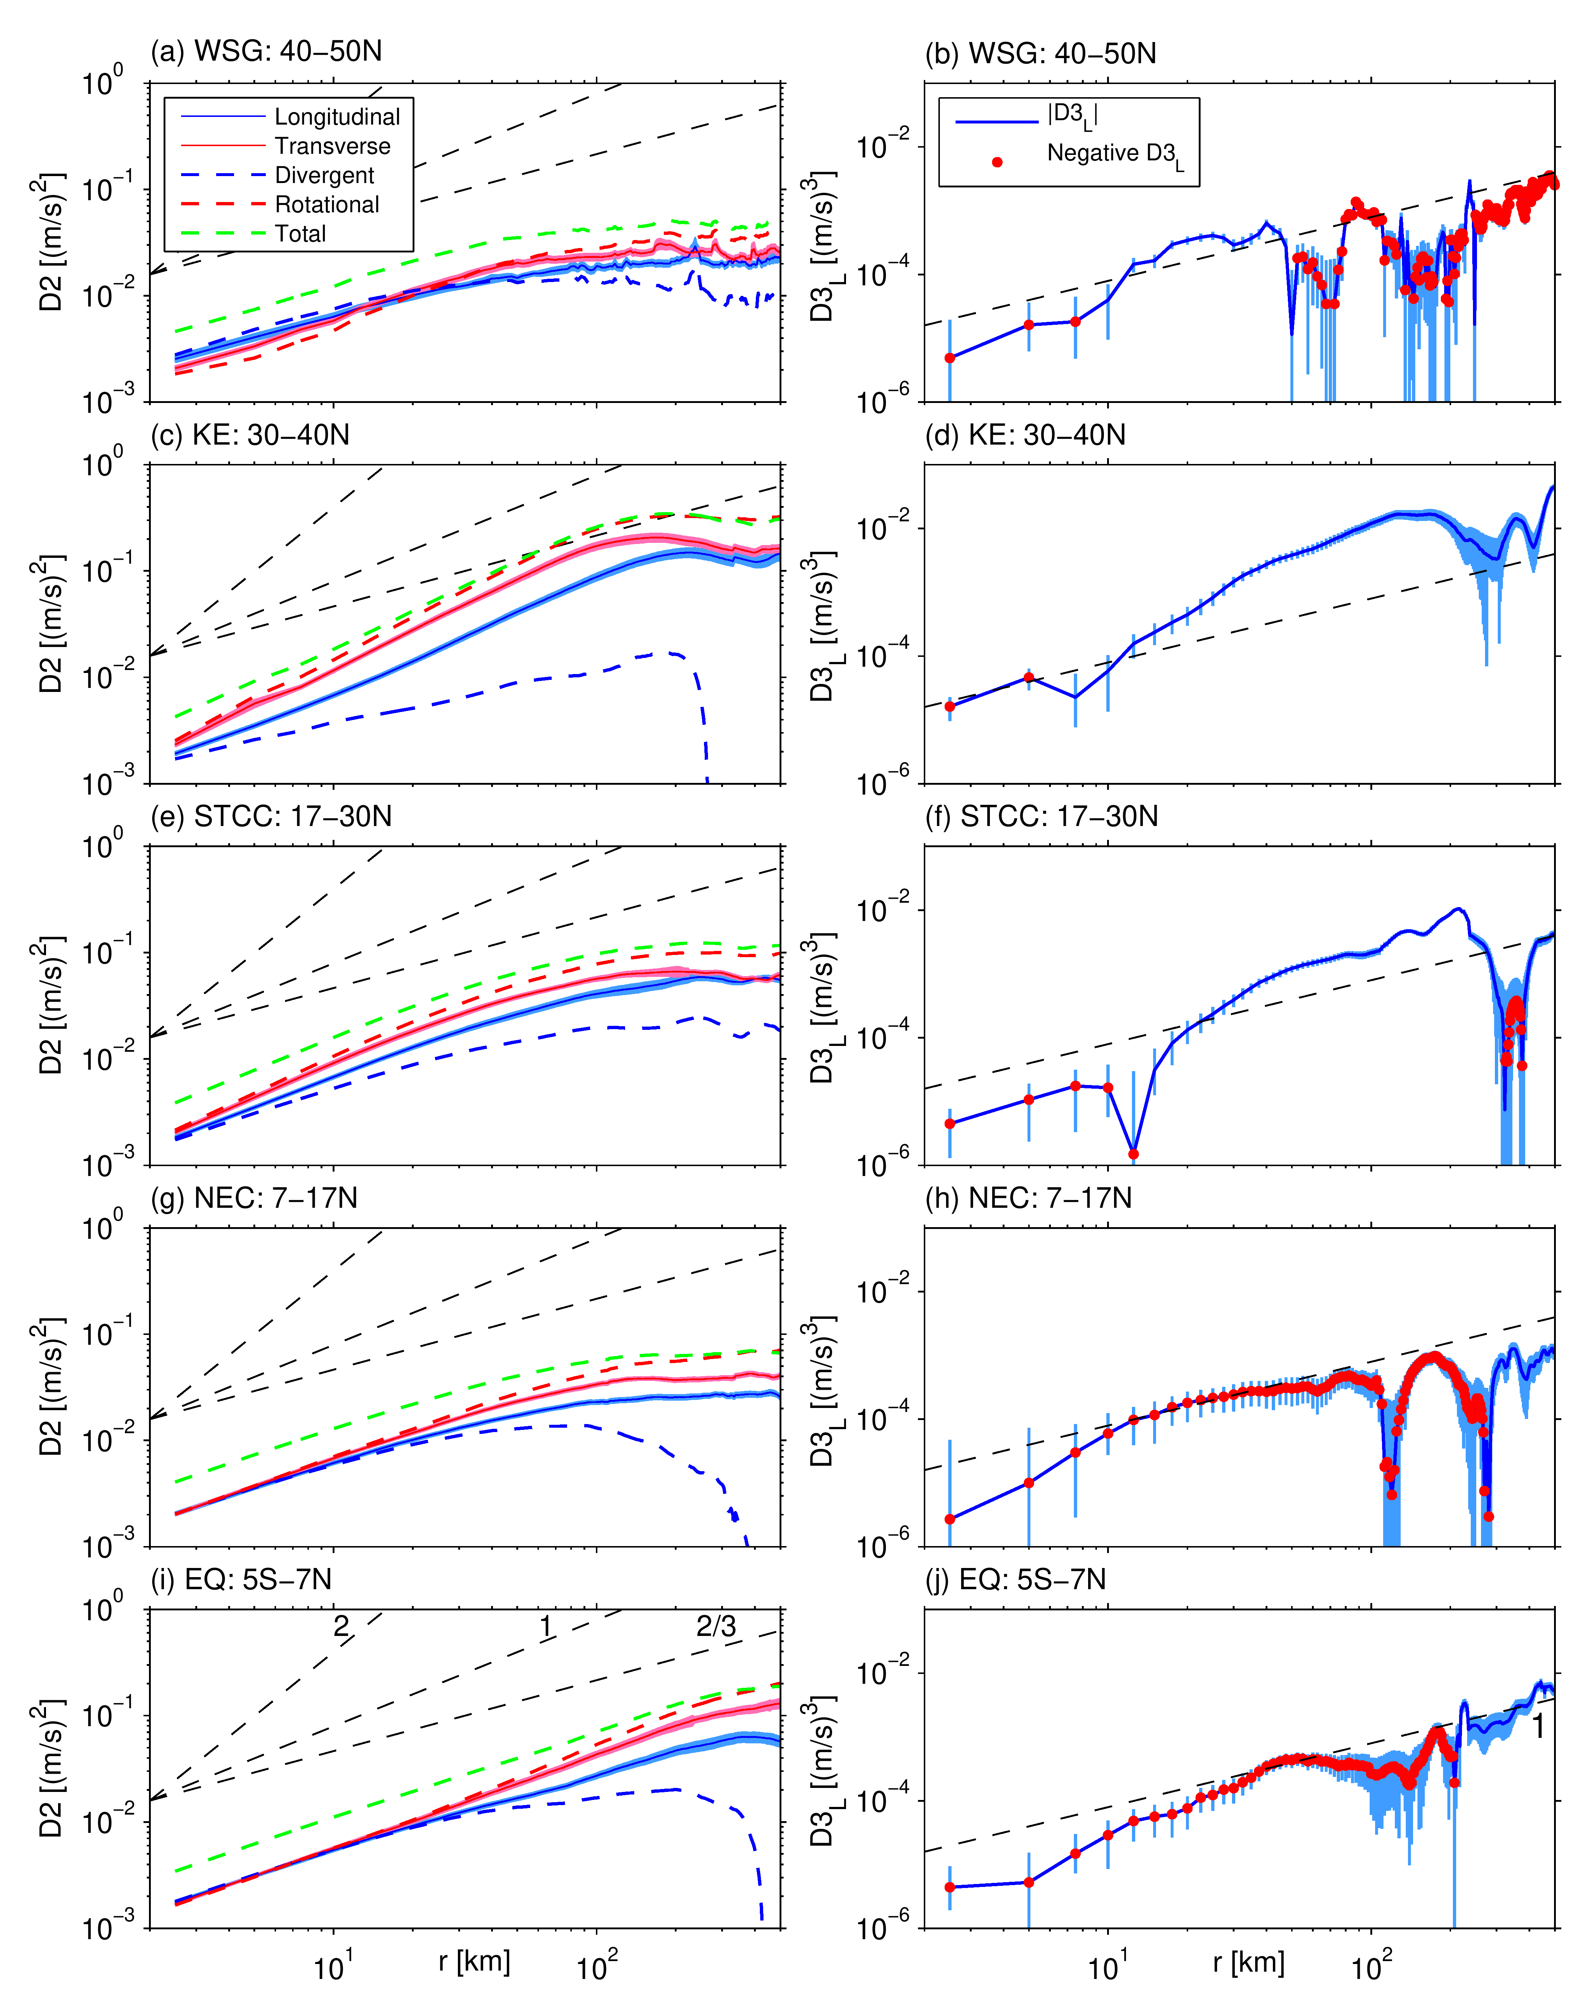
Kuroshio Extension band
• D2_{r} >> D2_{d} ; balanced motion
dominates over unbalanced one
• D2_{r} ~ r^{1.6} → SQG/QG mixture
• Bi-directional cascade separation
occurs near r = 8km; inverse
cascade (D3_{l} < 0) at r > 10 km;
cf. L_{R} = 30~40 km
2
1
2/3
WSG
KE
STCC
NEC
EQ
Equatorial band
• Balanced & unbalanced motions
have comparable amplitudes
• D2_{r} ~ r¹ → E(k) ~ k⁻² : dominated
by GM & SQG turbulence (?)
• Inverse cascade occurs when r ≥
200km; cf. L_{R} ≥ 200km
Subtropical Countercurrent band
• Balanced motion dominates over
unbalanced one to lesser extent
• D2_{r} ~ r¹ → SQG dynamics
• Inverse cascade occurs within
r = 30~200 km; cf. L_{R} = 40~70 km
North Equatorial Current band
• Low EKE level, inverse cascade
occurs when r ≥ 300km; cf. L_{R} =
70~200km
• Compared to Eq. band, inverse
cascade window is narrower due
to lack of balanced eddy motion
Western Subarctic Gyre band
• Lowest EKE band; unbalanced
motion is largely wind-forced &
can exceed balanced motion
• Inverse cascade occurs in narrow
r = 10~50 km window; cf. L_{R} ≈ 25
km

Slide 4
Discussion and conclusions
Due to co-existence of balanced & unbalanced motions, the scale separating
the bi-directional cascades do NOT scale with L_{R}
Inverse KE cascade can extend down to km-scales in regions where interior
& mixed layer instabilities prevail
The relative importance between the balanced-unbalanced motions & their
interactions control the window within which inverse cascade occurs
To understand the bi-directional KE cascade globally, there is a need to
observe both the balanced and unbalanced motions down to O(1~10km)
By respectively observing the balanced & total surface velocities, the SWOT
& ODYSEA missions could provide needed measurements for quantifying
the bi-directional cascade on a global scale.
ODYSEA’s concurrent surface wind measurements will also help to address
the unbalanced motion biased issue in high-latitude oceans
Qiu - 4

