Slide 1



Scale of Oceanic Eddy Killing by Wind from Global Satellite Observations
Shikhar Rai, Matthew Hecht, Matthew Maltrud, Hussein Aluie
Abbreviated abstract: While wind is the primary driver of the oceanic general circulation, we find that it inputs positive power only at scales larger than 260km, while killing smaller geostrophic scales at a rate of 50 GW, on a global average. We use satellite observations and coarse graining to disentangle multi-scale processes on the sphere. We find eddy-killing peaks in winter with winds and it removes a substantial fraction (up to 90%) of the wind power input in WBCs such as the Gulf Stream. This represents a major dissipation pathway for mesoscales, the ocean's most energetic scales.
Related publications:
Rai, S., Hecht, M., Maltrud, M., & Aluie, H. (2021). Scale of oceanic eddy killing by wind from global satellite observations. Science Advances, 7(28), eabf4920. DOI: 10.1126/sciadv.abf4920
Rai- 1
Acknowledgements:

Slide 2
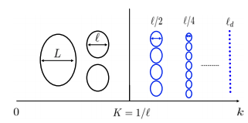

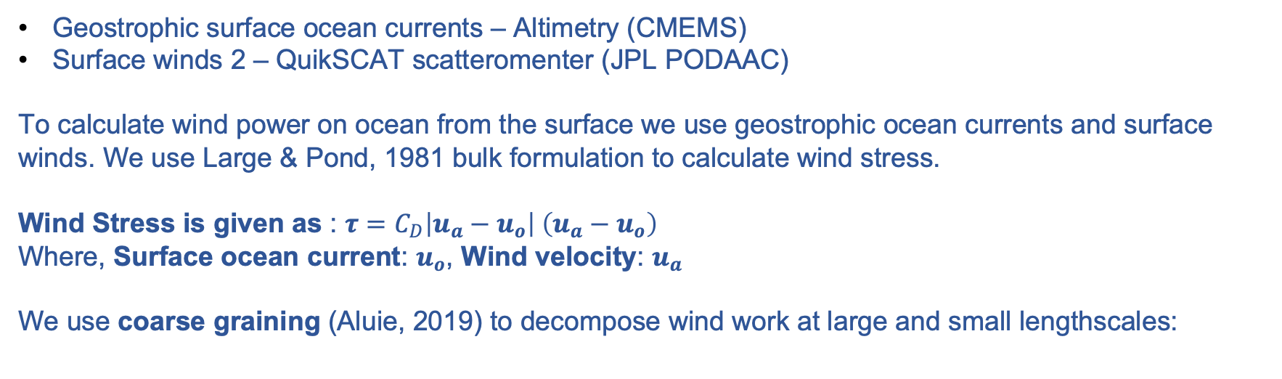
Data and methods
Geostrophic surface ocean currents – Altimetry (CMEMS)
Surface winds 2 – QuikSCAT scatteromenter (JPL PODAAC)
To calculate wind power on ocean from the surface we use geostrophic ocean currents and surface winds. We use Large & Pond, 1981 bulk formulation to calculate wind stress.
        Wind Stress is given as : $τ=C_{D}\left|u_{a}−u_{o}\right| \left(u_{a}−u_{o}\right)$
        Where, Surface ocean current: $u_{o}$, Wind velocity: $u_{a}$
        We use coarse graining (Aluie, 2019) to decompose wind work at large and small lengthscales:
Large scale
Small scale
$$ℓ$$
Power to scales larger than $𝓁 = \overline{τ}.\overline{u_{o}}$
Power to scales smaller than $𝓁 = \overline{τ.u_{o}}−\overline{τ}.\overline{u_{o}}$
Rai - 2

Slide 3
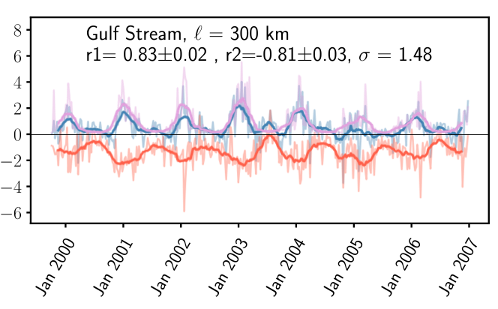
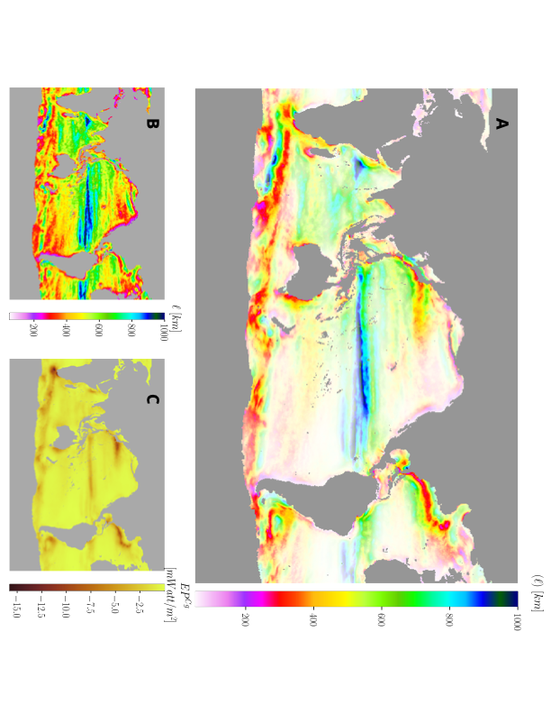


Results
Seasonality of eddy killing
-50 GW, 260 km
Wind
Eddy killing
Wind work at small (< 260km) scales ($EP^{Cg}$)
$$EP^{Cg}= \overline{τ.u_{o}}−\overline{τ}.\overline{u_{o}}$$
Lengthscales of eddy killing
Rai - 3

Slide 4
Discussion and conclusions
Wind work to scales less than 260km is negative and -50GW in global average.
This negative wind work(eddy killing) has seasonality peaking in winter and is correlated with winds.
The length-scale for eddy killing varies spatially, has some correlation with latitude.
Rai - 4
Lengthscale ?

