Slide 1

Observations of submesoscale flows in the Southern Ocean and early evidence of their coupling with air-sea fluxes
Seb Swart, Marcel du Plessis, Sarah Nicholson, Louise Biddle, Isabelle Giddy, Pedro Monteiro, Ronald de Souza, Andrew Thompson, Johan Edholm, et al…
@PolarGliders
Abbreviated abstract: Within the previous 10 years we have been able to directly observe and assess the role of the fine-scale ocean and rapidly evolving atmosphere boundary layer on the upper limb of the Southern Ocean’s overturning circulation. However, these efforts have been mostly limited to the ice-free Southern Ocean with major challenges remaining for the sea-ice regions. Here, we provide an overview of the observational progress, particularly using autonomous platforms, to assess how the SO mixed layer varies at the finescale (1-10 km, hours to seasons). In particular, we focus on the ocean coupling with the atmosphere and cryosphere, and how it directly moderates air-sea fluxes of heat and carbon. We attempt to elucidate research gaps and where we should be aiming for in the future.
Related publications:
Swart et al. Submesoscale fronts in the SO MIZ and response to wind forcing. GRL, 10.1029/2019GL086649. 2020.
Nicholson, et al. Storms drive outgassing of CO₂ in the subpolar Southern Ocean. Nature Comms. 10.1038/s41467-021-27780-w. 2022.
Giddy, et al. Stirring of sea‐ice meltwater enhances submesoscale fronts…. JGR, 10.1029/2020JC016814. 2021.
Biddle & Swart. The observed seasonal cycle of submesoscales in the SO MIZ. JGR 10.1029/2019JC015587. 2020.
Swart - 1

Slide 2
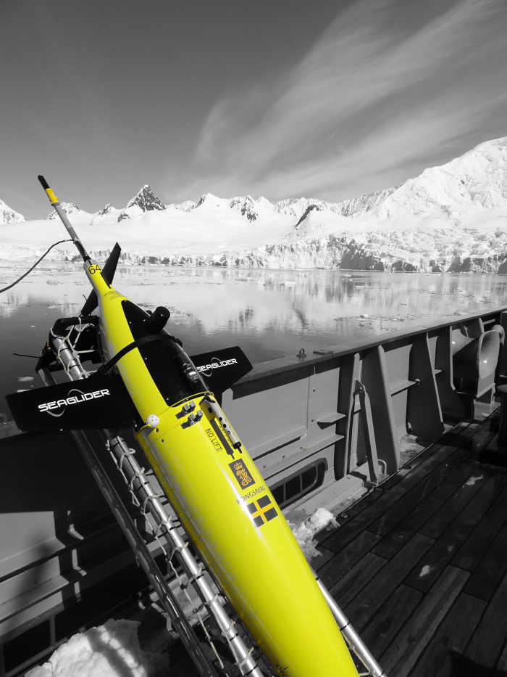
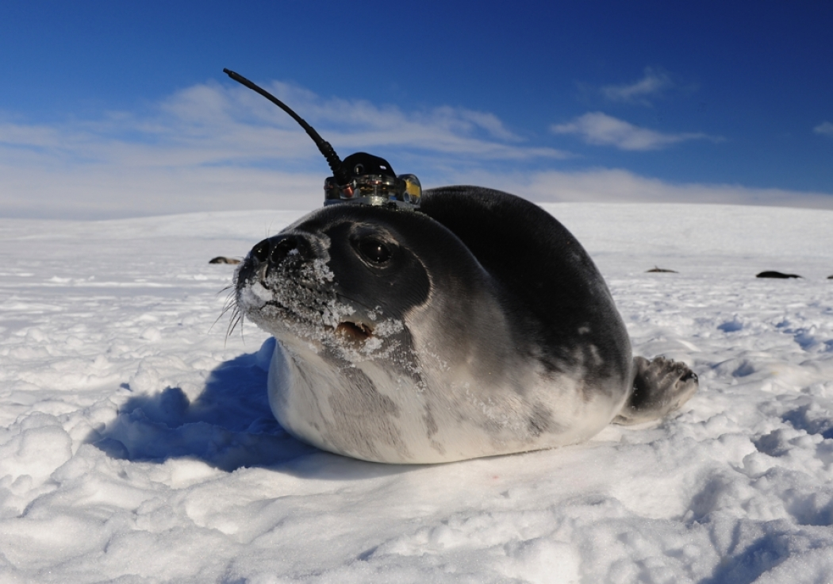
Data and methods
Sailbuoy
Various profiling and surface autonomous paltforms provide data and associated air-sea fluxes at finescale and over seasonal cycles in the Southern Ocean
Assess the scales and intensities of finescale ocean flows and atmosphere fluxes to understand winter to summer controls on stratification and ML physics in the SO from the Subantarctic to the sea ice covered ocean.
Gliders with microstructure
Seal tags
Swart - 2

Slide 3
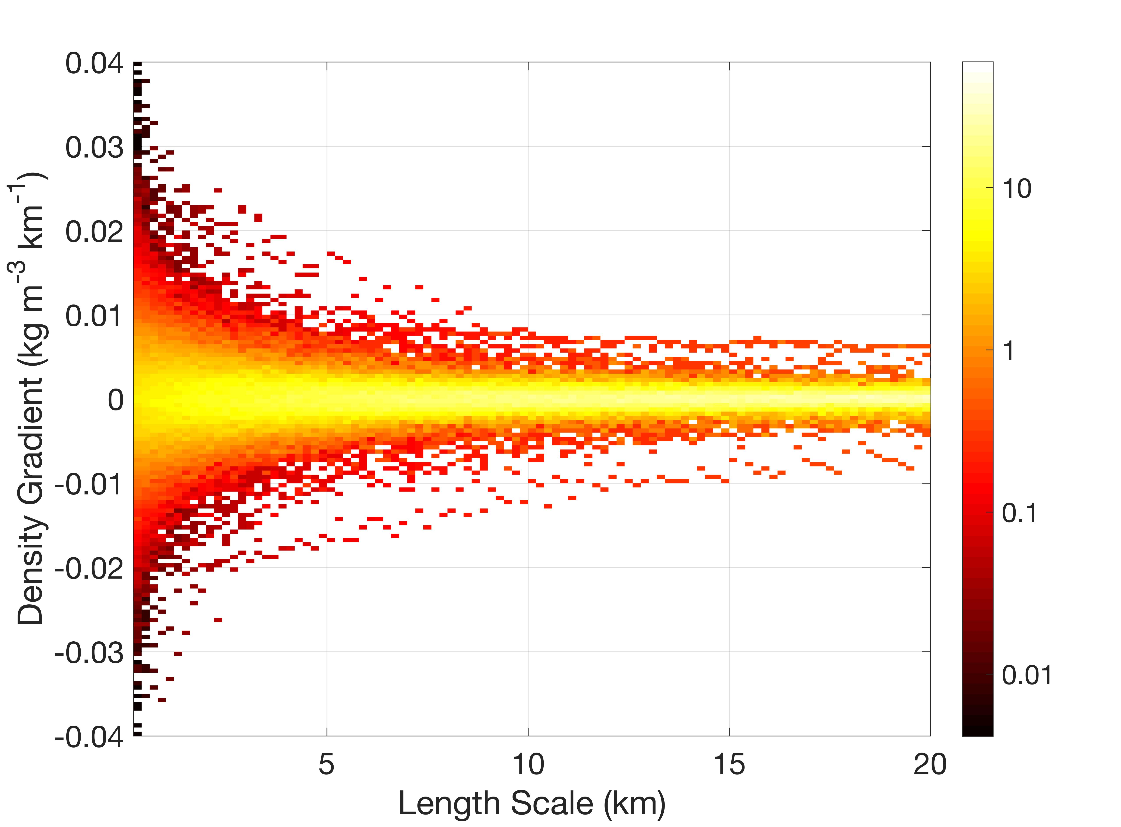
Results
- MIZ SMS flows are active and almost completely driven by salinity gradients.
SMS gradients vs sampling scale, Swart et al., 2020
R_{d} = 8 km
Wavenumber spectra,
Giddy et al., 2021
Log(E)
Salinity
- Storms drive deep turbulence from glider + microstructure observations that tap into C-rich deep waters. CO2 outgasses in the subpolar SO from Wave Glider obs
pCO2
Swart - 3
Nicholson et al., 2022

Slide 4
Discussion and conclusions
- Finescale ocean energy drop off rapidly with sampling scale, require sub km scale observations
- Seasonal cycle in sms flows in the MIZ driven by mesoscale freshwater gradients. Spectra steepen and narrow in variability from spring to late summer when freshwater gradients mix out and ML shoals.
- Obs start to show strong coupling between filescale ocean and rapidly evolving atmosphere leading to fluxes of heat and C
SMS flows are active under sea ice
Challenge: accurate and seasonal coverage of combined ocean and atmospheric boundary layer observations at fine-scale + fluxes
Challenge: Observing fine scale under sea ice <technological constraints and field access>
Challenge: Lack of autumn-winter observations in the high latitudes
Swart - 4

