Slide 1


Observed Southern Ocean mixed layers display distinct interannual basin-scale modes
Theo Spira, Sebastiaan Swart, Marcel du Plessis
@theo_spira
Abbreviated abstract:
The Southern Ocean is central to the world’s ocean circulation. The mixed layer is the gateway to the ocean interior, influencing air-sea fluxes. By collating various data sources, we show that observed mixed layers vary significantly and display an inhomogeneous climatology, with ties to geostrophic currents and water formation regions. We begin to investigate distinct modes that appear in the different basins by considering deviations from the climatological statistics and their relation to large-scale modes.
Spira - 1

Slide 2
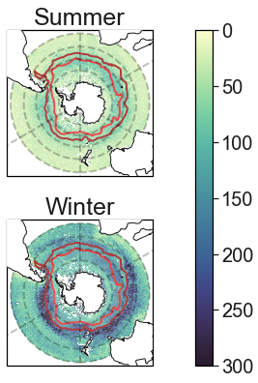
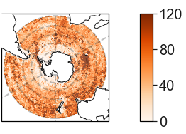
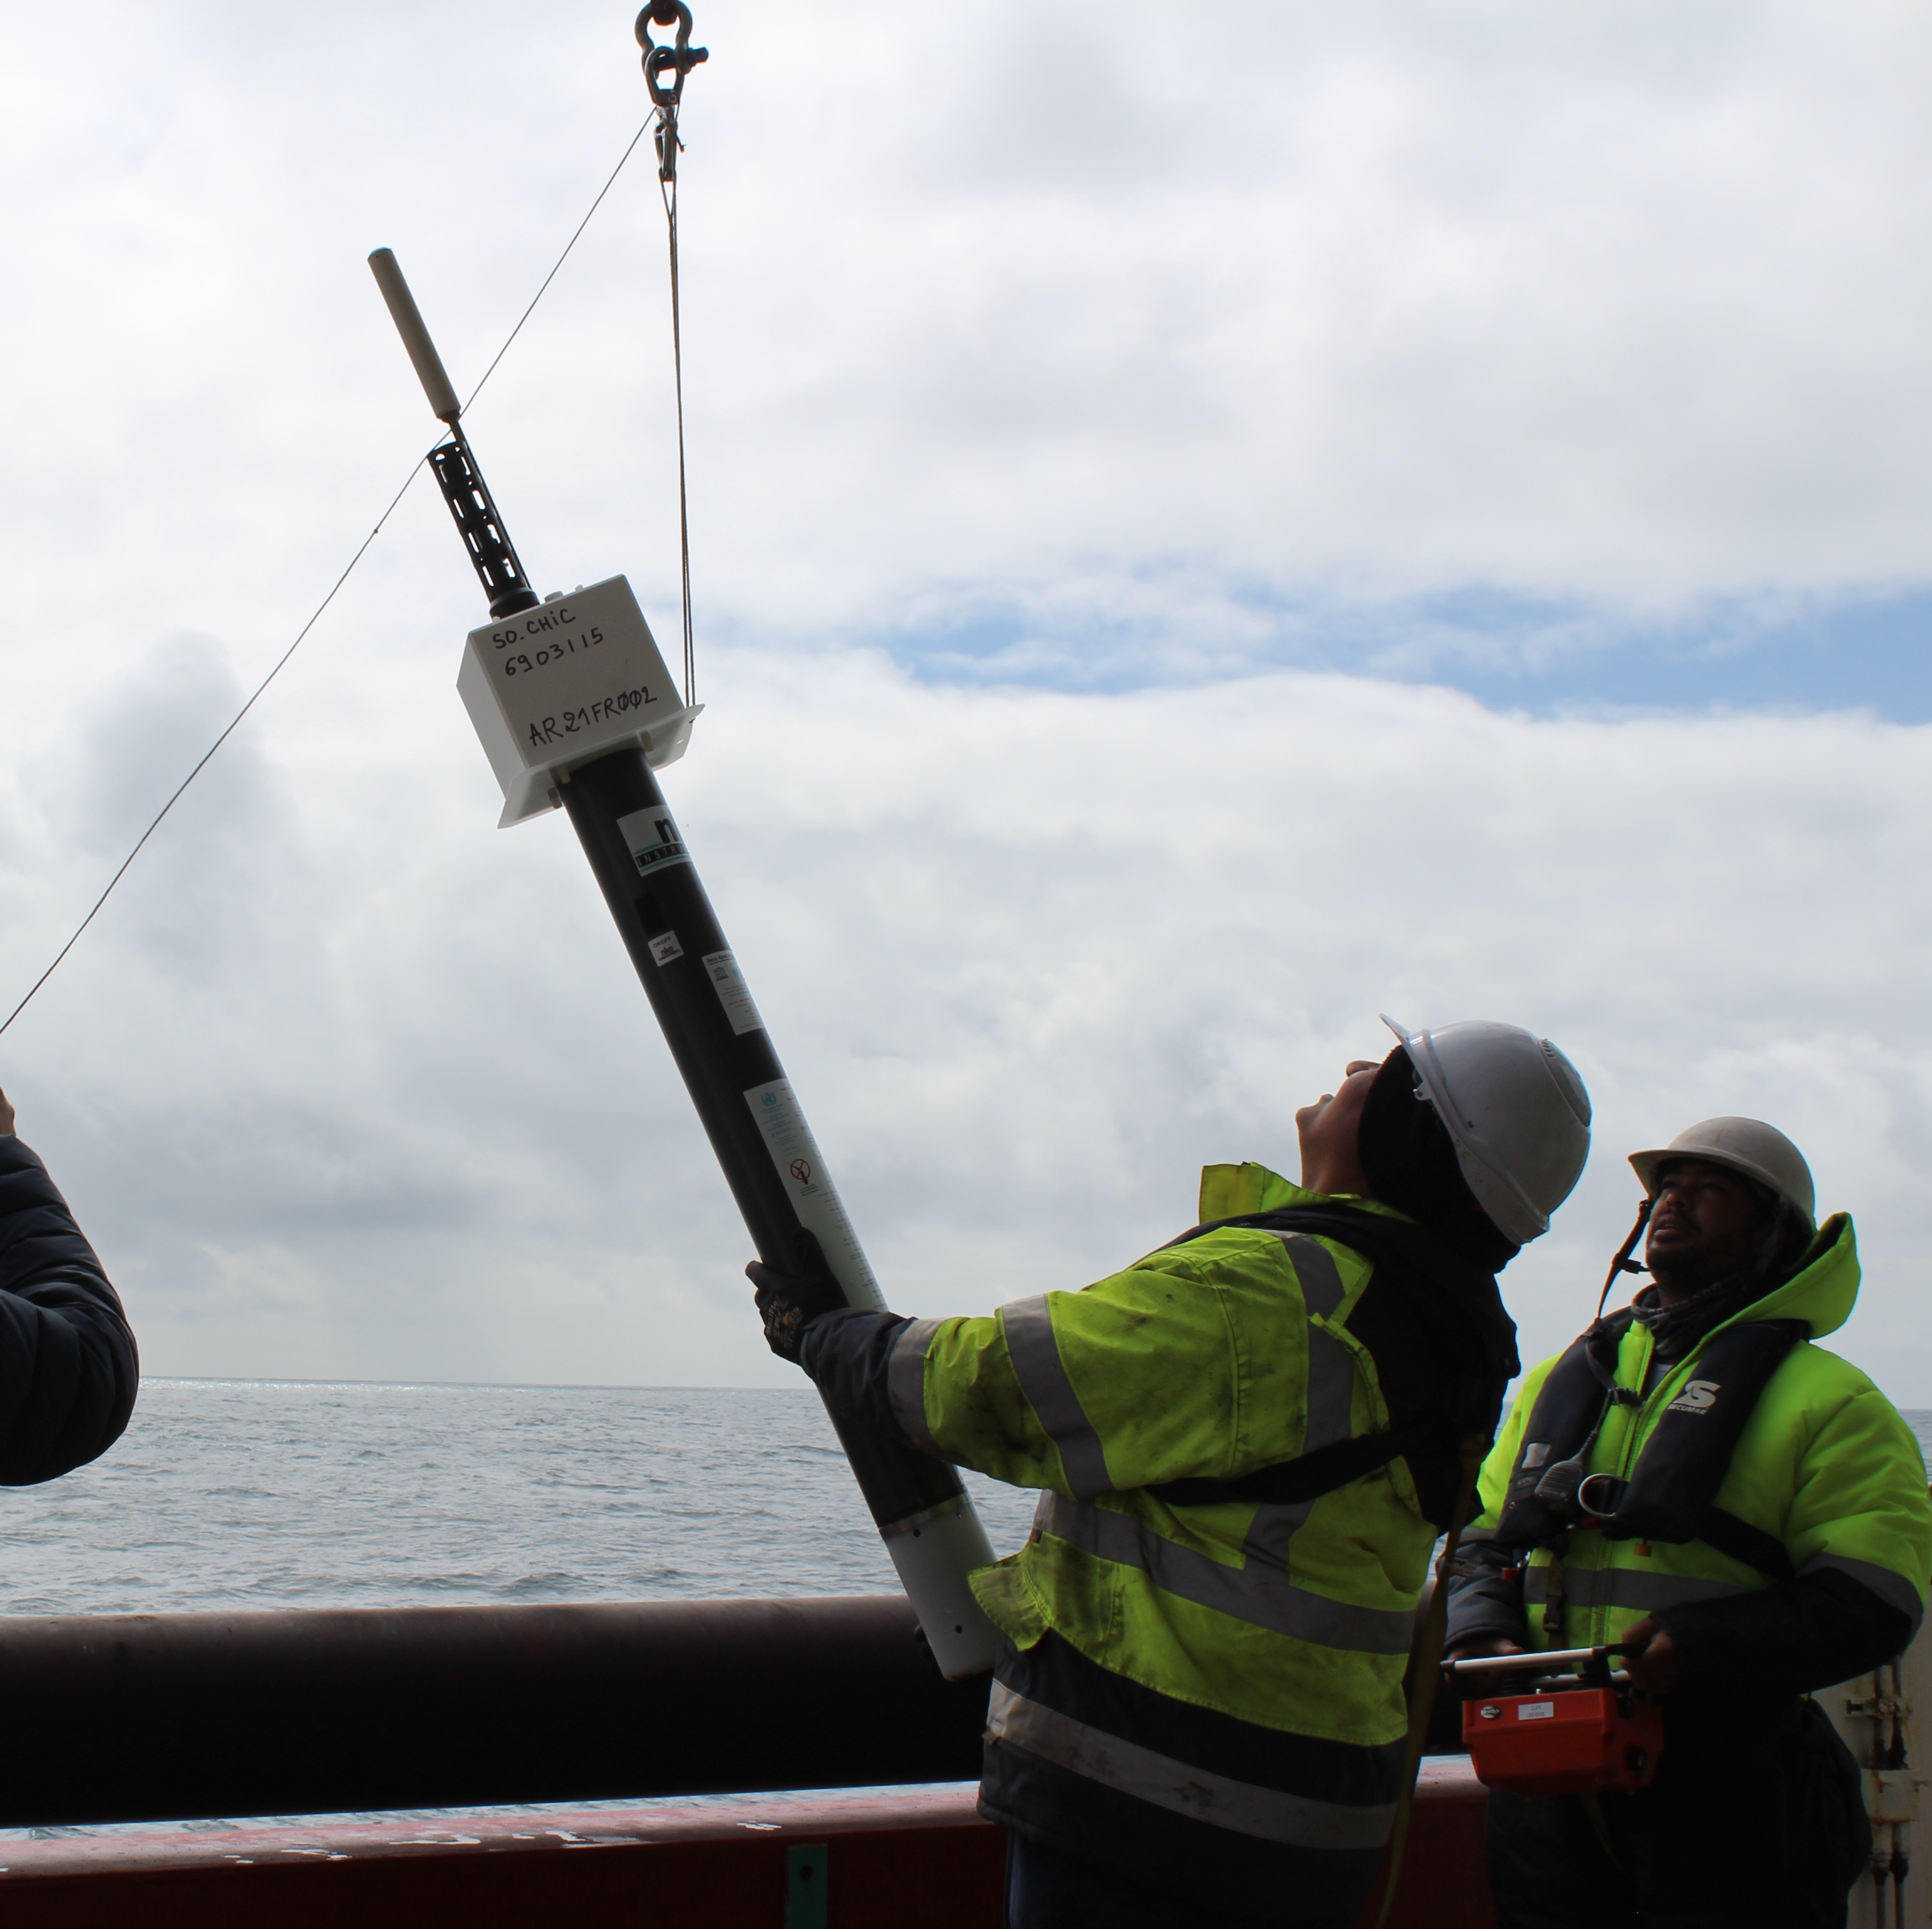
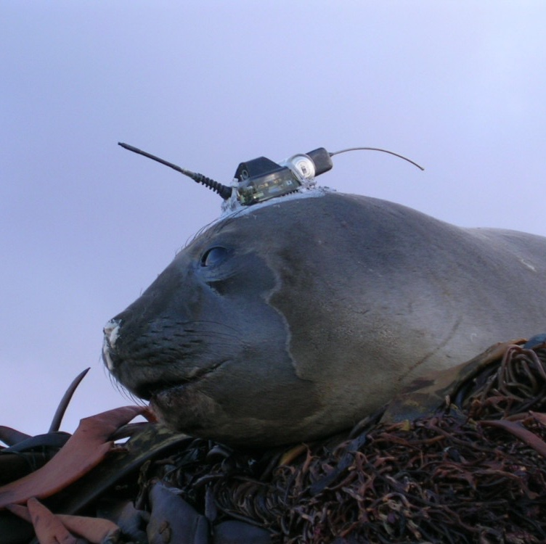
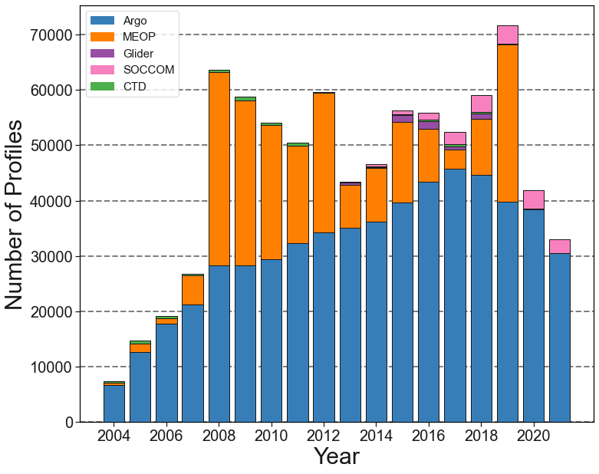
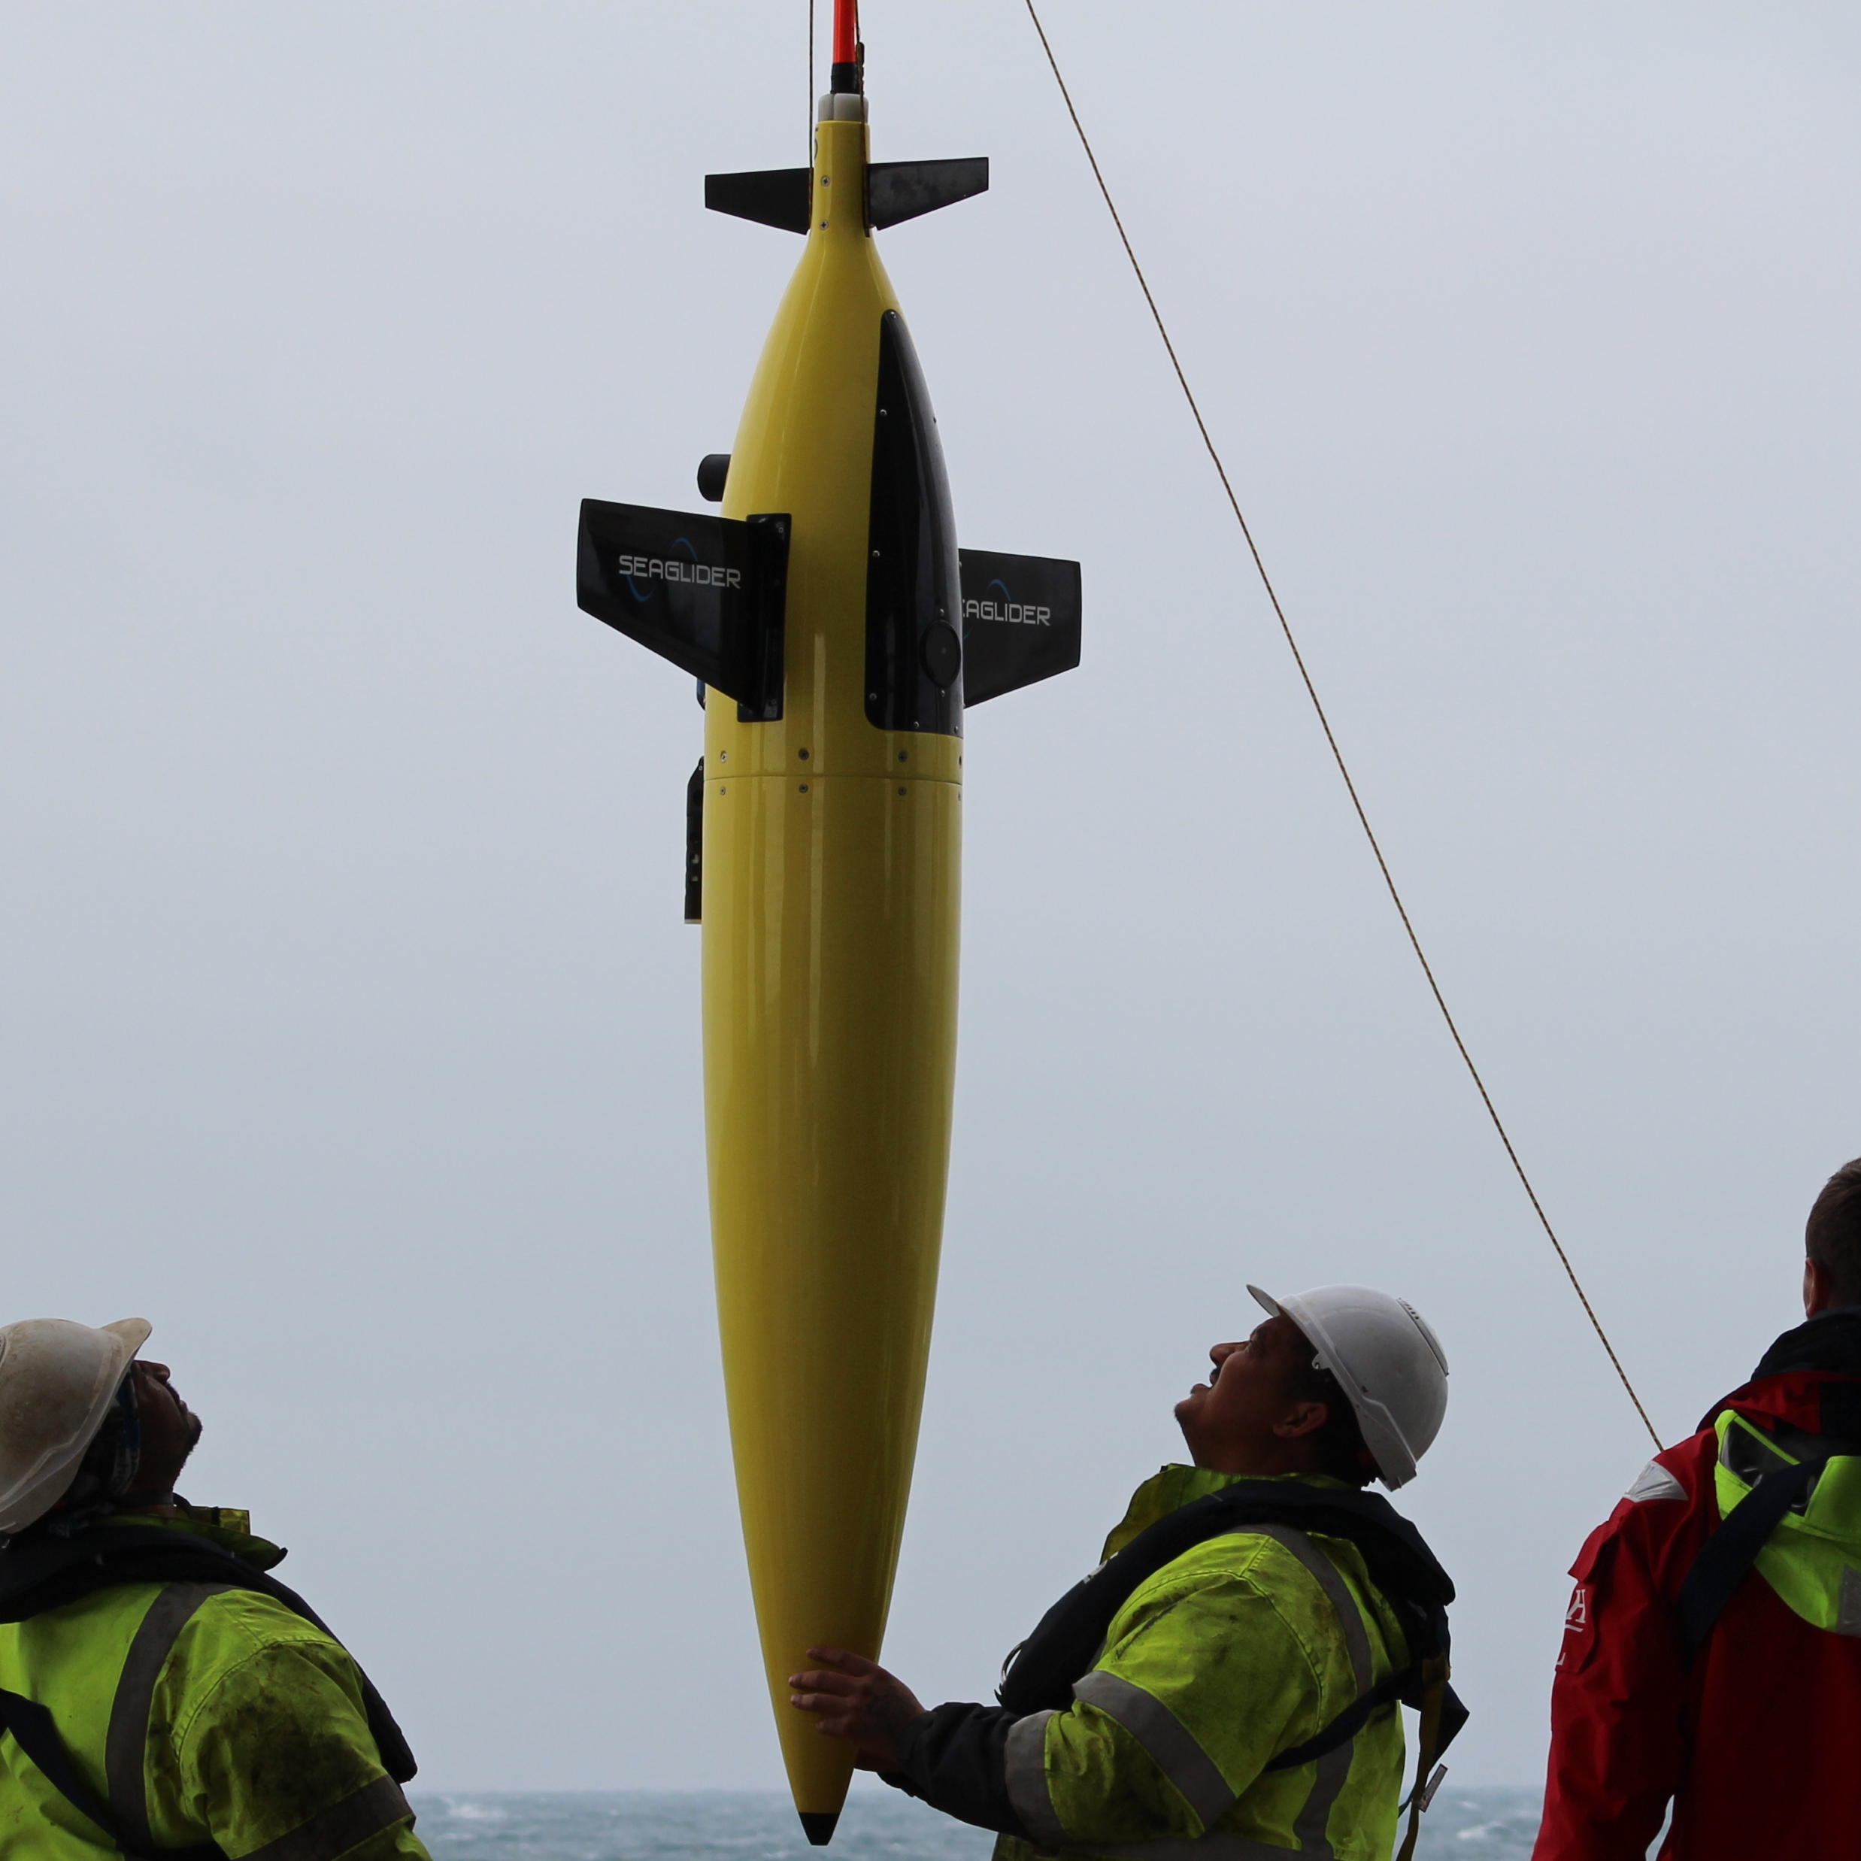
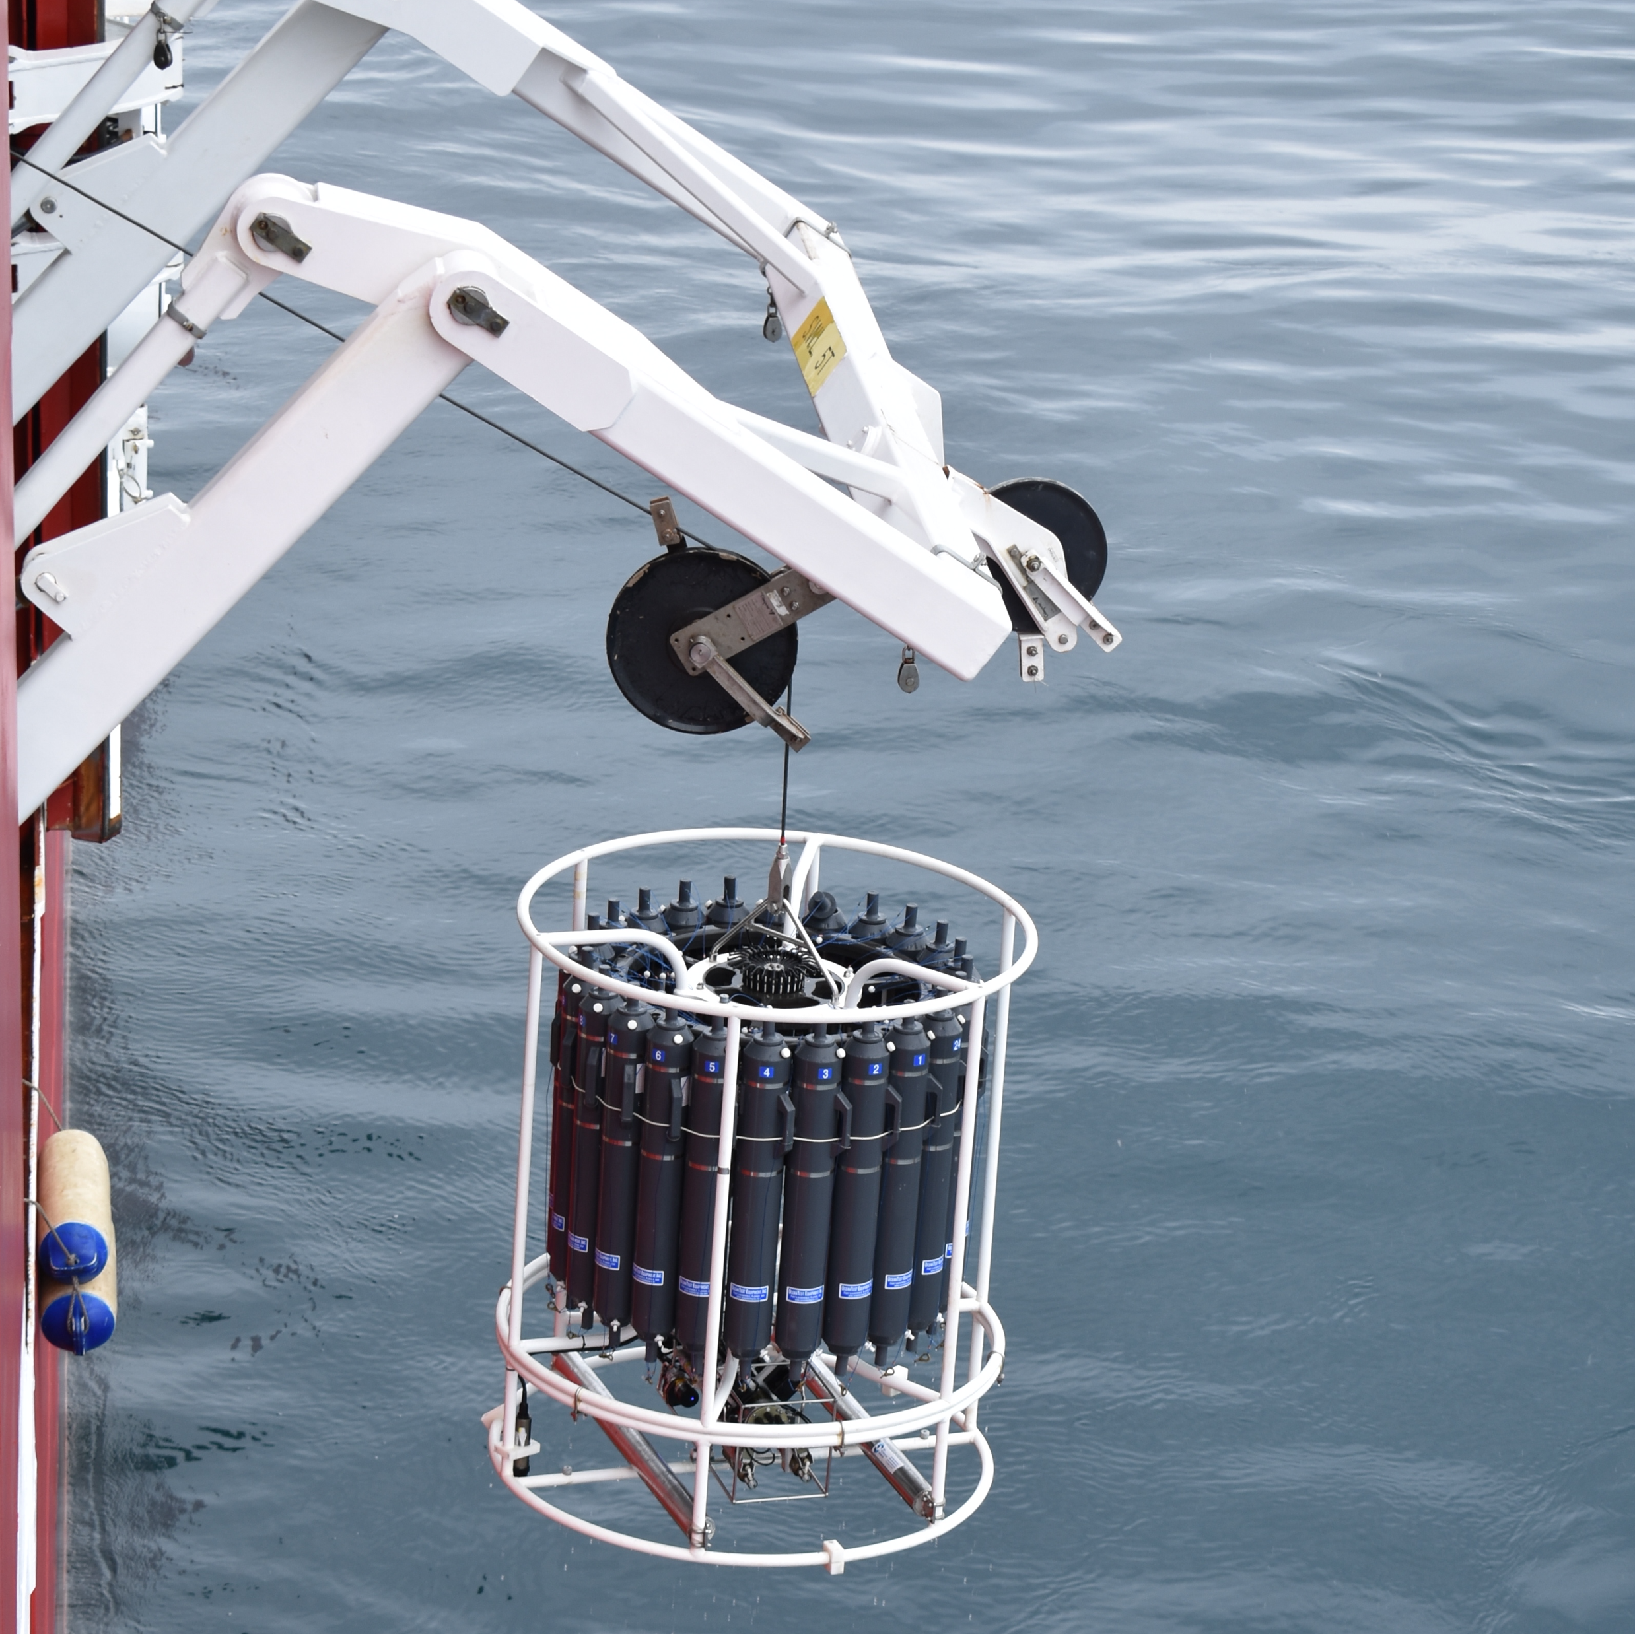
Data and methods
Profiles per 1° Grid Cell
Dataset comprised of floats (Argo and SOCCOM), MEOP, gliders and CTD data.
Annual coverage from 2004 to 2021 from 30°S.
Using only ‘good’ data and quality controlled following a specific set of criteria.
Nearly one million MLs quantified.
depth (m)
Data Distribution
Seasonal MLD
Spira - 2

Slide 3
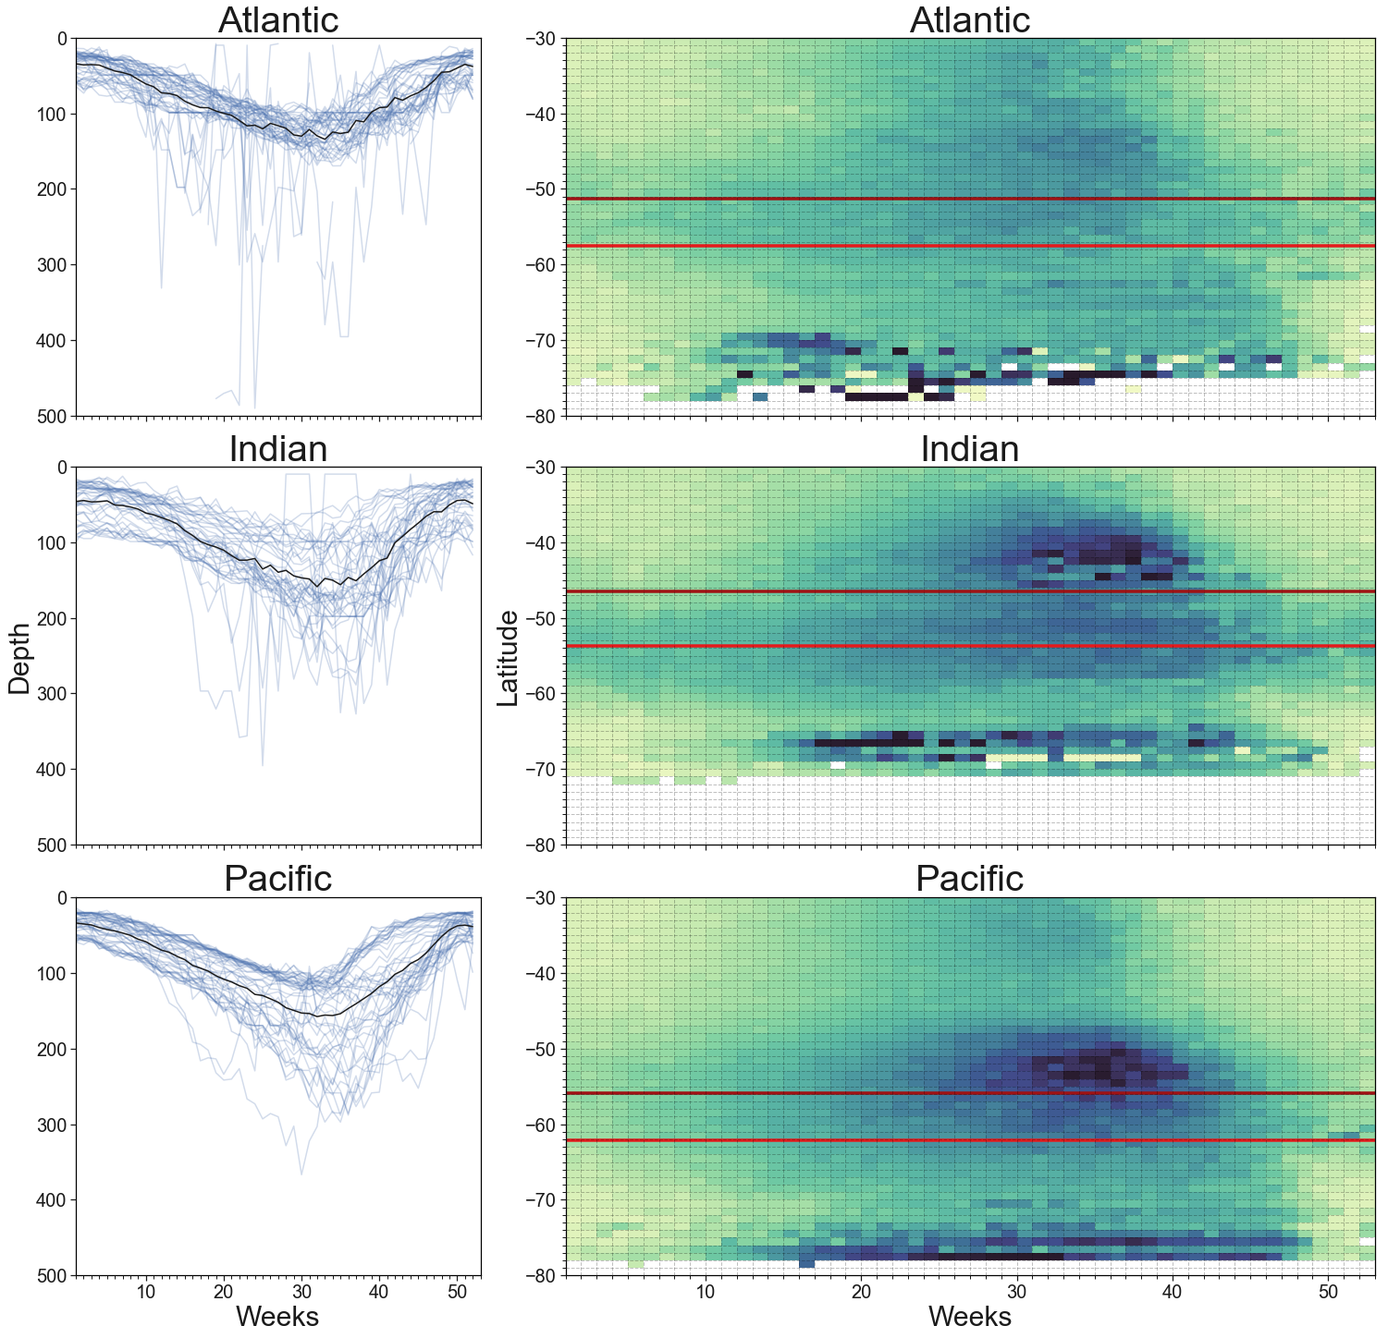


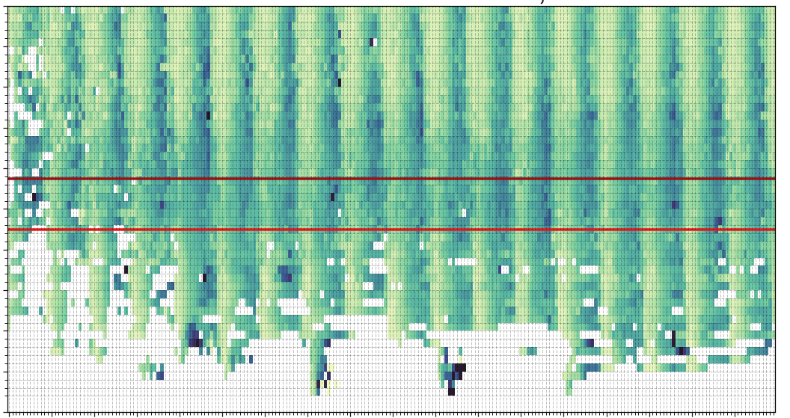
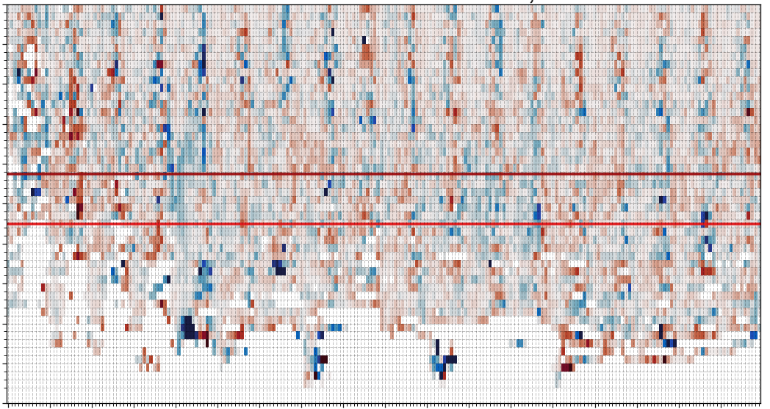
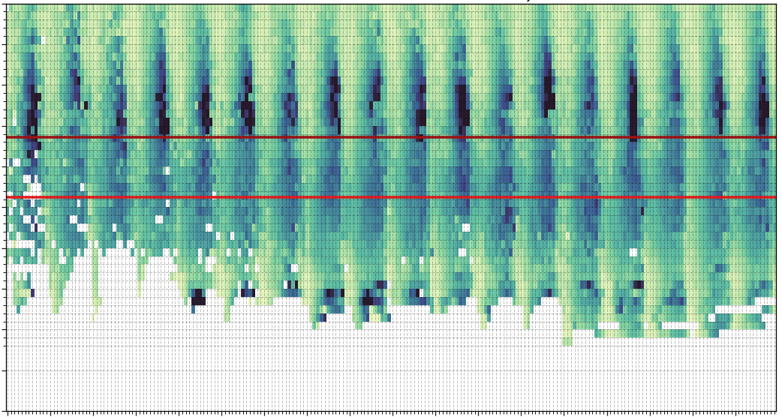
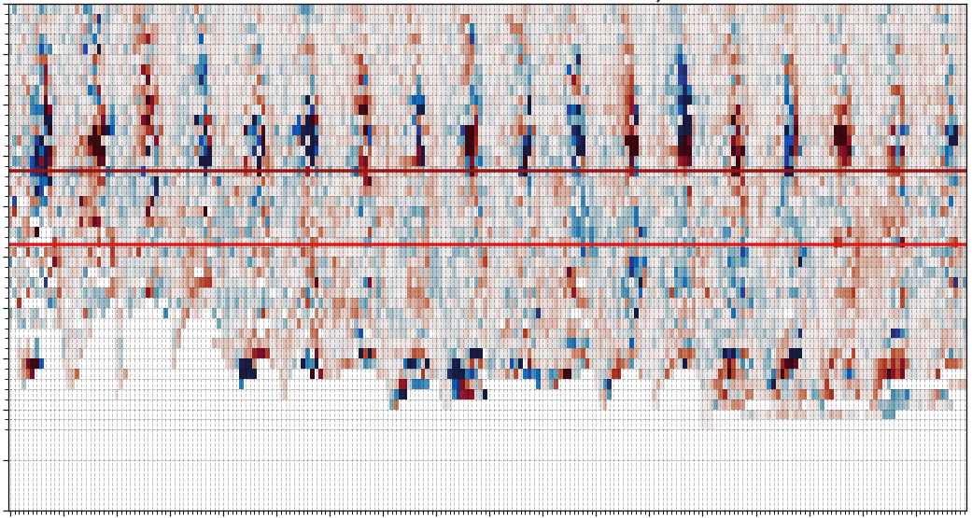
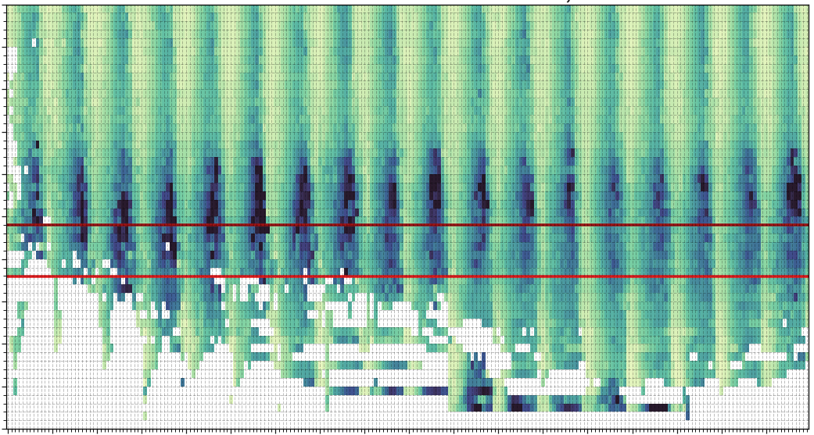
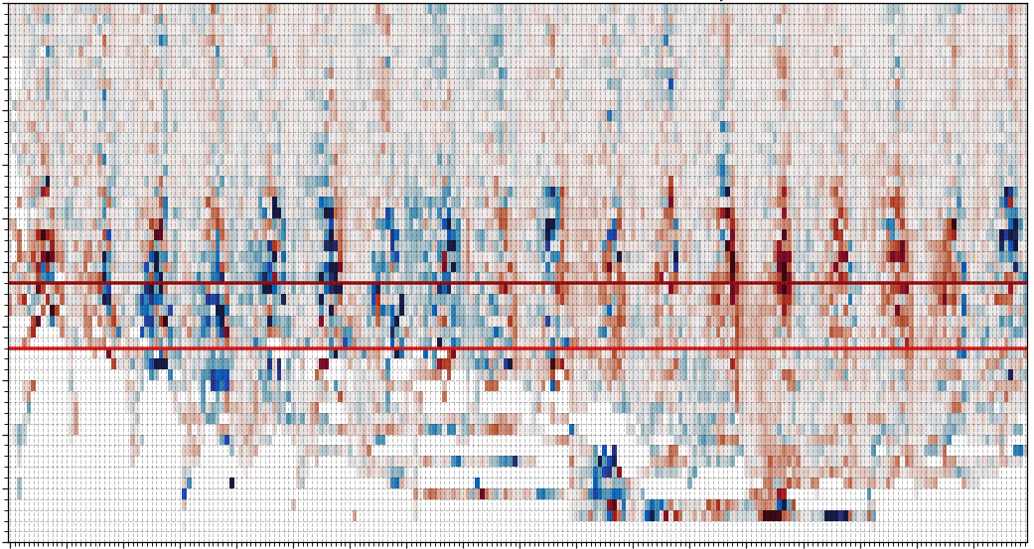
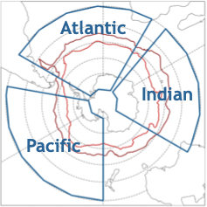
Results
Basin Climatologies
Monthly Basin Time Series
SAF
SAF
Atlantic
PF
PF
mean
latitude
Indian
depth (m)
depth difference (m)
Pacific
Latitudinal Change
Weekly Median
Monthly Median
Anomaly from Climatological Mean
Spira - 3

Slide 4
Discussion and conclusions
Weekly Climatology:
Atlantic MLs remain relatively shallow, whilst Indian and Pacific display clear annual deep MLs in Subantarctic Mode Water and Dense Shelf Water formation regions.
MLs within the ACC deepen only slightly and otherwise remain relatively consistent throughout the year for the Atlantic and Indian sectors. However, in the Pacific sector deep MLs extend to within the ACC and those MLs display a greater seasonal variability.
Monthly Time Series:
MLs remain relatively consistent in the Atlantic sector.
Meridional extent of deep MLs in the Indian sector appears wave-like in interannual variability.
Deep MLs consistently extend southwards across SAF in Pacific sector.
Distinct positive and negative anomalous modes throughout Pacific sector and south of ACC in Indian sector, which may relate to climate modes.
Spira - 4

