Slide 1
Transport Pathways for Iron Supply to the Australian Antarctic Ridge Phytoplankton Bloom
Vanegas Ledesma, Amanda; Thomas, Leif
Abbreviated abstract: Observations indicate that the productivity of the Australian Antarctic Ridge (AAR) phytoplankton is limited by the availability of dissolved iron (DFe). Therefore, to reveal the origin of this DFe is crucial to understand the dynamics of the bloom and how it will behave under a changing climate. Based on measurements of salinity, oxygen, and temperature of waters within the bloom, we hypothesize that these iron-rich waters might be coming from the shelf of the Ross Sea and then topography traps the water on the area near the AAR.
Related publications:
Gordon, A. L. et al. Western Ross Sea continental slope gravity currents. Deep Sea Research Part II: Topical Studies in Oceanography 56, 796–817 (2009).
Schine, C. M. S. et al. Massive Southern Ocean phytoplankton bloom fed by iron of possible hydrothermal origin. Nat Commun 12, 1211 (2021).
Vanegas Ledesma - 1
Notes:
snapshot of the bloom, and water properties, extra slide

Slide 2
Data and Methods
Data from Southern Ocean State Estimate: A. Verdy and M. Mazloff, 2017: " A data assimilating model for estimating Southern Ocean biogeochemistry." J. Geophys. Res. Oceans., 122, doi:10.1002/2016JC012650. The region of study encompasses the Southern Ocean between 140E and 130W, and south of 50S. Data is available at 1/6 of a degree of horizontal resolution and 30 days averages of temporal resolution. A higher resolution model output has horizontal resolution of 1/12 of a degree and temporal resolution of 5 days.
Methods: A Lagrangian Tracking Analysis was made with Ocean Parcels (The Parcels v2.0 Lagrangian framework: new field interpolation schemes. Delandmeter, P and E van Sebille (2019), Geoscientific Model Development, 12, 3571–3584). To better understand the dynamics of the region, we seed particles in areas of interest and perform forward and backwards advection over different time scales.
Vanegas Ledesma - 3
Notes:
Study region (and time?) Show domain. Resolution(s)
Backwards and forward advections, interpolation…

Slide 3
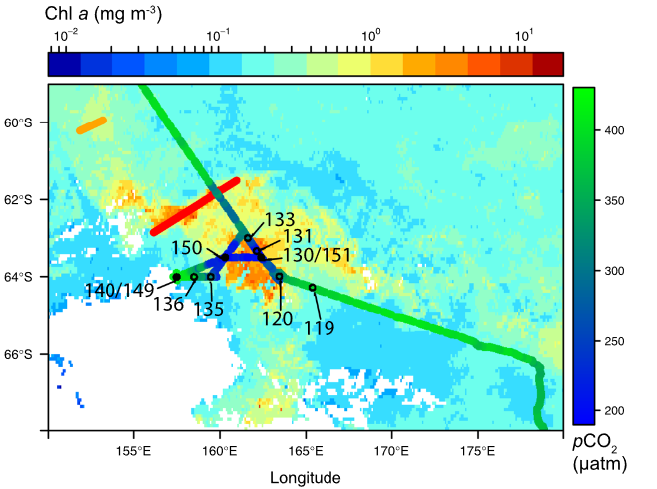
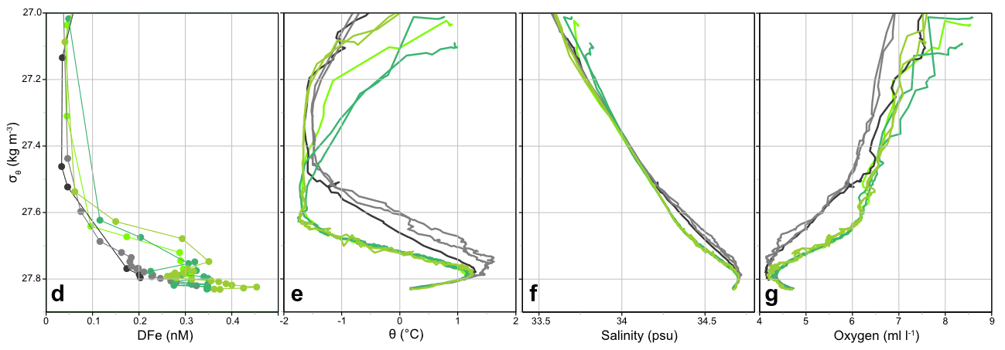
Observations: Waters within the AAR Bloom are fresher, colder, and more oxygenated than outside the bloom
From Schine et al. (2021)
The properties of the waters within the bloom resemble those of the Modified Circumpolar Deep Water (MCDW). This motivates our analysis of the transport of water properties along the ${\text{σ}}_{\text{θ}}=27.7$isopycnal.
From Schine et al. (2021)
Vanegas Ledesma - 2
Notes:
Study region (and time?) Show domain. Resolution(s)
Backwards and forward advections, interpolation…

Slide 4
Results: Analysis shows that potential multiple tracers are transported along the 27.7 isopycnal
By analyzing the ${\text{σ}}_{\text{θ}}=27.7$ isopycnal, we can observe a pathway of potential temperature and potential vorticity that travels West-East through the lower branch of the Eastern Ross Sea Gyre.
Lagrangian particle release experiment shows that particles seeded along the gyre are directed towards the Ross Sea Shelf.
Vanegas Ledesma - 4
Notes:
Break netCDF files into monthly chunks
Use low res data
why did we choose a particular density surface?

Slide 5
Discussion and conclusions
Our preliminary results suggest a pathway of MCDW that follows the lower branch of the Eastern Ross Sea Gyre from West to East. This water mass passes through the Ross Sea continental shelf, where it would mix with iron-rich sediments before being advected to the location of the bloom.
Work by Rickard et al. (2010) shows the presence of a western Ross Sea Gyre, that circulates remarkably close to the AAR Bloom. A gyre in this region would suggest that water recirculates the area, allowing for persistent and localized areas of enhanced iron.
Padman et al. (2008) reveals that tides of the northwestern Ross Sea can have a significant impact on mixing over the continental slope. They found that tidal currents often exceeded 1 m/s and that tidal advection can carry water parcels ~20km across slope.
Once iron-rich waters are advected from the continental shelf to the area of the AAR bloom, upwelling mechanisms are responsible of bringing these waters to the euphotic zone. Sokolov and Rintoul (2007) suggested that when fronts of the Antarctic Circumpolar Current generate upwelling when interacting with bathymetry.
In future work we will build on these results to study the mechanisms responsible for mixing and upwelling of water masses related to the AAR bloom.
Vanegas Ledesma - 5

